Slide 1
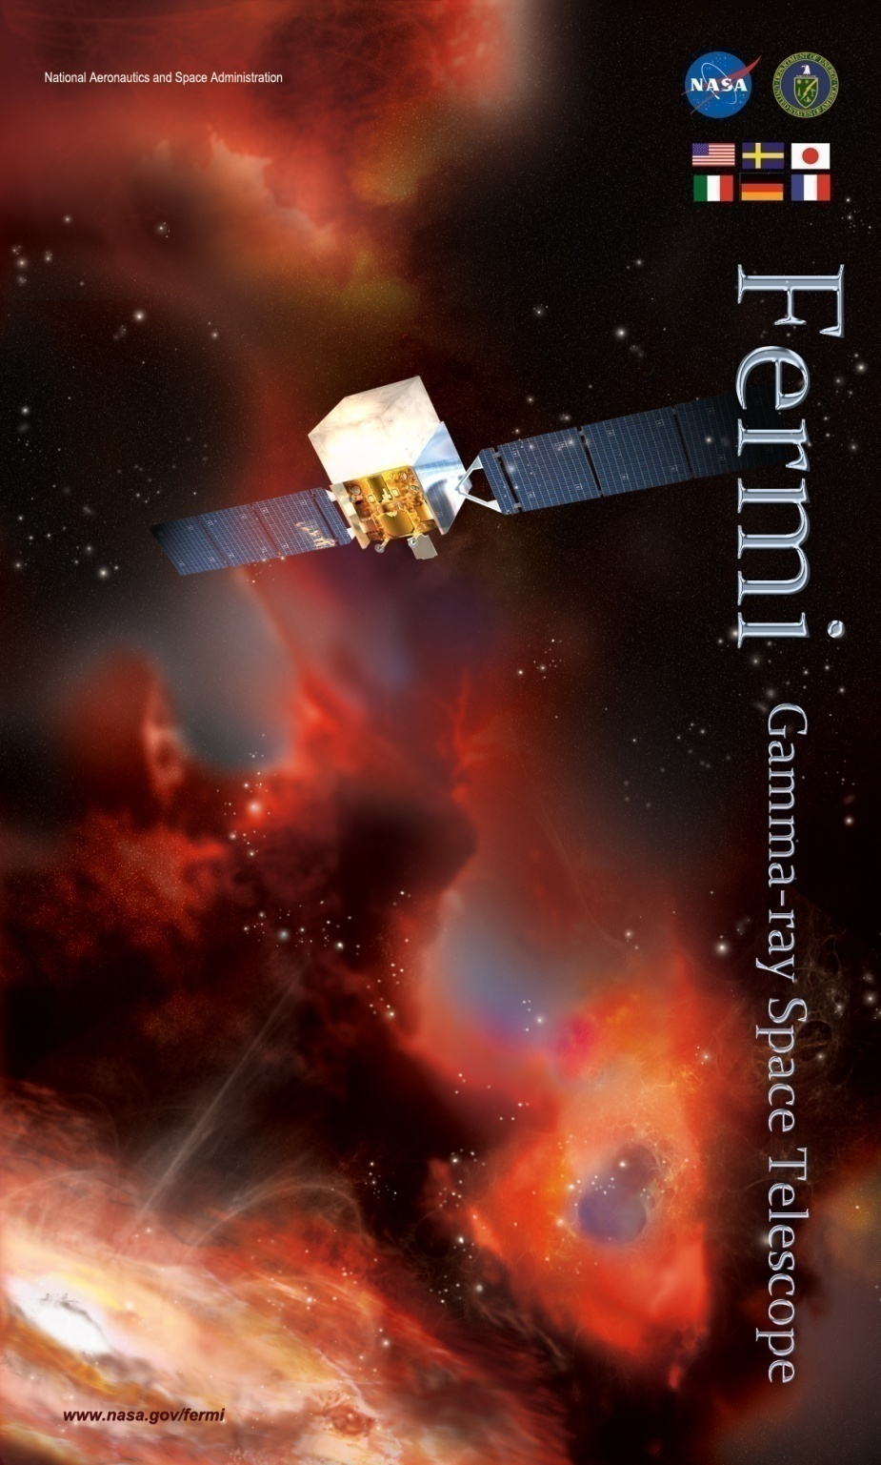
FERMI
Gamma Ray Space Telescope
(GLAST)
First Scientific Results
Claudia Cecchi
University of Perugia and INFN
On behalf of the
Fermi LAT Collaboration

Slide 2
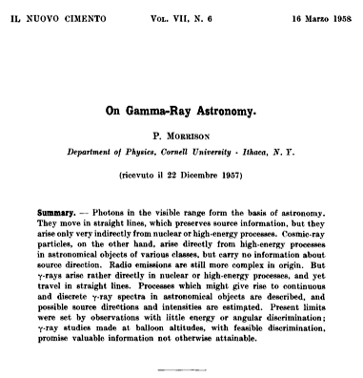
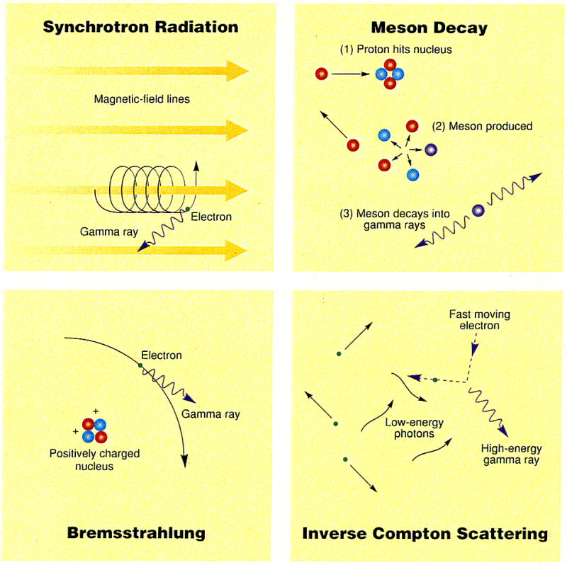
Why explore the Universe in gamma?
Gamma-rays are produced by non-thermal processes!
Extreme High-Energy end of em spectrum => extreme universe.
Notes:
Gamma produced from high energy particles, pointing directly to the region where they are produced

Slide 3
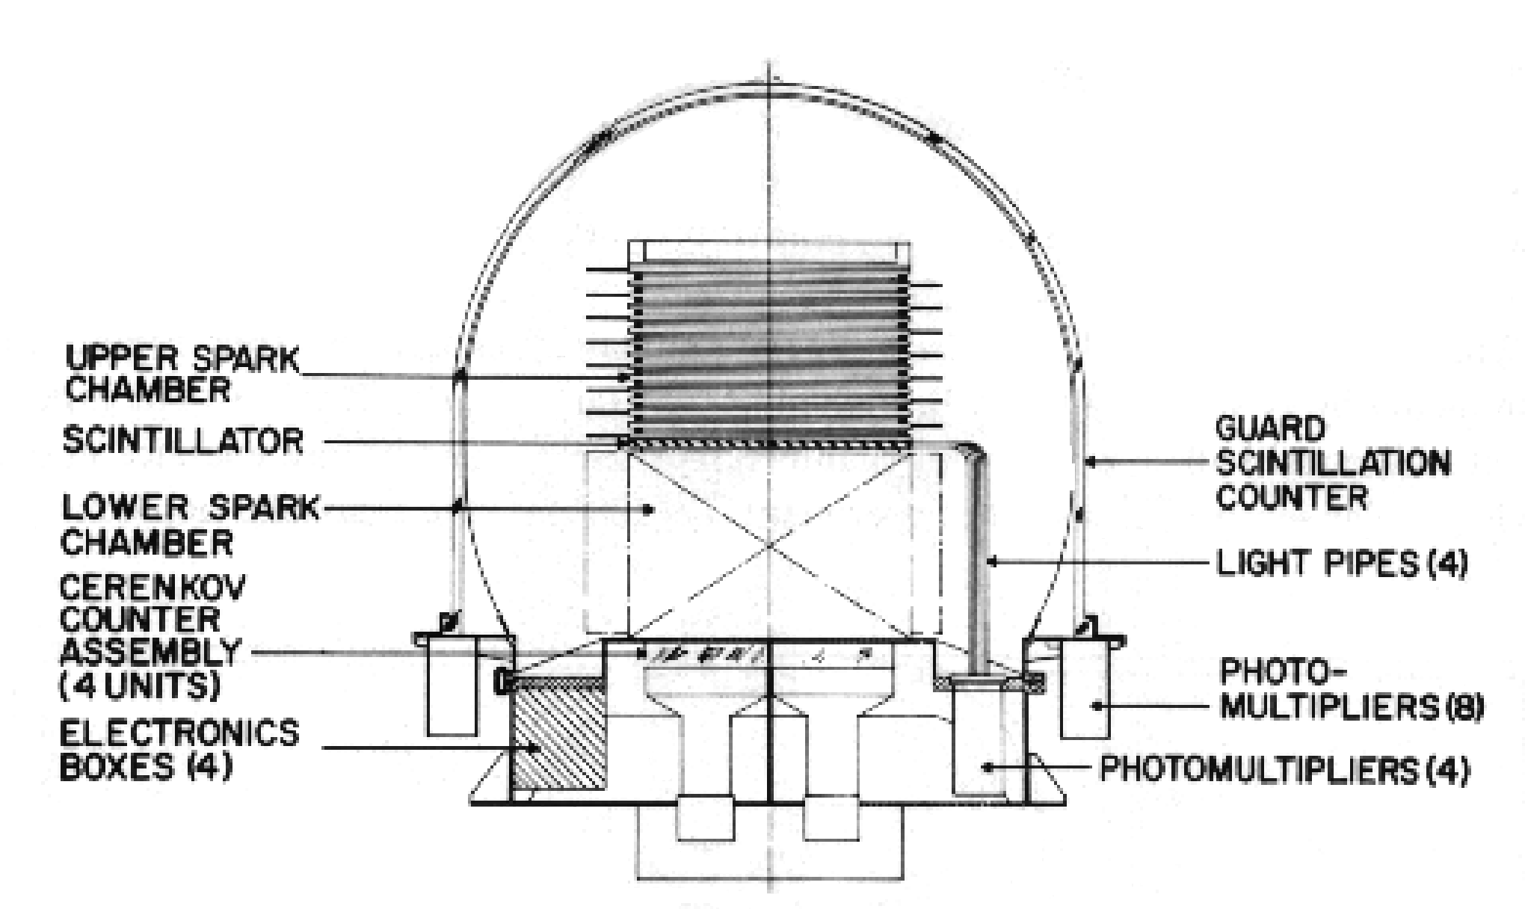
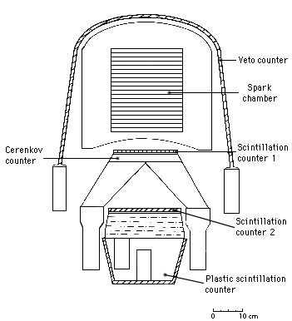
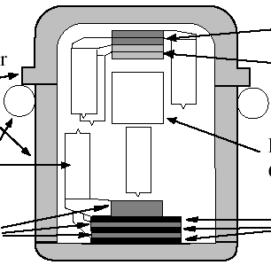
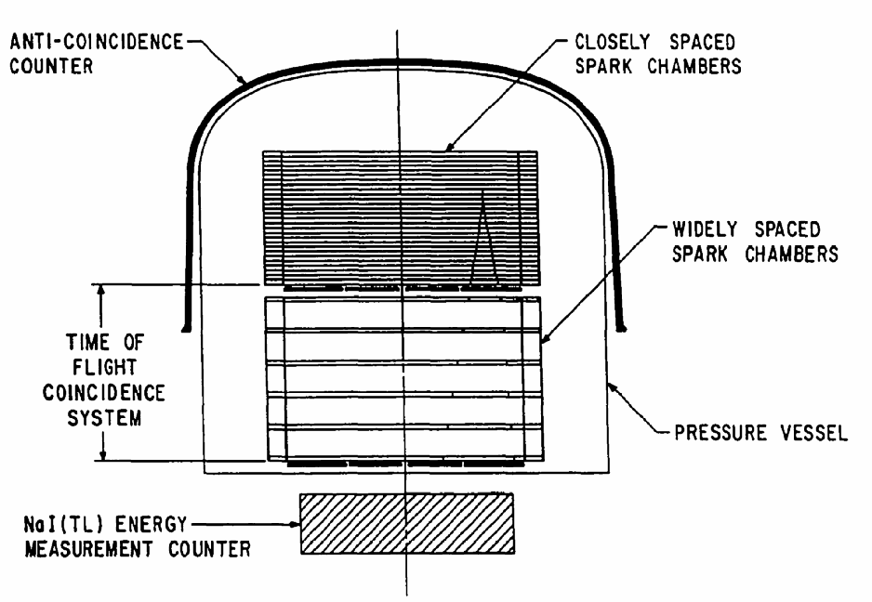
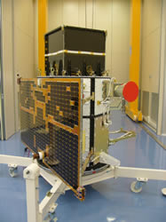
The discovery of the Gamma Ray Sky
1967-1968, OSO-3 Detected Milky Way as an extended γ-ray source
621 γ-rays
1972-1973, SAS-2,
~8,000 γ-rays
1975-1982, COS-B
orbit resulted in a large and variable background of charged particles
~200,000 γ-rays
1991-2000, EGRET
Large effective area, good PSF, long mission life, excellent background rejection
>1.4 × 10⁶ γ-rays
2007- AGILE Small Italian mission, in operation
COS-B
SAS-2
OSO-3
SAS-2
COS-B
EGRET
AGILE
EGRET

Slide 4
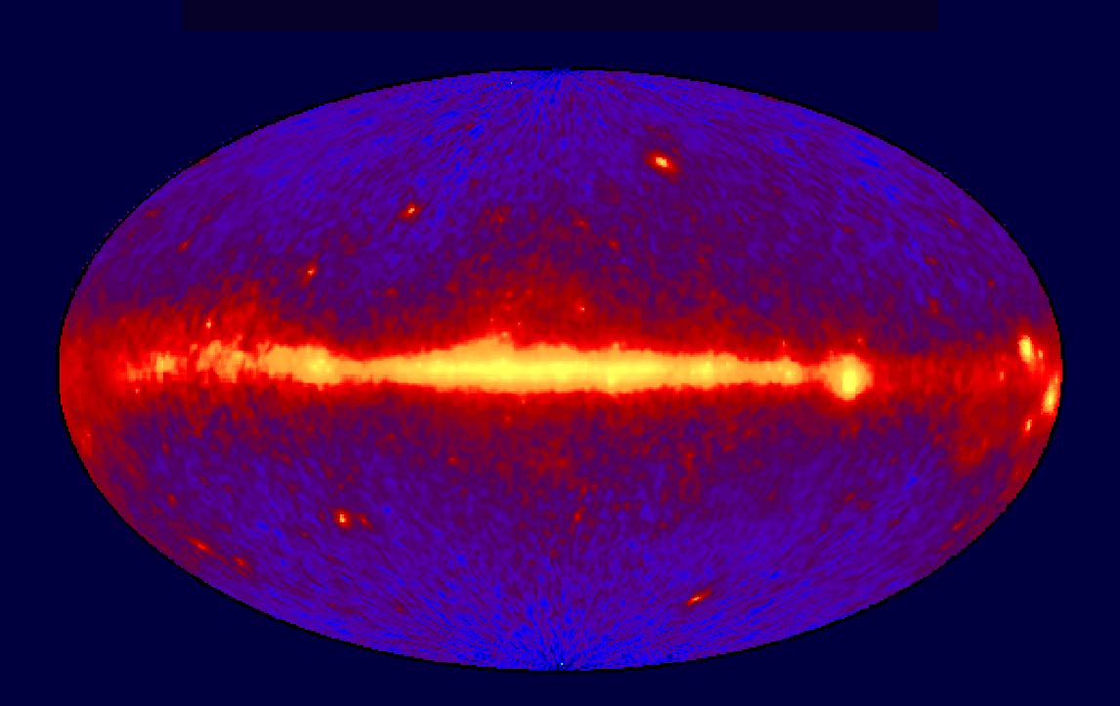
The EGRET Gamma Ray Sky
diffuse extra-galactic background (flux ~ 1.5x10⁻⁵ cm⁻²s⁻¹sr⁻¹)
galactic diffuse (flux ~30 times larger)
high latitude (extra-galactic) point sources (typical flux from EGRET sources O(10⁻⁷ - 10⁻⁶) cm⁻²s⁻¹)
galactic sources (pulsars, un-ID’d)
An essential characteristic: VARIABILITY in time!
Field of view important for study of transients.

Slide 5
Variability over 3 months (north-south Galactic Emisphere)
SUN path
E>100 MeV, poles view, 1 day time interval, extreme sensitivity to flux variation

Slide 6
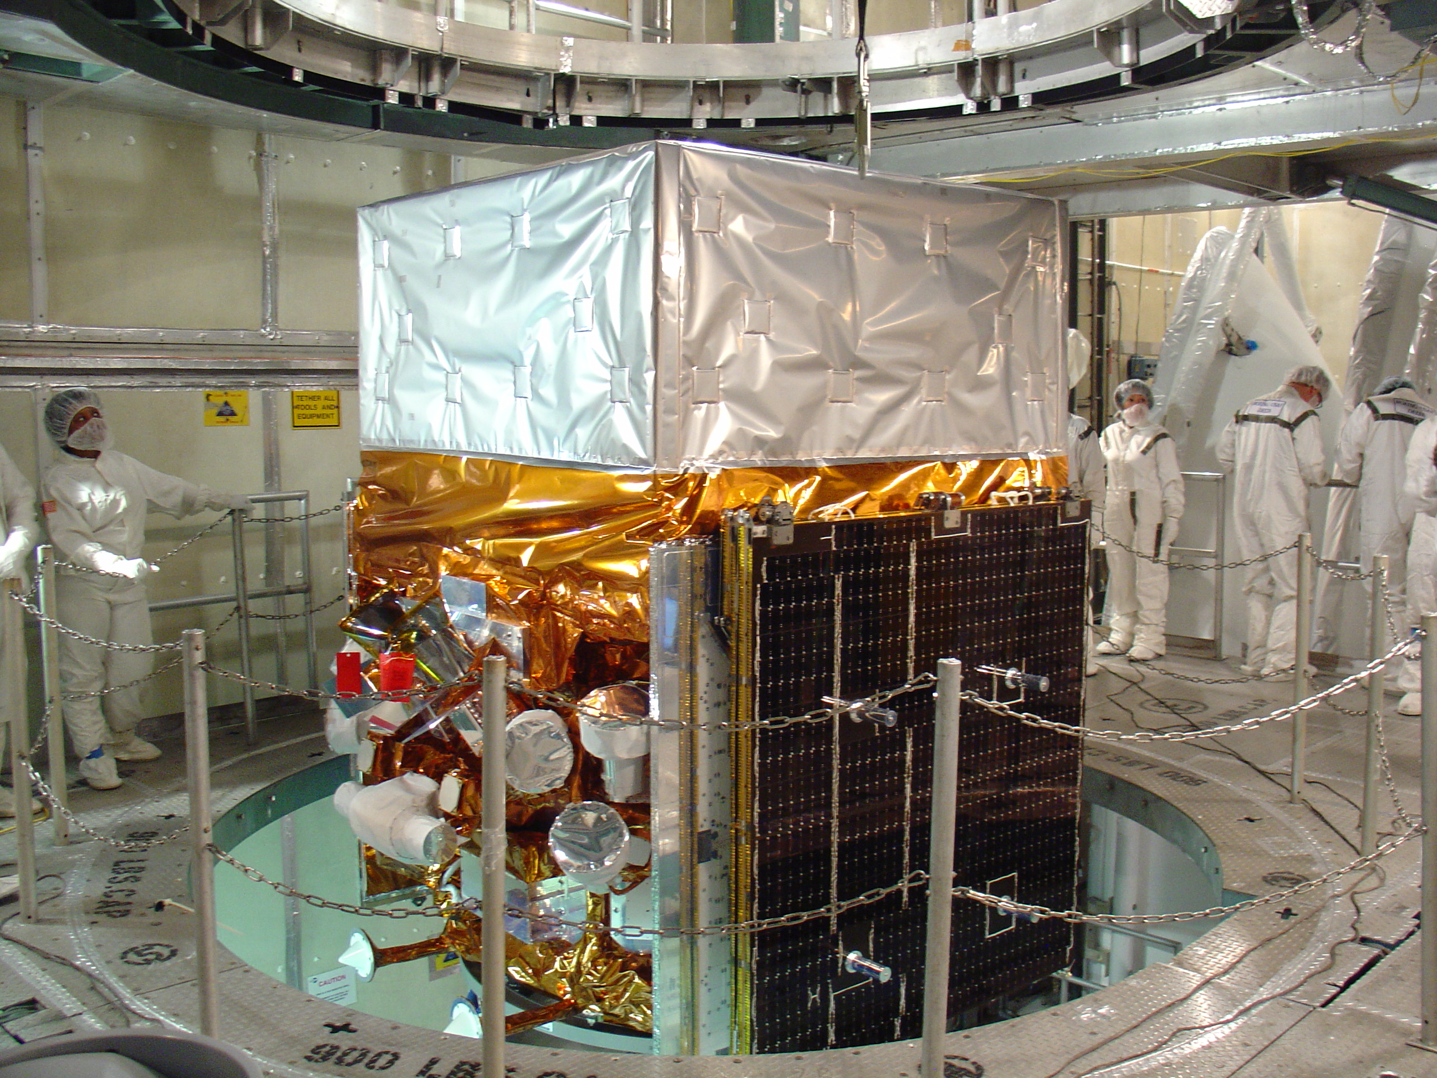
2008 - Fermi

Slide 7
The Observatory
Large AreaTelescope (LAT)
20 MeV - >300 GeV
Gamma-ray Burst Monitor (GBM)
NaI and BGO Detectors
8 keV - 30 MeV
KEY FEATURES
Huge field of view
LAT: 20% of the sky at any instant; in sky survey mode, expose all parts of sky for ~30 minutes every 3 hours. GBM: whole unocculted sky at any time.
Huge energy range, including largely unexplored band 10 GeV - 100 GeV. Total of >7 energy decades!
Large leap in all key capabilities. Great discovery potential.
Spacecraft Partner: General Dynamics

Slide 8
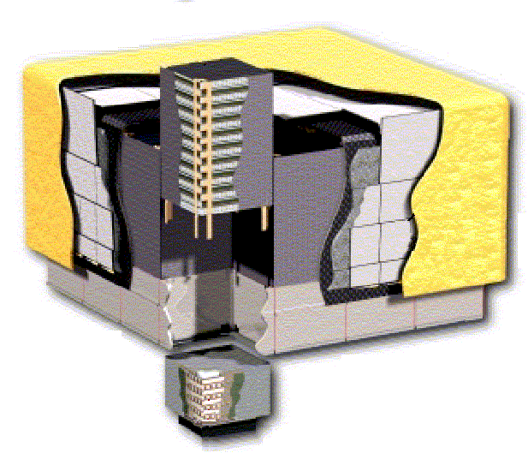
The LAT: how it works
Precision Si-strip Tracker (TKR): measure the photon direction; gamma ID.
Hodoscopic CsI Calorimeter (CAL): measure the photon energy; shower shape.
Segmented Anticoincidence Detector (ACD): reject background of charged cosmic rays; segmentation removes self-veto effects at high energy.
Electronics System includes flexible, robust hardware trigger and software filters.
γ
Tracker
e⁺
e–
ACD [surrounds 4x4 array of TKR towers]
Calorimeter
Atwood et al, ApJ submitted
Systems work together to identify and measure the flux of cosmic gamma rays with energy 20 MeV - >300 GeV.

Slide 9
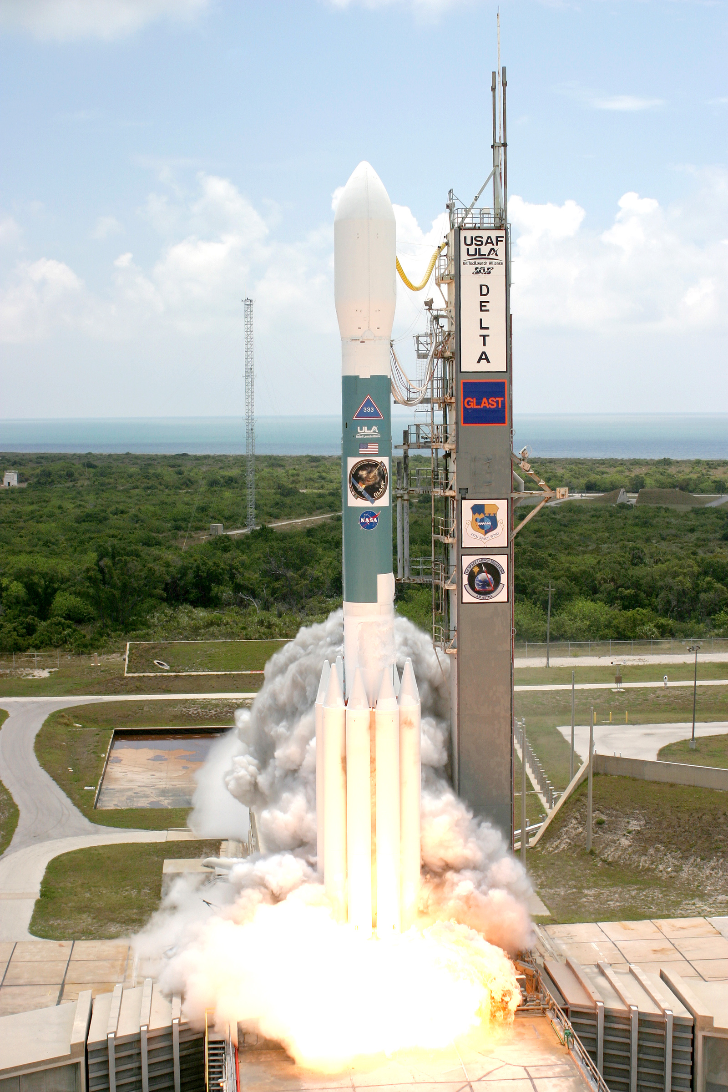
The Launch!
Launch from Cape Canaveral Air Station 11 June 2008 at 12:05PM EDT
Circular orbit, 565 km altitude (96 min period), 25.6 deg inclination.

Slide 10
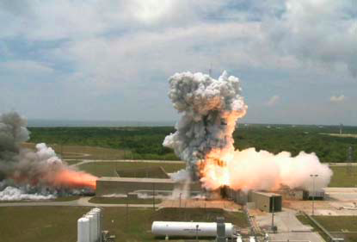
A moment later….

Slide 11
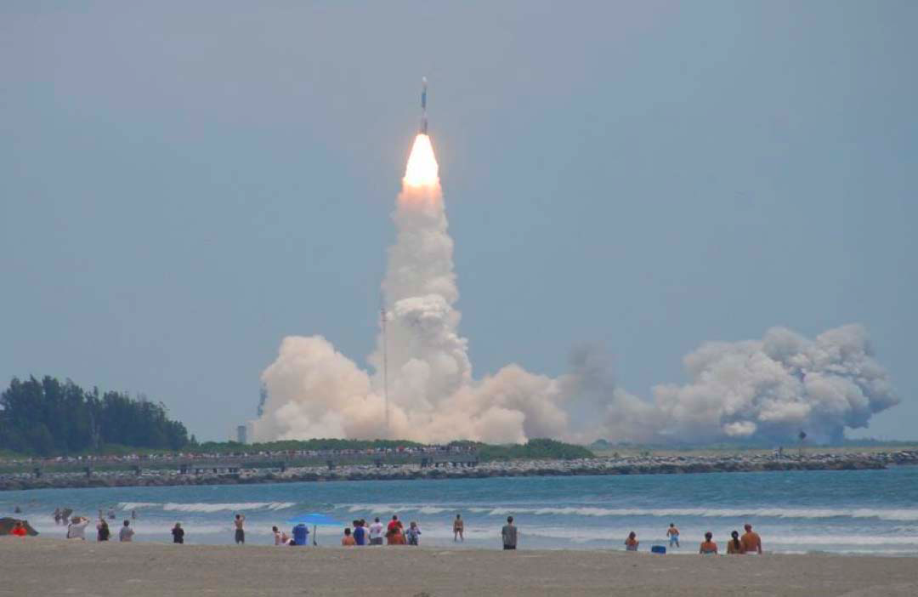
And then….

Slide 12
The LAT Collaboration
France
CNRS/IN2P3, CEA/Saclay
Italy
INFN, ASI, INAF
Japan
Hiroshima University
ISAS/JAXA
RIKEN
Tokyo Institute of Technology
Sweden
Royal Institute of Technology (KTH)
Stockholm University
United States
Stanford University (SLAC and HEPL/Physics)
University of California, Santa Cruz - Santa Cruz Institute for Particle Physics
Goddard Space Flight Center
Naval Research Laboratory
Sonoma State University
The Ohio State University
University of Washington
PI: Peter Michelson (Stanford)
~390 Scientific Members (including 96 Affiliated Scientists, plus 68 Postdocs and 105 Students)
Cooperation between NASA and DOE, with key international contributions from France, Italy, Japan and Sweden.
Managed at SLAC.

Slide 13
Fermi Science
A very broad menu, including:
Systems with supermassive black holes (Active Galactic Nuclei)
Gamma Ray Bursts (GRB)
Pulsars
Supernova Remnants (SNR), PWNe, Origin of Cosmic Rays
Diffuse emission
Solar physics
Probing the era of Galaxy formation, optical-UV background light
Unidentified sources
Discovery! New source classes, Dark Matter (?)
Draw the interest of both High Energy Particle Physics and High Energy Astrophysics communities

Slide 14
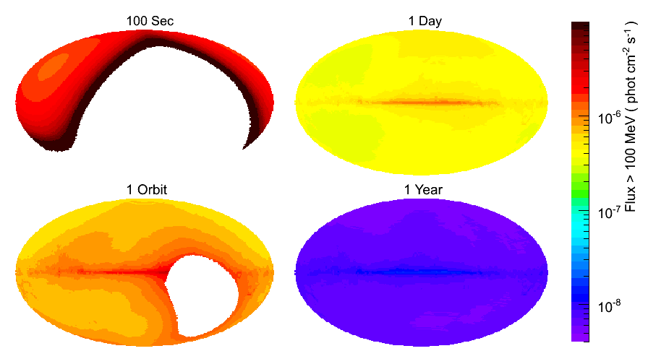
Operating modes
Primary observing mode is Sky Survey
Full sky every 2 orbits (3 hours)
Uniform exposure, with each region viewed for ~30 minutes every 2 orbits
Best serves majority of science, facilitates multiwavelength observation planning
Exposure intervals commensurate with typical instrument integration times for sources
EGRET sensitivity reached in days
Pointed observations when appropriate (selected by peer review in later years) with automatic earth avoidance selectable. Target of Opportunity pointing.
Autonomous repoints for onboard GRB detections in any mode.
Notes:
already have 2Ms exposure on entire sky!
5 year requirement, 10 year goal
We’ve had 3 ARRs. No joy yet on HE emission, but patience will be rewarded!

Slide 15
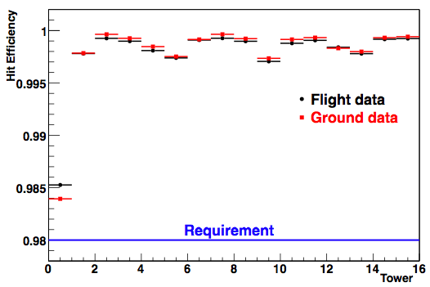
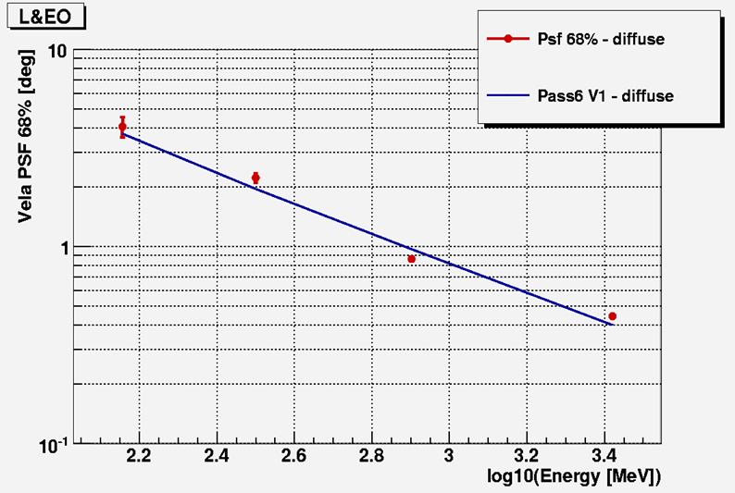
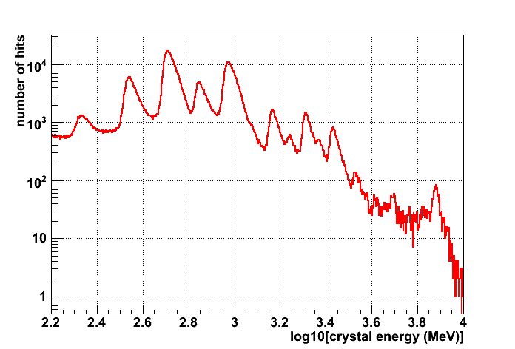
Performance of the LAT on Orbit
Total background rates very close to expectation (non-trivial!)
Spectacular charged-particle hit efficiency:
PSF on-orbit as expected (note intrinsic energy dependence => localization is source-dependent)
verify using on-pulse photons from Vela, compare with detailed MC simulation:
On-orbit calorimeter calibration stable
use cosmic ray heavy ions:

Slide 16
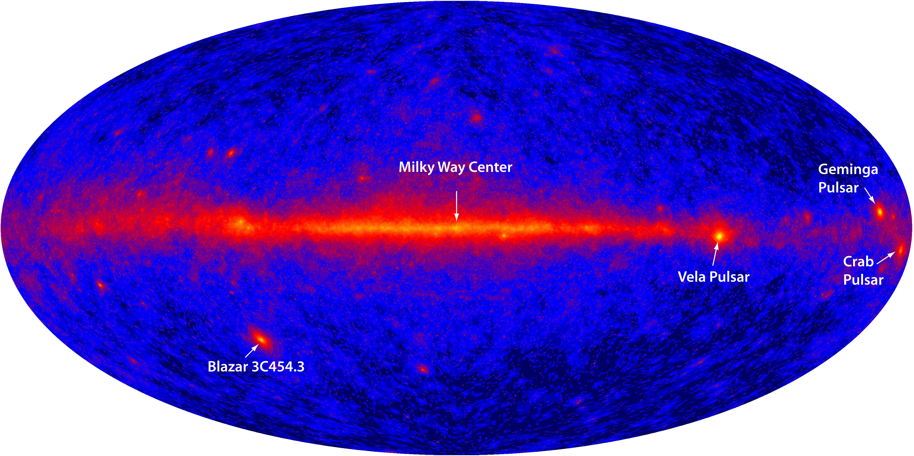
The First Light
Four days of all-sky survey engineering data.

Slide 17
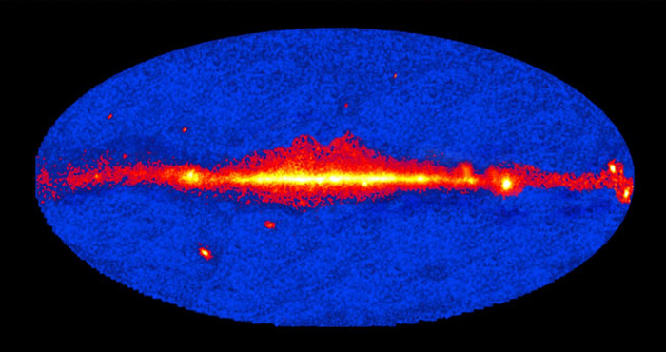
AGILE 9-month sky map

Slide 18
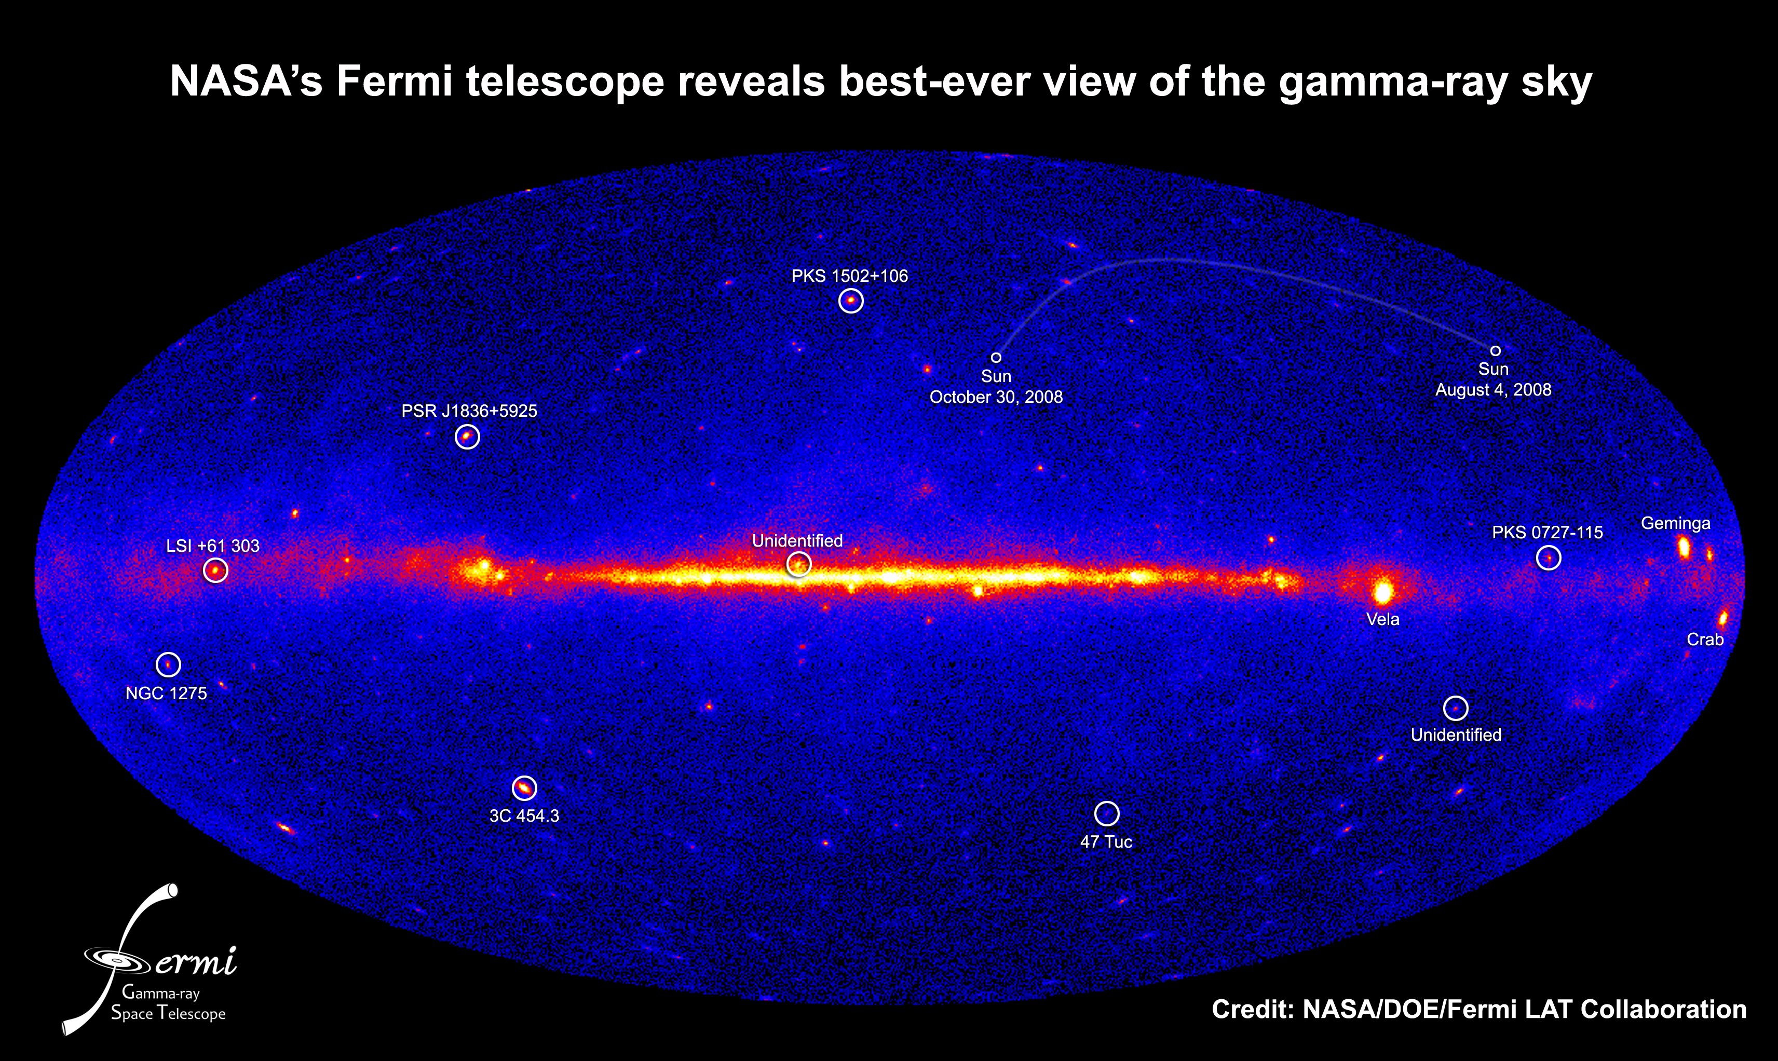
LAT Bright Sources
(March 11th 2009)

Slide 19
Open questions from EGRET
How and where do pulsars emit gamma rays? How common are radio-quiet pulsars?
necessary clue to magnetic field configurations and dynamics
What are the EGRET Unidentified Sources?
most of the EGRET source identifications are a mystery
What are the energy budgets of gamma-ray bursts? What are the temporal characteristics of the high-energy emission?
not well characterized yet, key tests of models.
What are the origins of the diffuse emissions?
galactic: cosmic-ray and matter distributions; sources
extragalactic: populations
new sources (Dark Matter annihilations, clusters, …)
How do the supermassive black hole systems of AGN work? Why do the jets shine so brightly in gamma rays?
temporal and spectral variability over different timescales
What remains to be discovered with great new capabilities?
EGRET showed us the tip of the iceberg. New sources and probes for new physics.

Slide 20
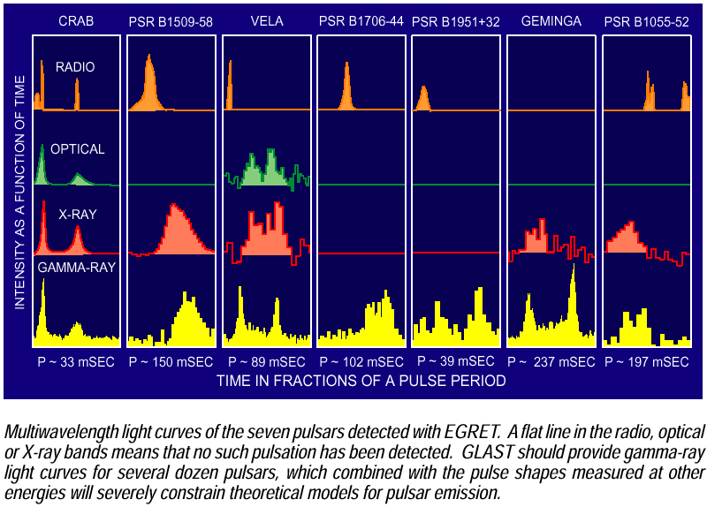
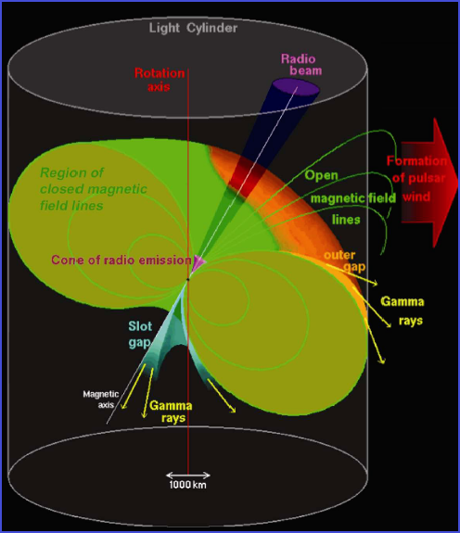
EGRET Gamma-ray Pulsar light curves
Rotating neutron stars
Magnetic axis inclinated with respect to the rotation axis
Rotation energy dissipated in the emission of the EM radiation and in the charged particle acceleration
Most of the energy emitted in the gamma band
Notes:
Light curves in various wavelengths can be a hint of pulse emission mechanisms. Some shows double-peaked structure. Relative phases of peaks are different in different wavelength except for the Crab.
Outer: B fied not strong enough for pair production interaction of gamma with not thermal X-ray, exponential
Inner: big field, gamma+B->e+ + e-, acceleration of electrons, superexponential

Slide 21
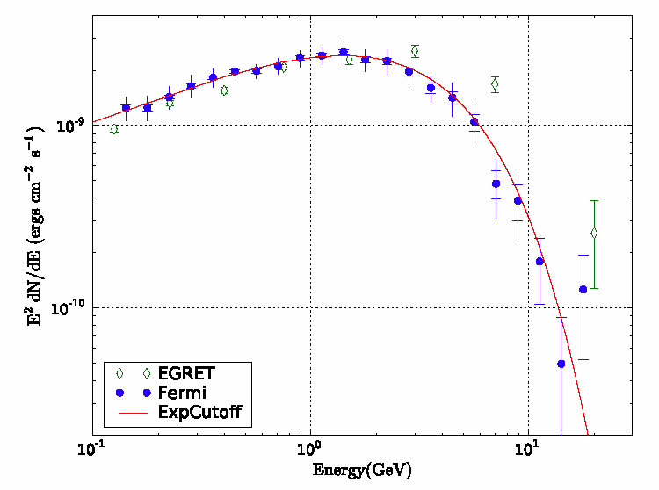
Phase averaged SED for VELA
Consistent with b=1, simple exponential
b=2 superexponential rejected at 16.5σ
GeV
No evidence for magnetic pair attenuation → near surface emission ruled out

Slide 22
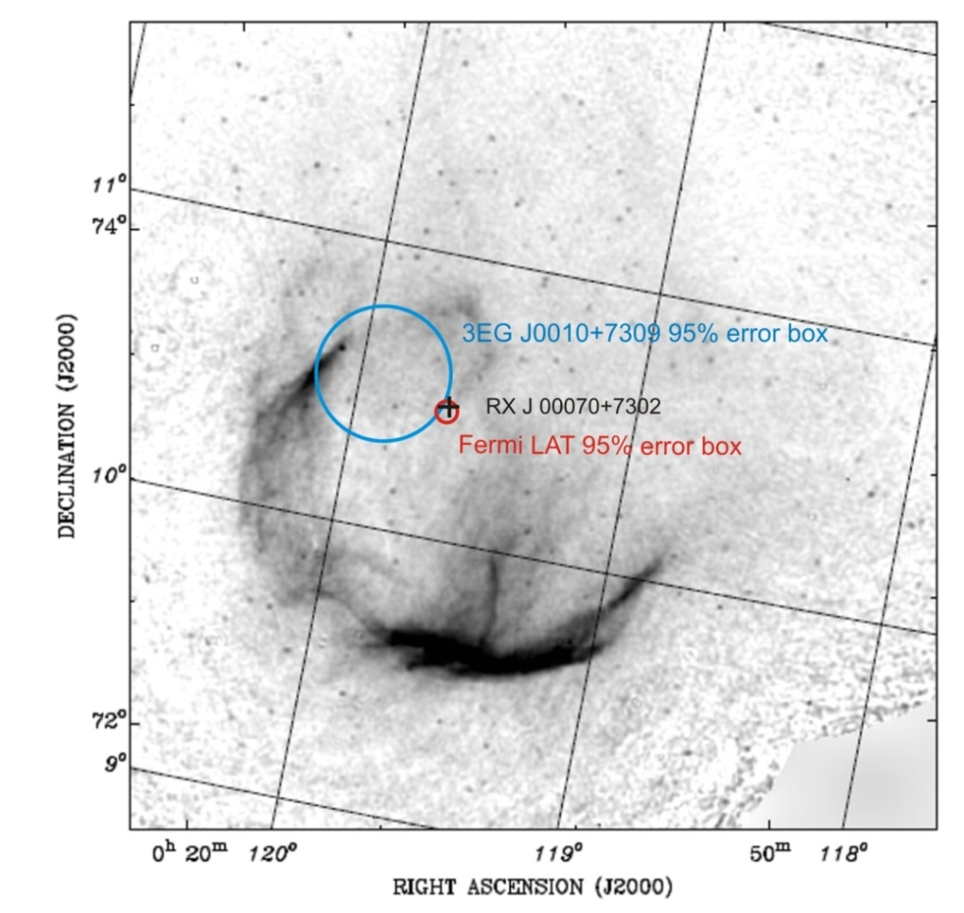
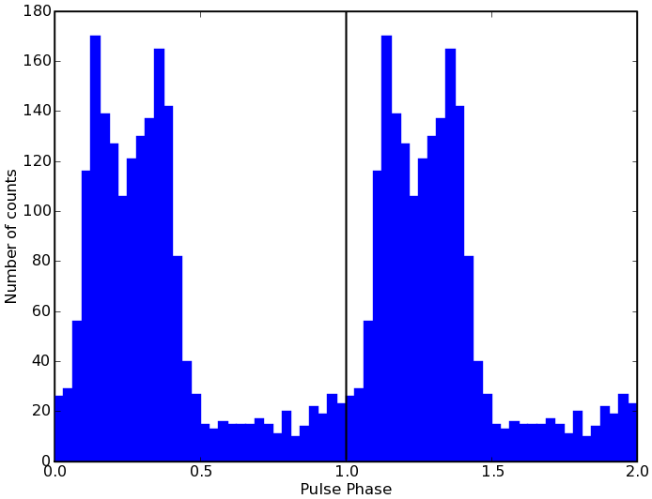
Discovery of the first Gamma-ray-only Pulsar
A radio-quiet, gamma-ray only pulsar, in Supernova Remnant CTA1
Quick discovery enabled by
large leap in key capabilities
new analysis technique (Atwood et al)
P ~ 317 ms
Pdot ~ 3.6E-13
Spin-down luminosity ~10³⁶ erg s⁻¹, sufficient to supply the PWN with magnetic fields and energetic electrons.
The γ-ray flux from the CTA 1 pulsar corresponds to about 1-10% of E_{rot} (depending on beam geometry)
Age ~(0.5 – 1)x10⁴ years
Distance ~ 1.4 kpc
Diameter ~ 1.5°
Notes:
localization source-dependent -- why! illustrates new capabilities. NEW TECHNIQUES -- not just doing EGRET better!
already knew about one radio-quiet pulsar, Geminga (xray, gammaray), but never found pulsation in gammas alone. sparse -- why difficult. ~dozen per day!
Owens Valley 1960 updated lightcurve with more data. discovery lightcurve quite similar.

Slide 23
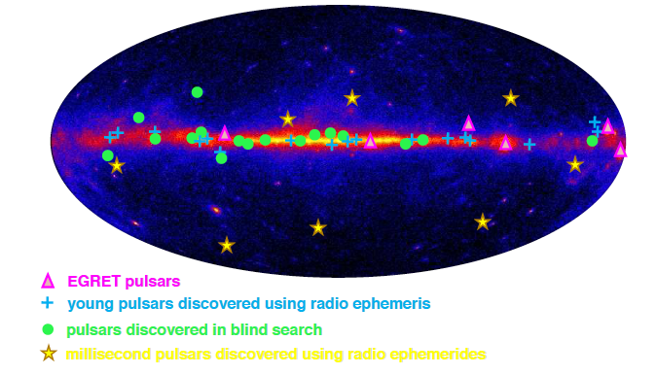
The Pulsing sky
31 gamma-ray and radio pulsars (includes 8 millisecond pulsars)
16 gamma-ray only pulsars

Slide 24
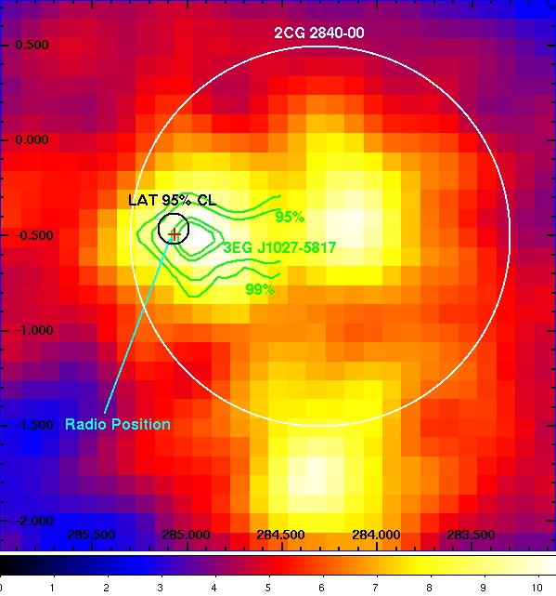
Resolving EGRET UNID’s: Pulsar J1028
LAT point source
(l,b)=(285.074,-0.459)
95% CL radius of 0.079º
Power law with a simple exponential cutoff
Cutoff ~2-3 GeV
Index ~1.2
Integrated flux (0.1-30GeV) 1.620.270.32 e-7 ph/cm²/s
3EG flux 6.60.7 e-7 ph/cm²/s
From power law with index 2
No cutoff modeled
Low energy contribution from nearby source
COS-B source
Flux 2.7 e-6 ph/cm²/s
Actually multiple sources
Counts map above 100MeV, gaussian smoothing applied with kernel radius of 3. Also plotted, 2CG position (Swanenberg et al 1981), 3EG countors (Hartman et al 1999), and radio position.

Slide 25
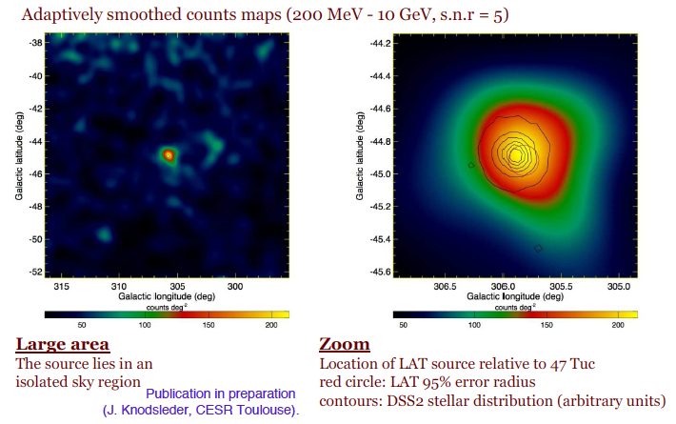
23 radio ms pulsars in the Globular Cluster 47 Tucanae
Seminar University of Heidelberg
April 28th 2009
Claudia Cecchi
Notes:
First detection of high energy gamma ray emission from globular cluster. Steady, point like emission a 17sigma. Emission originates from 40-63 MSP

Slide 26
Fermi-LAT Pulsar discovery summary
First 4 month of the mission more than 36 pulsars detected!
confirmed 7 known egret pulsars (and several EGRET candidates)
12 new young Radio pulsars
16 young pulsars pulsing in Gamma-Ray only
8 “milliseconds” Gamma-ray pulsars (establishing a new class) (EGRET low significance candidate confirmed PSR J0218+4232 )
16 new pulsars found directly in the Gamma-rays (blind search)
20 additional pulsars seen for the first time as Gamma-ray emitters
Notes:
Milliseconds: molto vecchie che rallentano, stanno in un sistema binario e la stella compagna gli restituisce di nuovo energia per pulsare.

Slide 27
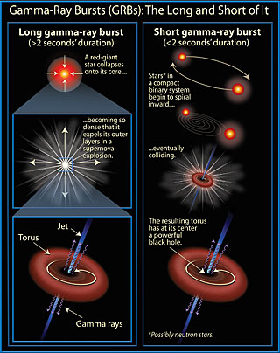
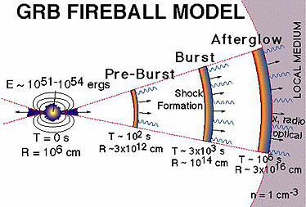
Gamma Ray Burst’s
Most explosive cosmological events!
Notes:
Short: merging of 2 compact objects
Long:Gravitational collapse of a massive star (M> 20 M) : LONG GRB (>2s)
ms time variability : compact source huge amount of energy : plasma in ultra-relativistic (Γ > 100) expansion
external layers of progenitor ejected as shells with different velocities : Internal Shocks
Shells interaction with the external medium : External Shock

Slide 28
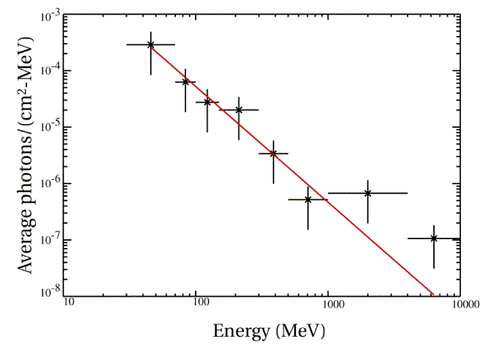
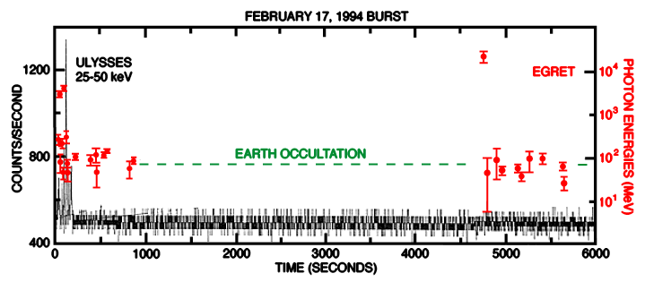
Gamma Ray Burst at High Energy
Little is known about GRB emission in the >50 MeV energy regime
EGRET detected few high-energy bursts
GLAST, compared to EGRET, will have:
Wider FoV
Short deadtime (~25 µs)
Repoint
Composite spectrum of 5 EGRET Bursts
Dingus et al. 1997
No evidence
of cutoff
Hurley et al. 1994
Extended/Delayed
emission
Extended or delayed GeV emission may require more than one emission mechanism, and remains one of the unsolved problems.
Seminar University of Heidelberg
April 28th 2009
Claudia Cecchi

Slide 29
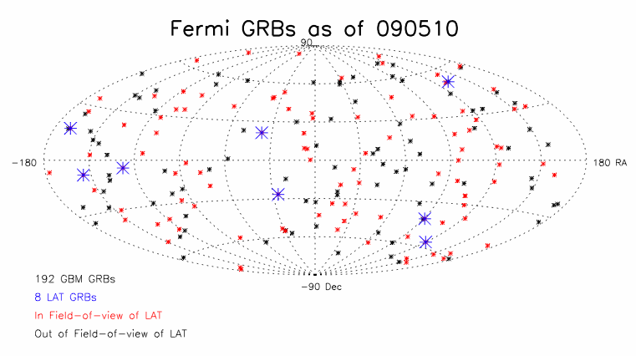
Gamma-Ray Bursts (GRB)
GBM GRB outside the LAT field of view
GBM GRB within the LAT field of view.
LAT GRB
GRB 080916C
red shift:
8 LAT-detected bursts (high-energy photons)
GRB 080825C
GRB 080916C z = 4.35 +/-0.15 (GROND/photometric) 13 GeV photon!
GRB 081024B short-duration burst
GRB 081215A
GRB 090217
GRB 090323 z = 3.6 (Gemini/spectroscopic)
GRB 090328 z = 0.736 (Gemini/spectroscopic)
GRB 090510 z = 0.903 (VLT/spectroscopic); short duration; 31 GeV photon!
Claudia Cecchi
Notes:
Delayed emission and short duration first observation.
No extra spectral component to explain GeV photons → GBM emission and second pulse from LAT from same region?
Is the delay of the LAT pulse an accident? Or there is a physical reason?

Slide 30
GRB080910C …first look at this burst…
Largest number, ≈ 200, of high-energy, >100 MeV photons (second is GRB 940217, with 28), allowing time-resolved spectral studies
Significant ≅4.5s delay between onset of >100 MeV and 100 keV radiation
First high-energy 100 MeV – GeV detection of a GRB with known redshift
Redshift z = 4.2±0.3 from GROND photometry on 2.2 m in La Silla, Chile (Greiner et al. 2008)
Large fluence burst (2.4×10⁻⁴ ergs cm⁻²) at 10 keV – 10 GeV energies
Apparent isotropic energy release is 8.3×10⁵⁴ ergs
Supports the black-hole jet/collapsar paradigm of GRBs
Extreme γ-ray events ⇒ extreme particle acceleration
GRBs as sources of the UHECRs
Test particle acceleration models
Highest energy photon (E = 13.22+0.70-1.54 GeV) from GRB with z
Largest minimum Doppler factors from opacity constraints (G_{min} ≅ 900)
Best limits on quantum gravity mass
Claudia Cecchi
Notes:
Quantum Gravity: Time dispersion between low and high energy photons
1 order of magnitude higher than the previous best estimate, 1 order of magnitude below the Planck mass)

Slide 31
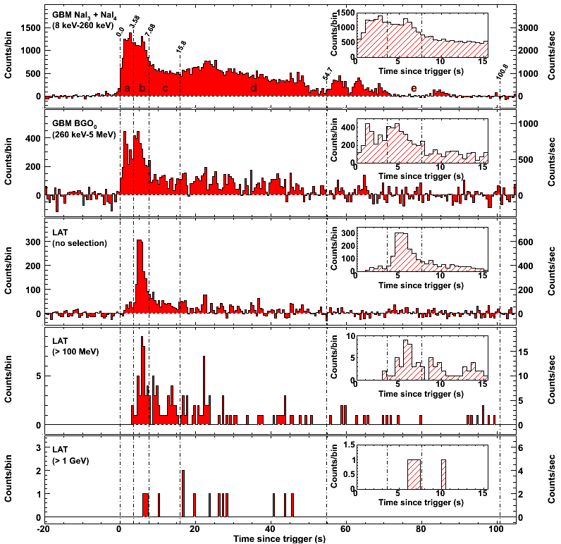
GRB080916C
PRELIMINARY!
[Paper submitted, in review]
The first low-energy peak is not observed at LAT energies
14 events above 1 GeV
The bulk of the emission of the 2nd peak is moving toward later times as the energy increases
Clear signature of spectral evolution
new era of GeV GRB lightcurves!
8 keV – 260 keV
260 keV – 5 MeV
LAT raw
LAT > 100 MeV
GROND optical follow up
[GCN 8257, 8272]
Faint (21.7 mag at T₀+32h)
and fading (T₀+3.3d) source
RA = 119.8472˚,
Dec = −56.6383˚ (±0.5” at 68% C.L.)‏
Photometric redshift of z=4.2 +/- 0.3
LAT > 1 GeV
T₀
Notes:
Highest energy photon detected was 13.2 +0.7 - 1.54 GeV, 16.4 sec after trigger.
QG mass limit conservative upper bound M_{QG}> (1.50 +/- 0.20) x 10¹⁸ GeV/c² ~10% Planck Mass
Fluence 10 keV - 10 GeV is 2.4 x 10⁻⁴ ergs/cm², E_{iso} =8.2x10⁵⁴ ergs!
GROND is operated as a PI-instrument at the MPI/ESO 2.2m telescope on La Silla (Chile).

Slide 32
Summary on GRB’s
Updated on May : 129 bursts detected by GBM (Gamma Ray Burst Monitor) including 8 LAT detection
High Energy GRB’ observation:
evidence for a delay between KeV-MeV emission and >100MeV emission
all spectra consistent with a Band function
first >GeV observation from a short burst
most energetic burst with a measured red shift
evidence of a temporally extended GeV emission, up to 23 min
→ Derived considerations:
narrow collimated relativistic jet
KeV-GeV spectrum and variability: unique mechanism, same emission region
leptonic or hadronic origin?
best constraint ever on Γ (> 600 - 900) and M_{QG} (1.50e18 GeV/c² ~ 0.1 M_{Planck})

Slide 33
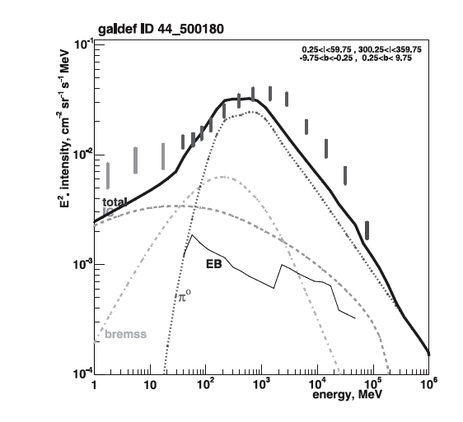
EGRET: diffuse emission from the Galaxy
GeV Excess
Diffuse emission model:
Locally measured CR spectrum
Observed distribution of interstellar matter + light
Theoretical/experimental cross sections for relevant interactions
Adding this component it is posssible to calculate energy spectrum of gamma-ray intensity
Credit: Strong, Moskalenko & Reimer 2004
Claudia Cecchi
Notes:
Non thermal emission from interaction between CR and interstellar medium + isotropic diffuse emission from unresolved AGN,
Star forming galaxies…etc.

Slide 34
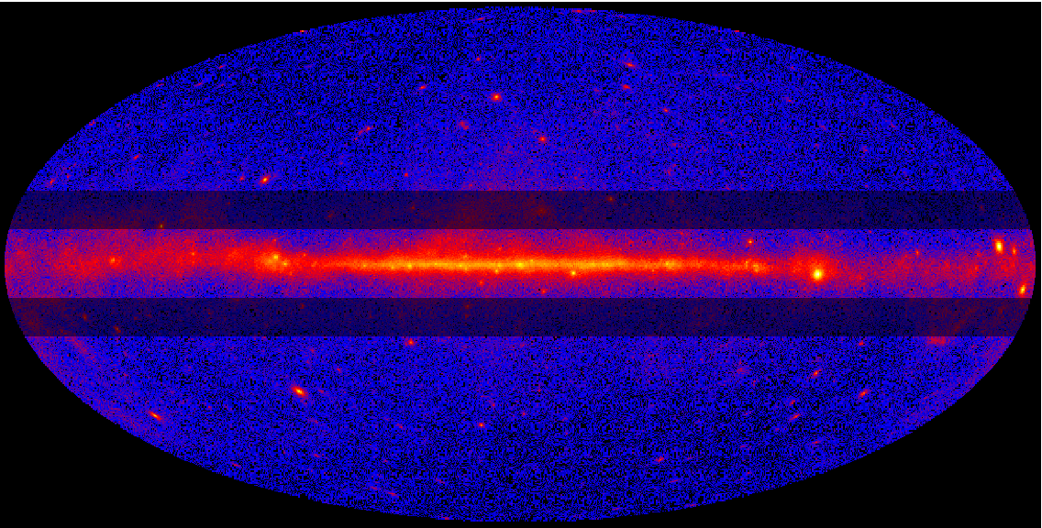
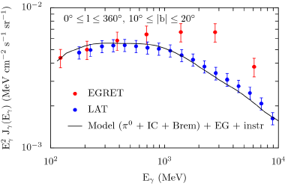
Diffuse emission: nailing the EGRET “GeV excess”
Galprop conventional
Spectra shown for mid-latitude range GeV excess in this region of the sky is not confirmed.
Sources are not subtracted but are a minor component.
LAT errors are dominated by systematic uncertainties and are currently estimated to be ~10% this is preliminary.
EGRET data is prepared as in Strong, et al. 2004 with a 15% systematic error assumed to dominate (Esposito, et al. 1999).
EG + instrumental is assumed to be isotropic and determined from fitting the data at |b| > 10°.
Claudia Cecchi

Slide 35
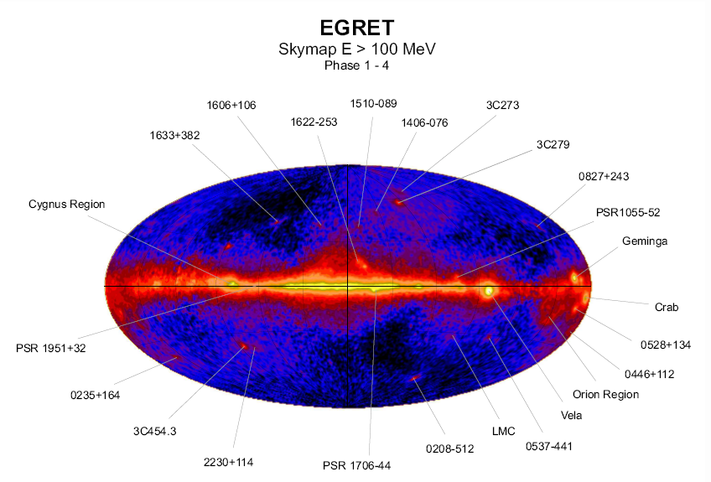
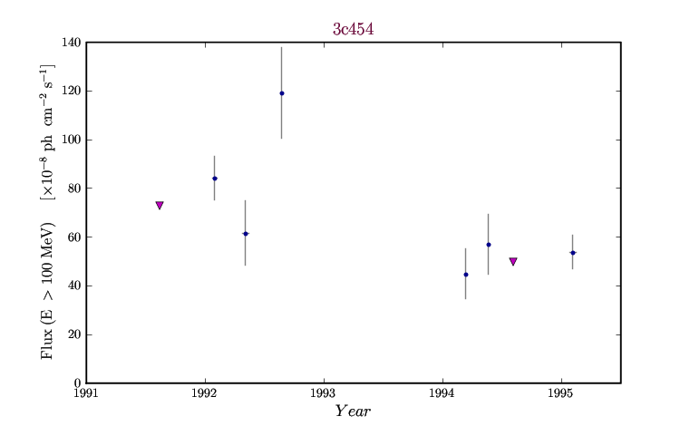
Gamma-ray loud Blazar: EGRET Era
Although blazars are only a few per cent of the
overall AGN population, they dominate the extragalactic
high-energy sky
The Energetic Gamma Ray Experiment Telescope (EGRET) onboard the Compton Gamma Ray Observatory (CGRO) discovered about 70 (3rd Catalog, Hartman et al 1999; >100 Sowards-Emmerd et al. 2003,2004) blazars emitting gamma-rays
Claudia Cecchi
Notes:
Blazars are AGNs with jets that are pointing directly at us (we are looking down the throat of the dragon!)
Radiation from the jet swamps out all other sources of radiation

Slide 36
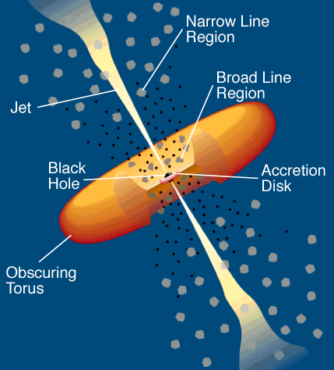
Extragalactic sources: Blazars
Almost all galaxies contain a massive black hole
99% of them is (almost) silent (e.g. our Galaxy)
1% per cent is active (mostly radio-quiet AGNs): BH+disk: most of the emission in the UV-X-ray band
0.1% is radio loud: jets mostly visible in the radio
Blazar characteristics
- Compact radio core, flat or inverted spectrum
- Extreme variability (amplitude and t) at all frequencies
- High optical and radio polarization
FSRQs: bright broad (1000-10000 km/s) emission lines often evidences for the “blue bump” (acc. disc)
BL Lac: weak (EW<5 Å) emission lines no signatures of accretion
Claudia Cecchi
Notes:
Highly relativistic beams of particles in the jets produce the observed gamma rays.

Slide 37
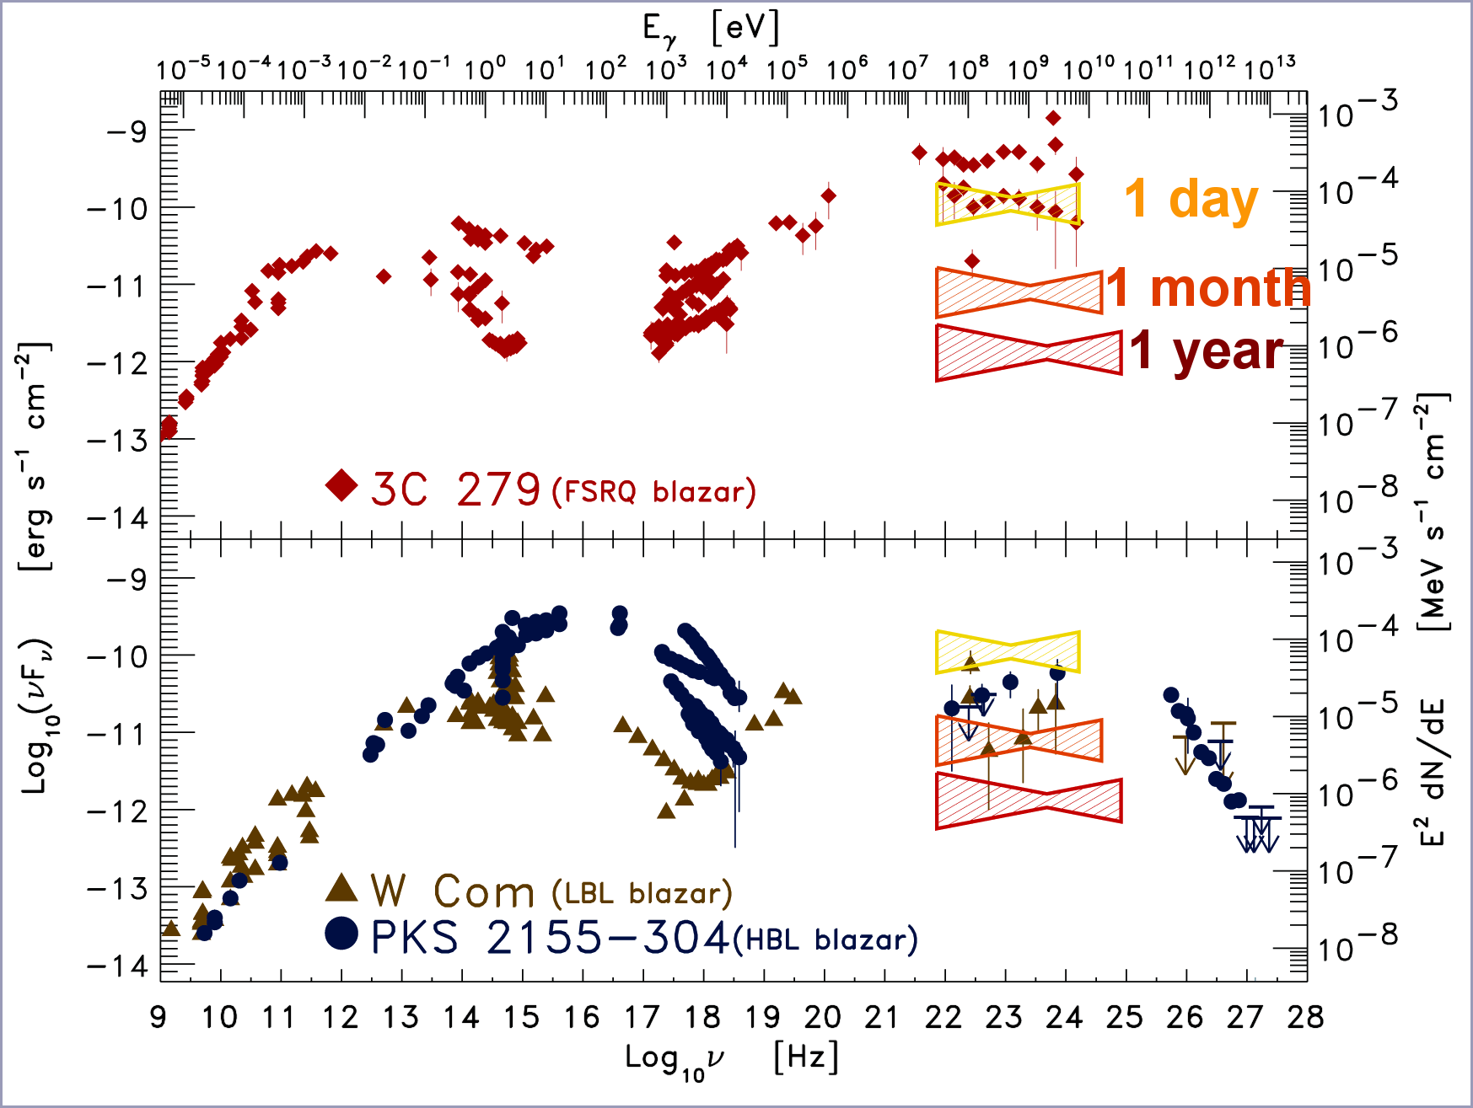
Blazars: Fermi LAT
Population Studies
Daily sampled LC can be easily obtained for most of the bright blazars → Variability on timescales >= 1 day can be well investigated.
Intra-day (hours) variations can be detected for the brightest gamma-ray blazars.
Detailed spectral variation analysis and intrabands delays studies may be performed
Multiepoch SEDs can be obtained.
Claudia Cecchi

Slide 38
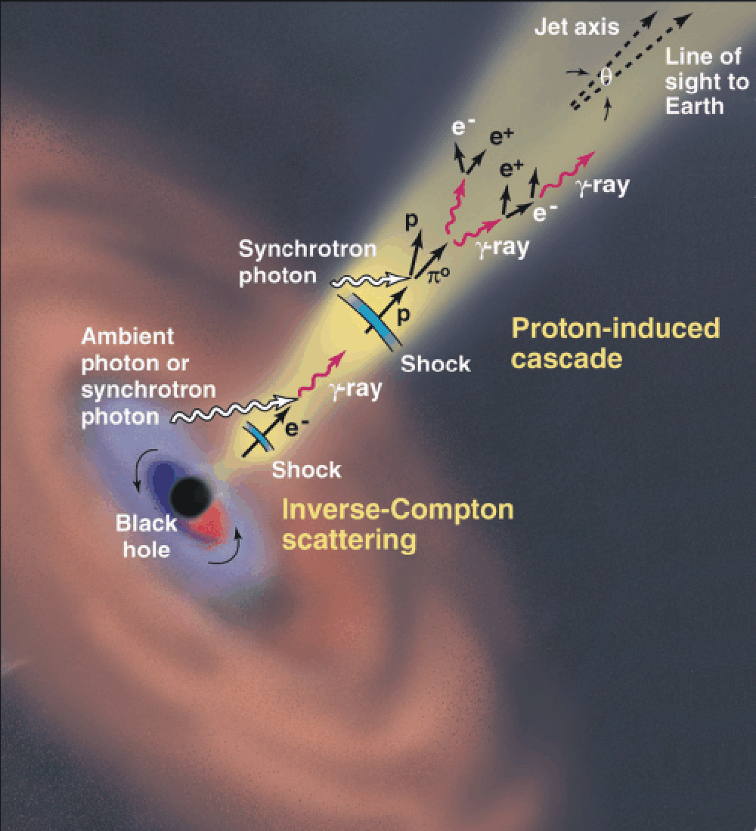
Open questions about Blazars
How are jets made by accreting black holes?
How and where are jets accelerated (why they have high Lorentz factors)?
How are jets focused to opening angles less than a few degrees?
How do shocks, turbulence, instabilities, jet bending and precession arise?
What is the jet matter content (electron-proton vs. pair plasmas)?
How are the relativistic electrons accelerated?
Which is the jet emission mechanism ?
How and where jets emit gamma-ray ?
What are the mechanisms producing blazar variability?
Which is the blazar duty-cycle?
Etc…
Fermi-LAT is starting to give an answer to most of these questions
Claudia Cecchi

Slide 39
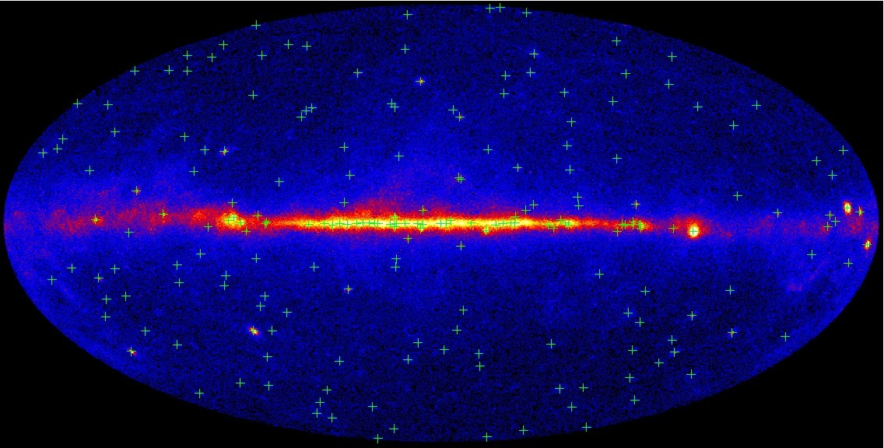
205 preliminary LAT Bright Sources
Claudia Cecchi

Slide 40
Vital statistics
205 “bright source list” 132 sources with >10σ detection and |b| > 10°
7 are pulsars or pulsar candidates
111 of the remaining 125 are associated with bright, flat-spectrum radio sources (89%)
98/111 have optical classifications (88%)
89/111 have measured redshifts (80%)
Much higher association rate than for 3EG (∼60%)
Claudia Cecchi

Slide 41
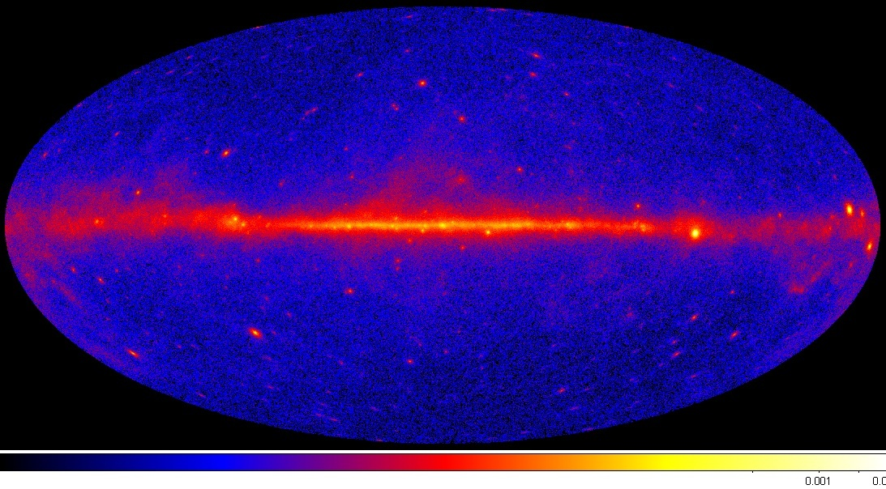
The LAT Sky, August – October
Claudia Cecchi

Slide 42
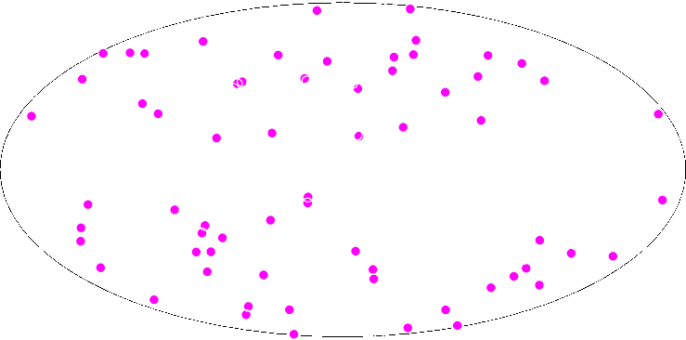
The LAT Sky, August – October
FSRQ
Claudia Cecchi

Slide 43
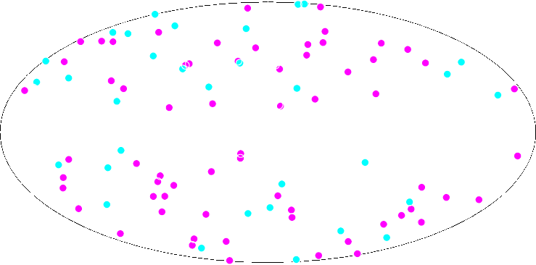
The LAT Sky, August – October
FSRQ
BL Lac
Seminar University of Heidelberg
April 28th 2009
Claudia Cecchi

Slide 44
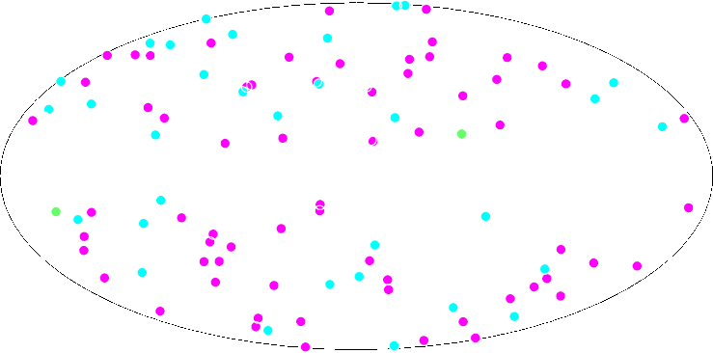
The LAT Sky, August – October
FSRQ
BL Lac
Other AGN
Claudia Cecchi

Slide 45
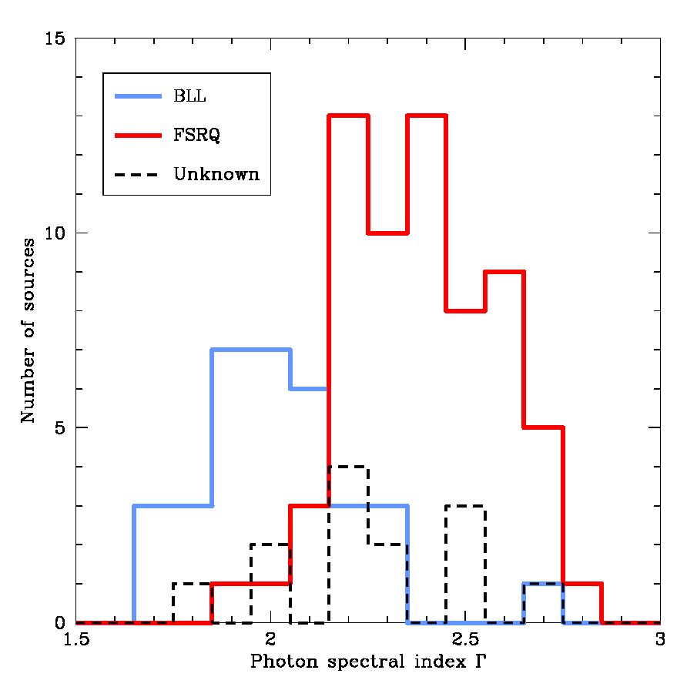
Spectral Index distribution
PRELIMINARY
Claudia Cecchi

Slide 46
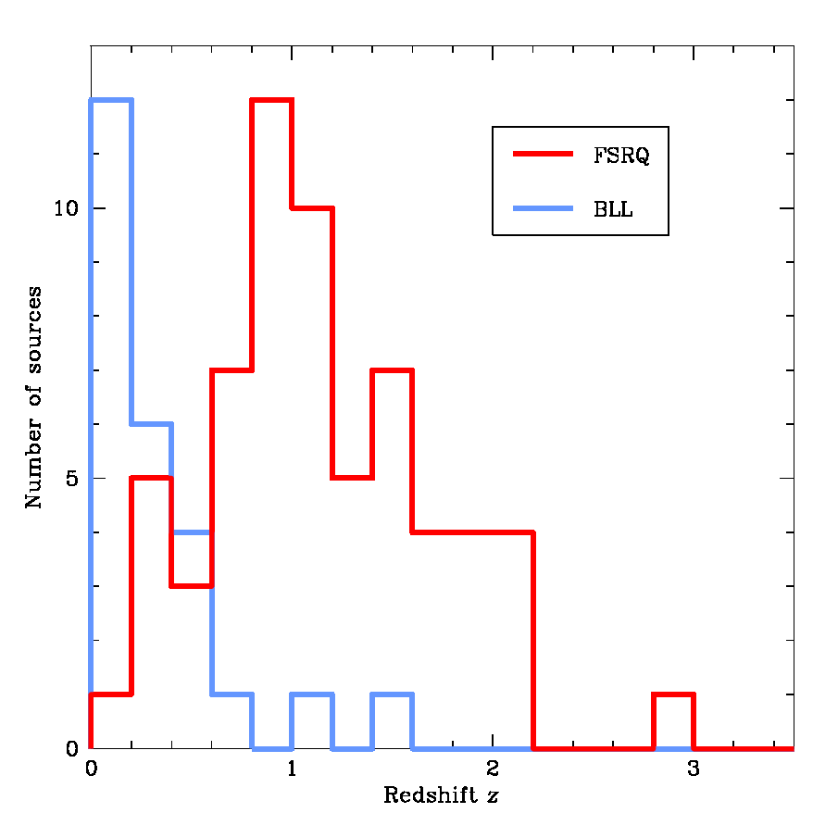
Redshift distribution
PRELIMINARY
Claudia Cecchi

Slide 47
Flaring and variability of Gamma-Ray Blazars
In survey mode, the LAT would detect a flaring source from any point
in the sky at any time.
Detailed studies require many photons, are only possible for flaring sources.
Correlated variability across different bands is tell-taling, providing rich information on:
- acceleration/cooling
- emission processes (EC/SSC)
Target-of-opportunity proposals have been submitted (Chandra, Suzaku, Spitzer, RXTE, Swift…).
Claudia Cecchi

Slide 48
The very first week: Aug 3 – Aug 10
Aug. 03. 2008 : First day: a possible discovery (detection of quiet-Sun on daily basis ?)
Aug. 06. 2008 : a new gamma-ray emitting and flaring blazar (PKS 1502+106, (OR 103)).
Claudia Cecchi

Slide 49
3C454.3 with LAT
Vital statistics:
* Well-known radio source,
identified with an OVV quasar at z = 0.859
* Good VLBI data, superluminal
expansion, d = 25, G_{jet} ~15, q ~ 0.8º
* Detected by EGRET, AGILE
* Very active (bright, rapidly variable) since 2000
3C454,3 has been clearly detected in the early Fermi LAT data, and showed rapid flares, with the risetime on a scale of ~3 days
Such rapid variability by itself implies a very compact emission region which would be optically thick to the escape of γ-rays via e+/e- pair production
Problem is avoided via invoking relativistic motion with Doppler factor d > 6 – consistent with the VLBI-measured jet geometry
Claudia Cecchi
Notes:
SED is not a simple power law, shows a break at about 2 GeV, broken power law, which is the origin of the break?
Gamma1=2.3, gamma2=3.5

Slide 50
3C454.3 with LAT
* The quality of Fermi LAT data is good enough to measure departures from simple spectral forms: 3C454.3 LAT spectrum is not a simple power law
* It steepens to higher energy – can be described as a broken power law with a break, Γ₁ ~ 2.3 to Γ₂ ~3.5 at E_{br} ~ 2 GeV
* Broken power law isn’t unique description
PRELIMINARY
Origin of the break?
It is not a simple “cooling break” (expected Δα = 0.5)
Instead, it can be either due to absorption on “local photons” due to the accretion disk, or a signature of intrinsic break in the electron distribution
First explanation is possible but, given the X-ray emission from the accretion disk – somewhat unlikely
Broken power law of the electron distribution is a better explanation: that would indicate the break at γ_{br} ~ 1000
There, the cooling time scales are quite short, much shorter than the source crossing time, and imply distributed acceleration throughout the jet volume
Claudia Cecchi

Slide 51
PKS 1502+106
Another example:
PKS 1502+106 (aka
OR 103), at z=1.84 (SDSS)
Extremely rapid flare,
possibly the highest
ΔL/Δt detected to date
in the GeV band (see
insert in the light curve)
Allows us to provide
the independent measure
of the Doppler factor
Claudia Cecchi
Notes:
Second brightest extragalactic source. Highly variable 3.3 factor in flux in 12 hours.
Post flare: curvature, log parabola→ intrinsic acceleration process
Prompt emission: power law

Slide 52
GeV-TeV connection: PKS 2155+304 Spectral Energy Distribution
VHE: ∼0.2 Crab, Γ_{int} ≈ 2.5
HE: Γ_{L}=1.61±0.16, Γ_{h}=1.96±0.08, E_{b}=1.0±0.3 GeV
X-ray: Γ_{L}=2.36±0.01, Γ_{h}=2.67±0.01, E_{b}=4.4±0.5 keV
SSC Model parameters (3-component power-law):
p₀=1.3, p₁=3.2, p₂=4.3 where dn/dε ∝ ε^{−p}
break energies: ε₁=7.4GeV, ε₂=120GeV
R=1.5×10¹⁷cm, δ=32, B=0.02G
X-rays are produced by highest energy electrons, ε > ε₂
HE and VHE are produced by electrons with ε₁ < ε < ε₂
⇒ X-rays can vary (mostly) independently of VHE emission (cf. July 2006 flare)
Claudia Cecchi
Notes:
Spectral break between HE and VHE
First quantitative evidence of correlation between optical and VHE → more observations
But not correlation optical and HE → optical emission from separate population wrt HE and VHE?

Slide 53
Dark matter searches with Fermi
Gamma-ray lines “smoking gun” signal, but loop suppressed
ex ”GeV excess”
DM contribution
Bkg
Continuum spectra
Claudia Cecchi
Energy (GeV)

Slide 54
How Fermi can help to disentangle the Dark Matter Puzzle?
Claudia Cecchi

Slide 55
Sensitivity Map for GC with Fermi
- Select a region of 0.5deg around the GC, assume NFW profile and consider one WIMP annihilation channel at the time.
- Remove astrophysical sources (based on spectral analysis, multiwavelength observations. Difficult, their behaviour at these energies needs to be determined) in the region and perform χ² test to disentangle dark matter contribution from diffuse background.
Claudia Cecchi

Slide 56
Electron + Positron flux
Fermi covers electron energy measurement 20GeV – 1000 GeV
Fermi paper accepted to PRL
Claudia Cecchi

Slide 57
Adding candidate pulsars within 1Kpc
Claudia Cecchi
Notes:
Nomura-Thaler e Arkani-Hamed models
DM mass 1.6 TeV

Slide 58
Conclusions
Fermi telescope is off to a great start!
Instruments are working very well, gamma ray sky is showing itself in its beautiful composition
Already addressing many important questions from EGRET era:
EGRET GeV excess excluded
Many variable sources discovered
Many pulsars discovered
Challenge of great discovery potential
November 2-5 2009 Second Fermi Symposium in Washington DC
Gamma-ray data are very fascinating join the fun!
Claudia Cecchi

