Slide 1
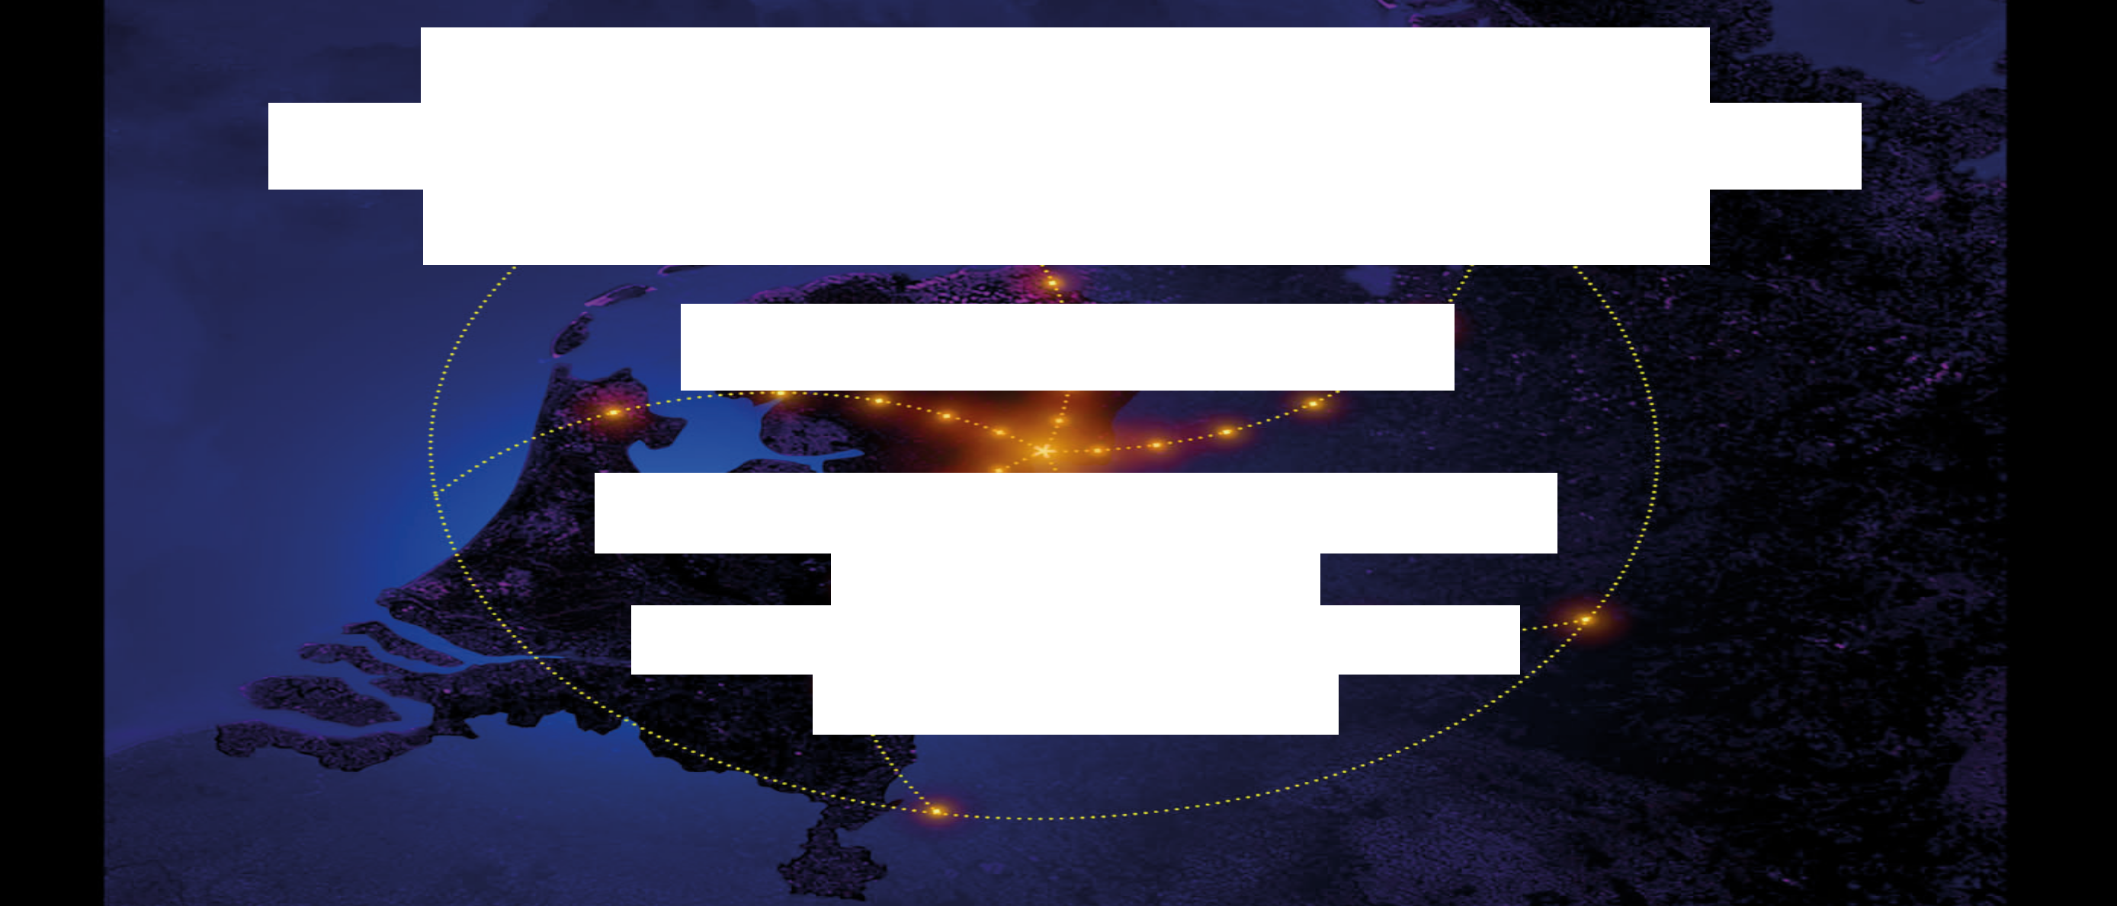


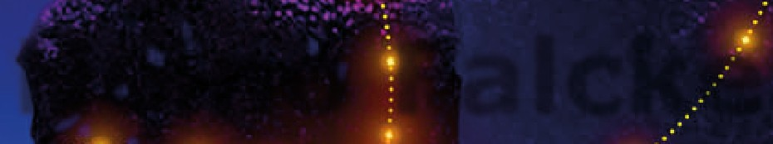

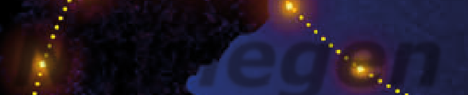
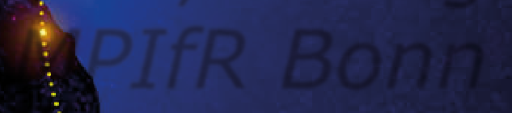

Slide 2

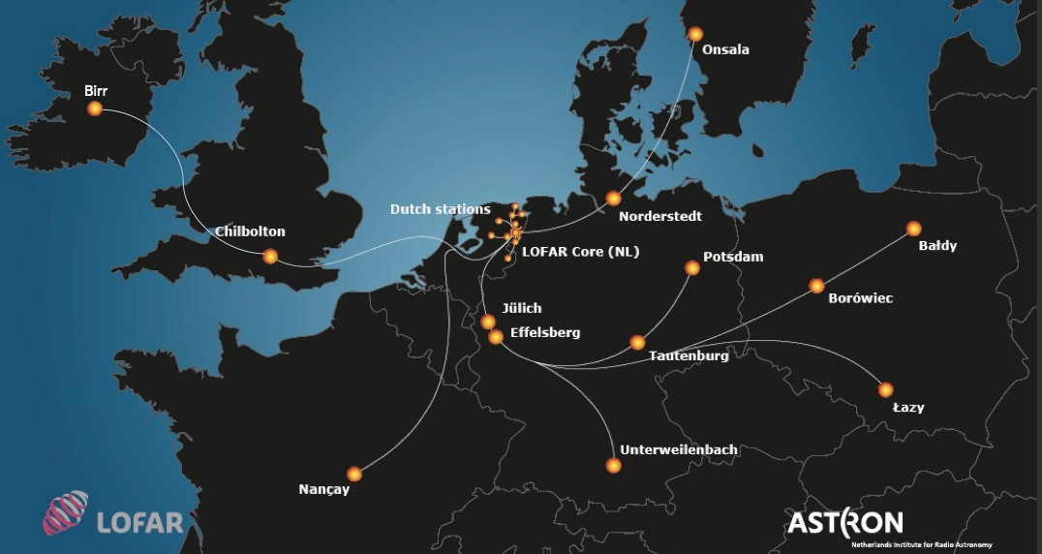
Telescope (ILT)
International LOFAR
50 operational stations completed
38 NL stations, 12 international stations
Includes 3 new stations in Poland
Ireland station coming this year
Yesterday Irish minister announced
1.4 M€ for Irish LOFAR station!!

Slide 3
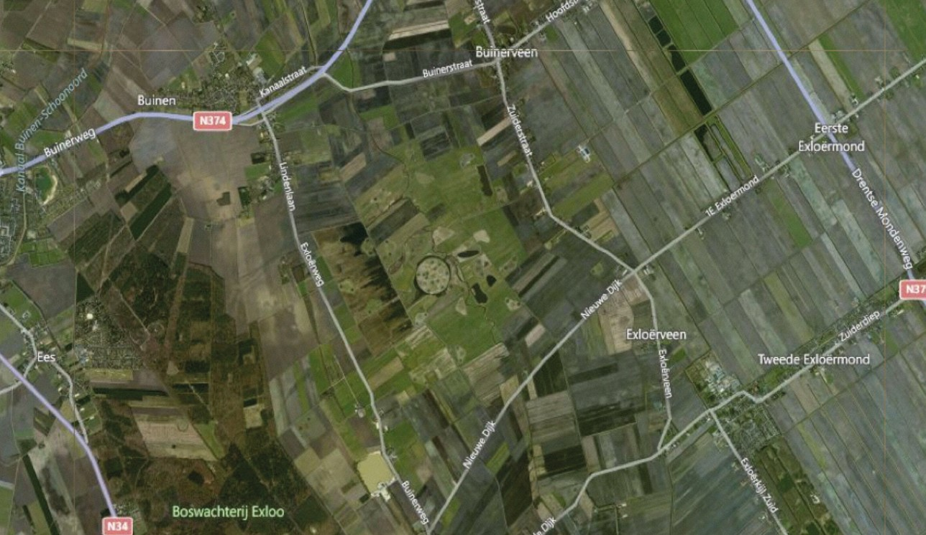
LOFAR core from space

Slide 4
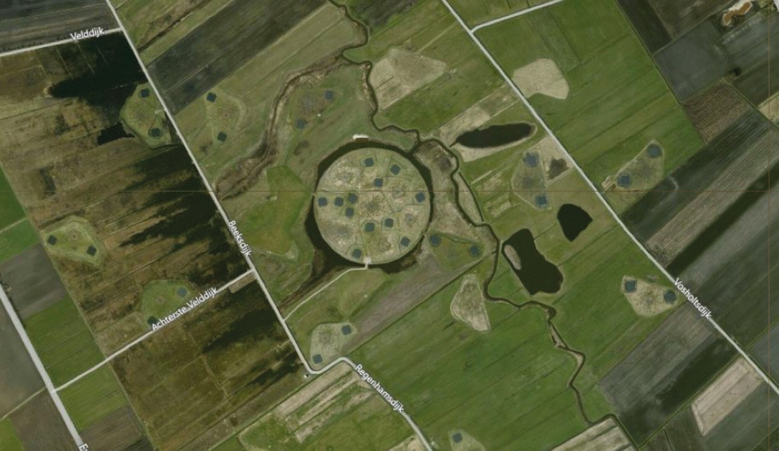
LOFAR core from Space

Slide 5
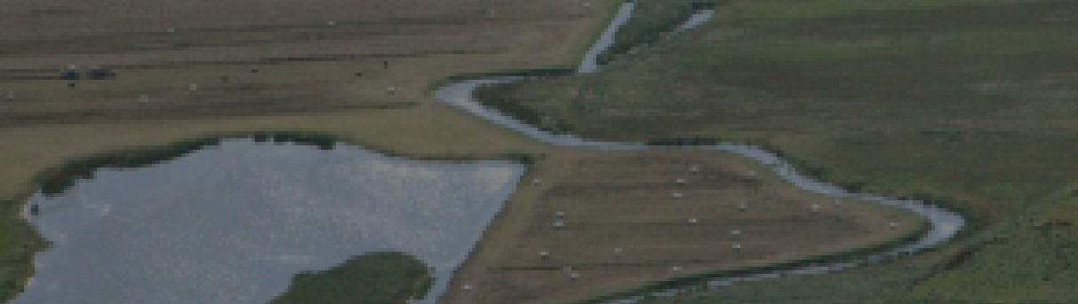
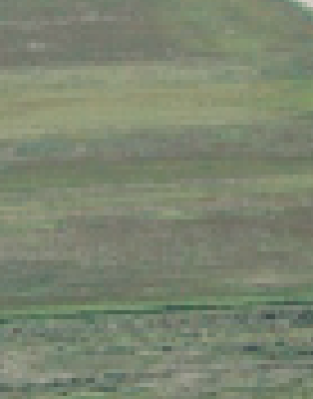
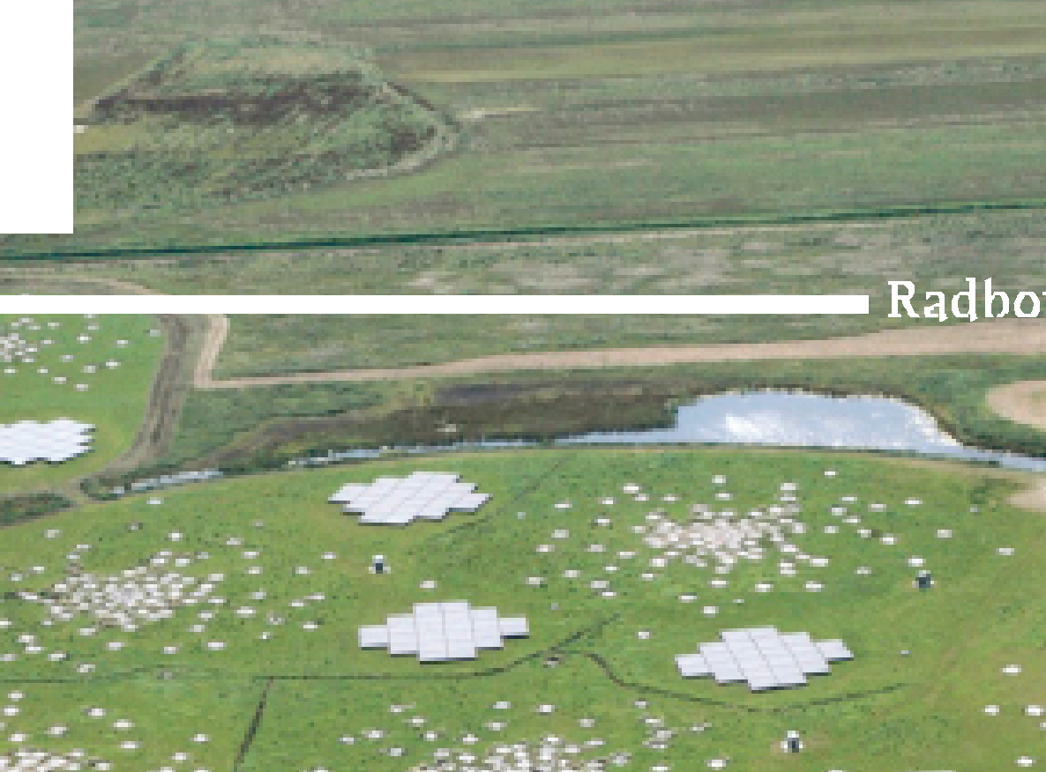
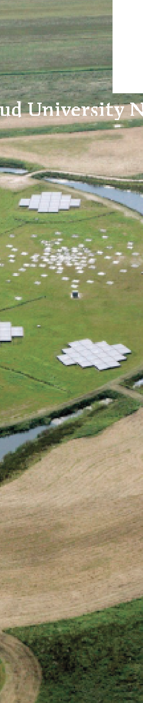
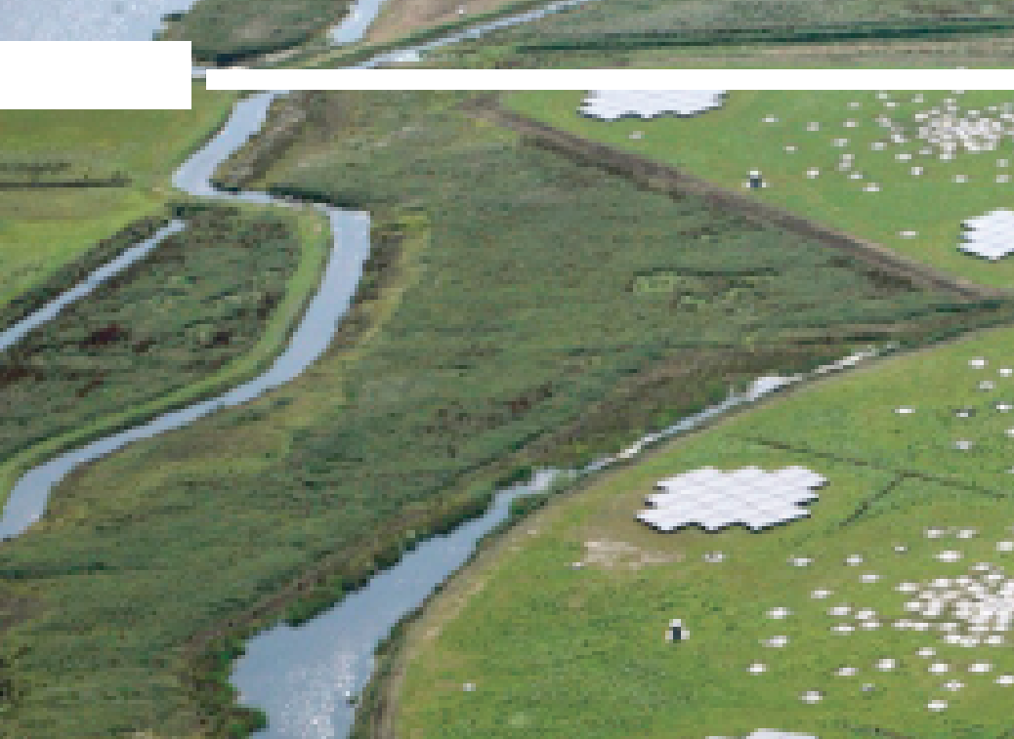







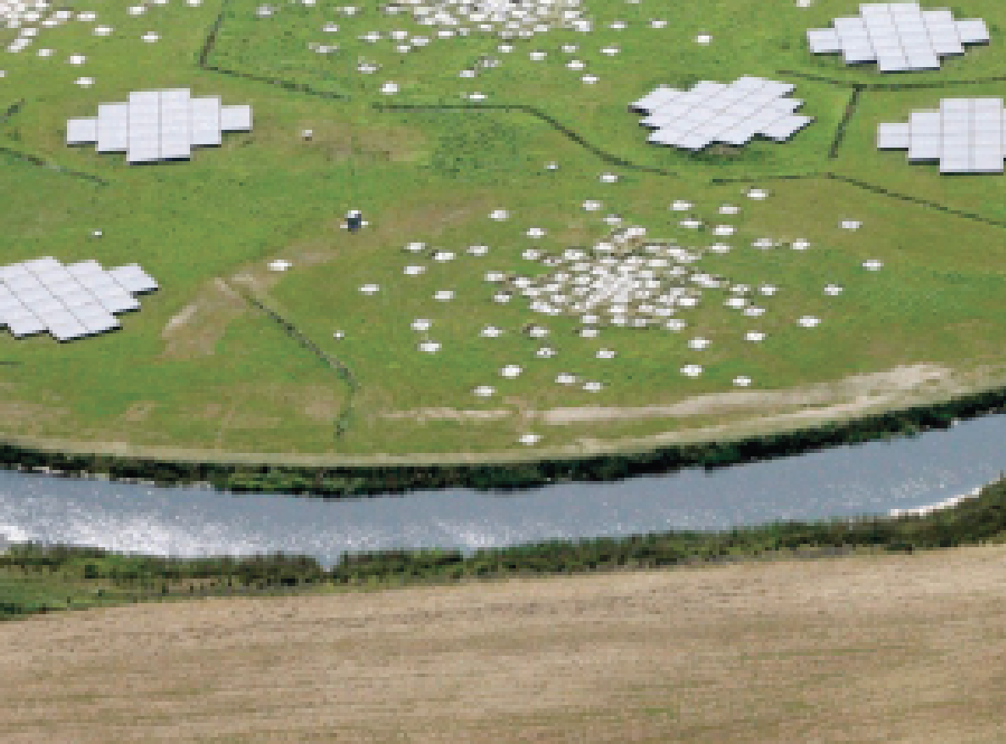
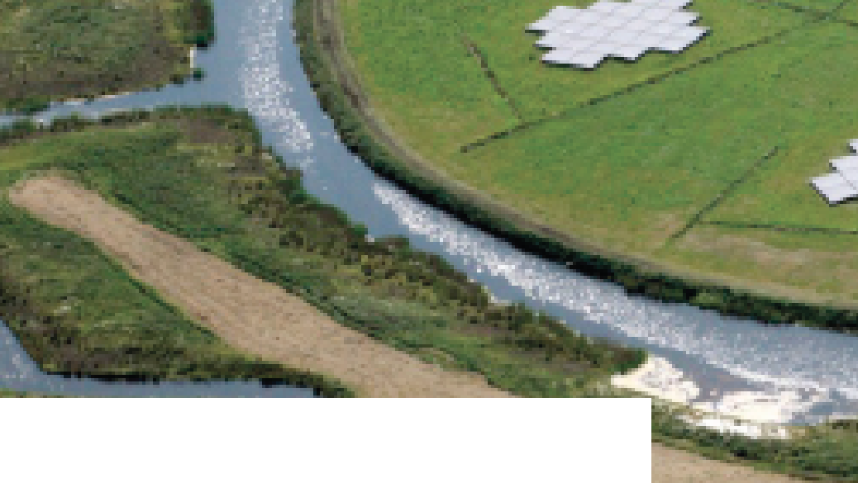
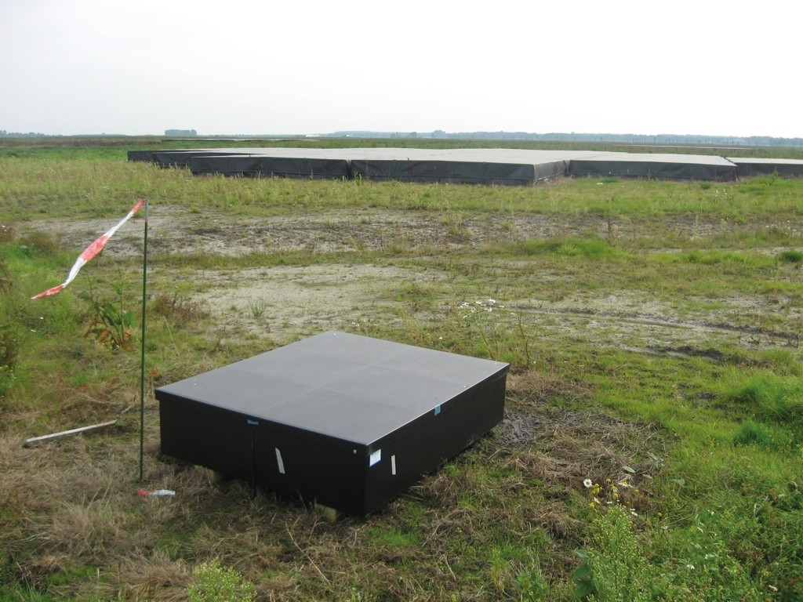
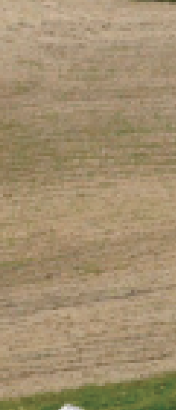
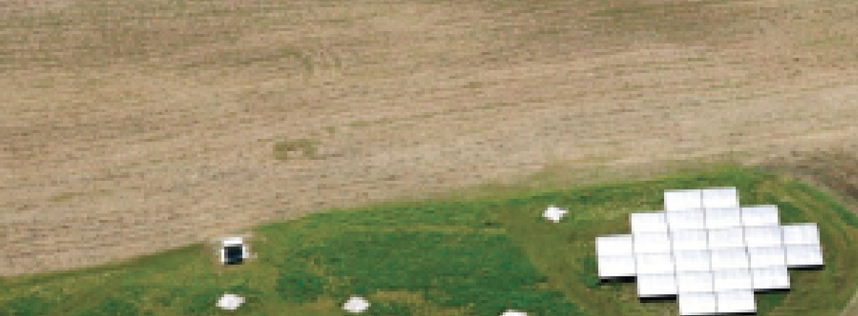
LOFAR “Superterp”
6 innermost LOFAR stations Station FOV: 10-100 deg²
+ LORA (LOFAR-Radboud Airshower array) 20 particle detectors

Slide 6
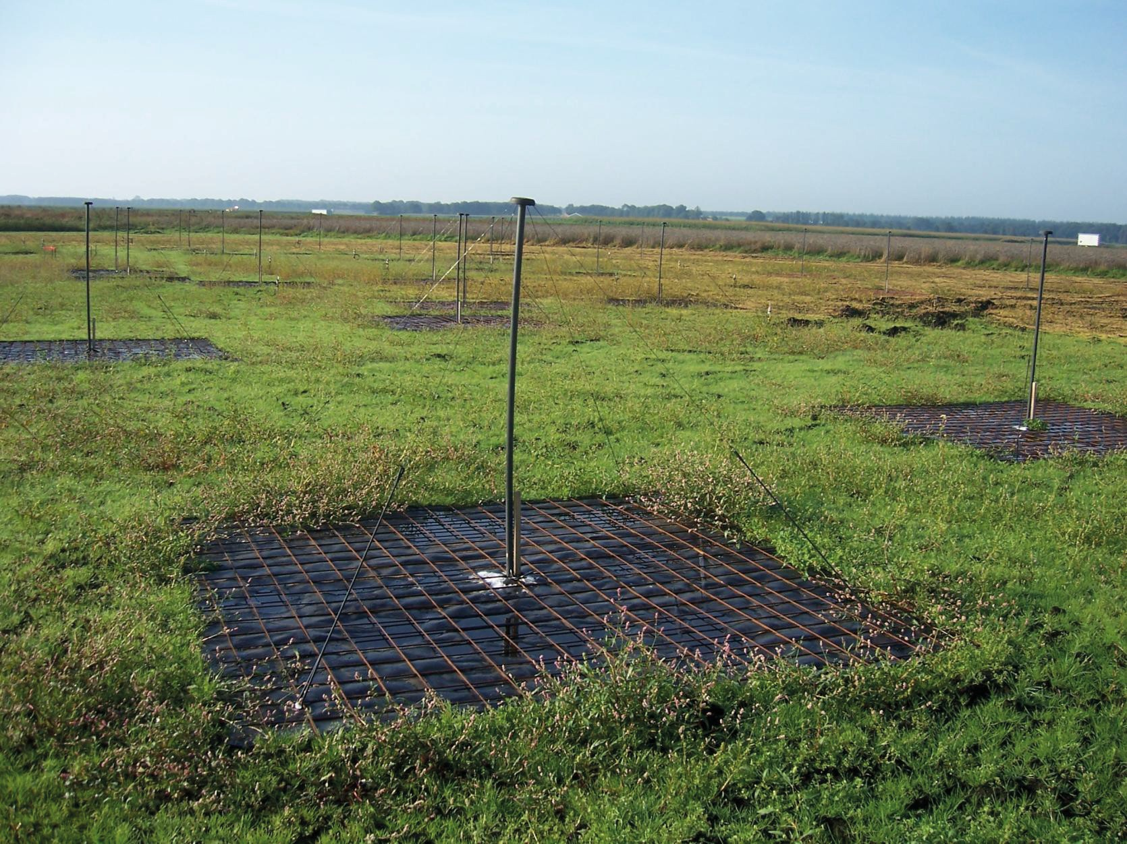
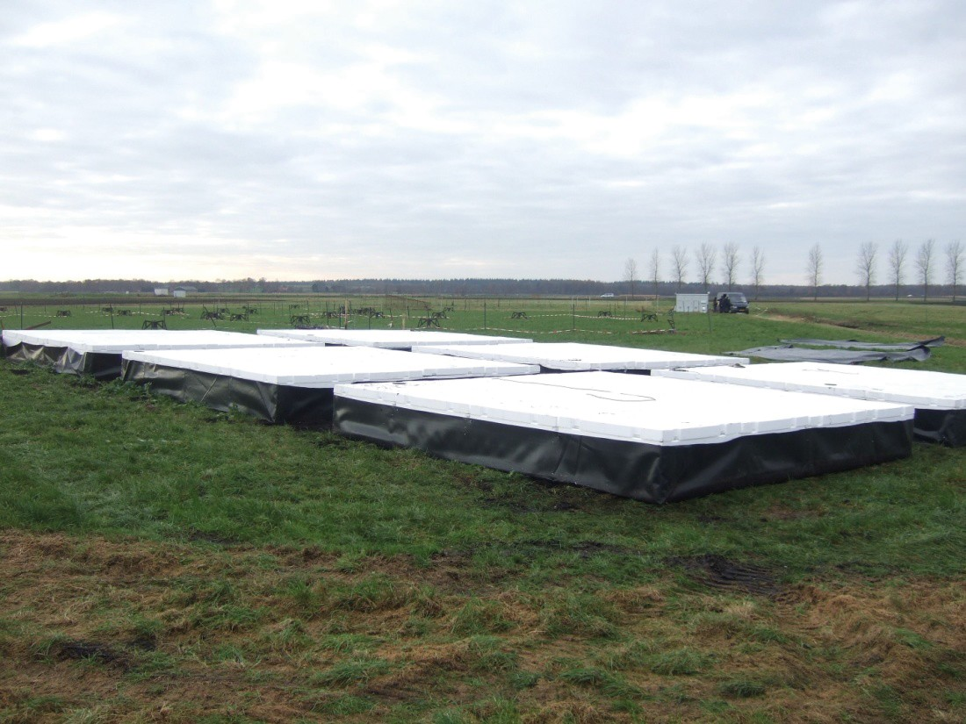
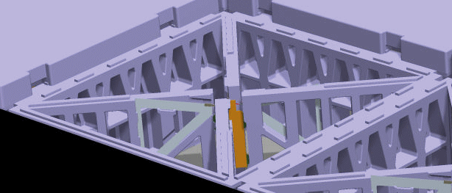
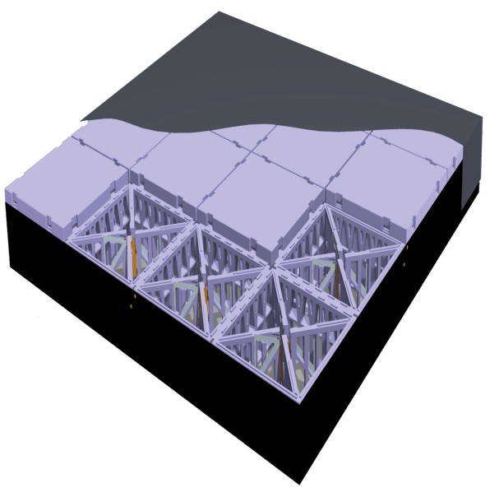
Low-Band Antennas (LBAs)
ν: 10-80 MHz / λ: 30 – 4 m
High-Band Antennas (HBAs):
ν: 120-270 MHz / λ: 2.5 – 1.1 m
~2000 crossed dipoles in NL
~850 in D, UK, F, S
~30.000 crossed dipoles in NL
~15.000 in D, UK, F, S
© ASTRON

Slide 7
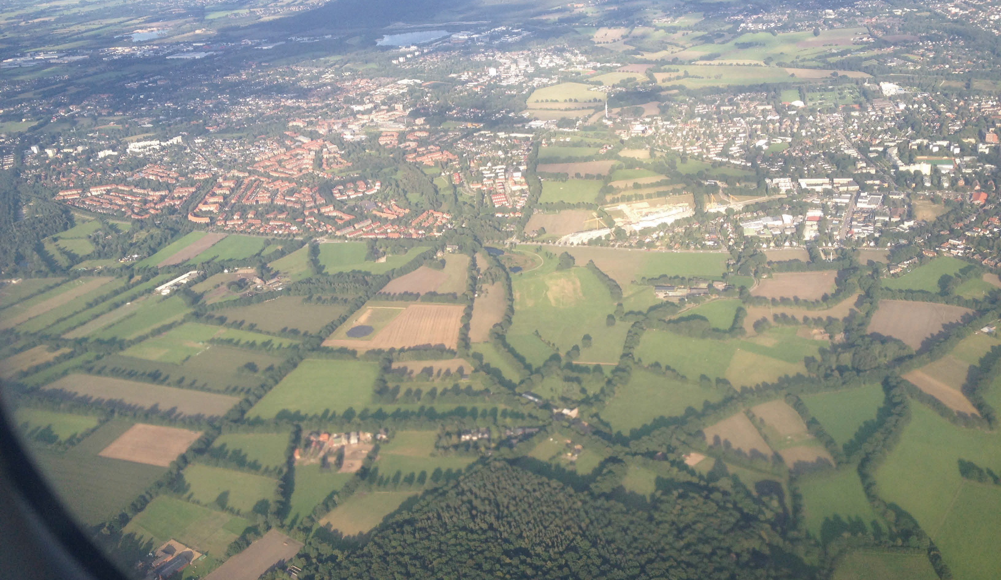
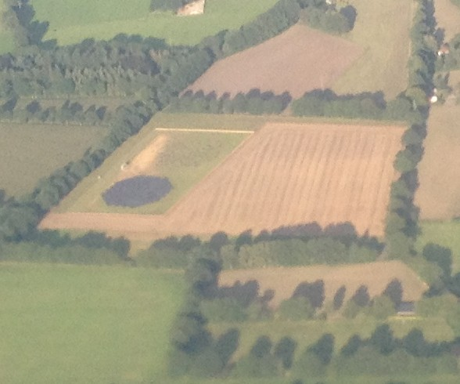
Hamburg/Norderstedt

Slide 8


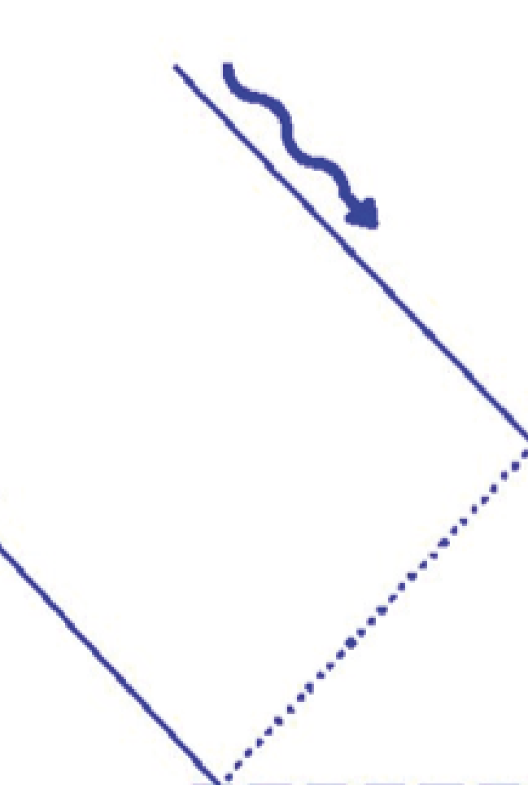
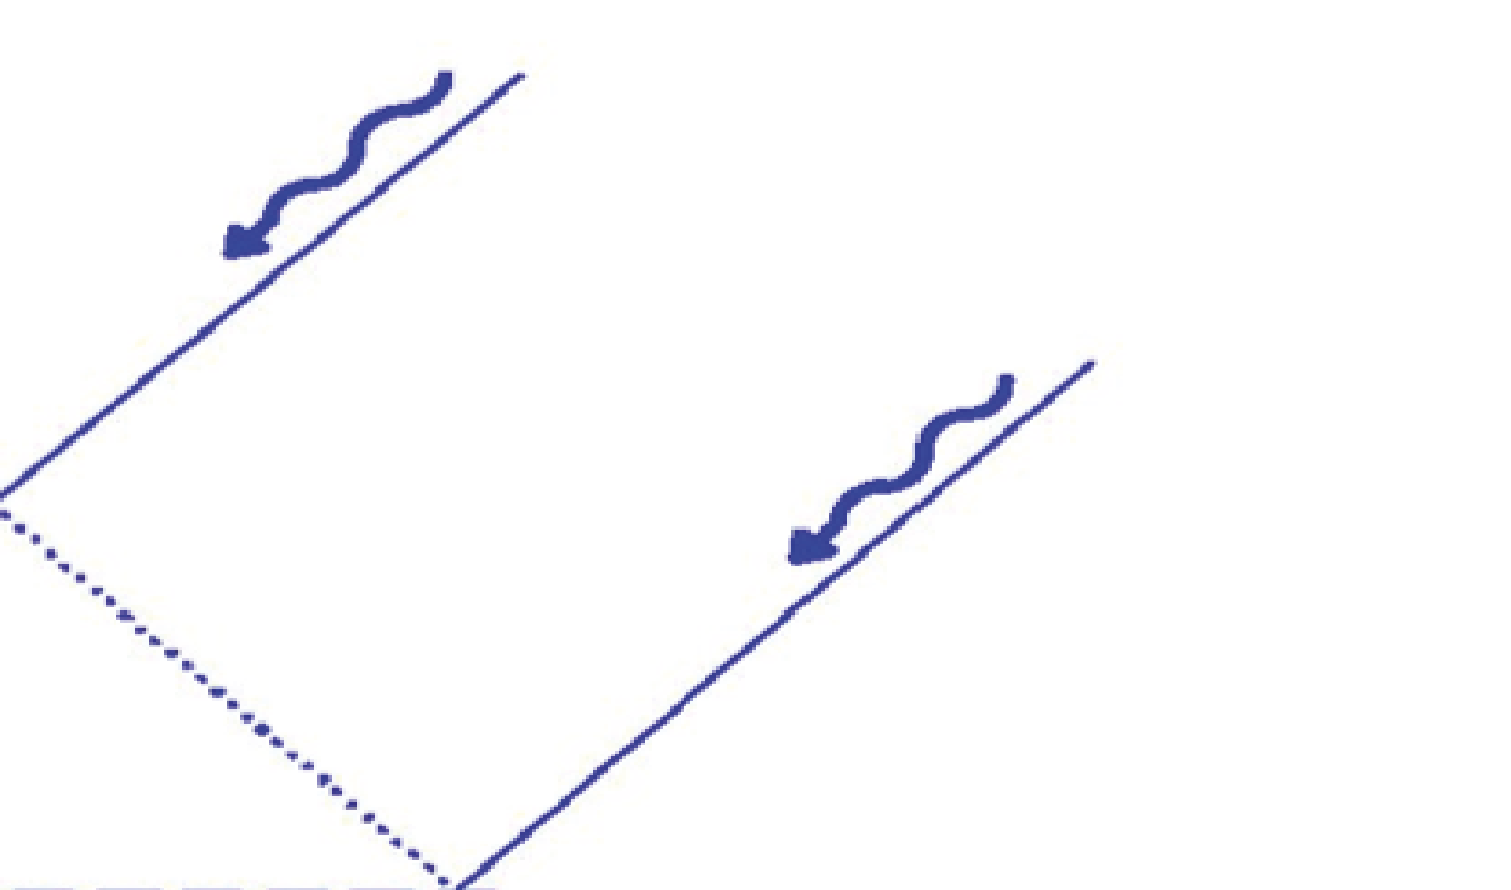

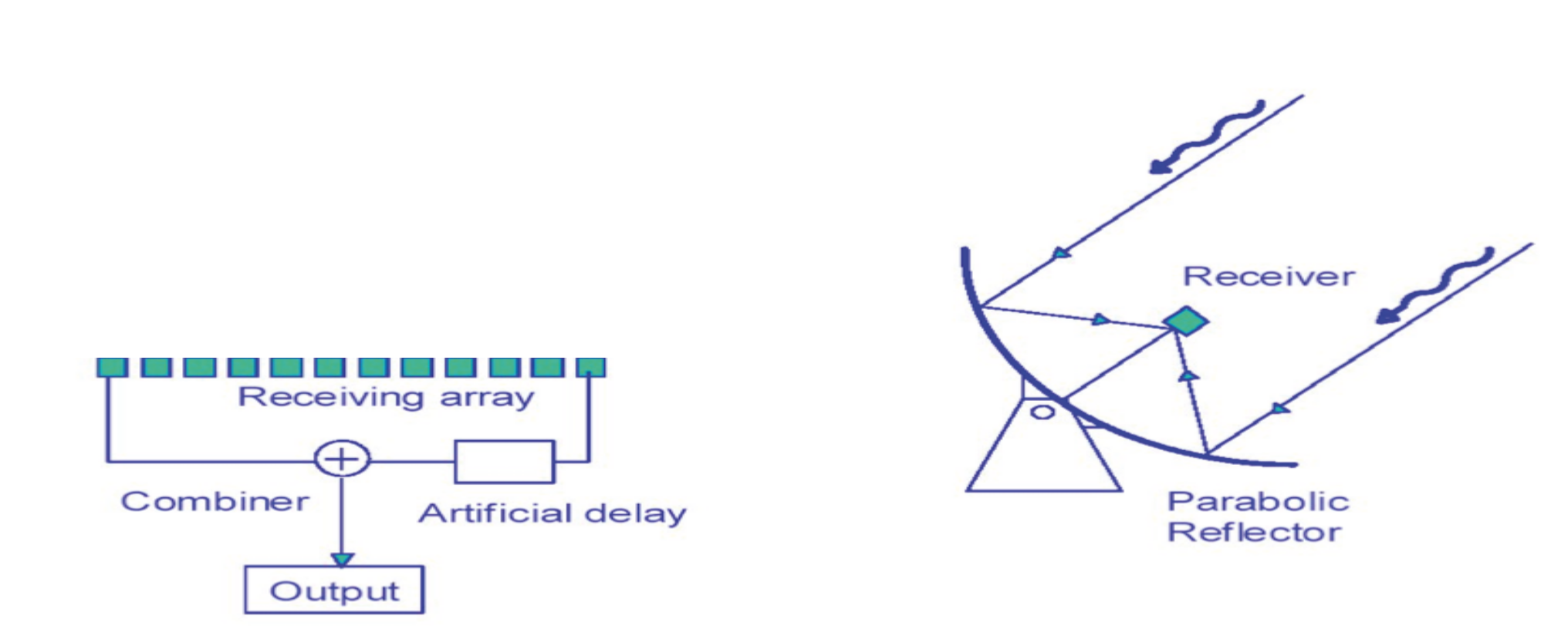




LOFAR: A “Phased Array”
-+±Δτ
Electronic beam steering

Slide 9
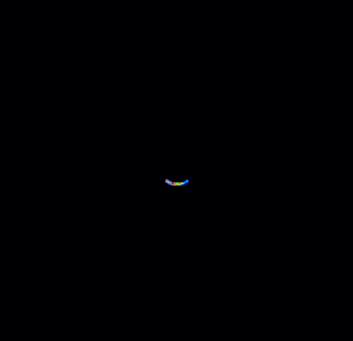
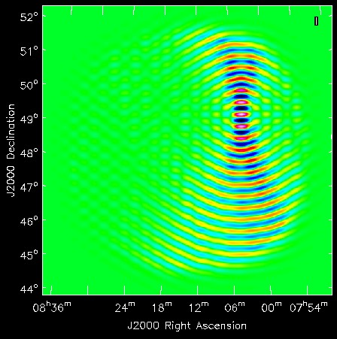
Inteferometer Principle
- Each antenna-antenna baseline “draws” a ring on the sky
- Interference between signals produces interferometry fringes
- The superposition of the information of many baselines (fringes) “draws” the image.
Distance between antenna
Slide: C. Tasse

Slide 10

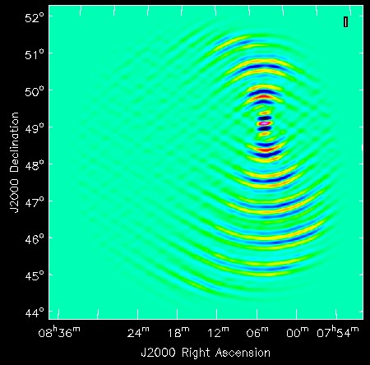
Interferometer Principle
- Each antenna-antenna baseline “draws” a ring on the sky
- Interference between signals produces interferometry fringes
- The superposition of the information of many baselines (fringes) “draws” the image.
Distance between antenna
Slide: C. Tasse

Slide 11

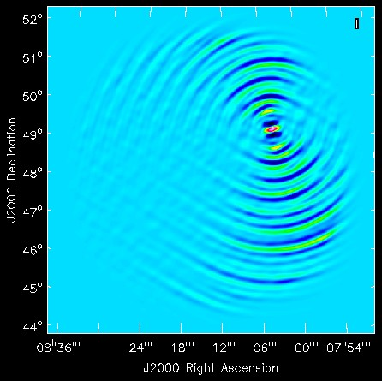
Interferometer Principle
- Each antenna-antenna baseline “draws” a ring on the sky
- Interference between signals produces interferometry fringes
- The superposition of the information of many baselines (fringes) “draws” the image.
Distance between antenna
Slide: C. Tasse

Slide 12
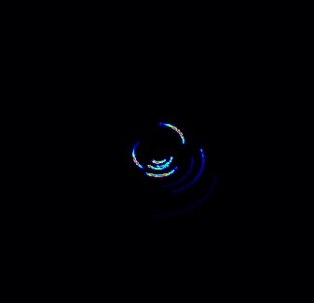
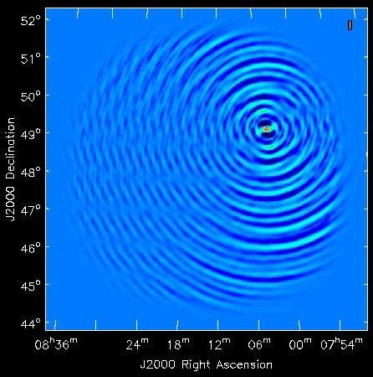
Interferometer Principle
- Each antenna-antenna baseline “draws” a ring on the sky
- Interference between signals produces interferometry fringes
- The superposition of the information of many baselines (fringes) “draws” the image.
Distance between antenna
With 100 % baseline coverage, the image would be perfect. Gaps will produce image artifacts. These gaps/artifacts are well-defined and can be “cleaned” from the final image.
Slide: C. Tasse

Slide 13
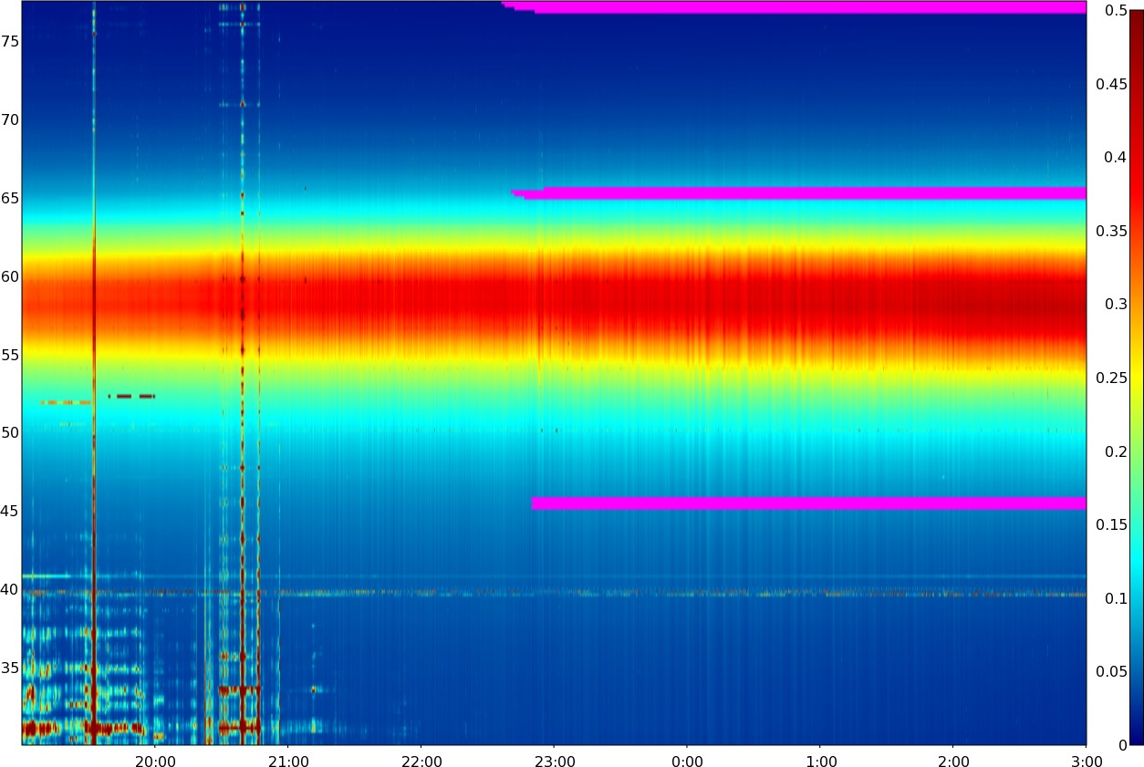
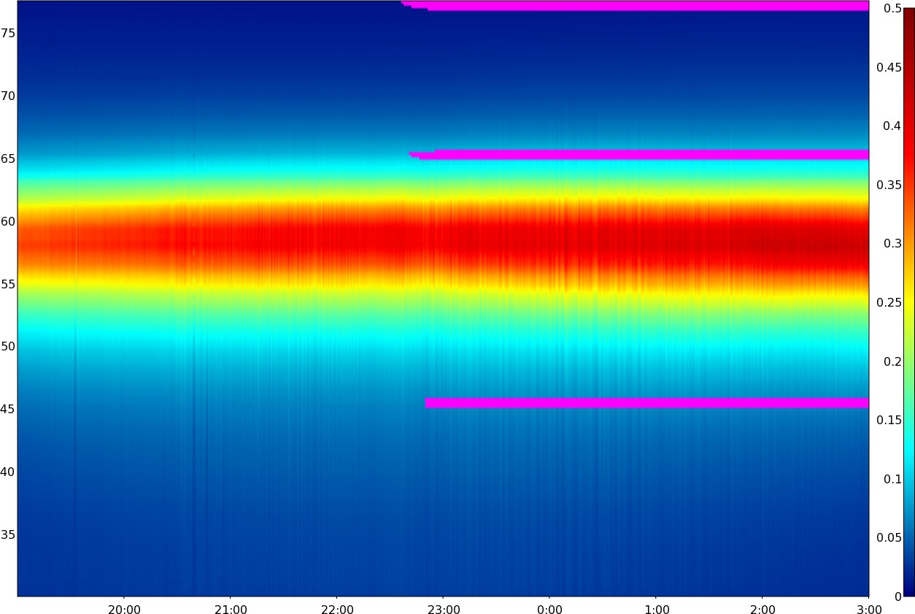
The Enemy: Interference
Before …
… and after interference removal
Frequency →
Time →
Offringa et al. (2012)

Slide 14
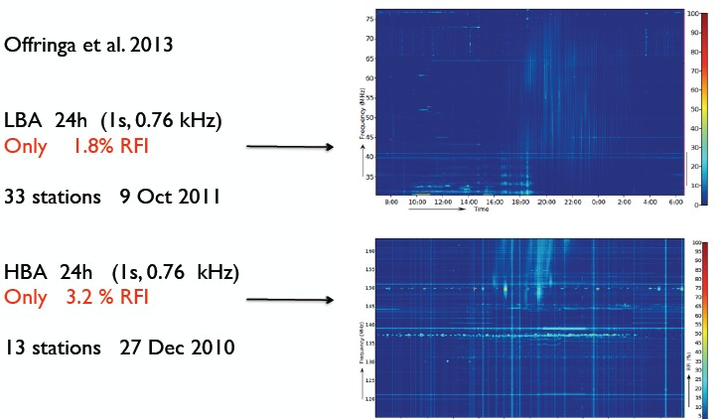
LOFAR RFI environment

Slide 15
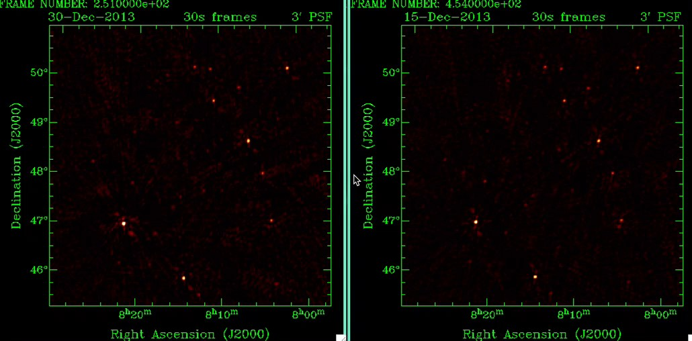
The Enemy: Ionosphere
Without ionospheric calibration
With ionospheric calibration

Slide 16
Science Topics
Pulsars
ISM and magnetic fields
Radio Galaxies & Surveys
Epoch of Reionization
Ultra-High Energy Cosmic Rays

Slide 17
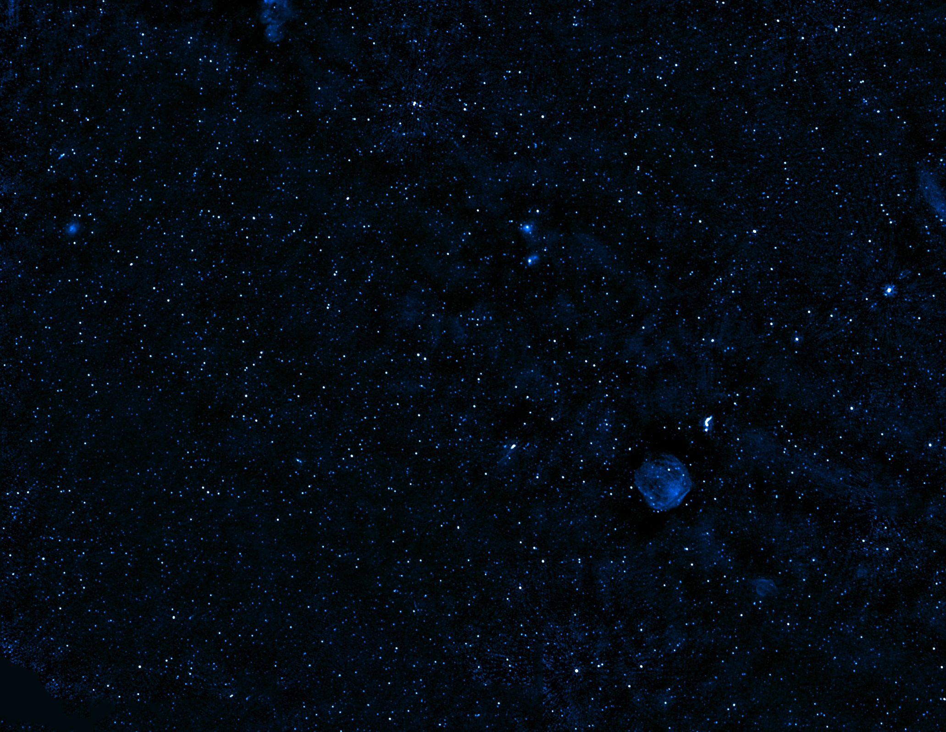

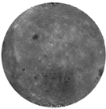
Snapshot (Northern) Sky Survey
LOFAR MSSS: Multifrequency
2°
G. Heald et al. (2015)

Slide 18
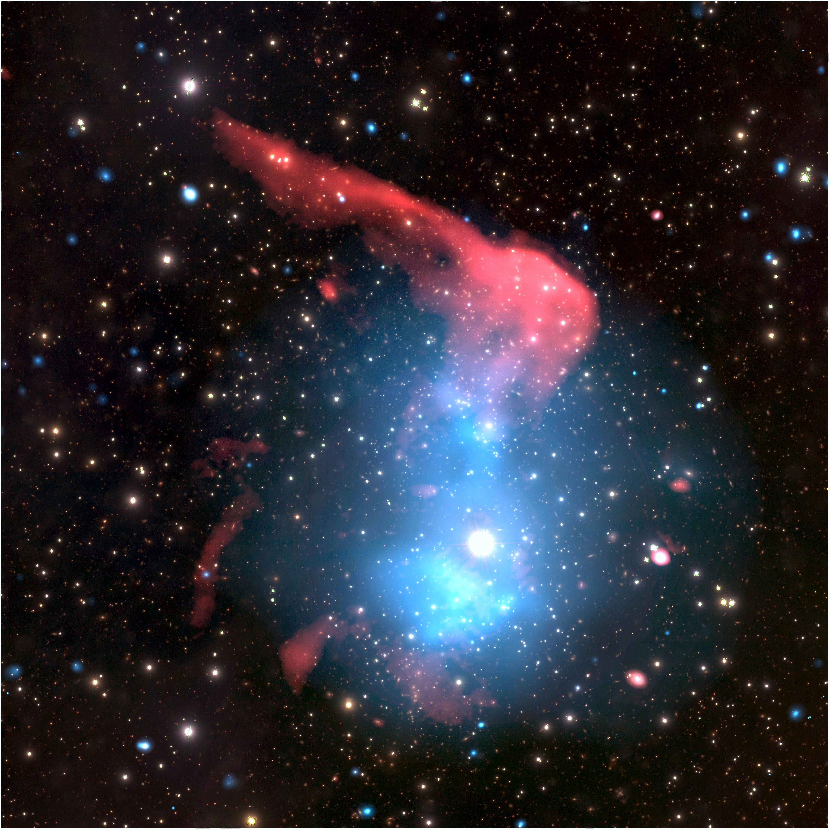
Galaxy Clusters with LOFAR
The Toothbrush
LOFAR HBA: Red
Chandra: Blue Subaru: optical
LOFAR survey KSP (Rottgering et al.) and Magnetism KSP (Brüggen et al.)
Reinout van Weeren

Slide 19
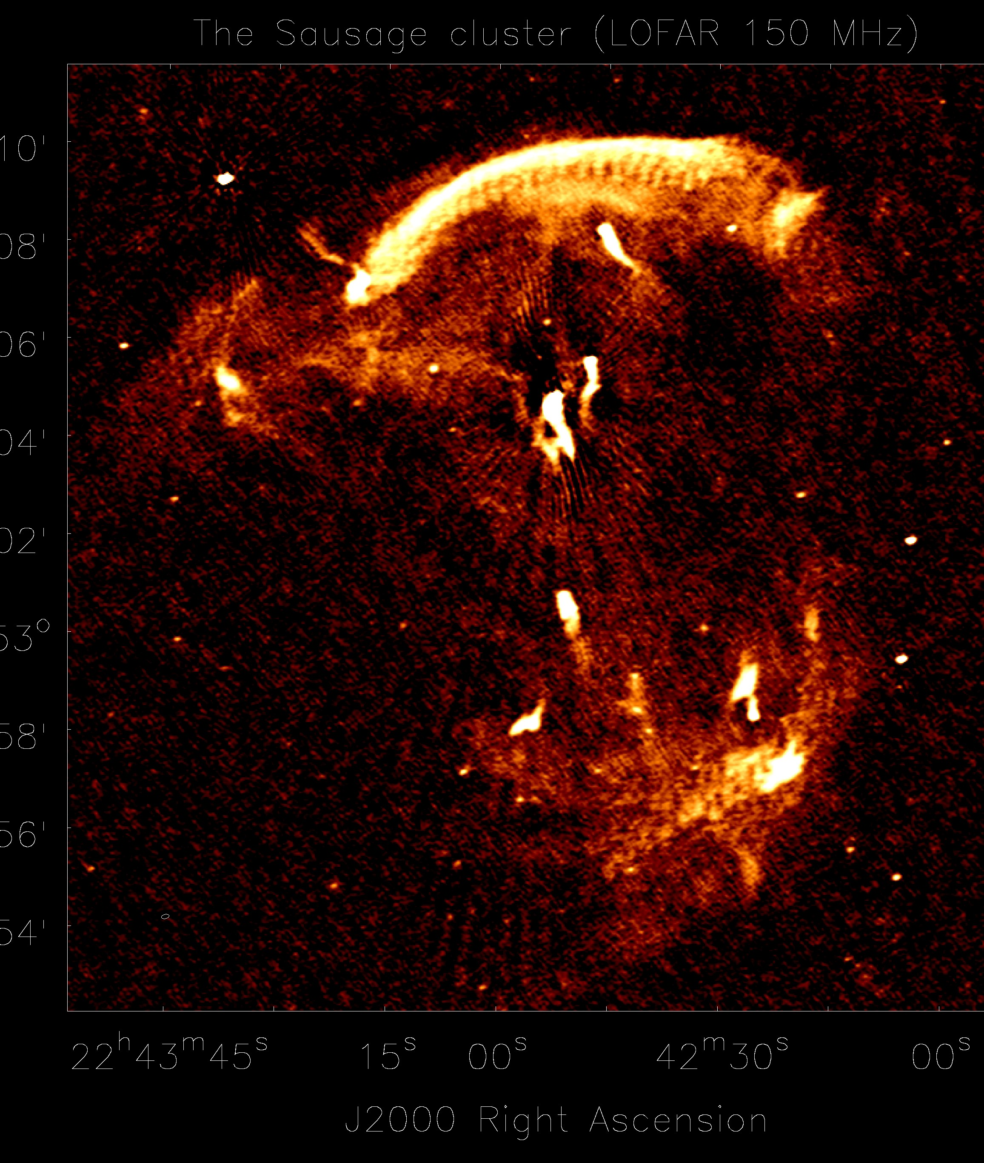
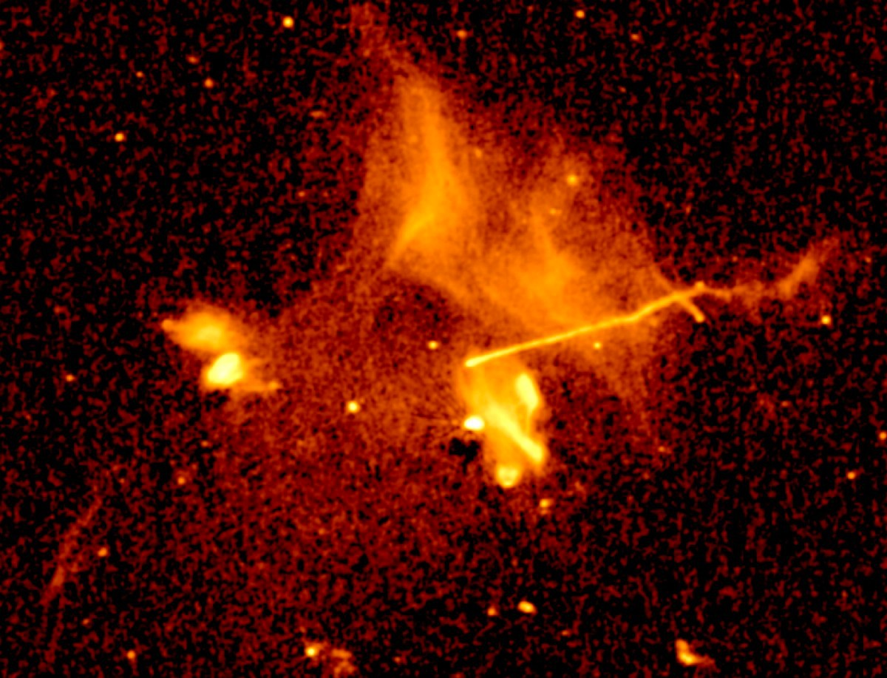
Galaxy Cluster with LOFAR
A2256
“Sausage Cluster”
Reinout van Weeren
Duy, Stroe, Shimwell

Slide 20
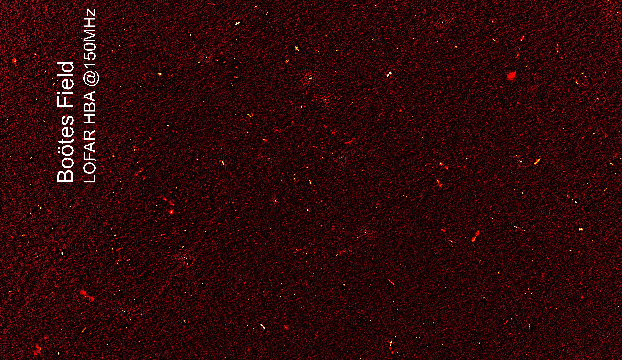
field after 4 hr integration
Part of a “random” empty
Williams, Rottgering et al. (2015)

Slide 21
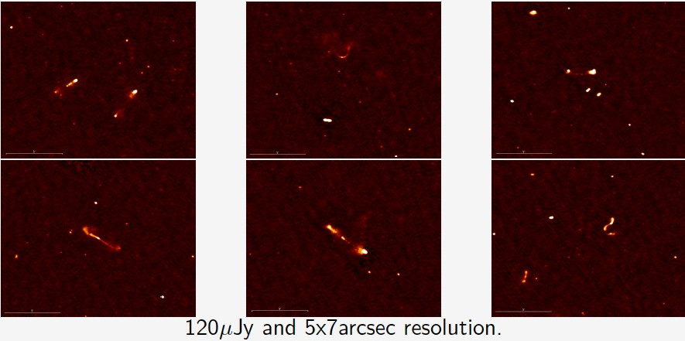
3° × 3° single pointing
Bootes Field: cut-outs from
Selected zooms into sub-regions
120 µJy RMS, 5×7 arcsec resolution
4 hrs integration – thermal noise limited
Wendy Williams et al. (2015, LOFAR Survey KSP)

Slide 22
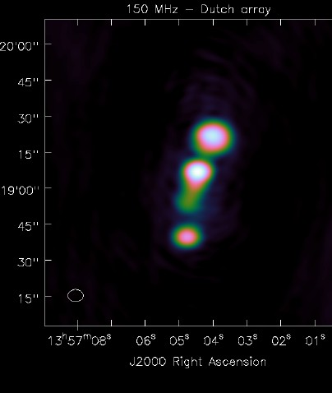
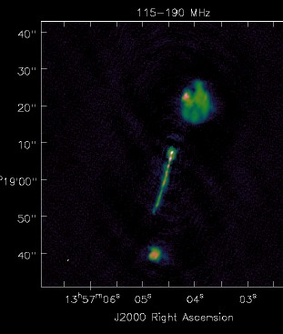
LOFAR Long Baselines
NL Array
EU Array
120-190 MHz
z=0.72 (7.2kpc/”)
0.5” x 0.3”
85 µJy (!)
Another world record …

Slide 23
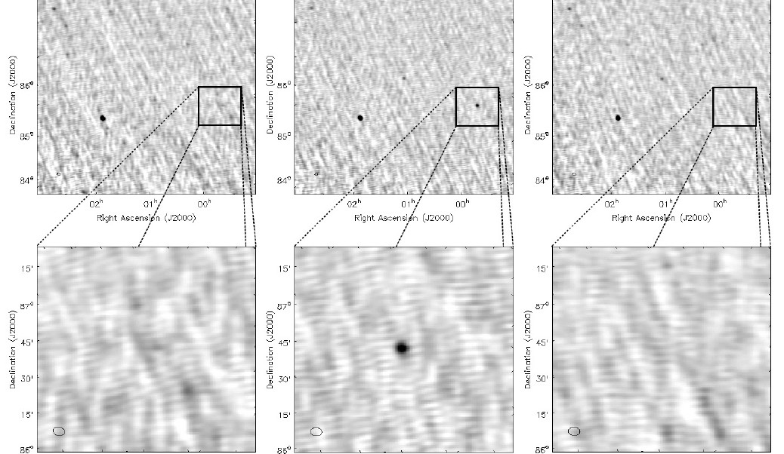
Transients
Flux: 15-25 Jy/beam
Time: < 19 minutes, never repeating Rate: (1+/-1)/2538 deg⁻² day⁻¹
Stewart et al. (2015)

Slide 24
Science Topics
Pulsars
ISM and magnetic fields
Radio Galaxies & Surveys
Epoch of Reionization
Ultra-High Energy Cosmic Rays

Slide 25
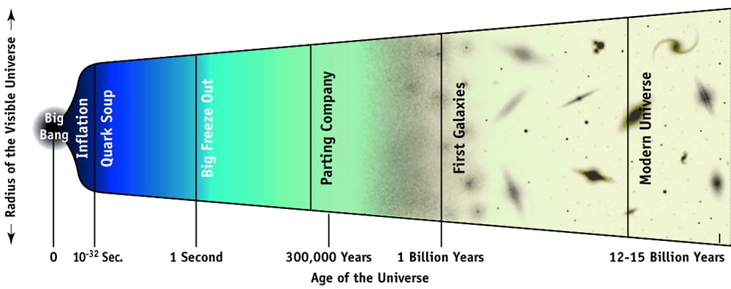
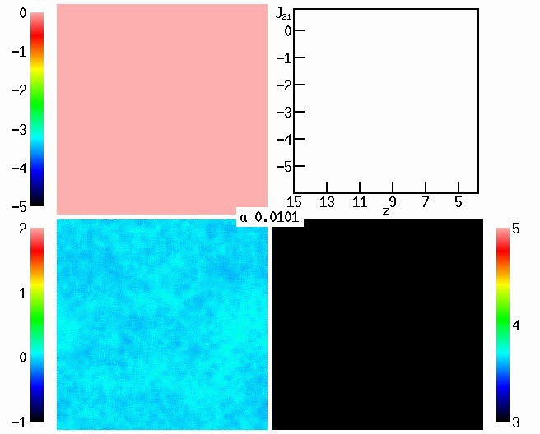
Epoch of Re-ionization HI at z~9
HI 21cm line: spin-flip of electron in hydrogen atom
1.4 GHz
14 MHz
140 MHz
Cosmological Redshift - Hydrogen line is seen at:
1.4 MHz
Sun & Earth
Now
Hydrog
First Stars
protons
en
Formation of Earth
Big Bang
Opaque
Invisible
400,000 Years

Slide 26
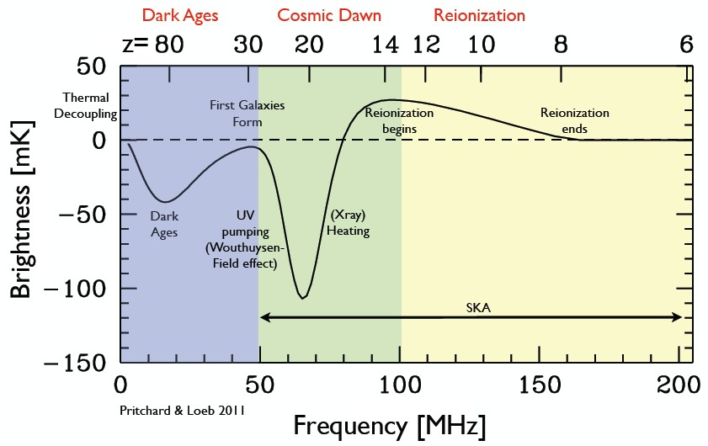
Hydrogen Brightness Temperature
Global Signal

Slide 27
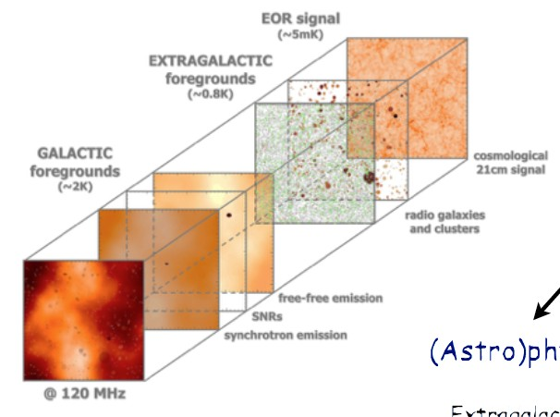
Foregrounds

Slide 28

Galactic Imaging Cygnus Region
LOFAR HBA (120-190 MHz)
Glenn White

Slide 29


Spectroscopy of Rydberg Atoms:
Radio Recombination Lines (RRLs) probing the Cold Neutral Medium (CNM)
Cas A at 60 MHz (LOFAR)
LOFAR spectrum towards Cas A
∆v ~ 1-10 km/sec
Carbon 576!
Atom size ~ 70 µm
C-RRLs actually seen throughout Galaxy!
Asgekar, Oonk, et al. (2013/2014)
First extragalactic detection in M82 by Morabito et al. (2014)!
van Weeren et al. (2013)

Slide 30


Faraday Rotation Measure Cubes: Interstellar Medium Structures
Slices through different Faraday depth (RM) with LOFAR
~ distances
Cameron van Eck (Magnetism KSP team)
Vibor Jelić (EOR KSP team)

Slide 31

Planck Dust Polarization

Slide 32


Planck Dust Map
LOFAR features align with
Jelic et al. (2015), Zaroubi et al. (2015)

Slide 33

The EoR windows
EOR KSP: de Bruyn, Koopmans, et al.

Slide 34

Celestial Pole (NCP) 155 hrs
EoR Window – North
₁st
Null: 10°, 2nd Null: 20°, 3’ – 3’’/pix Giga-pixel images
20.000 sources removed already
Peak: 7.2 Jy, RMS: 30 µJy
Deepest low-frequency map ever made

Slide 35

Current Upper Limits
LOFAR EOR:
Preliminary
Zaroubi et al. (2016, in prep.)

Slide 36
EoR Status
Current EoR limits (155h) at z=7.5 to z=10 are at ~20 mK levels at k ~ 0.05 Mpc-1
Already order of magnitude improvement
Signal expected between few-10 mK; thermal noise PS is already at/below the signal level !!
After Cycle 5: 2000 hours of data (NCP, 3C196) of which 900+700 = 1600 h of good quality
Now processing about one NCP-night/week; as of 1 Dec 2015 a new ERC-funded cluster (Koopmans) is operational, 5-10 x faster
2014/15, learning years: discovering ‘systematics’, improved wide-field broad-band calibration
2016 and 2017: Years to harvest and hope for first detection of HI from the EoR!
LOFAR EOR KSP: Koopmans, der Bruyn, Zaroubi et al.

Slide 37
Science Topics
Pulsars
ISM and magnetic fields
Radio Galaxies & Surveys
Epoch of Reionization
Ultra-High Energy Cosmic Rays
PI: Hörandel (Radboud) Co-PI: Buijtink (Brussels)

Slide 38

Cosmic Ray Spectrum (×E³)
knee 2ndknee ankle
Jets, GRBs,
… ???
Supernovae?
Hörandel (2008)

Slide 39



Air showers: simulations
proton
photon
iron nucleus

Slide 40




















Coherent Geosynchrotron Radio Pulses in Earth Atmosphere
Earth
B-Field •
~0.3 G
UHECRs produce particle showers in atmosphere
Shower front is ~2-3 m thick ~ wavelength at 100 MHz
e± emit synchrotron in geomagnetic field
Emission from all e± (N_{e}) add up coherently
Radio power grows quadratically with N_{e}
coherent E-Field
^{� E}total^{=N}e^{*E}e
� Power cxE_{e} cx N_{e}
2 2
� GJy flares on 20 ns scales
Falcke & Gorham (2003), Huege & Falcke (2004,2005), Scholten et al. (2007-2011)

Slide 41

Imaging Nanosecond Radiopulses
Cosmic ray radio signal imaged with data from single LOFAR station
direction from particle detectors (LORA)

Slide 42


Footprint
of an air shower
Most densely instrumented measurements of air shower radio emission!
S. ter Veen

Slide 43

Monte Carlo simulation of radiation processes: The endpoint formalism
discrete formulation for arbitrarily complex motion
radiation only from endpoints
Coupled to CR Monte Carlos codes
^_{r}
β₁
delay: R/c
β₂
endpoints:
decelerate from β₁ to rest then accelerate from rest to β₂
James, Falcke, Huege, Ludwig (2011), Phys. Rev. E
antenna
Couple this to CORSIKA air shower code and predict Radio Emission from Extensive Airshowers
→ CoREAS code (Huege et al. 2011,2013)

Slide 44




Radio Emission Pattern inherently 2D
v x v x B
v x v x B
v x B
v x B
CoREAS simulation
E-field vectors geomagnetic
E-field vectors charge excess
vector sum of geomagnetic and charge excess component
relativistic beaming
Cherenkov-like propagation effects (n≠1)
All radiation effects covered in simulations automatically by endpoint-method!

Slide 45













Emission Pattern at Low Frequencies: Theory & Observation
Background color: simulation Colored circles: LOFAR data
CoREAS simulation

Slide 46












Emission Pattern at High Frequencies: Cherenkov-Like Ring
Nelles et al. (2014), Astropart. Phys., subm.

Slide 47



Radio Lateral Distribution Function (LDF)
Cherenkov ring
asymmetry

Slide 48

Model vs Data
Buitink et al. (2015, Nature, accepted)

Slide 49

X_{max} from LOFAR
Buitink et al. (2016, Nature, accepted)

Slide 50

Unbinned Composition Analysis
Simulated distribution of iron and proton showers for LOFAR resolution
Calculate energy-independent mass parameter a for each event.
a = ⁽
Xproton Xshower
)−
(Xproton) −(Xiron)
iron
(a=1)
deep
proton
(a=0)
^{X}max
shallow
deep shallow
� High X_{max} resolution allows distinction between pure iron, pure proton, or mixed composition!
Energy
Buitink et al. (2014, PRD)

Slide 51

LOFAR Composition Fit
0% H
80% He
20% N
2 % Fe
Buitink et al. (2015, Nature, accepted)

Slide 52

The Cosmic Ray Spectrum
Thoudam et al. (2016, in prep.)

Slide 53


Air Shower Polarization
Polarization very regular:
100% polarization in v x B plane due to dominant geosynchrotron radiation
→→→→
→→→→
→→→→
plus some radial contribution from charge-excess radiation
←←→→
center:
←←→→
Schellart et al. (2014)

Slide 54

Polarization – Thunderstorms and Geoelectric Fields
During thunderstorm conditions the electric field dominates the magnetic field and changes the emission pattern significantly!
Schellart et al. (2015, PRL)

Slide 55





Astroparticlegeophysics
Lightning & Cosmic Rays:
LOFAR in the New York Times
Schellart et al. (2015, PRL), Tran et al. (2016, PRD)

Slide 56
Conclusion
LOFAR works (better every week ☺)
Shattered all world records at low frequencies:
  Highest resolution, highest sensitivity, highest dynamic range, densest air shower measurements
A lot of diverse and exciting science coming up:
  Pulsars: Discovery, Follow-up, Interstellar medium
  Interstellar medium: Radio-Recombination Lines, magnetic fields
  Multi-frequency radio surveys: Black holes, supernovae, transients
  Epoch of Reionization: order of magnitude improved limits, on track for discovery
  Cosmic Rays: composition and energy (also at Auger!!)
Future: LOFAR2.0, SKA, and … LOFAR on the moon!

