Slide 1
The road to the ElectroWeak Symmetry Breaking
14th - 15th February 2012
Seminar at DESY
S.Bolognesi (Johns Hopkins University)

Slide 2
Outline
The Higgs boson and the ElectroWeak Symmetry Breaking (EWSB)
Status: CMS results in a nutshell, focusing on high mass H->VV
What’s next ?
move to larger mass (>600 GeV beyond SM)
control of V+jets background
jet merging
signal characterization (angular analysis)
improve sensitivity to smaller xsec -> Vector Boson Fusion
control of VV background
The final arbiter: VV scattering
February 2012, DESY seminar
2
S.Bolognesi (Johns Hopkins University)

Slide 3
Why we need the Higgs
The Higgs boson provides
1) an EXPLICATION of the W,Z mass (ie EWSB)
2) a DESCRIPTION of the fermions masses
1 is really fundamental to make the SM “working” (next slides) … even if not less arbitrary!
2 is just another way of formulating the same question:
why the fermions have those particular masses?
why the fermions have those particular Higgs couplings?
(SM works well without 2: just the fermio-phobic Higgs)
February 2012, DESY seminar
3
S.Bolognesi (Johns Hopkins University)

Slide 4
EWSB and the W, Z mass
SU(2)
×
U(1)
Gauge invariance
complex scalar doublet of SU(2)
scalar potential (λ>0, μ<0)
with minimum (= empty state) at
(v = empty expectation value)
or
SU(2)
Gauge unitario
generic Gauge
1 physical scalar field -> Higgs
4 Gauge fields combined into known vector bosons: W,Z with mass, photon massless
1 physical scalar field
3 Goldstone bosons ω_{i}
4 Gauge fields W^{i}_{μ},B_{μ}
U(1)_{EM}
4
February 2012, DESY seminar
Notes:
Spontaneuos SB is not spontaneous

Slide 5
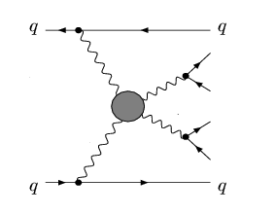
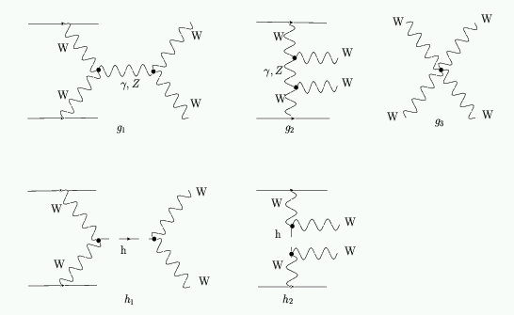
Higgs and unitarity in VBF
W,Z mass (-> longitudinal degrees of freedom) arise from the Higgs mechanism:
without Higgs, W⁺_{L}W⁻_{L}->W⁺_{L}W⁻_{L} would break unitarity
Vector Boson Fusion (VBF)
V
V
VV -> VV
V
V
V
V
Same behavior for all VV amplitudes
(s channel only)
(t channel only)
canale S
canale T
QGC
(t and u channels)
VBF is the smoking gun of the EWSB !
February 2012, DESY seminar
5
S.Bolognesi (Johns Hopkins University)
Notes:
The consequence is that Higgs restore unitarity in VV scattering
1) Diagrams based on TGC and QGC

Slide 6
VBF and VV scattering
VV scattering spectrum σ(VV->VV) vs M(VV)
is the fundamental probe to test nature of Higgs boson or to find alternative EWSB mechanism
Λ_{SB}<1TeV
Λ_{SB}>1TeV
SM No-Higgs
SB sector weakly coupled
SB sector strongly coupled
Unitarity violation
other scenarios possible:
eg, strongly interacting light Higgs
Whatever we will see or not see at low mass (<2×m_{W}), the EWSB mechanism must be probed in the VV final state
search for possible resonances in VBF
measurement of VV scattering spectrum
February 2012, DESY seminar
6
S.Bolognesi (Johns Hopkins University)

Slide 7
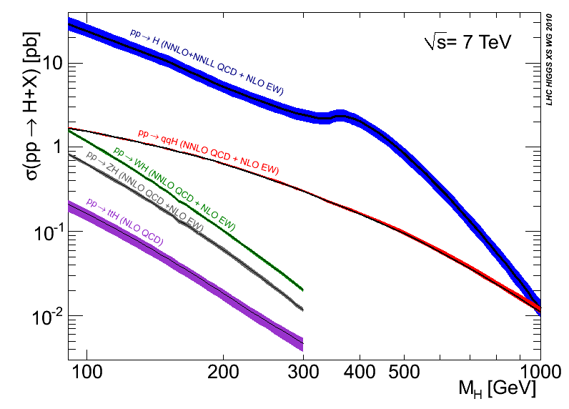
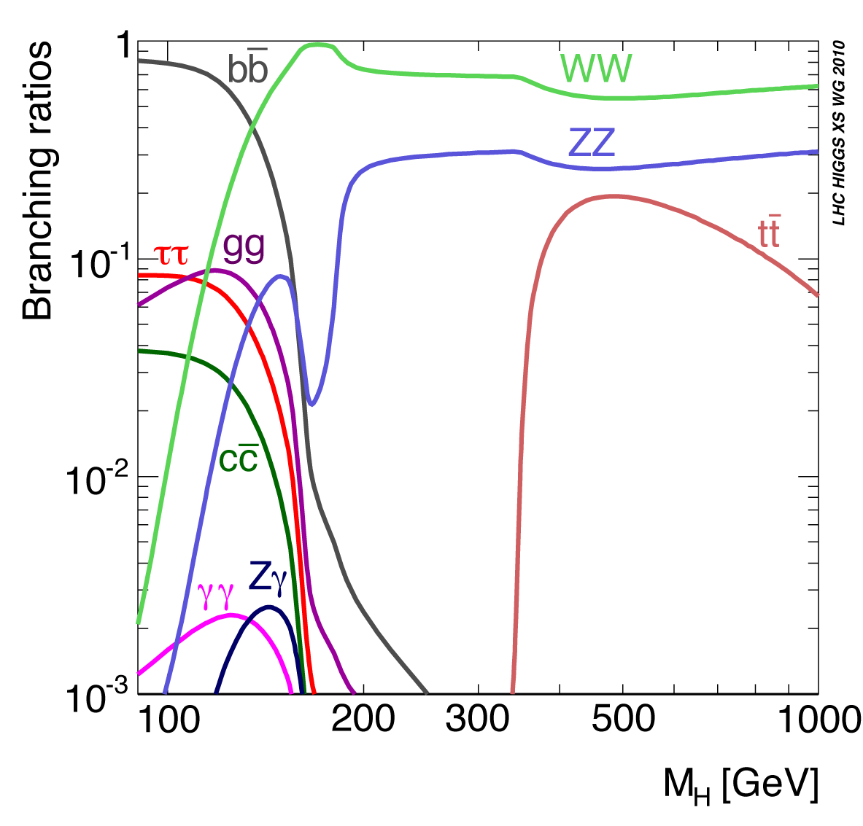
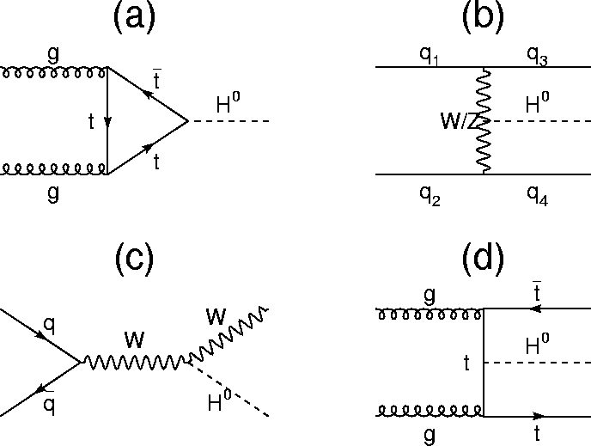
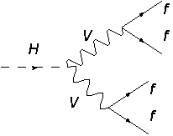


Higgs production and decay
February 2012, DESY seminar
7
S.Bolognesi (Johns Hopkins University)
Notes:
Experimental signature

Slide 8
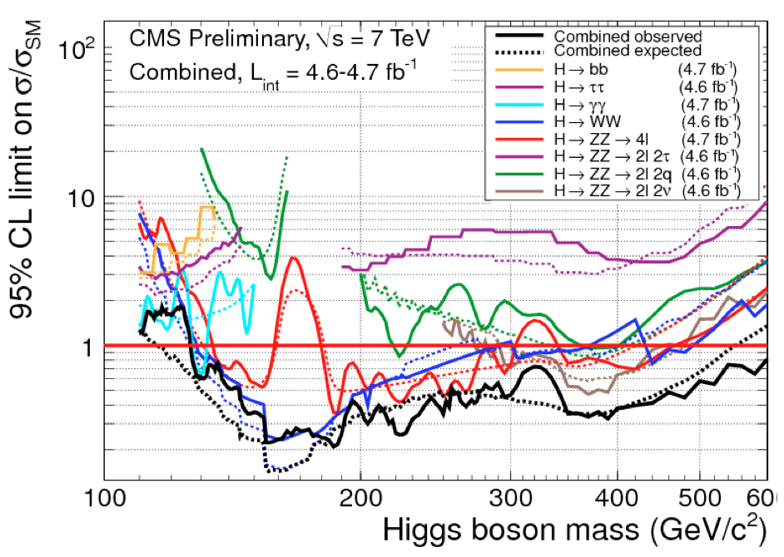
CMS results
WW→lnqq, ZZ→llqq limited by huge V+jets background, taken from simu/data with large theoretical/statistical error
WW→lnln at high mass limited by signal << WW background (Δφ not effective)
ZZ→llnn:
200-400 GeV limited by non-Z background (top, W+jets, WW)
>400 GeV limited by Z+jets tail at high MET: not large but not well known (controlled with γ+jets → statistical error+met uncertainty)
drives the UL for mH>300-400
ZZ→4l limited by statistics (only ZZ background: small and well known)
drives the UL for mH 200-300

Slide 9
Future improvements ?
Combination of >5 different channels (ele, mu, btag, …) Robust!
Very optimized analyses, some space for further improvement. With higher lumi:
use shape analyses (where not yet done)
extract signal with multidimensional fit (now only mZZ fit)
extract background (norm and shape) from data with lower uncertainty
February 2012, DESY seminar
9
S.Bolognesi (Johns Hopkins University)

Slide 10
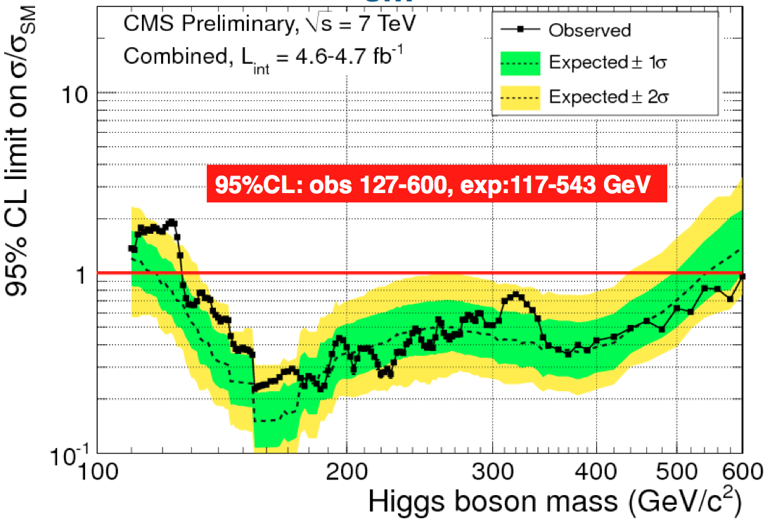
What’s next ?
higher mass
lower xsec
February 2012, DESY seminar
10
S.Bolognesi (Johns Hopkins University)

Slide 11
1 TeV masses: not anymore “the” Higgs
→ General search for X→VV→4f:
exotic models (eg, Technicolor,
ExtraDimension, …)
RS Graviton vs SM Higgs:
CMS AN-2010-35: Angular Analysis of Resonances pp → X → ZZ
xsec larger than Higgs:
at high mass still very low number of events per fb⁻¹
first, repeat “Higgs” search for different spin, width resonance
→ importance of semileptonic final states
February 2012, DESY seminar
11
S.Bolognesi (Johns Hopkins University)
Notes:
leggo che modello esattamente

Slide 12
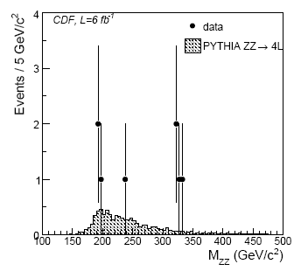
Available results: ZZ
CDF search for G→ZZ: same features discussed for high mass Higgs @ LHC
ZZ→4l
ZZ→llnn
MET control V+jets
low statistics
ZZ→lljj: large V+jets
arXiv:1111.3432v1
Notes:
leggo che modello esattamente

Slide 13
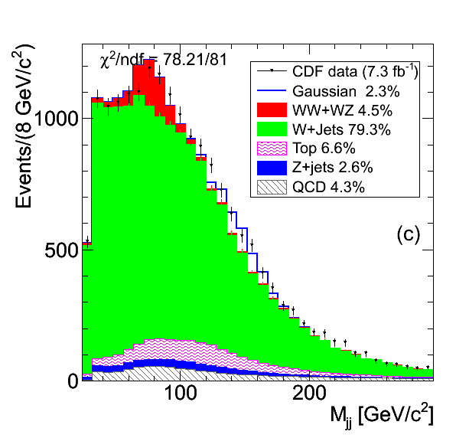
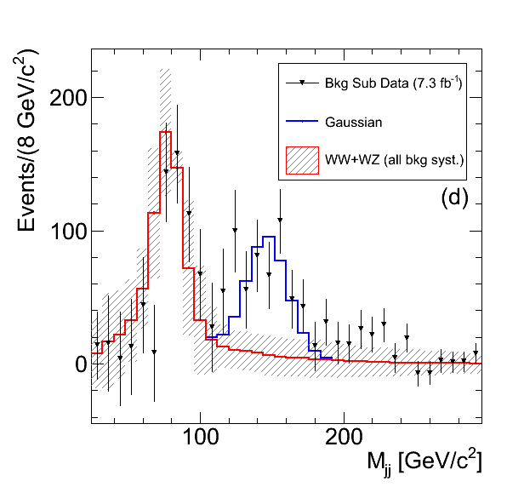
Available results: W+2jets
CDF “bump”
ATLAS & D0 xchecks
13
S.Bolognesi (Johns Hopkins University)

Slide 14
Control of V+jets
Control region (eg, Z→jj sidebands) has very low stat for M(lljj)~1 TeV
Improving theoretical tools (Blackhat, Madgraph, …)
test them where we have statistics
rely on them to extrapolate at higher energy/multiplicity
February 2012, DESY seminar
14
S.Bolognesi (Johns Hopkins University)

Slide 15
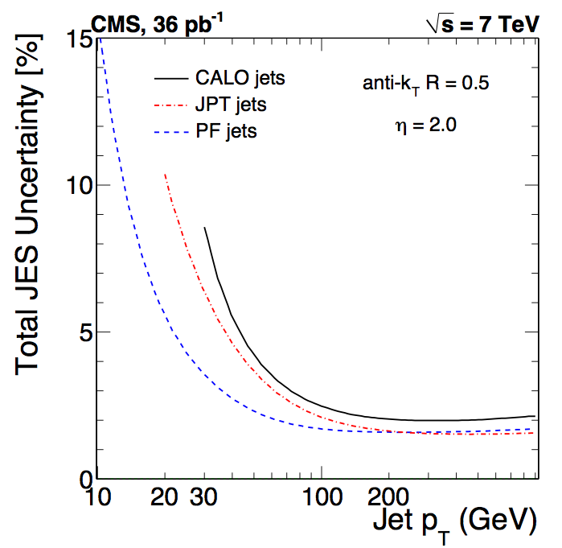
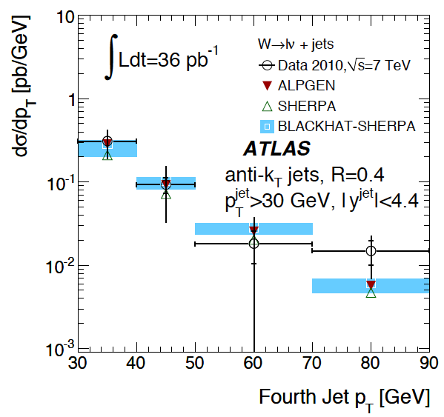
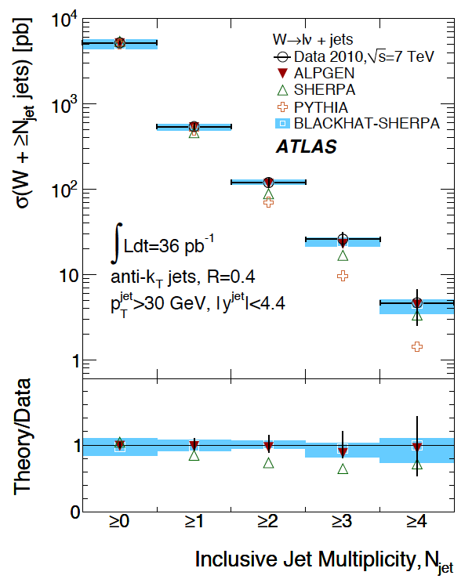
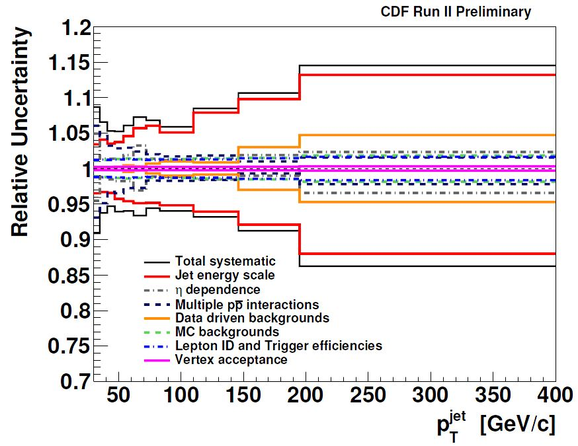
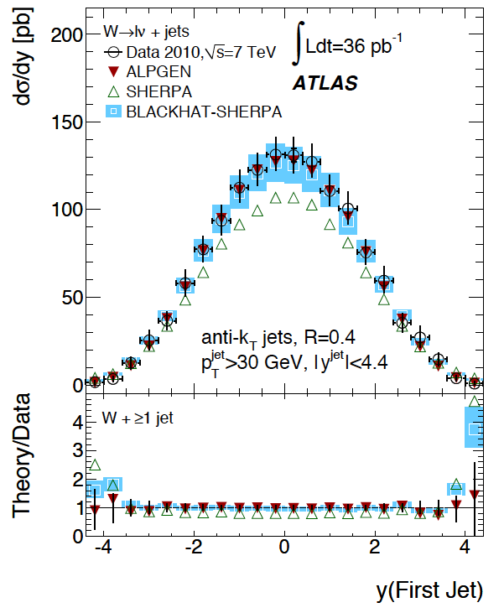
V+jets
QCD measurement (jet p_{T}>20-30 GeV):
→ syst. dominated by jet scale, PileUp removal
Data unfolded for detector effects → compared to NLO (“hadron level”)
ATLAS:
February 2012, DESY seminar
15

Slide 16
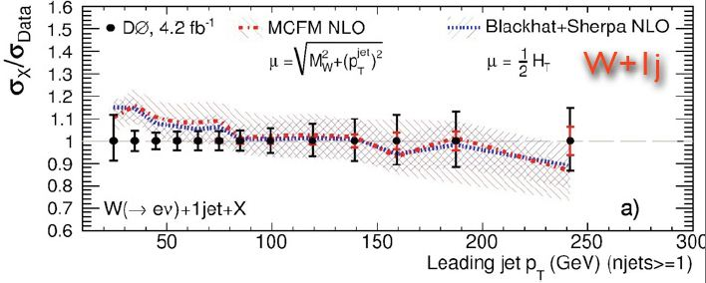
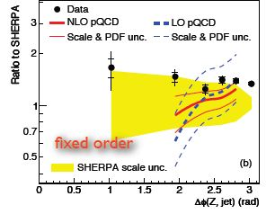
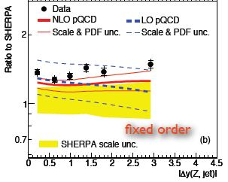
V+jets at Tevatron
At low p_{T}, low multiplicity:
interesting discrepancy data-NLO observed
but results limited by systematics
→ new variables
D0 novel measurement: angular correlations have much lower systematics
February 2012, DESY seminar
16
S.Bolognesi (Johns Hopkins University)
Notes:
questa si puo’ togliere

Slide 17
High mass: what’s new ?
Can we simply keep the same Higgs analysis strategy? Not at very high masses!
New experimental issues at very high mass (1 TeV and above)
X → boosted VV → jet merging (and nearby leptons)
Unknown signal and very small background → no point in pushed optimization! Keep model independent approach as much as possible
How to disentangle the various models?
peak → mass and width, xsec and BR
spin! → angular analysis
February 2012, DESY seminar
17
S.Bolognesi (Johns Hopkins University)

Slide 18
>1 TeV M(ZZ)→4f : jet merging (1)
Jet merging:
approx
ΔR 0.8 (CA) → M_{X}>600 GeV
ΔR 0.5 (Akt) → M_{X}>900 GeV
Handles to distinguish wrt to jets from QCD (eg, X→ZZ→2l2j VS Z+jets):
jet mass
ttbar → WW→ln (jj)
CMS EXO-11-006
February 2012, DESY seminar
18
S.Bolognesi (Johns Hopkins University)

Slide 19
Jet merging (2)
Handles to distinguish wrt to jets from QCD (eg, X→ZZ→2l2j VS Z+jets):
jet radiation:
no singularity, just decay!
soft/collinear singularity in QCD
JHU seminar: Path-Integral Jets
by David Krohn (Harvard)
www.pha.jhu.edu/groups/particle-theory/seminars/talks/F11/talk.khron.pdf
February 2012, DESY seminar
19
S.Bolognesi (Johns Hopkins University)

Slide 20
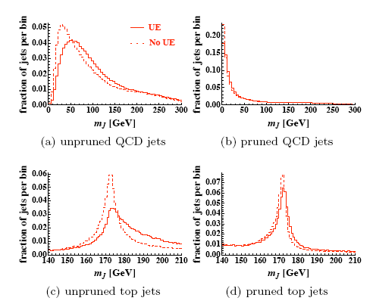
Jet pruning
Remove all parts of the jet which are soft and wide angle
QCD jets mass substantially decreased -> lower backgrounds
arXiv:0912.0033v1
Boosted objects mass reconstruction improved
Typically used for boosted top or boosted H→bb …
February 2012, DESY seminar
20
S.Bolognesi (Johns Hopkins University)

Slide 21
Example in X→ZZ→2l2j
RS Graviton
First look at Z boosted (no numbers yet) …
M_{G} 1500 GeV
preliminary, A.Bonato, R.Covarelli
CA 0.8
X->ZZ->2l2q signal
Z+jets
before jet pruning
before jet pruning
after jet pruning
after jet pruning
February 2012, DESY seminar
21
S.Bolognesi (Johns Hopkins University)

Slide 22
Angular analysis (1)
X→ZZ→4f decay kinematic fully defined by 5 angles
X→ZZ
Z decays
signal (M_{X} 250):
0+ , 0-
MC from Johns Hopkins
1+ , 1-
2+m , 2+L , 2-
February 2012, DESY seminar
22
S.Bolognesi (Johns Hopkins University)

Slide 23
Angular analysis (2)
CMS PAS -11- 017
Can be clearly used to disentangle different signals… but what about background?
Already used in H→ZZ→2l2q: cut on likelihood
signal: ideal × uncorr. accept
Z+jets from MC: no correlations,
(background from jj sidebands)
To optimize further (multidimensional fit), need full theoretical description of background:
qq → ZZ:
gg also available → can be used to disentangle qq-gg!!
February 2012, DESY seminar
23
S.Bolognesi (Johns Hopkins University)

Slide 24
What’s next ?
higher mass
lower xsec
February 2012, DESY seminar
24
S.Bolognesi (Johns Hopkins University)

Slide 25

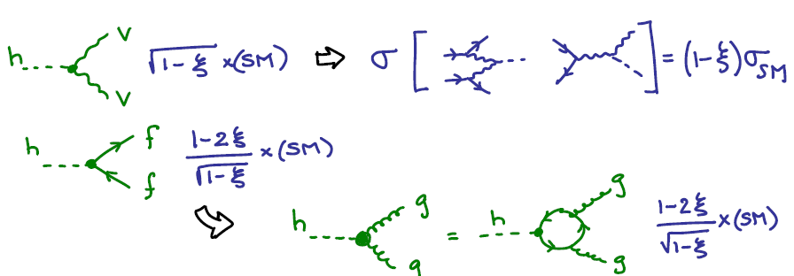
Improve sensitivity
First LHC to Terascale Workshop (Sept 2011):
LCH at LHC by J.R. Espinoza
WHY? Models with lower xsec
Ex of (light) composite higgs:
HOW?
Factor 5 in luminosity wrt to present results
Improve theoretical control of
signal: → NNLO&NNLL effects, precise mass shape prediction, signal-background interference (back-up)
(studied in the Higgs Xsec WG and documented in 2 Yellow Report)
background: → control of ZZ, WW ewk continuum
February 2012, DESY seminar
25
S.Bolognesi (Johns Hopkins University)

Slide 26
Diboson production (WW,WZ,ZZ)
qqbar → VV
gg→ VV
TGC
(LHC: few % of xsec with ~50% uncertainty)
+ NLO qqbar +
WW,WZ,ZZ
forbidden for ZZ
forbidden for ZW
SM test: TGC fixed by ewk gauge structure
→ any deviation from SM in VV xsec is direct hint of NP in bosonic sector
Backgrounds for high mass Higgs→VV
LHC focused on leptonic final state, Tevatron looked at semileptonic but limited by systematics (V+jets)
February 2012, DESY seminar
26
S.Bolognesi (Johns Hopkins University)

Slide 27
VV: theoretical prediction
PDF+α_{s}
qq
qq→ZZ NLO + gg→ZZ
scale
qq
Uncertainty dominated by QCD part
WW in jet bins: uncertainty on σ(>=N) + modeling: MC@NLO vs ALPGEN
February 2012, DESY seminar
27

Slide 28
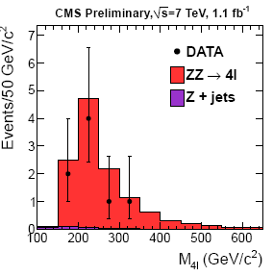
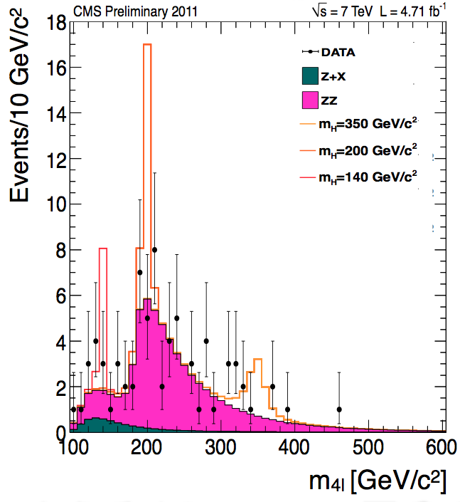
ZZ→4l: measurement
4l is 0.5% of ZZ xsec but very clean
Dedicated EWK analysis with very low luminosity, Higgs results much beyond that
observed events: 8
expected events: 12.5±1.1
39%
16%
February 2012, DESY seminar
28
S.Bolognesi (Johns Hopkins University)

Slide 29
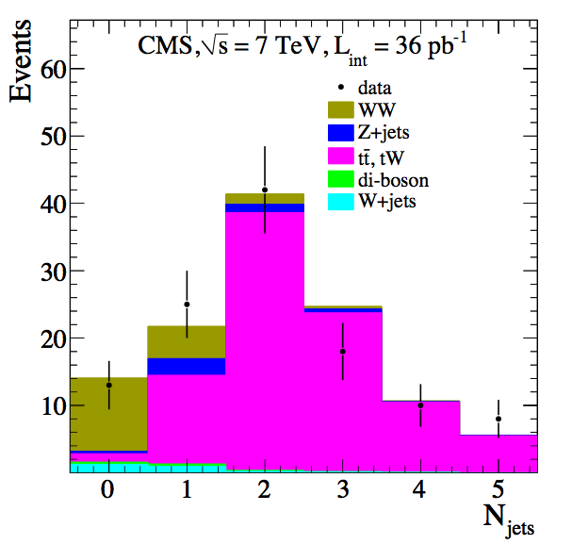
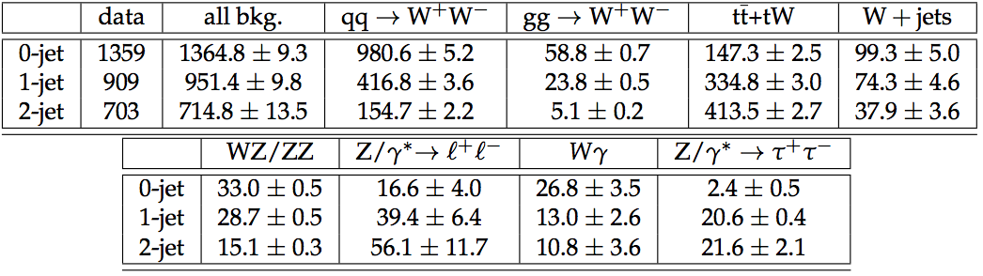
WW->lnln: measurement
Dedicated EWK results only with very low luminosity,
37%
Higgs analysis much beyond that:
stat. and syst. errors included
February 2012, DESY seminar
29
S.Bolognesi (Johns Hopkins University)

Slide 30
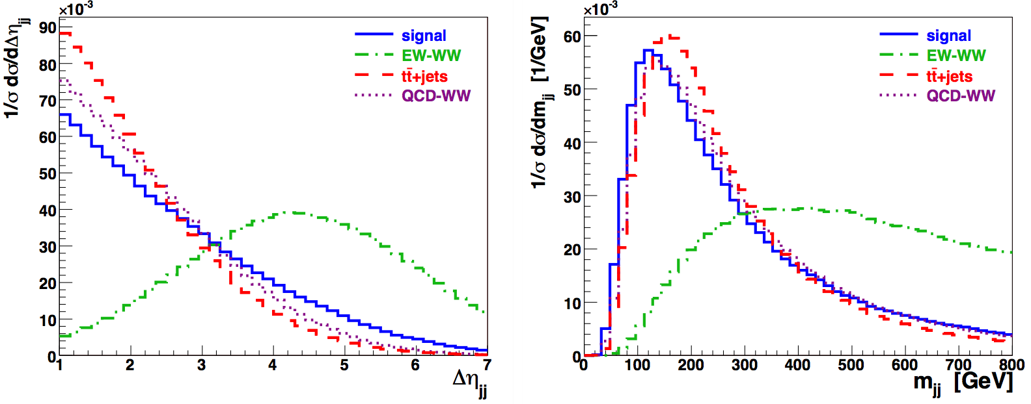
From VBF to VV scattering
First search for a VBF resonance, feasible in 2012
Measurement of VV scattering spectrum with higher lumi (>50 fb⁻¹)
Typical signature: forward-backward “spectator” jets with very high energy
ggH + 2jets
ggH + 2jets
VBF
VBF
JHEP 0704 (2007) 052
February 2012, DESY seminar
30
S.Bolognesi (Johns Hopkins University)

Slide 31
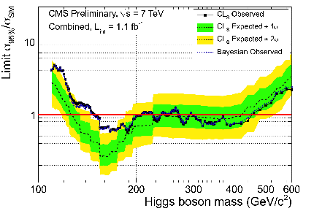
Higgs-like resonance in VBF
RE-DO all the analyses in VBF mode
Today only WW→lnln. Expectations for next year:
lumi > 10 fb-1
VBF yields in 2012 ~ 0.5 gg yields of 2011 summer results,
summer2011
σ(vbf) ~ 0.1×σ(gg)
0.5 effic. VBF cuts
with much less background:
ZZ→4l will be still limited by statistics
WW→lnln will improve S/B (signal/10, WW*α_{s}²)
semileptonic final states will have reasonable signal yields + much lower background than inclusive analysis
eg, ZZ→lljj :
signal yields for m_{H} 300-500 ~ 15 – 5 events
V+(N+1)jets/V+N jets ~ 0.15 → asking 2 jets reduces background to 2%!
S/B may increase of a factor 2 (eff 0.5 × σ 0.1 / 0.02)
February 2012, DESY seminar
31
S.Bolognesi (Johns Hopkins University)

Slide 32
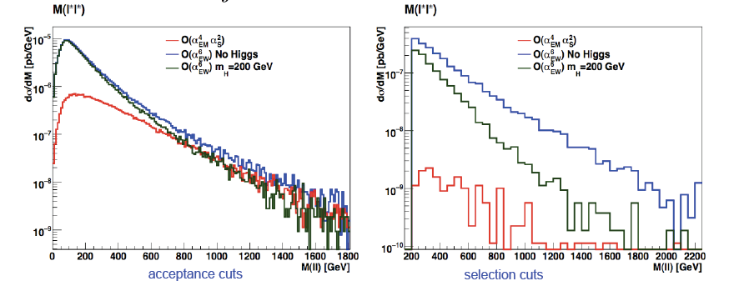
VV scattering spectrum
In no Higgs case:
BUT increasing of xsec at high VV is suppressed by
PDF
offshell bosons
unpolarized bosons
→ small difference btw SM and violation of unitarity (no Higgs)
reducible background
SILH
W±W± scattering
→ with proper cut (eg Δη jets) can be enhanced -> selection of the longitudinal W
February 2012, DESY seminar
32
S.Bolognesi (Johns Hopkins University)

Slide 33
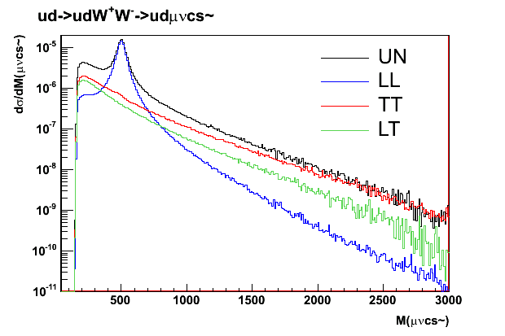
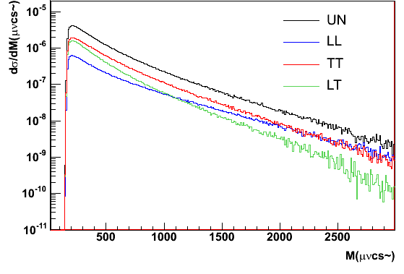
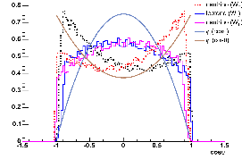
Longitudinal polarization
mH 500 GeV
noHiggs (unitarity violation)
ud->udWW->udcsμν
ud->udWW->udcsμν
Angular analysis can boost LL-TT separation (new!):
partonic study in the center of mass of W
WW tail (TT): neutrino
WW tail (TT): lepton
Higgs peak (LL): neutrino
Higgs peak (LL): lepton
Transverse distribution
Longitudinal distribution
February 2012, DESY seminar
33
S.Bolognesi (Johns Hopkins University)

Slide 34
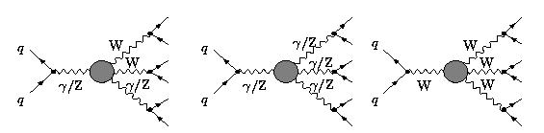
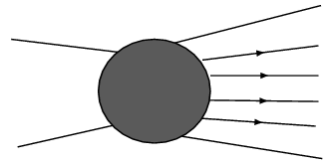
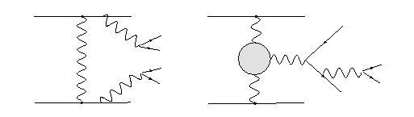
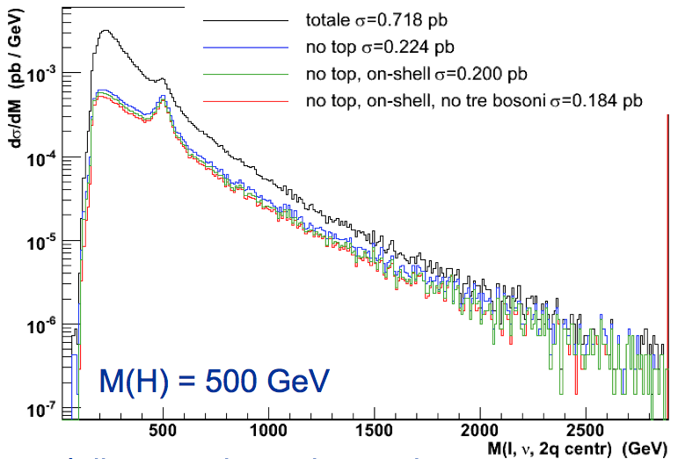
VV scattering: interference effects
JHEP 0603 (2006) 093
Accomando, Ballestrero, Bolognesi, Maina, Mariotti
Big interference effects considered only in Phantom
qq->6f O(α_{EW}⁶)
irreducible background (α_{EW}⁶)
signal
2
=
...
WW signal with “a posteriori” cuts
WW approximated without interference
February 2012, DESY seminar
34
S.Bolognesi (Johns Hopkins University)

Slide 35
Summary
The first aim of the Higgs search is the understanding of the EWSB
-> focus on H->VV final state
Main steps:
search for generic resonance X->ZZ->4f
search for VBF resonance and measuring of VV scattering spectrum
angular analysis
Ingredients along the EWSB road:
control of V+jets (jet pruning)
control uncertainties on VV EWK continuum
February 2012, DESY seminar
35
S.Bolognesi (Johns Hopkins University)

Slide 36
BACK-UP
The road to the ElectroWeak Symmetry Breaking
18th January 2012
Seminar at Johns Hopkins University
S.Bolognesi (Johns Hopkins University)

Slide 37
Sources
CMS AN-2010-35: Angular Analysis of Resonances pp → X → ZZ
JHU seminar: Path-Integral Jets
by David Krohn (Harvard)
www.pha.jhu.edu/groups/particle-theory/seminars/talks/F11/talk.khron.pdf
First LHC to Terascale Workshop (Sept 2011):
LCH at LHC by J.R. Espinoza
Boson Boson scattering analysis by A.Ballestrero (INFN Torino)
LHC To Terascale Physics WS
37
S.Bolognesi (Johns Hopkins University)

Slide 38
Mass shape
From Passarino talk at last LHC to Terascale WS
Present approx:
xsec for on-shell Higgs production and decay in zero width approx
acceptance from MC with ad-hoc BW distribution
10-30% uncertainty on xsec
for mH 400–600 GeV
Study with QFT-consistent Higgs propagator in the YR2

Slide 39
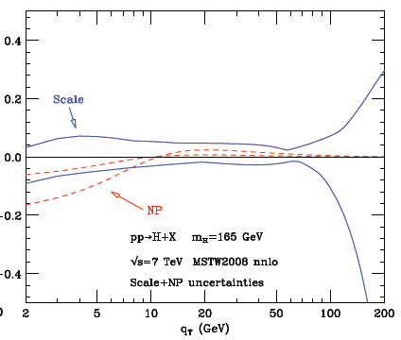
Higgs qT
HqT:
q_{T} > mH NNLO
q_{T} << mH NNLL (resumming ln(mH²/q_{T}²))
Uncertainties:
factor/renorm scale
non perturb. effects
(smearing with NP form factor)
PDF
large mt approximation
LHC To Terascale Physics WS
39
S.Bolognesi (Johns Hopkins University)

Slide 40
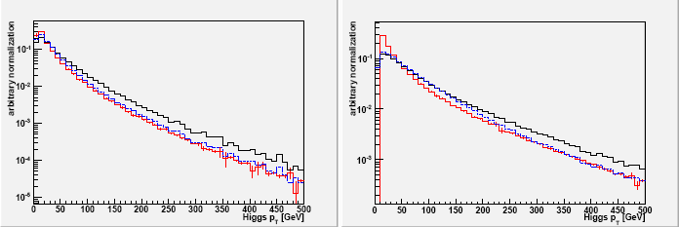
Reweight to HqT
HqT used to reweight full event generators (POWHEG at NLO)
H p_{T}
mH 120 GeV
mH 500 GeV
Powheg
Powheg re-weighted to Hqt
(to be redone before PS)
HNNLO
H y
mH 120 GeV
mH 500 GeV
Very small effect on acceptance in 4l: 1-2%
(larger if jet veto!)
LHC To Terascale Physics WS
40
S.Bolognesi (Johns Hopkins University)

Slide 41

Signal: jet counting
Analysis in exclusive jet bins
if background depends on Njets
(ex, WW+0,1,2 jets)
for VBF
→ theoretical uncert in jet bins to be combined with correlations
different treatments of the uncontrolled higher-order O(α³s) terms
varying renormalization and factorization scales in the fixed-order predictions for each exclusive jet cross section σN
i.e., different NNLO expansions
(results as 100% correlated)
inclusive xsec (σ≥Njets), as source of perturbative uncertainties
σN = σ≥N − σ≥N+1
with error propagation
LHC To Terascale Physics WS
41
S.Bolognesi (Johns Hopkins University)

Slide 42
Signal: jet veto
Resummation of jet-veto logarithms ( ln(p_{cut}/mH) ), induced by jet cut parameter p_{cut}
Presently doable only on beam thrust variable
(~raw approx of p_{cut})
and used to reweight MC@NLO
from inclusive to exclusive prediction
direct exclusive prediction
LHC To Terascale Physics WS
42
S.Bolognesi (Johns Hopkins University)

Slide 43
Signal-background interference
Recent results for WW, but focused on low mass
( arXiv:1107.5569v1 )
Effect on gg→H→WW at LO
m_{T} < mH
non-resonant diagrams can be large for m_{T} > mH
also shape effects!
Worth to investigate further at high mass?
01/18/2012 seminar
43
S.Bolognesi (Johns Hopkins University)

Slide 44
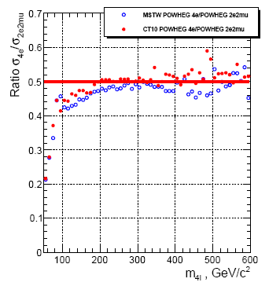
ZZ: theoretical prediction
Single resonant contribution
ZZ fully from MC, well under control
Interference in the final state with identical leptons
qq→ZZ NLO + gg→ZZ
01/18/2012 seminar
44
S.Bolognesi (Johns Hopkins University)

Slide 45
ZZ: theoretical uncertainties
qq
gg
PDF+α_{s}
S.Bolognesi (Johns Hopkins University)
45
qq
gg
scale
01/18/2012 seminar

Slide 46
WW: theoretical uncertainties
WW taken from MC for large m_{H}
→ gg+qq NLO available (MCFM)
PDF+α_{s} and scale uncertainty dominates
in jet bins using uncert on σ(>=N) + modeling: MC@NLO vs ALPGEN
WW from control region for m_{H}<200 GeV (mll, Δφll)
01/18/2012 seminar
46
S.Bolognesi (Johns Hopkins University)

Slide 47
WW→lνlν measurement
Complex analysis (no mass peak→counting experiment, many backgrounds)
Main systematics:
background estimate:
Background
Cuts
W+jets
tight lepton quality
top
(b-)jet veto
estimated from data
Drell-Yan
Z mass veto
missing E_{T}
WZ, ZZ, Wγ
2 leptons
→ estimated from MC
signal acceptance:
jet-veto efficiency
leptonic efficiency
missing E_{T} uncertainty
theoretical (gg box, PDF)
01/18/2012 seminar
47
S.Bolognesi (Johns Hopkins University)

Slide 48
WW/WZ→lν2j at CDF
First observation: 5.4σ (first evidence at D0 with 4.4σ in 2008)
Much larger backgrounds, no resolution to distinguish W/Z→jj
fit to Mjj (3.9 fb-1)
+ matrix element method: (2.7 fb-1)
discriminant exploiting full kinematic information, based on calculations of differential xsec of signal and background
QCD from data
data-MC validation of input kinematic variables
fit to shape of discriminant
(NLO expected )
Sara Bolognesi (CERN)
48
Physics in Collisions, August 2011

Slide 49
WZ/ZZ→lν/νν+2b at Tevatron
Crucial for Higgs search (ZH→ννbb). Very complex analysis!
WZ → lνbb + ZZ → ννbb
b-tag jets + missing E_{T} (+ topological cuts)
No leptons! → huge background: multijets QCD, V+jets (from data)
very sophisticated techniques:
b-tag probability with Boosted Decision Tree or Neural Network which exploits much info and different variables
CDF (2b-tags)
different channels combined (0,1,2 b-tag)
D0:
CDF:
(expected 4.6 pb)
(expected 5.1 pb)
Sara Bolognesi (CERN)
49
Physics in Collisions, August 2011

Slide 50
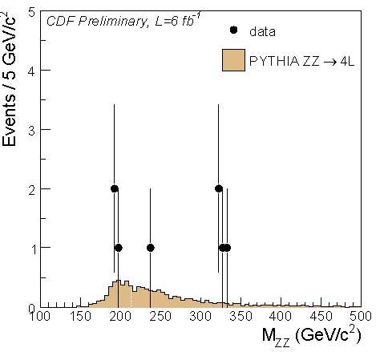
ZZ at CDF
ZZ→4l (6 fb-1) excess of events at high M_{ZZ} (eg Randall Sundrum Graviton)
But xsec still compatible with SM
No excess in other final states
ZZ→2l2ν (5.9 fb-1)
Shape analysis with fit to neural network
ZZ→2l2j
control of Z+jets is crucial
Control of Z+jets very challenging to measure ZZ xsec
Sara Bolognesi (CERN)
50

Slide 51
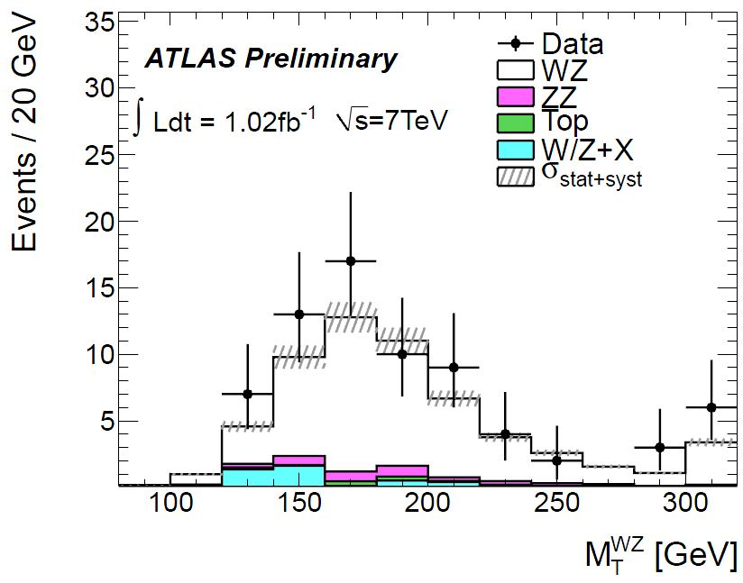
WZ→3l+ν at LHC
Very clean, low background
ATLAS:
CMS:
(NLO expected )
(NLO expected )
Sara Bolognesi (CERN)
51
Physics in Collisions, August 2011

Slide 52
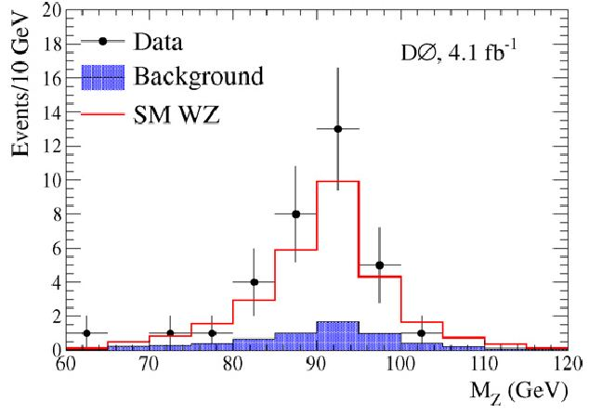
Recent WZ→3l+ν at Tevatron
Possible only at hadron colliders (charged final state)
observed events: 34
D0 with 4.1 fb-1
expected signal: 23.3±1.5
statistics 2 times smaller than LHC, while xsec is 6 times smaller
expected background: 6.0±0.6
(NLO expected )
CDF with 7.1 fb-1
Shape analysis with fit to neural network
(NLO expected )
Sara Bolognesi (CERN)
52
Physics in Collisions, August 2011

Slide 53
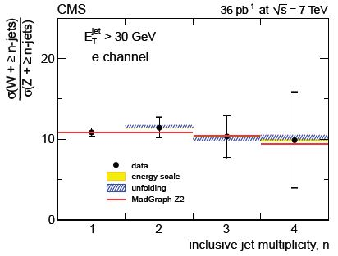
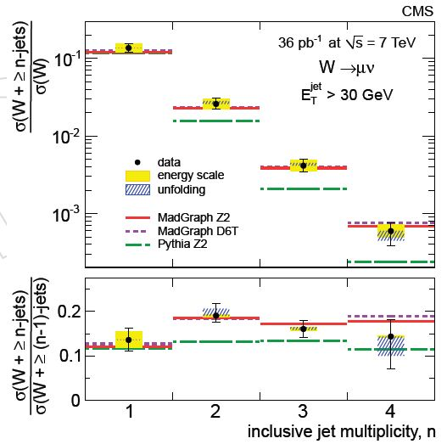
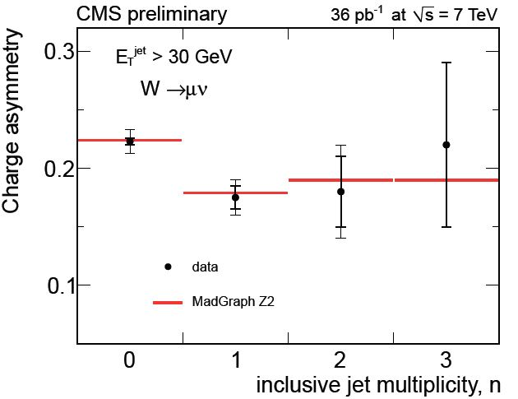
V+jets: ratios
Use high statistics W sample to predict Z+jets background for NP
CMS PAS EWK-10-011
Many systematics cancel out
Very well known theoretically → any deviation is hint of NP
01/18/2012 seminar
53
S.Bolognesi (Johns Hopkins University)

Slide 54
The input: signal description
Common effort CMS-ATLAS-theoreticians: Higgs Xsec working group
(2 yellow reports published: arXiv:1101.0593 [hep-ph]
arXiv:1201.3084 [hep-ph] )
Higgs p_{T} reweighted at NNLO+NNLL (Powheg+HqT+HNNLO)
uncertainties:
factor/renorm scale
non perturb. effects, PDF
Mass shape uncertainty at high mass:
xsec for on-shell Higgs production and decay in zero width approx
acceptance from MC with ad-hoc BW distribution
10-30% uncertainty on xsec for mH 400–600 GeV
Now shape from proper (QFT-consistent) Higgs propagator available!
6 Febr. 2012 – CERN Winter school
8
S.Bolognesi (Johns Hopkins University)

Slide 55
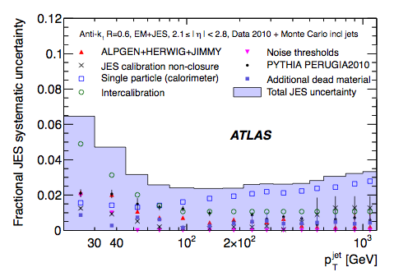

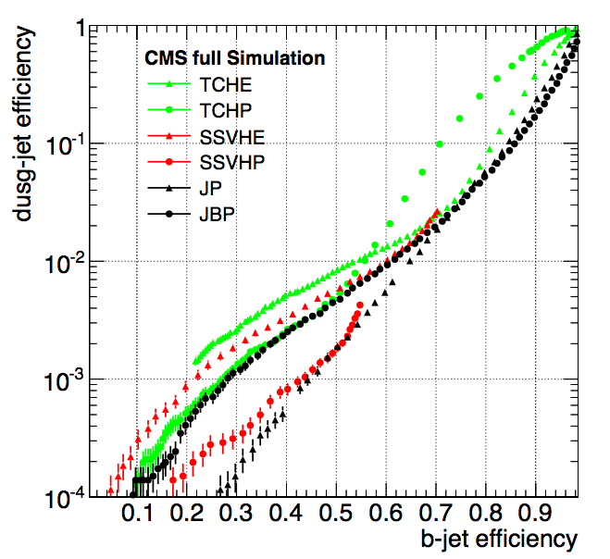
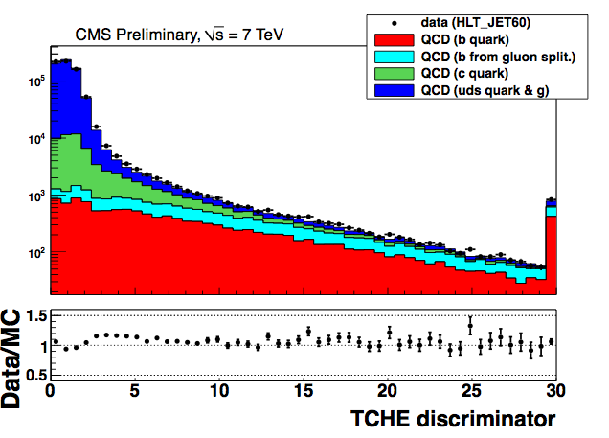
The input: object reconstruction
Leptons (e,μ) from V: p_{T}>20 GeV, isolated, if from Z then M(ll)~91 GeV
-> optimal performances, see previous lecturer
Jets:
ATLAS: clusters of calorimeter deposits, p_{T}>25 GeV
CMS: particle-flow (full particle identification with tracker+calo), p_{T}>30 GeV
B-tagging
MET :
calorimeter deposits (in CMS also part. flow)
6 Febr. 2012 – CERN Winter school
9
S.Bolognesi (Johns Hopkins University)

Slide 56
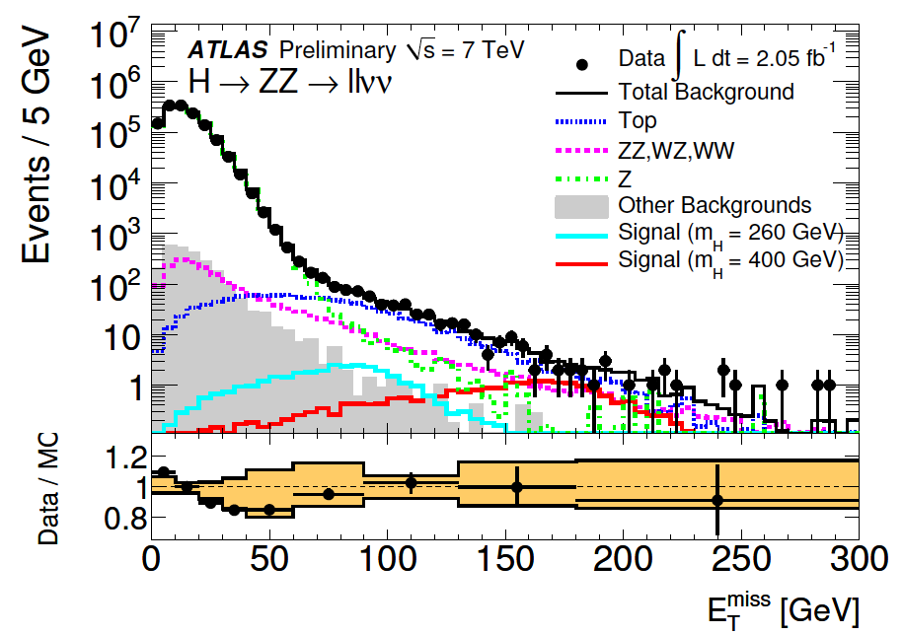
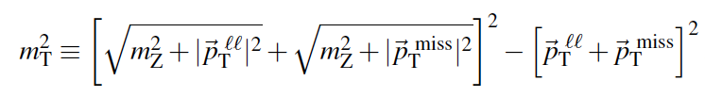
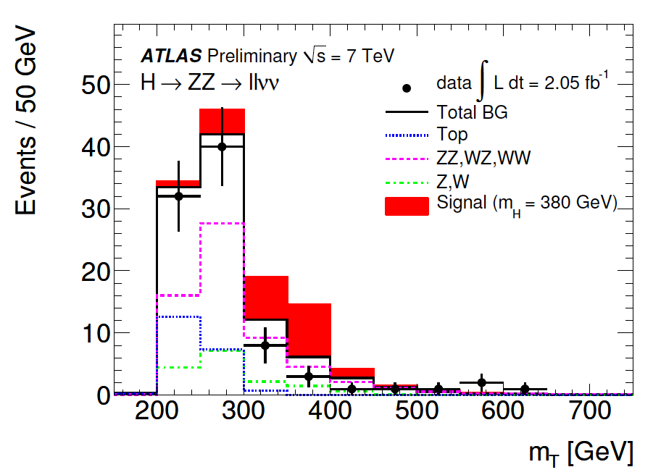

H->ZZ->llνν
2 leptons from Z + MET.
Backgrounds:
Z+jets
removed asking for high, “real” MET
high Δφ(jet-MET, Z-MET)
ttbar
removed vetoing b-tag jets
VV mainly irreducible
W+jets with lepton fake or from HF
Final cuts:
high MET
high Δφ(ll) or p_{T}Z -> for high mH
UL from fit to m_{T}
broad distribution but pretty good S/B
6 Febr. 2012 – CERN Winter school
10

Slide 57

H->ZZ->llνν: Z+jets control
Z+jets is 10⁵ × signal and steeply falling with MET and p_{T}Z
high MET tail dominated by fake MET (difficult to simulate)
cut on Z boost depends on Z+jets modeling
ATLAS
CMS: fully data-driven
MET shape comparison pythia-alpgen (5-20%)
γ+jets reweighted vs
N jets, boson p_{T}, N vertices
boson mass by sampling Z line-shape from fit to data
JES systematics on MET
normalization data-MC comparison m(ll) (2.5%)
Main systematics: contamination from
γ + real MET
Z+jets left float btw
0 and γ+jet prediction
(-100%,+0% uncertainty)
7% uncertainty
6 Febr. 2012 – CERN Winter school
11
S.Bolognesi (Johns Hopkins University)

Slide 58



H->ZZ->llνν: non resonant backgrounds
ATLAS:
CMS:
ttbar from MC
non resonant from data:
xcheck in control regions
(mll sidebands, e+mu)
e+mu and m(ll) sidebands
systematics btag eff and mistag rate
=
×
-> 9% uncertainty
systematics from statistics in e+mu data
W+jets normalization from control region (same-sign ll + MET)
-> 15-100% uncertainty
-> 100% uncertainty
VV from MC ->systematics on norm from PDF, scale, missing VZ*
-> 5-10% uncertainty
CMS 4.6 fb⁻¹
6 Febr. 2012 – CERN Winter school
12
S.Bolognesi (Johns Hopkins University)

Slide 59


H->ZZ->llνν: results
270-440 GeV excluded
310-470 GeV excluded
ATLAS includes H->WW->lνlν (13%-77%) and H->ZZ->4l, H->ZZ->2l2q
(exclusive cuts wrt to dedicated analysis to avoid double counting in combination)
6 Febr. 2012 – CERN Winter school
13
S.Bolognesi (Johns Hopkins University)

Slide 60



H->ZZ->lljj
2l from Z + 2jets from Z
(to improve mH resolution:
kinematic fit M(Z->jj) in CMS,
mZ/mjj rescaling in ATLAS)
Main background Z+jets
still peaking ~M_{Z} because of kinematic pT cuts
no b-jets -> b categories (CMS:0,1,2 bjet; ATLAS: 2 bjets or less)
(CMS remove jet from gluons with qg-likelihhod discriminant)
In 2 btag ttbar relevant -> MET cut (MET significance in CMS)
6 Febr. 2012 – CERN Winter school
14

Slide 61





H->ZZ->lljj: final cuts
ATLAS: higher p_{T} jets + small Δφ(jj), Δφ(ll) -> high Z p_{T} for high mass Higgs
CMS: exploit full angular info H(spin0) -> ZZ ->4f :
likelihood discriminant built with angles distributions
->no m(jj) bias -> background from sidebands
UL from fit to m(lljj)
6 Febr. 2012 – CERN Winter school
15

Slide 62
H->ZZ->lljj: background control
ATLAS:
CMS:
Z+jets
All background at once, data-driven
shape from MC -> uncertainty from Pythia-Alpgen comparison
(highly dominated by Z+jets)
shape and normalization from data M(jj) sidebands
normalization from data M(jj) sidebands
-> uncertainty from data statistics: 1-12% depend. on mH and untagged (16%)
rescaled SB/SR from MC
-> uncertainty from statistics
ttbar from MC
xcheck in MET>50 GeV, M(ll) sidebands
-> uncertainty from data statistics + theoretical uncertainty (~15-20%)
6 Febr. 2012 – CERN Winter school
16
S.Bolognesi (Johns Hopkins University)

Slide 63


Combined results: high mass
127-600 GeV 95% CL exclusion
131-237 251-468 GeV 95% CL exclusion
6 Febr. 2012 – CERN Winter school
24
S.Bolognesi (Johns Hopkins University)

