Slide 1
The LHC long term upgrade plans and the CERN Magnet development program
Gijs de Rijk
CERN

Slide 2
Content
LHC performance and short term plans
The long term upgrade plans for the LHC
Accelerator R&D magnet programs for the upgrades

Slide 3
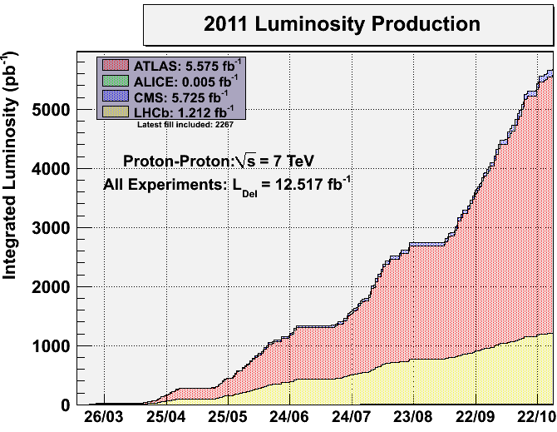
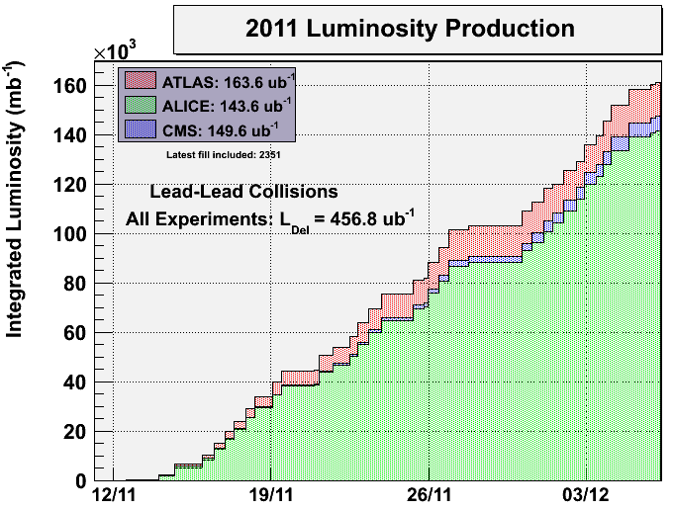
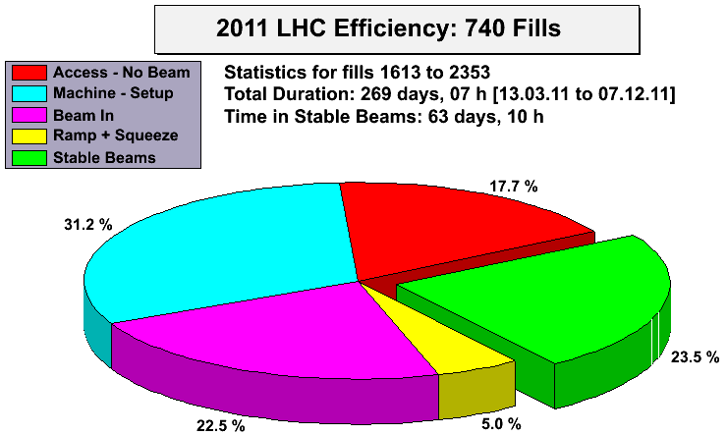
The 2011 LHC run
p-p 5 fb⁻¹
Pb-Pb 150 μb⁻¹

Slide 4
The 2012 LHC plan/prediction
Energy 4 TeV per beam, Integrated Luminosity 16 fb⁻¹
Decisions after Chamonix12 meeting
Lower β* (down to 0.6 m)
Tight collimator settings
50 ns bunch spacing
Pileup ≤30 events per crossing
Many (small) HW and operation modifications
  R2E mitigation
  Fast turnaround
  Improved procedures

Slide 5
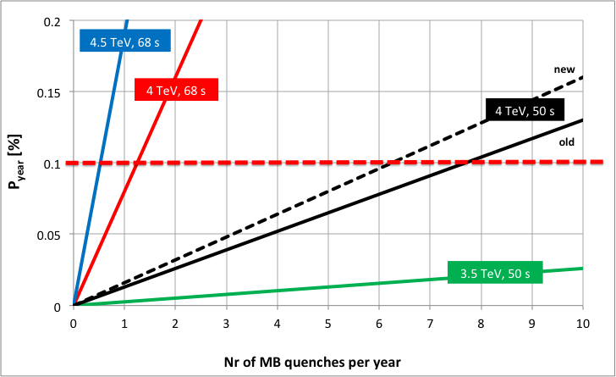
2012: What is the envisaged maximum beam energy?
The issue is the stability of the 13kA splices between the main magnet bus-bars
If during 2012 the number of high current quenches stays below 5-6 then we have the same probability of burn-out as during 3.5 TeV run in 2011 with 40 quench limit (and we had 0 in 2011)
1 quench/month
No show-stoppers from equipment point of view to operate LHC in 2012 at maximum beam energy of up to 4 TeV

Slide 6
LHC and the nominal performance
Nominal performance: 7 TeV per beam, L_{peak} 1. 10³⁴ cm⁻²s⁻¹,
(25 ns bunch spacing; 2808 bunches; 1.15 10¹¹ protons p bunch; β* 0.55 m;
Transverse norm. emittance 3.75 μmrad; bunch length 7.55 cm, 19 events/crossing)
What’s still less ?
Energy: 2011 3.5 TeV ; 2012 4 TeV
  Splice stability risk: to be fixed in 2013-2014 shutdown LS1
  Dipole training memory loss: training up to 6.5 TeV in 2014, the step to 7 TeV is then to be seen later
Bunch spacing: 50 ns at the moment (1400 bunches): scrubbing runs needed to overcome e- cloud formation (only tests in 2012)
What’s already more ?
Bunch intensity 1.5 10¹¹ protons p bunch
Transverse norm. emittance 2.5 μmrad

Slide 7
Schematic LHC layout

Slide 8
LHC nominal parameters
Circumference 26.7 km
Beam energy at collision 7 TeV
Beam energy at injection 0.45 TeV
Dipole field at 7 TeV 8.33 T
Luminosity 10³⁴ cm⁻².s⁻¹
Beam current 0.56 A
Protons per bunch 1.1x10¹¹
Number of bunches 2808
Nominal bunch spacing 24.95 ns
Normalized emittance 3.75 mm
Total crossing angle 300 mrad
Energy loss per turn 6.7 keV
Critical synchrotron energy 44.1 eV
Radiated power per beam 3.8 kW
Stored energy per beam 350 MJ
Stored energy in magnets 11 GJ
Operating temperature 1.9 K

Slide 9

Looking towards an interaction point

Slide 10
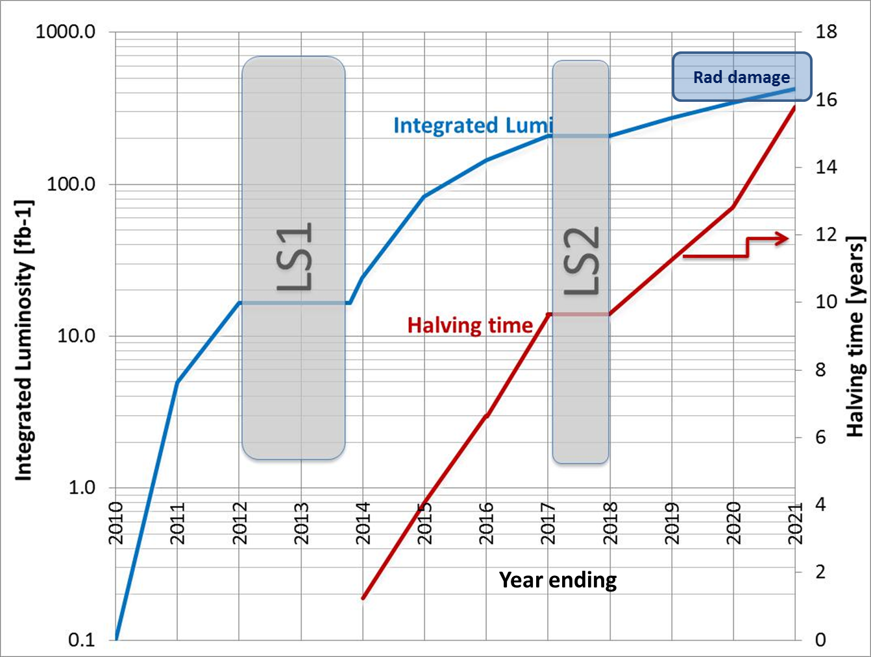
LHC planning and forecast for the next 10 years
LS3

Slide 11



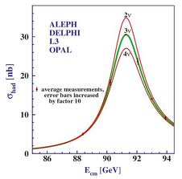



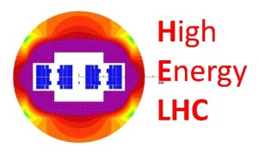
time line of CERN LHC tunnel (proto) projects
1980
1990
2000
2010
2020
2030
2040
LEP
Constr.
Physics
Upgr.
LHC
Design,
R&D
Proto.
Constr.
Physics
HL-LHC
Design,
R&D
Constr.
Physics
  runs in parallel to HL-LHC; tight R&D schedule
Design,
R&D
Constr.
LHeC
Physics
  follows HL-LHC; R&D & protot. time < for LHC
HE-LHC
Design,
R&D
Constr.
Physics
Source: L. Rossi. LMC 2011 (modified)

Slide 12
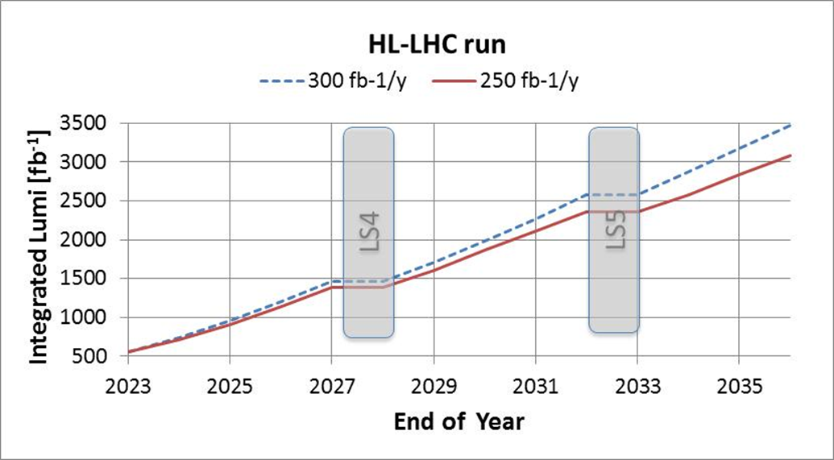
HL-LHC
HL-LHC Final Goal: Given by Physics: 3000 fb⁻¹ in 10-12 years of running

Slide 13
HI-LUMI for HL-LHC: The HL composition
Matching section and correctors
Collimation
Project
High Field Magnets R&D
Beam Diagnostics
HE-LHC Studies
Hardware Commissioning

Slide 14
LHC planning and forecast for the next 10 years
LS3

Slide 15
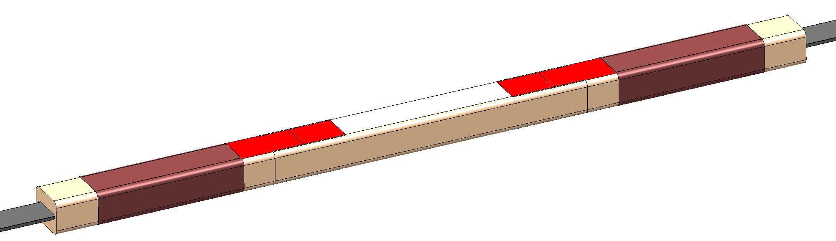
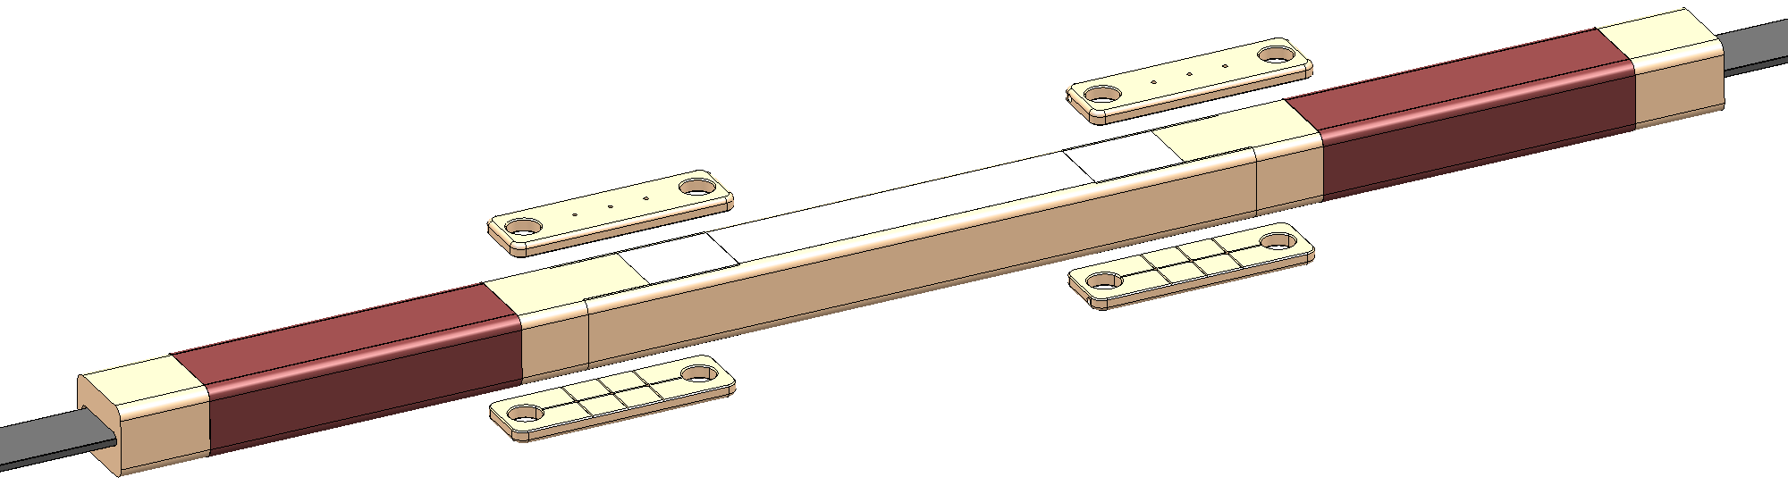
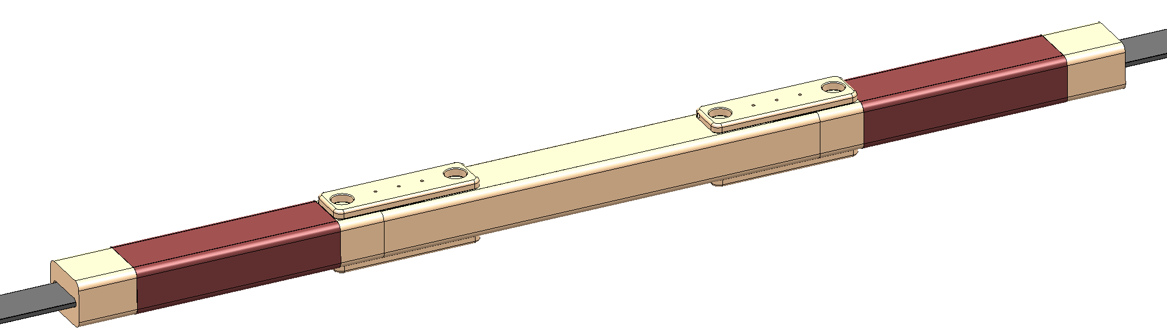
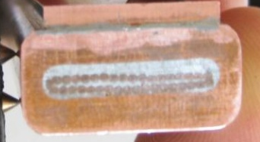
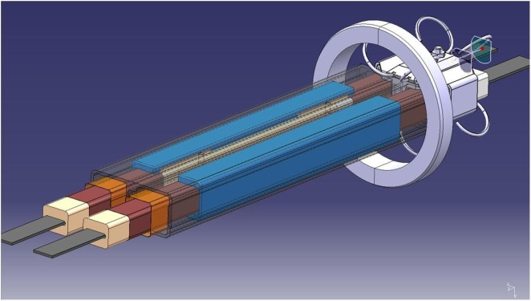
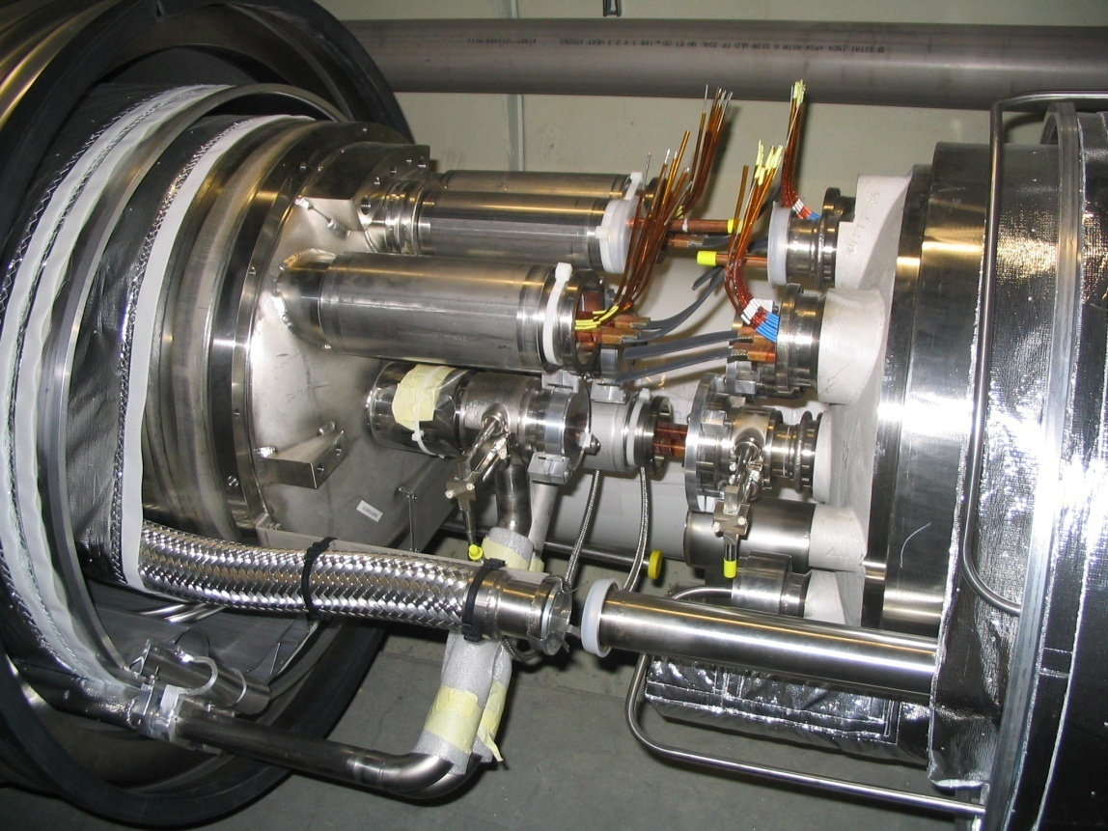
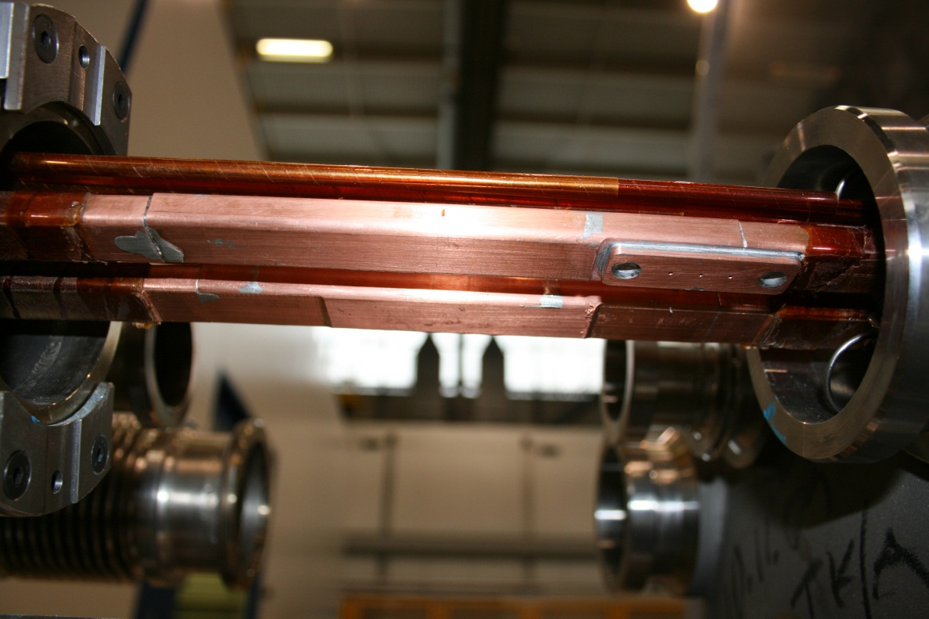
LS1: go to the full energy
Consolidation of the splices (soldering connections between the magnets):
Replace magnets with an issue
Repair known issues
Total magnet to magnet interconnects in the machine: 1 695
Total 13 kA splices: 10 170
Number of splices to be redone: ~1 500 (15%)
Number of shunts to be applied: > 27 000

Slide 16
LS1 Splice intervention train
Start at P5 / clockwise
5
4
6
Cryo-dipole
SSS
High inner splice
Highest leak
Electrical integrity issue
Critical reversed beam screen
3
Beam optics
7
SAM (He, DN160)
Y-lines repair
CC Consolidation / Inspection
DN 200 installation
Triplet braid (End of LS1 for rad prot)
Circuit and splices issues
Spread all around : work on leaks, PIMs,
2
8
1

Slide 17
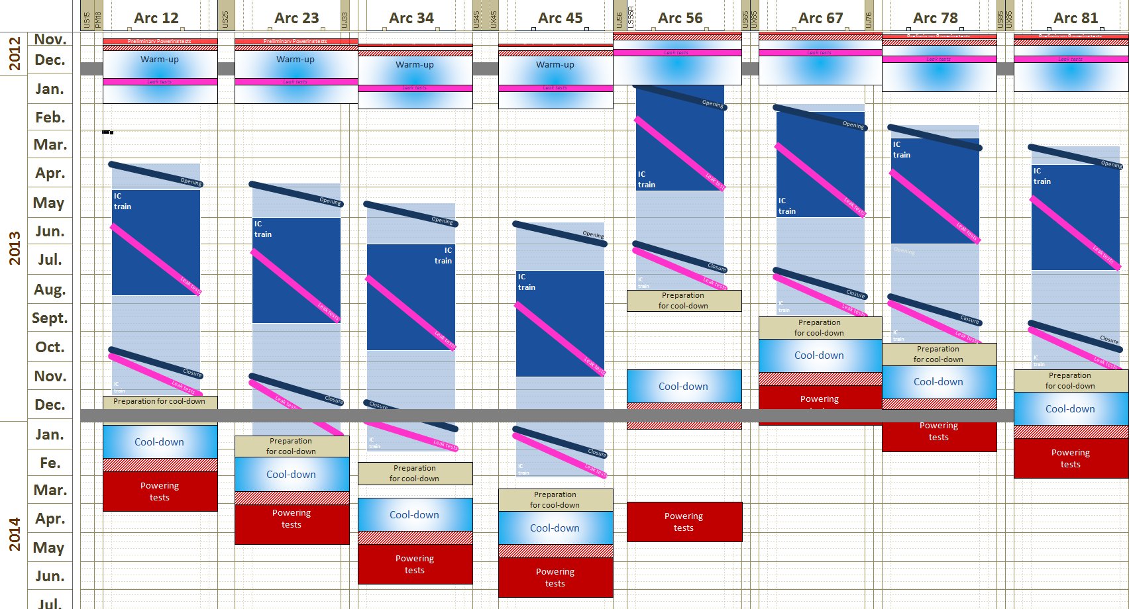
Global Planning LS1
Preliminary powering tests
Warm-up
Opening
Splice consolidation
(incl. internal leak tests)
Closure
Leak tests (Ins vacuum)
Preparation for cool-down
Cool-down
ELQA@cold
Powering tests

Slide 18
LHC planning and forecast for the next 10 years
LS3

Slide 19
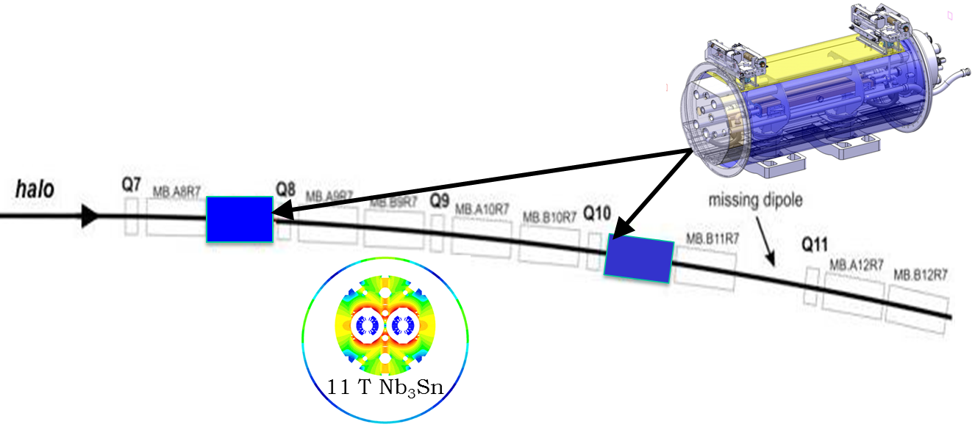
LS2: first steps of HL-LHC
Shut down to overcome some beam intensity limitations
  Collimation of off momentum particles in the Dispersion suppressors: replace 15 m 8T dipole with a 11 m 11T dipole to gain space for the collimator
  New Cryo P4
  Injectors Upgrade

Slide 20
LHC planning and forecast for the next 10 years
LS3

Slide 21
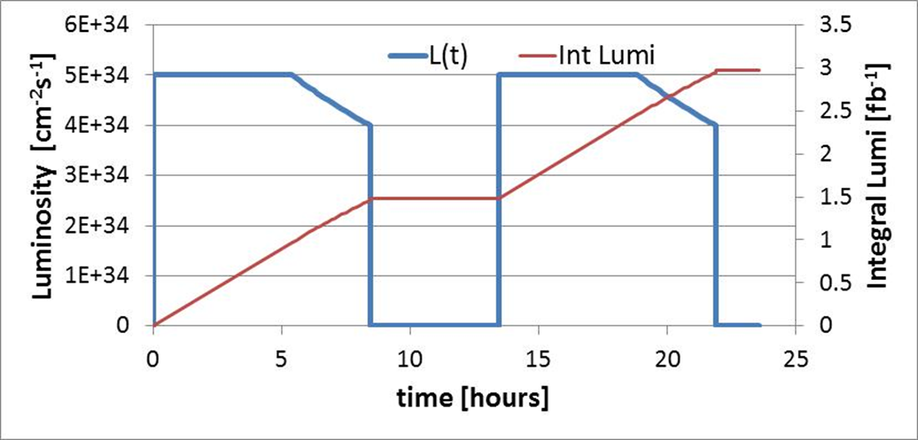
After LS3: Machine cycling for HL-LHC
pile up
heat deposition in IR and DS
other?
20E+34
150 days of Physics /y of this cycle
with 60% efficiency will give 250 fb⁻¹/y
Levelling
The set of parameters we need to reach this goal: the scenarios are known

Slide 22
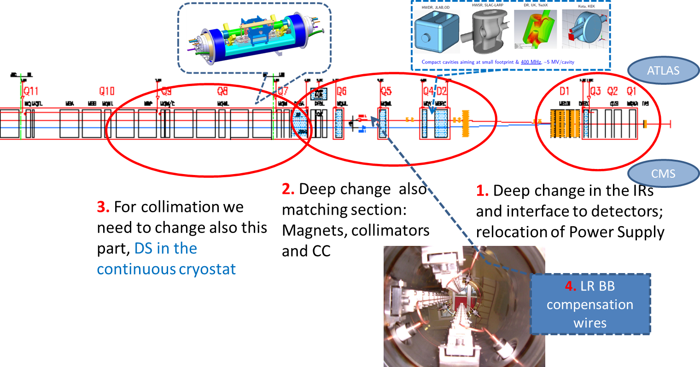
LS3: full implementation of HL-LHC
Many changes : IR Magnets (triplet, D1, D2, MQ4, …), SC Crab Cavities, IR Col, New Cryo IP1-IP5, Cold Powering on surface 0.1-1 GW d.c. HT

Slide 23
What is needed for L= 5 .10³⁴ cm⁻²s⁻¹ ? (1)
  High Gradient/Large Aperture insertion Quadupole magnets
    Possibly: l = 8 m, G= 150 T/m, A=140 mm, (B_{peak-ss} =13 T)
     ≤ 22 cm are possible with a factor 2.5 in luminosity by itself,
    Necessarily coupled with a mechanism to compensate the geometrical reduction .
  Crab Cavities:
    best candidate for exploiting small  (for _{nominal} only +15%).
    However today Crab Cavities are not validated for LHC , conceptually the desin is moving fast: the issue of machine protection should be addressed with priority.
    Global Scheme: 1 cavity in IP4, Proof on LHC, good for 1 X-ing.
    Local scheme; 1 cavity per IP side

Slide 24
What could be needed for L= 5 .10³⁴ cm⁻²s⁻¹ ? (2)
  Separation dipole D1: 8 T , 3.5 m long , 150 mm aperture
  SC links to replace at the surface electronic equipment today in the tunnel and exposed to high radiation (Power Converters & DFBs)
  New Cryoplants in IP1 & IP5
  Improve some correctors
  Commissioning the lattice sextupoles @ 600-650 A
  New MQT corrector scheme using existing spare 600 A bus bars
  Review Matching section (MS) : new large aperture Q4 (today 2x70 mm)
  Matching section : with new stronger corrector orbit, displacements of few magnets
  Larger aperture separation magnet D2
  Cryo-plant for RF in point 4 : 5-7 kW @ 4.5 K
  For extra collimators: l = 11 m, B= 11 T Dispersion Supressor dipoles

Slide 25
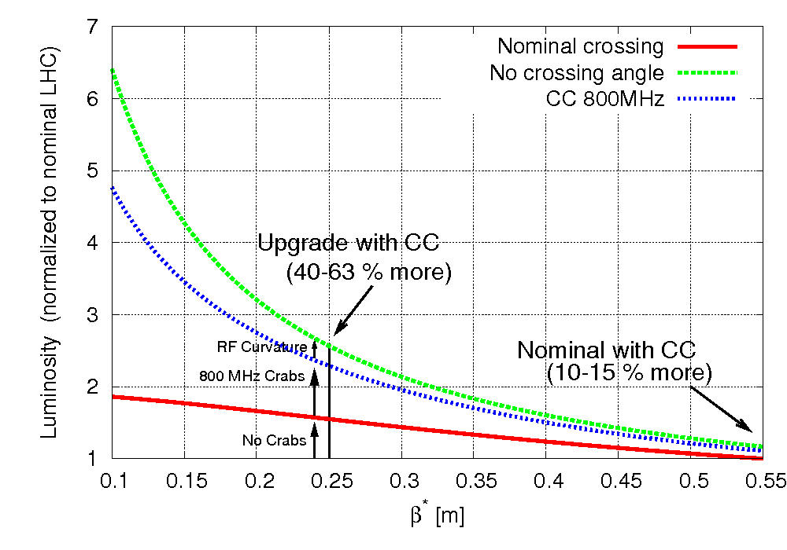
Crab Cavities
θ_{c}
When colliding under an collision angle, if the beams are not ‘head on’ there is a geometrical reduction factor in the luminosity.
Cure: turn the bunches with a transversely accelerating RF field
First successfully used at KEK B-factory BELLE

Slide 26
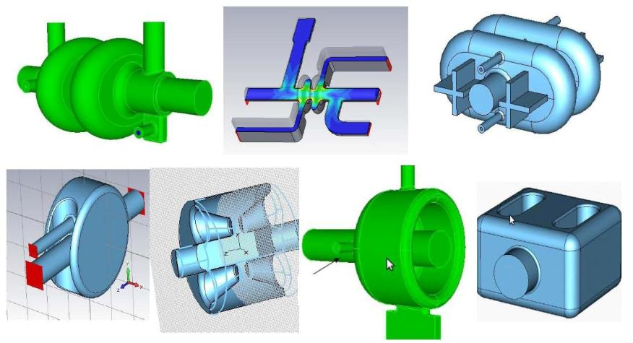
Crab Cavities
Elliptical 800 MHz is not far from being designed. Requires a 400 mm beam-beam distance
400 MHz small cavity under conceptual study, they can (?) fit in 194 mm beam-beam. Required for final solution
Work done by the LARP collaboration, EuCARD and at CERN
Ref. : F. Zimmermann, Ed Ciapala

Slide 27
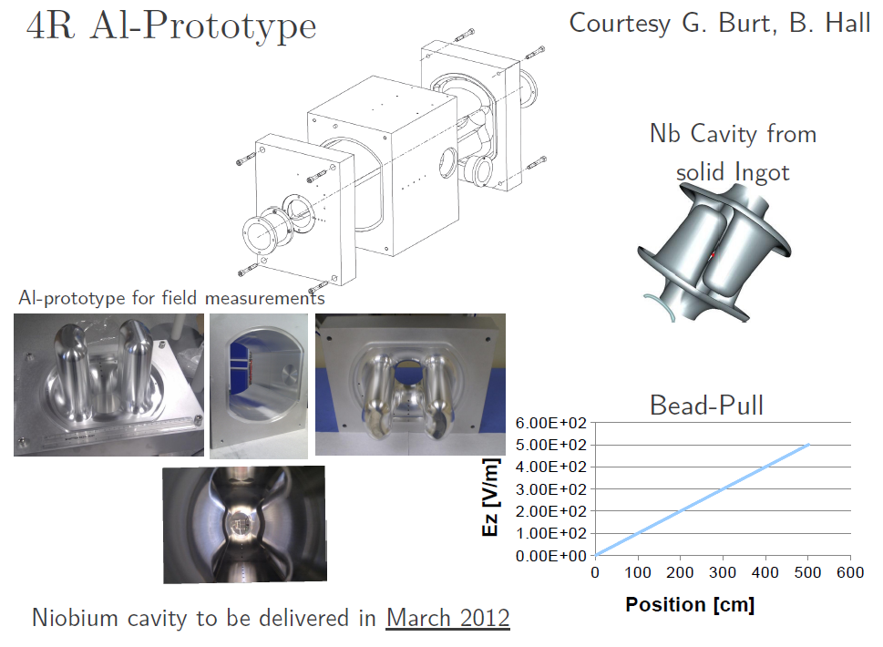
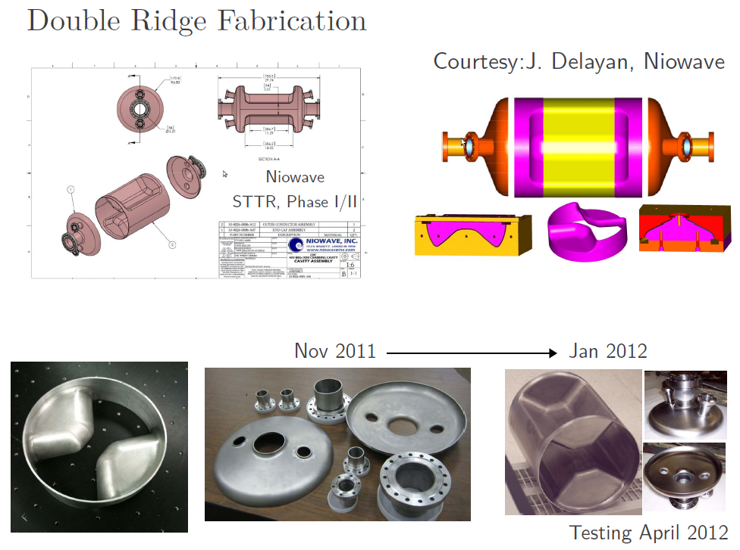
Crab Cavities: fast progress since 2 years
They started building crab cavities in Europe and the US!

Slide 28
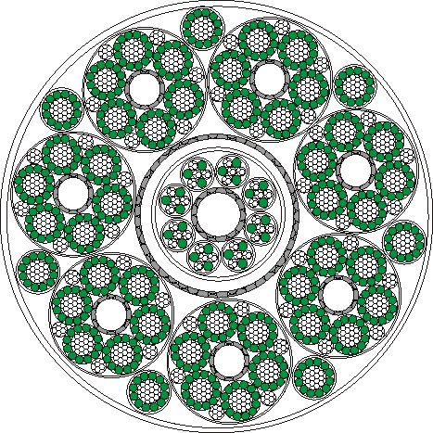

SC link to remove Power Convertors from High Rad zones
1.1 mm
MgB₂ wire
Vertical link
H = 100 m
Semi-horizontal link (100-700 m)
Courtesy: A. Ballerino

Slide 29
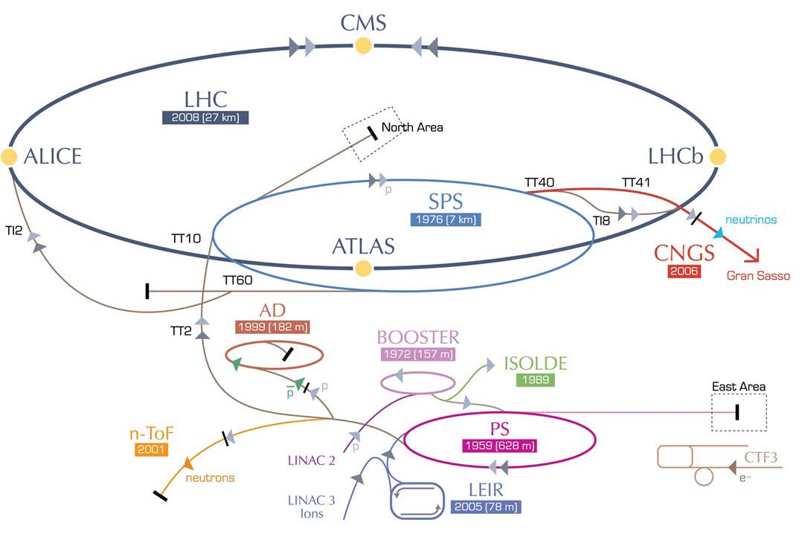
HE-LHC – (33 TeV cms)
HE-LHC
2030?
SPS+,
1.3 TeV, 2030?
2-GeV Booster
Linac4
By courtesy of our DG

Slide 30
CERN program on High Field Magnets
HFM program aim: High field magnets technology (dipoles and quads) for LHC upgrades and future accelerators
Priorities: - Conductor is the heart of the magnet
        - Magnet design and tests
        - Germinate new projects
First step (2004 – 2012):
    Conductor technology : NED 1.25 mm, Fresca2 1 mm (2010), 11 T 0.7 mm (2011)
    Magnet technology : Short Model Coil (2011)
    Personnel training on existing technologies : test TQ & HQ @ CERN (2009)
Second step (2009 – 2014):
    Magnet models : Fresca2 (2013), IR quad model (2013), 11 T dipole model (2013)
    Conductor test facilities upgrade to 15 T test station (2014-2015)
    Radiation hardness studies for Nb₃Sn and coil insulation (2010-2014)
    Magnet concepts from 15 T to 20 T : EuCARD 6 T insert (2013), EuCARD2 (2016)
Third step (2014 – 2016):
    LHC Dispersion Suppressor dipole prototype (2015)
    LHC Inner triplet quadrupole prototype (2016)

Slide 31
HFM program gantt chart
Continuous conductor development , starting with Nb₃Sn , now also HTS
From the HFM project new construction projects germinate
After 2016 this will result in : IT Quad construction, 11 T DS construction and a more targeted HE-LHC magnet development project

Slide 32
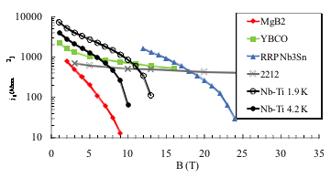
Conductors for HFMs
To meet these requirements one has to switch from Nb-Ti to Nb₃Sn conductors
Courtesy E. Todesco
Engineering current density in practical superconductors

Slide 33
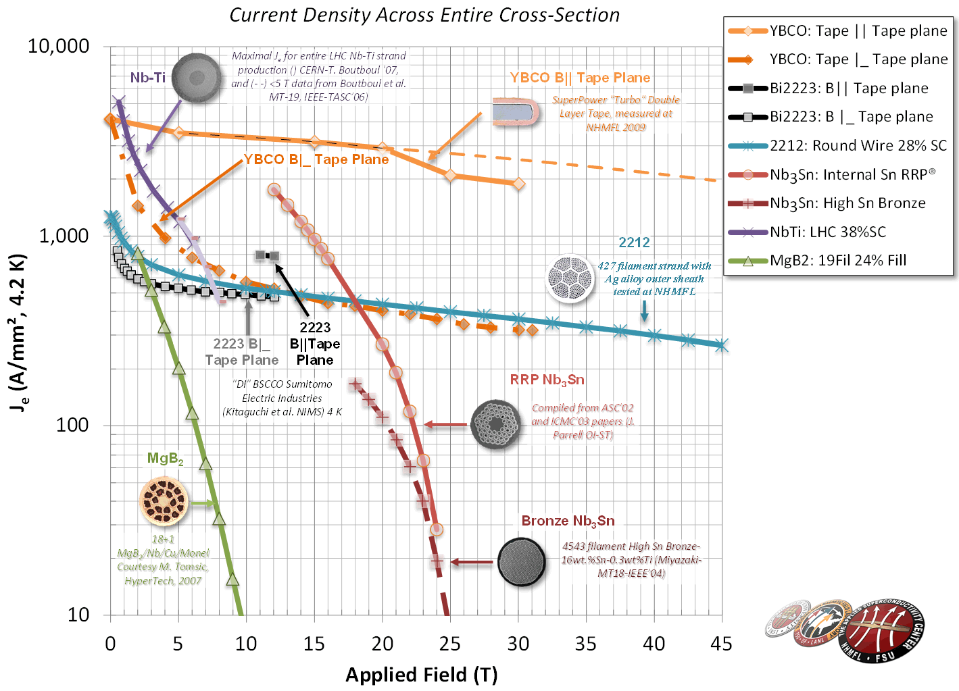
Superconductors
Compilation of engineering current densities

Slide 34
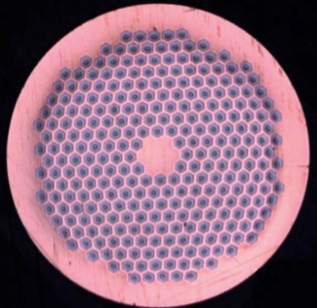
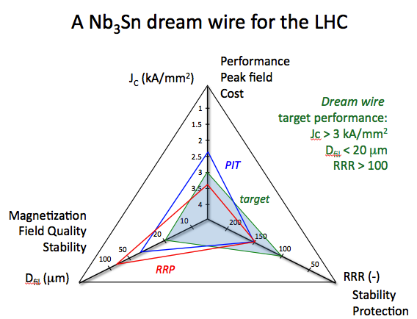
Conductor R&D - NED and post-NED strands
The NED program (2004-2008/2010) achieved Nb₃Sn 1.25 mm strands with J_{C} of 1500 A/mm² at 15 T and 4.2 K, filament diameter of 50 μm, and RRR regularly in excess of 150
The HFM program has since focussed on issues of cable production and degradation, and thermo-magnetic stability
Bruker-EAS PIT, 288 subelements, (Nb-Ta)₃Sn
Courtesy L. Bottura, B. Bordini

Slide 35
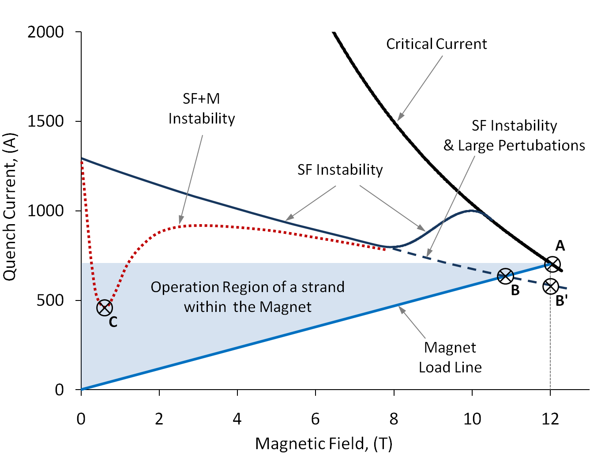
Conductor R&D: improve Jc and stability
Conductors to be studied in detail:
Nb₃Sn Critical current as function of field and temperature
Nb₃Sn stability: magneto-thermal instabilities understanding
Accompany industry with detailed characterization and metallurgic studies
Example:
Magneto-thermal instabilities
In-depth study to understand this effect which was seen in other labs,
Guide strand choice and strand layout development :
-small sub-elements ≤50 μm
-reduce strand diameter: 1mm, -high RRR: ≥100
-reduce J_{c}: 1250A/mm²@15T, 4.2 K
Courtesy of B. Bordini (CERN)

Slide 36
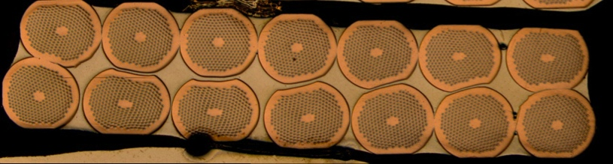
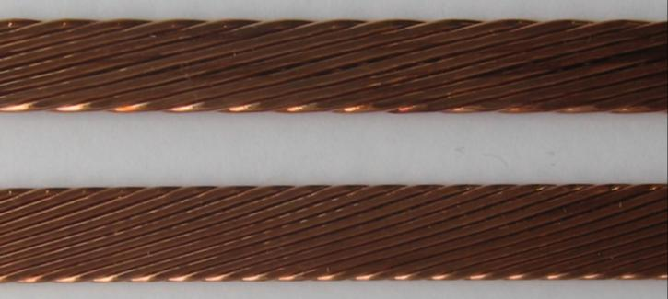
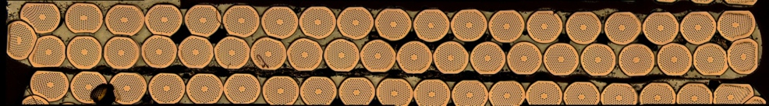
Cables for HFM Program
Cabling tests were performed on several variants of strands/cable sizes to explore the space of parameters, and among others: dimensions, compaction, twist pitch, cabling angle and cabling force, …
Cabling degradation was reduced from 45 % (worst case) to negligible (within the scatter of measurements of extracted strands)
SMC Dipole cable – 14 strands (1.25 mm) and
18 Strands (1 mm), Width = 10 mm, Twist Pitch = 60 mm
Average I_{C} degradation 0 … 4 %
Cabling by L. Oberli and A. Bonasia (CERN)
Fresca 2 Dipole cable – 40 Strands (1 mm)
Width = 20.9 mm, Twist Pitch = 120 … 140 mm
Average I_{C} degradation < 15 %
DS Dipole cable – 40 Strands (0.7 mm)
Width = 14.7 … 15.1 mm, Twist Pitch = 100 mm, 0.8° keystone
Average I_{C} degradation < 3 %

Slide 37
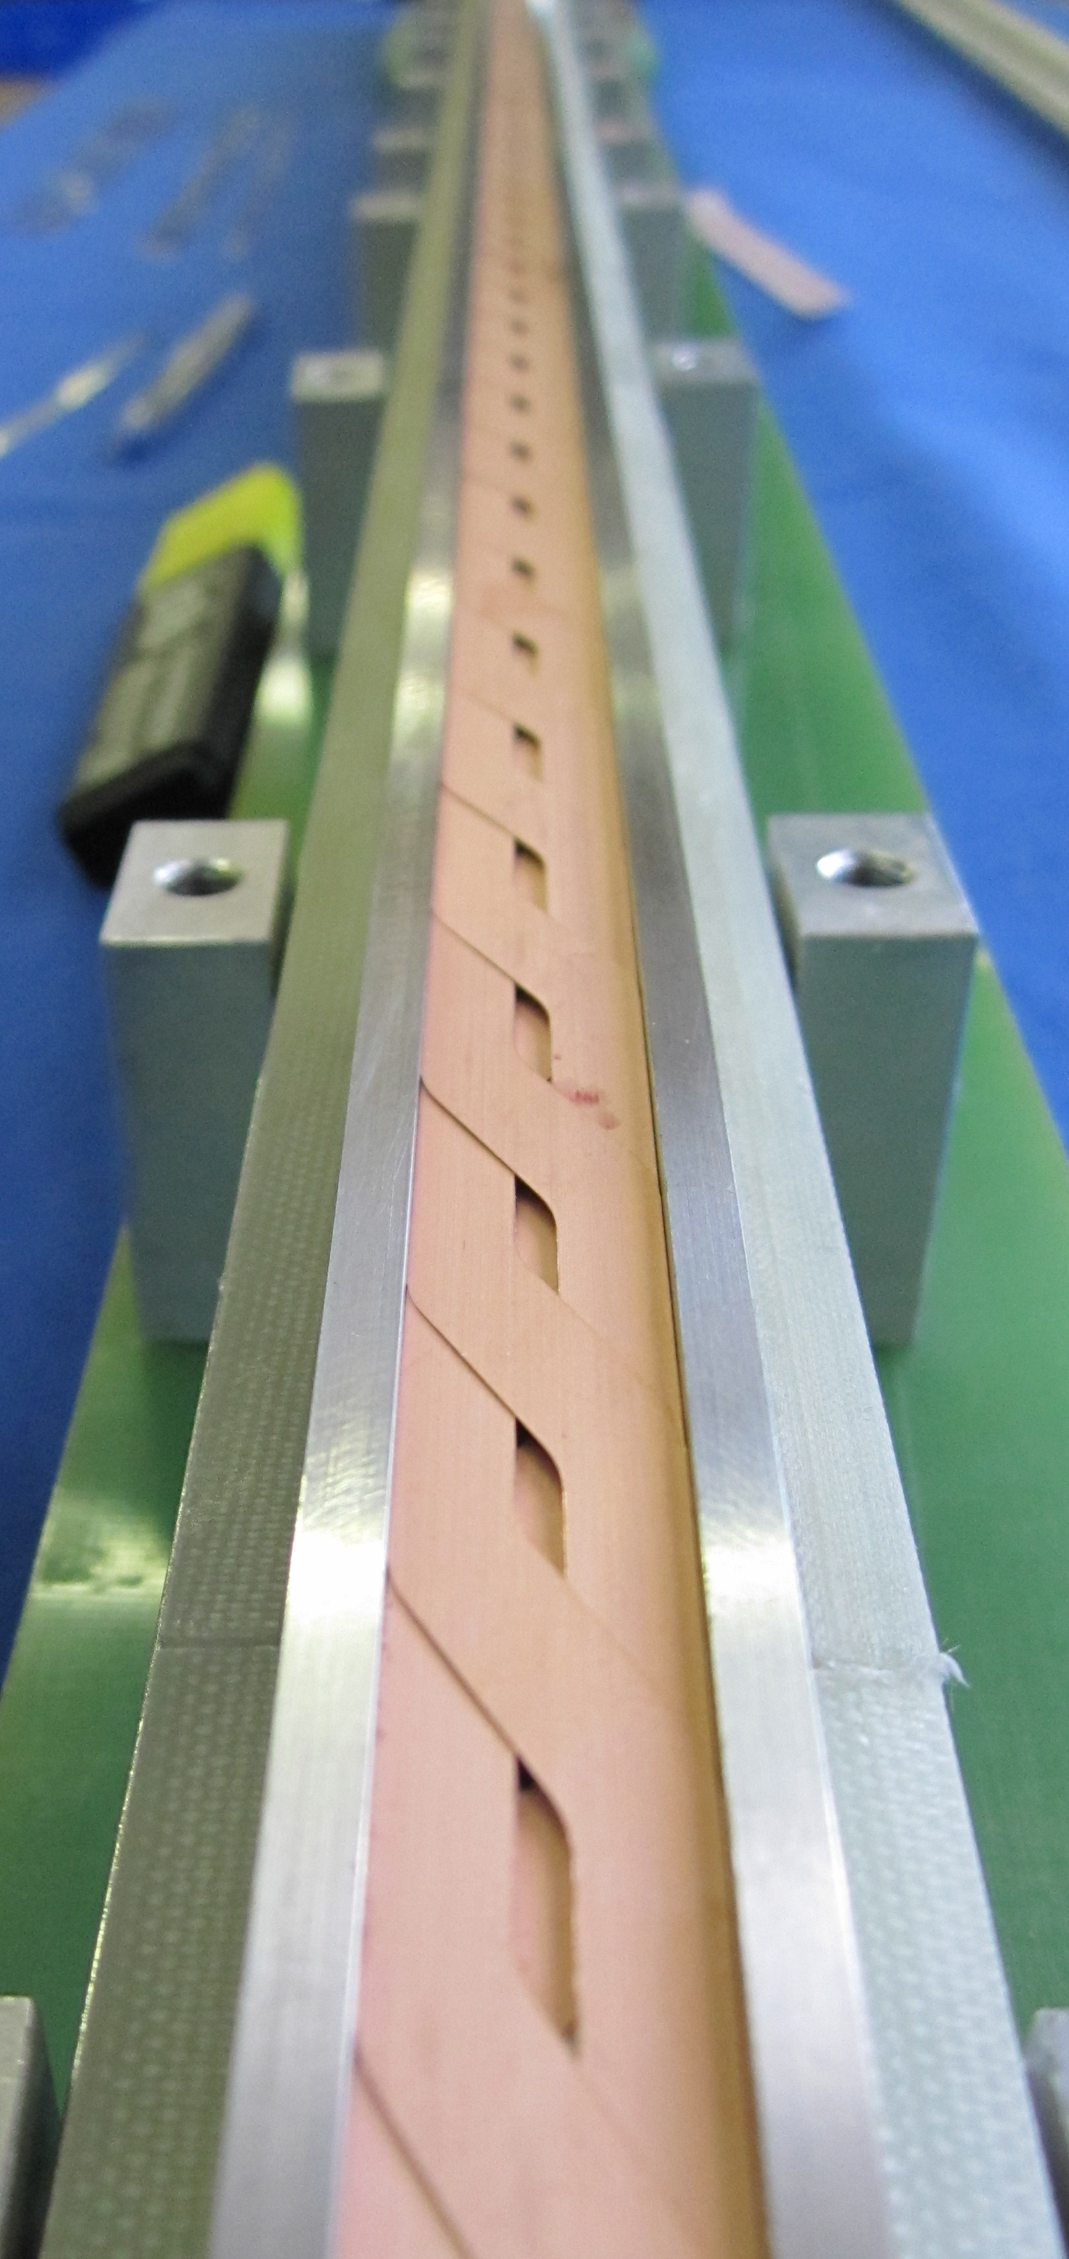
A high current HTS (YBCO) cable
Roebel cables of punched HTS tapes after an idea of W. Goldacker (KIT)
Manufacturing by IRL Ltd.
First test at liquid helium (4.3 K) and in high field (10 T) show a current carrying capacity of 4 to 10 kA
By courtesy of J. Fleiter, Ph. Denis, G. Peiro, A. Ballarino

Slide 38


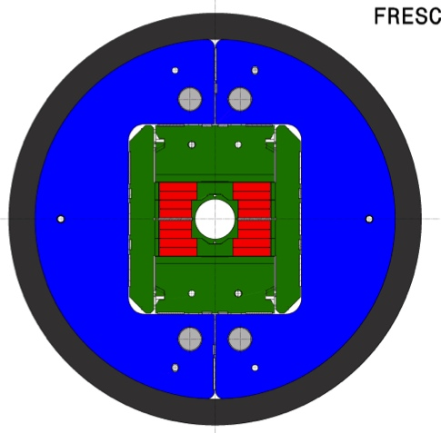
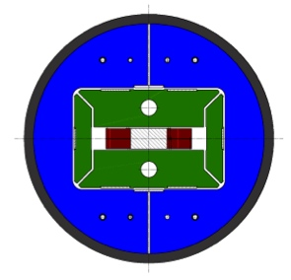
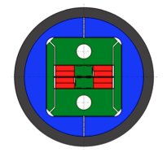
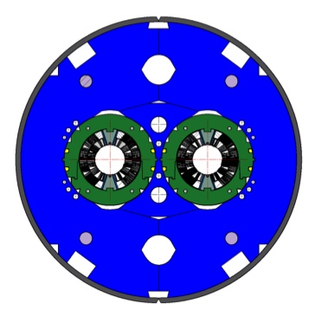
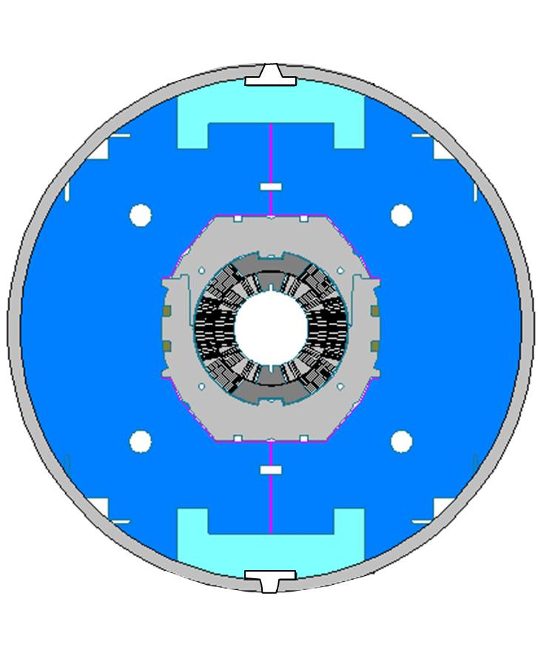

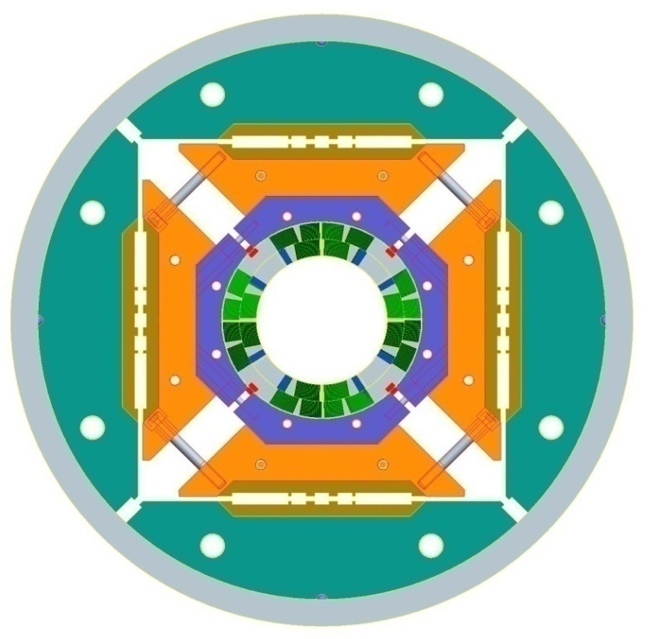


High Field Magnet R&D
FReSCa2
Nb₃Sn Dipole
Short Model Coil
Race-track
Model Coil
11 T DS
Nb₃Sn Dipole
11 T DS
1-in-1 model
HQ/LHQ
Nb₃Sn Quadrupole
US-LARP program
2012
2013
2014
2015
2016
2017
2018
2019
2020

Slide 39
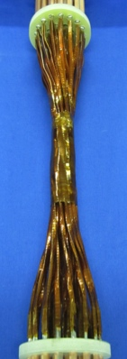
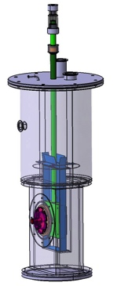
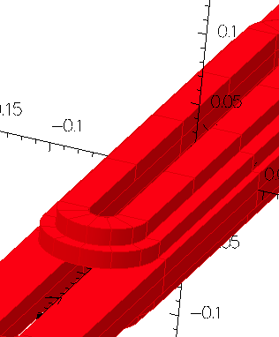
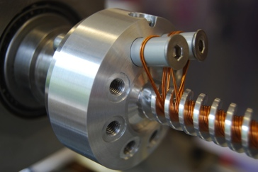
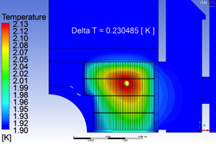

EuCARD WP7 High Field Magnets
12 partner collaboration : CEA-Saclay, CERN, CNRS-Grenoble, Columbus (Genova), BHTS (Bruker), INFN-LASA (Milano), KIT (Karlsruhe), PWR (Wroclaw), SOTON (Southampton), STFC-Daresbury, TUT (Tampere), UNIGE (Genève)
One management and 5 R&D tasks:
Coordination and Communication.
Support studies, thermal studies and insulation radiation hardness
High field model: 13 T, 100 mm bore (Nb₃Sn)
Very high field dipole insert (in HTS, up to ΔB=6 T)
High Tc superconducting link (HTS powering links for the LHC)
Short period helical superconducting undulator (ILC e⁺ source)
Duration: 1-4-2009 – 31-3-2013, Budget:6.4 M€ total, 2.0 M€ EC contr.
25 × 2 × 600 A
Φ < 40 mm

Slide 40
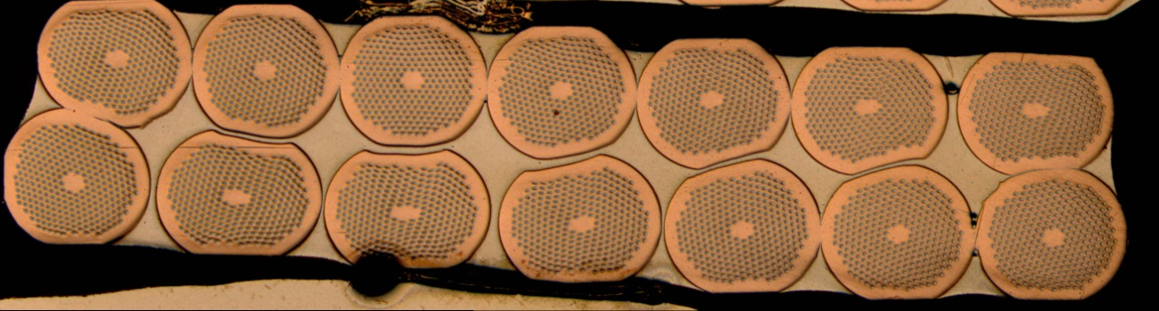
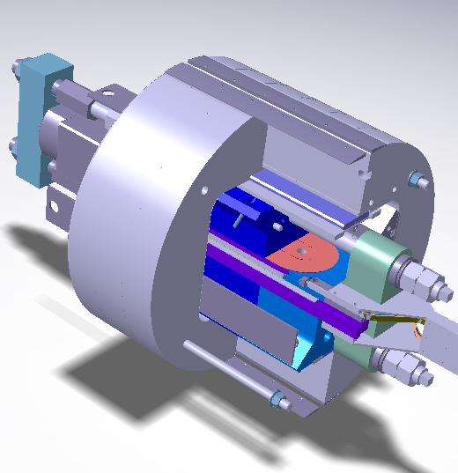
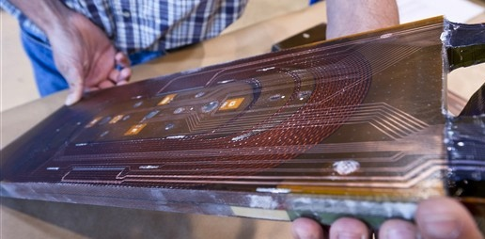
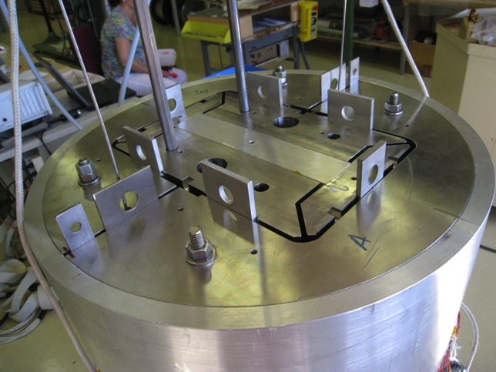
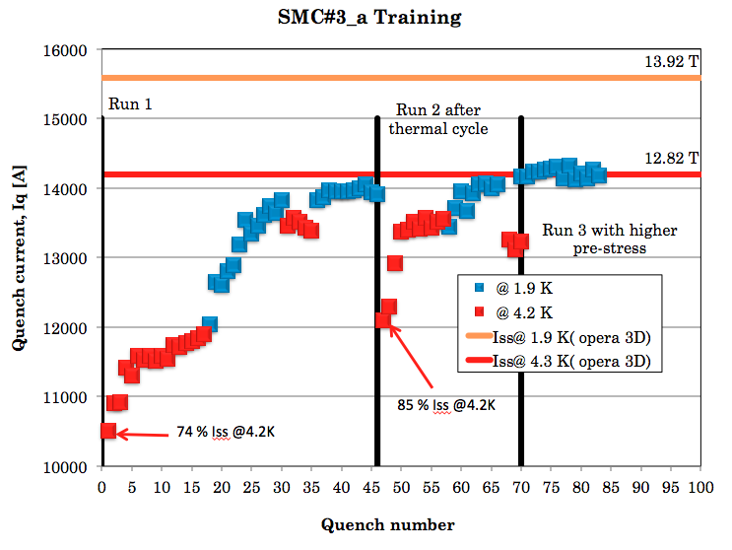

SMC, tested in 2011: 12.5 T on the coil
Courtesy of J. Perez and M. Bajko

Slide 41




EuCARD High field model (Fresca2)
Challenging construction with several new concepts:
Block coil geometry with flared ends
Shell-bladder and key structure
(inspired by the HD2 of LBNL)
156 turns per pole
Iron post
B_{center} = 13.0 T
I_{13T} = 10.7 kA
B_{peak} = 13.2 T
E_{mag} = 3.6 MJ/m
L = 47mH/m
Diameter Aperture = 100 mm
L coils = 1.5 m
L straight section = 700 mm
L yoke = 1.6 m
Diameter magnet = 1.03 m
42
42
36
36
Construction ongoing, first coil 2012, test end 2013
Courtesy Attilio Milanese, Pierre Manil

Slide 42


Dispersion Suppressor Upgrade: collimators & 11 T dipoles
LS2 2017-18: Point-3,7 & IR-2
LS3 2020+: IR1,5 as part of HL-LHC
MB.B8R/L
MB.B11R/L
11 T Nb₃Sn
∫BdL = 119.2 Tm @ I_{nom} = 11.85 kA
in series with MB with 20 % margin
LS2: 12 coldmass + 2 spares = 14 CM
LS3: 8 coldmass + 2 spares = 10 CM
Total 24 CM
LS2: 24 coldmass + 4 spares = 28 CM
LS3: 16 coldmass + 4 spares = 20 CM
Total 48 CM
11 m Nb₃Sn
3 m Collim
5.5 m Nb₃Sn
5.5 m Nb₃Sn
3 m Collim
5.5 m Nb₃Sn
3 m Collim.
5.5 m Nb₃Sn

Slide 43



HFM R&D for an LHC luminosity upgrade: 11T DS dipole
  Development started for a twin aperture ∅ = 60 mm, B = 11 T, L = 5.5 m dipole magnet:
  40 strands of 0.7 mm
  2 layers 14.7 mm width cable
  B=11.0 T at 80.4% I_{ss}, T=1.9 K, I=11850 A
  Coil length 5.3 m
  Issues being addressed:
  Stability of the strand at 1.9 K
  LHC dipole like collar structure
  Insulation type
  Heat removal from the coil
  Inter-strand resistance in the cable : cored cable
  Is sub-element diameter 50 μm small enough ? 30 μm

Slide 44
11T Dispersion Suppressor dipole
Developed at FNAL and CERN for the LHC luminosity upgrade.
two 5.5 m 11 T dipoles should replace one 15 m 8.3 T main dipole
Has to operate in series with the main bend dipole chain: 11 T @ 11850 A
Potentially the first Nb₃Sn magnet to be used in an accelerator (2017)
Courtesy M. Karppinen,
A. Zlobin, et al.

Slide 45
HFM R&D for an LHC luminosity upgrade: IT Quad
R&D in the US (LARP):
Up to now achieved (LQ): Aperture ∅ = 90 mm, G = 220 T/m, L = 3.4 m
Now testing (HQ): Aperture ∅ = 120 mm, G = 170 T/m, L = 1 m
Conductors used:
OST-RRP-54/61 and OST-RRP-108/127
Cable 27 strands, ∅ = 0.7 mm , sub-elements ∅ = 50 μm
Issues to address:
Inter-strand resistance in the cable is low and variable : used a core in the cable
Stability of the strand at 1.9 K to be confirmed
In the sub-element diameter of 50 μm small enough ? : develop 30 μm
Length limit at 3.4 m, should be 8 m
Radiation hard insulation
Heat removal from the coil

Slide 46






LARP IT quad development program
Achieved with Nb₃Sn:
TQ: 1 m, 220 T/m, 90 mm aperture
LQ: 3.8 m, 220 T/m, 90 mm aperture
HQ: 1 m, 170 T/m, 120 mm aperture
with alignment features
Plan:
4 m LHQ technology demonstrator by 2015

Slide 47



HTS inserts
EuCARD
  6 T insert built with YBCO tapes
  Current density of 250 A/mm²
  Race-track, 20 mm aperture (no bore)
  self-supported for test in FReSCa-2
EuCARD2 (proposed)
  5 T, 40 mm bore, accelerator quality HTS magnet
  10 kA-class HTS cable at 20 T
5 T cos-θ magnet design based on flat cable geometry
By courtesy of B. Auchmann

Slide 48





EuCARD, 6 T insert (2009-2013)
Conductor: YBCO 12 mm tape, back to back soldered, and 2 in parallel, transposed between the poles
Number of turns 73 + 61 + 36 = 170 (of 4 tapes)
Aperture h = 20 mm , w = 15 mm “chopped cylinder” inside racetrack
Force detainment with welded clamp + shrinking rings
L total = 700 mm
L straight part = 274 mm
I = 2800 A
350 mm
700 mm
Detailed insert design ongoing
Manufacturing of test solenoid pancakes in progress
Test of test solenoids this year
Quench studies in progress
3D geometry
Courtesy:
J-M Rey (CEA),
P. Tixador (CNRS & Grenoble)
A. Ballarino (CERN)

Slide 49




A really high field dipole
HTS
x 2
Nb₃Sn
x 3
Nb-Ti
HTS/Nb₃Sn/Nb-Ti nested coil magnet
B_{coil}
high-grade
Nb₃Sn
low-grade
Nb₃Sn
HTS
Nb-Ti
By courtesy of E. Todesco

Slide 50
Radiation resistance
The radiation resistance of the Nb₃Sn magnets (and HTS) has to be fully proven
  Effects of radiation on the superconductor, the stabiliser (Cu, Al) and the insulator
CERN started in 2010 a program to test radiation effects on the Nb₃Sn conductor
  Radiation tests on Nb₃Sn conductor carried out at ATI (Vienna) and Kurchatov (Russia)
In the EUCARD program there is a task to select radiation hard insulator material material (impregnation) for the Nb₃Sn coils
  Radiation tests on Nb₃Sn insulation carried out in at Swierk (Poland) (irradiation starting this month)

Slide 51



Radiation resistance: irradiation tests
Measurement of Jc of various HEP-grade Nb₃Sn strand in the TRIGA reactor at the Atominsitut of the Technical University in Vienna
Insulator electron irradiation at Swierk
Courtesy H. Weber (ATI)
Courtesy M. Chorowski (PWR)

Slide 52
Spare slides

Slide 53
2012 parameter table (protons)
Parameter | Value at 450 GeV | Value at top energy
Energy [ GeV ] | 450 | 4000
β*IP1/5 [ m ] | 11.0 | 0.6
β*IP2 [ m ] | 10.0 | 3.0
β*IP8 [ m ] | 10.0 | 3.0
Parallel separation [ mm ] | 2.0 | 0.67
Crossing angle IP1/5 [ μrad ] | 170 | 145
Crossing angle IP2 [ μrad ] | 170 | 90⁺
Crossing angle IP8 [ μrad ] | 170 (H) | 100 (V)
Ramp duration [ s ] | 2010: 1020 → 770
Squeeze duration [ s ] | 2010: 548 (1.0 m) → 819 (0.6 m)
Collision BP duration [ s ] | 2010: 56 → 56

Slide 54
Top energy - IV
Comparison of performance reach for various options at 4 TeV (again focusing on ATLAS and CMS).
Parameter | Unit | 50 ns |  |  | 25 ns
Half crossing angle IP1/5 | μrad | 118.00 | 134.00 | 145.00 | 192.00
Beta * IP1/5 | m | 0.90 | 0.70 | 0.60 | 0.80
Total number of bunches |  | 1380 | 1380 | 1380 | 2760
Bunch intensity (10¹¹) |  | 1.50 2.50 | 1.50 2.50 | 1.50 2.50 | 1.15 3.50
Normalised transverse emittance | μm
Protons per beam (10¹⁴) |  | 2.07 | 2.07 | 2.07 | 3.17
Current per beam | mA | 372.43 | 372.43 | 372.43 | 571.07
Stored energy per beam | MJ | 132.69 | 132.69 | 132.69 | 203.46
RMS bunch length | cm | 9.40 | 9.40 | 9.40 | 10.10
Beam size IP1/5 | mm | 0.023 | 0.020 | 0.019 | 0.026
Geometric factor IP1/5 |  | 0.901 | 0.849 | 0.809 | 0.797
Number of colliding pairs in IP1/5 |  | 1331 | 1331 | 1331 | 2662
Luminosity in IP1/5 (10³³) | cm⁻² s⁻¹ | 4.57 | 5.54 | 6.16 | 3.82
Events per crossing IP1/5 (76 mbarn) |  | 23.22 | 28.15 | 31.29 | 10.0

Slide 55
2012 proton run – 50 ns
Assumptions:
  147 days of physics
  22 days of MDs
  21 days of commissioning with beam (small number of bunches)
  20 days of Technical stops
  6 (2x3) days of recovery after Technical Stops
  8 days of special physics runs
  3 day of scrubbing with 25 ns beam including setting-up and 1 day of contingency. To be planned as soon as possible before serious intensity ramp-up.
Intensity ramp up as discussed in Evian (for 50 ns):
  48-84-264-624: 3 fills and 6 hours of Stable Beams (assumed 25% SB time)
  840-1092-1380: 3 fills and 20 hours of Stable beams (assumed 28% SB time)
  ➔ 2 weeks for validation of maximum number of bunches

Slide 56

50 ns – 4 TeV – very optimistic
HF=0.26
Peak perf.
HF=0.26
control
L=0.75 ➔ 0.9 L_{peak}
HF=0.26
N_{b} ramp
L=0.75 ➔ 0.9 L_{peak}

Slide 57

25 ns -4 TeV
HF=0.2
No experience with this beam!!!

Slide 58
Summary table

