Slide 1
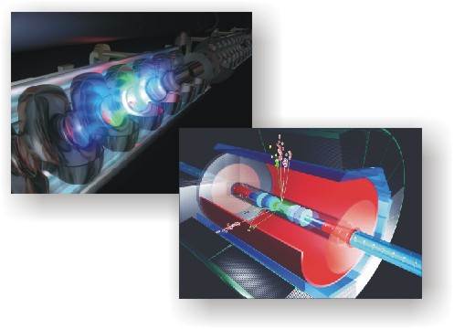
Electron-Positron Linear Collider:
Past, present and future
Nick Walker – DESY
6th December, 2011

Slide 2
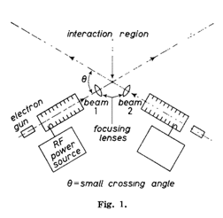
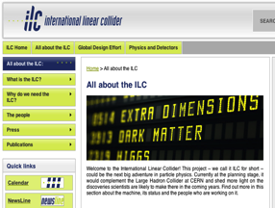
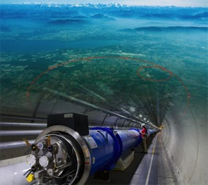
Content
The Past
The Present
The Future

Slide 3

The Past

Slide 4
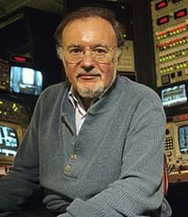
The Beginning – in theory
A Possible Apparatus for Electron-Clashing Experiments (*).
M. Tigner
Laboratory of Nuclear Studies. Cornell University - Ithaca, N.Y.
M. Tigner,
Nuovo Cimento 37 (1965) 1228
“While the storage ring concept for providing clashing-beam experiments (¹) is very elegant in concept it seems worth-while at the present juncture to investigate other methods which, while less elegant and superficially more complex may prove more tractable.”

Slide 5
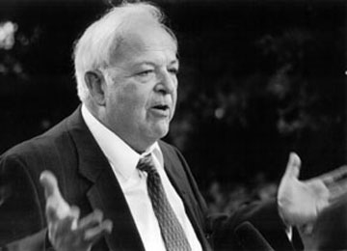
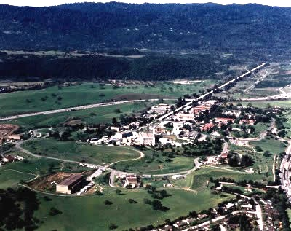
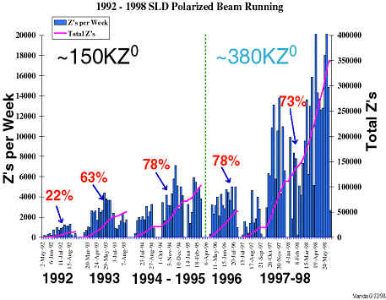
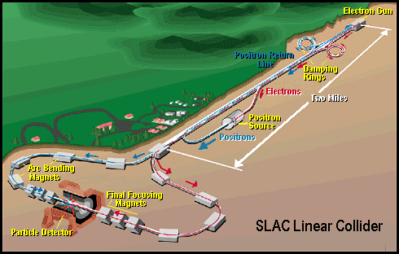
The Beginning – in reality
SLAC Linear Collider (SLC)
E_{cm} ~ 90 GeV
1989-1998
A proof of principle
Burt Richter

Slide 6
Luminosity Scaling Law
RF→beam power efficiency
Beamstrahlung
(physics)
Vertical emittance

Slide 7
The Luminosity Issue
High current (n_{b} N)
High efficiency
(P_{RF} →P_{beam})
High Beam Power
Small IP vertical
beam size
Small emittance ε_{y}
strong focusing
(small β*_{y} , σ*_{y} ~ nm)

Slide 8
The Luminosity Issue
High current (n_{b} N)
High efficiency
(P_{RF} →P_{beam})
Superconducting RF
Technology
Small emittance ε_{y}
strong focusing
(small β*_{y} , σ*_{y} ~ nm)

Slide 9
Superconducting RF (1990)
“[del...] The requirements for luminosity do favor superconducting accelerators. The wavelengths of such structures can be made large, which render the wakefields negligible. The damping time being essentially infinite, rf power can be fed continuously from a low power, high efficiency source. Unfortunately at this time, the highest accelerating gradient that can be achieved is about 7 MeV/m, and that is far too low. However the true limit (achieved in small cavities) is about 40 MeV/m ...[del].
If such gradients could be achieved, then superconducting structures would be highly desirable”
taken from
R. B. Palmer, “Prospects for High Energy e⁺e⁻ Linear Colliders”,
Annu. Rev. Nucl. Part. Sci. 1990. 40: 529-92

Slide 10
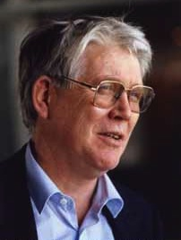
1992 - The TESLA Vision
Reduce the cost/MV of SCRF by a factor of 20
  over existing state-of-the art (CEBAF)
How?
  Increase the gradient from 5 to 25 MV/m
  Decrease the cost/m by a factor of 4
    cryomodule integration and mass production
Goal: 2,000 € per MV
Bjorn Wiik 1937-1999
20 years later, have we achieved this?

Slide 11
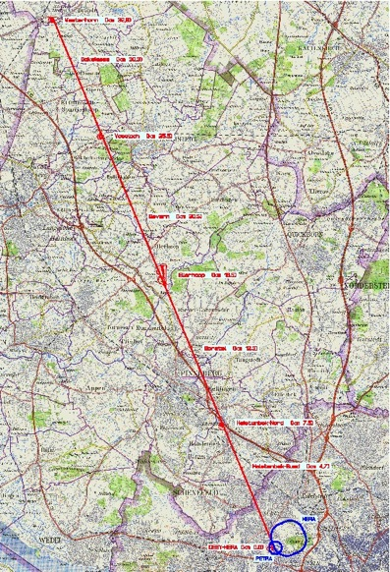
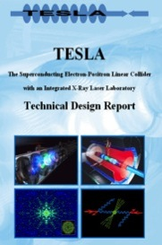
the TESLA linear collider
Westerhorn (32.8 km)
Ellerhoop (16.5 km)
2001
DESY

Slide 12
A Big Jump

Slide 13
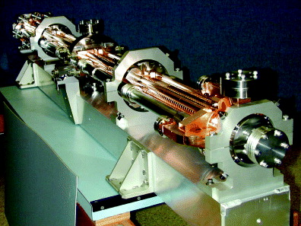
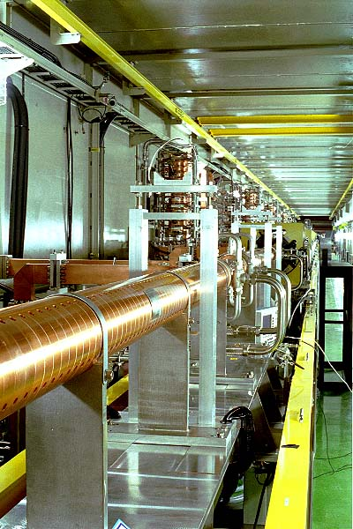
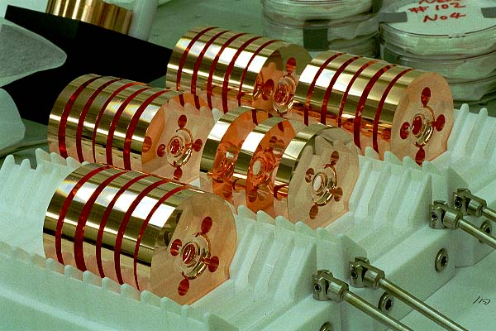
The Primary Competition
NLC/JLC
(SLAC / KEK)
11.4 GHz X-Band
E = 65 MV/m
(E_{acc} = 50 MV/m)
~15 years of R&D
Fully integrated LC design, strongly based on SLC experience

Slide 14
The Big Picture: 1994
E_{cm}=500 GeV
 | TESLA | SBLC | JLC-S | JLC-C | JLC-X | NLC | VLEPP | CLIC
f [GHz] | 1.3 | 3.0 | 2.8 | 5.7 | 11.4 | 11.4 | 14.0 | 30.0
L×10³³ [cm⁻²s⁻¹] | 6 | 4 | 4 | 9 | 5 | 7 | 9 | 1-5
P_{beam} [MW] | 16.5 | 7.3 | 1.3 | 4.3 | 3.2 | 4.2 | 2.4 | ~1-4
P_{AC} [MW] | 164 | 139 | 118 | 209 | 114 | 103 | 57 | 100
γε_{y} [×10⁻⁸m] | 100 | 50 | 4.8 | 4.8 | 4.8 | 5 | 7.5 | 15
σ_{y}* [nm] | 64 | 28 | 3 | 3 | 3 | 3.2 | 4 | 7.4

Slide 15
The Big Picture: 2002
E_{cm}=500 GeV
 | TESLA | SBLC | JLC-S | JLC-C | JLC-X/NLC | VLEPP | CLIC
f [GHz] | 1.3 |  |  | 5.7 | 11.4 |  | 30.0
L×10³³ [cm⁻²s⁻¹] | 34 |  |  | 14 | 20 |  | 21
P_{beam} [MW] | 11.3 |  |  | 5.8 | 6.9 |  | 4.9
P_{AC} [MW] | 140 |  |  | 233 | 195 |  | 175
γε_{y} [×10⁻⁸m] | 3 |  |  | 4 | 4 |  | 1
σ_{y}* [nm] | 5 |  |  | 4 | 3 |  | 1.2

Slide 16
ICFA and ITRP: Making a choice
2003
“…there would be compelling and unique scientific opportunities at a linear electron-positron collider in the TeV energy range. Such a facility is a necessary complement to the LHC hadron collider now under construction at CERN. Experimental results over the last decade from the electron-positron colliders LEP and SLC combined with those from the Tevatron, a hadron collider, have led to this worldwide consensus.”

Slide 17
The 12 Wise Men of the ITRP

Slide 18
ITRP: The Decision went Cold
20th August, 2004
The large cavity aperture and long bunch interval simplify operations, reduce the sensitivity to ground motion, permit inter-bunch feedback, and may enable increased beam current.
The main linac and rf systems, the single largest technical cost elements, are of comparatively lower risk.
The construction of the superconducting XFEL free electron laser will provide prototypes and test many aspects of the linac.
The industrialization of most major components of the linac is underway.
The use of superconducting cavities significantly reduces power consumption.
Taken from ITRP Executive Summary

Slide 19
As of August 20th 2004
E_{cm}=500-1000 GeV
 | ILC | SBLC | JLC-S | JLC-C | JLC-X/NLC | VLEPP | CLIC
f [GHz] | 1.3
L×10³³ [cm⁻²s⁻¹] | ≥20
P_{beam} [MW] | 5-23
P_{AC} [MW] | 140-300
γε_{y} [×10⁻⁸m] | 3-8
σ_{y}* [nm] | 3-8

Slide 20
As of August 20th 2004
E_{cm}=500-1000 GeV
 | ILC | SBLC | JLC-S | JLC-C | JLC-X/NLC | VLEPP | CLIC
f [GHz] | 1.3 |  |  |  |  |  | 30.0
L×10³³ [cm⁻²s⁻¹] | ≥20 |  |  |  |  |  | 21
P_{beam} [MW] | 5-23 |  |  |  |  |  | 4.9
P_{AC} [MW] | 140-300 |  |  |  |  |  | 175
γε_{y} [×10⁻⁸m] | 3-8 |  |  |  |  |  | 1
σ_{y}* [nm] | 3-8 |  |  |  |  |  | 1.2

Slide 21
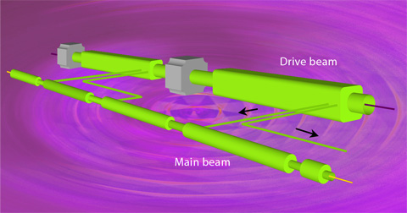
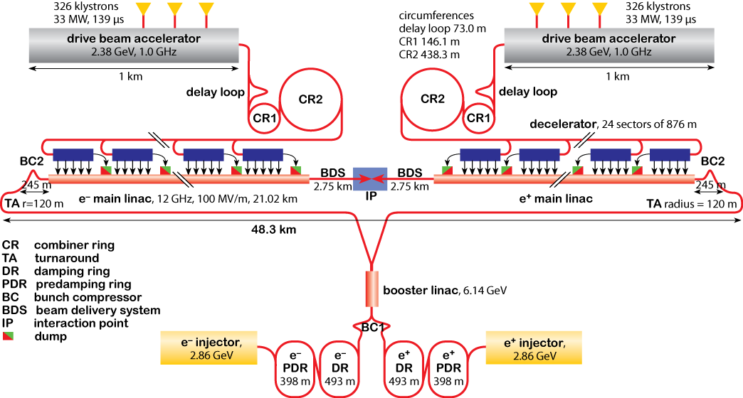
Compact LInear Collider
Novel two-beam acceleration concept
  generating high peak power at 30 GHz (now reduced to 12 GHz)
  150 MV/m
CERN centred R&D project
Proposed as 0.5-5 TeV
  optimised for 3 TeV
ITRP (2004): considered too early in R&D phase to be considered

Slide 22
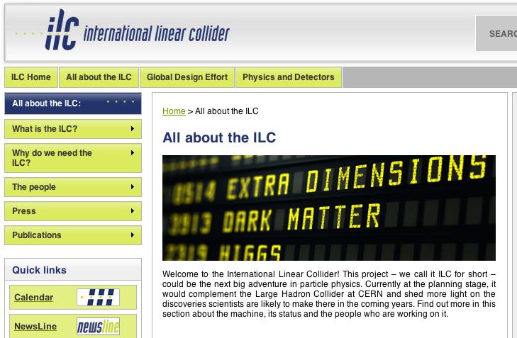
The Present

Slide 23
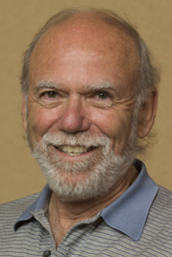
The ITRP Reloaded
“This recommendation is made with the understanding that we are recommending a technology, not a design. We expect the final design to be developed by a team drawn from the combined warm and cold linear collider communities, taking full advantage of the experience and expertise of both.”
January 2005, ICFA (ILCSC) creates the
Global Design Effort (GDE)
Barry Barish, GDE Director

Slide 24

ILC GDE: A Truly Global Effort
EU
US
No “host” laboratory!
Design team(s) remain at their home institutes
Funding via local agencies
Global coordination provide by core management team
Asia
An experiment in and of itself

Slide 25
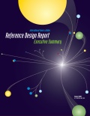
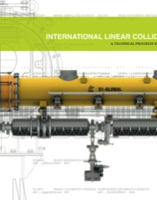
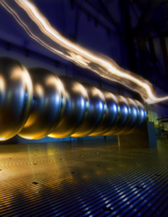
ILC (Modern) History
2001
Pre Global Design Effort
  1992 TESLA starts (TTF)
  2002 BMBF XFEL decision
  2004 ITRP decision
  2009 XFEL construction begins
Since 2005: GDE
  2005-2007 Reference Design Report and cost estimate
  2008-2012 Technical Design Phase
  end 2012 Technical Design Report
  ≥2013 Project realisation
2006
2007
2011
R&D status report
2013
ILC Technical Design Report

Slide 26
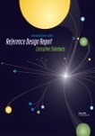

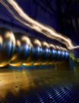
GDE Timeline
2005
2006
2007
2008
2009
2010
2011
2012
2013
2014
GDE
Reference Design Report (RDR)
Tech. Design Phase (TDP) 1
TDP 2
TDR international review
Transition to new LC org.
Beyond 2012
Formation of ILC project
Funding
Site selection
etc
LHC physics
We Are here ➨
TDR publication.
Ready for Project Submission.

Slide 27
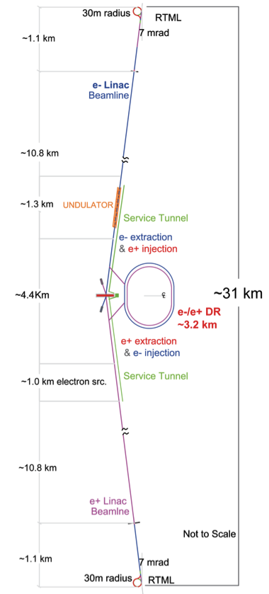
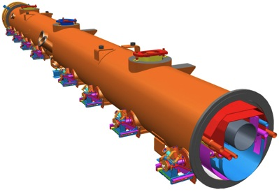
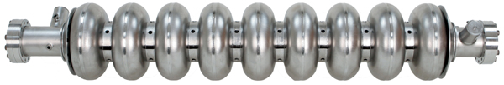
International Linear Collider
200-500 GeV E_{cm} e⁺e⁻ collider L ~2×10³⁴ cm⁻²s⁻¹
  upgrade: ~1 TeV
SCRF “TESLA” Technology
  1.3GHz SCRF with 31.5 MV/m
  ~18,000 cavities
  ~1,700 cryomodules
Developed as a truly global collaboration
  Global Design Effort – GDE
  ~130 institutes
  http://www.linearcollider.org

Slide 28
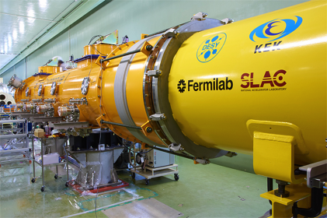
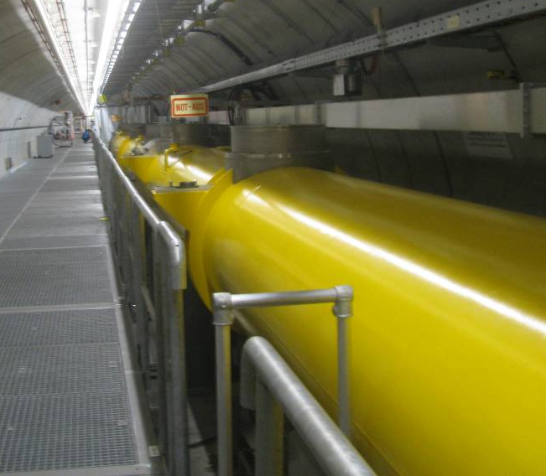
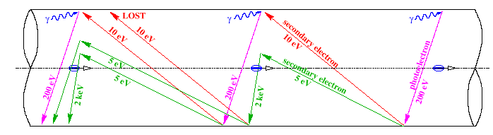
2008-2012: Risk Mitigating R&D
35 MV/m Cavity gradient
  achieving routinely (yield)
31.5 MV/m Cryomodule
  RF performance (without beam)
  cost effective development
String (integration) tests
  with beam
(Positron) Damping Ring electron cloud (EC)

Slide 29
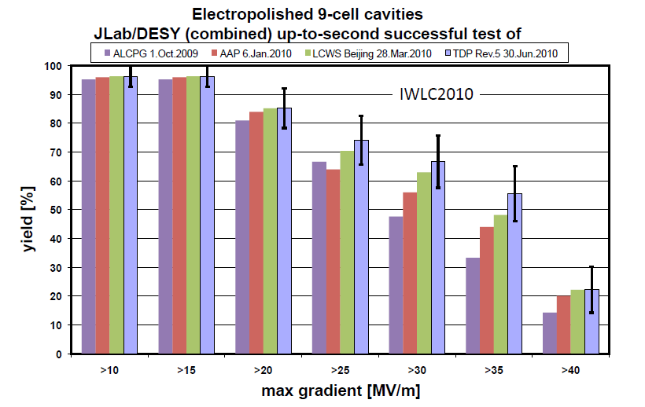
SCRF Gradient
2012 Goal
Database containing worldwide results.
Maintained by international team
“Qualified” vendors

Slide 30
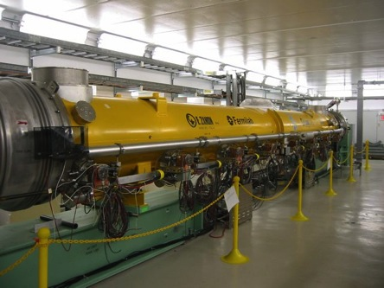
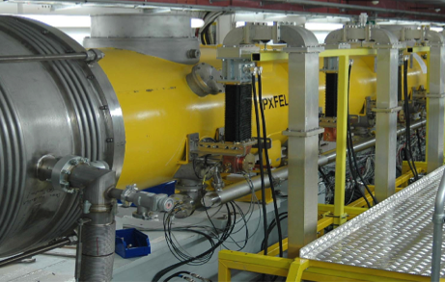
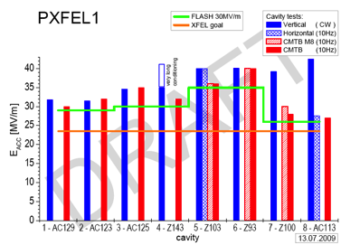
Cryomodule Development & Test
KEK: STF (S1-Global)
FNAL: NML Facility
DESY: FLASH & XFEL
  including prototype module ACC7 in FLASH (~30MV/m)

Slide 31
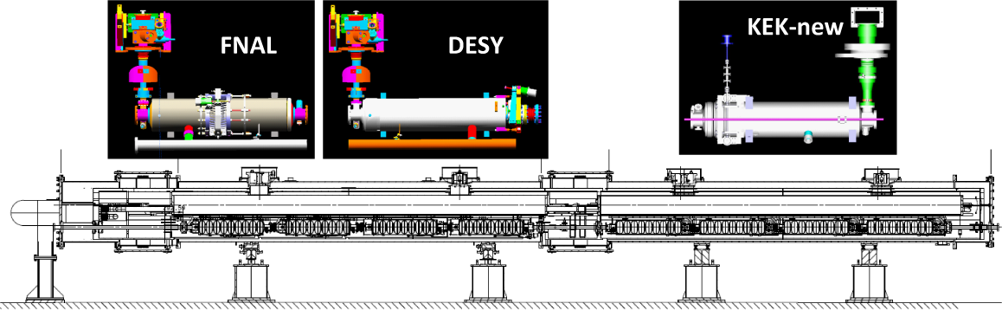
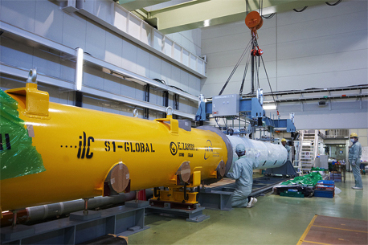

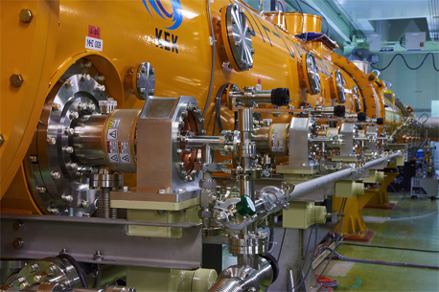
S1-Global @ KEK
S1 G

Slide 32
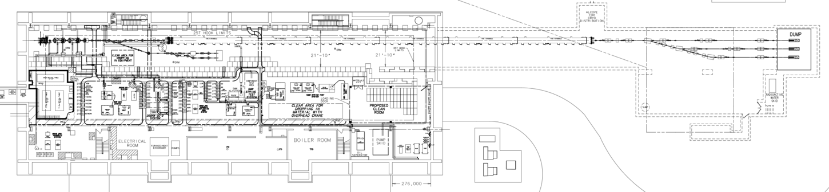
FNAL: NML Status and Expansion
Capture Cavity II operational
CM1: cold and operational
New Underground Tunnel Expansion
(Space for up to 6 Cryomodules (2 RF Units), AARD Test Beam Lines)
Civil construction complete (doubles tunnel length to 160 M)
Phase 1 NML Building

Slide 33
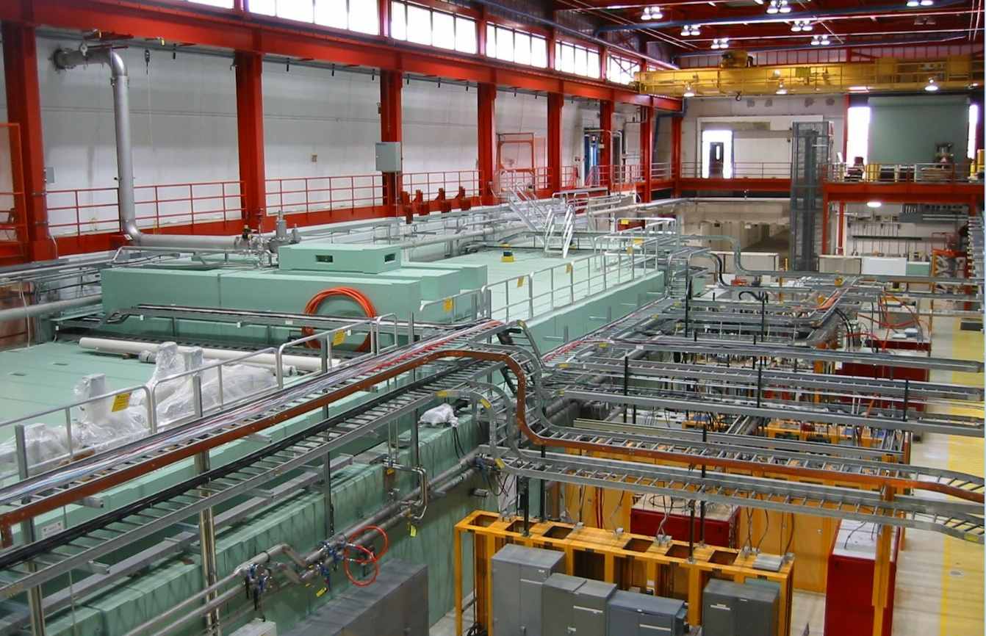
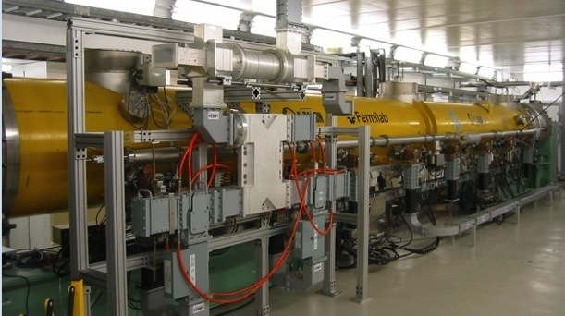
NML: RF Unit Test Facility
1st Cryomodule Cold and under test

Slide 34
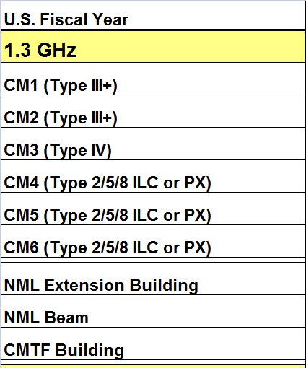
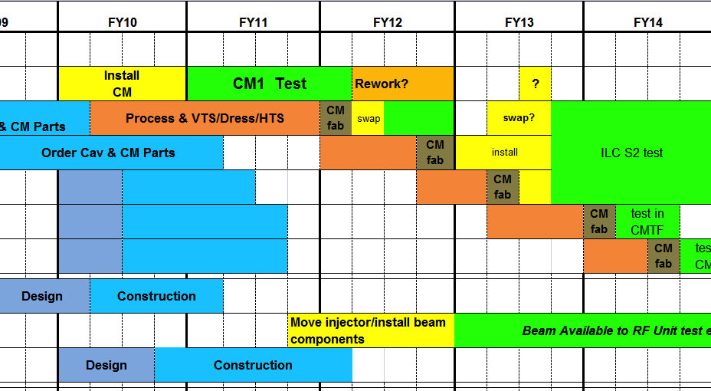
NML Systems Tests schedule

Slide 35
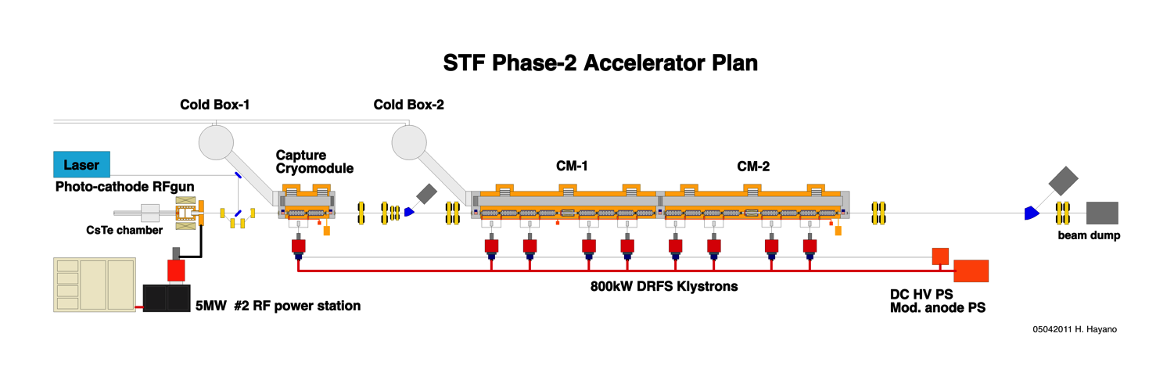
KEK STF Phase 2 development
STF phase2 demonstrate KEK-capability of ILC cryomodule construction with ILC performance.
With ILC-like beam, loaded to cavities,
To confirm LLRF performance, HOM damping, alignments together with SC-quad and BPM,
To demonstrate ILC high quality beam acceleration.
Cavity : Capture Module(2 cavities）+
CM1(8 cavities）
+CM2(8 cavities）
Beam : 1ms, 9mA, 5Hz
RF-gun exit: 4.7MeV
Capture Module exit :21MeV,
CM1 exit：273MeV
CM2 exit：525MeV
RF-gun operation： 41.4MV/m (3.5MW input power）
Cavity operation : Capture Module : 15.2MV/m
CM1 : 31.5MV/m
CM2 : 31.5MV/m

Slide 36
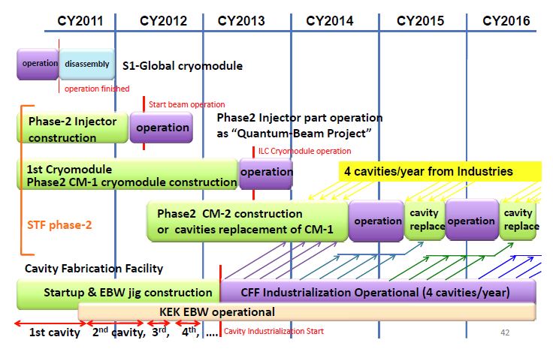
KEK System Tests

Slide 37
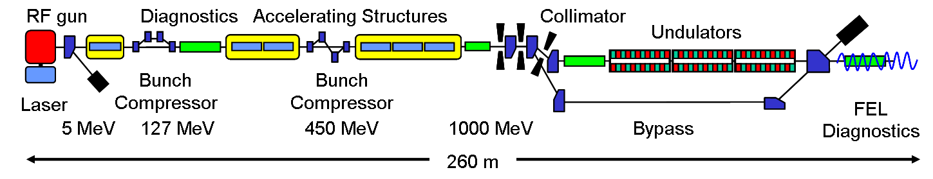


TTF/FLASH at DESY
TTF/FLASH: currently a unique facility world-wide
 |  | XFEL | ILC | FLASH design | FLASH experiment
Bunch charge | nC | 1 | 3.2 | 1 | 3
# bunches |  | 3250* | 2625 | 7200* | 2400
Pulse length | μs | 650 | 970 | 800 | 800
Current | mA | 5 | 9 | 9 | 9

Slide 38
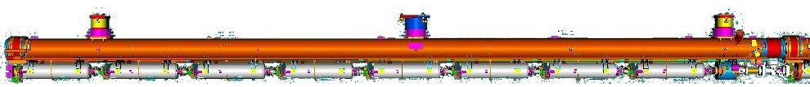





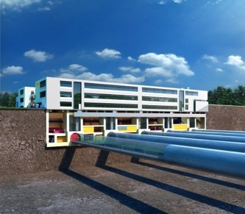
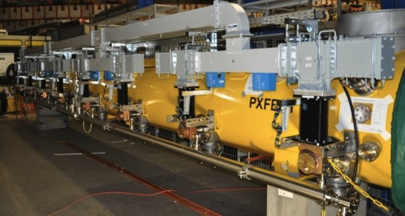
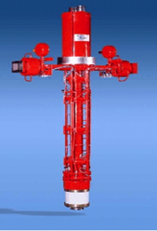
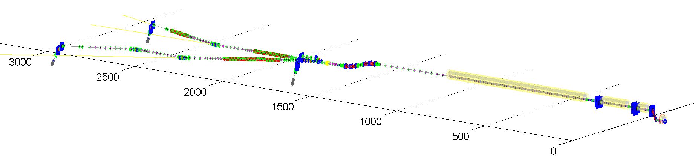

Accelerator Complex 17.5 GeV Start-up Version
100 accelerator modules
800 accelerating cavities
1.3 GHz / 23.6 MV/m
25 RF stations 5.2 MW each
ITRP: A prototype for the ILC
courtesy H. Weise

Slide 39



Global SCRF Technology
TRIUMF, Canada
◉
IHEP, China
◉
STFC
◉
FNAL, ANL
◉
Cornell
◉
◉
◉
KEK, Japan
SLAC
JLAB
LAL
Saclay
◉
DESY
◉
◉
◉
INFN Milan
◉
BARC, RRCAT India

Slide 40




Beam Test Facilities (non SCRF)
Two Large Scale Test Facilities for R&D:
  Damping Ring (ATF, CesrTA for electron cloud)
  Beam Delivery System (Final Focus) (ATF2)
● ATF/ATF-2 (KEK)
● CesrTA (Cornell)

Slide 41



Electron Cloud: CesrTA Programme
Major Reconfiguration of CESR ring
2 Year Programme
  2008-2010
Achievements
  Measured EC build-up in wigglers / arcs
  Evaluated experimentally mitigating techniques
  Developed (benchmark) models for EC-driven instabilities

Slide 42

Test facilities – ATF2

Slide 43



ATF-2 (KEK)
LBM Fringe Pattern
Shintake laser monitor (LBM)
  improved S/N
Significant progress on optics
  beam based alignment
  tuning algorithms
  optics modelling
Recovery from earth quake
σ_{y} ~ 310 nm
[goal: 38 nm]
Dispersion measurement

Slide 44
(Global) Mass Production (SCRF)
Cost Effective Mass-Production
Cavity Specs. / Yield
Plug Compatible Interfaces
Vendor Models
Production process models
In-kind contribution models
Critically important TDP2 activity
Learn from XFEL experience
  5% ILC
Learn from LHC experience
  cryomodule assembly and test studies
Develop realistic models on which to base cost estimate
  With industry

Slide 45

The ILC Baseline Design
Post-RDR Design Studies
Cost Constraint
  ‘Global’ Value Engineering
Towards an agreed-upon baseline for the TDR
  Top-Level Change Control Process
  (TLCC)
  Communication with stakeholders (e.g. Physics & Detector groups)
2008 RDR
2013 TDR

Slide 46
2008 RDR to 2013 TDR
SCRF Gradient
  31.5 MV/m average
  Support for ±20% gradient spread → higher yield
Beam power
  Reduced n_{b} by factor 2 (2625→1312)
  Smaller damping ring (6.4→3.2 km)
  Reduced RF power (klystrons & modulators)
  Lumi recovered by pushing beam-beam
Removal of 20km of main linac service tunnel
  Resulted in two new RF power generation concepts.
Consolidation of all injectors into ‘central region’
  undulator-based e+ source returns to the end of the linac

Slide 47




Single Tunnel Options (RF power)
Distributed RF Sources (DRFS)
  800 kW MAK
  Everything in tunnel
Klystron Cluster Scheme (KCS)
  Surface clusters of klystrons (2×32 MBK)
  RF power distributed via over-moded waveguide (350 MW)
    ±1 km
RDR HLRF Technology
  e.g. XFEL-like solution
  (pulsed cables)
  Back-up (risk-mitigation)

Slide 48


Preparing for the TDR
2007
2011
2013*
TDR Part I:
R&D
~250 pages
ILC Technical Progress Report
(“interim report”)
TDR Part II:
Baseline
Reference
Report
~300 pages
Technical Design Report
Reference Design Report
* end of 2012 – formal publication early 2013

Slide 49




The Future
未来へようこそ

Slide 50

The ILC Roadmap
?
From a White Paper on the Comprehensive Project Design Guidance (CPDG) for the International Linear Collider, prepared by a sub-group of ICFA , ILCSC and GDE.

Slide 51
The Status
ILC is technically ready and the design is mature
Pre-construction engineering and design phase requires significant funding
  not likely to happen before project approval
The need to maintain worldwide GDE ‘core competency’
  Post-TDR R&D plans (reduced worldwide funding)
  System tests (STF2, NML, TTF/FLASH)
  Ultra-high gradient and high Q₀ R&D
Finding a host…

Slide 52







CFS Study: Progress in Japan

Slide 53
CFS Study: Progress in Japan
JFY | Progress
2009 | AAA volunteered to study ‘ILC tunnel design’ for SB2009,
2010 | Local communities (LCs) organized geological survey by themselves. KEK studied 8 cases of the tunnel design, and reached a ‘Bread-shape (Kamaboko) shape tunnel’ to be an economical candidate, specifically, in Japanese mountainous regions.
2011 | AAA re-volunteered to evaluate the tunnel design and environmental conditions, to assist KEK. LCs reported the geological survey to KEK. KEK going to progress the engineering work of tunneling, electrical, and mechanical issues, based on the information given by AAA and LCs, Japanese Civil Engineer Association is active to professionally assess the geological surveys and civil engineering. S&T Policy Council of the Cabinet received a brief report from MEXT on Sept. 1, on science objectives of the ILC project and global status. A Supplemental Budget being discussed at the Diet to encourage/boost recovery of national and regional activities. It may include some support for further site-dependent geological studies at the candidate sites in cooperation of KEK with the local communities (universities, and local Gov.)

Slide 54


Council for Science and Technology Policy
ILC science objectives and global status was reported to the Japanese Government Council from MEXT, Sept. 1
http://www8.cao.go.jp/cstp/gaiyo/yusikisha/20110901/siryobun-2.pdf

Slide 55



Introduction and Status Report
(Sept. 1, 2011)
What is ILC & objectives
Activities in two regional candidates, and in political parties
Technical status in JP, EU, and US

Slide 56
Other Regions
US (Americas)
  Now centred completely at Fermilab
  Current (political) situation not favourable for large investment in LC on-shore project
    Fermilab focusing on ‘intensity frontier’ and Project-X
  Scope of possible off-shore contribution being discussed
    1/3 SCRF linac as possible in-kind contribution
EUROPE (aka CERN)
  Has stated firm interest to host the LC
    CLIC or ILC
  Dominated by LHC until at least 2020
  Note European LC funding likely via C.E.R.N.
  Primary LC resources directed at CLIC
ASIA (Japan) best short-term opportunity for ILC

Slide 57
Compact LInear Collider
8 years after ITRP
Significant progress (CTF3)
CERN centred R&D project
Feasibility / proof-of-principle
Many years of R&D still remain (my opinion)
Cost and Power Consumption issues
  true also for ILC

Slide 58

S. Stapnes, LCWS 9.11

Slide 59


S. Stapnes, LCWS 9.11

Slide 60


TeV and Beyond
Volts cost money: more volts, more money
  Linac capital costs which scale as E_{cm}
P=V×I requires MWatt
  We need to be more ‘green’ aware
  CLIC @ 3 TeV 580 – 700 MW !
  ILC 1 TeV option: limited to 300 MW
    management decision

Slide 61


AC Power (RDR Linac)
RF Power Generation
(Modulator, klystron, Waveguide distribution)
Wall Plug
P_{beam} = V_{acc} ×I_{beam} ≈ 20 MW
20 MW
P_{RF} ≈ 32 MW
η ≈ 44%
P_{AC(RF)} ≈ 76 MW
132 MW
+56 MW to remove (cool)
Notes:
Slide will get animated to make clear.

Slide 62

Getting a 6-8 B$ Science Project
LHC results
  Next year we will know about the SM Higgs
  Sets the possible energy range for an LC
Solid physics case
  Global consensus required (mandatory) !
  2003: 2,700 physicists signed Understanding Matter, Energy, Space and Time: The Case for the Linear Collider
Outreach
  To other science disciplines
  To funding agencies and decision makers
  To the general public
Remain resolute and determined
  Still a long road ahead
Sell Your Science!

Slide 63
The Beginning - Revisited
A Possible Apparatus for Electron-Clashing Experiments (*).
M. Tigner
Laboratory of Nuclear Studies. Cornell University - Ithaca, N.Y.
M. Tigner,
Nuovo Cimento 37 (1965) 1228
2015 will be the 50th anniversary of the linear collider
What better way to celebrate than by getting the ILC approved ☺
日本であなたを参照してください。

Slide 64


