Slide 1
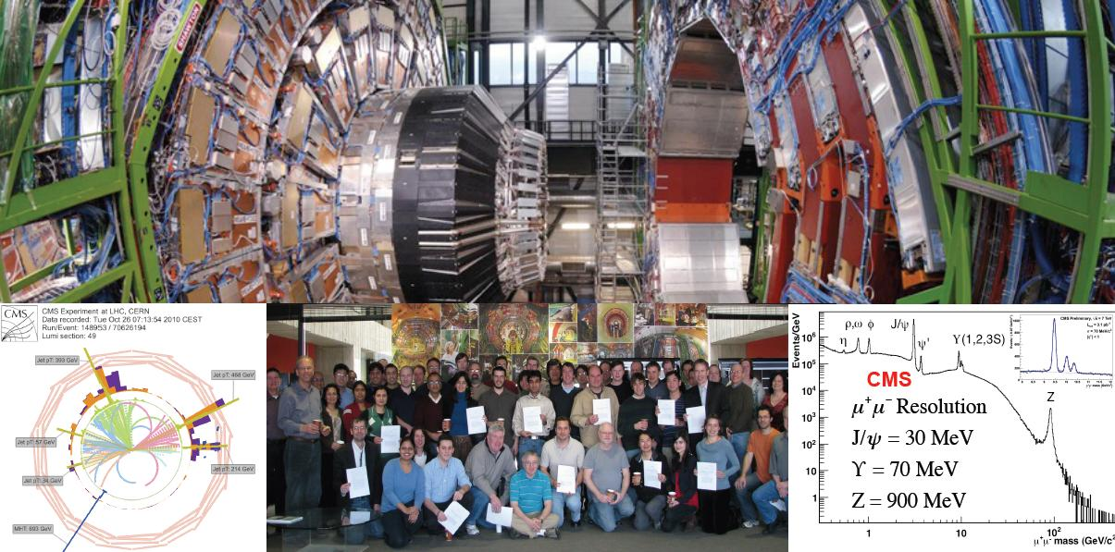
DESY
Physics Seminar
Latest results from CMS and the Impact of the Fermilab LHC Physics Center.
Ian Shipsey (Purdue)
Tuesday, 14 June 2011, 16:00 h
DESY Auditorium, Hamburg
The successful 2010 proton-proton LHC run has allowed ATLAS and CMS to complete the commissioning of the detectors and to perform early measurements of key standard model processes involving jets, photons, onia, beauty, W, Z and top, and to make initial searches for physics beyond the standard model including non-SM Higgs, supersymmetry, large extra dimensions and black holes. Physics measurements from the 2010 CMS data and early results from the 2011 run will be presented. The success of the early LHC physics program, achieved so quickly after startup, is the result of a globally distributed scientific effort of unprecedented scale, suggesting a new paradigm in scientific collaboration; one in which significant numbers of scientists are no longer co-located at the host lab. The efficacy of a remote regional center, of which the LHC Physics Center at FNAL is an example, will be discussed in the context of early CMS results.
Coffee, tea and cookies will be served at 15:45 h.
After the seminar there is a chance for private discussions with the speaker over
soft drinks and pretzels
Accelerators | Photon Science | Particle Physics
Deutsches Elektronen-Synchrotron
A Research Centre of the Helmholtz Association
Notes:
1
1

