Slide 1
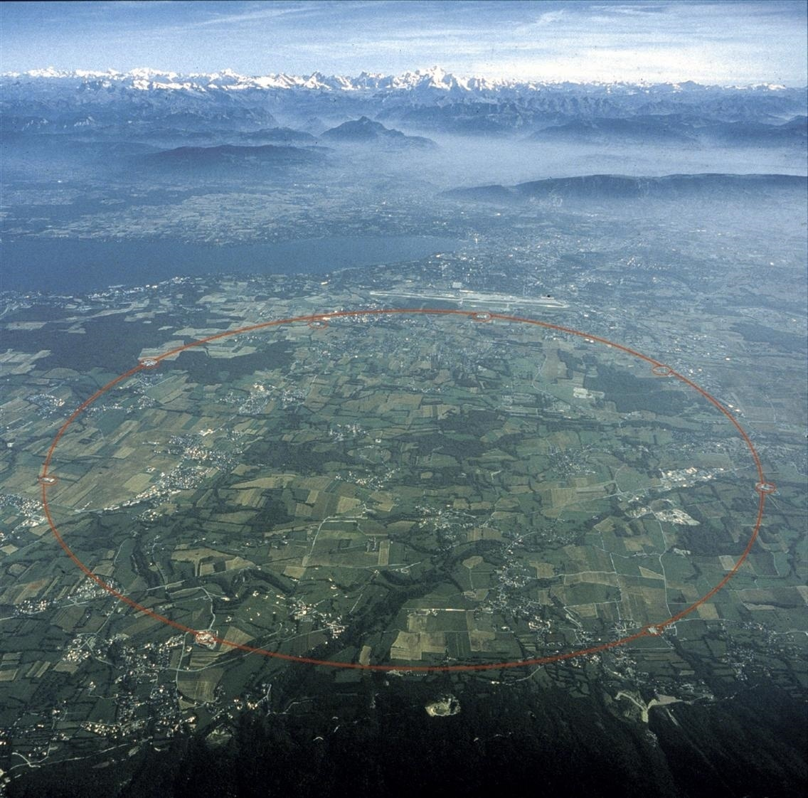
Searching for SUSY
at the LHC
Kolloquium Freiburg
June 2011
Sascha Caron (Freiburg)

Slide 2
Outline
Beyond the Standard Model ?
The first ATLAS (CMS) SUSY results
What have we learned ?
A Summary

Slide 3
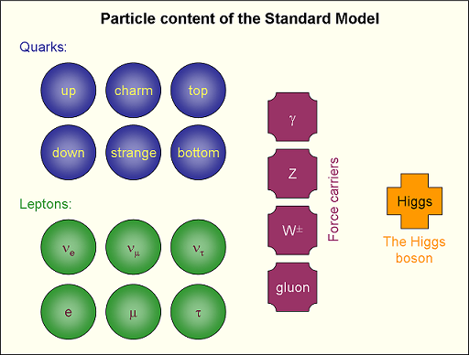
The Standard Model of Particle Physics
Is this picture
correct?
What is this object ?
Important, but not
part of this talk
(soon enough data!)

Slide 4
The Standard Model: Is this it ?
Dark Matter / Dark Energy is not explained by the Standard Model
Higgs mass suffers from unnatural fine-tuning due to quadratic quantum corrections
(hierarchy or fine-tuning problem)
Why 3 (or 4) forces ?
Why 3 families ?
Why different fermion masses? ….
Many other open questions
(Gravity not included, where is the antimatter?,…)
Some of these questions might be solved (or better understood) with LHC data
Candidate Nr. 1 : Supersymmetry
Most studied theory model + high LHC cross section ➔ big impact

Slide 5
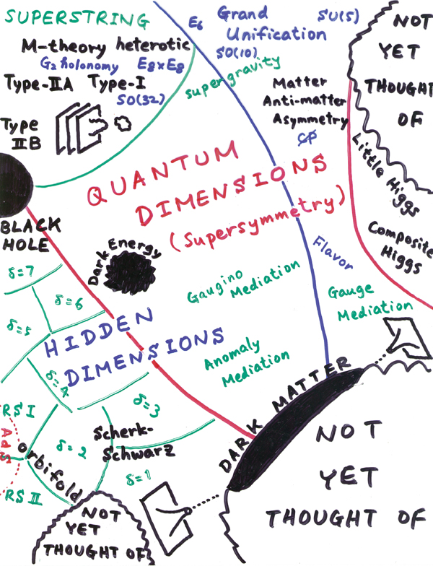
The situation in 2011
What do we expect to find at the LHC?
Today we
concentrate on
this area, i.e.
low energy SUSY
One physicist's schematic view of particle physics in the 21st century
(Courtesy of Hitoshi Murayama)

Slide 6
Candidate Nr. 1 : Supersymmetry
SUPERSYMMETRY (SUSY) is an extension of the
Standard Model with a new symmetry between
half-integer spin fermions and integer spin bosons
New SUSY “shadow” particles predicted:
- SUSY particles are not always the mass eigenstates (mixing)
- The Higgs sector is modified/extended with SUSY
No SUSY particles with the mass of the SM particles
➔ SUSY is a broken symmetry
A new Quantum Number (R-parity) is added which forbids strong proton decay (Baryon and Lepton number violation)

Slide 7
Candidate Nr. 1 : SUSY
Most studied new physics theory for several reasons :
“Easier QFT”: Fermion and Boson loops protect the Higgs mass at large energies (reduces “fine tuning”) if SUSY mass scale is not too large (LHC)!
SUSY is a broken symmetry and thus offers (with
R-parity conservation) weakly interacting massive particles for Dark Matter with a mass of O(100) GeV
- unification of 3 coupling constants at high energy in one point
(GUT scale at 10¹⁶ GeV?), SUSY breaking connected to electroweak
symmetry breaking ?

Slide 8
Candidate Nr. 1 : SUSY
Most studied new physics theory for several reasons :
“Easier QFT”: Fermion and Boson loops protect the Higgs mass at large energies (reduces “fine tuning”) if SUSY mass scale is not too large (LHC)!
SUSY is a broken symmetry and thus offers (with
R-parity conservation) weakly interacting massive particles for Dark Matter with a mass of O(100) GeV
- unification of 3 coupling constants at high energy in one point
(GUT scale at 10¹⁶ GeV?), SUSY breaking connected to electroweak
symmetry breaking ?
Important drawback:
SUSY has not been found yet
➔ some (small) fine tuning needed already in the model!

Slide 9
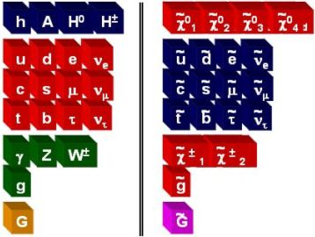
SUSY particles (MSSM)
MSSM particle Zoo
Models of SUSY breaking
>100 parameters
in MSSM
Sub-models with
Less parameter:
mSUGRA
GMSB
AMSB
etc.
SUSY
breaking
mechanisms
generate
masses
The new colored particles are produced with a high rate by the strong force

Slide 10
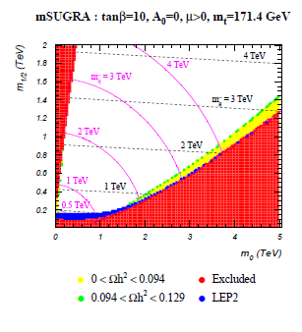
SUSY or mSUGRA / CMSSM
Most studied scenario is the 5 parameter mSUGRA model
M₀: common boson mass at GUT scale
M_{1/2}: common fermion mass at GUT scale
tan β: ratio of higgs vacuum expectation values
A₀: common GUT trilinear coupling
μ : sign of Higgs potential parameter
Most points give too much Dark Matter !
Large DM (LSP) annihilation cross section
required by DM constraints
Huge restriction of parameter space
in restrictive models
But if we are not in this restrictive model:
No stringent constraint on allowed
masses
+ we do not know exact susy breaking
A-Funnel region at
large tan beta

Slide 11
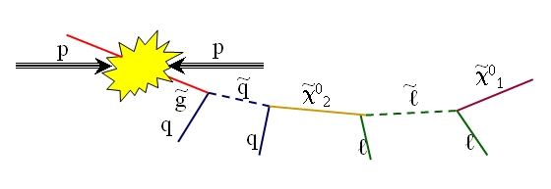
SUSY and the LHC : Signal
If R-Parity is conserved then SUSY particles are
pair produced
LHC:
Due to strong force dominant
production of squarks and gluinos (if not too heavy)
Cascade decay to lighter SUSY particles
and finally the lightest SUSY particle (LSP)
LSP
Mass pattern in general SUSY unknown ! Searches need to be quite general and
model-parameter-independent
Similar conclusions /channels
For many other models
( Universal Extra Dimension,
ADD, Little Higgs, ….)

Slide 12
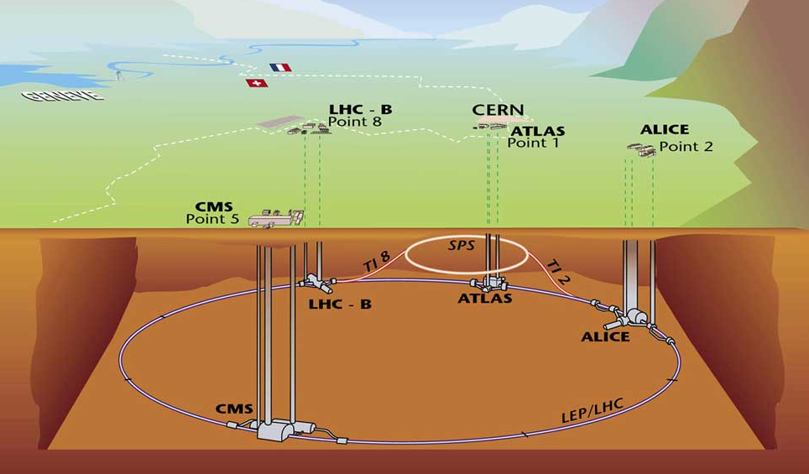
LHC is a proton-proton (and lead nuclei) collider with design centre-of-mass energy of 14 TeV and an instantaneous luminosity of 10³⁴ cm⁻²s⁻¹
The LHC is operating 2010-2012 at 7 TeV centre-of-mass energy
and delivering an integrated luminosity of about 50 pb⁻¹ in 2010
and > 1100 pb⁻¹ in 2011 (delivered per experiment so far) with a peak luminosity of about 1.25 10³³ cm⁻²s⁻¹
Notes:
Quench protection system, valves to get rid of pressure

Slide 13
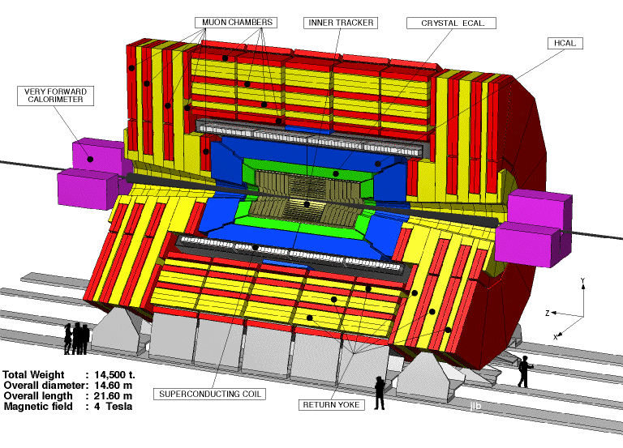
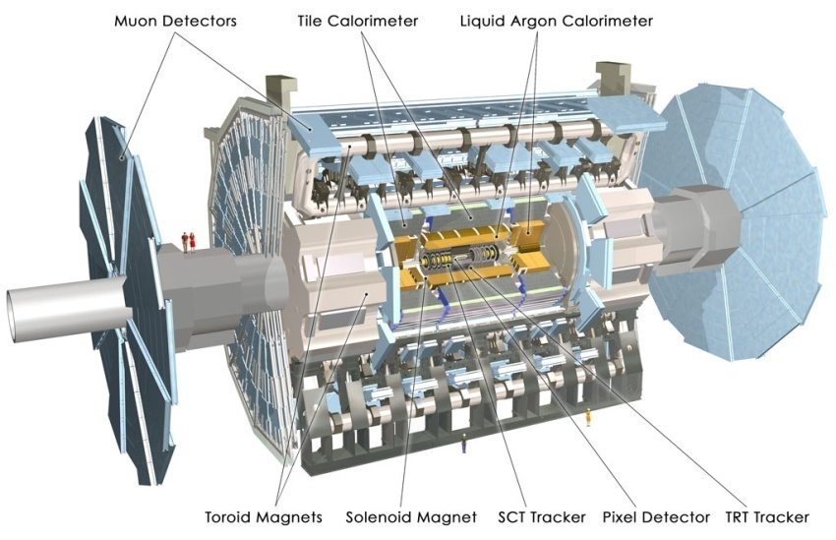
CMS and ATLAS
15*21 m
14500 tons
25*44 m
7000 tons
Huge silicon detector (pixel and strips)
4 Tesla solenoid
Crystal EM calorimeter:σ(E)/E~3%/√E + 0.003
Brass and scintillator had. Calorimeter:
σ(E)/E ~100%/√E + 0.05
Muon Chambers: σ(p)/p <10% at 1TeV
Level 1 + higher level trigger
Silicon detector (pixel and strips)
and Transition Radiation Tracker (TRT)
2 Tesla solenoid + barrel and endcap toroid
Em. calorimeter (PB+Lar) :σ(E)/E~10%/√E+0.007
Hadronic calorimeter (Iron Tile + Scint.,
Cu +Lar): σ(E)/E~50%/√E+0.03
Muon Chambers (Drift Tubes): σ(p)/p <10% at 1TeV
3 level trigger system
Resolutions might be
measured in different
experimental environments
Both detectors operational at high efficiency

Slide 14
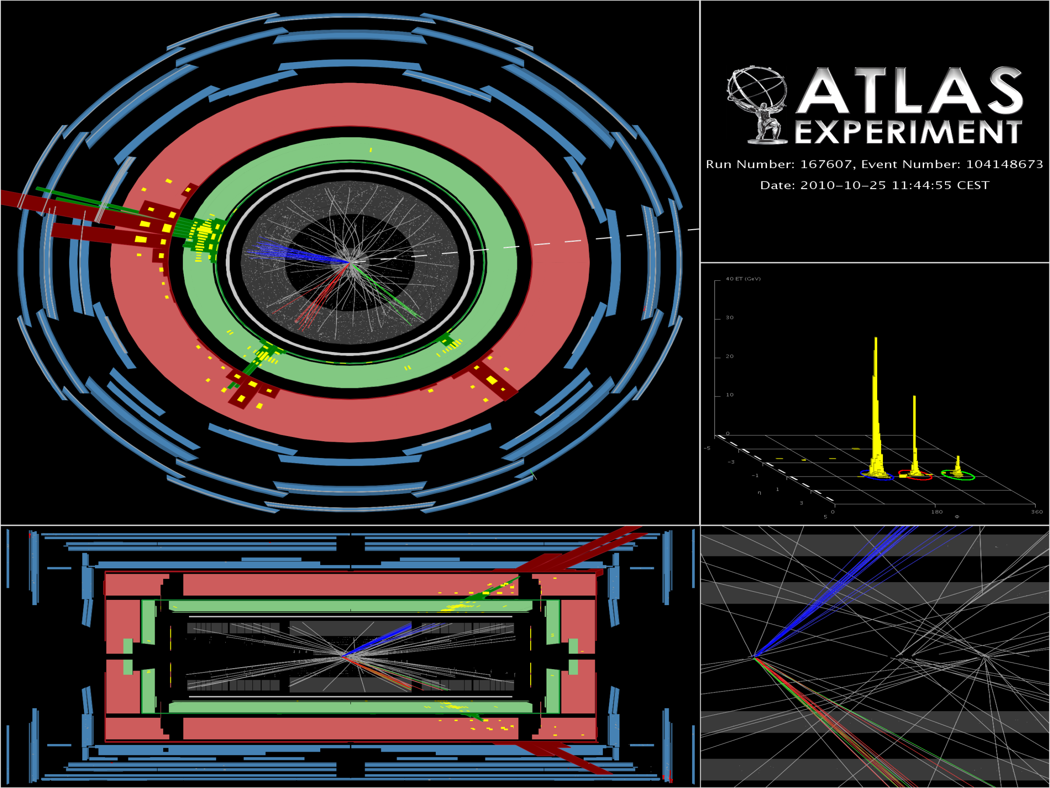
MET and event display
Event
found in signal region
of jet+ E_{t}^{miss}
Analysis
in 2010 data
3 jets with p_{T} of approximately 400 GeV, 120 GeV, 60 GeV and E_{t}^{miss} of approximately 420 GeV

Slide 15
Searches presented today
Supersymmetry:
Jets + lepton + E_{t}^{miss} (2010 data published PRL, 2011 prelim.)
Jets + E_{t}^{miss} (2010 data published PLB, 2011 prelim.)
Jets + b-tag + E_{t}^{miss} (accepted)
Dilepton + E_{t}^{miss} (accepted)
e mu (accepted)
Slow Moving Particle (accepted)
… other channels in preparation
Exotics:
1st and 2nd generation Leptoquarks
High mass dilepton resonances and contact interactions
Dijet resonances
W’ …
Higgs:
SM Higgs limits
Accepted/
Published
ATLAS
results
with 2010
luminosity
Similar list of channels
studied in CMS
This talk concentrates on ATLAS
results, CMS shown for comparison

Slide 16
Analysis model - signal
Signal region
Predict to see new physics at :
Large mass scale (masses beyond tevatron reach)
Large missing transverse momentum (neutralinos!)
Signal region
(QCD, W, Z, top)

Slide 17
Analysis model - signal
Signal region
Predict to see new physics at :
Large mass scale (masses beyond tevatron reach)
Large missing transverse momentum (neutralinos!)
Background can be determined
via Monte Carlo simulation
of physics processes and
a detailed detector simulation
However the simulation needs
to be validated
Signal region
(QCD, W, Z, top)

Slide 18
Analysis model - background
Signal region
Predict to see new physics at :
Large mass scale (masses beyond tevatron reach)
Large missing transverse momentum (neutralinos!)
Before cuts
(σ scales exp. with box size)
Signal region
(QCD, W, Z, top)
QCD
Background
σ>1000000 pb +
mainly fake E_{t}^{miss}
due to mismeasurement
W + jets background
σ≈10400*3 pb
(real E_{t}^{miss} )
Top pair production
σ≈160 pb
(real E_{t}^{miss})
Z ➔ neutrinos is irreducible
σ≈1070*6 pb
(real E_{t}^{miss})

Slide 19
Analysis model - background
Signal region
Predict to see new physics at :
Large mass scale (masses beyond tevatron reach)
Large missing transverse momentum (neutralinos!)
After cuts
(background
size scales with
box size linearly)
Signal region
(QCD, W, Z, top)
QCD
Background
σ>1000000 pb +
mainly fake E_{t}^{miss}
due to mismeasurement
W + jets background
σ≈10400*3 pb
(real E_{t}^{miss} )
Top pair production
σ≈160 pb
(real E_{t}^{miss})
Z ➔ neutrinos is irreducible
σ≈1070*6
(real E_{t}^{miss})

Slide 20
Analysis model - control regions
Signal region
(QCD, W, Z, top)
QCD control region
W control region
Top control region
Z control region
Transfer functions
- Measure number of events in control selections
Predict number of events in signal region via a fit to control regions
Important : Test model and transfer functions
(e.g. by alternative control regions or methods)

Slide 21
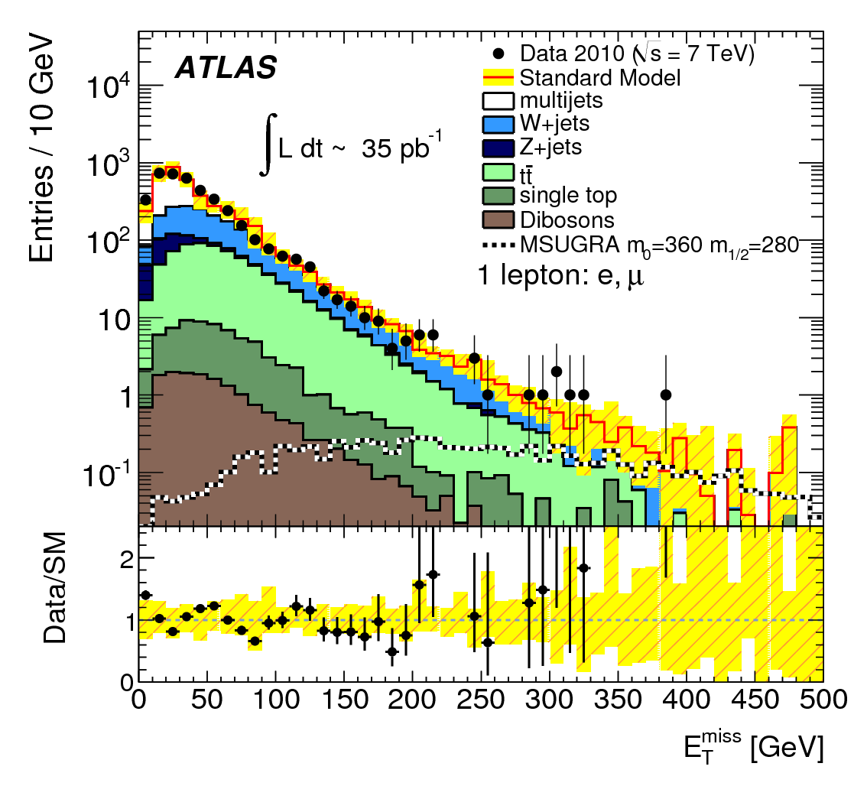
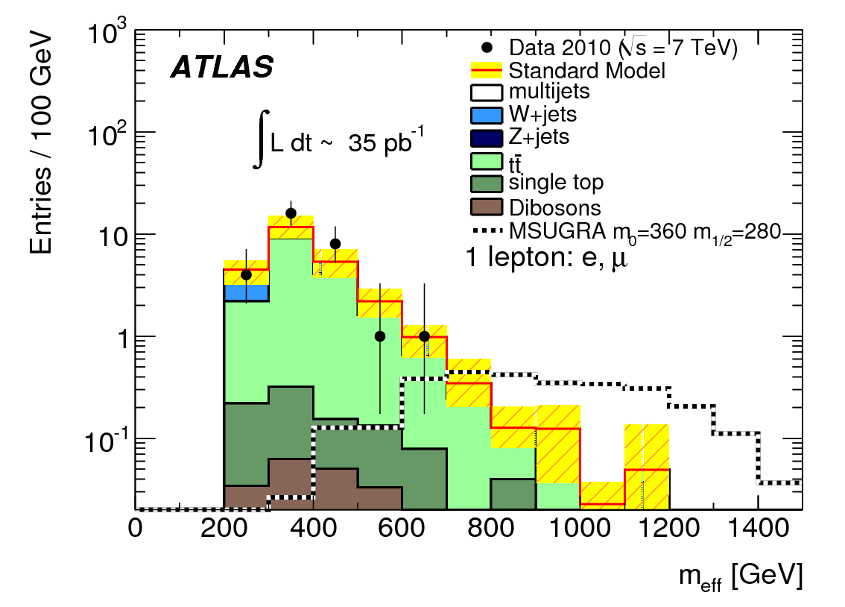
Jets + lepton + E_{t}^{miss}
Expected to be less effected by potentially “dangerous” QCD background, main background W and top pairs
Analysis cuts follow quite closely previous ATLAS MC studies (work between 2006-2009)
1 electron or muon with p_{T}>20 GeV
3 jets with p_{T}> 60,30,30 GeV
E_{t}^{miss} > 125 GeV and E_{t}^{miss} > 0.25 * M_{eff}
Transverse mass > 100 GeV
M_{eff} > 500 GeV
Definition of W and top control regions:
30< E_{t}^{miss} < 80 GeV
40< transverse mass < 80 GeV
Veto b-tag : W control region
➔Apply b-tag : top pair control regions
3

Slide 22
Jets + lepton + E_{t}^{miss}
First ATLAS SUSY paper arXiv:1102.2357

Slide 23
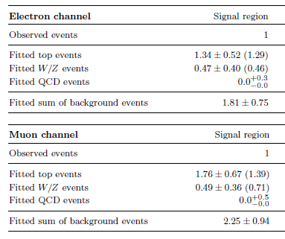
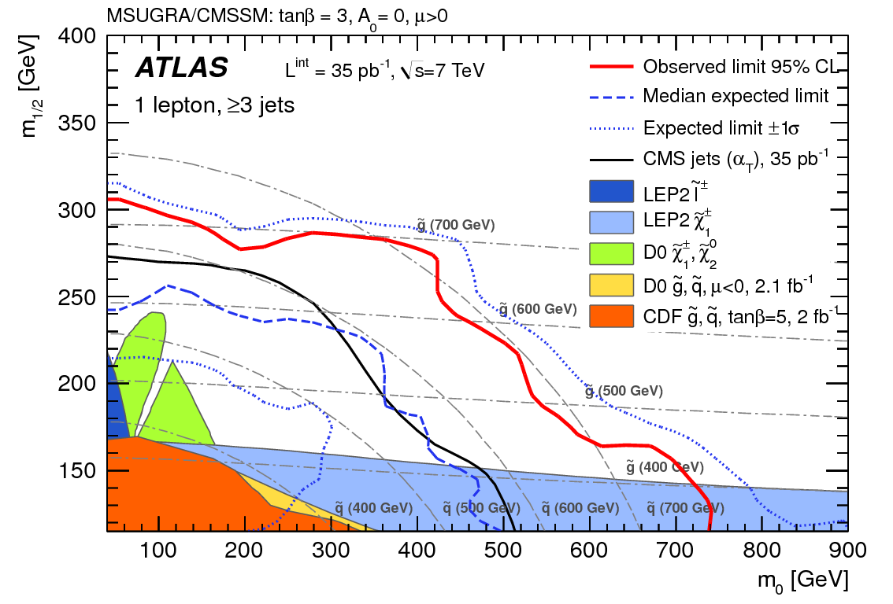
Jets + lepton + E_{t}^{miss}
Fits to control regions predict the number of Top, W and QCD events in the signal region
Several cross checks performed (e.g. tests with alternative control regions)
Profile likelihood ratio test + toys
Main result: Table and 95% CL
Limits on Cross section * Acceptance *effi.
Electron channel:
Muon channel:

Slide 24
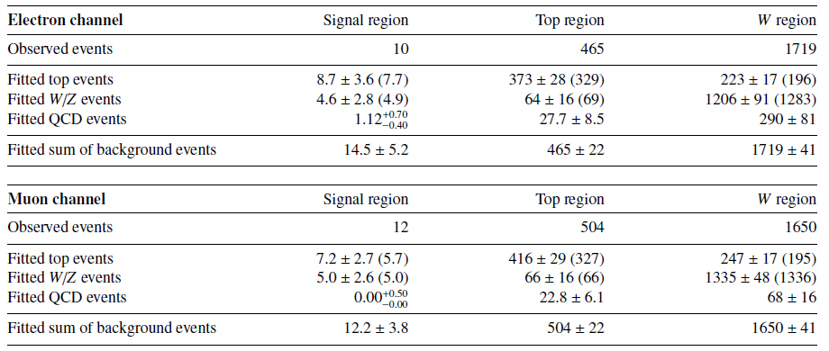
Jets + lepton + E_{t}^{miss} : 165 pb-1
Preliminary
result with 2011 data
Signal region identical to 2010 analysis:

Slide 25
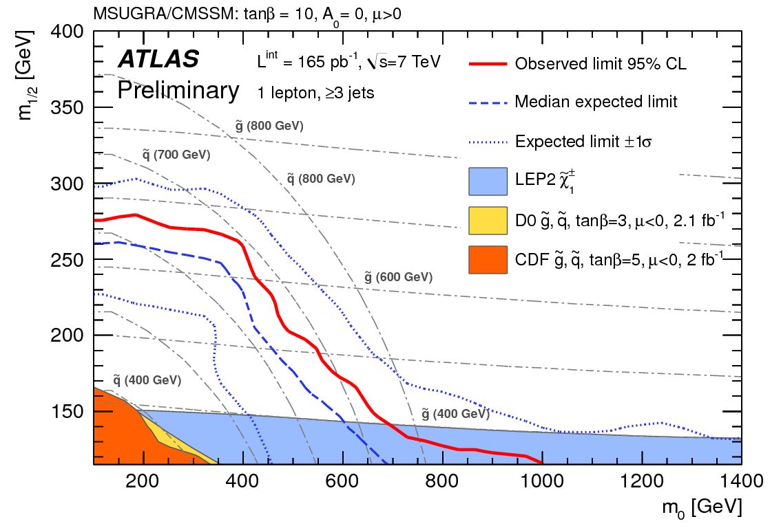
Jets + lepton + E_{t}^{miss} : 165 pb-1
Preliminary
result with 2011 data
5 times more data,
but new observed
limit is slightly
worse compared
to 2010 data

Slide 26
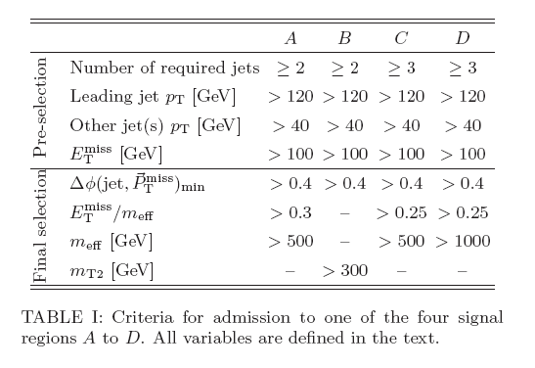
Jets + E_{t}^{miss}
The signal regions A,B,C,D are inclusive
Very simple model-independent
classification of signal regions:
Low and high mass dijets
(squarks➔ quark neutralino)
Region A and B
Low and high mass 3-jets
(associated squark/gluino
and gluino pair production):
Region C and D
Region C gluinos pairs
Region D
Squark/gluino
Region B
Region A squark pairs
Trigger efficiency close to 1 for all
signal and control regions

Slide 27
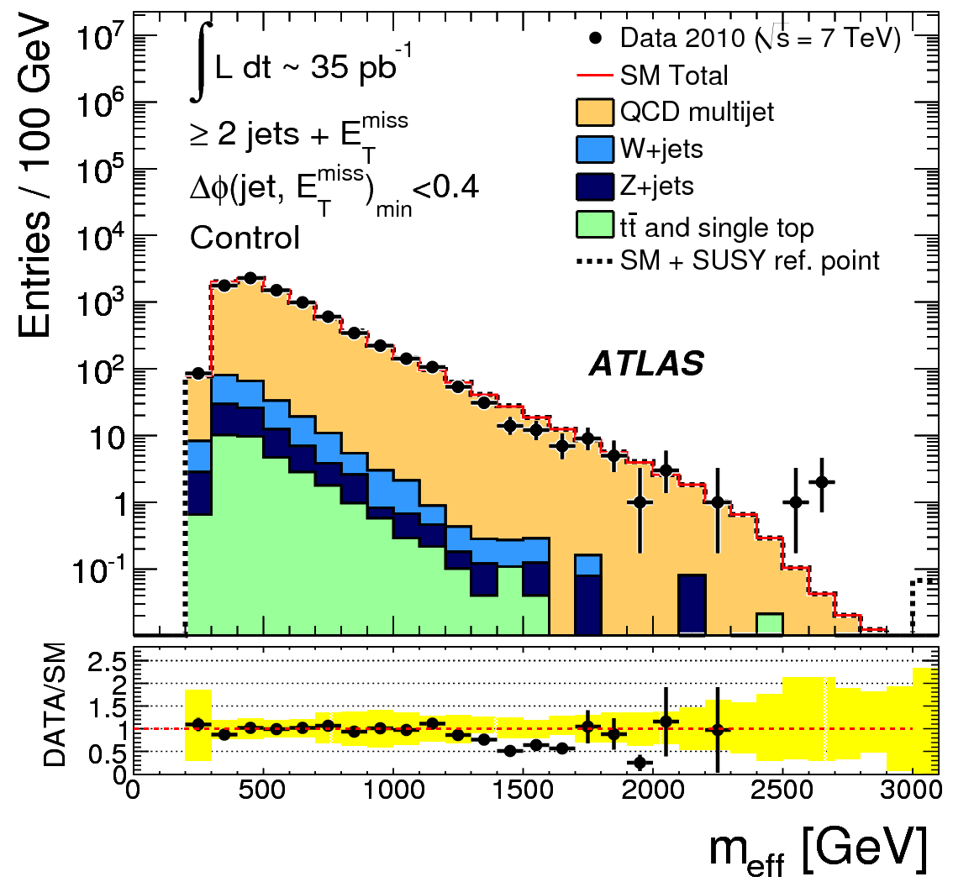
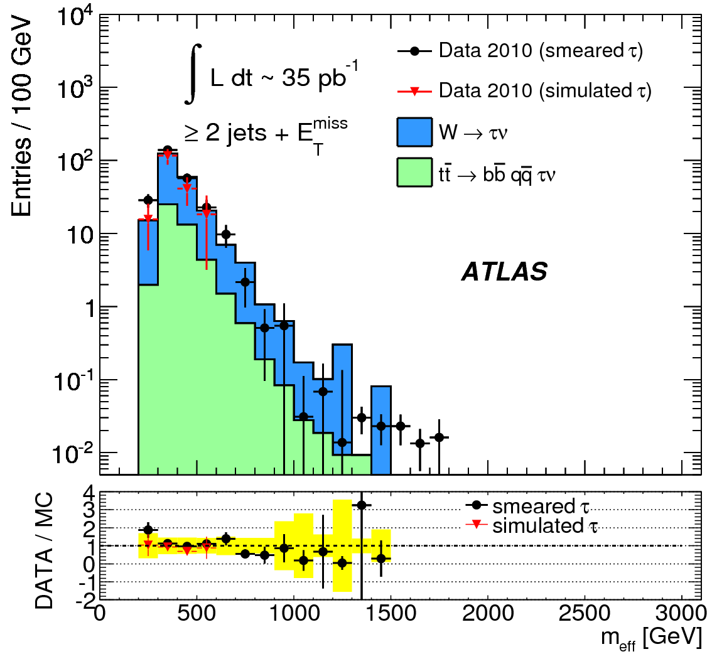
Jets + E_{t}^{miss} : Background evaluation
Main work:
Typically 2-4 control region
measurements or “data driven”
methods performed for each
background (and each signal region)
Examples:
QCD : control regions with inverted cuts e.g. δφ(jet,MET), determination without MC but smearing data with the measured detector response.
Z+ jets: Z➔μμ, Z➔ee and W control regions
W+ jets: W➔μν and W➔ev control regions, tau embedding
Top pairs: Top control regions with or without lepton, and W embedding

Slide 28
Jets + E_{t}^{miss} : Results
Signal region A, B, C, D exclude non-SM process within acceptance*effi. of
SUSY model-independent search
Interpretation: Take the signal region with the largest expected sensitivity
Show reach of the search for 2 examples

Slide 29
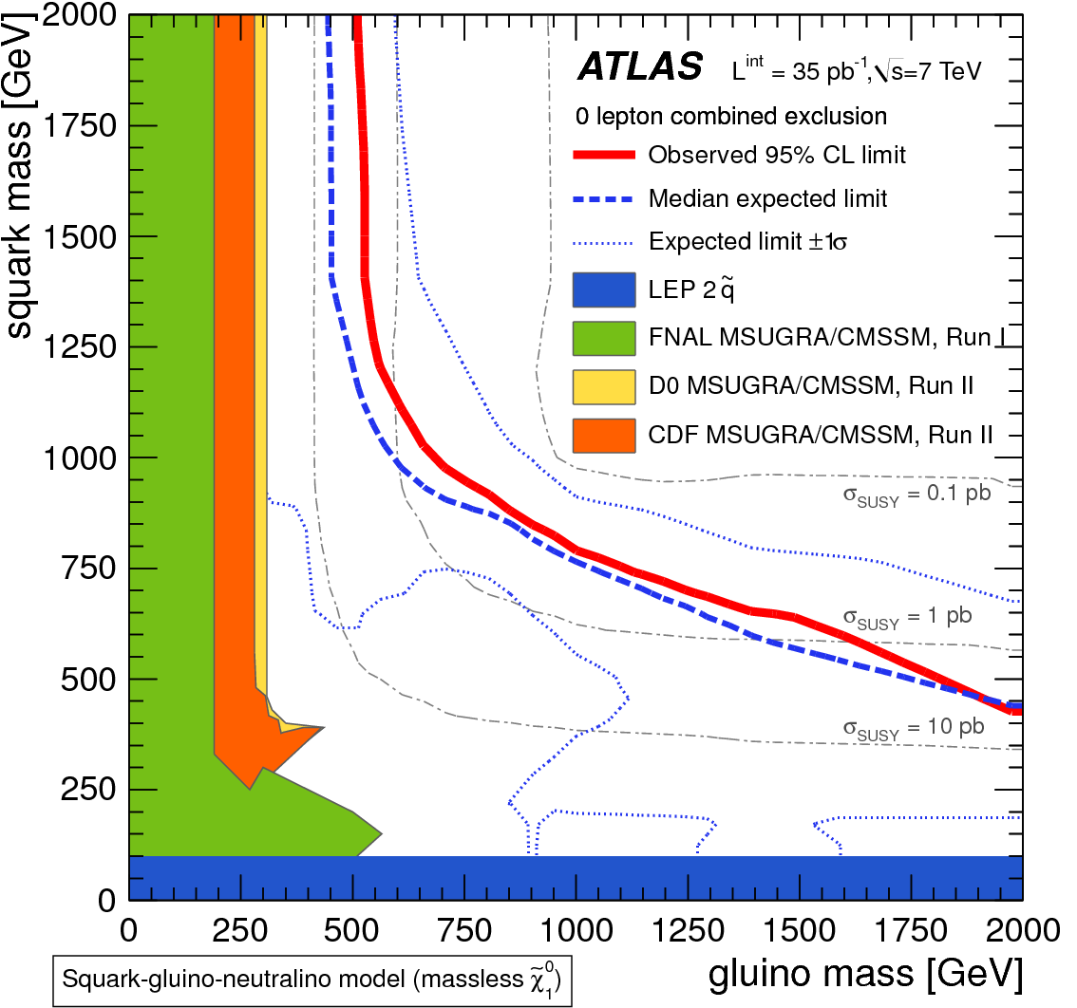
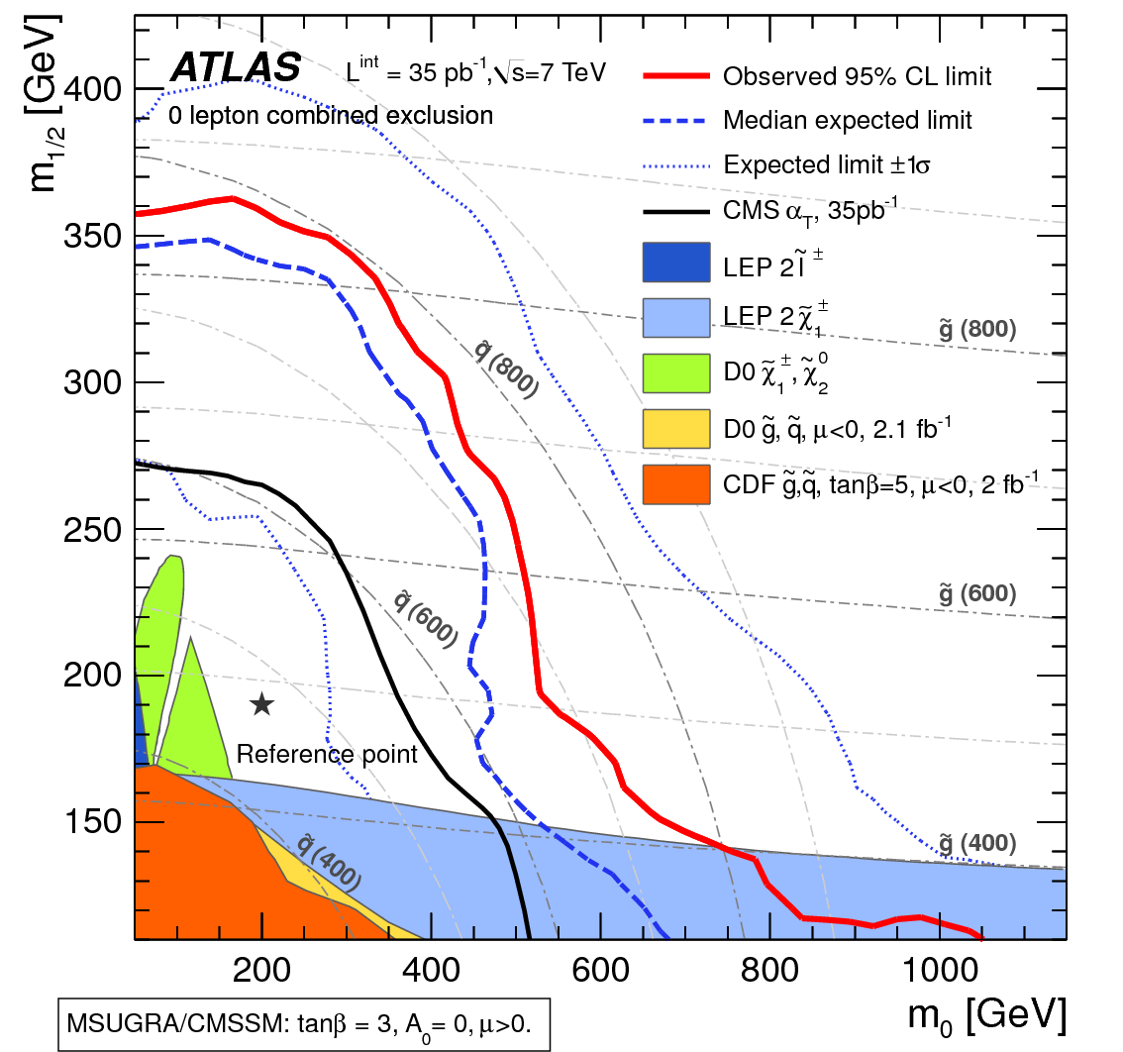
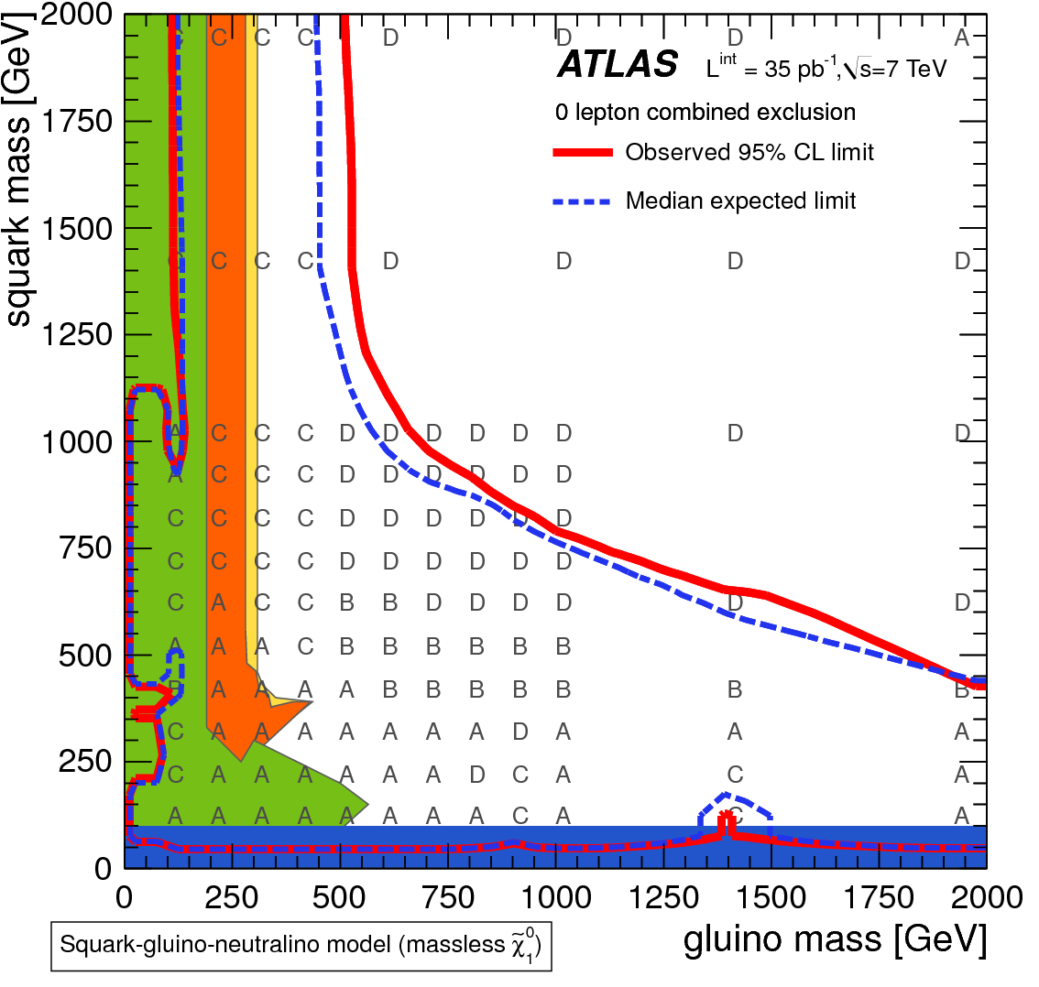
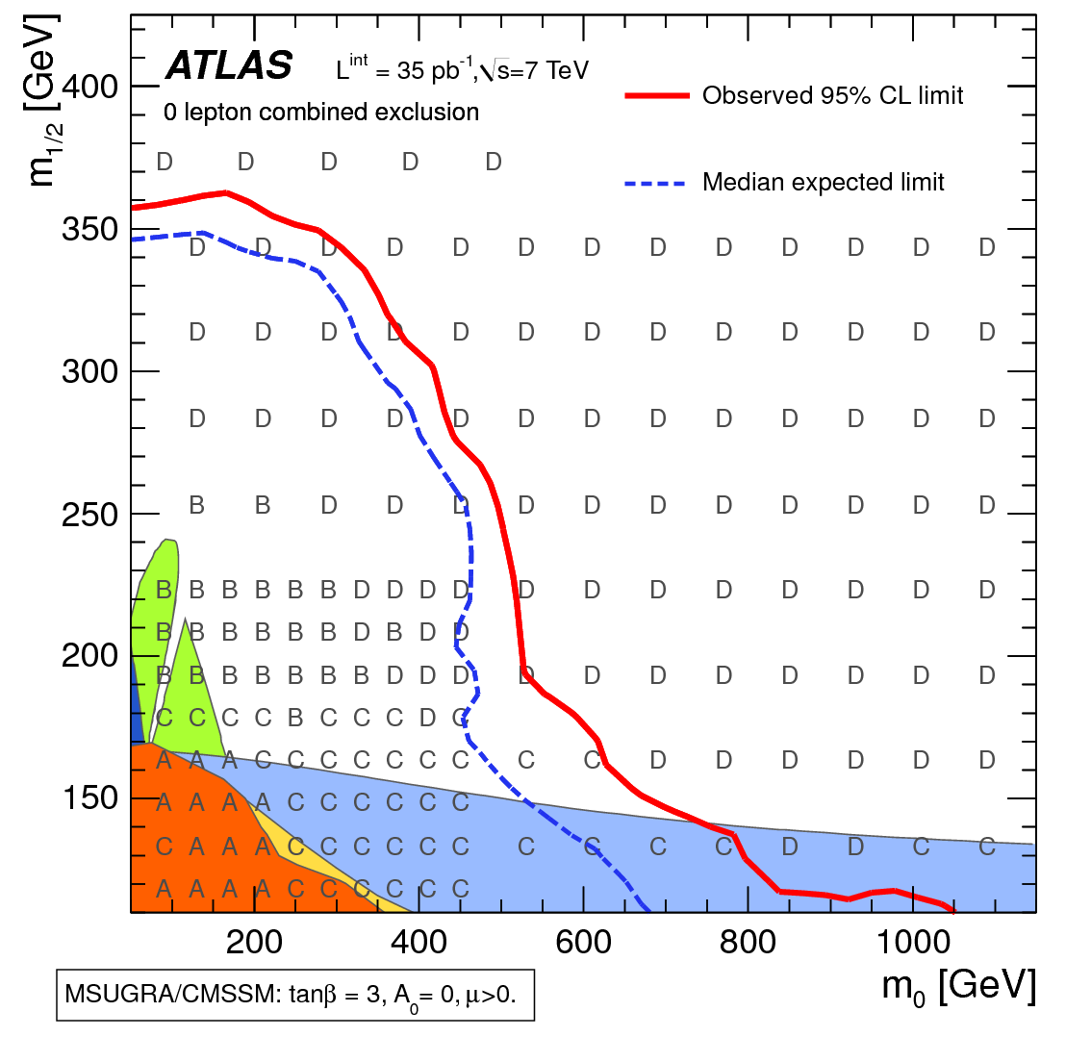
Jets + E_{t}^{miss} : Results
Simple MSSM
Model with light 1st and 2nd gen.
squarks , gluinos and
a massless neutralino
1 sigma total experimental
uncertainty band shown
(shows roughly the 1 and 3 sigma exclusion)
Exclusion reach not strongly sensitive
to sign(mu), tan beta and A₀

Slide 30
Jets + E_{t}^{miss} : Results
Shows best mSUGRA fits to low energy
data ➔ excluded
(here arxiv 1102.4693, M0=75, M1/2=329 GeV)

Slide 31
Jets + E_{t}^{miss} : Results
Consider the signal region with the best expected upper limit.
Automatically chosen by limit setting algorithm

Slide 32
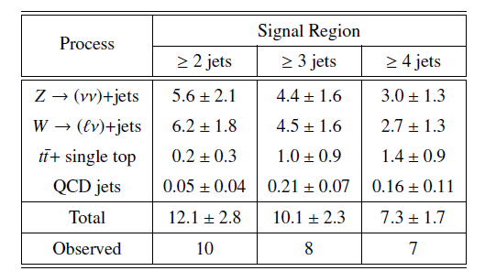
Jets + E_{t}^{miss} : 165 pb-1
Preliminary
result with 2011 data
-Only high mass (M_{eff}>1000 GeV) region analyzed so far
Background fit to control regions (5*3 control regions, gamma+jets for Z+jets)
4 jet channel has been added

Slide 33
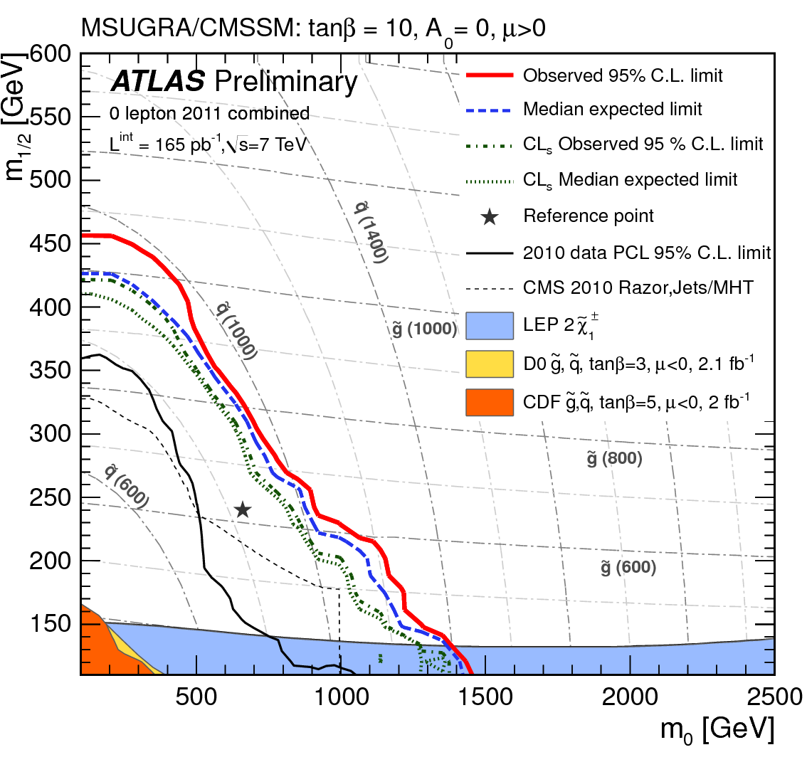
Jets + E_{t}^{miss} : 165 pb-1
Preliminary
result with 2011 data
In mSUGRA :
M_{squark} = M_{gluino}
> 950 GeV
Improvement due to
4 jet channel

Slide 34
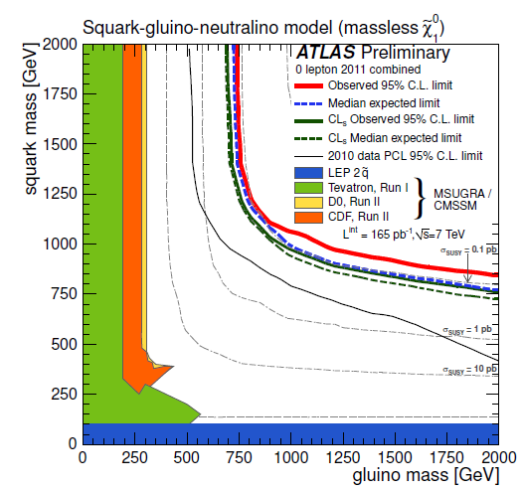
Jets + E_{t}^{miss} : 165 pb-1
Preliminary
result with 2011 data
Simplified MSSM :
M_{squark} = M_{gluino}
> 1025 GeV

Slide 35
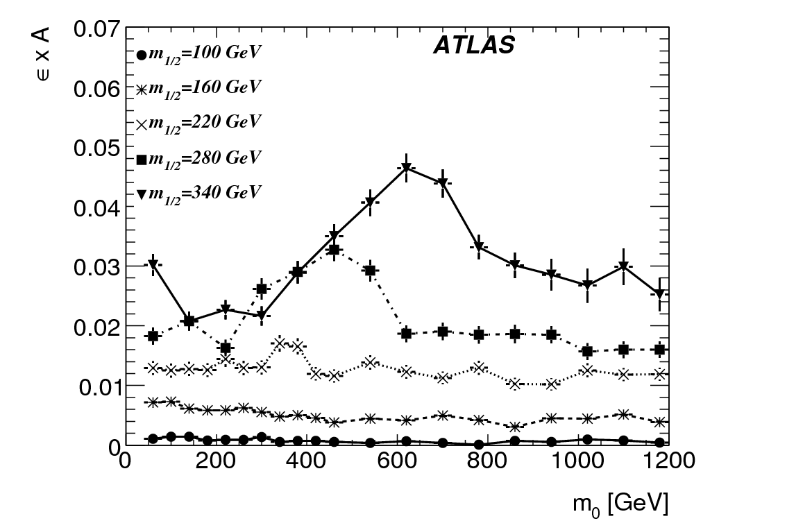
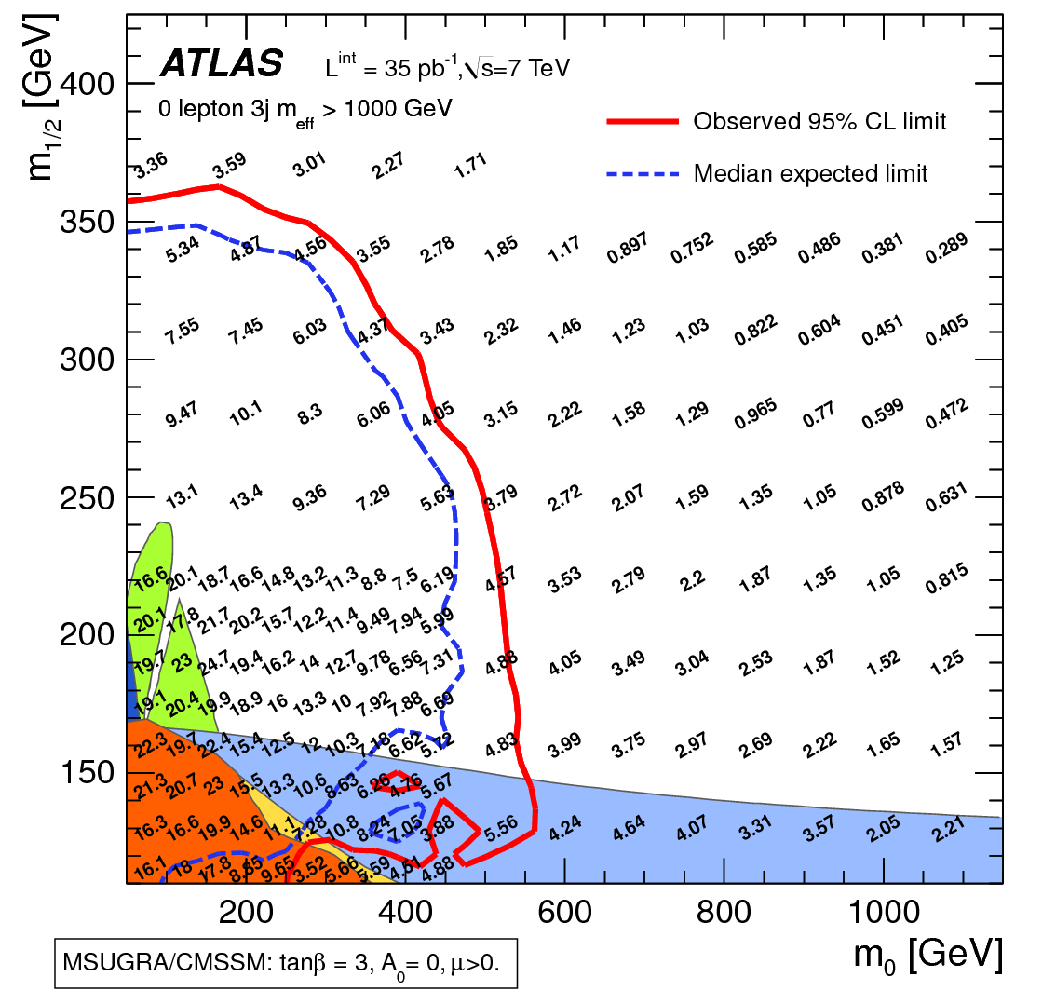
Other Interpretations possible !
lepton + jets analysis
Example:
How can a theorist use these data ?
Jets analysis
Signal efficiency * acceptance provided
for each signal region and analysis channel
(see ATLAS public SUSY results webpage)
Les Houches Accord SUSY steering files provided
Validate your “local” setup
Interpret the data with your favored model.
or “simplified” model

Slide 36
CMS 0 lepton channel
3 (independent) searches in the jets+MET channel:
- “alpha_T” (Phys.Lett.B698:196-218,2011)
- “Razor“ (prelimary result, see backup slides)
- “HTMiss” (submitted to JHEP)

Slide 37
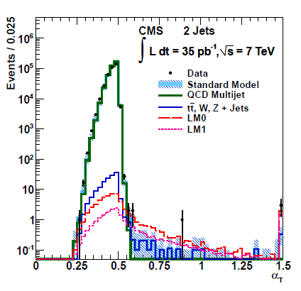
CMS alpha_T
First LHC SUSY limit
Basic selection quantity
Randall
/Tucker-Smith
E_{T}^{j2} is E_{T} of less energetic jet
M_{T} is transverse mass of the
dijet system
Exploits that QCD dijet events
are back to back with equal PT
If > 2 jets, the jets are combined
to form a di-jet system by
minimizing the ET difference
of the neighboring jets

Slide 38
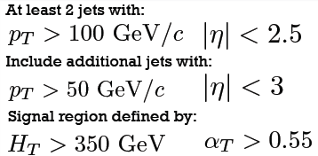
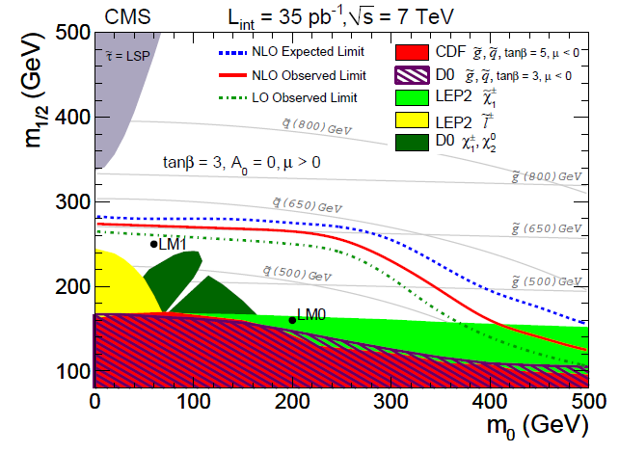
CMS alpha_T limits

Slide 39
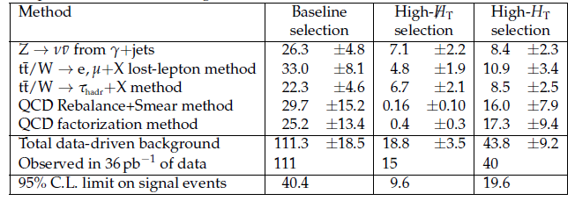
CMS “HTMISS”
Strategy similar to ATLAS jets+MET
calculated also only via p_T> 30 GeV jets
Two signal regions:
As in ATLAS background is
estimated with several
control selections, e.g.
- QCD via jet resolution functions
- Z background from via

Slide 40
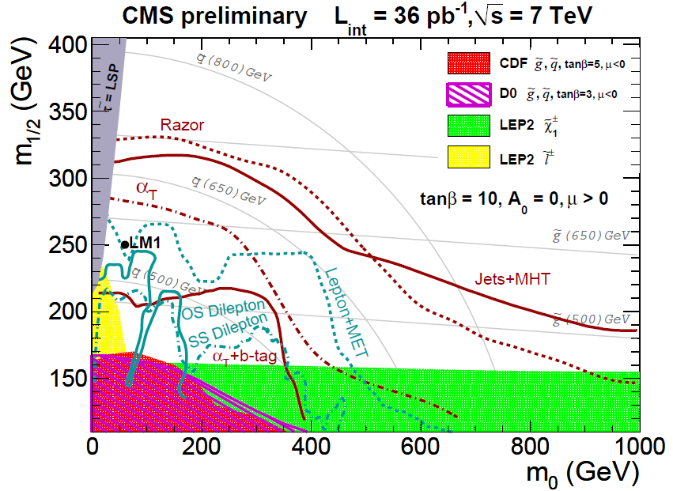
CMS limits in CMSSM/mSUGRA

Slide 41
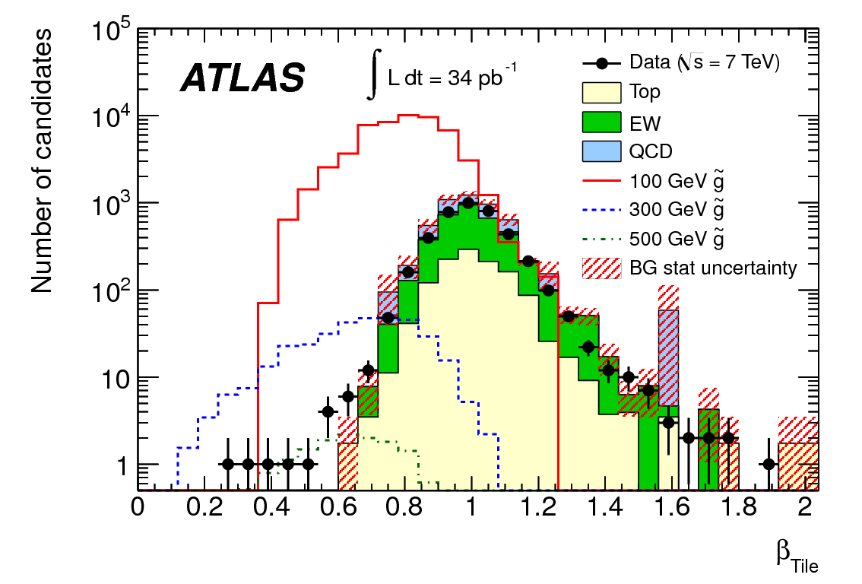
Stable Massive Particle Search
Search for R-hadrons (stable hadrons including a stable gluino, stop or sbottom)
Selection: E_{t}^{miss} >40 GeV for triggering + track with p_{T} > 50 GeV
Two complementary subsystems used to measure SMPs
Background estimates and signal distributions for the pixel and tile mass measurements
Tile sampling calorimeter
iron+plastic scintillators, time resolution of 1-2 ns, calibrated with
muons from Z decays
Pixel detector:
dE\dx is measured
with the charge loss
(prop. to time over treshold)

Slide 42
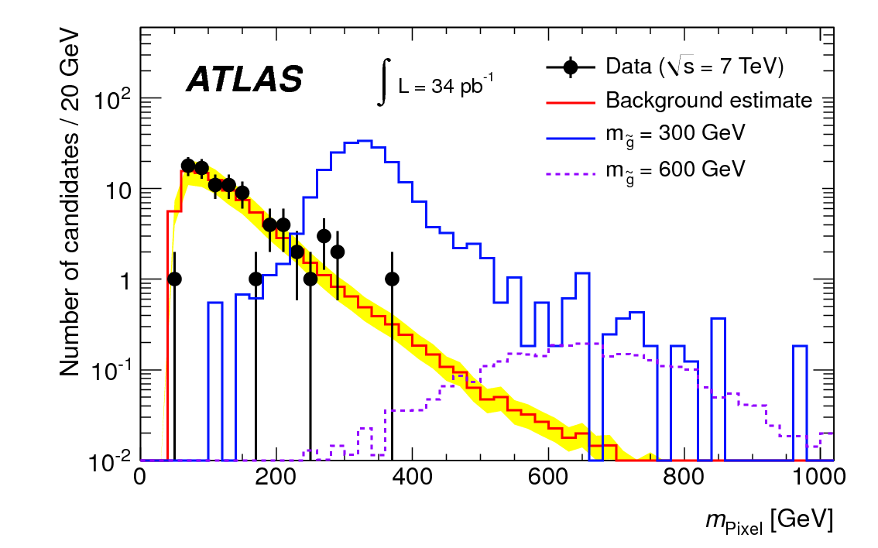
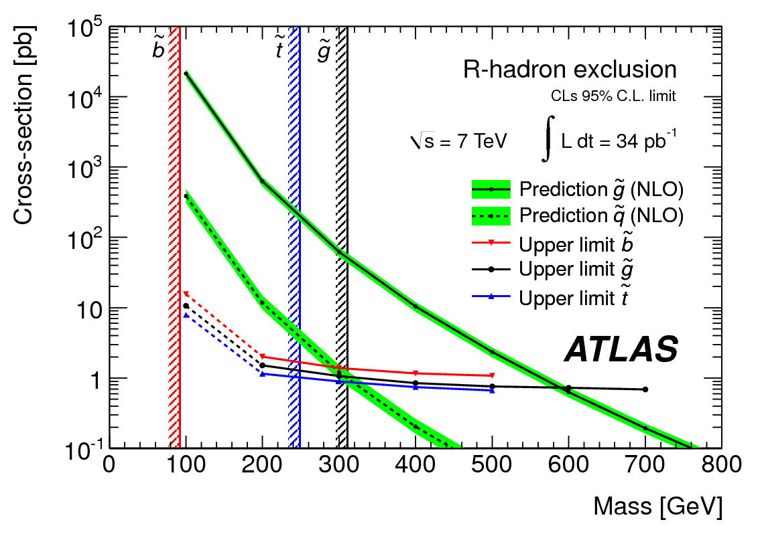
Stable Massive Particle Search
Measure dE/dx to determine βγ via Bethe/Bloch formular for Pixel
and beta of the tile calorimeter
Transform these measurement into
mass via M = p / βγ
Background determined via random
picking of momentum, tile, pixel information
Final signal regions defined by requiring
cuts on both mass measurements
No events after final selections
New strongest limits
limits on stable the masses of

Slide 43
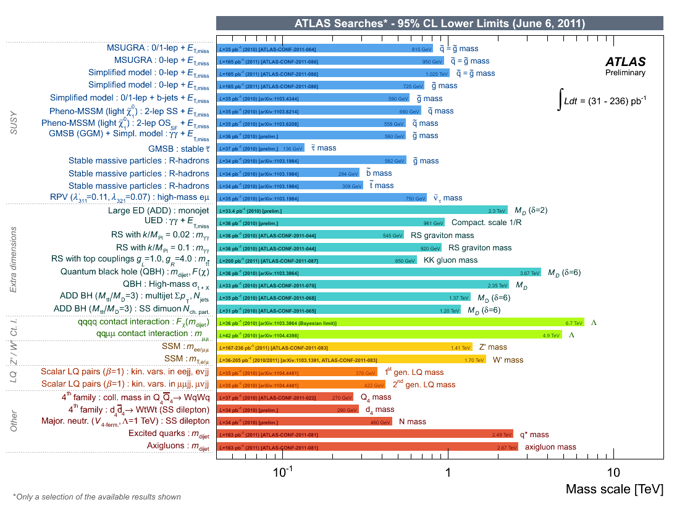
ATLAS search limits

Slide 44
Interpretations: What does this all mean ?
?
By how much do the ATLAS/CMS limits reduce the probability
to allow low mass Supersymmetry
to be the solution of the DM and
hierarchy problem?
What is the effect of the early mSUGRA results on
direct DM experiments ?
ATLAS jets and jets + 1 lepton papers
are the most-cited 2010 ATLAS papers

Slide 45
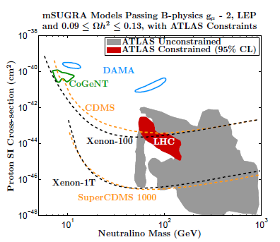
Dark Matter implications
Find consistent picture in the next decade !
Strong Implications
for DM-proton
detection when using
constrained models
(CMSSM, msugra,…)
Note that big part
of this
region needs very
large fine tuning
Shown is only 2010
data limit

Slide 46
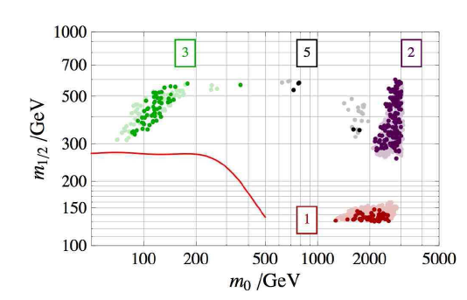
Fine tuning after early LHC
Regions of
mSUGRA
Parameter space
with minimal
fine tuning (delta <100)
CMS
Alpha_t
Regions of minimal fine tuning
and consistent with DM
will only be excluded
after LHC upgrade !
ATLAS 0l+1l 2010
ATLAS 0l 2011
CMS 2010

Slide 47
Summary and Conclusion
2009
SUSY Phase Space
300
700
1100
1500

Slide 48
Summary and Conclusion
2010 data
SUSY Phase Space
300
700
1100
1500

Slide 49
Summary and Conclusion
2011 data
so far
SUSY Phase Space
300
700
1100
1500

Slide 50
Summary and Conclusion
2011 data
so far
SUSY Phase Space
300
700
1100
1500
The search has begun, the baseline analyses are in place !
mSUGRA: M_{squark} = M_{gluino} > 950 GeV (ATLAS)
Expect sensitivity around 1.1 TeV for summer conferences
Exploiting full relevant SUSY phase space needs 14 TeV
& ATLAS upgrade

Slide 51
EXTRA SLIDES

Slide 52
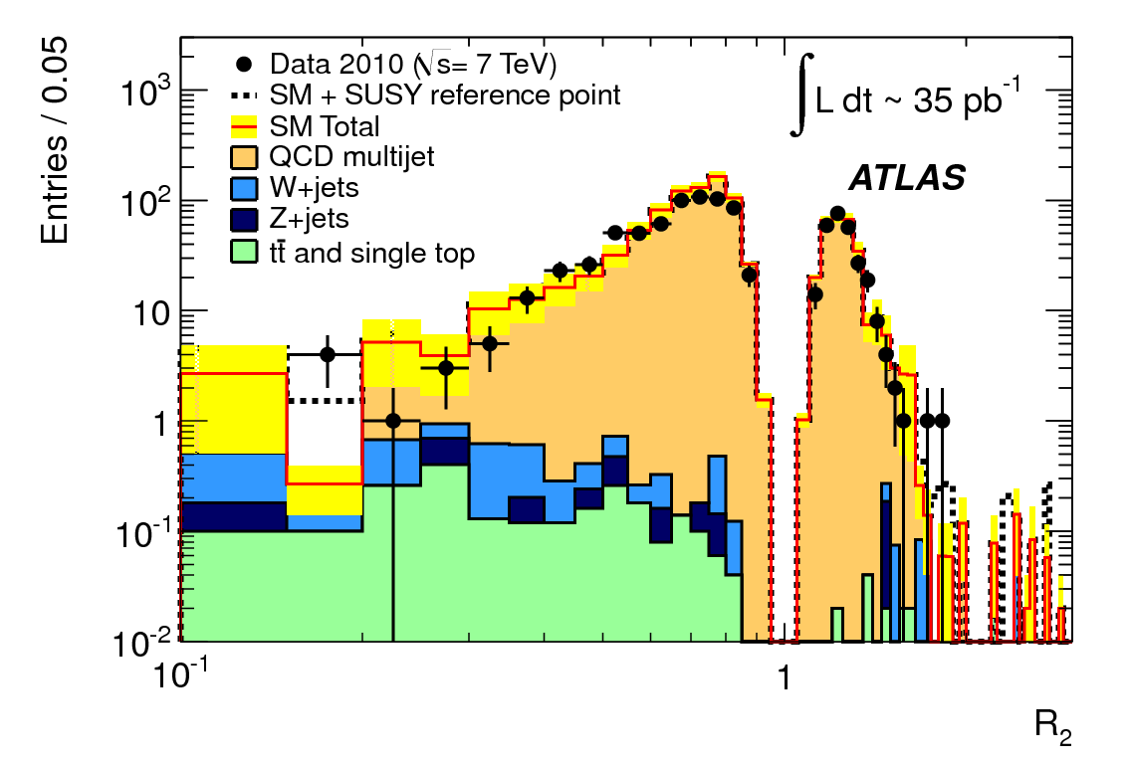
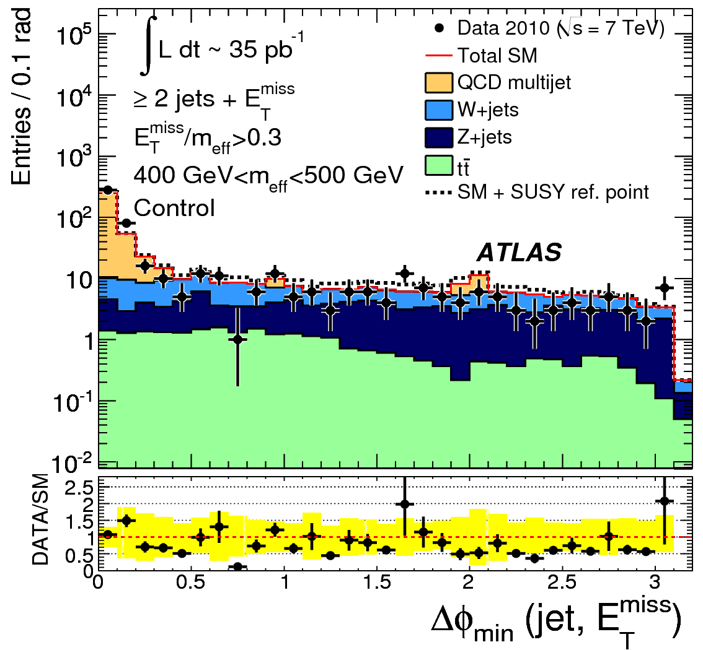
0 lepton background determination
Non gaussian tail of the jet response function
R_2 = (p_T.(p_T+p_T^miss))/|p_T + p_T^miss|.
Events in which requirements have been used to associate the source of the P_T^miss with only one of the jets.
The Gaussian core of the jet response function is removed by the selection requirements on E_T^miss. For each p_T bin the tails at low R_2 are subsequently used, together with the central Gaussian part of the response function (measured separately), and a set of low-E_T^miss seed events to form the fully data-driven QCD determination

Slide 53
No SUSY ? Or different SUSY ?
Many good reasons for physics beyond the Standard Model at LHC energies
Two important future LHC research topics:
1. Is SUSY realized ?
- Final conclusion only after LHC upgrade
2. Is there something else ?
- General search for new phenomena at ATLAS
3. Is the Higgs really the SM Higgs?
- Higgs prospects , measure Higgs parameters
Part of the answers in already till 2012
LHC answer to all 3 questions need large integrated luminosities & sqrt(s) =14 TeV

Slide 54
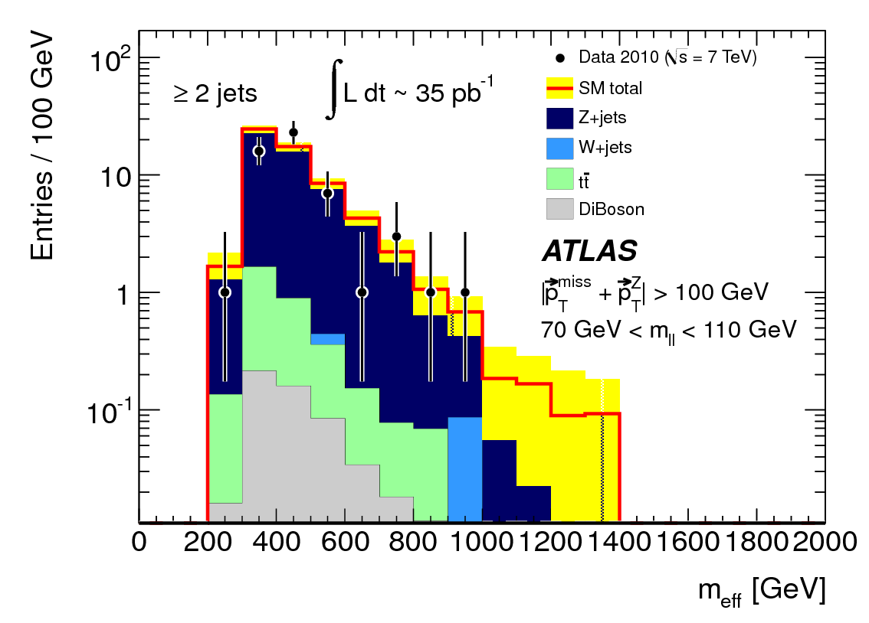
0 lepton background determination
Distribution of m_eff in the dileptonic
Z+jets control region for the
>=2-jet selection.
Pre-selection requirements
have been applied.
The missing transverse momentum requirement has been applied
using the value that would be obtained if the leptons were not observed,
|p_T^miss + p_T(l^+) + p_T(l^-)| > 100 GeV. In addition a requirement on the dileptonic invariant mass 70 GeV < m_ll < 110 GeV

Slide 55
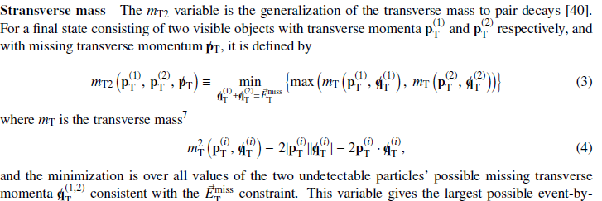
0 lepton - Signal variables detail

Slide 56
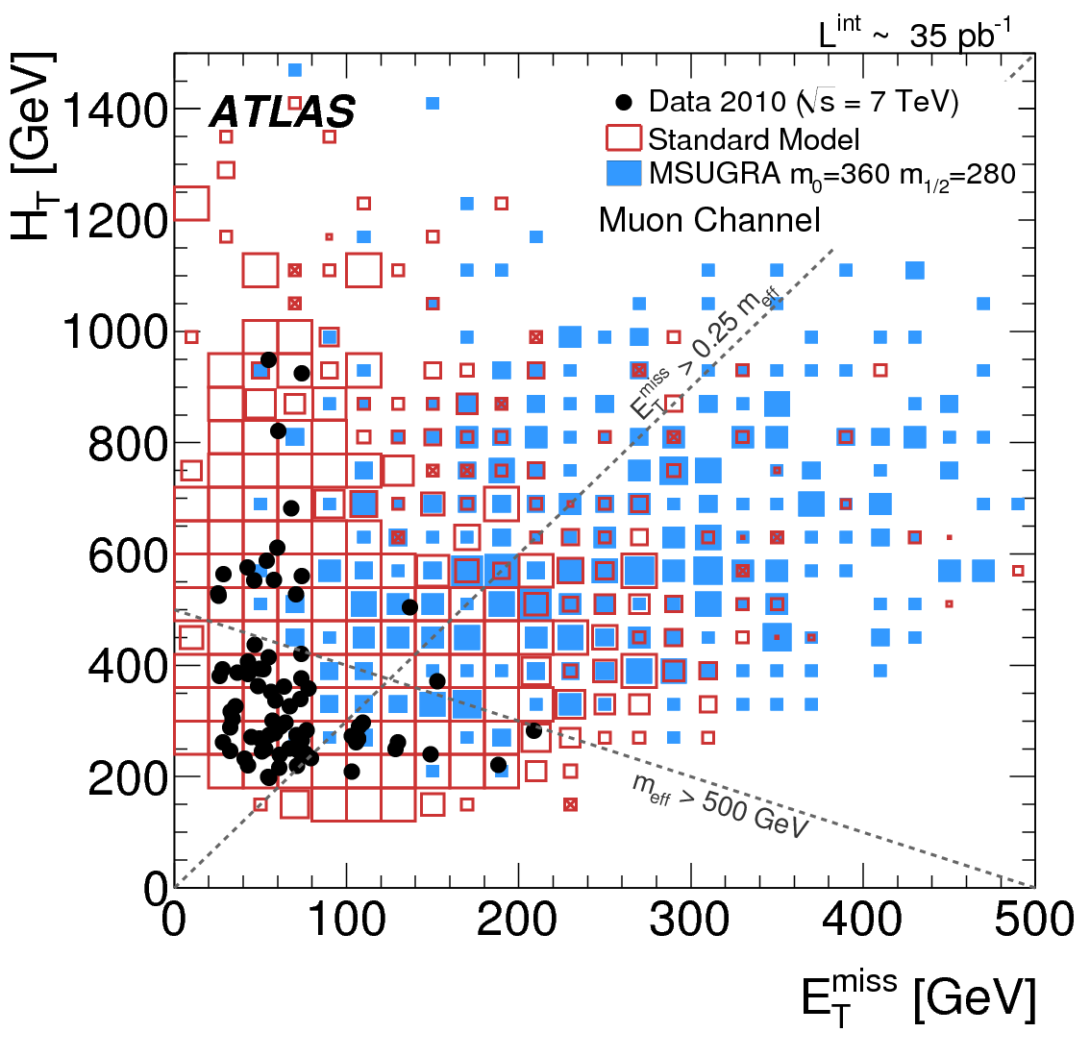
1 lepton channel details
Selection
criteria

Slide 57
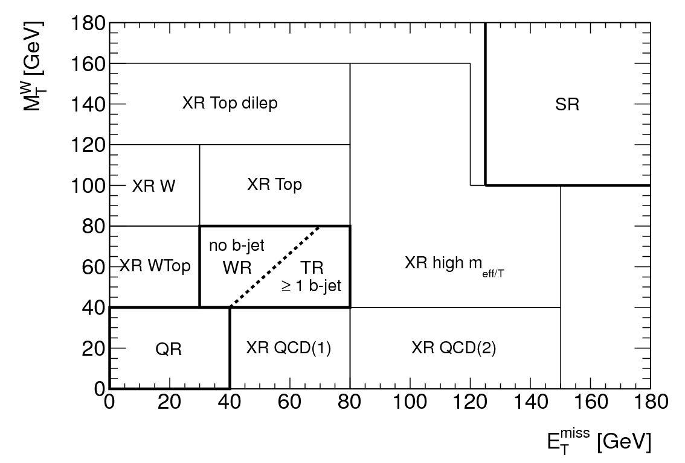
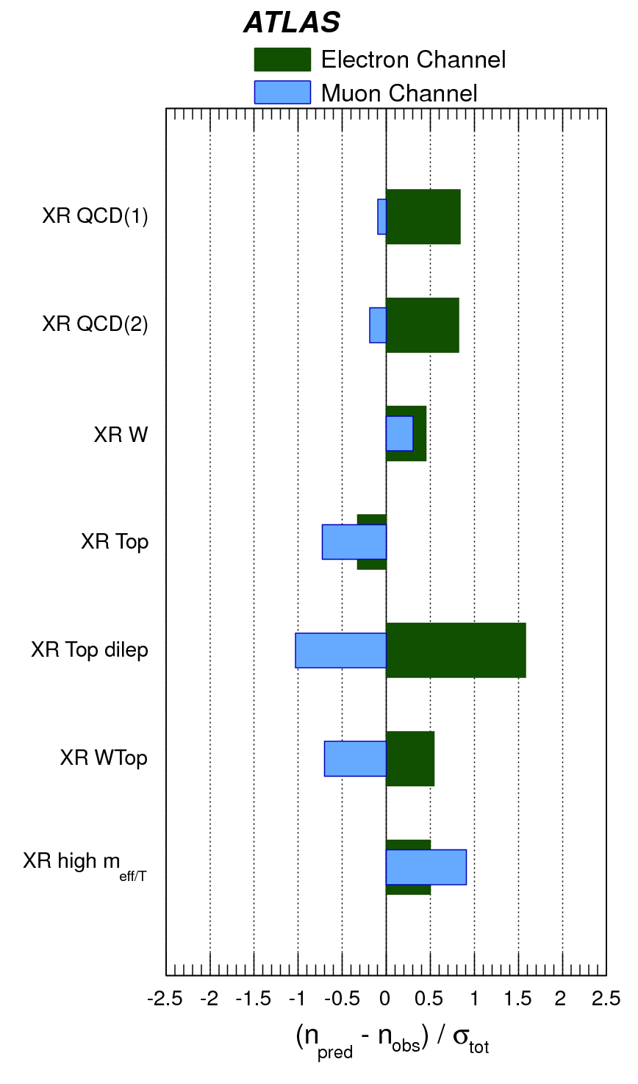
1 lepton channel details
Fits to alternative control regions

Slide 58
Grid 2 lepton
The Phenogrid2 allows the presence of sleptons in the gluino and squark decays chains:
m(3rd generation)=2000 GeV,
m(slepton_R)=m(slepton_L),
m(squark_R)=m(squark_L).
Two scenarios are considered:
a less favourable scenario, PhenoGrid2a with a very compressed spectrum yielding softer values of the discriminant variables, defined by m(chi_2^0)=M-50 GeV, m(chi_1^0)=M-150 GeV and m(slepton_L)=M-100 GeV, where M is the minimum of the gluino and squark mass
and a more favourable one, PhenoGrid2b with m(chi_2^0)=M-100 GeV, m(chi_1^0)=100 GeV and m(slepton_L)=M/2 GeV

Slide 59
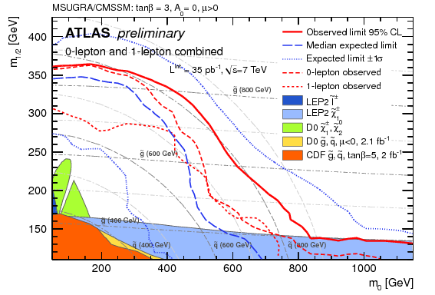
ATLAS SUSY Combination
2010 Combination
of the “expected best”
jets channel and the
1 lepton channel in
CMSSM/mSUGRA
Strongest limit in
this phase space:
squarks and gluinos
of equal mass are excluded below 815 GeV at 95% CL.

Slide 60
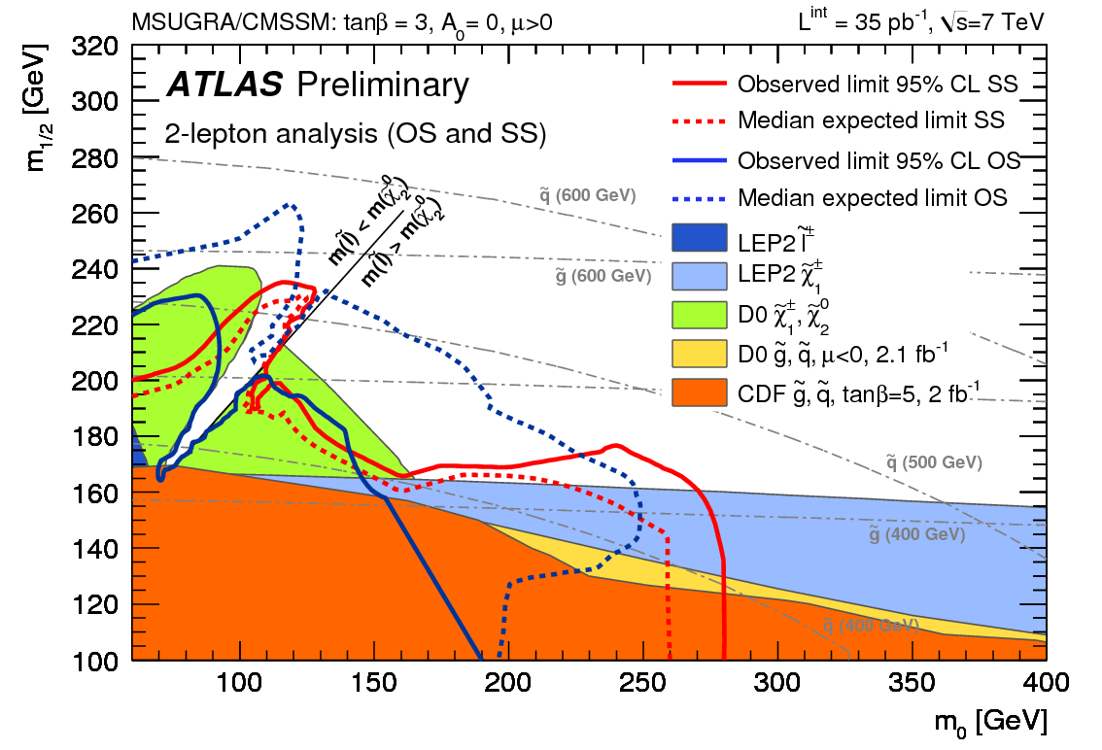
2 lepton SS/OS msugra limit

Slide 61
SMP search
No correlations between the measurements of momentum, dE/dx (Pixel), and Beta (Tile)
➔ Exploited to estimate the amount of background arising from instrumental effects.
Estimates for the background mass distributions from dE/dx (Pixel) and beta (Tile) are obtained by independently combining random momentum values (from the momentum distribution obtained after all kinematic cuts)
with random measurements of dE/dxPixel and beta Tile respectively to yield mass estimates.

Slide 62
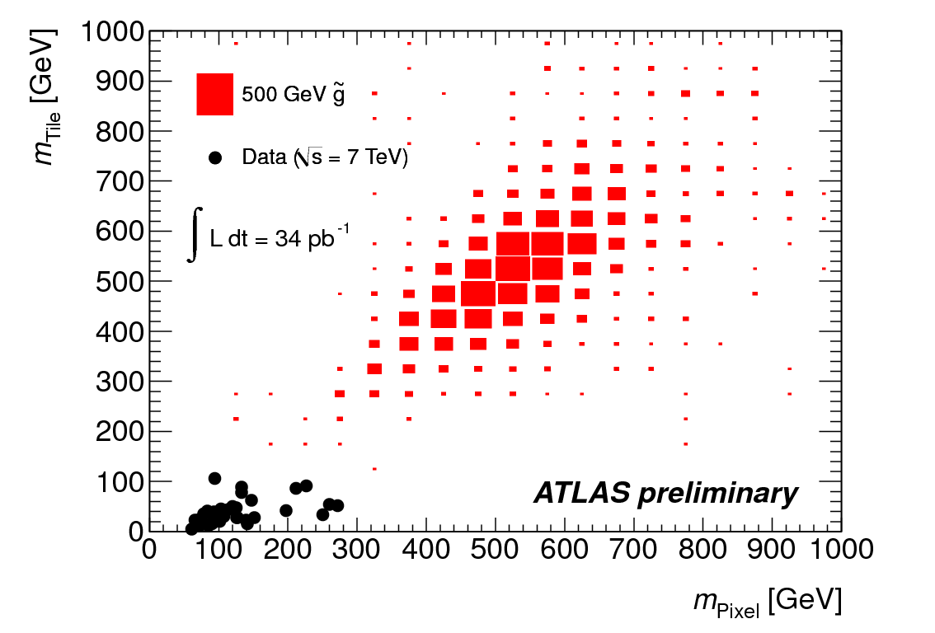
SMP search
Signal region and 2d plots

Slide 63
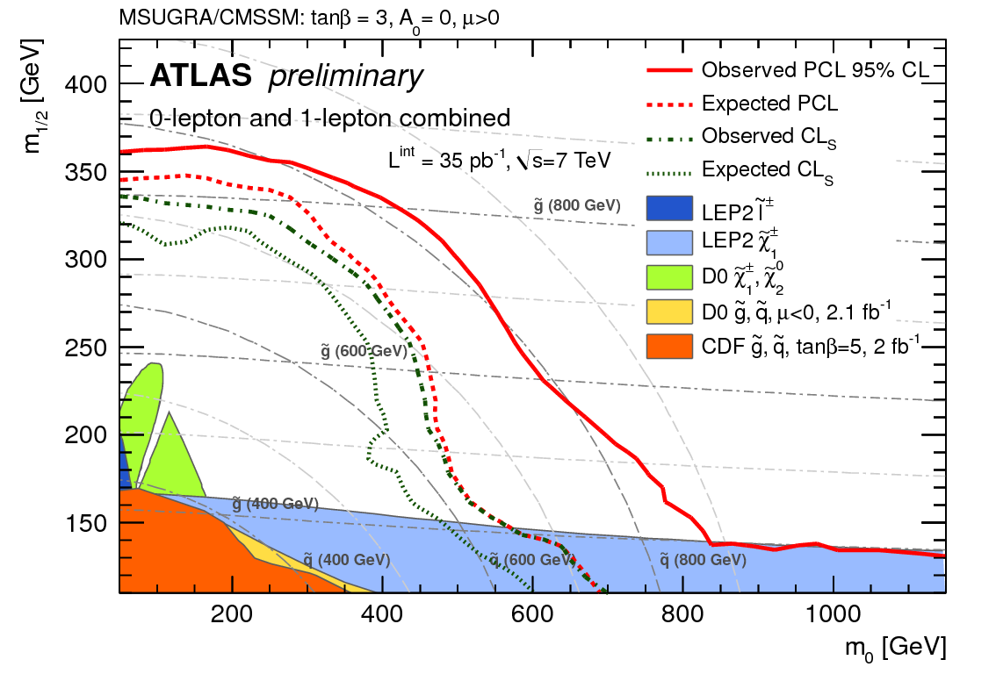
CL_s+b vs CL_s limits

Slide 64
ATLAS detector status

Slide 65
Multilepton search limits

Slide 66
CMS 0 lepton channel
3 (independent) searches in the jets+MET channel:
- “alpha_T” (Phys.Lett.B698:196-218,2011)
- “Razor“ (prelimary result)
- “HTMiss” (prelimary result)

Slide 67
CMS alpha_T
First CMS analysis
Basic selection quantity
Randall
/Tucker-Smith
E_{T}^{j2} is E_{T} of less energetic jet
M_{T} is transverse mass of the
dijet system
Exploits that QCD dijet events
are back to back with equal PT
If > 2 jets, the jets are combined
to form a di-jet system by
minimizing the ET difference
of the neighboring jets

Slide 68
CMS alpha_T limits

Slide 69
CMS “Razor”
For the kinematics
see also
“Dijet topology” explored, a jet is formed in each hemisphere
Assume signal like and relevant scale
- The R frame (squark rest frame) is the longitudinally boosted frame that equalizes the magnitude of the two mega-jet 3-momenta.
Expect peak in M_R for signal at M_{Δ}
Define a transverse mass in the R-frame
With M_{T}^{R}max=M_{Δ}
Expect large values of R for signal

Slide 70
CMS “Razor”
QCD
background
Background determination
by extrapolating via
functional form (“exponential”)
to signal regions
Additional control selections and
methods for W, Z and top background
via lepton control samples
Signal region has combined cut
on R and M_R

Slide 71
CMS “HTMISS”
Strategy similar to ATLAS jets+MET
calculated also only via p_T> 30 GeV jets
Here
Distributions
Compared to
Monte Carlo

Slide 72
CMS “HTMISS”
Strategy similar to ATLAS jets+MET
calculated also only via p_T> 30 GeV jets
Two signal regions:
As in ATLAS background is
estimated with several
control selections, e.g.
- QCD via jet resolution functions
- Z background from via

Slide 73
CMS limits in CMSSM/mSUGRA

Slide 74
Stable Massive Particle Search
Search for R-hadrons (stable hadrons including a stable gluino, stop or sbottom)
Selection: E_{t}^{miss} >40 GeV for triggering + track with p_{T} > 50 GeV
Two complementary subsystems used to measure SMPs
Background estimates and signal distributions for the pixel and tile mass measurements
Tile sampling calorimeter
iron+plastic scintillators, time resolution of 1-2 ns, calibrated with
muons from Z decays
Pixel detector:
dE\dx is measured
with the charge loss of clusters formed with the pixels

Slide 75
Stable Massive Particle Search
Measure dE/dx to determine βγ via Bethe/Bloch formular for Pixel
and beta of the tile calorimeter
Transform these measurement into
mass via M = p / βγ
Background determined via random
picking of momentum, tile, pixel information
Final signal regions defined by requiring
cuts on both mass measurements
No events after final selections
New strongest limits
limits on stable the masses of

Slide 76
Jets + E_{t}^{miss} with b-tag
0 and 1-lepton channel also studied for events
with b-tag to enhance sensitivity to 3rd generation
Slightly modified selection criteria
Aim is here to maximize sensitivity to e.g.
0l :
1l :
and

Slide 77
Jets + E_{t}^{miss} with b-tag
Here is the lightest quark and
produced in 100% of the gluino decays
(or directly produced)
and the stop decays via
Exclusion of gluinos below 520 GeV for stops in
in the range 160-240 GeV
Sbottom_1 produced via gluino or
directly and decay via
➔ Limit on gluino mass of 590 GeV

Slide 78
Jets + E_{t}^{miss} with b-tag
Interpretation within mSUGRA
Combination of 0 and 1 lepton channel
with b-tag
Also here strong limits in mSUGRA
phase space
(here shown at high tan beta)

Slide 79
Dilepton + E_{t}^{miss} (OS/SS)
2 leptons with pT > 20 GeV + E_{t}^{miss} cut
- Fake background estimation by solving
linear equations to get the fake probability for a
“tight” lepton selections via a “loose” selection
- Top background estimated with control region
Exclusion plot shown for
a phenomenological MSSM scenario
which allows sleptons in the decay chains
M(Squark/gluino) > M(chi2) > M(slepton)
> M(chi1 )
Shown is a compressed (“soft” particles)
and a favorable scenario (“harder”particles)

Slide 80
Dilepton + E_{t}^{miss} (flavour substraction)
Search for events with E_{t}^{miss} , opposite
charge and identical flavour (ee, μμ)
SM processes do equally produce ee+μμ and
emu events
➔ Background can be subtracted !
In SUSY events the production
of the two leptons can be correlated
due to lepton flavor conservation in
the decays.
S_{expected} =

Slide 81
Electron Muon Resonance
Generic Search for a electron muon resonance
Selection: e and mu of opposite charge
p_{T,lepton} > 20 GeV and not cut on MET
Determination of the instrumental (single
and double fake) again via soft/tight equations
Limits on R_{P} violating production
extending previous searches at high
mass

Slide 82
The Large Hadron Collider
Proton Proton Collider
operating 2010-2012 at
7 TeV centre-of-mass energy
and delivering an integrated
luminosity of about 50 pb⁻¹ in 2010
and >1000 pb⁻¹ in 2011 (so far)
CMS
2010 : 50 pb-1
Peak instantaneous luminosity :
End of 2010 run : 2 * 10 ³² cm⁻² s⁻¹
2011: >1000 pb-1
till today
April 2011 : 4.7 * 10 ³² cm⁻² s⁻¹

