Slide 1
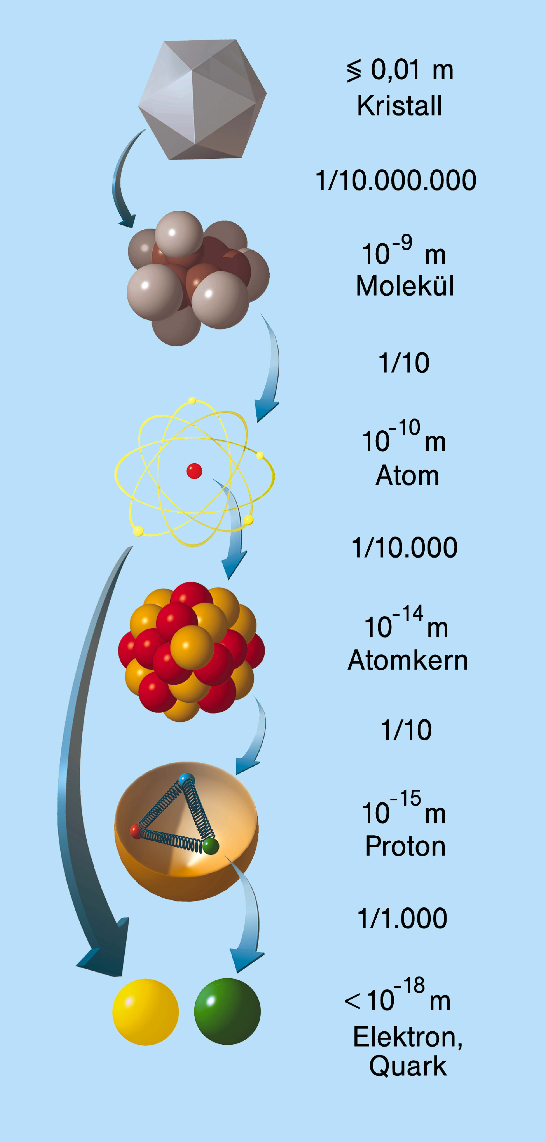
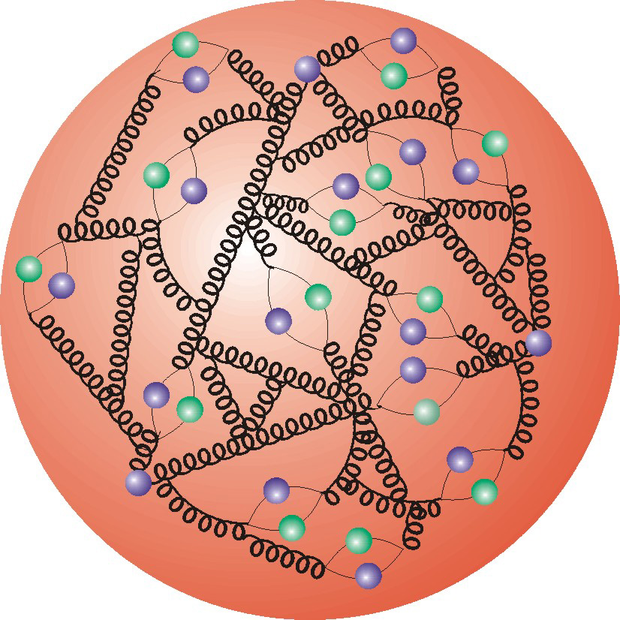
The Harvest of HERA
A. Caldwell
Max-Planck-Institut f. Physik
Festkolloquium
on the occasion of the retirement of
Robert Klanner

Slide 2
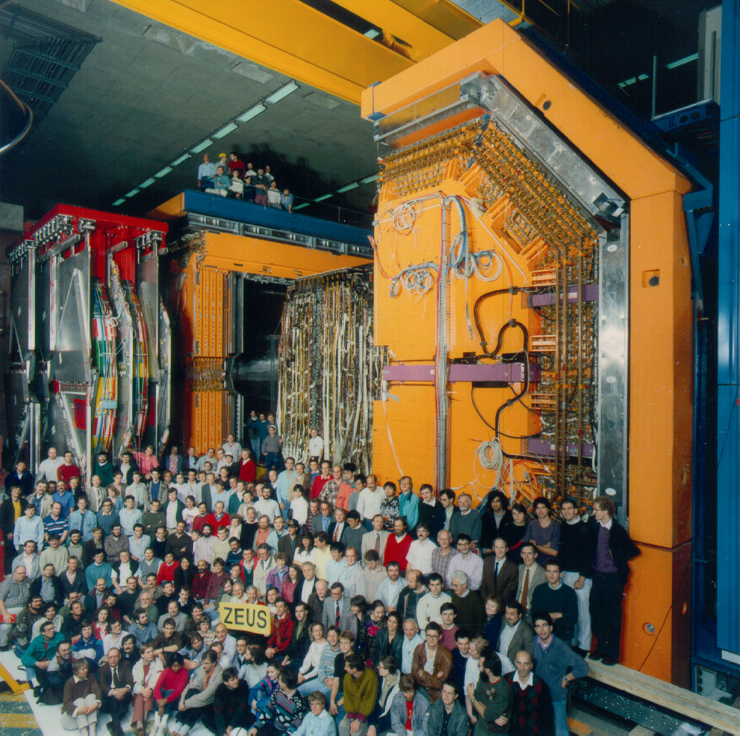
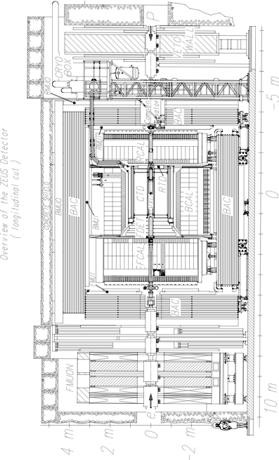
The physics results I will show will be from ZEUS+H1
However, since Robert was a member of ZEUS, I will tend to dwell on the ZEUS experiment.

Slide 3
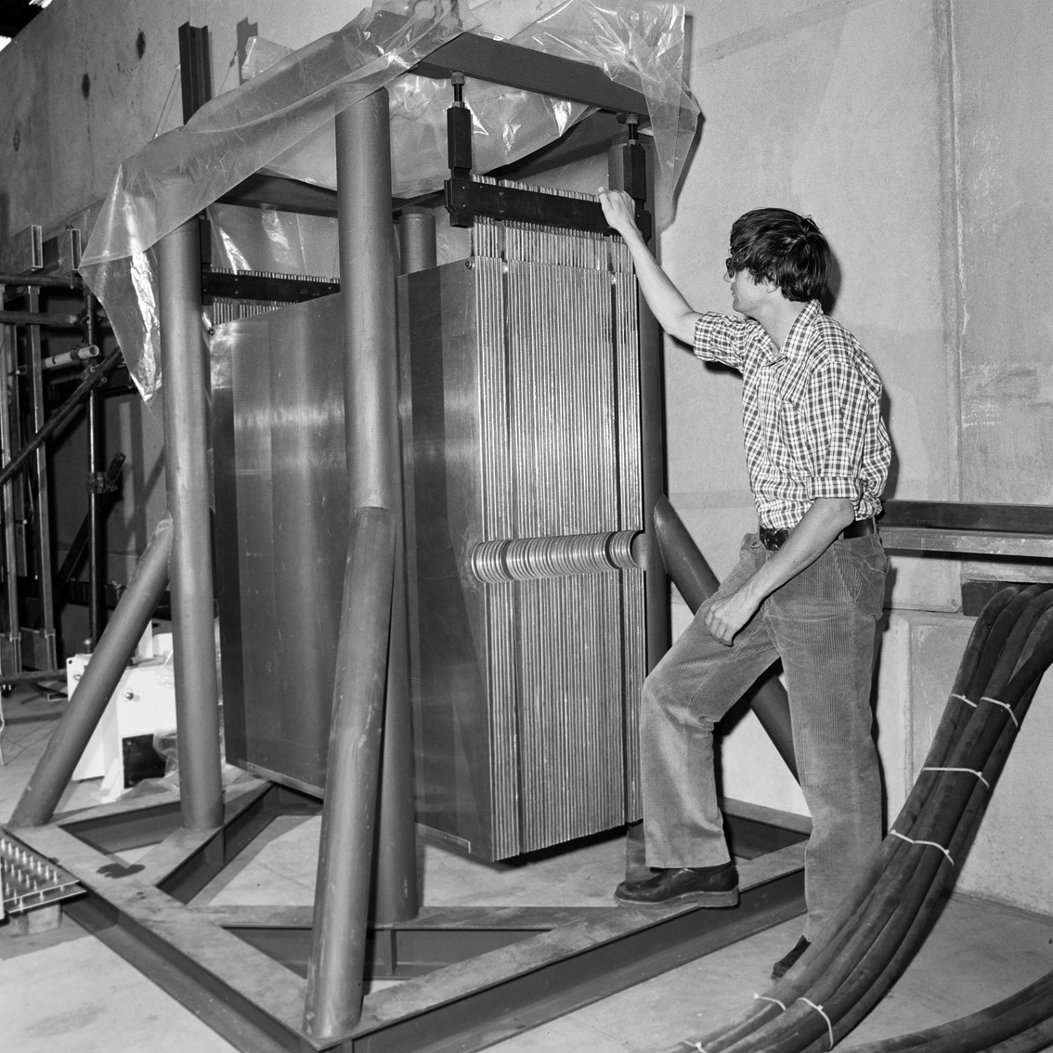
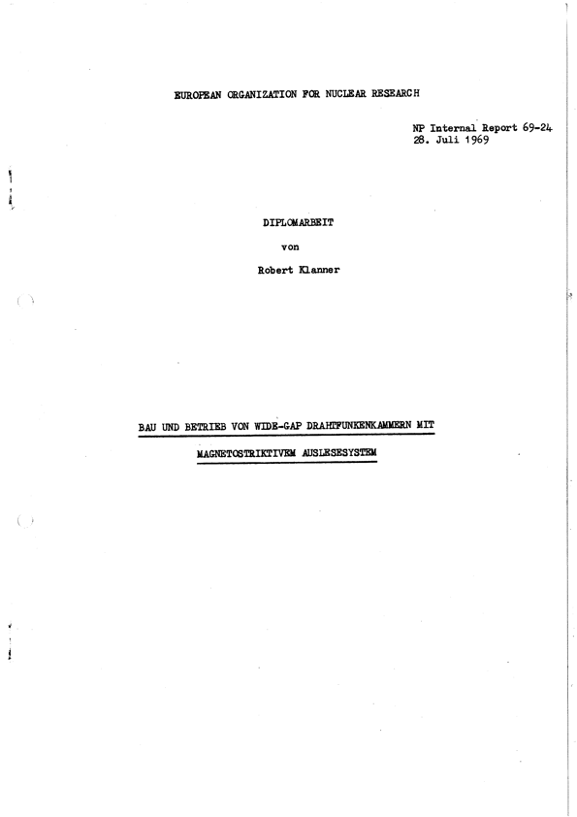
Robert & detectors – a relationship which began early
WA3 Experiment, 1977
Diplomarbeit, München
Construction and operation of a wide gap spark chamber …

Slide 4
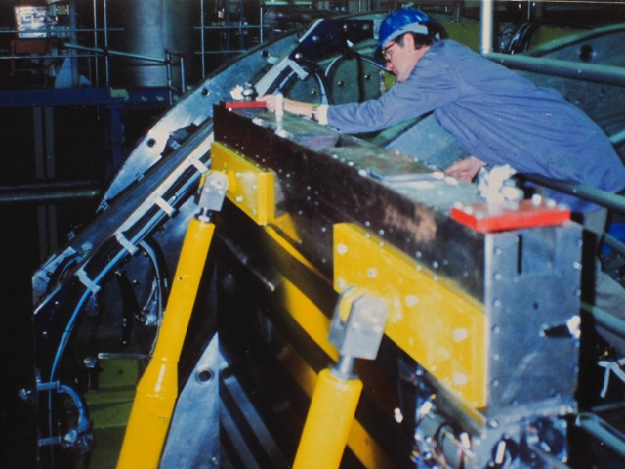
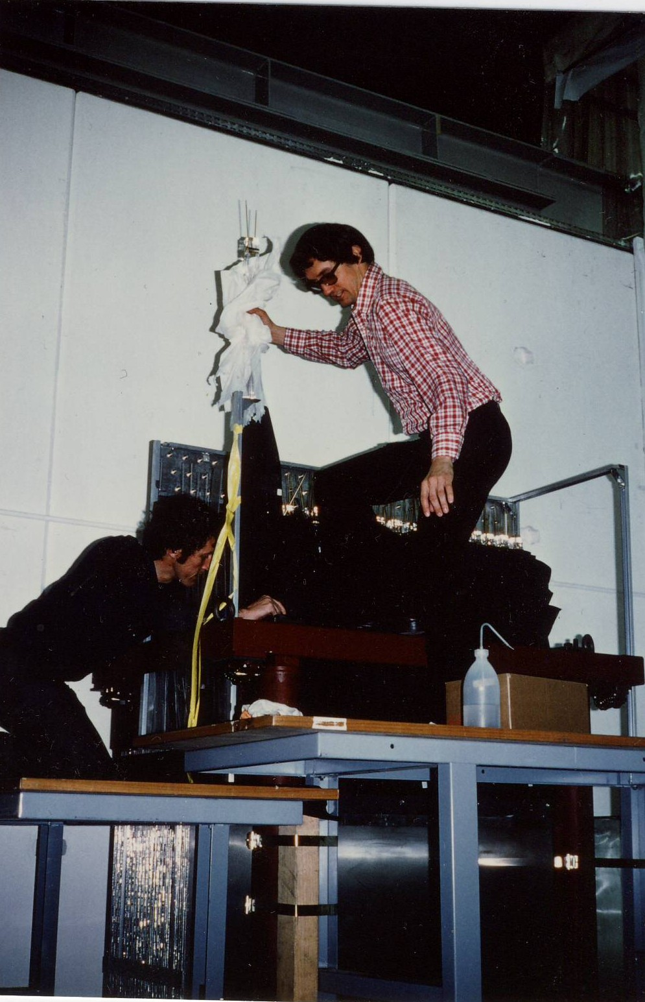
ZEUS Calorimeter Design/Construction

Slide 5
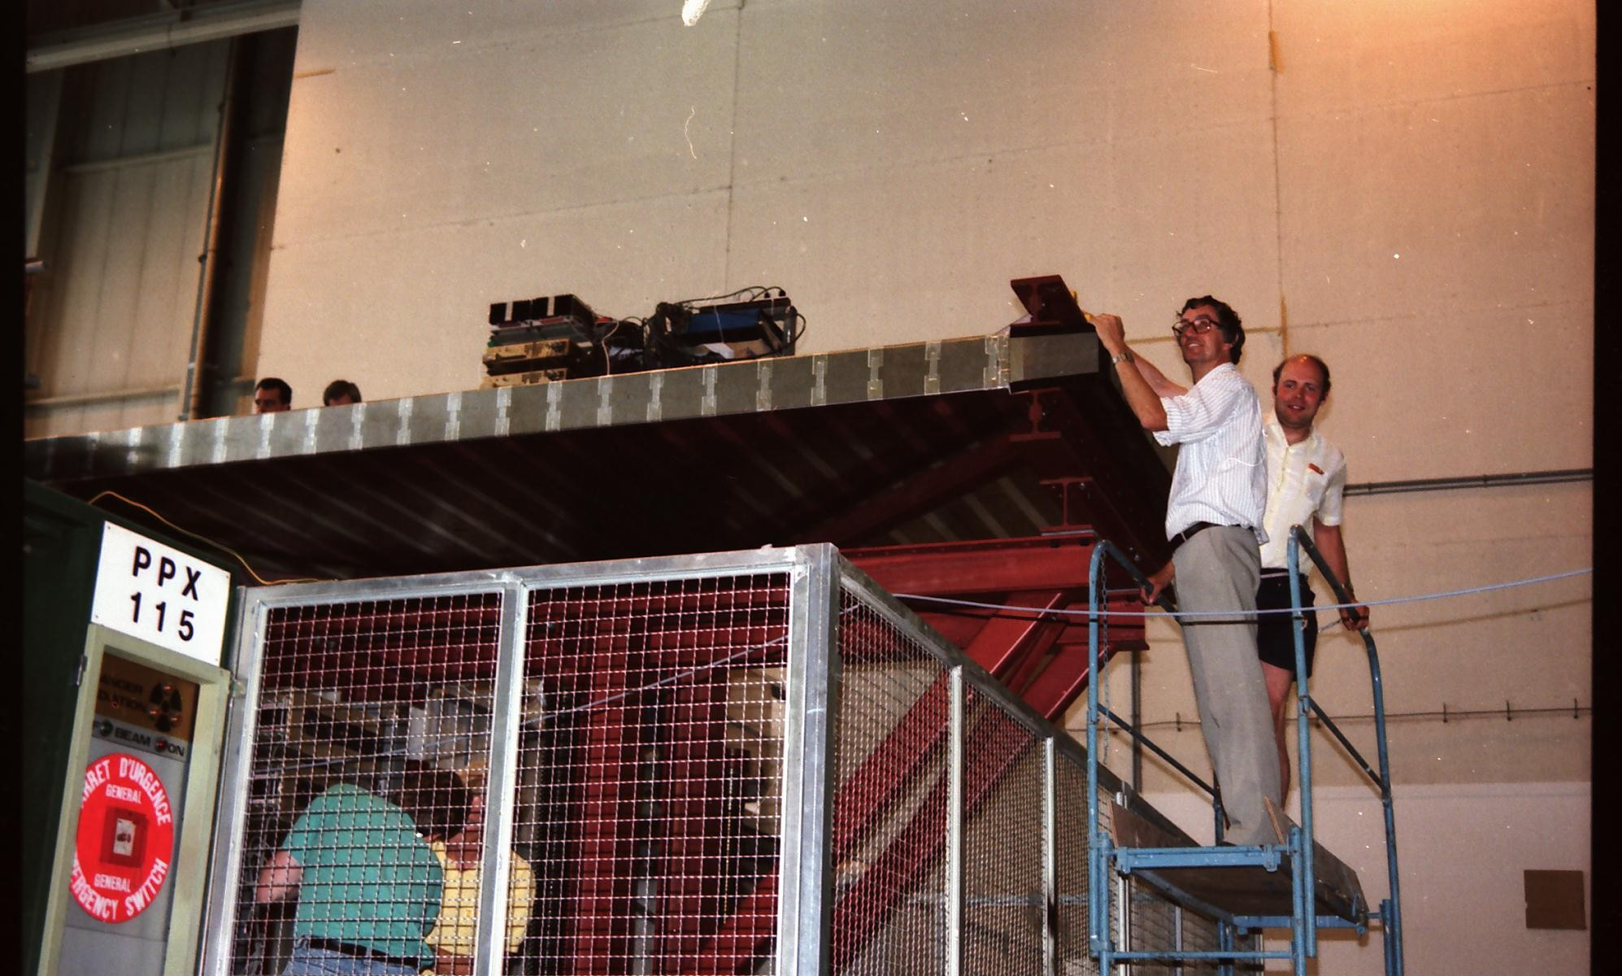
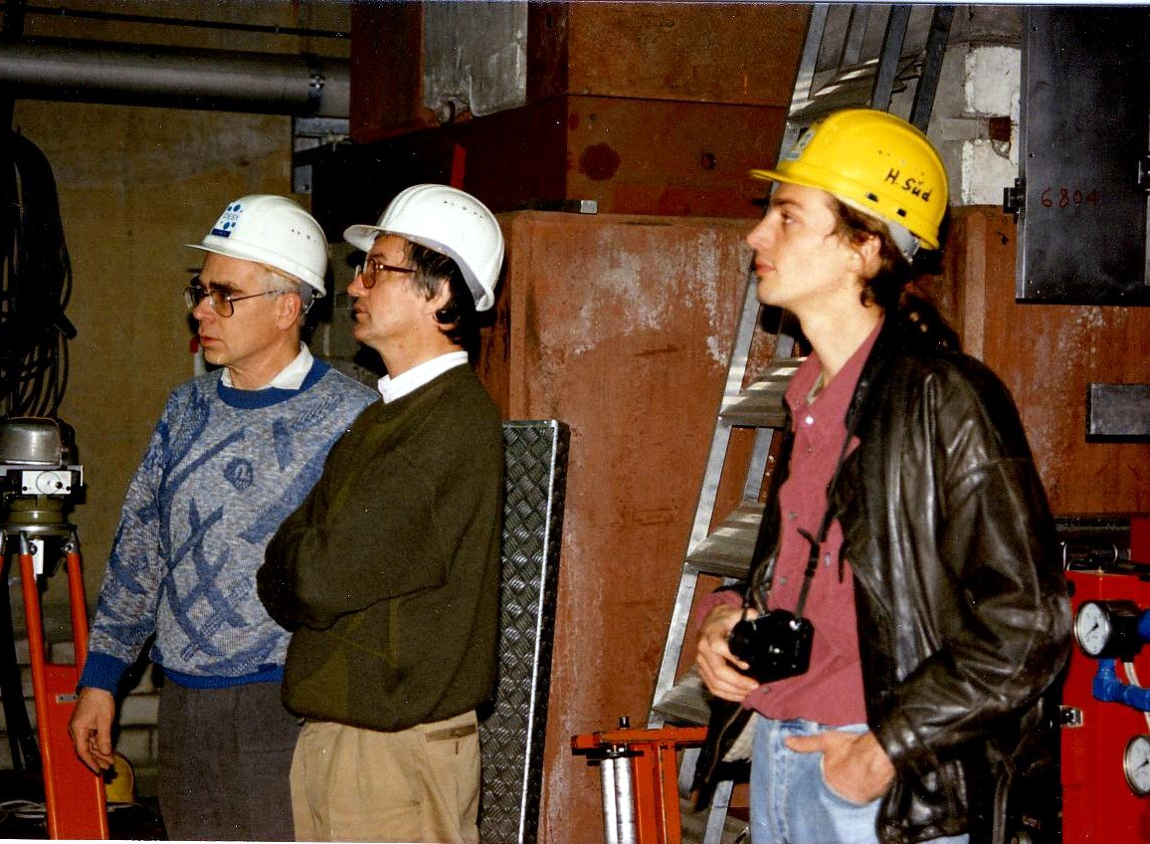
The Heart of ZEUS

Slide 6
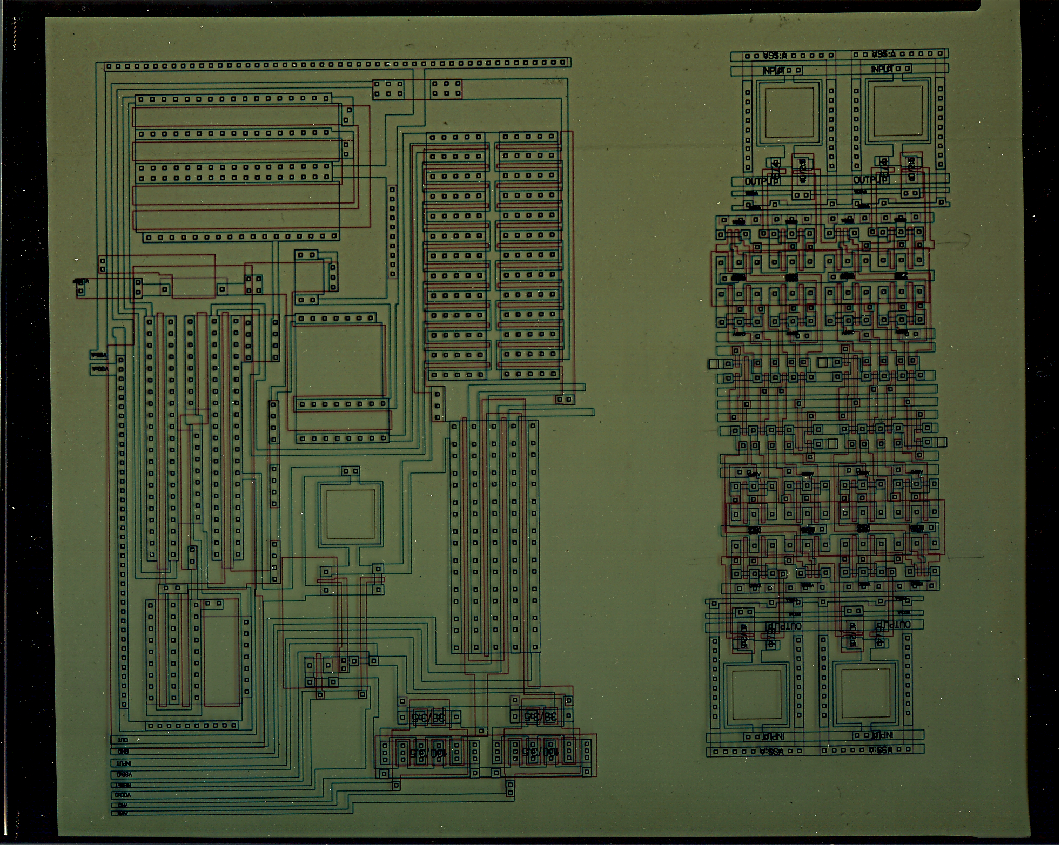
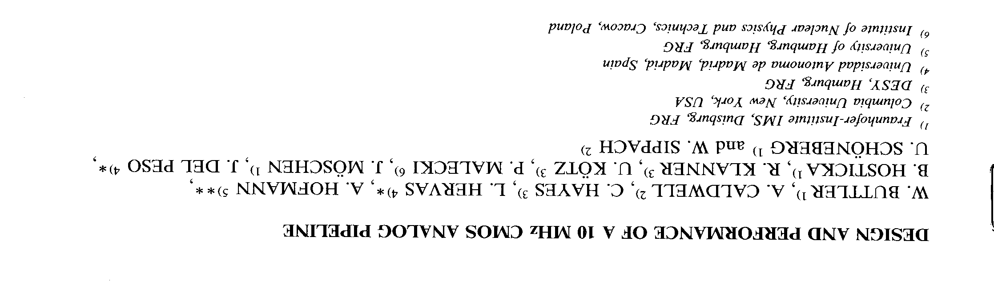
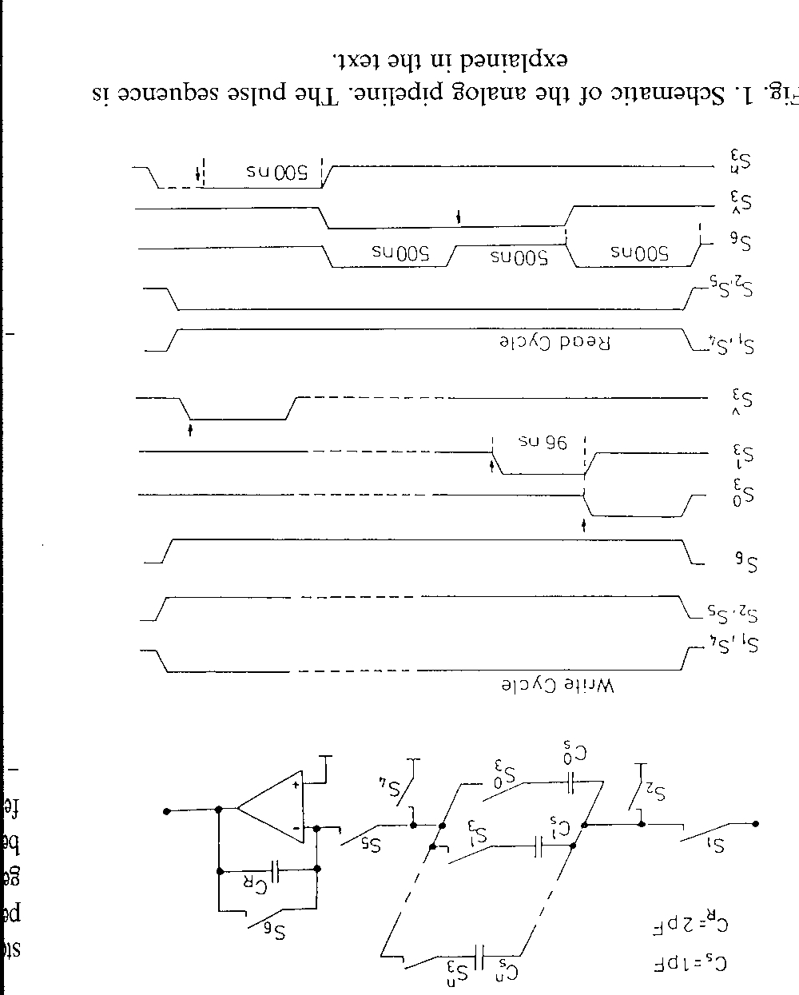
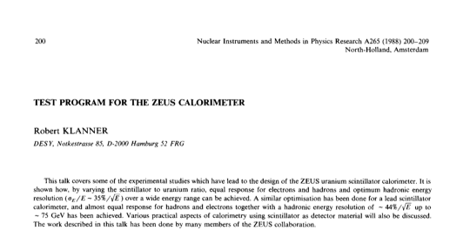
It is hard to convey this fact: development of new detectors and test beam experiments are tremendous fun !

Slide 7
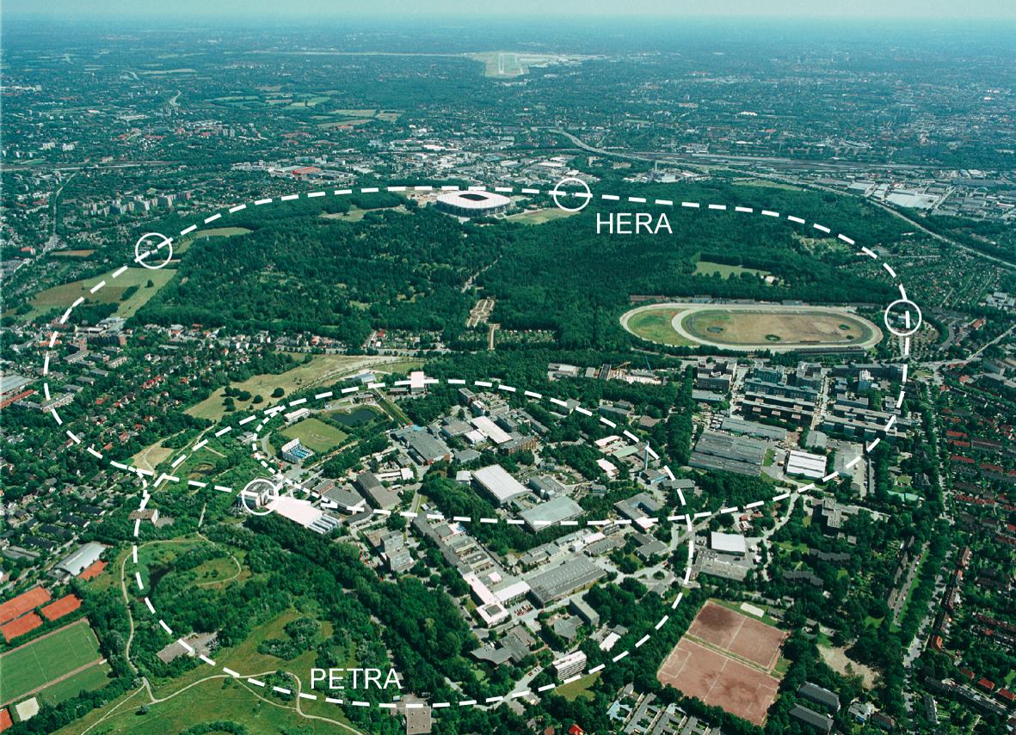
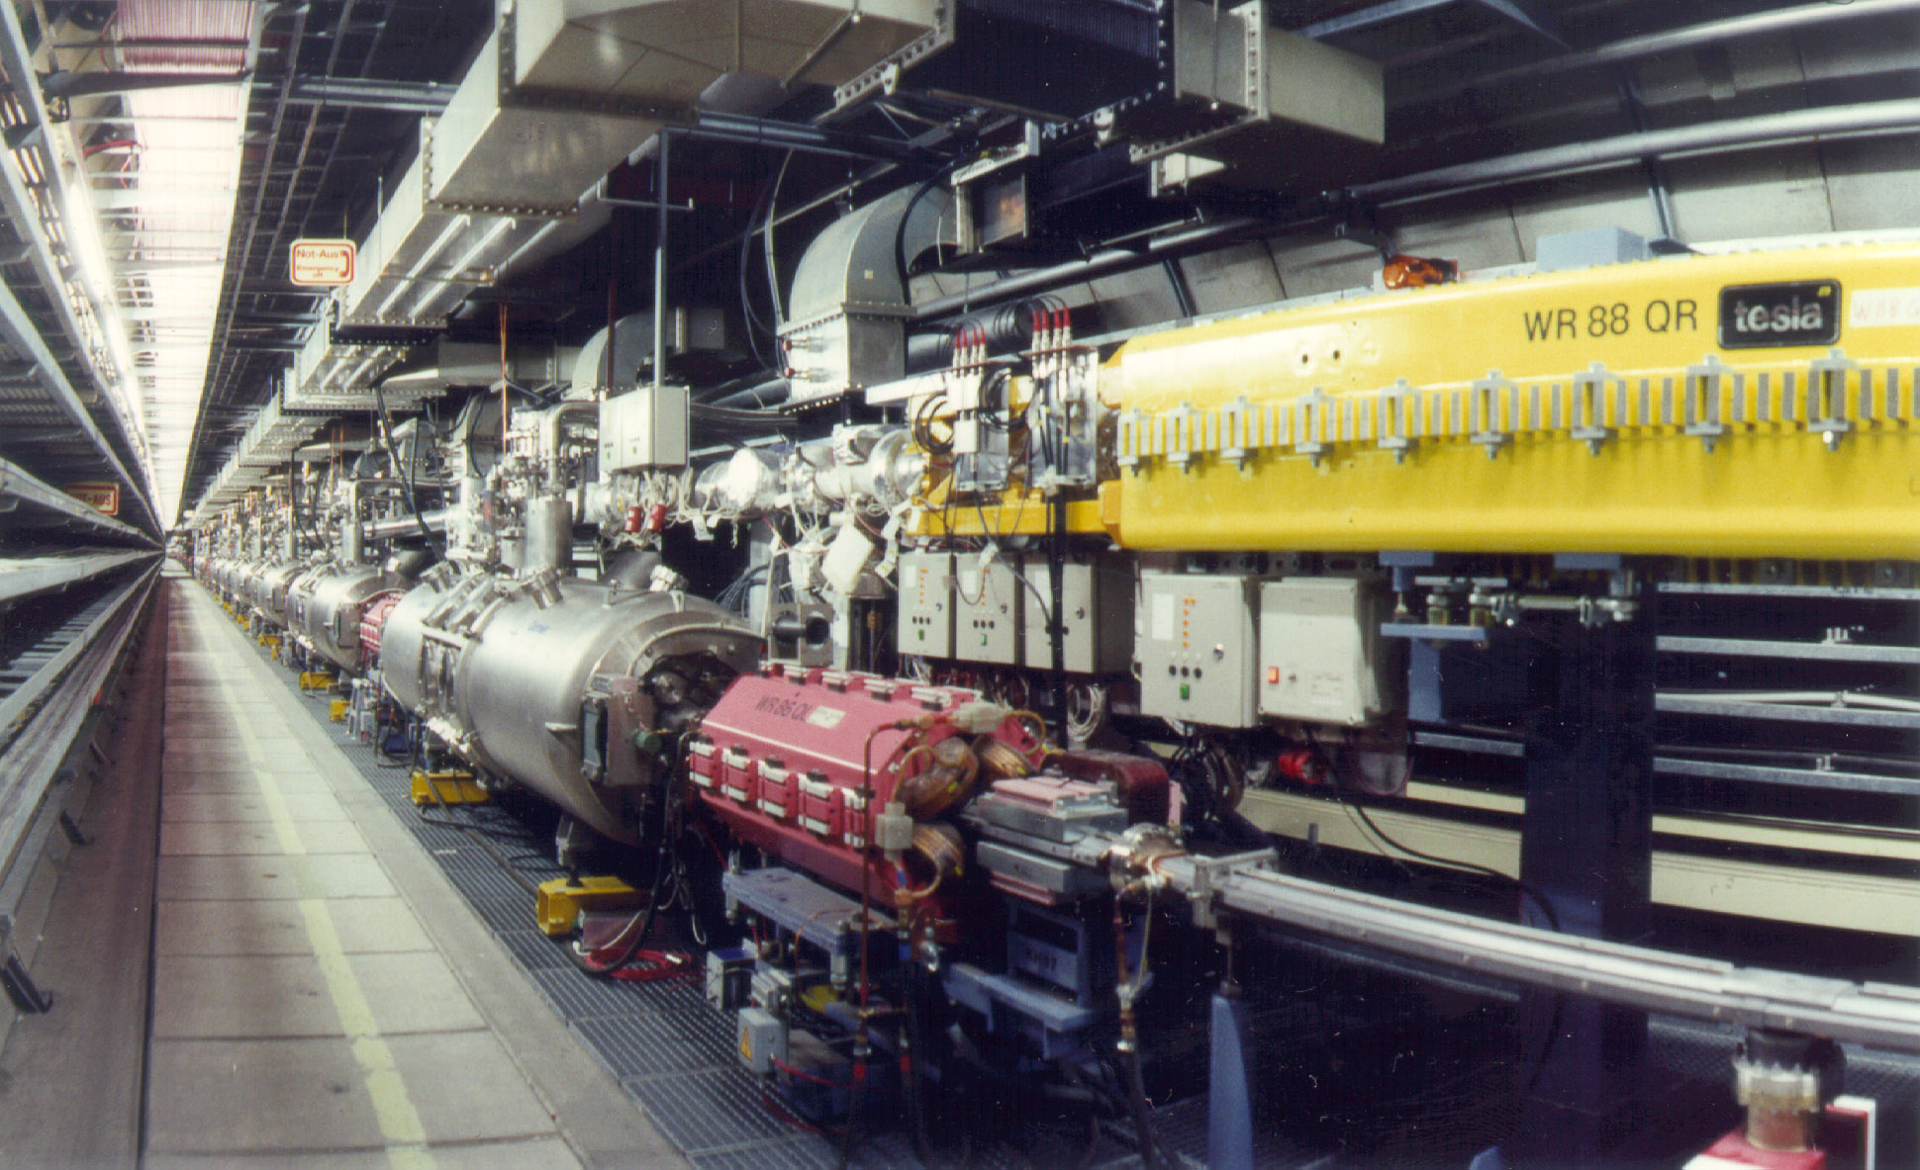
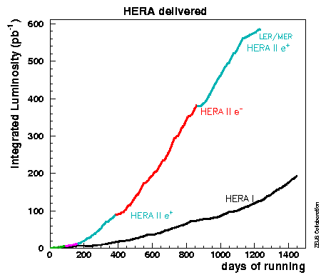

HERA: a 6.3km circumference accelerator of electrons and protons. Two experiments observed the collisions (H1, ZEUS) + two fixed target experiments (HERMES - eN, HERA-B - pN). Ended running 30/6/07.

Slide 8
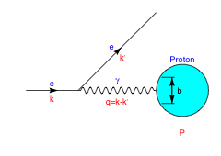
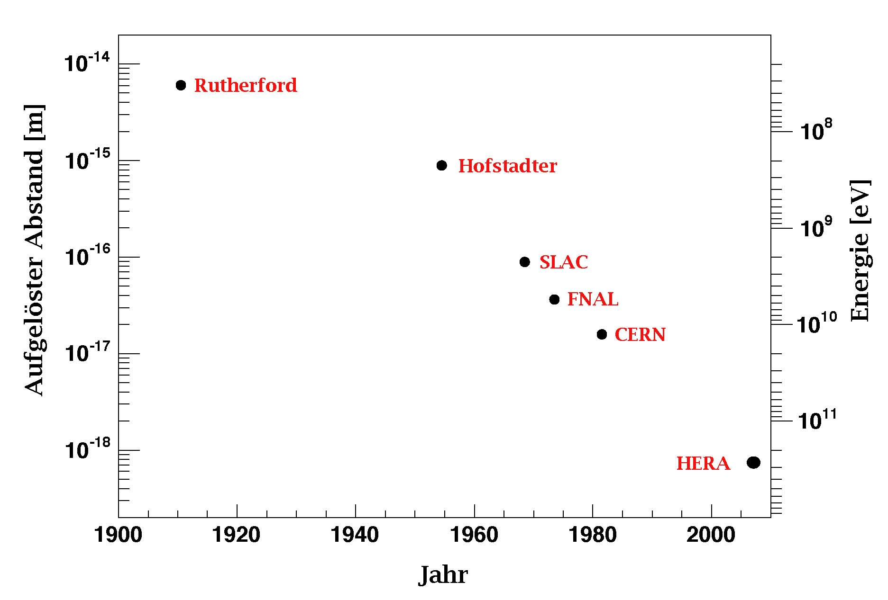
HERA Kinematics
E_{e}=27.5 GeV
E_{P}=920 GeV
s=(k+P)² = (320 GeV)²
Transverse distance scale:

Slide 9
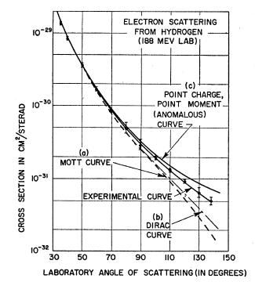
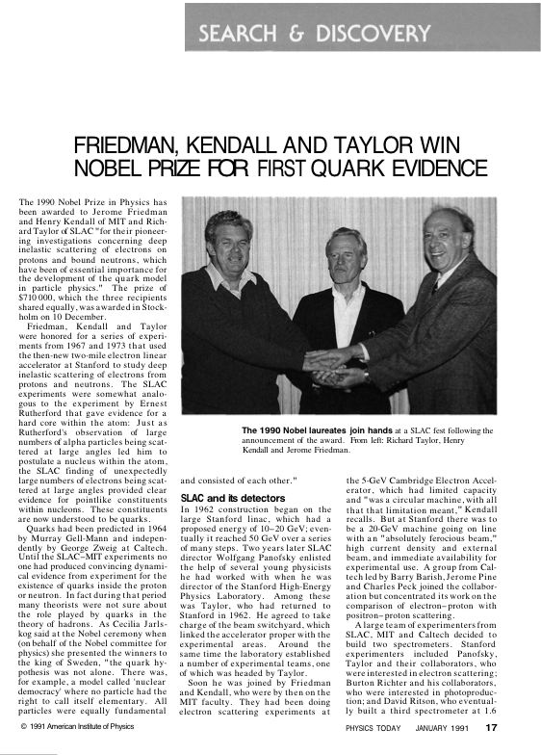
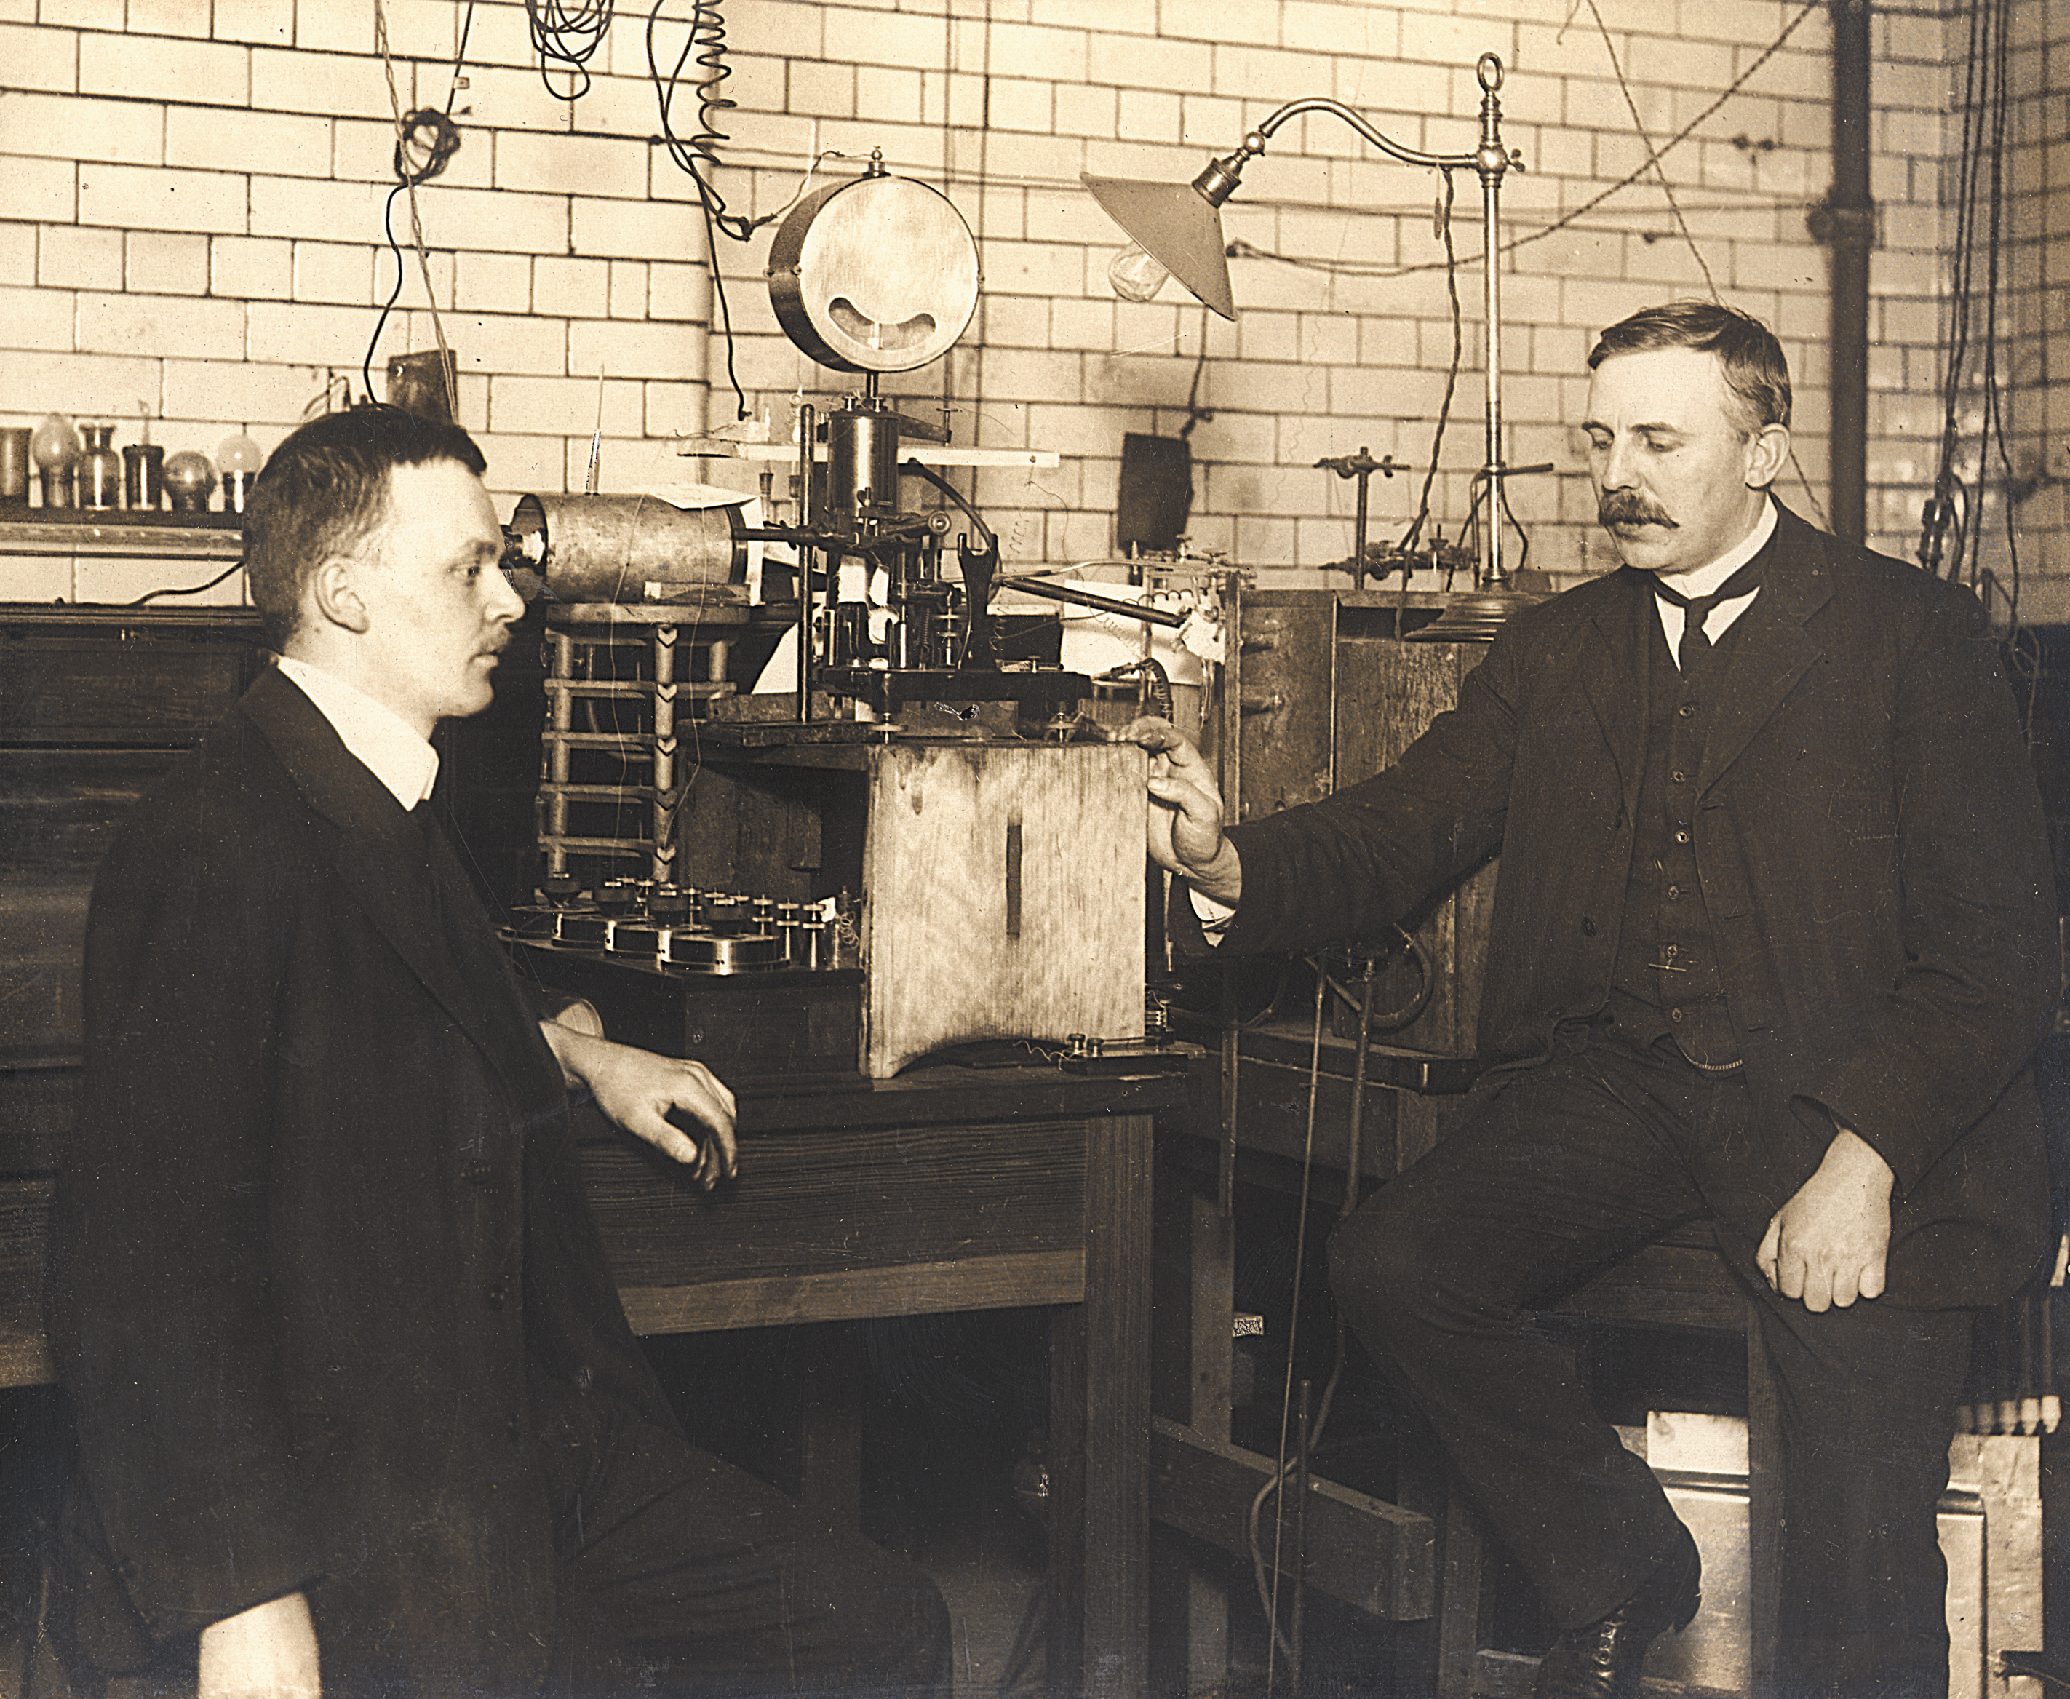
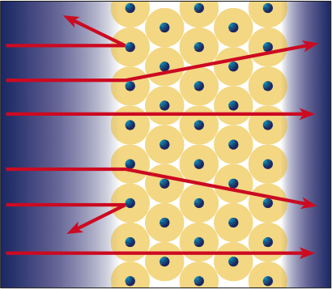
The structure story
Rutherford + Geiger & Marsden 1909
McAllister and Hofstadter 1956: radius of proton 0.7-0.8 fm

Slide 10
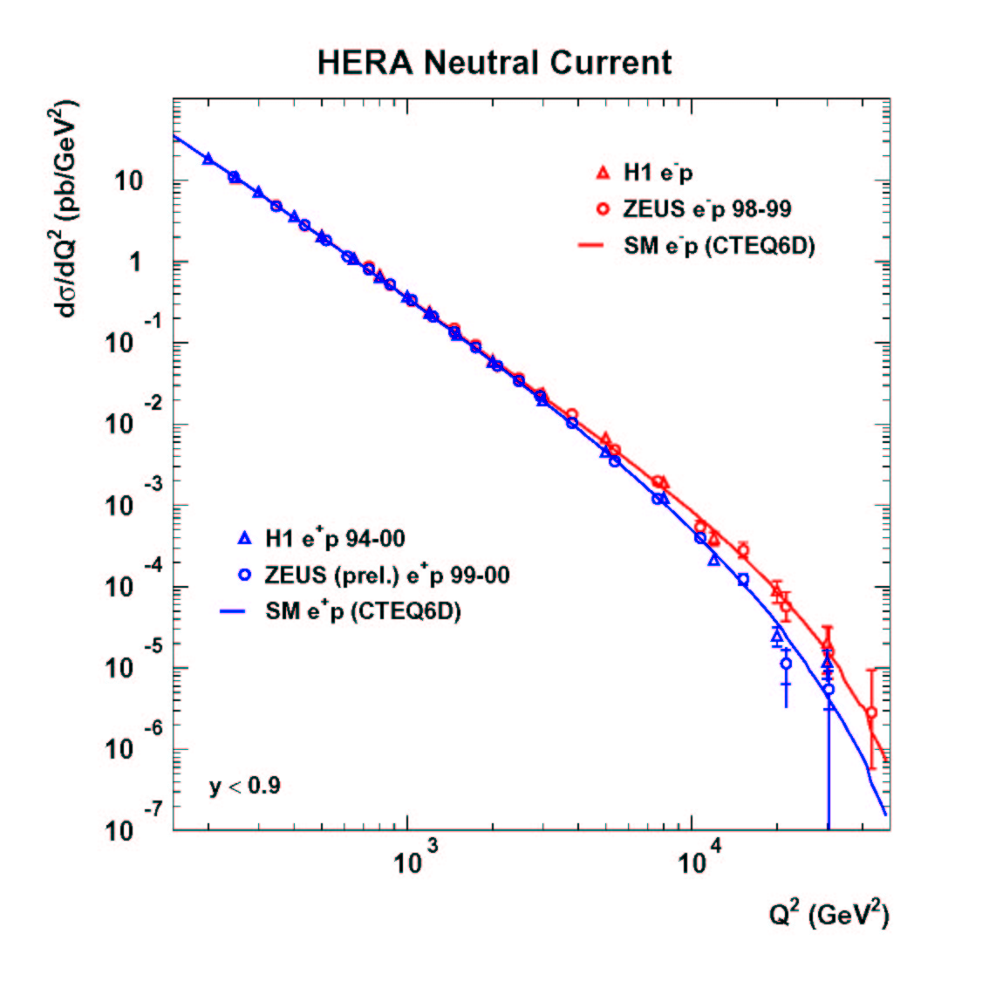
Is there substructure to quarks ?
Assuming R²Q²<<1
HERA: radius of quark <0.001 fm

Slide 11
Proton with three valence quarks ??
No sign of further substructure – quarks are as point-like as electrons
.
d
.
u
.
u
1.6 fm

Slide 12
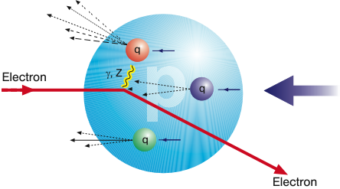
Structure Functions
k
k’
‘structure functions’
{
Transverse resolution
What we measure
Parton momentum
(fraction of proton momentum)
Inelasticity

Slide 13
Feynman’s parton model
Nucleon ∞ momentum frame. Virtual photon from the electron samples the quark distribution.
p
All partons moving parallel to the nucleon. Assume massless and no significant transverse momentum. Parton carries fractional momentum
γ
Interactions between partons in this frame time-dilated, so wavefunction not changing during the time of the interaction.
e

Slide 14
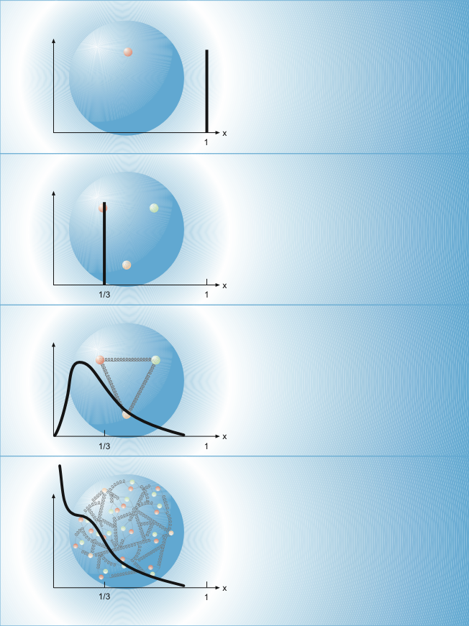
F₂
Single quark
Behavior of F₂ for different models of the proton
Three non-interacting quarks
Three interacting quarks

Slide 15
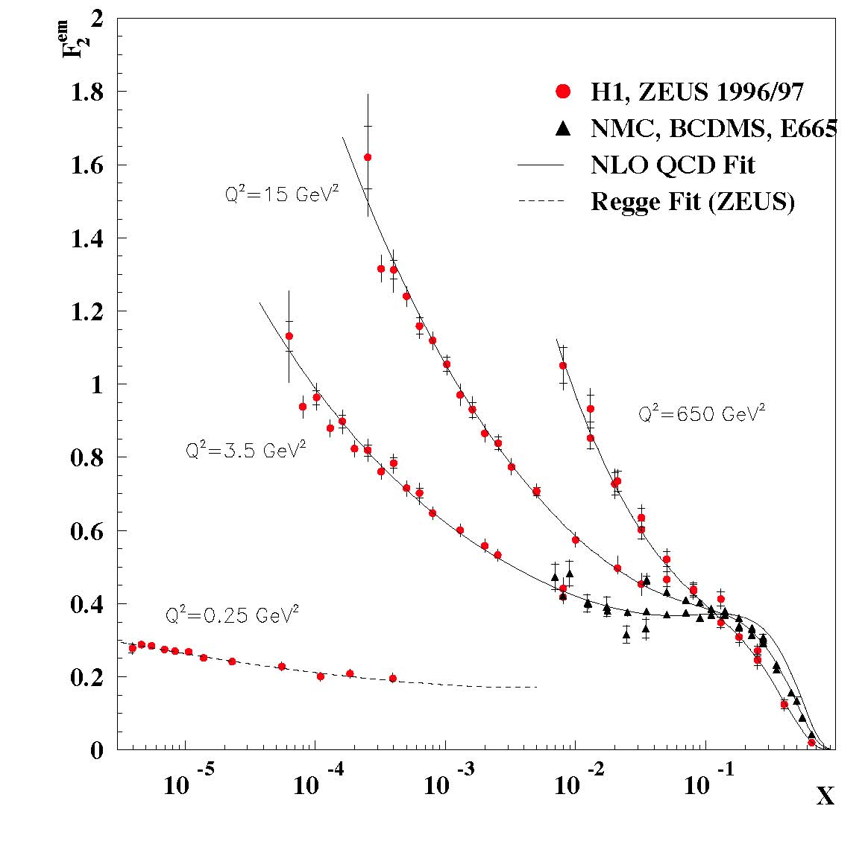
First HERA discovery
Small-x
F₂∝ x^{-λ}
The rise of F₂ with decreasing x is strongly dependent on Q².
Or, the proton, viewed with a fine probe, is full of quarks, antiquarks and gluons !
BPC/BPT data
Increasing energy
shorter time fluctuations

Slide 16
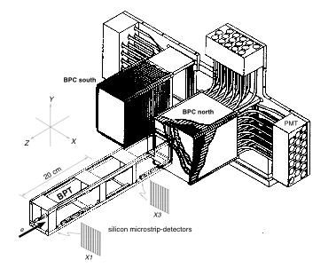
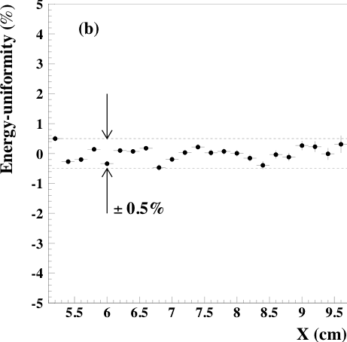
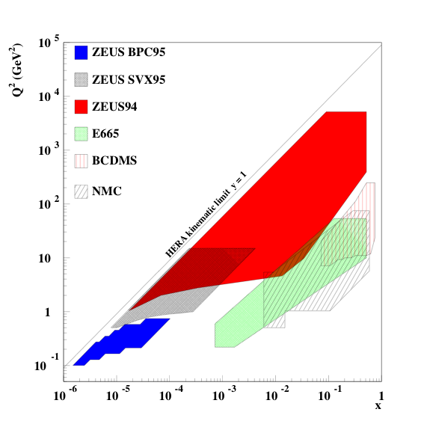
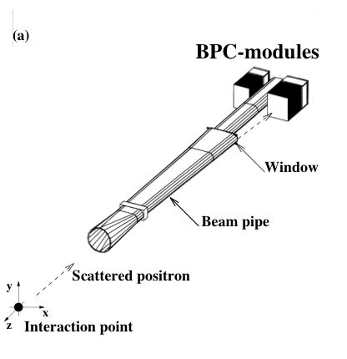
Robert designed and oversaw the construction of the BPC/BPT

Slide 17
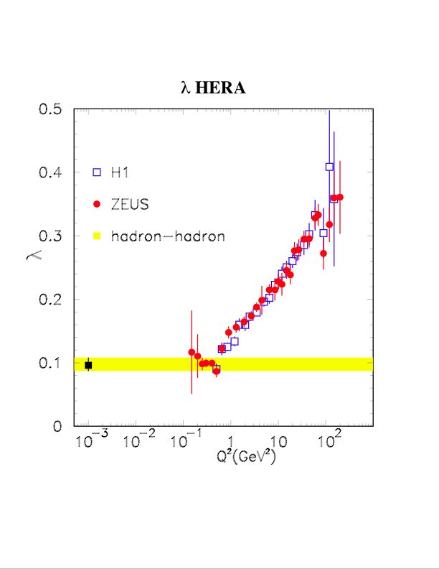
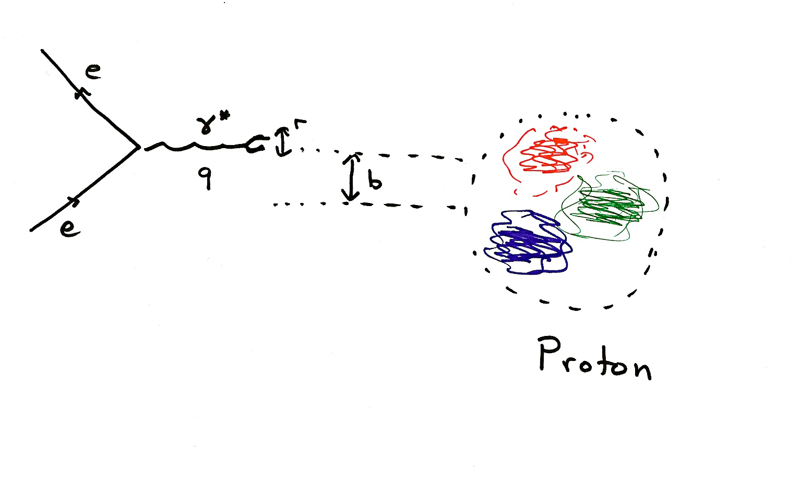

The rise at small x
Parametrize:
Below Q² ≈0.5 GeV², see same x (energy) dependence as observed in hadron-hadron scattering
Q=1 GeV corresponds to about 0.2 fm
Transition region

Slide 18
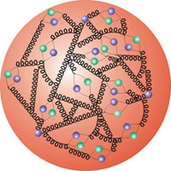
Proton with three ‘dressed’ valence quarks
.
‘Quark substructure’ can be seen when we get resolution smaller than about 0.3 fm. With finer resolution, see that the three quarks are composed of many subconstituents.
.
~0.3 fm

Slide 19
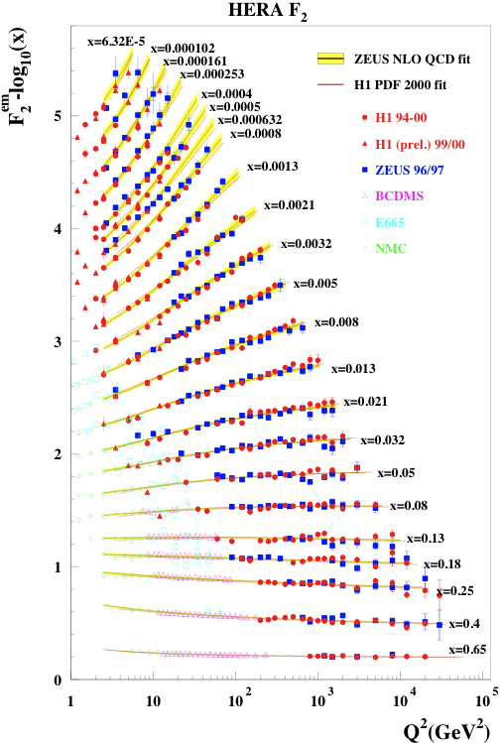
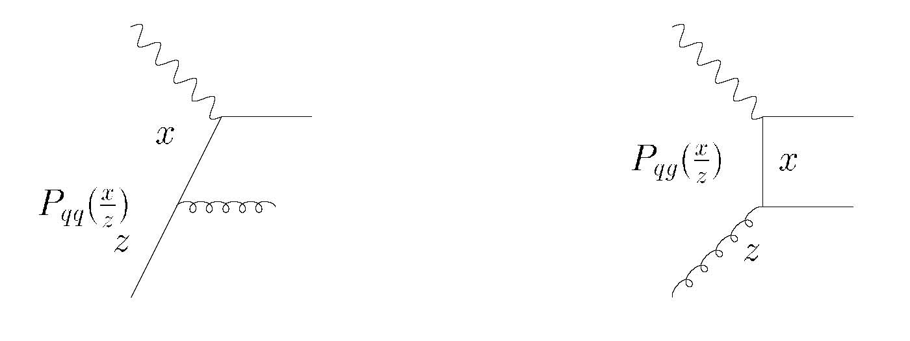
The variation in F₂ with Q² (for Q²> few GeV²) is in excellent agreement with the expectations of standard perturbative QCD (famous Dokshitzer, Gribov, Lipatov, Altarelli, Parisi evolution equations).

Slide 20
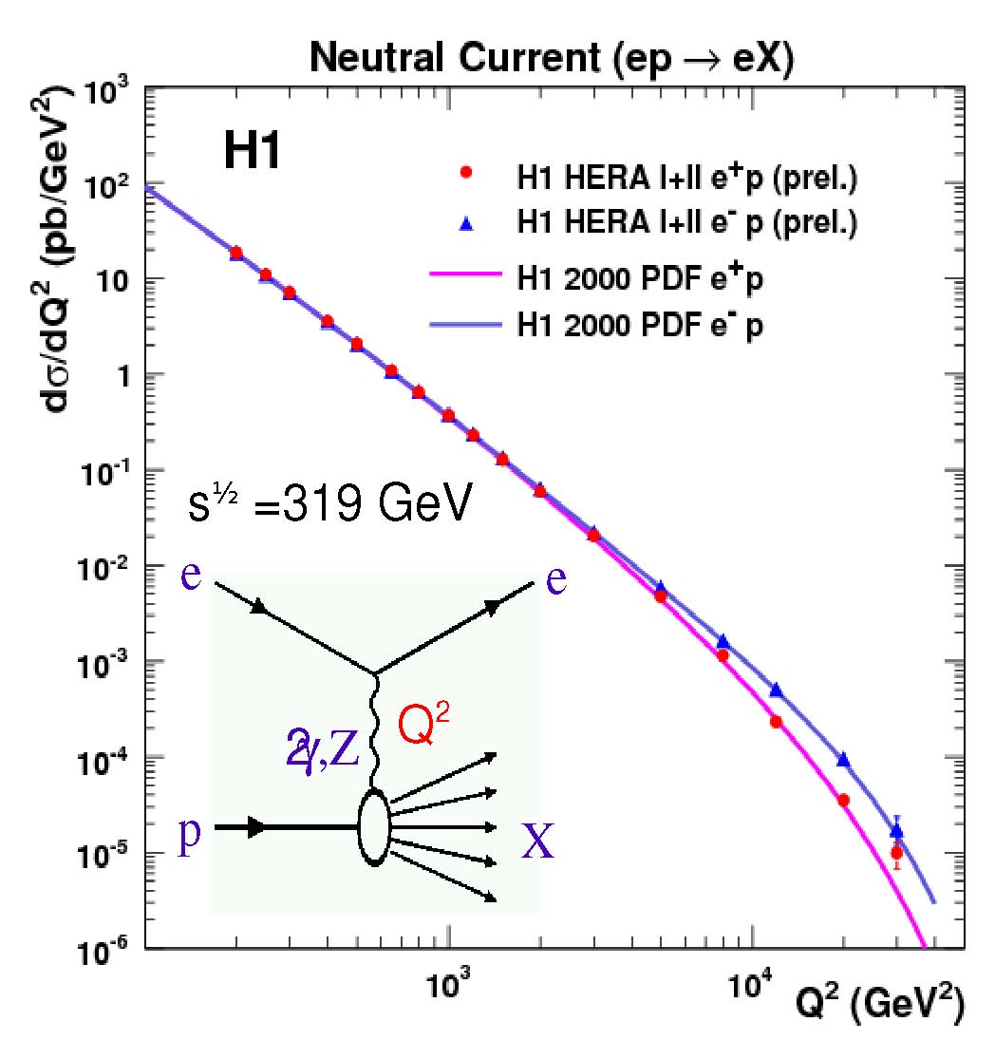
Valence Quarks from xF₃
Note: information on valence quarks comes primarily from pre-HERA fixed target experiments.

Slide 21
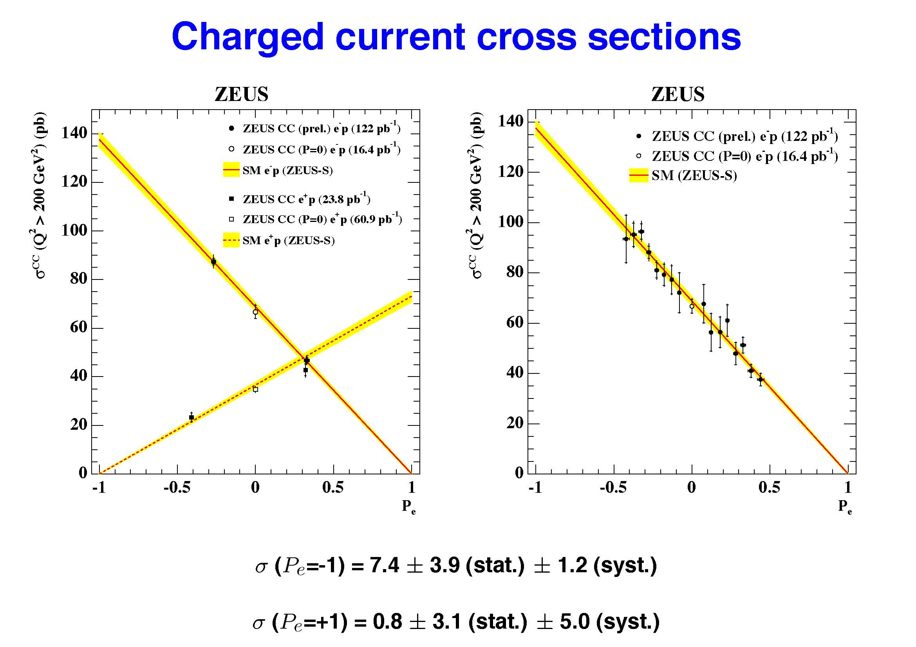
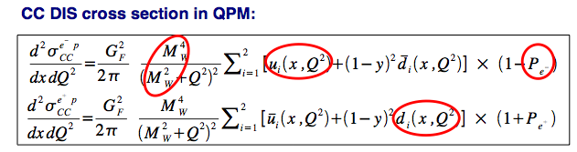
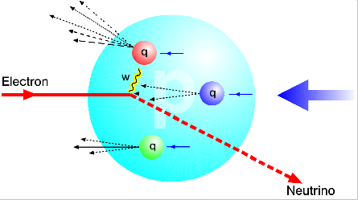
No sign of a W_{R}

Slide 22
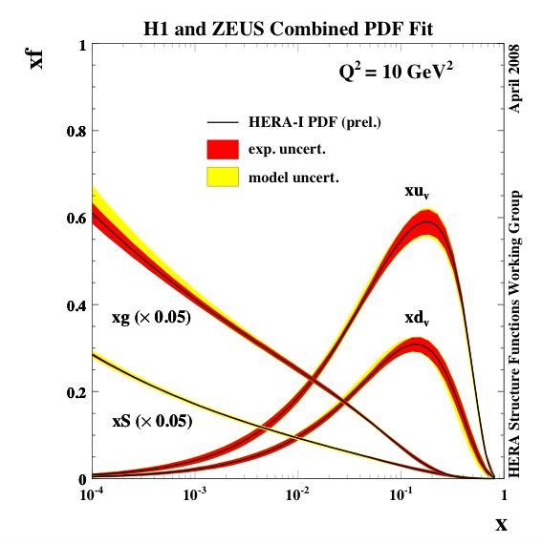
Analysis of cross sections in terms of parton densities (quarks and gluons)

Slide 23
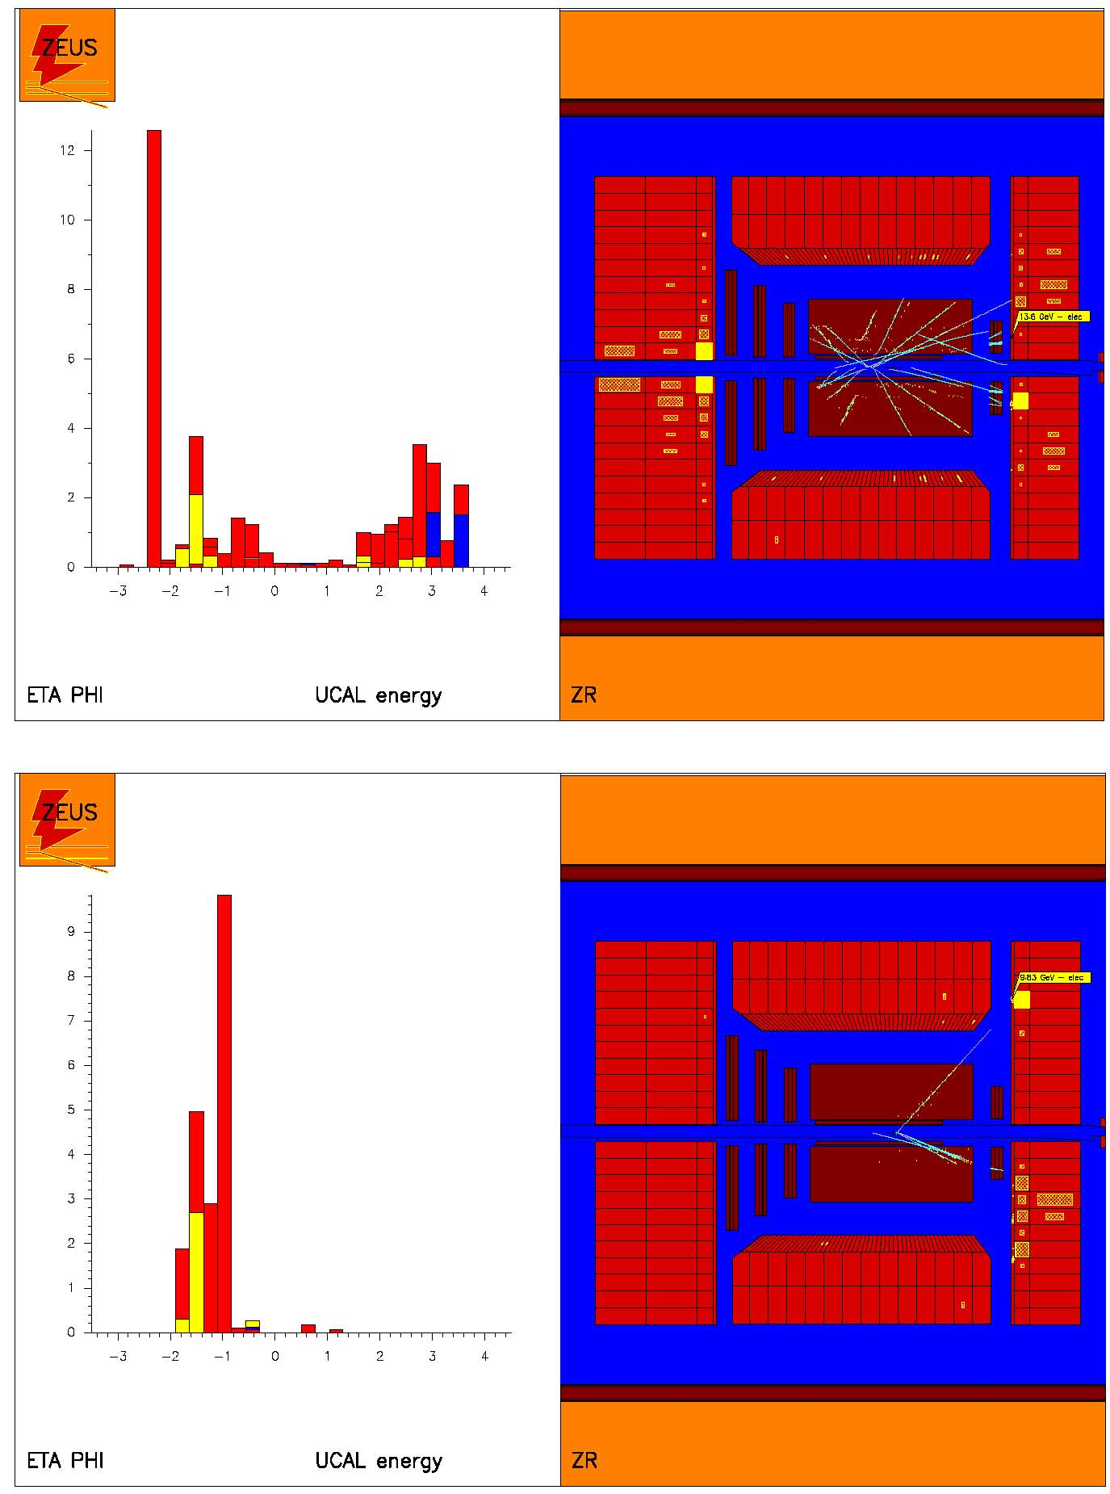
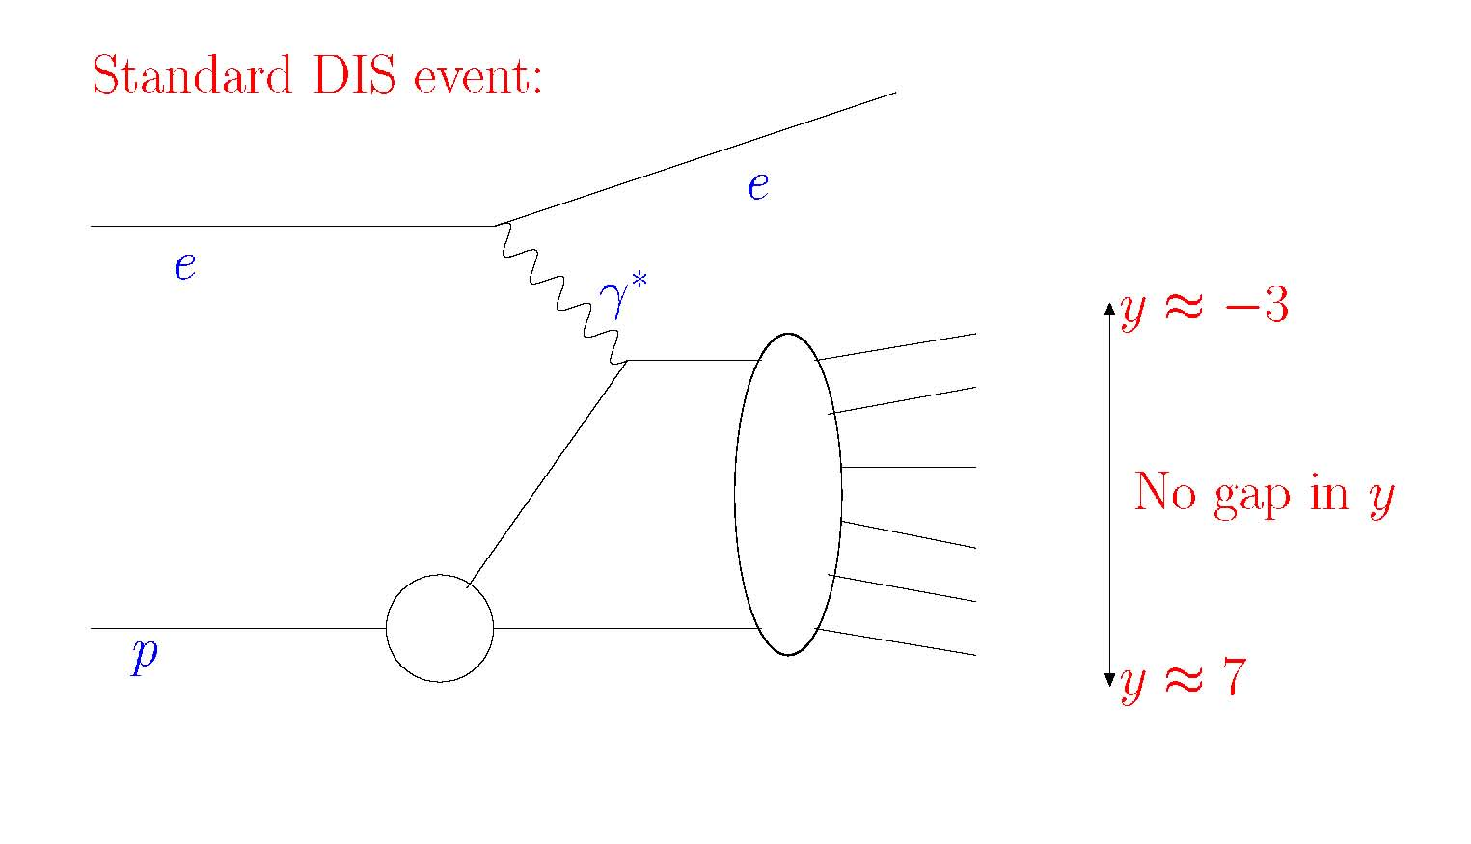
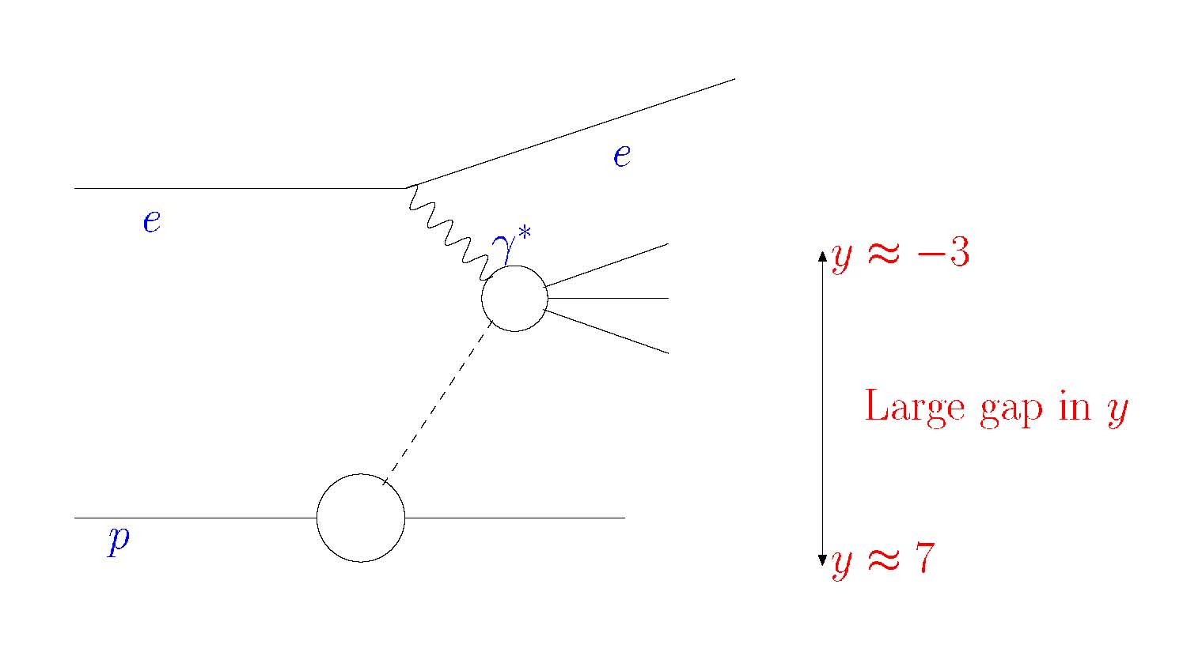
Second HERA surprise: large rapidity gaps !
E
rapidity
Color-neutral object

Slide 24
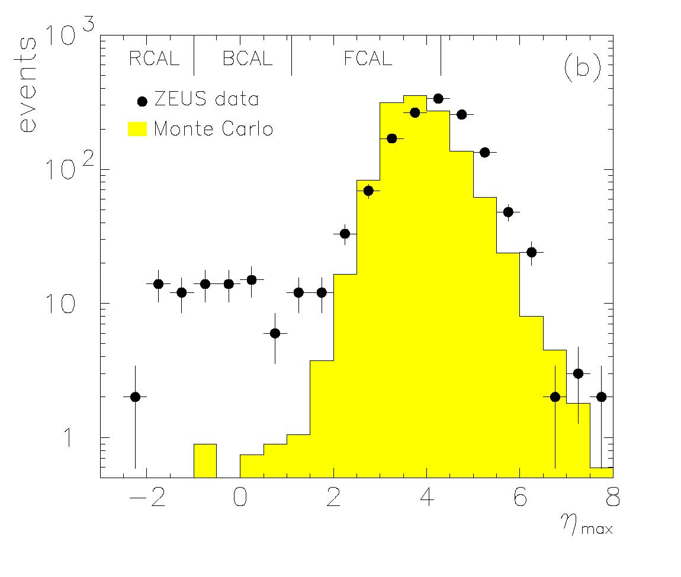
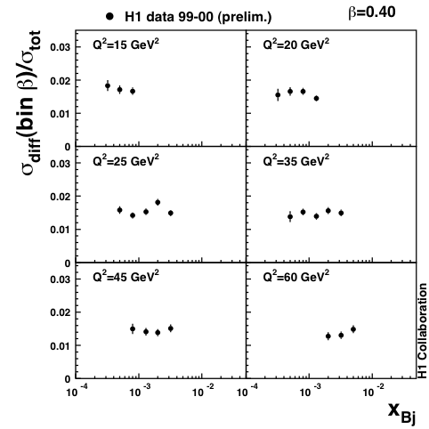
≥10% of events have large rapidity gap !
Implies scattering on color neutral cluster: at least two gluons. Sometimes called ‘Pomeron’.
η≈y
Ratio of diffractive/total independent of x at small x.
Indication: small-x physics is universal.

Slide 25
Proton with three dressed valence quarks +
‘Quark substructure’ can be seen when we get resolution smaller than about 0.3 fm. With finer resolution, see that the three quarks are composed of many subconstituents.
Small colorless gluon clusters between the valence quarks. Colorless clusters have similar structure as valence quarks.
Plus short lived fuzz outside (the expanding proton).
.
.
~0.3 fm

Slide 26
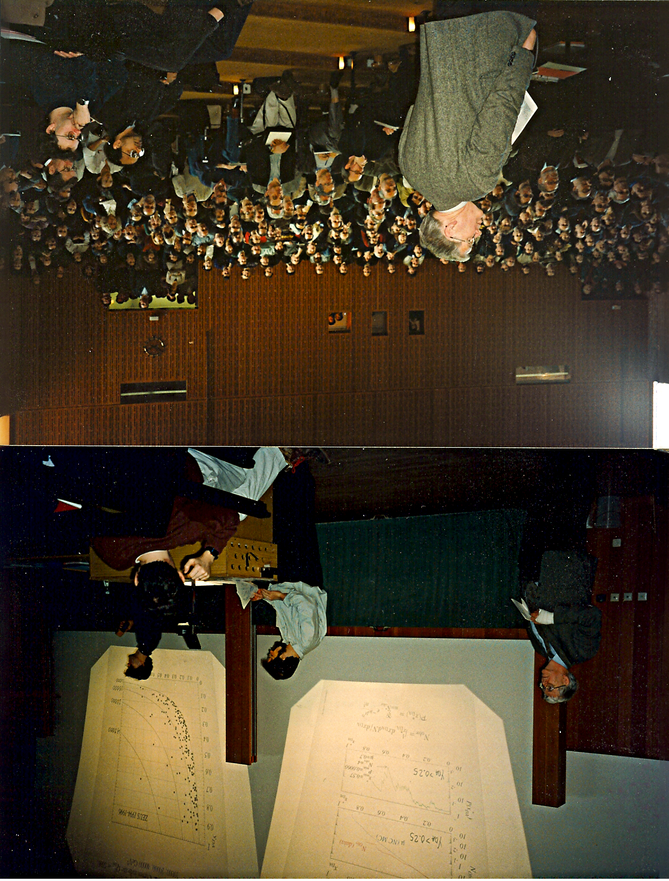
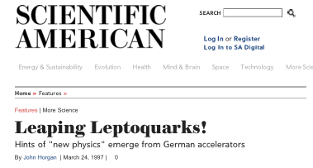
Robert was spokesperson of ZEUS when the “leptoquark” excitement broke out…

Slide 27
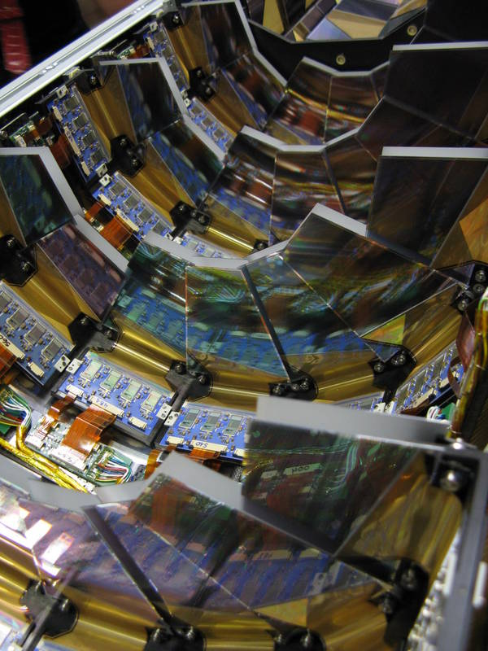
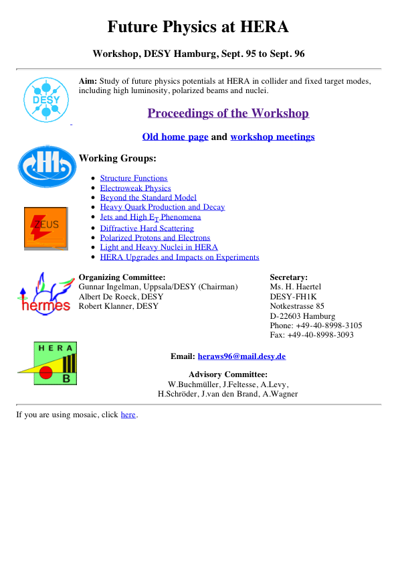
As ZEUS Spokesperson, Robert motivated and pushed for the construction of the Silicon micro vertex detector
As DESY Research Director, Robert guided the start-up of HERA II and presided over the first years of high luminosity running.

Slide 28


Slide 29

BPC had a second life as luminosity detectors for ZEUS in HERA II
The Hamburg group designed, constructed and commissioned the 6m Tagger. Important to F_{L} measurement, allowed first ever measurement of energy dependence of γP cross section at high energies.

Slide 30


Measured with 6m tagger

Slide 31



Standard parton density extraction gives predictions for F_{L} in good agreement with measurements, except for Q²<10 GeV².

Slide 32


Heavy Quarks

Slide 33


Theory of small-x
The small-x domain is a wonderful theoretical playground: BFKL, dipole scattering, travelling waves, stochastic differential equations, chaos, biological evolution,…
It is complicated (so far), but also likely goes very deep.
Asymptotic scaling

Slide 34

Is this the right way to look at nucleons in the high energy limit ?

Slide 35


Strong interactions led to string theory…

Slide 36


.
.
~0.3 fm
~1900
~1970
today
With HERA, we see resolved constituent quarks - still missing the full evolution picture. Small-x partons are a universal property of matter → fundamental physics. Several options for new experiments are under discussion.

Slide 37

My first encounter with Robert came while I was a PhD student on the TASSO experiment.
Robert was asked by Günter Wolf to proof-read my contribution to the 1986 Moriond proceedings…

Slide 38

Robert,
Thank you for showing us the way
Thank you for all you have done for ZEUS
Thank you for all you have done for DESY
Thank you for all you have done for particle physics !
And, enjoy your retirement !!!

