Slide 1
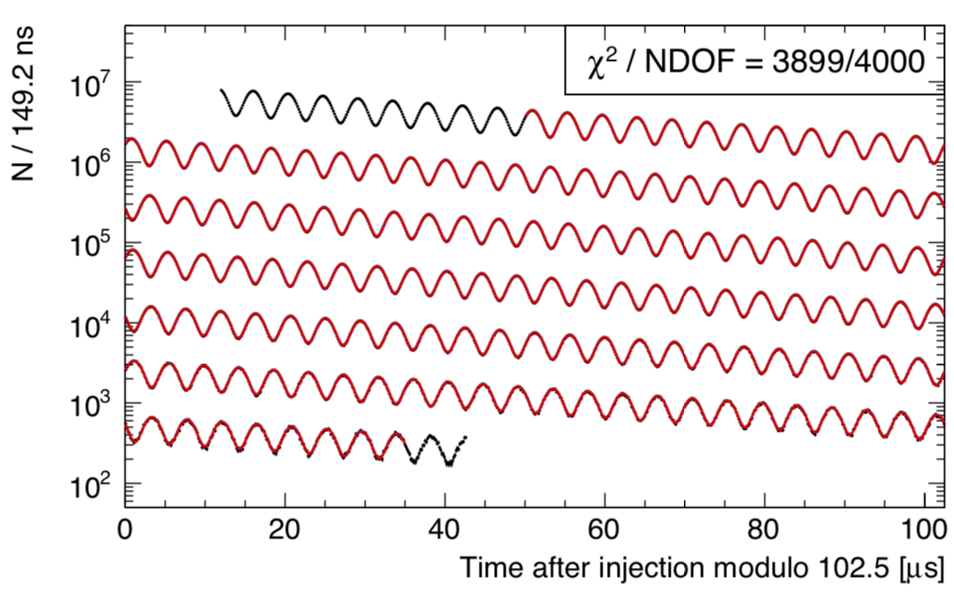
First results from the Fermilab Muon g-2 Experiment
Brendan Casey, Fermilab
DESY Particle and Astroparticle Physics Colloquium
May 4, 2021

Slide 2
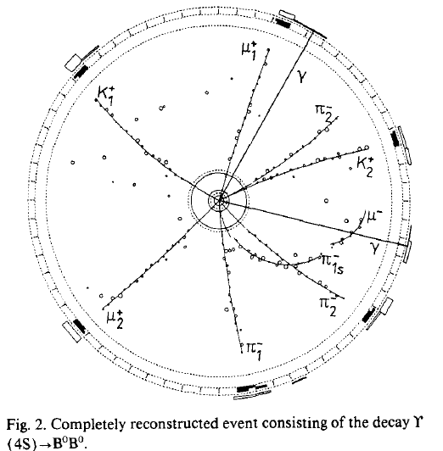
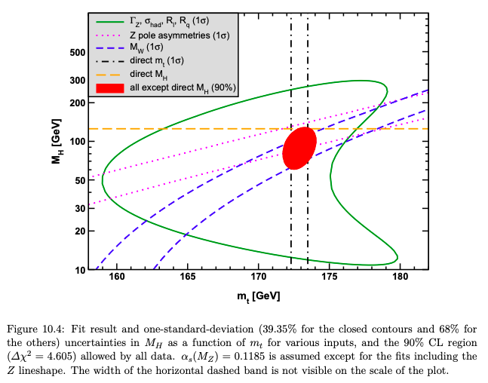










Particle Properties
Elementary particles talk to each other through loops and boxes.
This allows us to learn information about new particles by making precision measurements of the properties of old particles.
$$m(t)$$
$$B^{0}→D^{∗}μ^{−}ν$$
$$D^{∗}→D^{0}π^{−}$$
$$D^{0}→K^{+}π^{−}$$
$$m(W)$$
$$m(H)$$
ARGUS Collab, PLB 192, 245 (1987)
$$B^{0}→D^{∗}μ^{−}ν$$
$$D^{∗}→D^{−}π^{0}$$
$D^{−}→K^{+}π^{−}$ $π^{−}$
b
t
d
W
W
Erler, Freitas, PDG Review (2020)
d
b
t
The Higgs looks like the Standard Model Higgs
$$m(t)≫m(W)$$

Slide 3



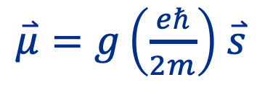



The g-factor
The g-factor relates a particle’s magnetic moment to its intrinsic spin in units of the Bohr Magnetron
$\overset{⃑}{μ}=g\left(\frac{eℏ}{2m}\right)$ $\overset{⃑}{s}$
For a simple classical system:
Magnetic moment:
Angular momentum:
$$μ=IA$$
$$L=rmv$$
$$I= \frac{qv}{2mr}, A= πr^{2}$$
Ratio:
r
$$\frac{μ}{L}=\frac{q}{2m}$$
$$μ=\frac{1}{2}qvr$$
m, q
$$g=1$$
The classical or non-relativistic quantum mechanics prediction is g=1

Slide 4
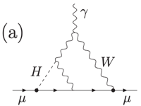
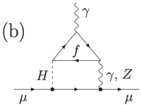
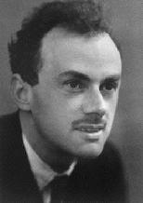
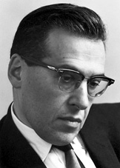


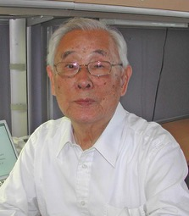
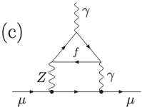
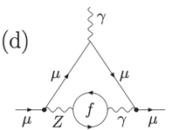





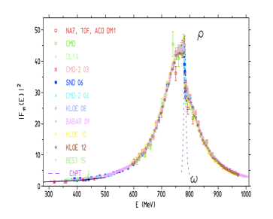

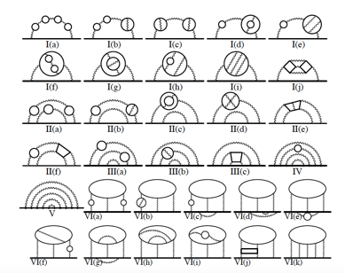

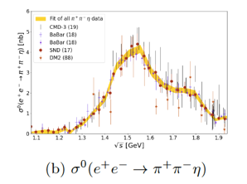
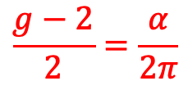
The muon’s g-factor
Stokinger et. al:
g_{μ}(predicted)
QED
QCD
EW
= 2.00
2331
83
622
Schwinger:
$$\frac{g−2}{2}=\frac{α}{2π}$$
Dirac’s equation in a weak magnetic field
Kinoshita et. al:
BJ, Drell
2 comes from the extra degrees of freedom associated with antimatter

Slide 5
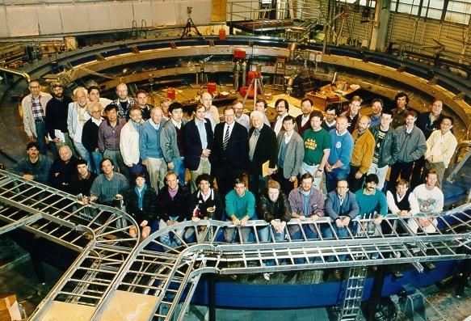
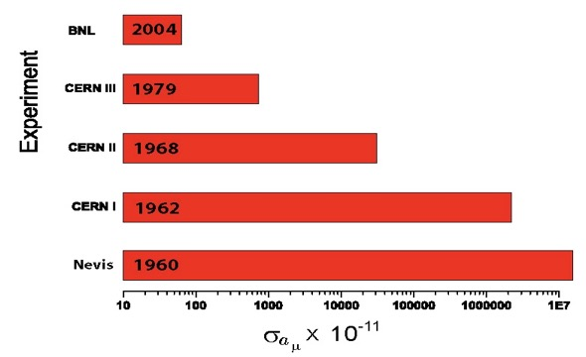
The muon’s g-factor
g_{μ}(predicted)
QED
QCD
EW
= 2.00
2331
83
622
(076)_{KNT}
g_{μ}(measured)
= 2.00233184182
(127)_{BNL}
Brookhaven E821 Collaboration
Large improvements over 4 decades of experiments at Columbia, CERN, and Brookhaven led to the current measured value (as of a month ago)

Slide 6
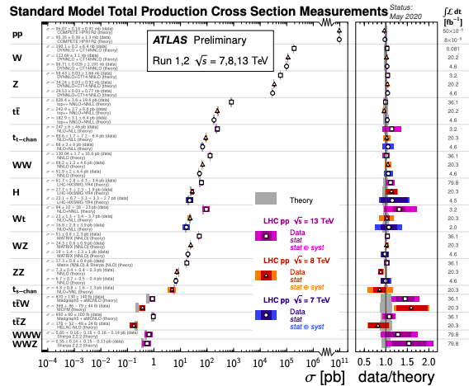
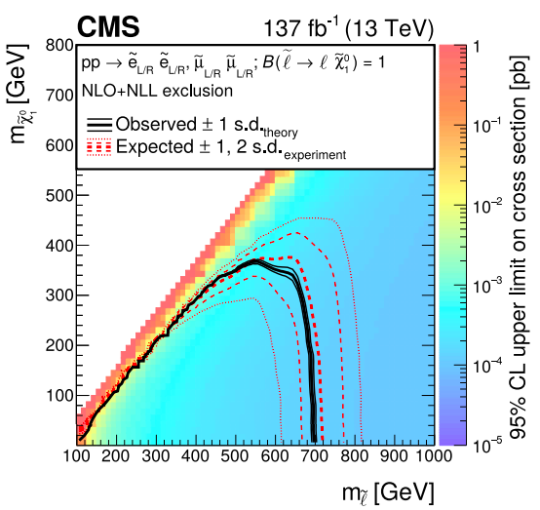
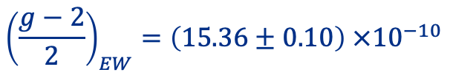

The muon g-2 discrepancy
Measured – predicted g-2:
$∆\left(\frac{g−2}{2}\right)=\left(28.02±7.37\right) ×{10}^{−10}\left(3.8σ\right)$
Electroweak contribution to g-2:
$${\left(\frac{g−2}{2}\right)}_{EW}=\left(15.36±0.10\right) ×{10}^{−10}$$
Discrepancy is almost twice as large as electroweak contribution!
This must be something big!
The mystery:
If this is something that’s bigger than the weak force, why didn’t we see new particles at
UA1, UA2, LEP, LEP-II, SLD, the Tevatron,
or the LHC?

Slide 7
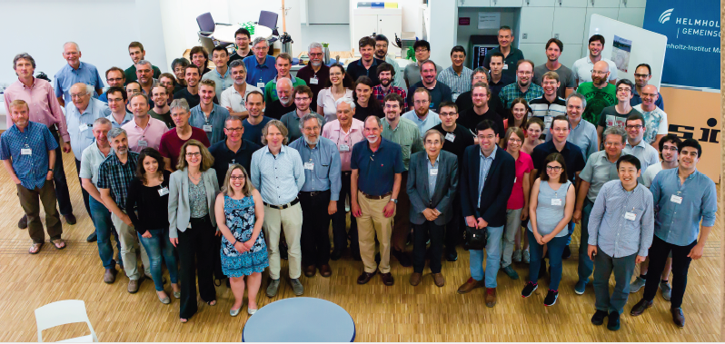
The muon g-2 discrepancy
Next feature of the discrepancy that pops out is it starts in the digits dominated by QCD.
So maybe this is ‘simply’ an underestimate of the QCD contribution.
(we’ve all seen anomalies that wound up being underestimates of QCD)
QED
QCD
EW
g_{μ}(predicted) = 2.00233183622
g_{μ}(measured) = 2.00233184182
The muon g-2 Theory Initiative
Group of 132 theorists and experimentalists that worked from 2017-2020 to put together a major update of the predicted value of g-2
Produced a 196-page white paper including 824 references
arxiv:2006:04822

Slide 8
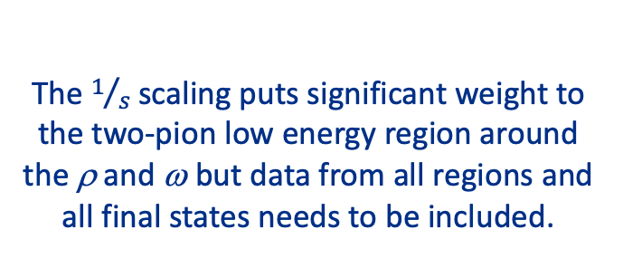
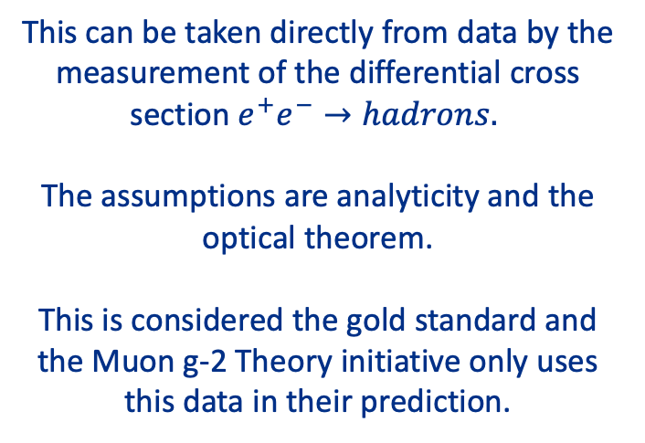
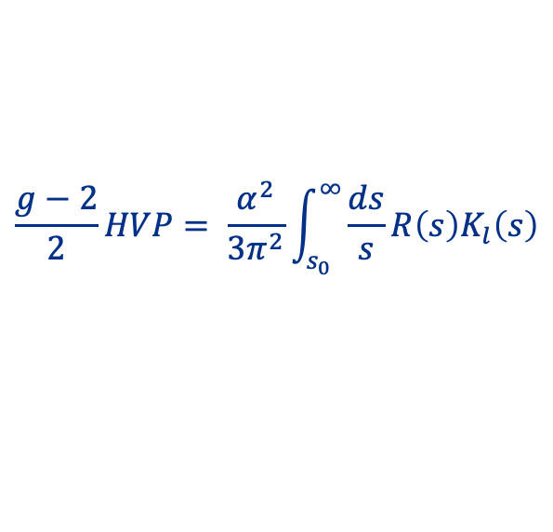
Leading order QCD: HVP
γ
The leading order QCD contribution comes from Hadronic Vacuum Polarization
μ
μ
Quarks, gluons, resonances
This can be taken directly from data by the measurement of the differential cross section${ e}^{+}e^{−}→hadrons.$
The assumptions are analyticity and the optical theorem.
This is considered the gold standard and the Muon g-2 Theory initiative only uses this data in their prediction.
e⁺
hadrons
R-scan data
γ
e⁻
e⁺
hadrons
Radiative return
γ
e⁻
γ
The $1/s$scaling puts significant weight to the two-pion low energy region around the ρ and ω but data from all regions and all final states needs to be included.
$$\frac{g−2}{2}HVP= \frac{α^{2}}{{3π}^{2}}\int_{s_{0}}^{∞}{\frac{ds}{s}R\left(s\right)K_{l}\left(s\right)}$$

Slide 9
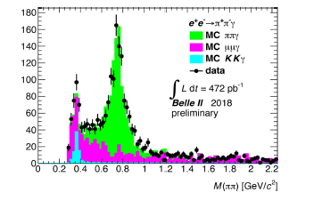
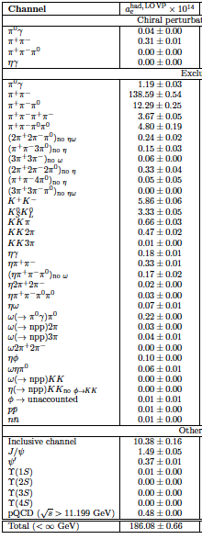
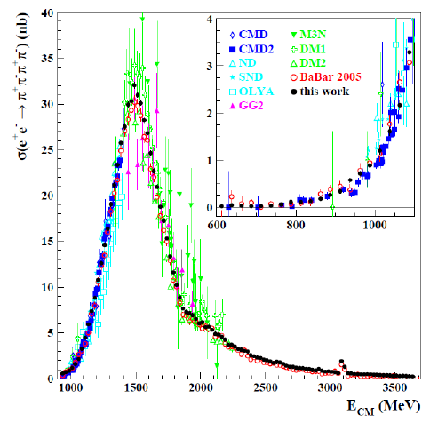
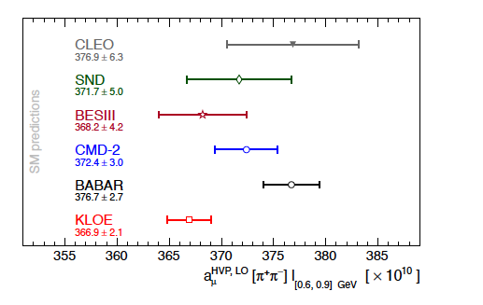
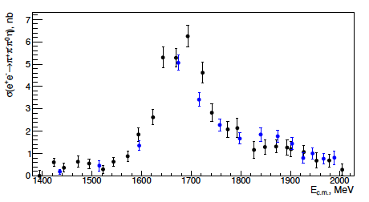




Gold Standard: $e^{+}e^{−}→hadrons$
3-body
BaBar
$$π^{+}π^{−}γ$$
KLOE
$$π^{+}π^{−}$$
2-body
4-body
$$π^{+}π^{−}π^{+}π^{−}$$
CMD-III
$$π^{+}π^{−}π^{0}η$$
8-body
g-2 theory initiative value

Slide 10
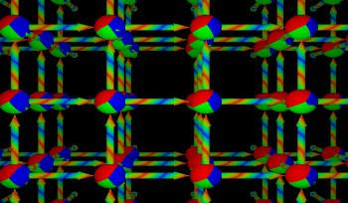
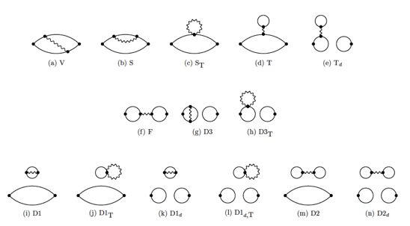
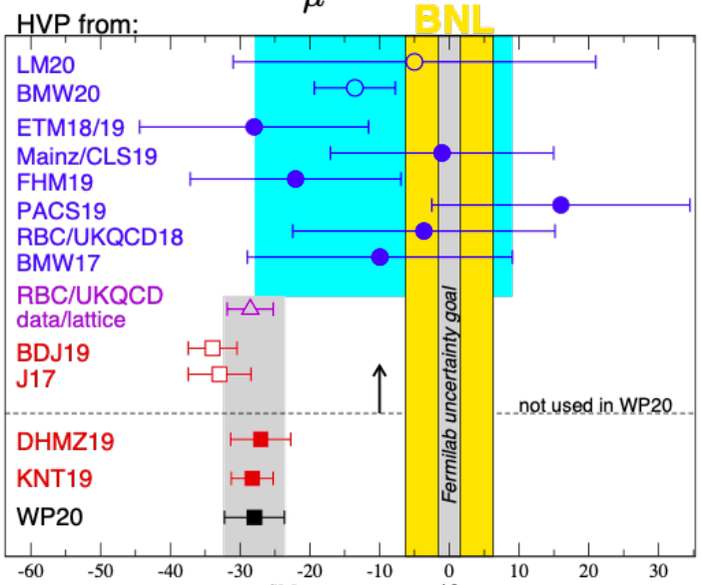
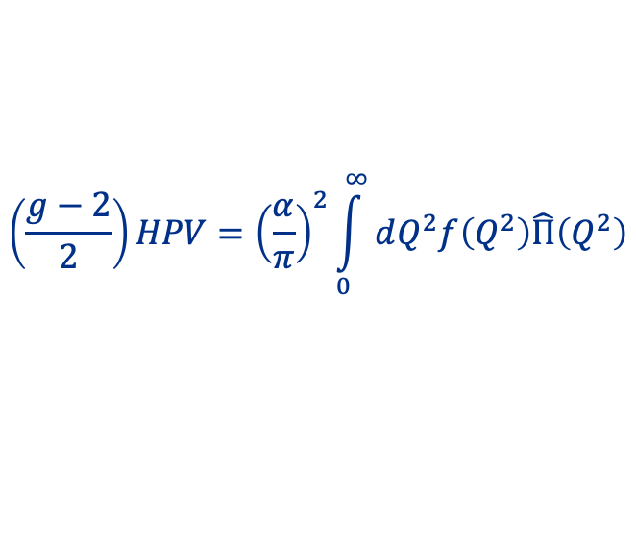

Other HPV evaluations: Lattice
A promising and ambitious alternative is to calculate the QCD contribution from scratch by integrating over discrete lattice spacing and and extrapolating to the continuum limit
$$\left(\frac{g−2}{2}\right)HPV={\left(\frac{α}{π}\right)}^{2}\int_{0}^{∞}{dQ^{2}f\left(Q^{2}\right)\hat{Π}\left(Q^{2}\right)}$$
BMW preliminary result came out soon after the release of the original white paper.
If it is confirmed by other groups, it will be a clear indication that the QCD contribution is not under control.
$$\left(\frac{g−2}{2}\right)pred−meas ×{10}^{−10}$$

Slide 11
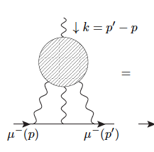
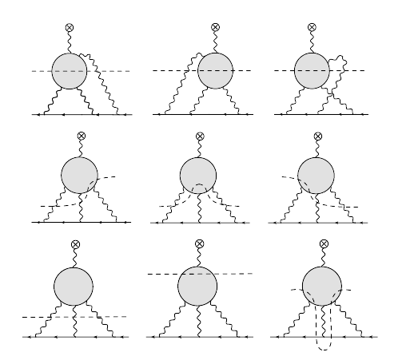
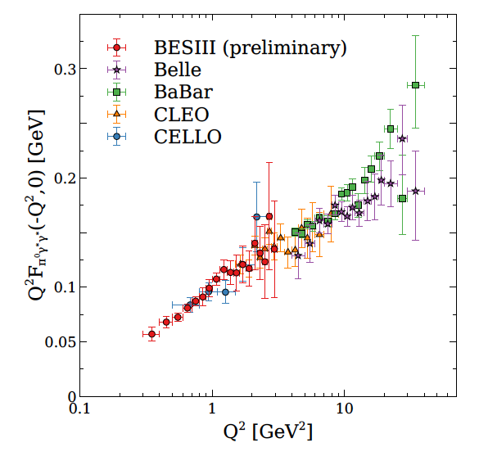
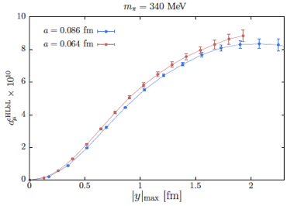
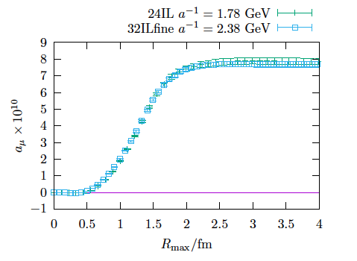
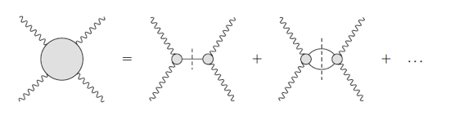
Higher order QCD: HLbL
Main higher order QCD contribution is hadronic light-by-light scattering.
In the past, this was based on model calculations and there have been worries about how well the model errors were under control.
Contribution is now based on the sum of several dispersive relationships.
Also now competative results from the lattice
Mainz
RBC

Slide 12
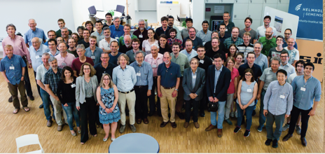
The muon g-2 discrepancy
QED
QCD
EW
g_{μ}(predicted) = 2.00233183622
g_{μ}(measured) = 2.00233184182
After a ton of work by a ton of people, the QCD contribution and all other SM contributions are mainly unchanged
g_{μ}(QED + EW + HVP_{LO} + HVP_{NLO} + HVP_{NNLO} + HLbL + HLbL_{NLO}) =
g_{μ}(Theory Initiative) = 2.00233183620(86)
Expect another major update once results are available from the VEP2000 experiments and the flavor factories and when the BMW lattice result is confirmed
Only one thing left to do, redo the measurement!

Slide 13
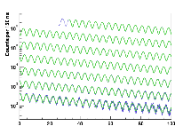
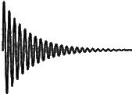
Muon g-2 technique
Muonium and hydrogen hyperfile splitting
μ
e
p
e
B
μ
p
Free induction decay in NMR probes
# high energy positrons versus time from the stored muon beam

Slide 14
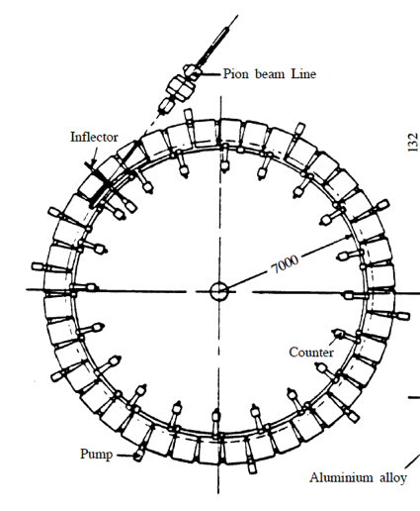
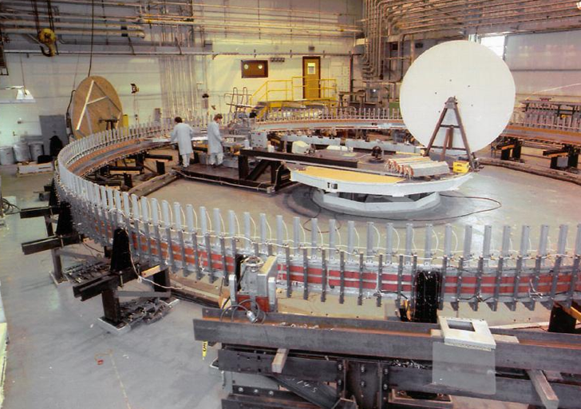

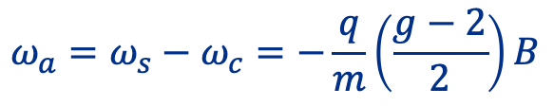
Storage ring technique
Main observable is the difference between the muon precession frequency and the cyclotron frequency
$ω_{c}=\frac{q}{m}B, { ω}_{s}= \frac{g}{2}\frac{q}{m}B$
$$ω_{a}=ω_{s}−ω_{c}=−\frac{q}{m}\left(\frac{g−2}{2}\right)B$$
Developed and improved by the CERN I, II, III experiments and the BNL E821 experiment
CERN III ring
40 separate magnets
BNL: One continuous magnet
First decision: reuse BNL magnet!

Slide 15
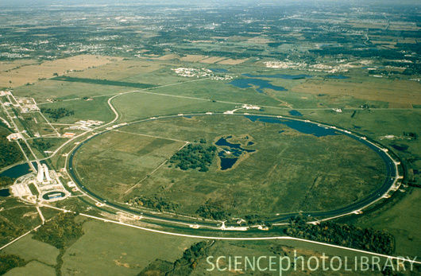
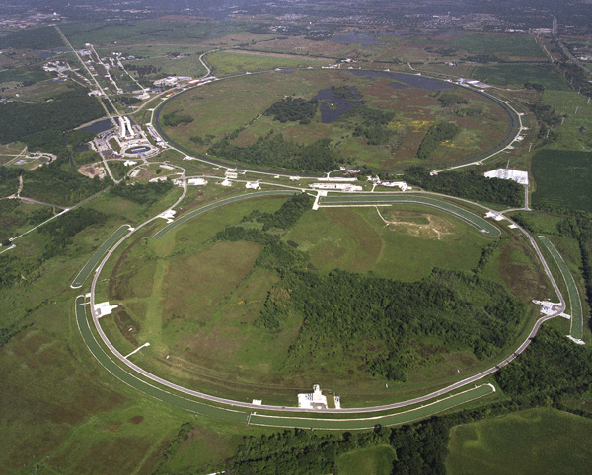
Right place, right time
Fermilab pre 1985
before antiprotons:
1 linac, 2 rings
Antiproton production
New synchrotron + 3 new storage rings
With the end of Tevatron Run II, these are all now available for muon physics and allow us to repeat the BNL statistics once every 4-6 weeks

Slide 16
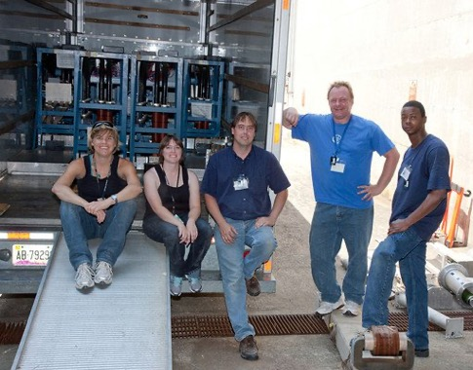
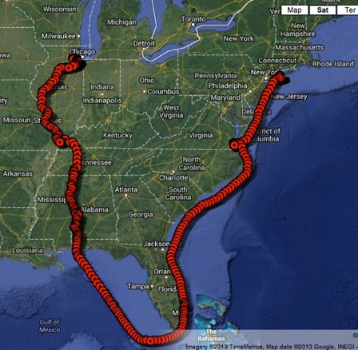
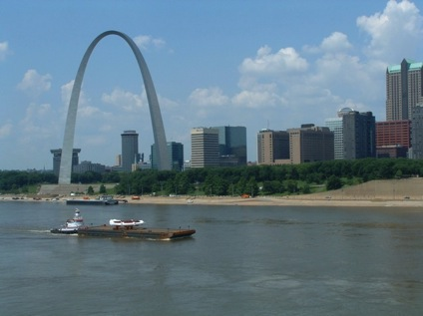



From NY to Illinois the hard way
Summer 2011
Summer 2013
Fall 2014

Slide 17
Shimming
N
N
N
S
S
S
N
N
S
S

Slide 18



More shimming

Slide 19

The results

Slide 20

Muon Production (above ground)

Slide 21


















Below ground

Slide 22

Muon precession frequency measurement
V-A decay, positron follows spin direction, and highest energy positrons occur when spin and momentum vector are aligned
momentum
# high energy positrons versus time
spin
What data looks like if g-2 = 0
What data looks like if g-2 = 0.002
t(μs)
t(μs)
Direct measurement of radiative corrections

Slide 23




Calorimeters
PbF₂ xtals
e⁺
9x6 array of PbF₂ crystals at 24 locations on the inside of the ring (54 segments at FNAL, 1 segment at BNL)
GPU based DAQ(18 GB/s at FNAL, 1 MB/s at BNL)
10 MHz GPS disciplined Rubidium clock with ~1ppt Allan variance
800 MSPS WFDs with 128 MB memory (400 MSPS w/64kB mem at BNL)

Slide 24

Beam dynamics
Beam parameters: acceptance is different when the beam is breathing (big effect early).
not all muons are on the ideal (magic) orbit. Leads to ppm level corrections
extended and off-center beam sees non-uniformities in the field
Power spectrum of residuals to a simple cos(ωt+φ) fit
Must be able to measure beam parameters in different locations as a function of time to validate our model of the beam.

Slide 25



Trackers
Doublet layers of 5mm diameter, 15mm wall thickness straws with UV layers at 7.5 degrees stereo angles
Located in front of two calorimeters at ~90 degrees and ~270 degrees.
125 mm hit resolution and sub mm resolution on beam location

Slide 26






(Removing) Beam motion
22 parameter fit
Muon losses
Mean horizontal motion
Mean vertical motion

Slide 27
Muon precession frequency systematics
Dominant feature:
φ is the phase between the spin and momentum at the beginning of the fit.
BNL 2001 run
# high energy positrons versus time

Slide 28
Systematics
Leading systematics come from time dependence in the phase
Taylor expansion:
Things that change “early to late” in the fill typically lead to a time dependence in the phase of the accepted sample that directly biases the extracted value of ω_{a}

Slide 29
Systematics
φ₁
φ₂
Pileup: two low energy positrons fake a high energy positron
(happens early, not late)
φ_{early} ~ φ₁ + φ₂
φ_{late} ~ φ₁
momentum
spin
calo
Gain change:
example: saturation (happens early, not late)
φ_{early} ~ φ₁
φ_{late} ~ φ₂
φ₁
φ₂
Above thresh. early
Above thresh. late
calo
Δω ~ Δφ
Design not driven by absolute performance, but relative stability early to late

Slide 30




Laser System
Highly tunable, precise laser system sends pulses to all crystals
Recovery after beam splash
Recovery between two consecutive hits
Templates tuned for each crystal
Pileup and gain systematics reduced from 180 ppb at BNL to 41 ppb

Slide 31





Residual systematics from beam motion
Towards the end of the run, a few HV feedthrough resistors broke, changing the RC time constant of the ramp
So the beam is moving
early-to-late
in the fill

Slide 32





Phase coupling to acceptance
Phase between the muon spin and momentum
Phase advance between decay time and detection time due to path length
If the beam is moving, this phase advance is changing
Vertical decay position
Horizontal decay position
$$\frac{∆ω_{a}}{ω_{a}}=−164±80 ppb$$
Phase at calorimeter depending on muon decay point
For final run period:

Slide 33










Muon precession frequency results
$$σ_{ω_{a}}=\left(434 stat ±56 sys\right)ppb$$
Run dependent corrections$=\left(449 −601\right)ppb$

Slide 34
Muon g-2 technique
Muonium and hydrogen hyperfile splitting
μ
e
p
e
B
μ
p
Free induction decay in NMR probes
# high energy positrons versus time from the stored muon beam

Slide 35

Nuclear Magnetic Resonance

Slide 36







Field measurement
Spherical absolute calibration probe
Calibration transferred to plunging probe in an MRI magnet at Argonne
Trolley maps the field around the ring
Plunging probe placed in front of all probes in a trolley

Slide 37

Field measurement
Field changes are primarily due to temperature changes in the hall that cause the steel to expand and contract, closing and opening the pole gap
Trolley makes a poor beam dump so it gets parked in a garage during muon storage
Array of NMR probes are placed above and below vacuum chamber to track field changes between trolley runs
Tracking is not perfect and the offsets define the systematic error

Slide 38

Field measurement leading systematic
Muon fills are 1 ms long every 10 ms for 8 pulses followed by a long gap
NMR is much slower, is done every few seconds, and is asynchronous with bean delivery
Built in assumption is that nothing is changing faster than the NMR can see it and that nothing is correlated with the beam so that the protons and muons are seeing the same field
Transients generated in electronics outside the vacuum chamber are shielded by the vacuum chamber. But anything generated in the vacuum chamber is a problem.

Slide 39




Quadrupole mechanical vibrations
When we synchronize NMR with beam timing, this is what we see
In regions without quads
In regions with quads
FNAL
Mechanical resonance around 50 Hz, our pulse train is about 100 Hz

Slide 40




Transient fields during muon storage
Built new probes with PEEK shells and supports so that they could run inside the vacuum chambers while the quads are pulsing
Correction:
$$\left(−15±82\right)ppb$$
Grey lines are when beam is in the ring
Error dominated by extrapolation between measurement points
We spent most of the COVID downtime mapping this out as well as smaller eddy currents from the kickers

Slide 41








Proton precession frequency results
$$σ_{ω_{p}}=114 ppb$$
Absolute calibration
Trolley probes
Interpolation
Convolving with muon distribution
Kicker eddy currents
transients
quads

Slide 42



Putting it all together
$$\left(\frac{g−2}{2}\right)$$
The Fermilab experiment confirms the Brookhaven experiment’s result

Slide 43

The muon g-2 discrepancy
g_{μ}(Theory Initiative) = 2.00233183620(86)
g_{μ}(BNL + Fermilab) = 2.00233184122(82)
The mystery remains

Slide 44

Moving forward
We expect two more rounds of publications with the final data set being at least 10x larger than the current result’s data set
We will take data until we need to turn the complex over to Mu2e, currently scheduled for Spring 2023. We will try and fit a μ⁻ run in
Systematics associated with beam motion are expected to remain being the dominant systematic
Transient fields can be reduced but not removed. Error is expected to come down with better measurements this summer
JPARC muon g-2 experiment under construction with very different systematics. Should see if there is something we are fundamentally missing in the storage ring technique.

Slide 45

Conclusions
We have not found any new physics that can explain the muon g-2 discrepancy, we continue to search
We have not found any problems with the SM calculation that could fundamentally solve the discrepancy. More data and more lattice calculations are on the way.
We have not found any problems with the BNL result and it is confirmed with a new result from Fermilab with drastically improved instrumentation. More data on the way from Fermilab and JPARC.
g-2 theory initiative value
Any of the above has the potential to solve the mystery either by discovering new physics or by bringing the SM calculation and the experimental value closer together.
But for now, the mystery remains.

Slide 46
Backup

Slide 47

$$e^{+}e^{−}→π^{+}π^{−}$$
BaBar data points are the green band. KLOE combined data points are the small pink points.
Yellow combination is pulled towards the KLOE data by the small KLOE error but is broader then expected due to the discrepancy between KLOE and BaBar data.
This is the KNT combination. The white paper combination has about a 60% boarder error.

Slide 48


Combining the combinations
KNT: Combination of all e⁺e⁻ data
DHMZ:
Central value =
½ (combination w/o BaBar + combination w/o KLOE)
Extra error = ½ difference
g-2 Theory Initiative White Paper:
Bin-by-bin Central value = ½ (KNT + DHMZ)
Bin-by-bin error = larger of the two: either KNT or DHMZ errors

Slide 49







Other HVP evaluations: taus
e⁺
π⁺
τ
π
γ
CVC +
isospin
$$σ_{π^{+}π^{−}}\left(s\right)= \frac{{4πα}^{2}}{s}f\left(Γ\left(π^{+}π^{0}\right),\frac{dN}{ds}\left(π^{+}π^{0}\right)\right)R_{IB}\left(s\right)$$
e⁻
π⁻
ν_{τ}
π⁰
$$Z→ττ$$
@ ALEPH
$$e^{+}e^{−}→ττ$$
@ Belle-II
Isospin breaking corrections are currently not under control at a level that makes tau data competitive
There are ideas for using lattice to constrain the isospin breaking effects that are promising

Slide 50

Courtesy L. Gibbons

Slide 51

Courtesy L. Gibbons

Slide 52

Courtesy L. Gibbons

