Slide 1
Superspreaders in the Covid-19
Epidemics
Kim Sneppen
& Lone Simonsen

Slide 2
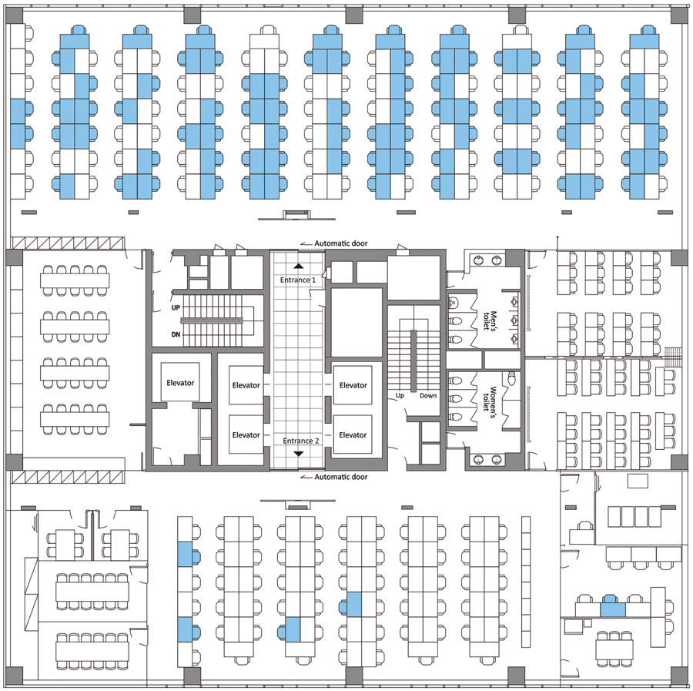
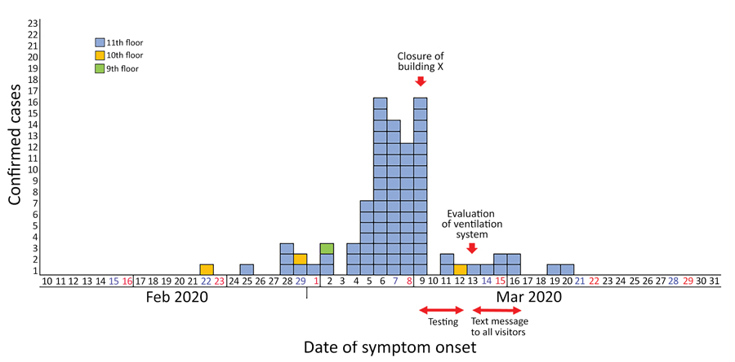
Korea Call center:… 1(?)→7→68….(Lock-Down)
Household secondary cases only 17%...

Slide 3
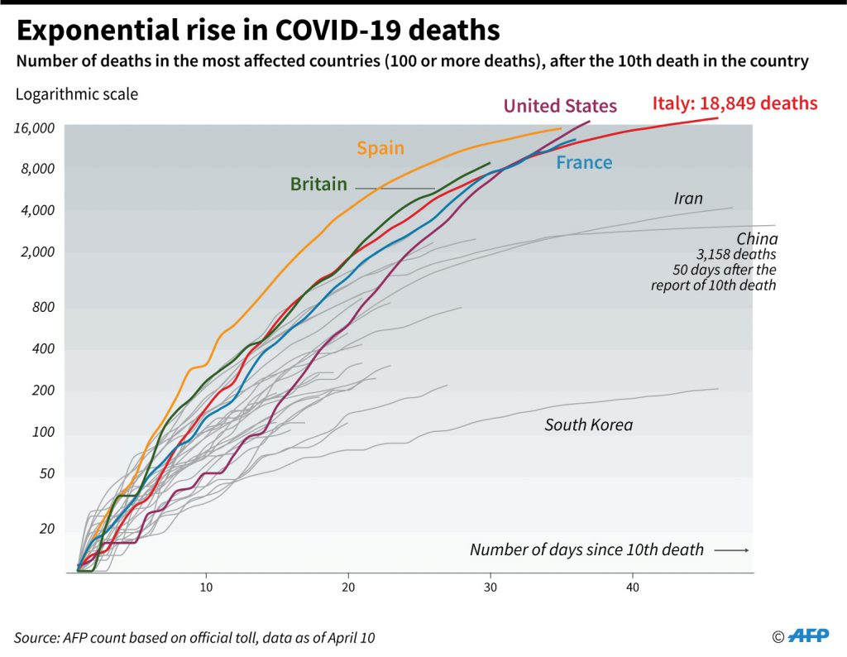

Slide 4
Exponential growth:
Modeling Covid-19 epidemic
S → I → R
Two numbers: R0 and Speed (How long time to get from S to R)
Kim Snepppen, May 2020

Slide 5
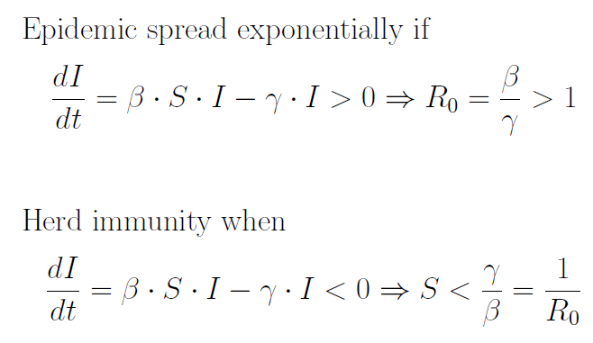
Epidemiology 101:

Slide 6
Both growth rate
And
R0 matters:
Covid-19
have
R0 =?=3
``slow”
R0=2.7
grow 23%/day
``fast”
R0=1.7
grow 23%/day
Kim Snepppen, May 2020

Slide 7
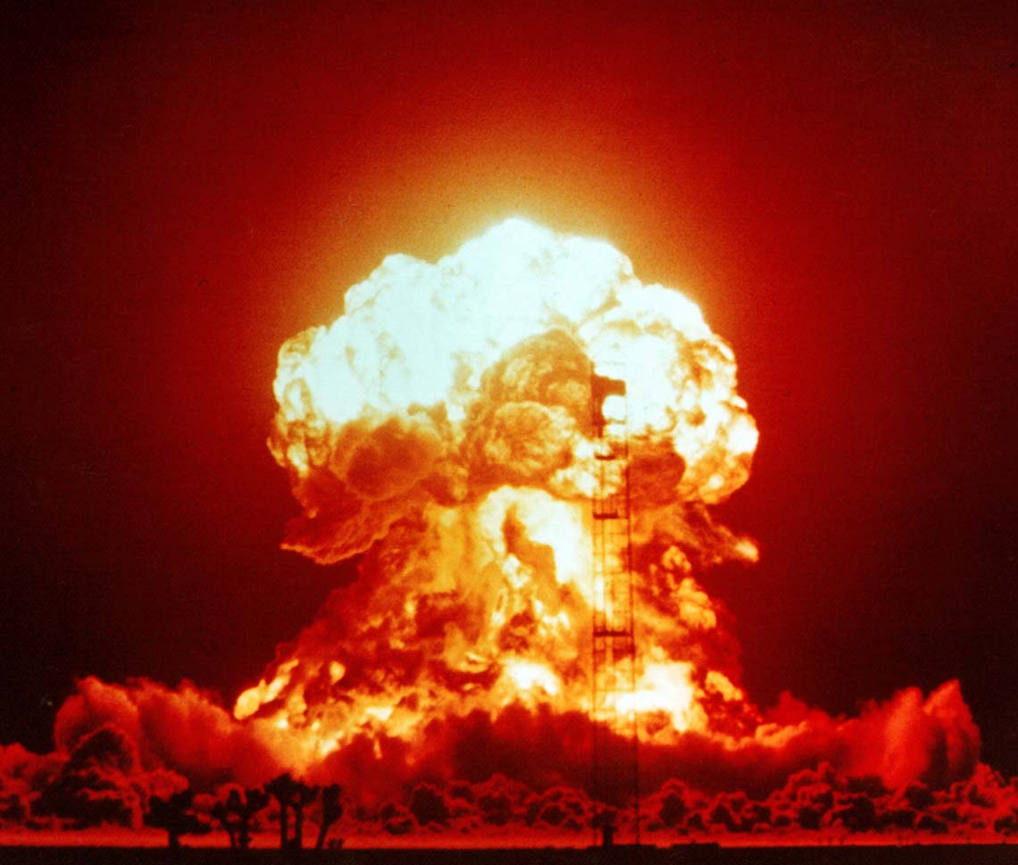
Another reaction with R0=3:
….Another process with R0=3
….somewhat faster timescale
Kim Snepppen, May 2020

Slide 8
Agent based model:
Follow individuals:
Can give people real homes & work, don’t give them a new family every evening (as done in SEIR models)
Can give people individual properties….`` Quenched noise”

Slide 9
Fixed for all unmitigated
epidemics

Slide 10
1) What it can be used to:
E.g: follow an individual after potential infection find optimal days to test:
→now test on day
4 And on day 6.

Slide 11
2) What it can be used to:
Contact tracing with light quarantine:
(in own home with family)
10% found
50% found
Anndreas Eilersen, Kim Snepppen, March 2020

Slide 12
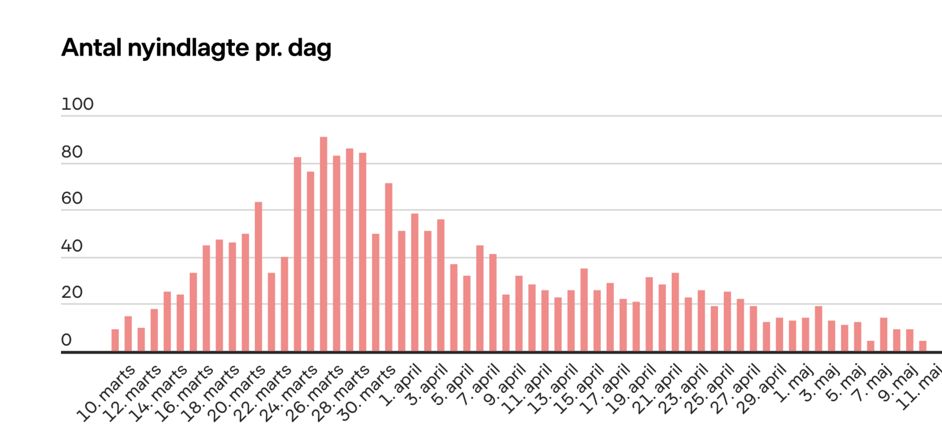
3) Predictions under lock down:
Superspreader
Event (horse market)
In Herning
Work=45%
School=0
Work=60%
School=45%

Slide 13
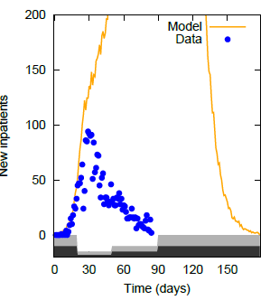

Predict what will happen under lock down:
10% found
Fit
Not
Perfect…
Kim Sneppen & Lone Simonsen, 2020

Slide 14
… fudge factor= social distancing=1/3
10% found
?
future
Is
uncertain
Kim Sneppen & Lone Simonsen, 2020

Slide 15
What do we not understand….
A lot…..
Why does the epidemic continue decline after we opened up?
Why does the Swedish strategy works
Why does the epidemic varies so much between regions
Why does it concentrate in cities,
Why is there no real epidemics in Africa
Why is the epidemic in decline now, nearly everywhere?
How to stop the disease most cheaply
How is the disease actually transmitted between people…
….. Of course by air, but how far and in which situations … big variations
Kim Snepppen, May 2020

Slide 16
→Superspreaders &
An R0=3 means average should be 1→3 person. Infecting >20 persones essentially impossible:
P(secondary > 20)=0.0000000001…… thus with 100.000.000 cases there would be 1% chance for one event
… and there is of order 10 just in Denmark with its about 100.000 cases

Slide 17
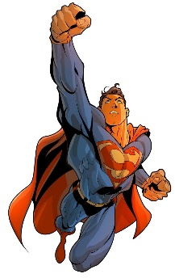
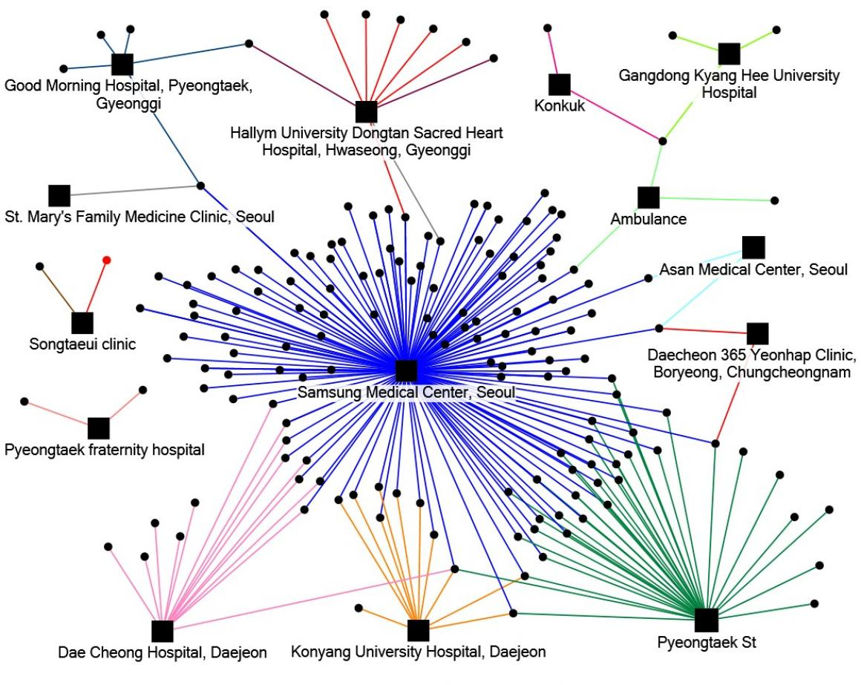
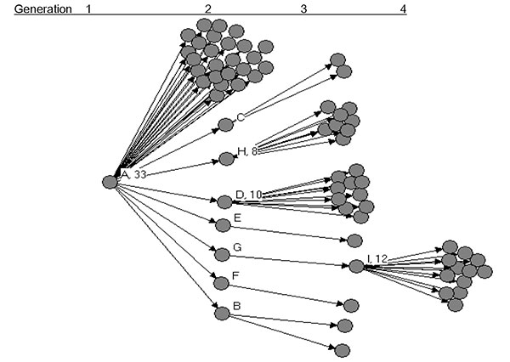
Observed Super Spreading
SARS had enormous heterogeneity; average Ro = 2,5 obscures this
Shen et al, Emerg Inf Dis 2004
Superspreading SARS Events, Beijing, 2003
2015 E-CDC Epidemiological update on MERS
Middle East respiratory syndrome coronavirus (MERS-CoV)
From 2015 South Korea outbreak

Slide 18
Superspreading from other diseases:
Lloyd Smith et al. , Nature 2005

Slide 19
Superspreaders and COVID-19
Considerable heterogeneity in infectivity
  5-20% of infected population may cause 80% of infections (4 ``experimental/data analysis” papers now)
Multiple reports of superspreading events
  Choir in WA State: ~75% of 60 singers infected after 2.5 h practice
    Careful, distance, hygiene – aerosolized?
  Bar hopper in S. Korea: ~60 cases one night
  3 people in Faroe Islands directly infect 70
  1 patient at orthopedic department in Hillerød hospital infect 17
  1 person infect 40 at wedding in Uruguai
Remember that R0=3 means average should be 1→3 person: Infecting >20 persons essentially impossible
P(secondary > 20)=0.0000000001…… thus with 100.000.000 cases it would be 1% chance for one event
… and there is of order 10 just in Denmark with 100.000 cases

Slide 20
Covid-19 Viral load: (different patients)…
………………..factor 1000.000 different…
Range where virus grow in cell culture
T.C. Jones et al, 2020 (An analysis of SARS-CoV-2 viral load by patient age)

Slide 24
Fit to real epidemic data from Denmark, Sweden with 1/s^1.5 superspreaders equivalent to
10% spreading 100x compared to normal:
Must assume lock-down
*0.3 social distancing
Lesson:
With superspreaders one needs
less intervention to contain..…
One can keep work and school open
Must assume lock-down*0.5 social distancing, other*0.2

Slide 26
→ Summary:
The more extreme the superspreader phenomenon, the easier it is to contain a COVID-19 epidemic !!!
With 10%/75% superspredning, one can largely stop the Covid-19 epidemic by removing diffuse contacts
  large events, public transportation, fitness centers etc
And this will also be true in the middle of an epidemic!!!!!
For observed inpatient data from Denmark (and Sweden), adding superspreaders to the model can explain both the effective mitigation in lock-down, as well as the absence of a 2nd wave following the reopening
It is time to consider heterogeneity when modelling COVID-19 to generate an effective way to mitigate the epidemic in future waves
Kim Sneppen & Lone Simonsen, 11 Juni 2020

Slide 27
Speculation: Do not need lock downs if
NO big Gatherings/parties/crowded lecture halls
Face mask in public transport (busses/trains/stations)
People should abstain from many diverse social contacts within an infection period (say 3-5 days.., maybe even shorter)
Kim Snepppen, May 2020

Slide 28
Thanks to:
Andreas Eilersen
Gorm Gruner
Gustav Halvorsen
Mathias Heltberg
Bjarke Frost Nielsen
Joachim Mathiesen
Lone Simonsen
medRxiv preprints

Slide 30
CV=spread/mean
=1/sqrt(k)

Slide 31
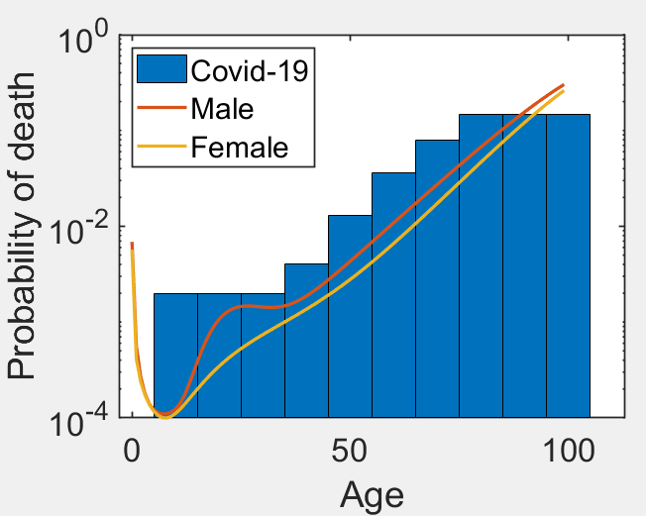
Overall Fatality rate: Now estimated
To be between 0.3% and 1% … depend on ….

