Slide 1
Junior Professor Oliver Gerberding QU Day 5.11.2019
Laser interferometry on ground and in space for gravitational wave astronomy
Credit: The Milky Way Galaxy by Derek Rowley

Slide 2
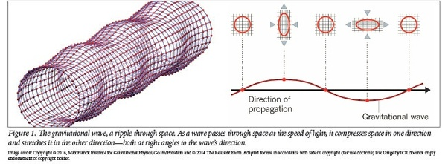
gravitational waves
Propagation & Polarisation
Proposed by H. Poincare in 1905
Predicted by A. Einstein in 1916
Non-spherical acceleration
Strain from a Binary
Strain
Astronomy
Credit: ESO/L. Calçada

Slide 3
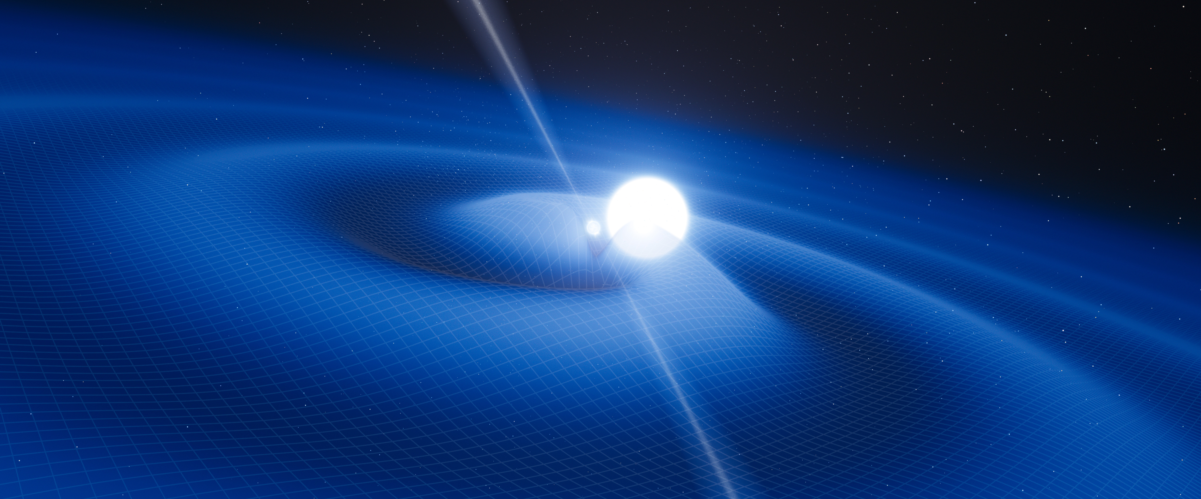
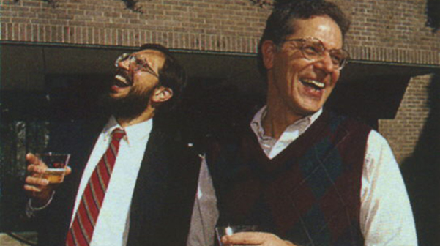
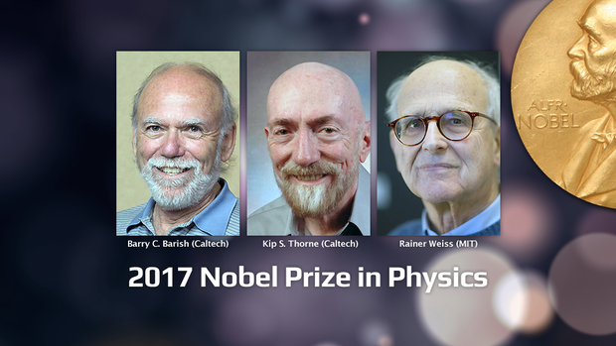
gravitational waves
Proposed by H. Poincare in 1905
Predicted by A. Einstein in 1916
Non-spherical acceleration
Hulse-Taylor Binary-Discovery 1974
Orbital decay fits gravitational waves
Nobel Prize 1993
Gravitational wave
astronomy
First direct detection by LIGO in 2015
Laser interferometry measures strain
Nobel Prize 2017
Credit: ESO/L. Calçada

Slide 4
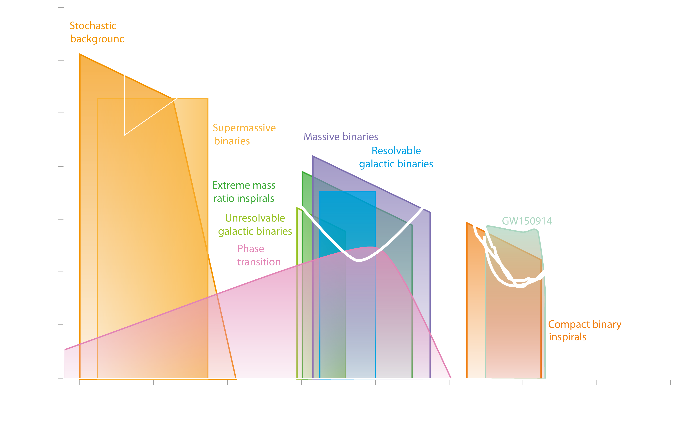
The gravitational universe
Credit: gwplotter.com, Moore, Christopher J., Robert H. Cole, and Christopher PL Berry.

Slide 5
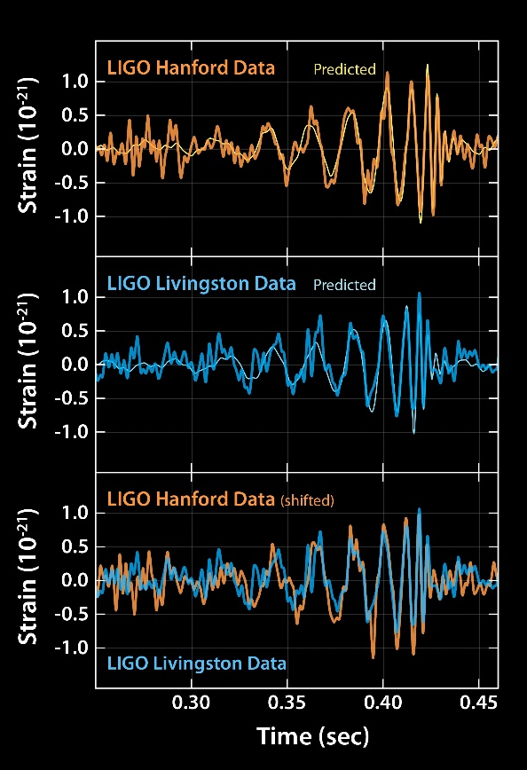
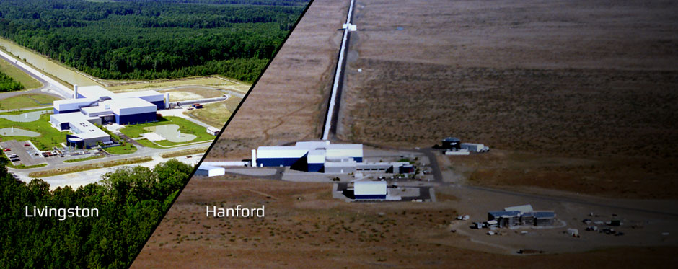
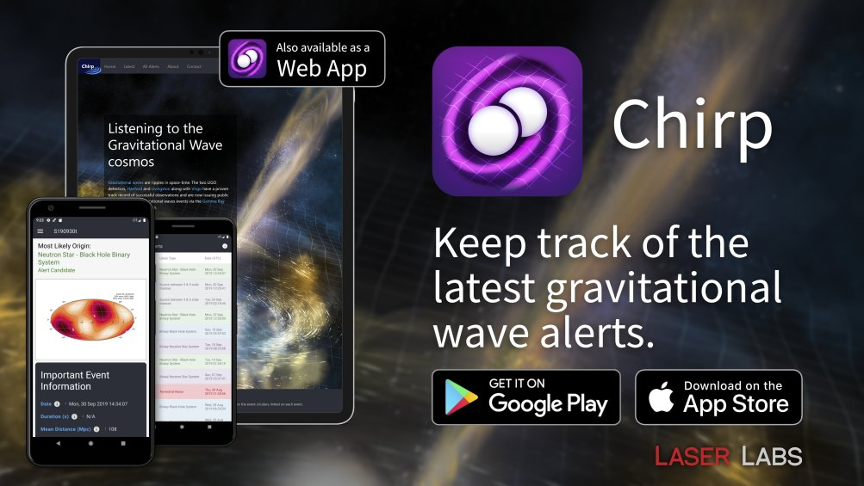
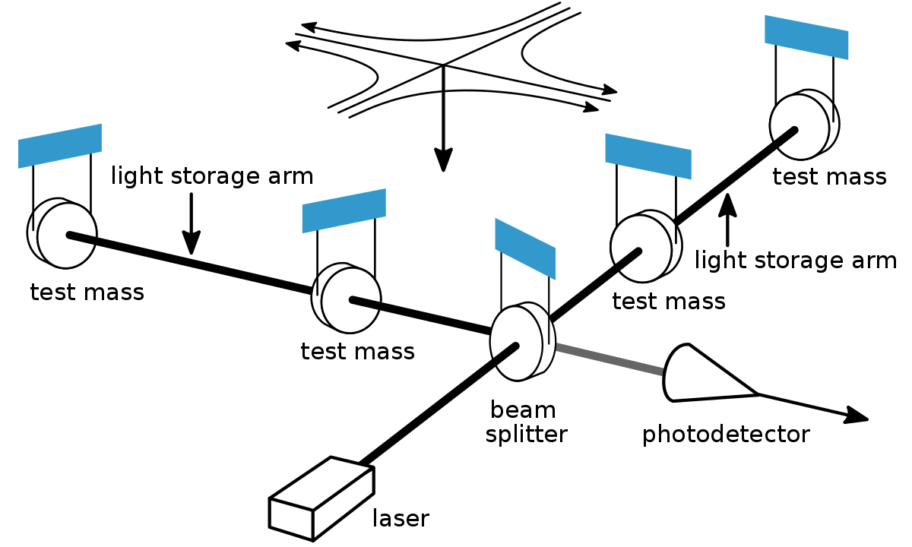
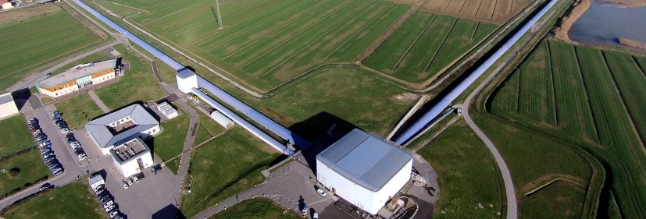
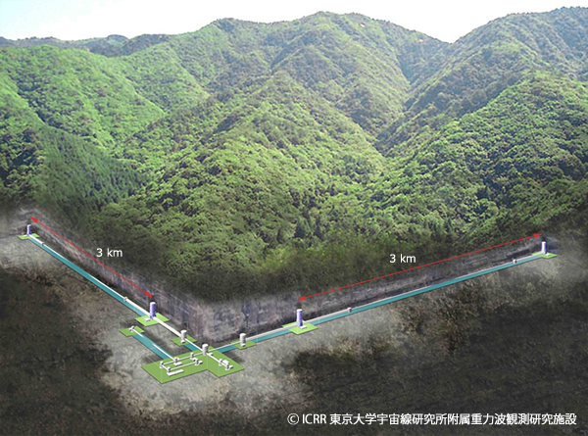
Ground-based Detectors
LIGO
VIRGO
KAGRA
Credit: gwplotter.com, Moore, Christopher J., Robert H. Cole, and Christopher PL Berry.

Slide 6
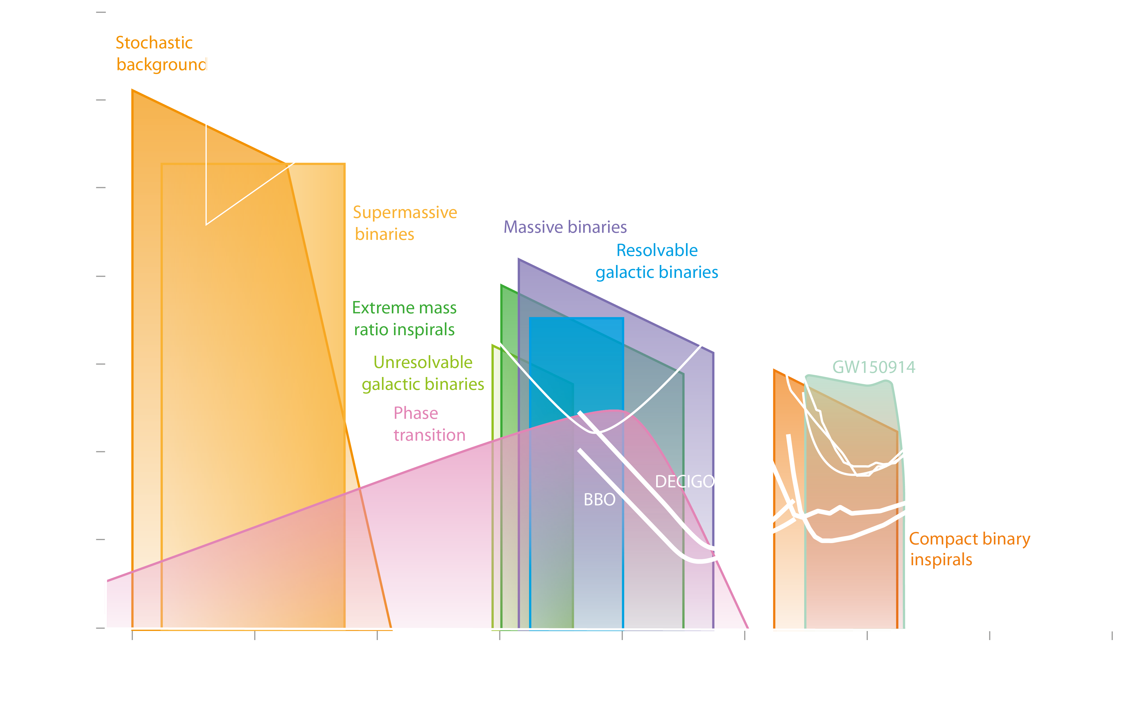
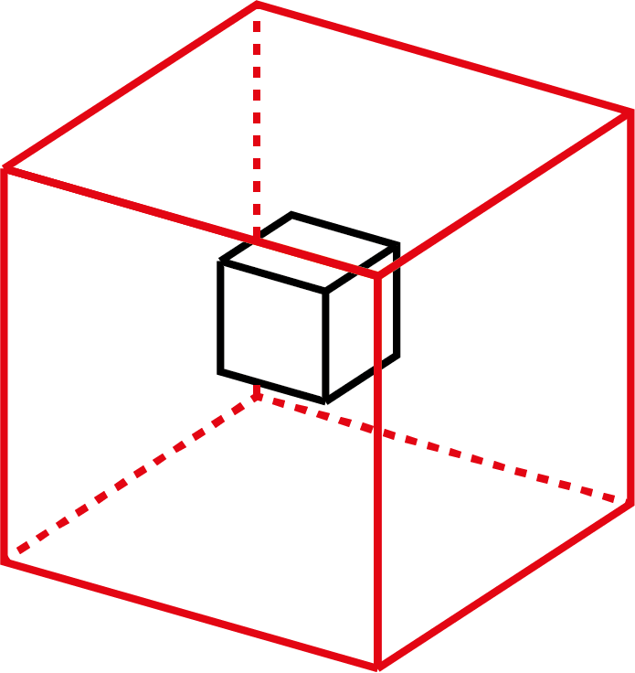
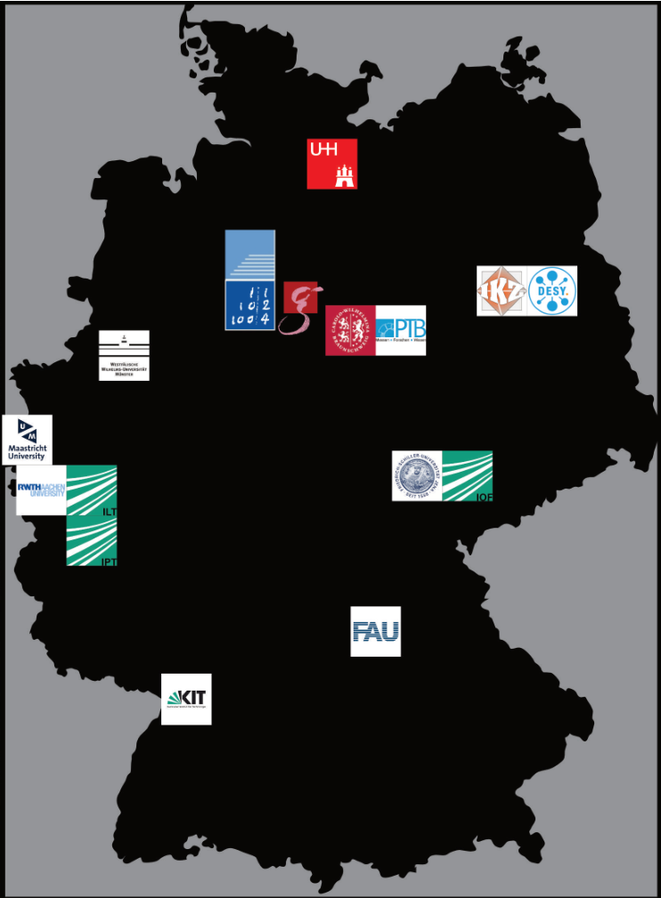
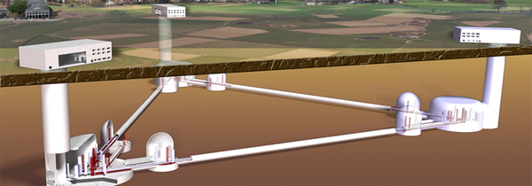
Ground-based Detectors
German
Instrument consortium
Einstein telescope
Credit: gwplotter.com, Moore, Christopher J., Robert H. Cole, and Christopher PL Berry.

Slide 7
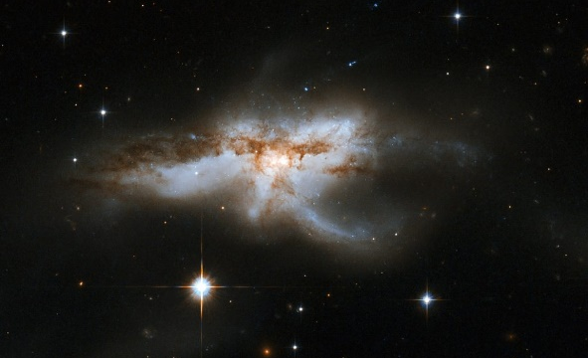
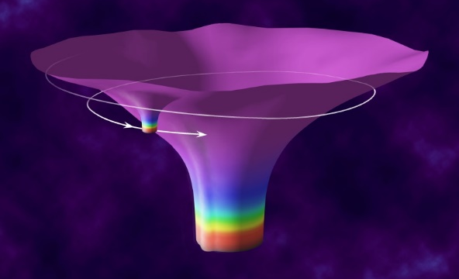
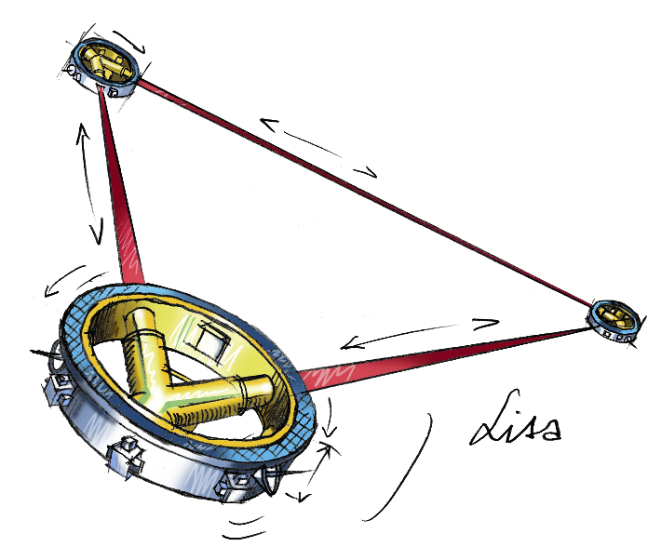
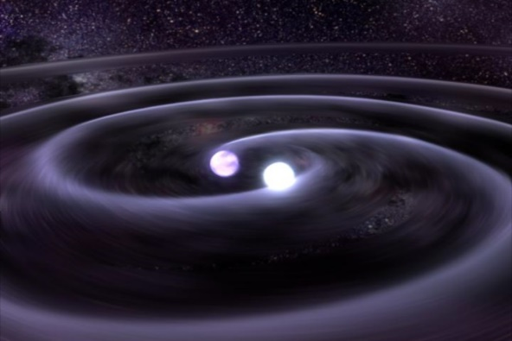
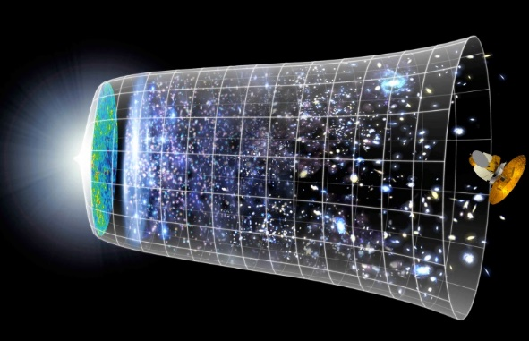
SPACE-based Detectors
LISA
Credit: gwplotter.com, Moore, Christopher J., Robert H. Cole, and Christopher PL Berry.

Slide 8
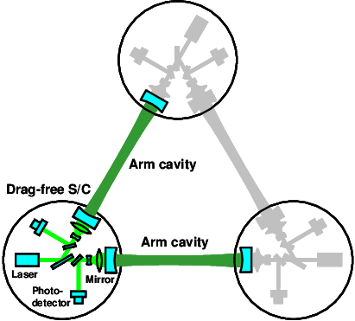
SPACE-based Detectors
DECIGO
Credit: gwplotter.com, Moore, Christopher J., Robert H. Cole, and Christopher PL Berry.

Slide 9
Instrument science
Primary objectives
Lower noise
Larger bandwidth
Higher duty cycle
Understand the noise
Secondary objectives
Fundamental metrology research
Technology development for other applications & research
Credit: gwplotter.com, Moore, Christopher J., Robert H. Cole, and Christopher PL Berry.

Slide 10
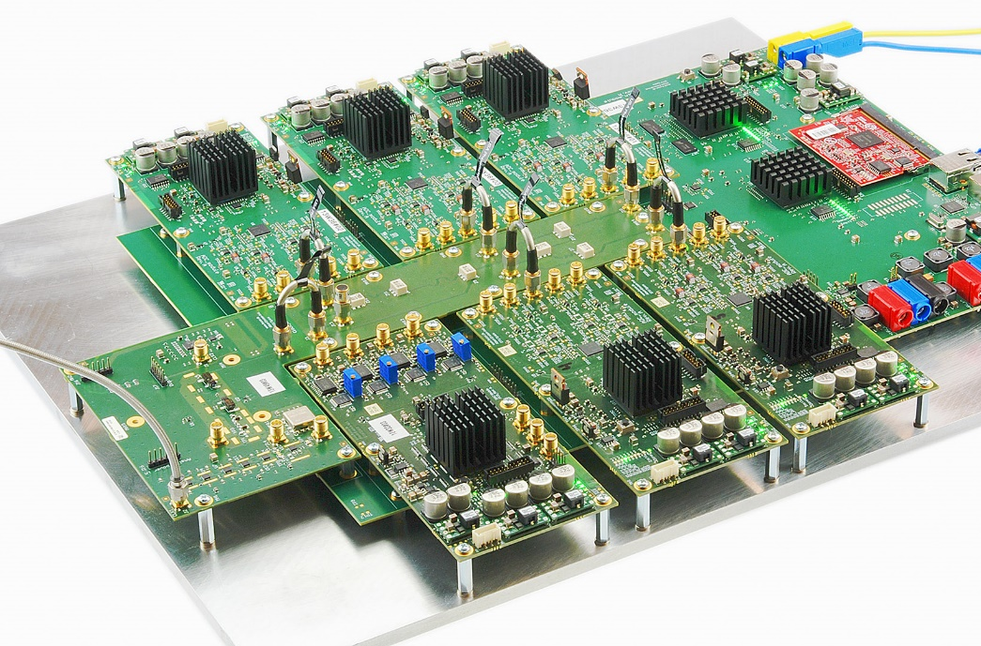
Tools: Laser Interferometry &
Instrument Science
New technologies
Conceptual studies
Proof-of-principle
Technology development
Detailed design
Test & Verification
Detector integration
Deployment
Commissioning
Digital readout & control
Quasi-monolithic optics

Slide 11
LISA
Einstein telescope

Slide 13
LISA INterferometry
$$φ$$

Slide 14
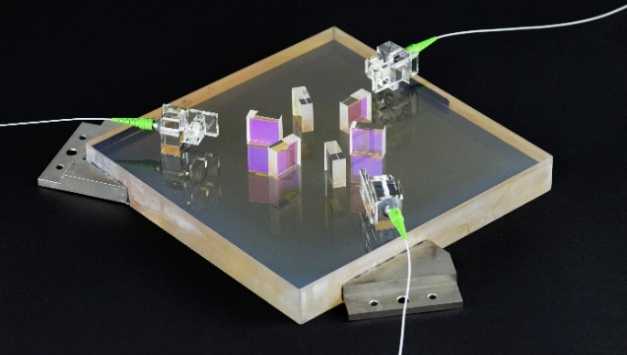
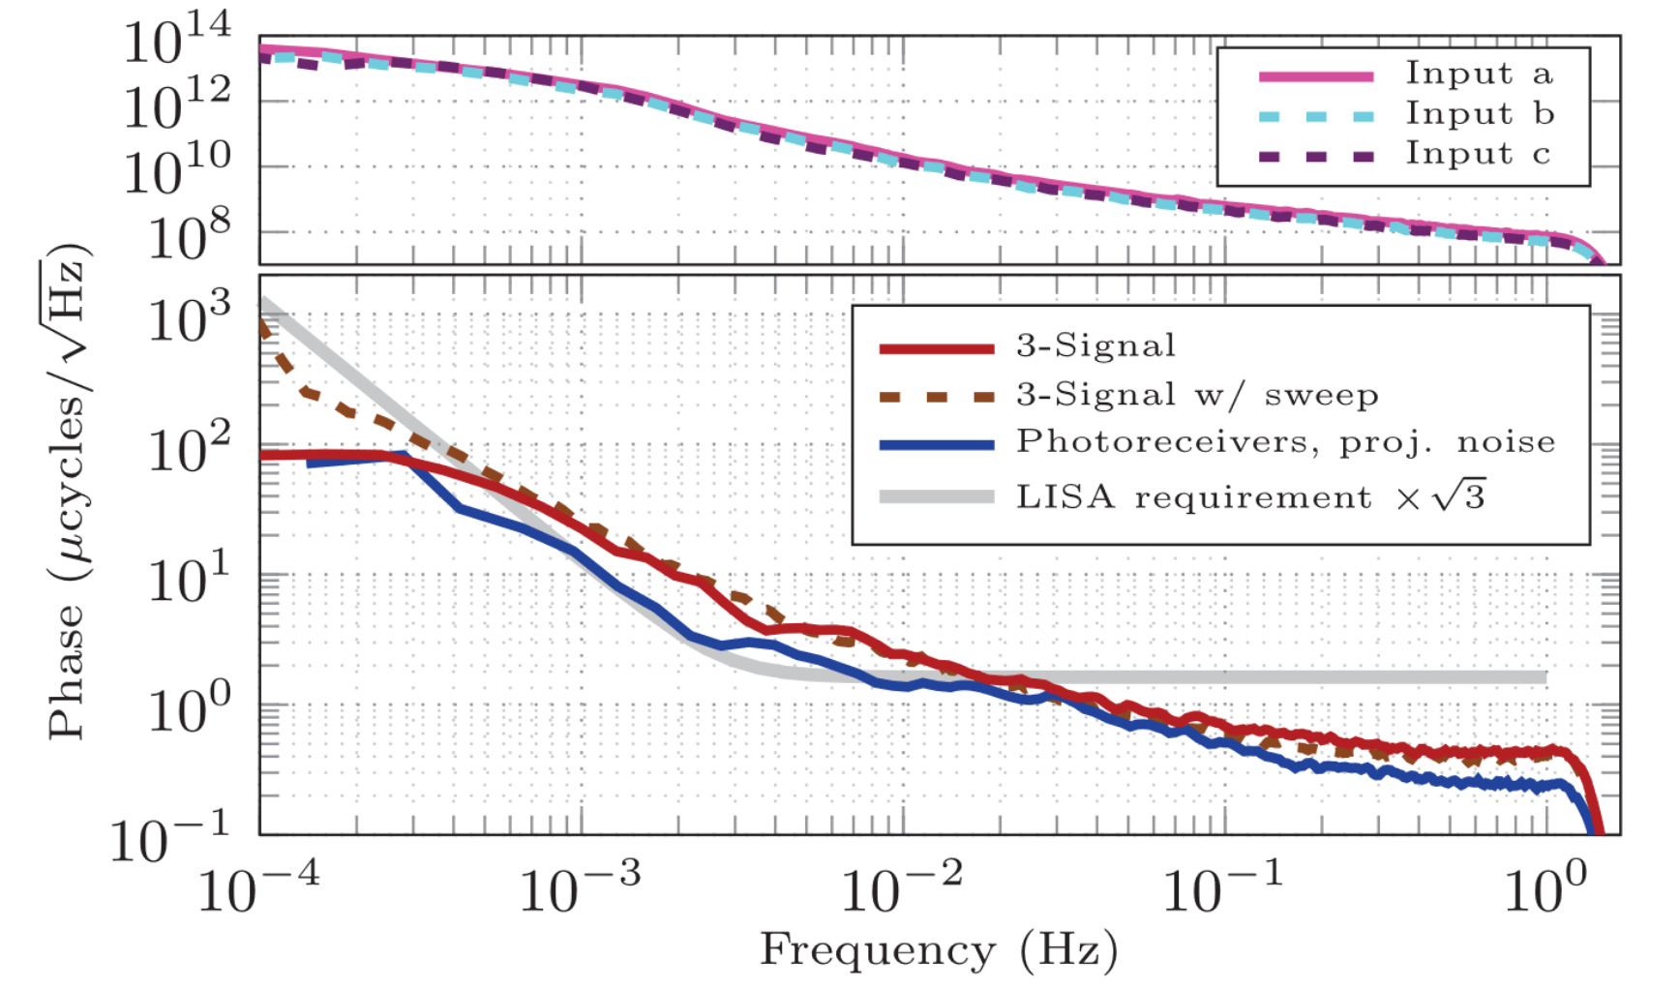
LISA Phasemeter
Phase-locked loop algorithm
Breadboard model developed in 2013
Optical three-signal test interferometer
High dynamic range phase readout
Flight model development at AEI in Hannover and DTU in Copenhagen
O. Gerberding et al., Rev. Sci. Inst. 86, 074501 (2015)
S. Barke, et al. Final Report, online (2014)
O. Gerberding et al., CQG 30, 235029 (2013)
T. Schwarze et al., PRL 122, 081104 (2019)

Slide 15
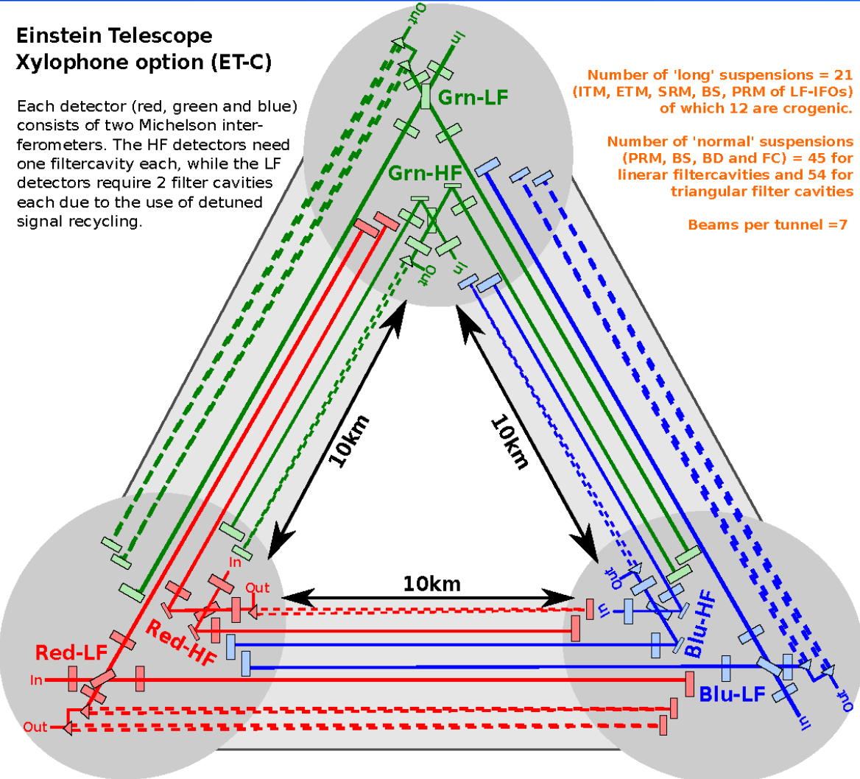
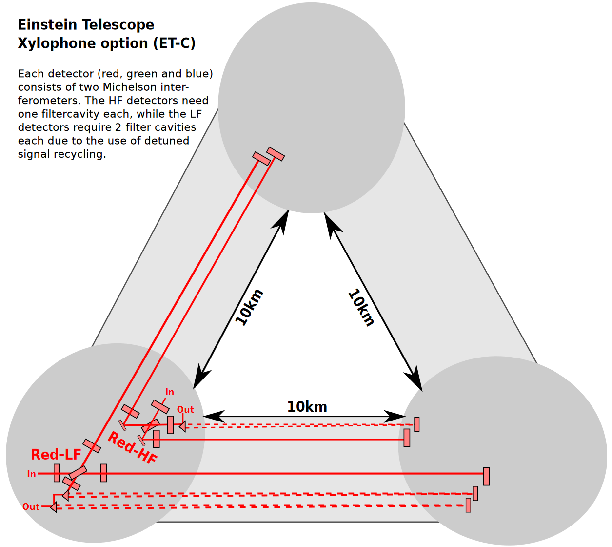
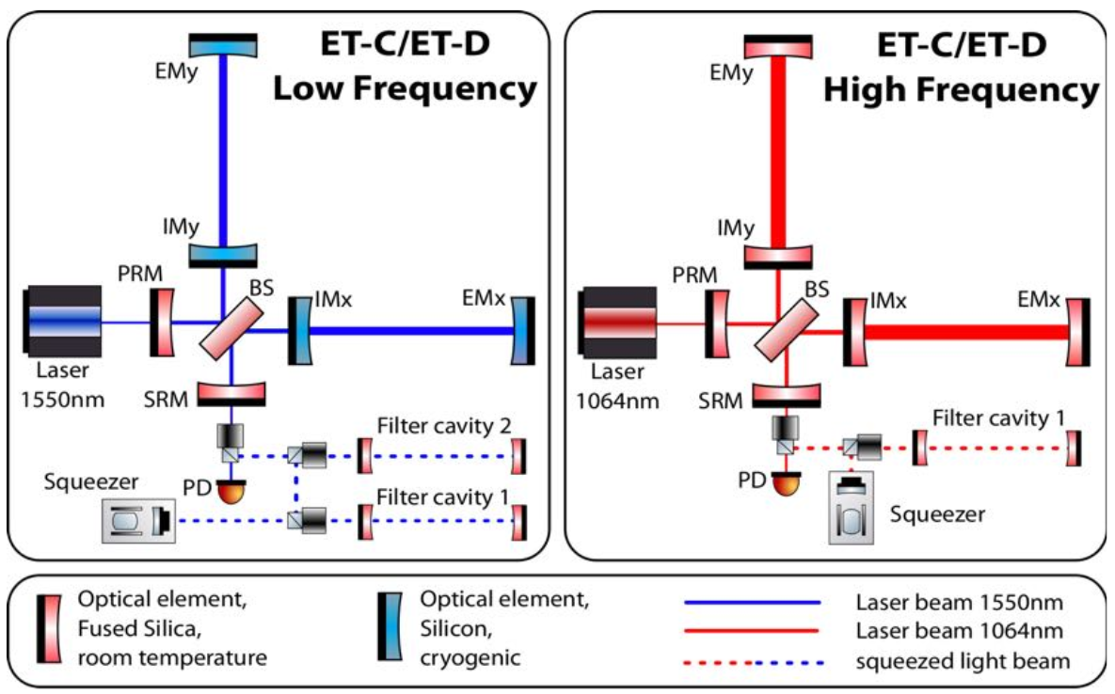
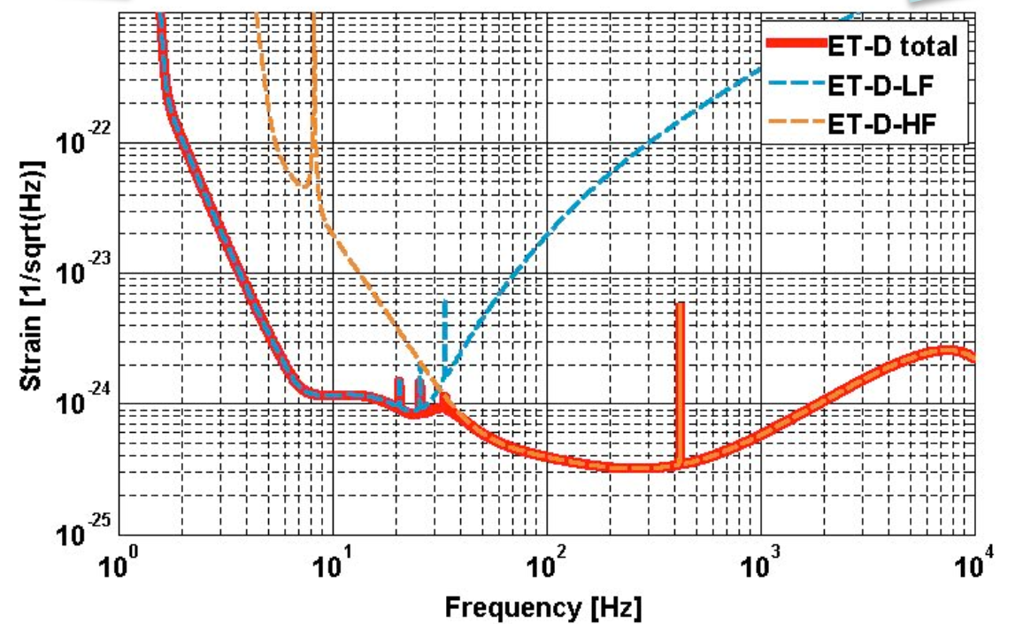
Credit: Artist Impression Einstein Telescope, door Marco Kraan (Nikhef), ET Design Study

Slide 16
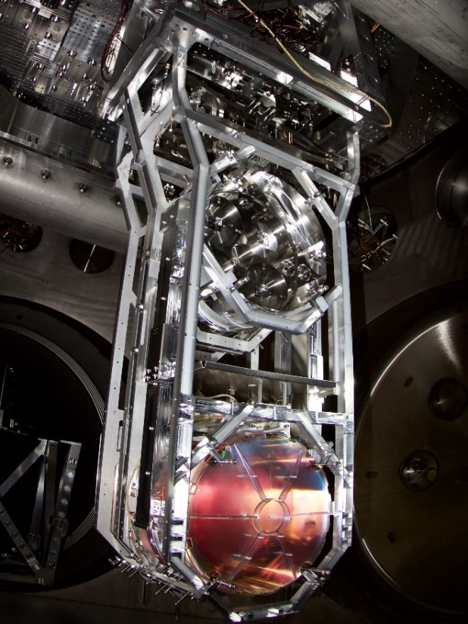
Seismic isolation
Passive:
Pendula
Springs
Inverted Pendula
Active:
Actuation (hydraulic, Piezoelectric)
Sensing (LISA-like interferometry)
www.advancedligo.mit.edu
Credit: Artist Impression Einstein Telescope, door Marco Kraan (Nikhef)

Slide 17
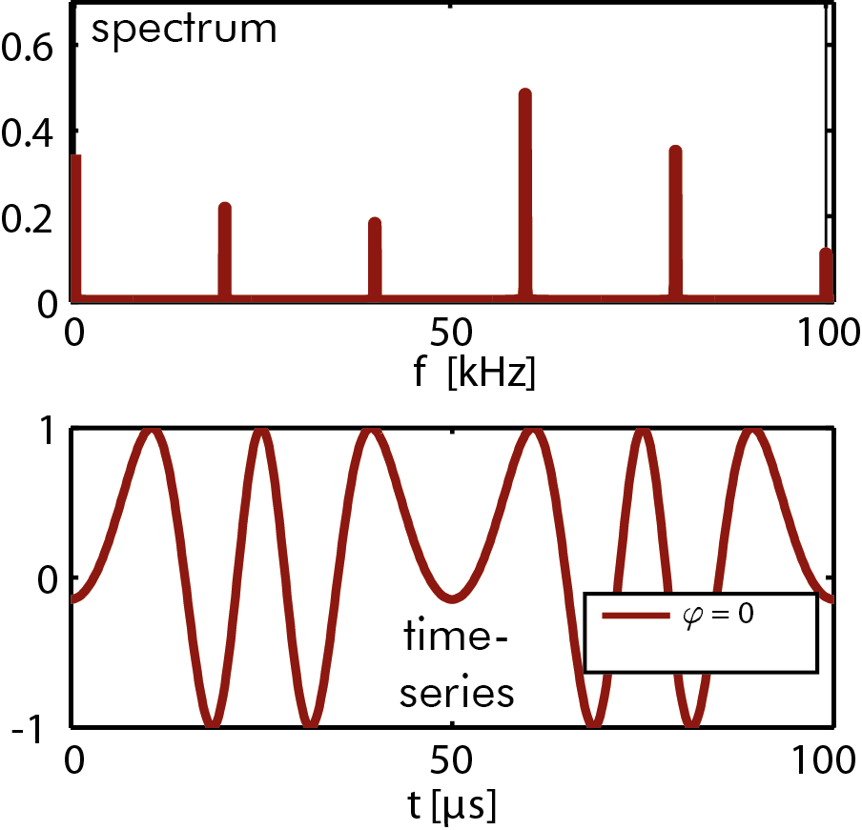
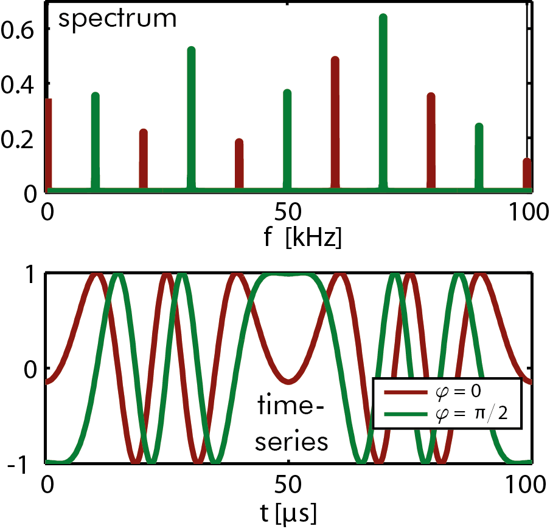
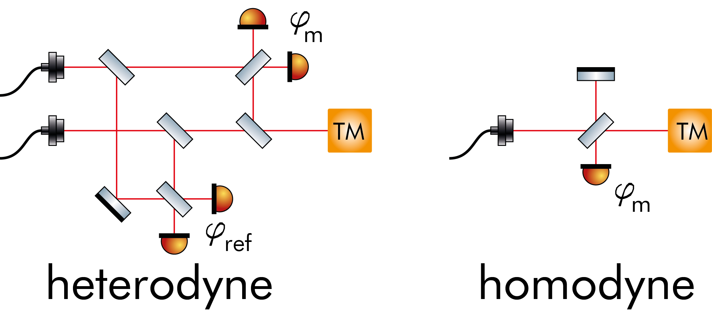
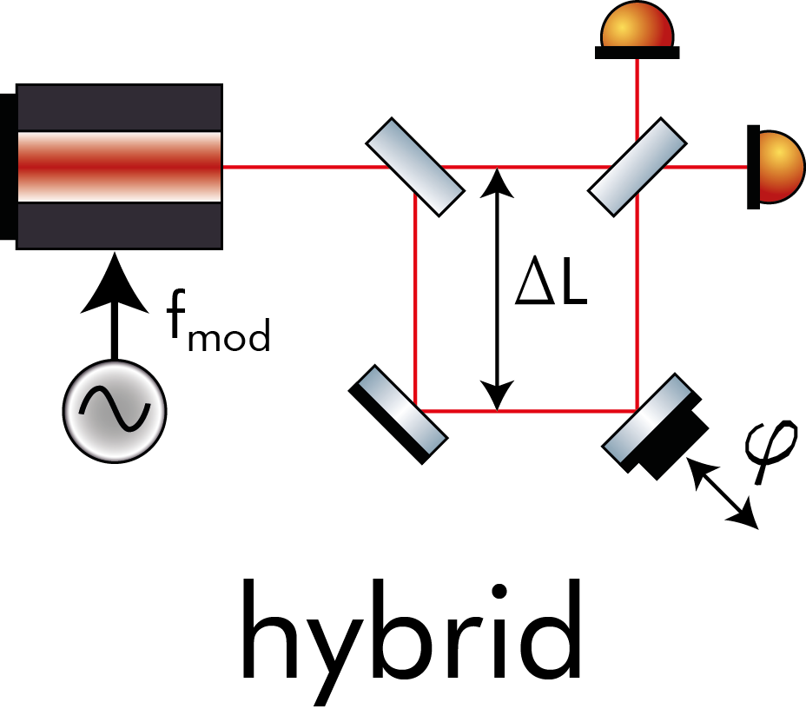

Slide 18
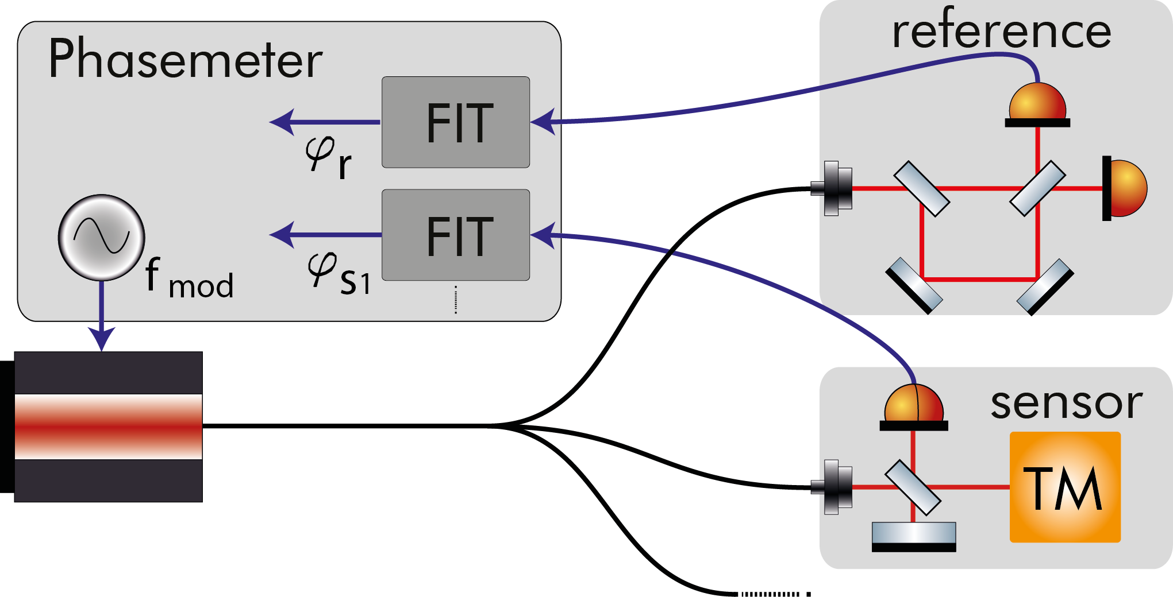
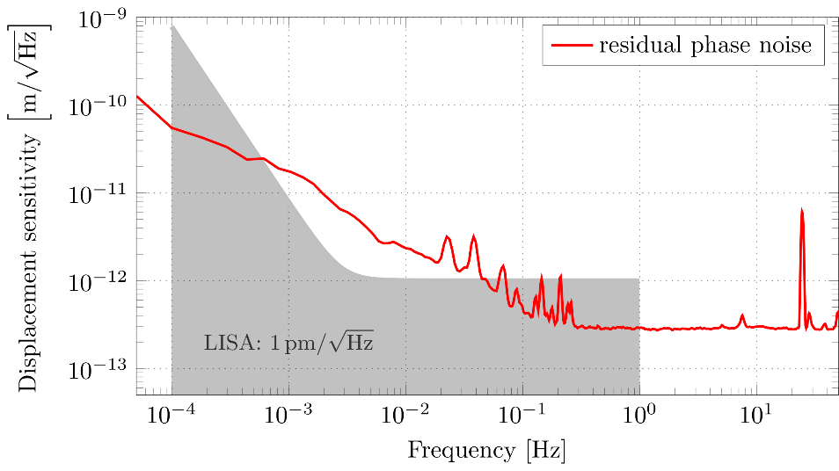
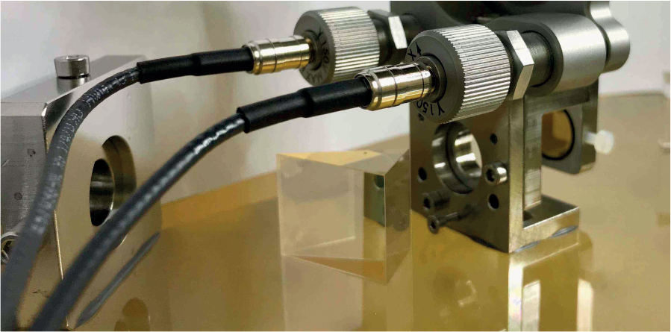
Deep Frequency Modulation
Minimalistic optical head design
Demonstration of sub-picometer noise
NOW @ UHH:
Study Einstein Telescope application
Improve noise performance (algorithm)
Create an inertial sensing test-bed
G. Heinzel et al., Optics Express, 18, 19, (2010)
O. Gerberding, Optics Express, 23, 11, (2015)
K.-S. Isleif et al., Optics Express, 24, 2, (2016)
K.-S. Isleif et al., PRApplied 12, 034025 (2019)

Slide 19
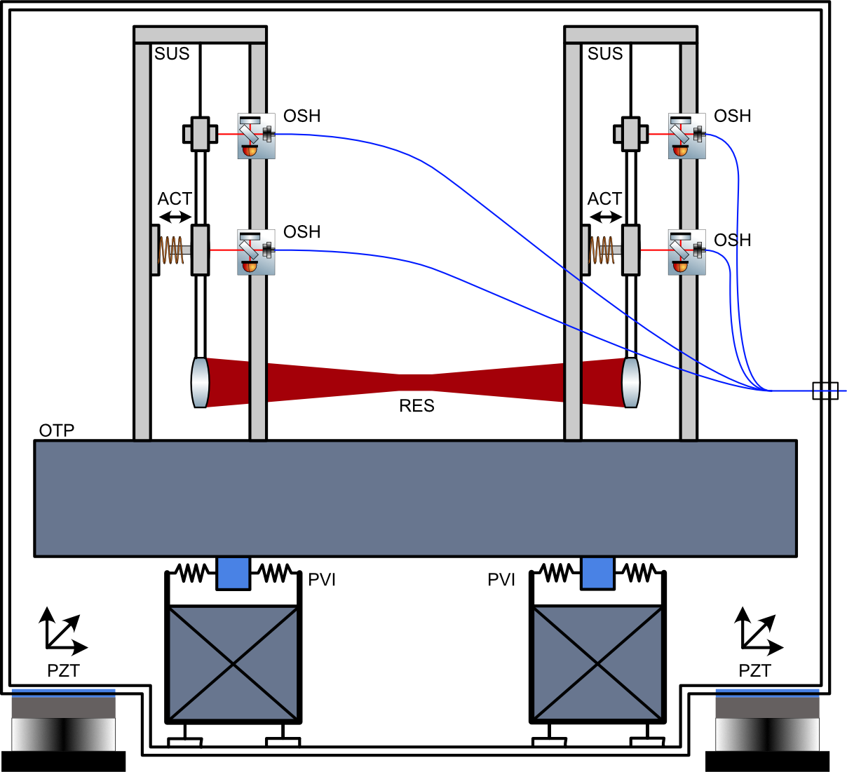
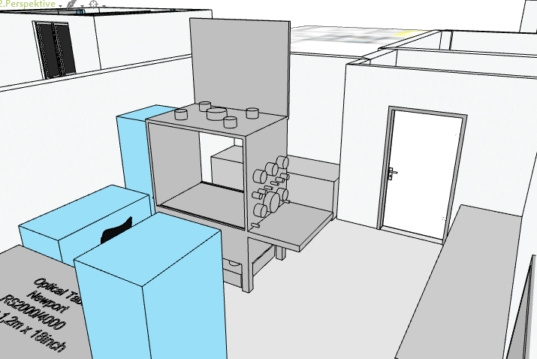
Inertial sensing Test-Bed
Seismically isolated platform in vacuum
Mirror suspensions (compact version)
Test local readout and inertial sensors
Credit: UHH Gerberding

Slide 20
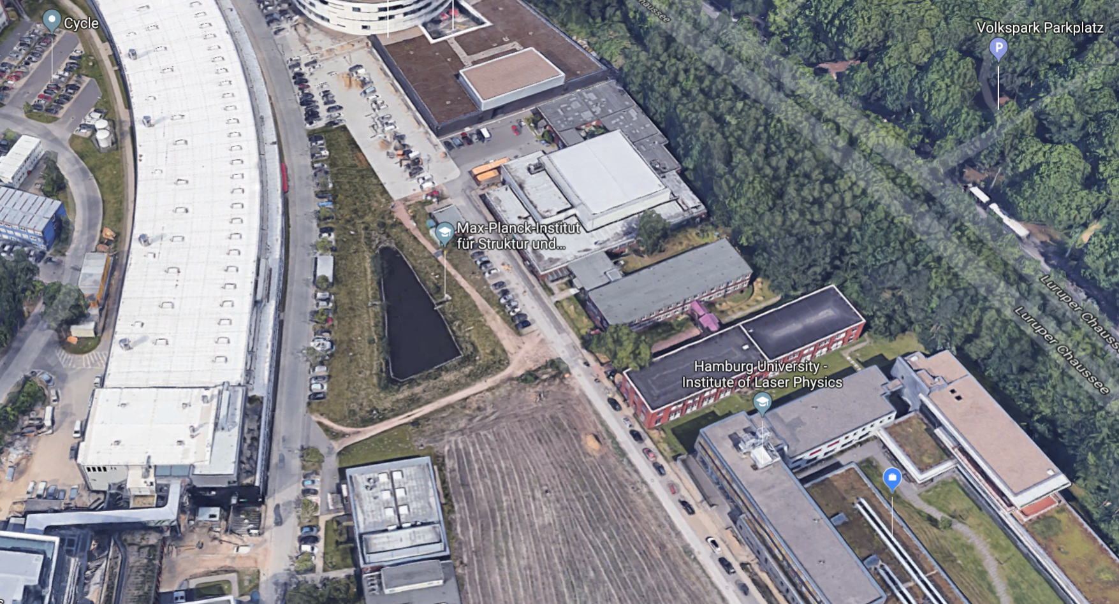
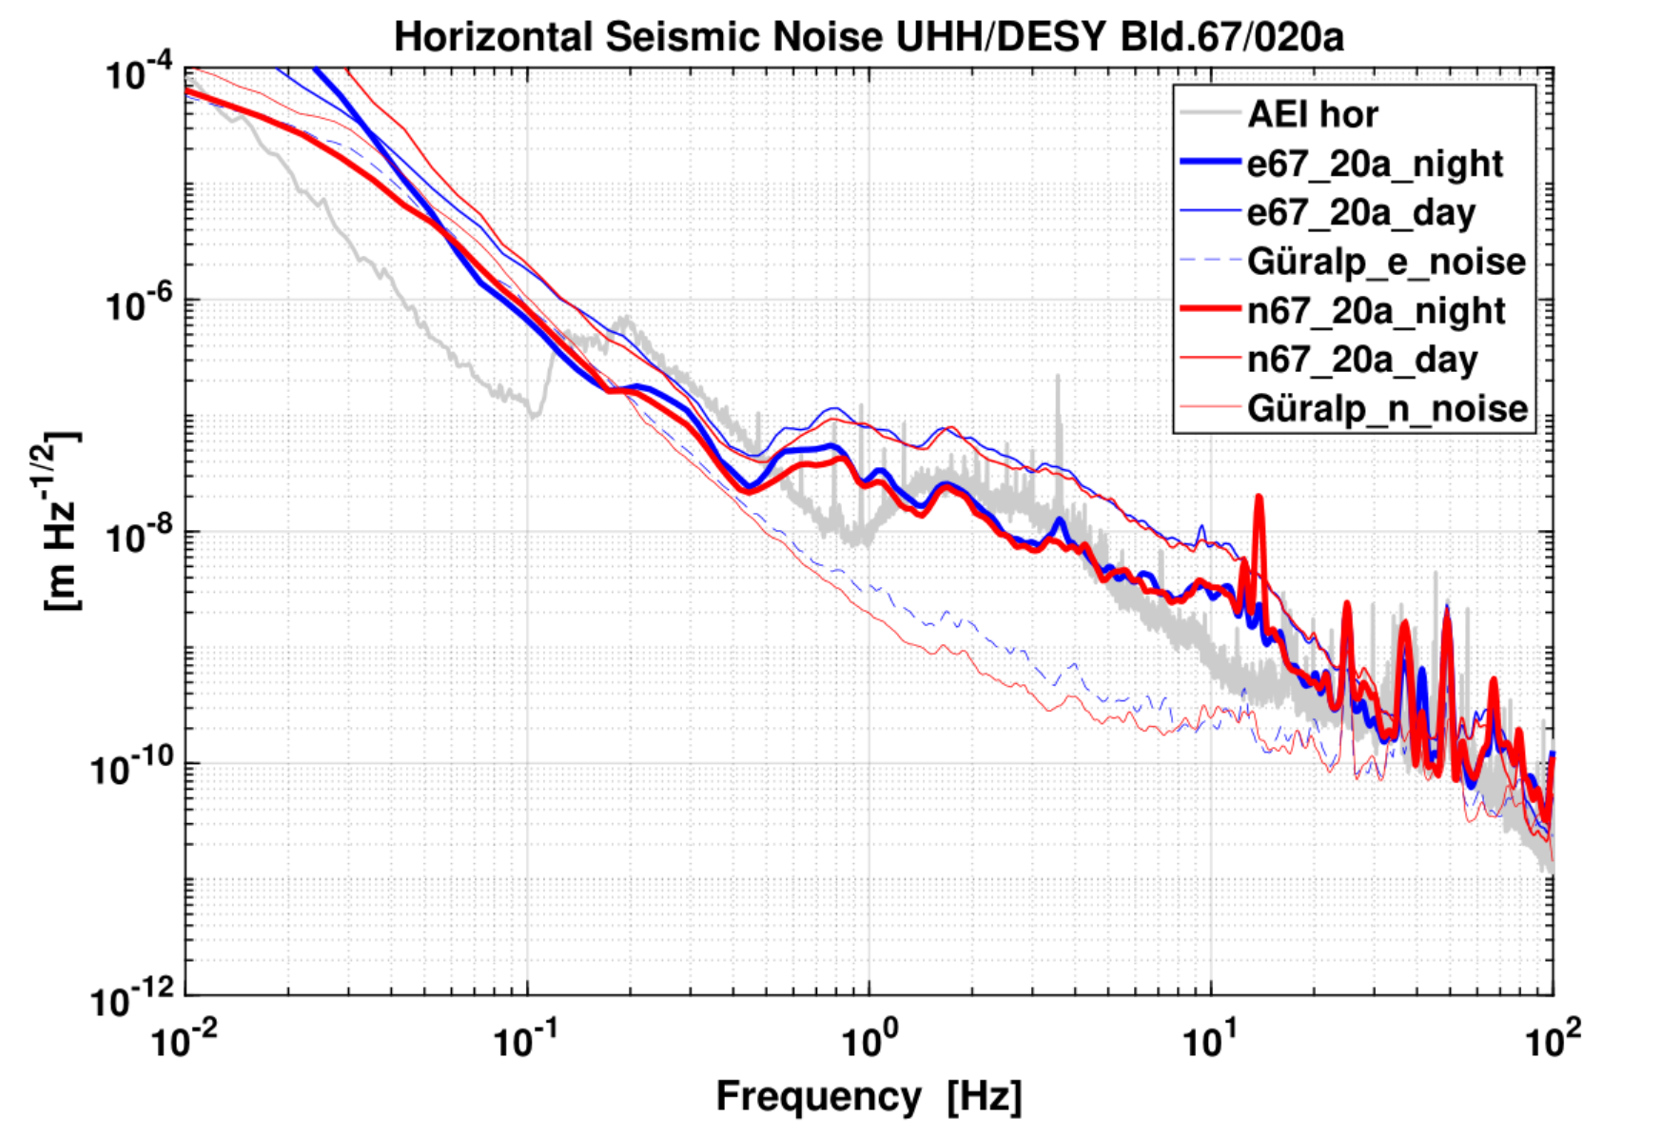
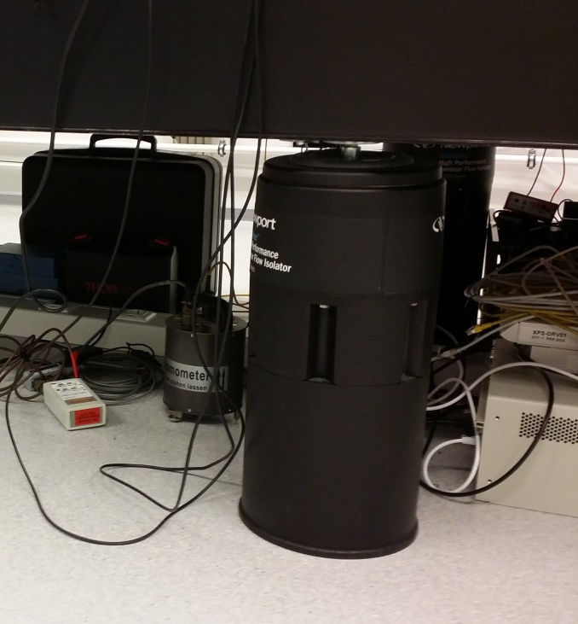
Inertial sensing Test-Bed
First measurement of seismic in building 67
Basis for detailed isolation design
Seismic team at DESY:
https://vibration.desy.de/
Credit: UHH Gerberding

Slide 21
Gravitational wave astronomy has enormous potential
Laser interferometry is central to current and next generation detectors
Digital and monolithic Interferometry techniques Can solve critical challenges
Credit: gwplotter.com, LIGO.Org

Slide 22
Thank you
Credit: The Milky Way Galaxy by Derek Rowley

