Slide 1
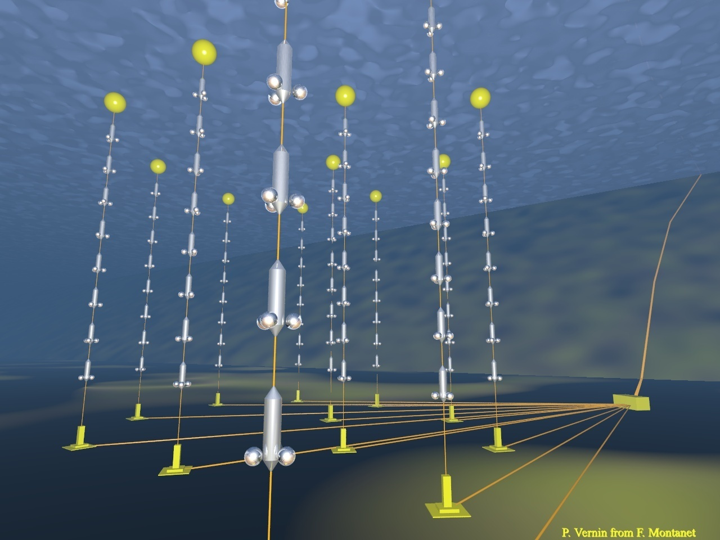


The ANTARES Deep-Sea
Neutrino Telescope
Introduction
Detector
First results
Muons, Neutrinos, Point Sources, DM
Sea and Earth sciences
KM3NET
Paschal COYLE-
CNRS/CPPM-Marseille
DESY Seminar , 23rd June, 2009

Slide 2
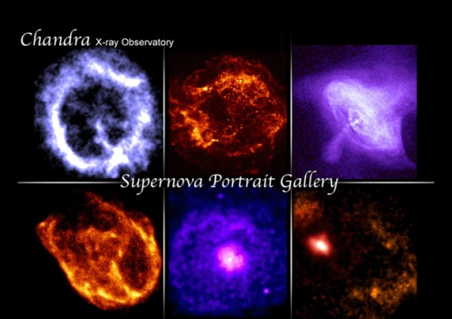
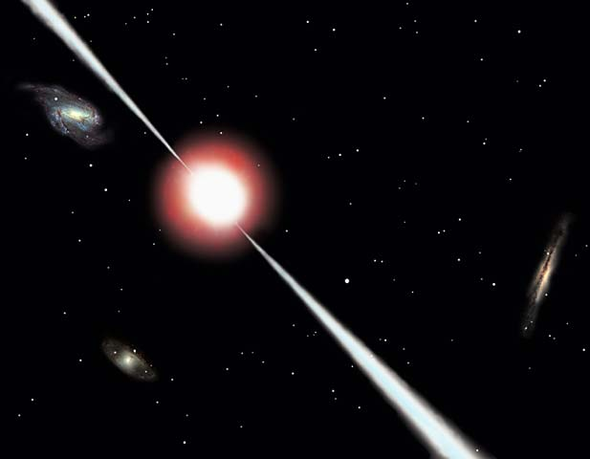
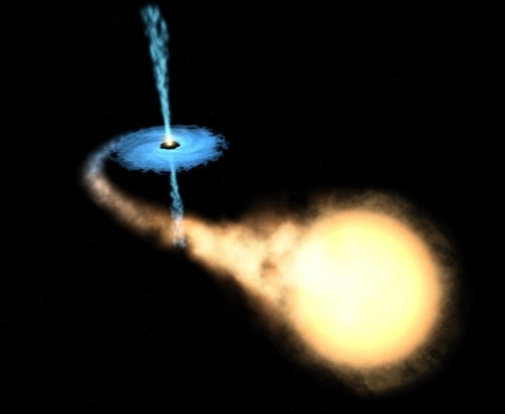
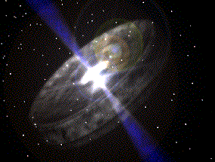
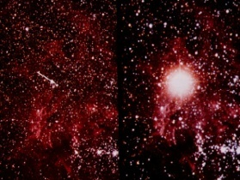
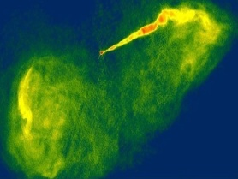
Science with High Energy Neutrinos
SNR
High energy neutrino astrophysics:
galactic: SN, SNRs, μ-quasars...
extra-gal: AGNs, GRBs,
GZK
Search for New Physics:
Dark matter (sun, GC), Monopoles..
Earth-Sea Science:
oceanography, sea biology, seismology, environment monitoring...
GRB
Binary systems
AGN
Micro-quasars
?
~MeV | GeV-100 GeV | GeV-TeV | TeV-PeV | PeV-EeV | > EeV

Slide 3

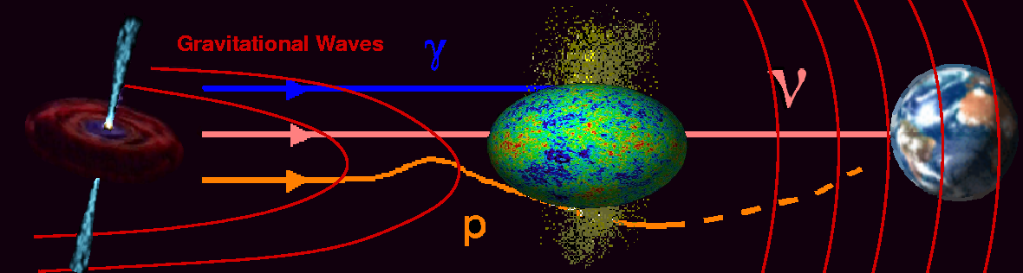
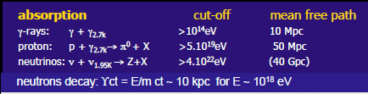
Neutrinos and Multi-Messenger Astronomy
Neutrinos
Not deflected by magnetic fields Unlike p+
Not absorbed by dust Unlike γ
Horizon not limited by interaction with CMB/IR Unlike p+ and γ
Detectable over full energy range (GeV->PeV) Unlike p+ and γ
Can be correlated with optical signals Unlike p+

Slide 4
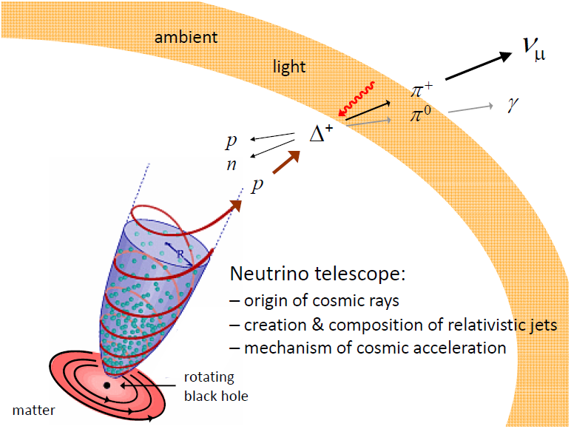
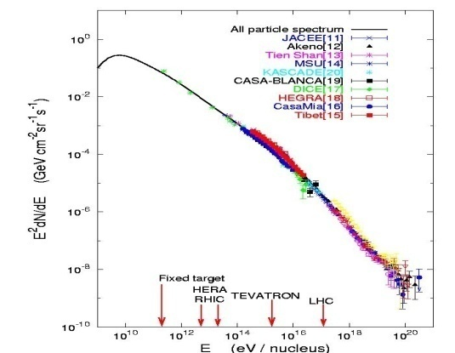
Neutrino Production and Transport
HE protons exist!
Oscillations during transit:
1ν_{e}: 2ν_{μ}: 0ν_{τ} → 1ν_{e}: 1ν_{μ}: 1ν_{τ}
Unambiguous probe of
hadronic processes

Slide 5
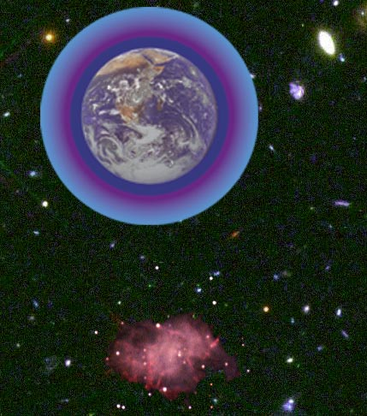
Detection principle
3D PMT
array
Cherenkov light
from μ
ν_{μ}
42°
Sea floor
μ
The reconstruction is based on local coincidences compatible with the Cherenkov light front
ν_{μ}
interaction
- Main detection channel: ν_{μ} interaction giving an ultra-relativistic μ (νe and νtau also)
Energy threshold ~ 10 GeV

Slide 6
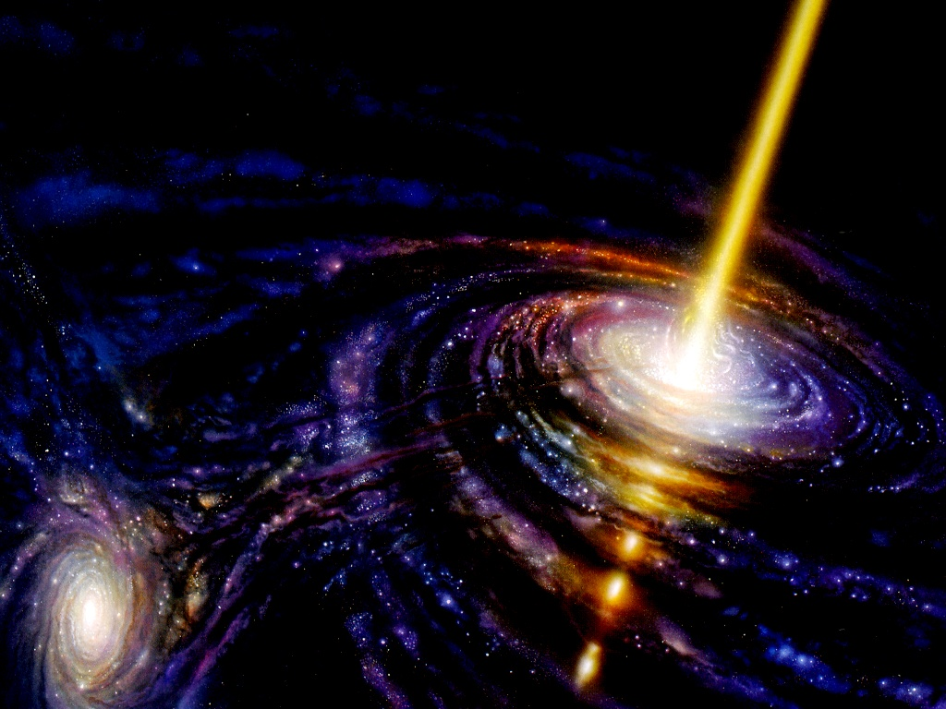
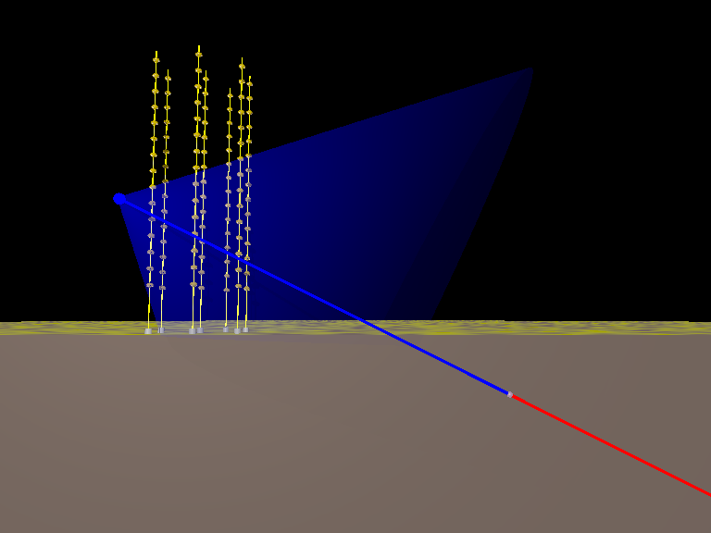



atmospheric
Neutrinos
3000 per year
Cosmic ray
atmospheric
Muons
10 million per year

Slide 7

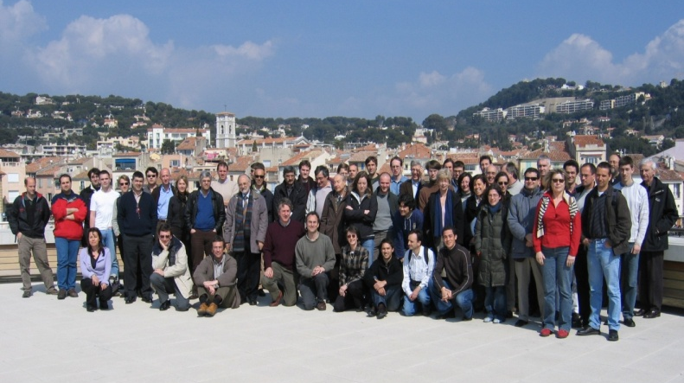
The ANTARES Collaboration
NIKHEF,
Amsterdam
Utrecht
KVI Groningen
NIOZ Texel
ITEP,Moscow
Moscow State Univ
University of Erlangen
Bamberg Observatory
ISS, Bucarest
IFIC, Valencia
UPV, Valencia
CPPM, Marseille
DSM/IRFU/CEA, Saclay
APC, Paris
LPC, Clermont-Ferrand
IPHC (IReS), Strasbourg
Univ. de H.-A., Mulhouse
IFREMER, Toulon/Brest
C.O.M. Marseille
LAM, Marseille
GeoAzur Villefranche
7 countries
29 institutes
~150 scientists+engineers
University/INFN of Bari
University/INFN of Bologna
University/INFN of Catania
LNS – Catania
University/INFN of Pisa
University/INFN of Rome
University/INFN of Genova
7
Notes:
M. Spurio- ANTARES
7

Slide 8
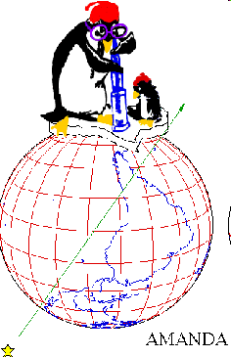
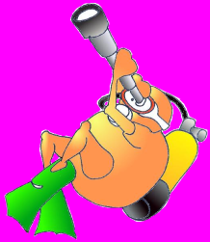
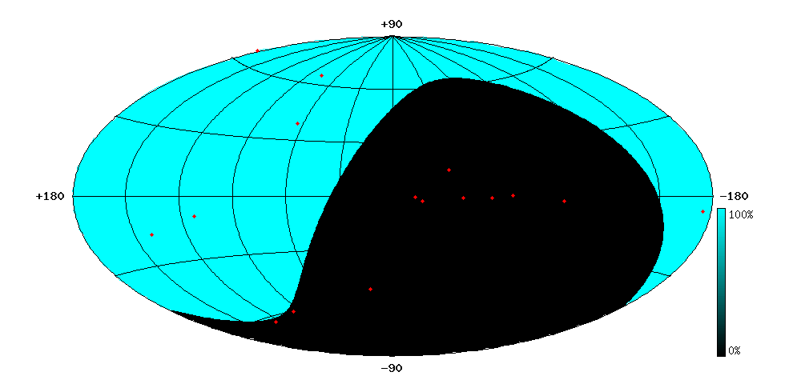
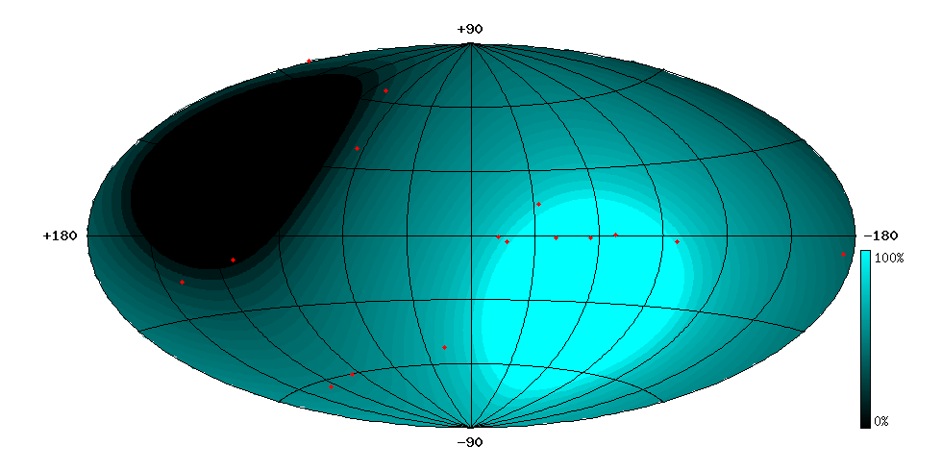
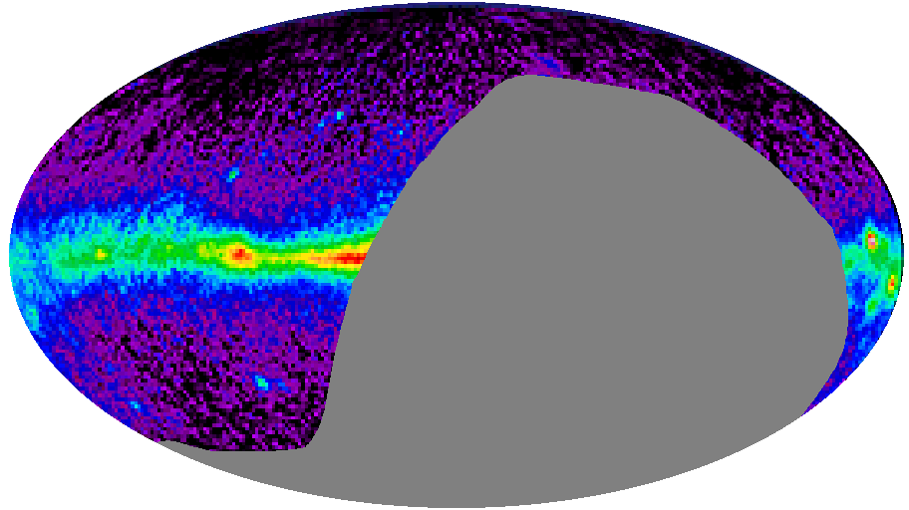
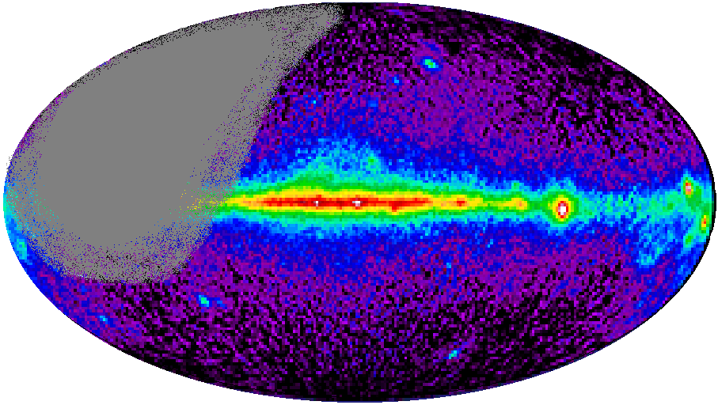
Region of Sky Observable by Neutrino Telescopes
AMANDA/IceCube (South Pole)
(Ice: ~2°/0.6°)
ANTARES/KM3 (43° North)
(water: ~0.2°/0.1°)
Mkn 421
Mkn 501
Mkn 501
CRAB
RX J1713.7-39
CRAB
SS433
SS433
GX339-4
VELA
Galactic
Centre

Slide 9
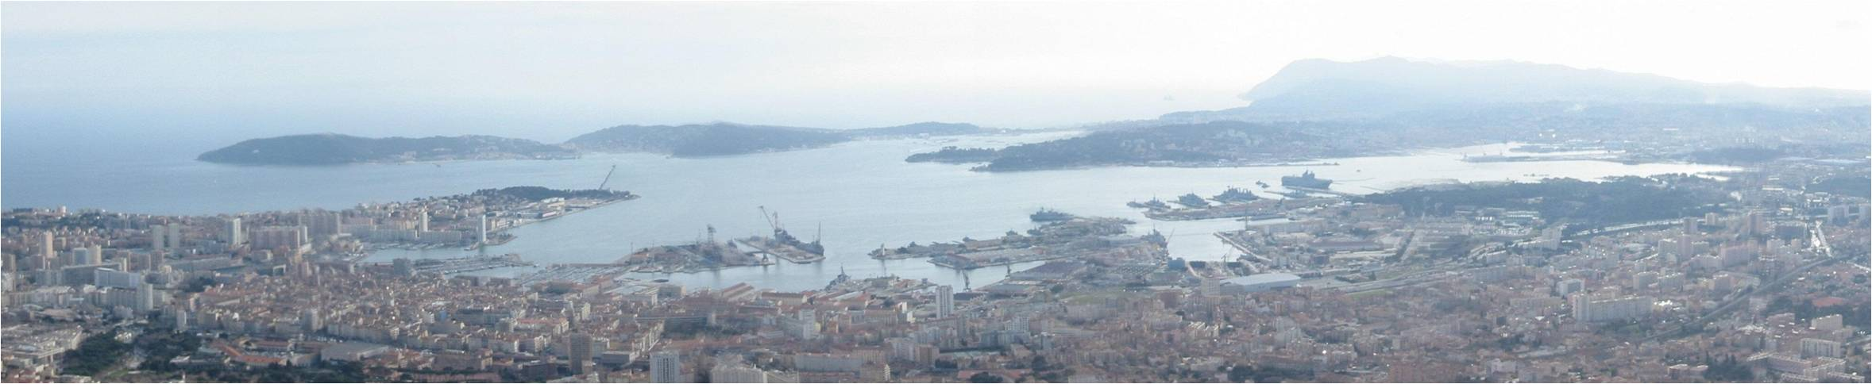
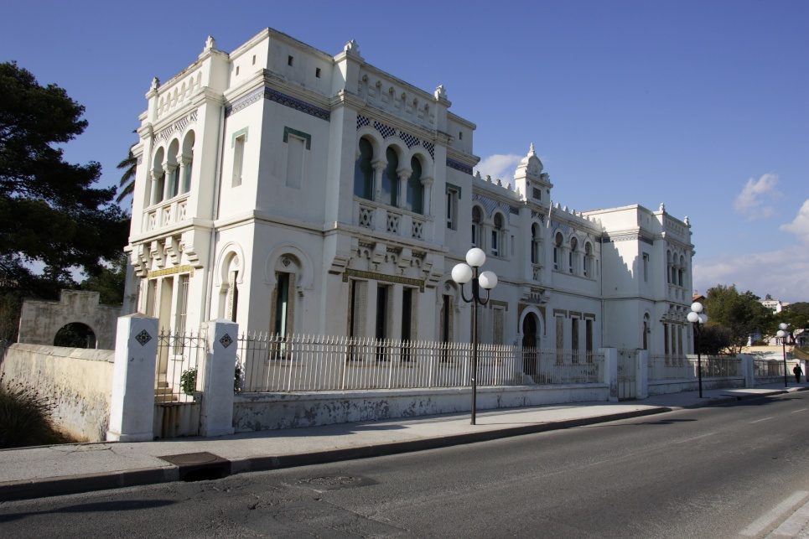
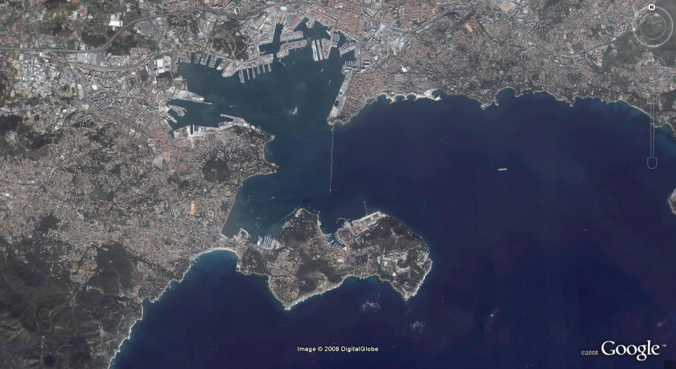
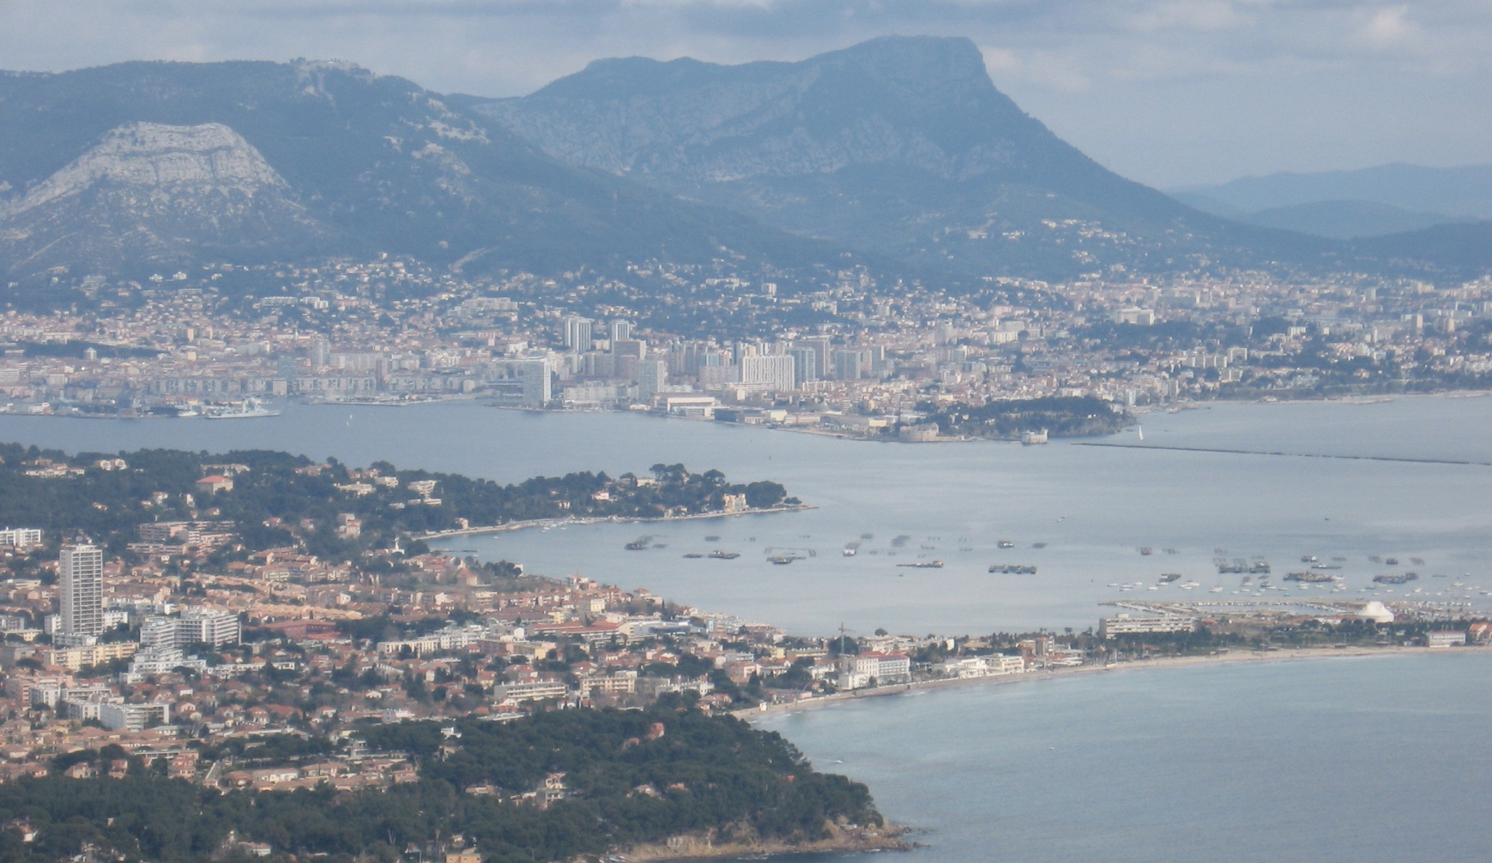
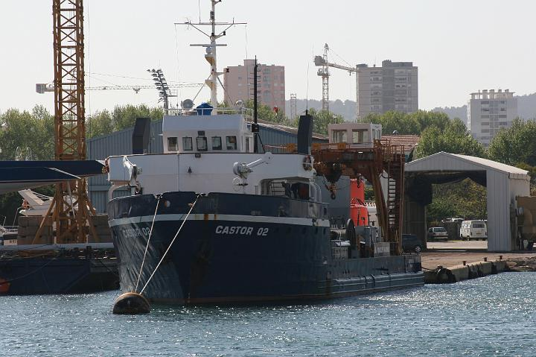
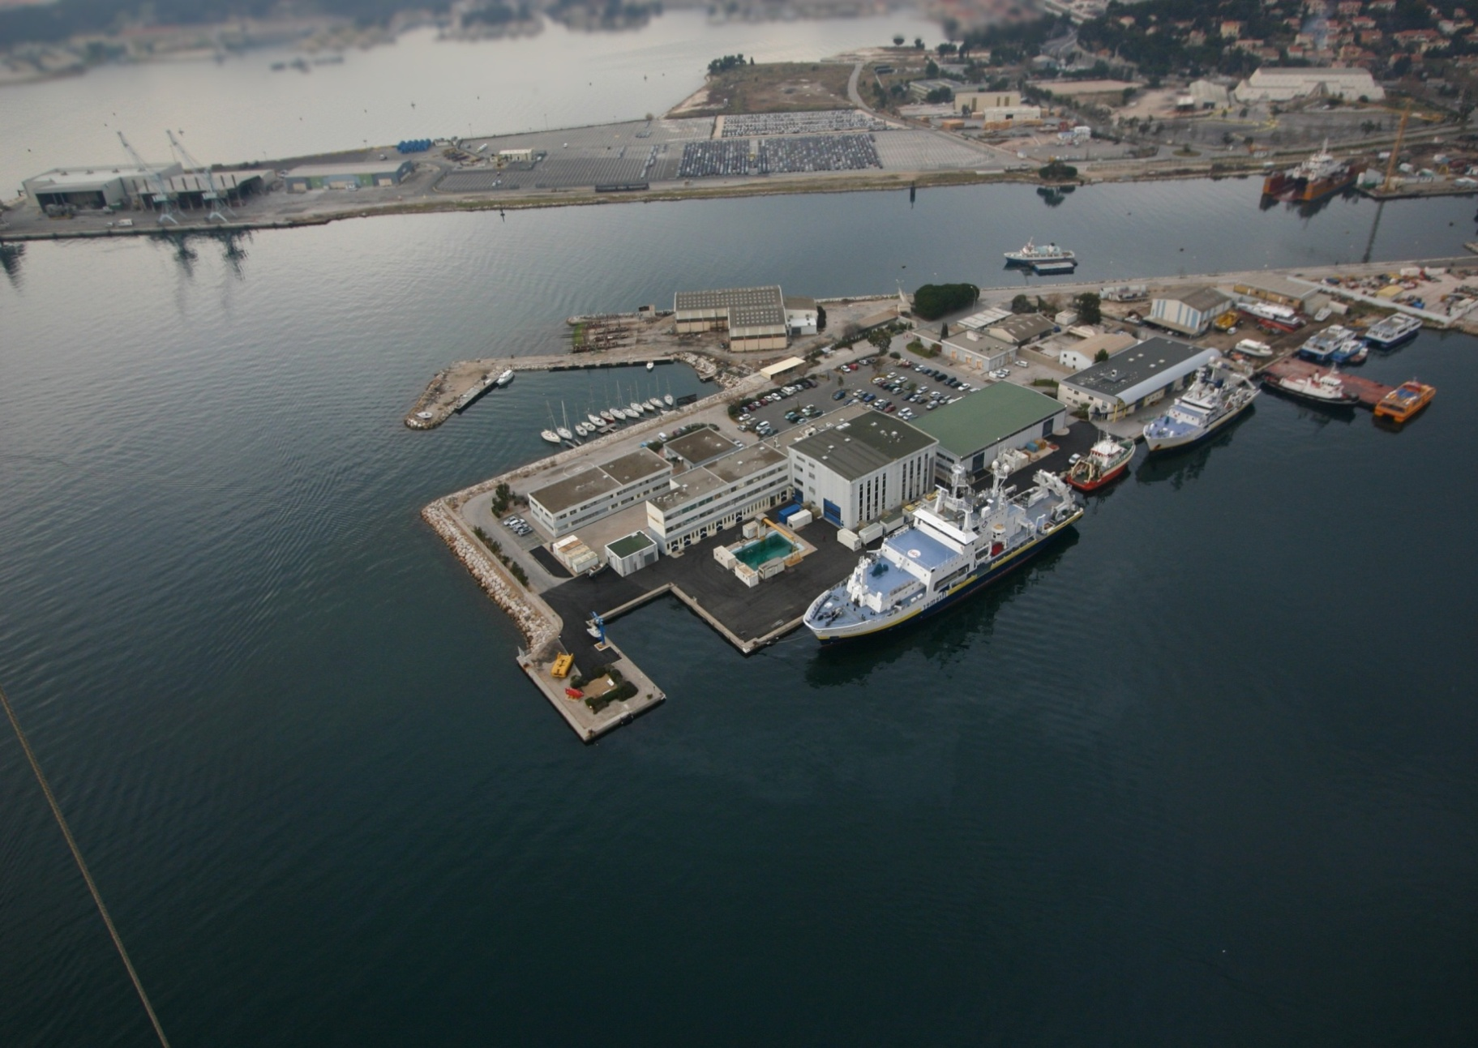
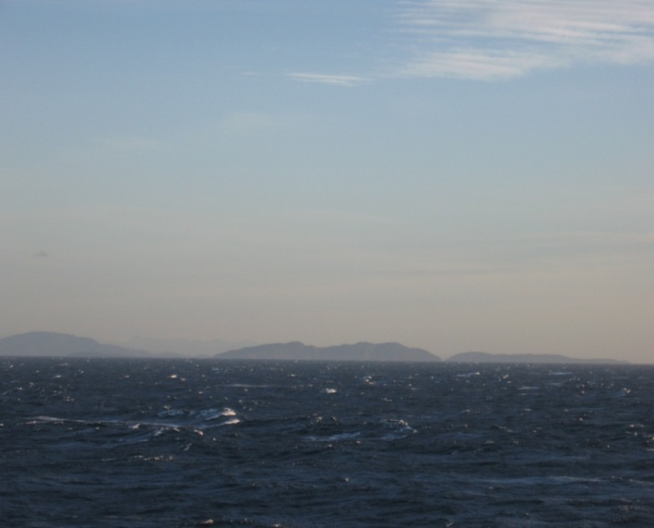
The ANTARES Site & Infrastructure
Shore Station
Site
20 km from nearest land
Submarine cable
40 km
IFREMER Toulon Centre
FOSELEV Marine Shipyard

Slide 10
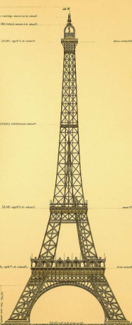
The ANTARES Detector
900 PMTs
12 lines
25 storeys / line
3 PMTs / storey
2500m
40 km to
shore
450 m
Junction
Box
70 m
Interlink cables

Slide 11
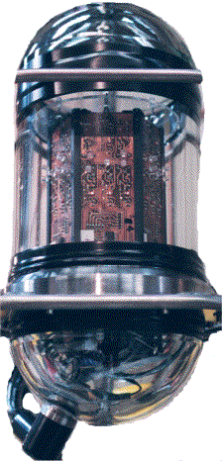
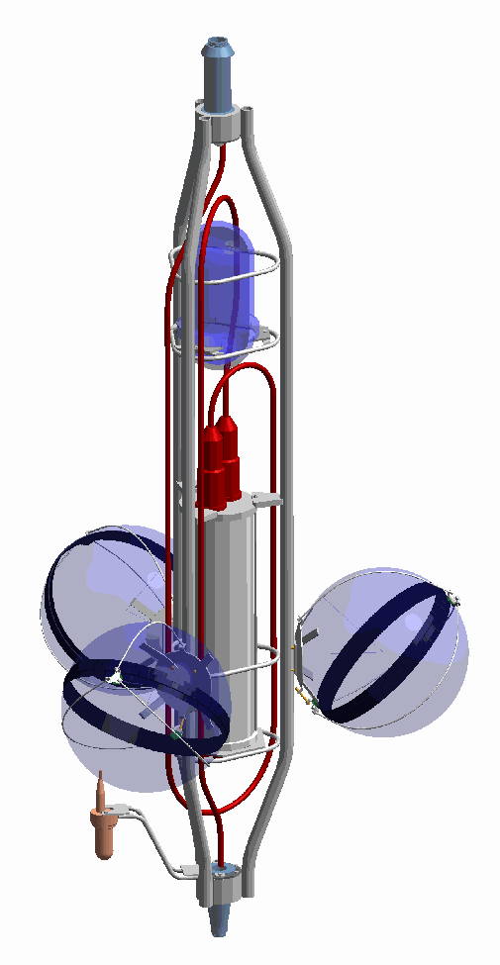
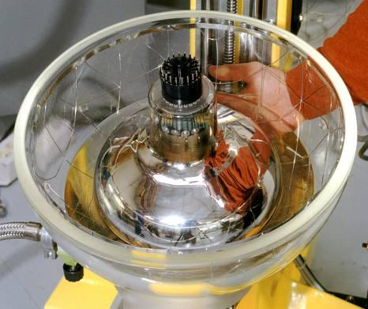
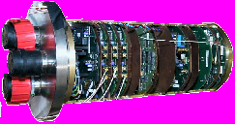
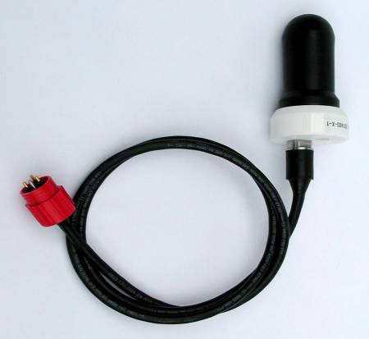
Basic Detector Element: a storey
titanium frame: support structure
Optical Beacon
with blue LEDs:
timing calibration
Optical Module:
10” Hamamatsu PMT
in 17” glass sphere
(σ_{TTS} ≈ 1.3 ns)
photon detection
Local Control Module
(in Ti cylinder):
Front-end ASIC, DAQ/SC, DWDM,
Clock, tilt/compass, power distribution…
Hydrophone:
acoustic positioning

Slide 12
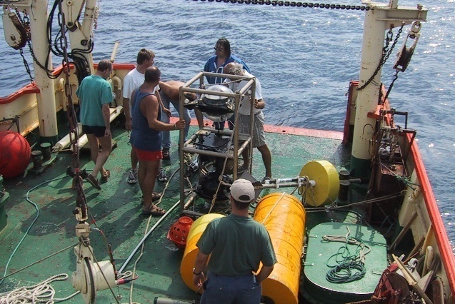
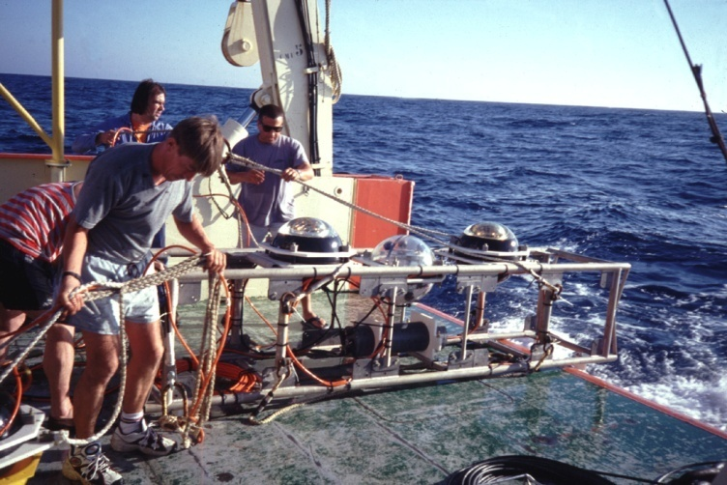
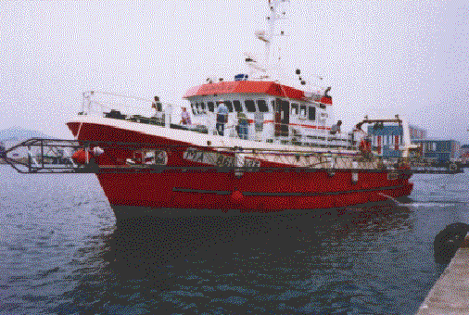
ANTARES Site Exploration
1996 - 2000 Measurements with autonomous lines
Optical background study: 15 deployments
2) Biofouling-sedimentation study: 4 deployments
3) Optical properties study: 28 deployments

Slide 13
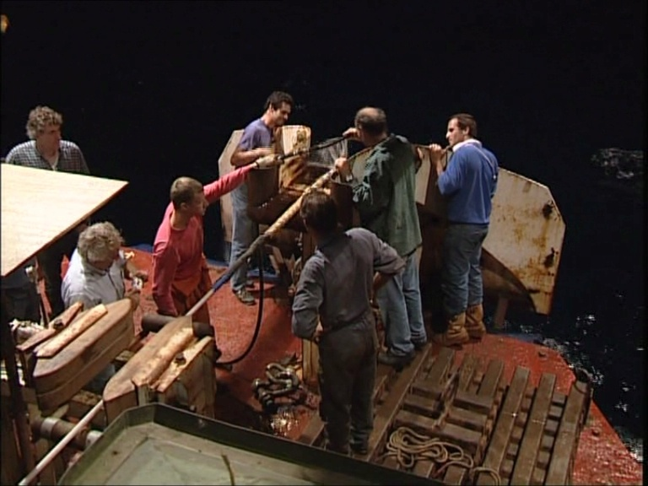
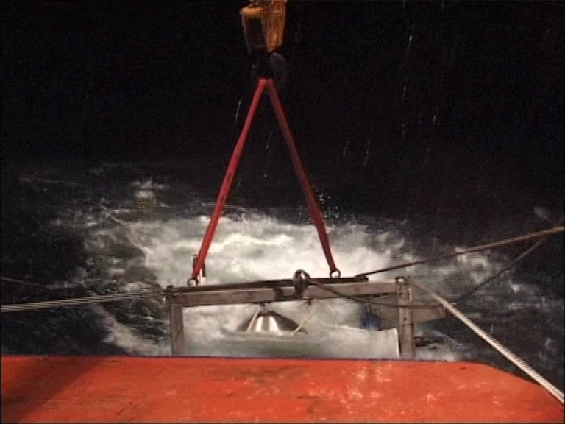
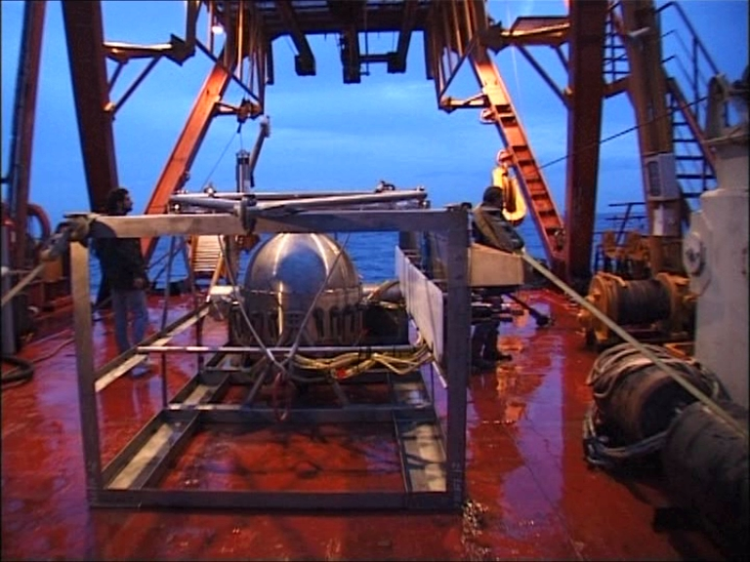
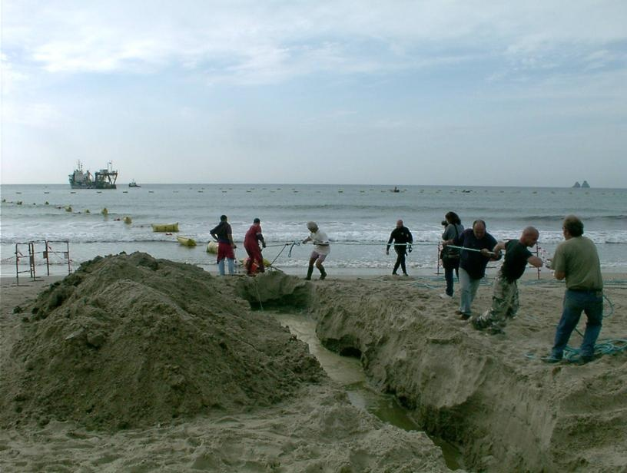
Building the Detector - 1
Main Cable and Junction Box
2001 Deployment of 45 km electro-optical cable (Alcatel)
2002 Deployment of Junction Box

Slide 14
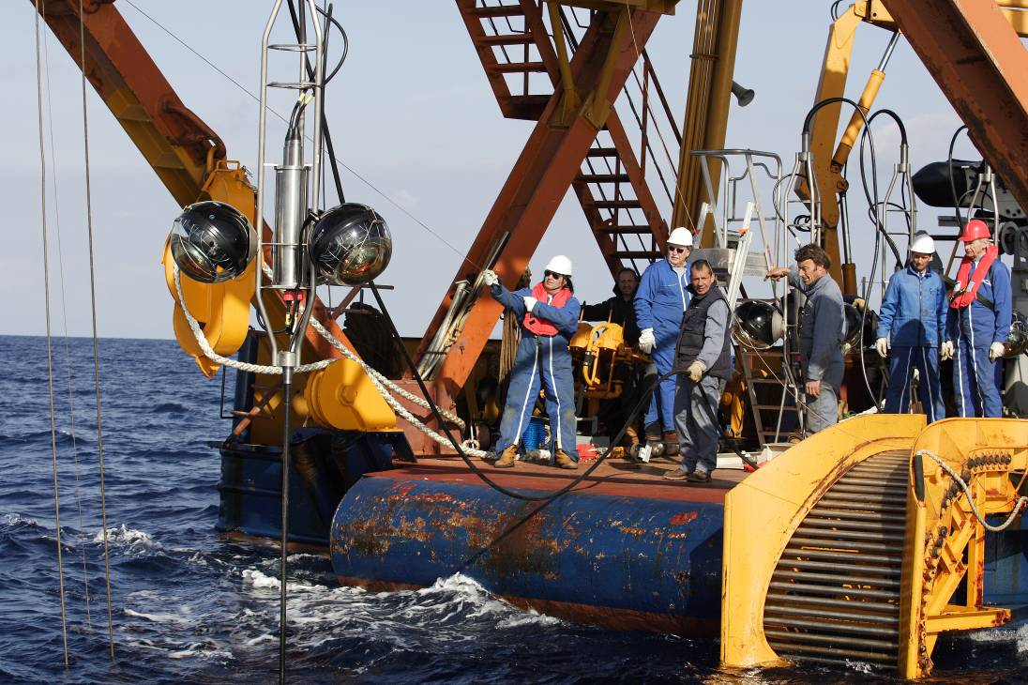
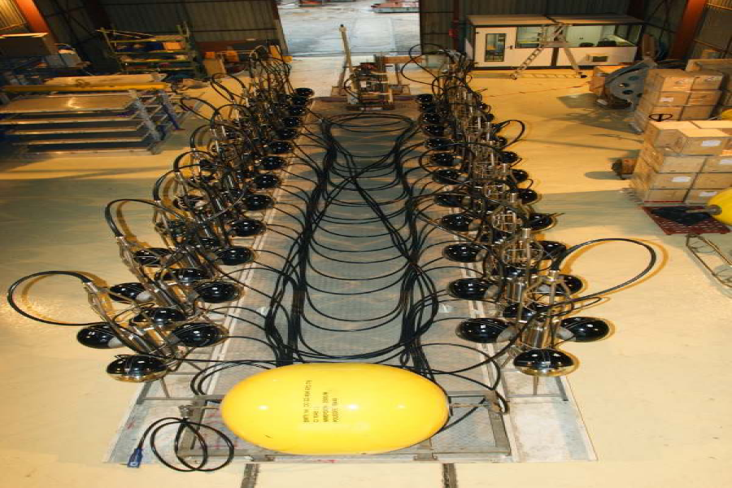
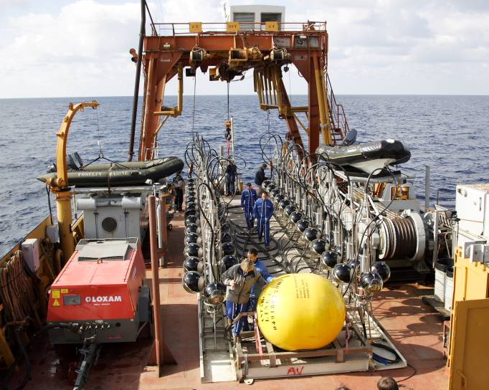
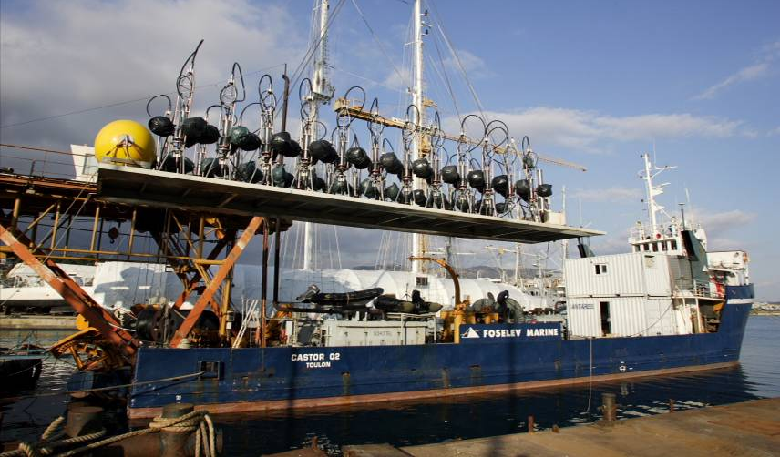
Building the Detector - 2
Line Deployment
2003-2005 Various prototype lines
2006 Lines 1, 2
2007 Lines 3, 4, 5, 6, 7, 8, 9,10
2008 Lines 11, 12

Slide 15
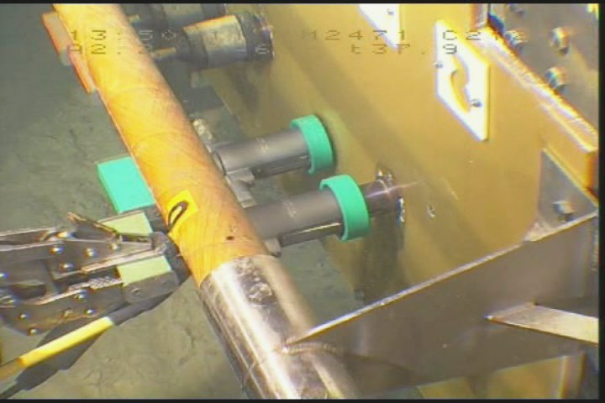
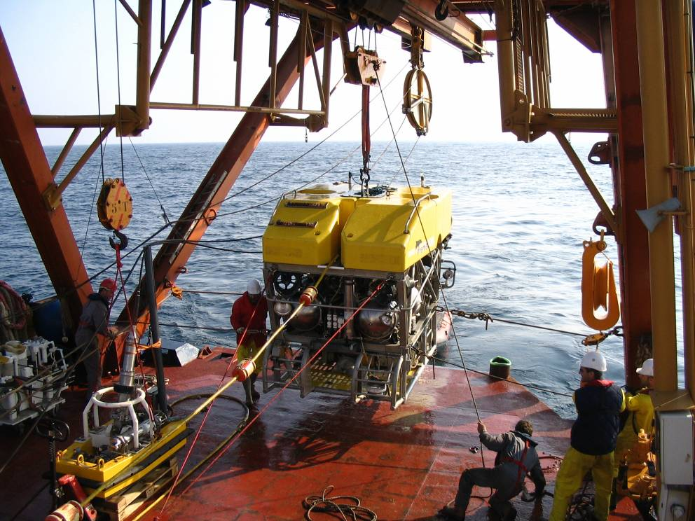
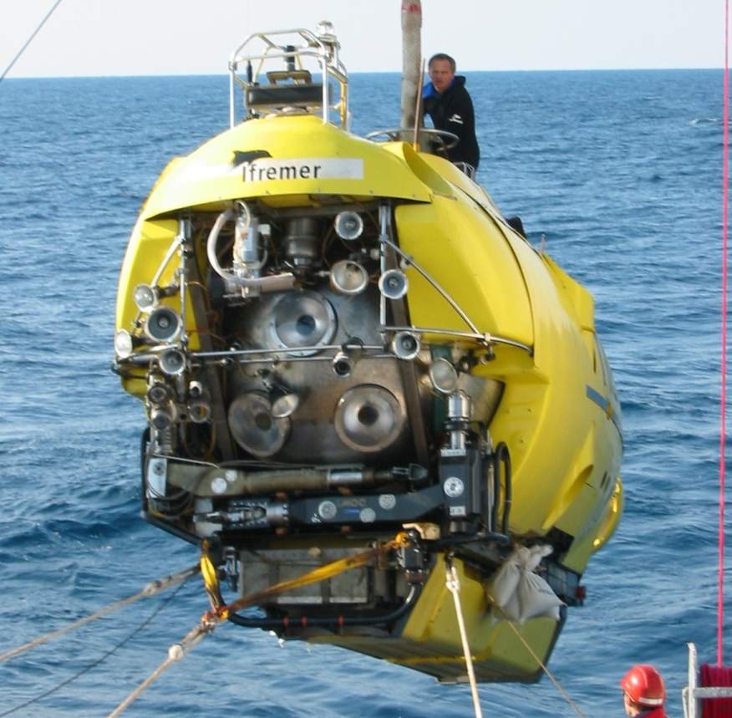
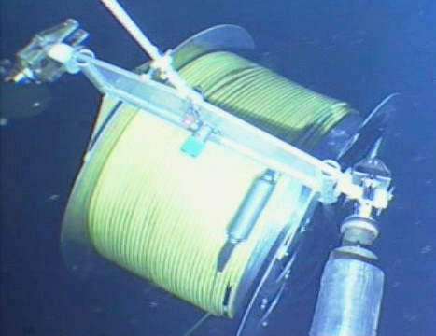
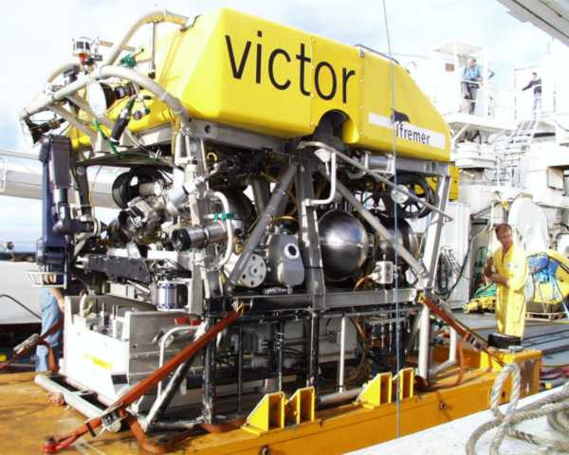

Building the Detector - 3
Line Connections
2006 Line 1, Line 2
2007 Lines 3 - 5, Lines 6 -10
2008 Lines 11, 12
Manned submarine Nautile
Robot submarine Victor

Slide 16









Detector on Seabed
Junction Box
100 m
Line bases
N
Line storeys
IL07
L1
L5
L2
L3
L9
L4
L7
L6
L8
L11
L10
Submarine
cable
to shore
L12
seismometer
Junction box

Slide 17

Detector status after completion
88% of modules operational
Regular maintenance of
in-situ infrastructure
foreseen

Slide 18







Counting Rates (short timescale)
2 min
Continuous baseline:
Radioactivity in the sea (⁴⁰K)
+ bioluminescent bacteria
Bursts:
bioluminescence from
Macroscopic organisms
⁴⁰K

Slide 19


Counting Rates (long timescale)
MILOM
L1F1
L1F25
IL07
MILOM
& L1
L1 & L2
Ant. 5L
Ant. 10L
& IL07
Full Antares
MILOM
out
Cable Fault
MILOM
Only
2005
2006
2007
2008
2009
Long term variations due to seasonal
and sea current variability

Slide 20





In situ calibration with Potassium-40
Gaussian peak on
coincidence plot
Integral
under
peak
^{γ}
Cherenkov
Precision (~5%)
monitoring of OM efficiencies
Peak offset
e⁻ (β decay)
⁴⁰K
Cross check of time calibration
⁴⁰Ca

Slide 21

Time evolution of K40 coincidence rate
All OM pairs of Line1 during more than 2 years
OM gain drop reduces efficiency
Recovery after threshold retuning
Recovery due to HV off during period of cable repair

Slide 22



Light Absorption Measured using Beacons
~150 m
~70 m

Slide 23


Position Alignment
Z(m)
Example for
Sea current
v= 25 cm/s
r_{max} = 22m
Measure every 2 min:
Distance line bases
to 5 storeys/line
and also storey
headings and tilts
r(m)
r = (a z - b ln[1-cz] ) v²

Slide 24



Line position measurements
Acoustic positioning:
Hydrophone positions
from July→Dec 2007
Acoustic positioning:
Precision ~ few cms
Within a line
Between lines
Storey 1
Storey 8
Storey 14
Storey 20
Storey 25
Radial displacement

Slide 25
Data Acquisition
x,t,Q
~1 MB/s→
F.E.
F.E.
F.E.
F.E.
F.E.
F.E.
off-shore
Time
(slices ~100ms)
on-shore
Ethernet switch
PC n-1
PC n
PC n+1
Storage
1-10 MB/s
Trigger
Trigger
Trigger
M. Circella – Status of ANTARES
VLVnT08

Slide 26
Online Triggers
3N- directional scan
= 1 local coincidence (20ns) of 2 out of 3
or a single large amplitude (>3spe)
Trigger 3N = 5 within 2.2μs,
and causally related
2T3
Trigger 1T3 = 2 in 3 adjacent storeys
Trigger 2T3 = 2 x 1T3 within 2.2 μs
Galactic Centre-directional trigger

Slide 27


Number of triggers
5 lines (2007)
10 or more lines (2008)
19.10⁶ μ
65.10⁶ μ
CABLE
REPAIR
Total : 240 days = 80% of calendar
Selected :167d = 70% of total
Total : 243 days = 83% of calendar
Selected :173d = 71% of total

Slide 28



Expected Performance (full detector)
Neutrino effective area
Angular resolution
N_{det}=A_{eff} × Time × Flux
For E_{ν}<10 PeV, A_{eff} grows with energy due to the increase of the interaction cross section and the muon range.
For E_{ν}>10 PeV the Earth becomes opaque to neutrinos.
For E_{ν}<10 TeV, the angular resolution is dominated by the ν-μ angle.
For E_{ν}>10 TeV, the resolution is limited by track reconstruction uncertainities.

Slide 29


Event Displays
z (m)
z (m)
r (m)
t (ns)

Slide 30










Event Displays
Hits are plotted for each line: z coordinate (height) as function time
Characteristic pattern in function of zenith angle and point of closest approach between line and track
upward
downward

Slide 31


Event Display: Atmospheric Muons
height
Example of a reconstructed down-going muon, detected in all 12 detector lines:
time

Slide 32


Event Display: Neutrino-induced muon
height
Example of a reconstructed up-going muon (i.e. a neutrino candidate) detected in 6/12 detector lines:
time

Slide 33



Data-MC comparison for downgoing events
(5-lines)
data
CORSIKA
QGSJET +NSU
MC uncertainty
No quality cuts applied
Agreement within (substantial) theoretical + MC uncertainty
Main experimental errors stem from OM efficiency and acceptance and optical water properties (λ _{abs} λ_{scatt})
MUPAGE
data
CORSIKA
QGSJET +NSU
CORSIKA
QGSJET+Horandel

Slide 34


Depth intensity relation-1 line
2,5km
6km
The ANTARES collaboration:
Performance of the First ANTARES
Detector Line.
AP 31 (2009) 277

Slide 35


5 lines (2007): Depth vs. Intensity
Preliminary
Preliminary
Two independent analyses:
Good agreement
(“deconvolution” and “bin-to-bin correction”).
Work on reducing systematics is ongoing

Slide 36
Delay between adjacent storeys
Fixed for vertical muons
In general large distribution
The integral below the peak
is proportional to the μ flux
No systematic effects
of trigger or reconstruction
Shape is sensitive to angular acceptance of optical modules and angular distribution of muon flux

Slide 37


Vertical muon intensity
Muon flux measured without track reconstruction
Error dominated by detector systematics
-angular acceptance of PMTs
-absolute PMT efficiencies
Measured Rate
Derived Flux

Slide 38

Depth Dependency: ICECUBE vs ANTARES

Slide 39


ICECUBE vs ANTARES: Location, Location, Location!!

Slide 40


5 line data (2007): angular distribution
p, α
ν_{μ}
p
ν_{μ}
γ
168 active days
168 upward events
(multi-line fit)
down
up
horizontal

Slide 41


Point source search
List of 25 sources
No significant excess found
5-line data, 168 days
94 upgoing events

Slide 42



Point SOURCE sEARCH
Stringent cuts to ensure low background and good angular resolution.
Search applied to 25 selected sources.
Distribution of time residuals
Two independent statistical methods used : one binned and another unbinned
Blinding policy followed and several “challenges” performed on scrambled data before final analysis
The lowest value corresponds to a
p-value pre-trial of 2.8σ found with UNBINNED method.
It is expected in 10% of the experiments when looking at 25 sources (post-trial probability)

Slide 43


All-sky search results
BIC distribution of only background
BIC_{obs}
In our sample :
  BIC_{obs} = 1.4 (highest value)
  p-value = 0.3 (1σ excess)
  (δ = -63.7º RA =243.9º)
EM algorithm
No significant excess was found
Cross-check: Cone method
δ | RA | N_{events} | P_{BIN}
-28.8 | 31 | 1 | 0.053
-42.7 | 164 | 1 | 0.050
24.2 | 32 | 1 | 0.069
-51.4 | 159 | 1 | 0.052
-63.38 | 244 | 1 | 0.055

Slide 44


2008 data
174 active days
582 upgoing events
(multi-line fit)

Slide 45

BLINDED 2007+2008 SKYMAP

Slide 46

Gamma Ray Bursts
Fireball model (Meszaros, Rees 1994)
TeV neutrinos from
inside,the star
[Meszaros & Waxman, 2001]
[Razzaque et al. 2003]
PeV Neutrinos from
internal Shocks
[Waxman & Bahcall 1997]
[Gupta & Zhang, 2006]
[Murase & Nagataki 2006]
EeV Neutrinos from
external Shocks
[Dermer 2001]
[Waxman & Bahcall, 2000]

Slide 47


Choked/Dark Gamma Ray Bursts
Γ=3, E_{K}~3 10⁵¹ergs
Baryon rich (dirty fireball)
enhanced neutrino signal
More frequent than ‘standard’ GRBs
No optical counterpart
kaon decay contribution dominates
Detected neutrinos above 100 GeV
~30 per km3 @ 10 Mpc
~ 3 per km3 @ 30 Mpc
Neutrinos cluster within 10s
and 3 degree angular bin
⇒ Extremely low background
R_{SN} (< 10 Mpc) ~ 3 yr⁻¹,
R_{SN} (< 30 Mpc) ~ 90 yr⁻¹

Slide 48


GRBs with ANTARES
Triggered search
Rolling search
Uses Satellite trigger list
Low backgrounds due to direction and time coincidences
Low signal per GRB, use stacking
Currently just muon neutrinos
Sliding window around events
Sensitive to dark bursts
Fast online reconstruction ⇒
optical follow up to identify source
Idea initiated by the ICECUBE Collaboration
(astro-ph/0701618, M. Kowalski & A. Mohr)

Slide 49






Triggered Search: Time delays
GRB alerts from three satellites
INTEGRAL
Swift
Fermi
Response time = time delay – buffering time
INTEGRAL
Swift
Fermi
24 alerts from INTEGRAL 241 alerts from Swift 198 alerts from Fermi
(From February 2007 to May 2009)

Slide 50

Triggered Search: special data taking
all-data-to-shore
GCN
5 – 60 seconds
40 km
GRB alert from satellite
60 seconds
Junction Box
Buffering of data
Trigger selection
Standard data storage:
Only filtered events
(all hits within 2.2 μs)
GRB data storage:
All data without filtering
during 2 minutes

Slide 51

Rolling Search Triggers
- Single High Energy Neutrino
Above ~20 - 50 TeV, the background rate begins to be negligible
- Multiplet of neutrino events
From the same direction and within a short time window
Application to ANTARES:
ΔΩ = 2° x 2°
Δt = 10 min

Slide 52



Optical Follow-Up
TAROT (Télescope à Action Rapide pour les Objets Transitoires)
(Fast action telescope for transient objects)
TAROT La Silla
Two robotic 25 cm diameter telescopes
TAROT Calern, France
TAROT La Silla, Chile
Field of view of 1.86° x 1.86°
Magnitude V<17 (10s)
V<19 (100s)

Slide 53

Expected Sensitivity to GRBs

Slide 54


Indirect Search for Dark Matter
dark matter annihilations in the sun
χ
Sun
WIMPs gravitational trapped
via elastic collisions in the sun
Earth
χ
χ
χ
χ
ν
χ
Antares
<E_{ν}> ~ M_{χ}/3
χ
χ
→
WW, ff
W, f
→
ν X

Slide 55

Dark matter search
5 lines, 68 days, ν flux
5-line data, 68.4 days
168 days + 51% Sun under horizon + trigger corr.
No excess observed
(90% C.L. limits) à la Feldman-Cousins
mSugra model predictions
green : WMAP favoured relic density
red : > WMAP favoured relic density
blue : < WMAP favoured relic density
Ф_{νμ+νμ} from the Sun

Slide 56

Dark matter search
12 lines, 5 years, ν flux
Ф_{νμ+νμ} from the Sun

Slide 57


Search for Monopoles & Nuclearites
ANTARES sensitivity to monopoles
(5-line detector and 127 days)
ANTARES 5 lines
AMANDA II 137 days
Search of monopoles
Extremely high energy deposition
Direct Cherenkov light for β > 0.74
Through δ-rays for β > 0.51
Monte Carlo generation done (study of trigger efficiencies, selection, background rejection etc.)
Good prospects for limits
A dedicated reconstruction needed
Search of nuclearites (strangelets, quark nuggets, Q-balls).
Very characteristic signature:an extended source of photons “heated wire”
Analysis ongoing. Good prospects for limits

Slide 58
Earth and Sea Sciences
IL 07
hydrophones
CT
  Seismology
  Acoustic Detection
  Oceanography
  Bioluminescence
  Environmental Monitoring
14.5m
Camera
ADCP
OM
80m
C-Star
SV
CT
14.5m
hydrophones
O₂
14.5m
hydrophones
C-Star
80m
Camera
OM
ADCP
hydrophone
98m
RxTx
Seismometer
Notes:
58

Slide 59



Acoustic Detection of Neutrinos
neutrino
Hydrophone Array
Cascade
Acoustic Pressure Waves
Coordinated by Univ. Erlangen

Slide 60



Localisation of Acoustic Signals

Slide 61






feb-may
2008
61
Notes:
M. Spurio- ANTARES
61

Slide 62






World’s Deepest Online Camera
AXIS221 vidéosurveillance
Sensistivity: 0.1 lux
Field of view: up to 90 degrees
Infra red night vision

Slide 63





Seismology
In laboratory
deployment
Buried at site Antares
(gain 20 dB of noise)
PEROU
The ANTARES seismograph is part of a seismic monitoring network, complementary to
the terrestrial stations.
Collaboration with Laboratoire Géosciences Azur

Slide 64

Examples of seismic events
Examples of Seismic Events
M. Circella – Status of ANTARES
VLVnT08
64
Notes:
M. Spurio- ANTARES
64

Slide 65



Oceanography
Programme Hydro-Changes of CIESM
(Commission Internationale pour l’Exploration Scientifique de la mer Méditerranée)
ANTARES
Circulation studies in the Mediterranean Sea
Collaboration with Centre d’Océanologie de Marseille

Slide 66







Secondary JB for Scientific/Technological Applications
To be connected 2010:
system management and project selection by IFREMER/CNRS
66
Notes:
M. Spurio- ANTARES
66

Slide 67


Toward a km³-scale detector in the Mediterranean sea
Antares (1/50 km³)
Toulon, France
-2500m
Nestor
Pylos, Greece
-4000m
Nemo
Capo Passero, Italy
-3350m

Slide 68






Mediterranean Efforts
Antares (1/50 km³)
Toulon, France
-2500m
Since 2000
R&D
∼ 80 members
Nestor
Pylos, Greece
-4000m
Since 1996
Data taking
∼150 members
Since 1990
R&D
∼ 50 members
Nemo
Capo Passero, Italy
-3350m

Slide 69


The challenge
12 lines, 900 PMTs
  Maximise physics potential
    Substantial improvement over ICECUBE
    Instrumented volume >1km3
    Angular resolution ~0.1 degrees (E>10 TeV)
  Build in a reasonable time ∼ 4 years
    New deployment techniques
    Speed-up integration time
    Sub contract part of the production
    …
  At a reduced cost
    Factor 2 reduction cf ANTARES
    Simplified architecture
    Reduced maintenance
    Multi-line deployments
    …
100-200 lines, 5000-10000 PMTs

Slide 70






Optimisation Studies
Optimisation Studies
8-10m
cluster
cuboid
ring
Detection structures
(under cost evaluation)

Slide 71

Timeline Towards Construction
Feb 2006
Mar 2008
Oct 2009
Mar 2011
Design Study
Preparatory phase
Construction phase
Data taking
CDR
TDR
Final
prototyping
Downloadable from the
KM3NeT web site
http://www.km3net.org/CDR/CDRKM3NeT.pdf
Partially funded by FP6&FP7
ASPERA/APPEC roadmap
ESFRI ‘list of opportunities’

Slide 72

Point Source Sensitivity
Based on muon detection
Factor ~50 more
than ANTARES
Factor ~3 more sensitive than IceCube
  Better angular resolution
  centre galactic
KM3NeT 1 an (détecteur typique)‏

Slide 73



Outlook
ANTARES infrastructure completed since May 29th 2008
  Detector operation and calibration under control
  Maintenance capability demonstrated
Exciting physics program ahead
  Over a thousand neutrinos already reconstructed
  Unexplored regions of sensitivity
  astronomical sources, dark matter, oscilllations, ……
  Multi-messenger approach
  Real-time readout and in-situ power capabilities facilitates
  a large program of synergetic multi-disciplinary activities: acoustics, biology, oceanography, seismology……
Major step towards the KM3NeT multi-disciplinary
deep-sea research infrastructure

