Slide 1
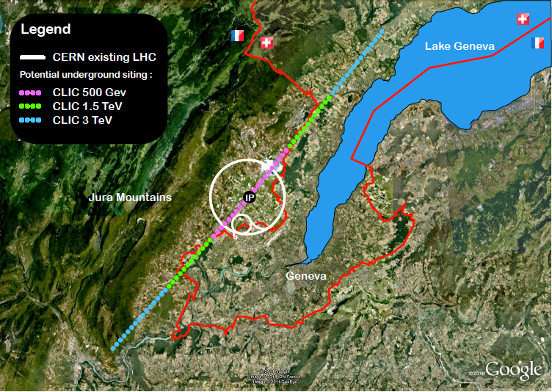
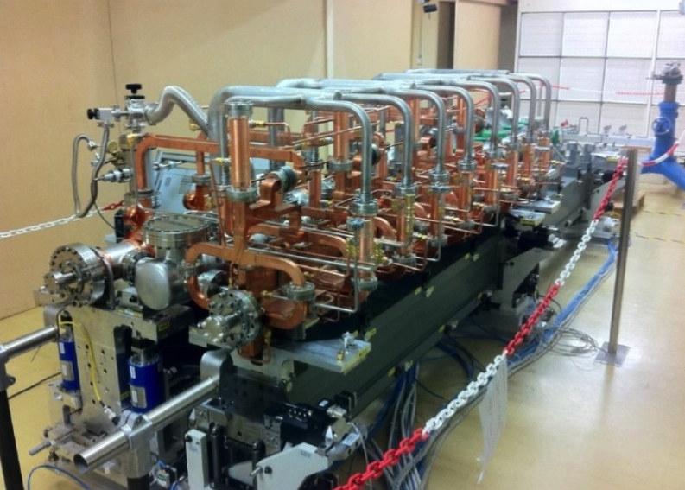
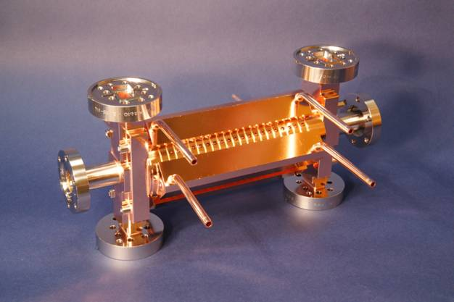
The CLIC project
Outline:
Brief introduction and overview
Across the main activities
- Brief summary
Key features:
High gradient (energy/length)
Small beams (luminosity)
Repetition rates and bunch spacing (experimental conditions)
<number>
Notes:
<number>

Slide 2
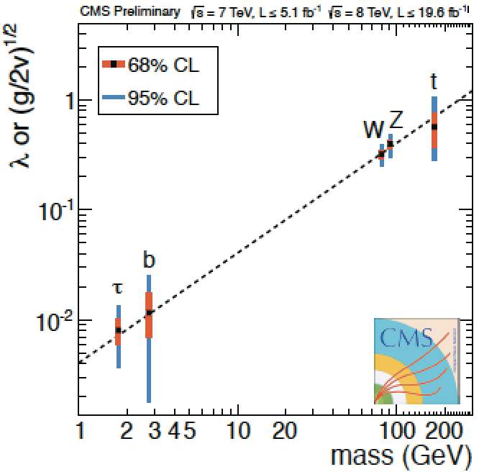

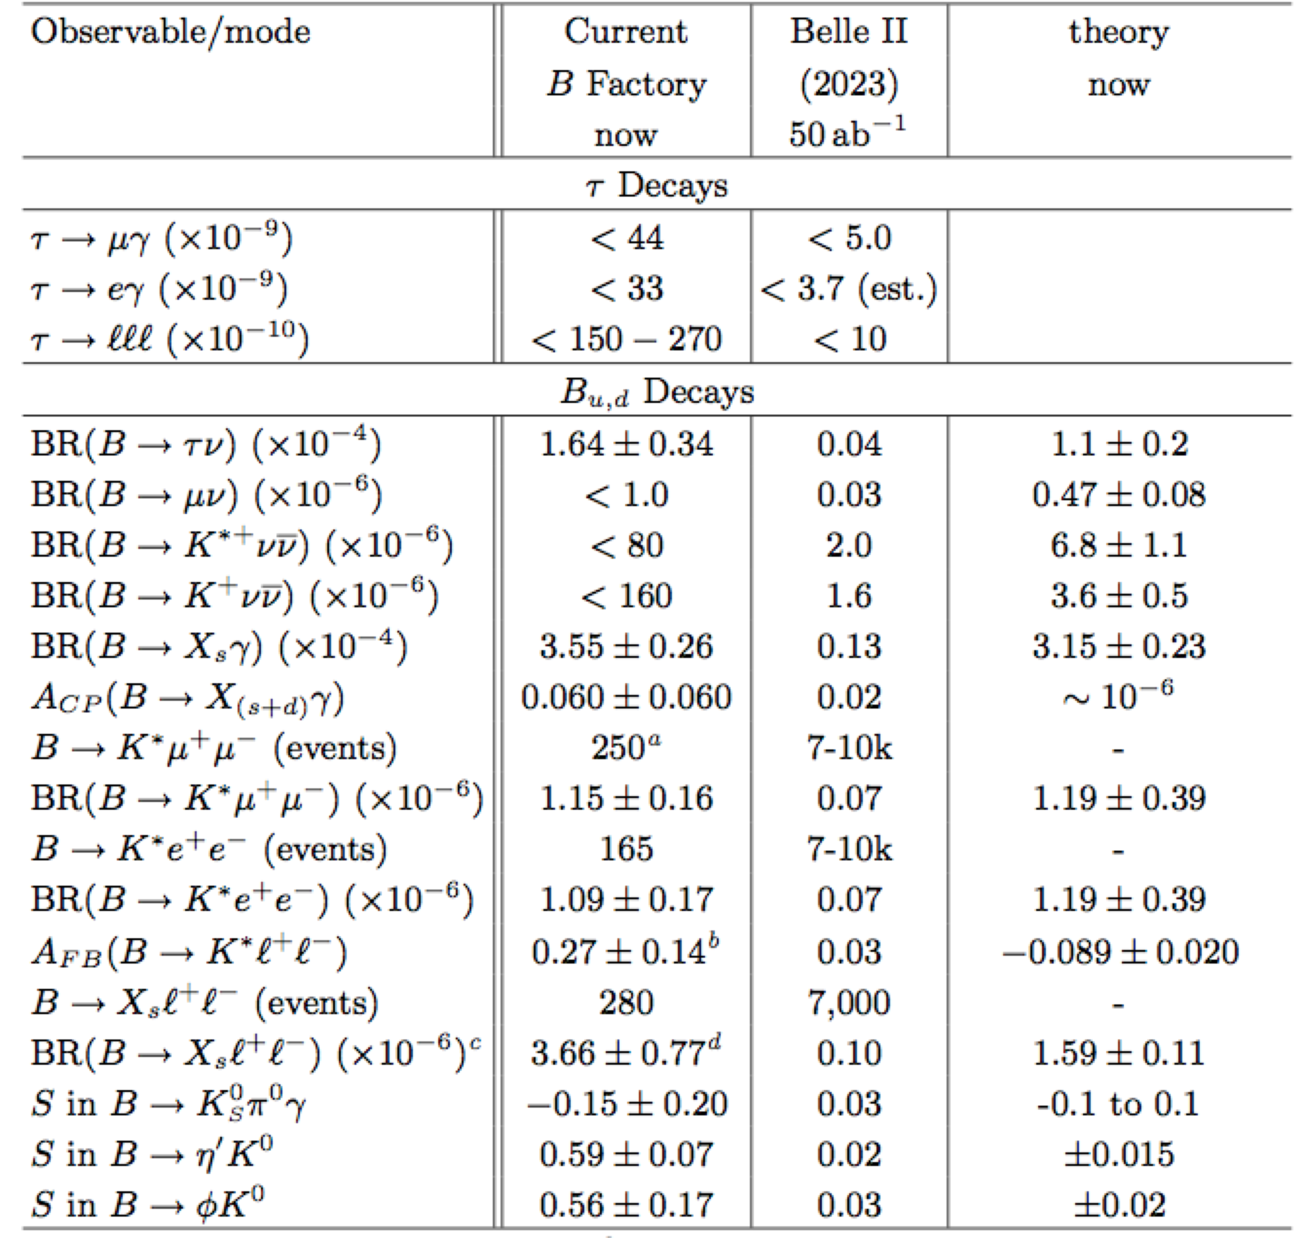
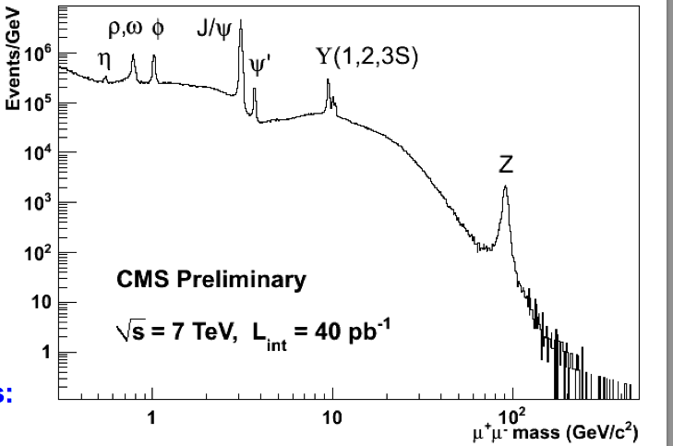
The Standard Model

Slide 3
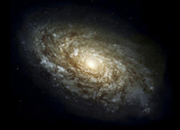
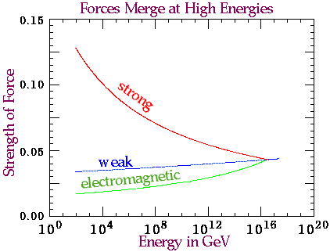
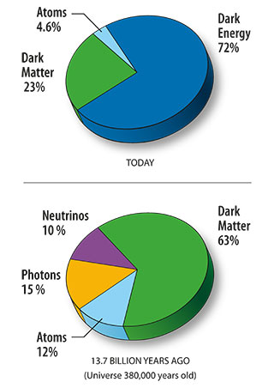
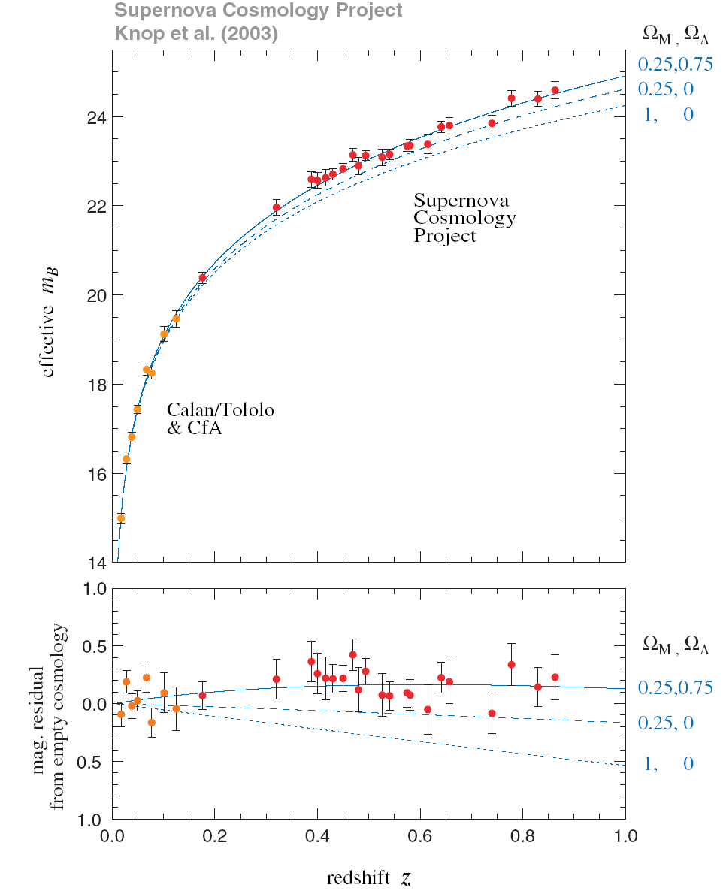
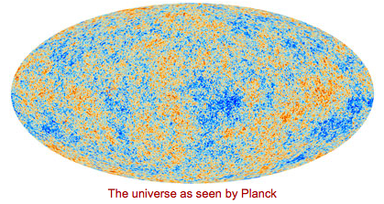
Beyond the Standard Model
Unknowns :
Flavour structure
Matter-antimatter
Why is the Higgs so light
Forces merging ?
Gravity
…
Notes:
<number>

Slide 4
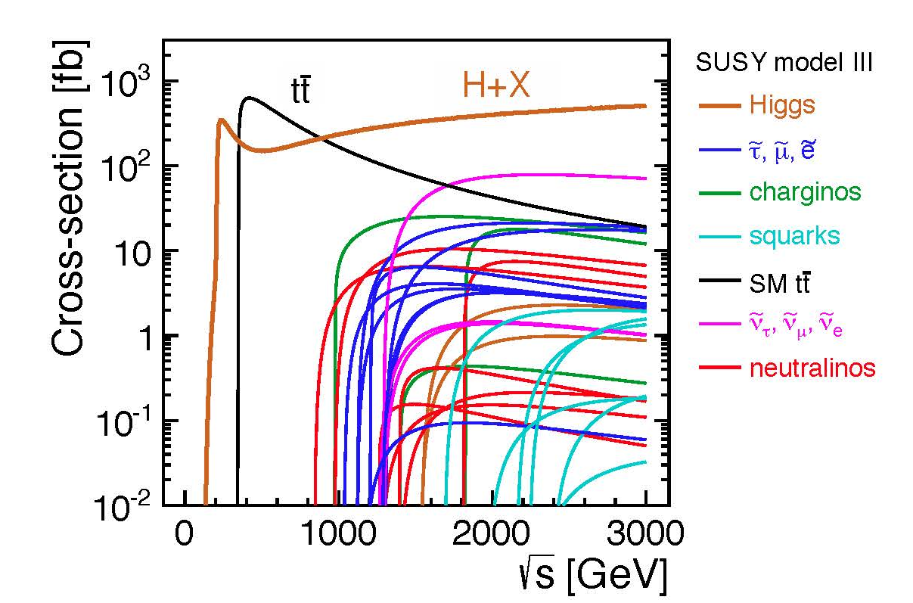
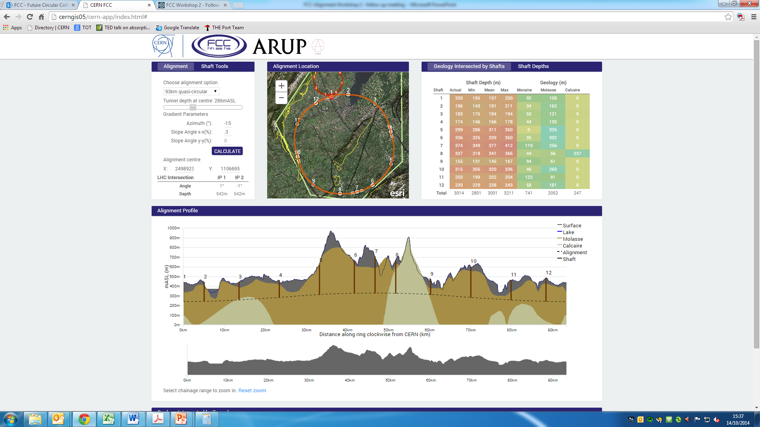
Some possibilities

Slide 5

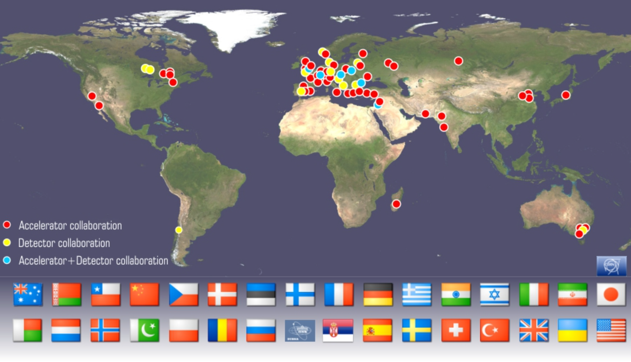
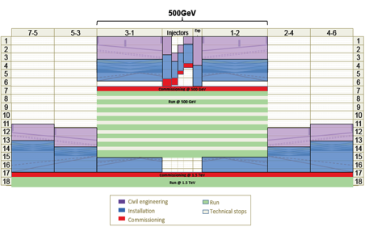
Accelerator collaboration with ~50 institutes
New institutes are joining:
In 2014 SINAP Shanghai and IPM Tehran
Detector collaboration operative with ~25 institutes
2013-18 Development Phase
Develop a Project Plan for a staged implementation in agreement with LHC findings; further technical developments with industry, performance studies for accelerator parts and systems, as well as for detectors.
4-5 year Preparation Phase
Finalise implementation parameters, Drive Beam Facility and other system verifications, site authorisation and preparation for industrial procurement.
Prepare detailed Technical Proposals for the detector-systems.
Construction Phase
Stage 1 construction of CLIC, in parallel with detector construction.
Preparation for implementation of further stages.
Common work with ILC related to several acc. systems as part of the LC coll., also related to initial stage physics and detector developments
Common physics benchmarking with FCC pp and common detect. challenges (ex: timing, granularity), as well as project implementation studies (costs, power, infrastructures …)
2018-19 Decisions
On the basis of LHC data
and Project Plans (for CLIC and other potential projects as FCC), take decisions about next project(s) at the Energy Frontier.
2024-25 Construction Start
Ready for full construction
and main tunnel excavation.
Commissioning
Becoming ready for data-taking as the LHC programme reaches completion.
Notes:
<number>

Slide 6

~260 registered (and ~200 talks)
Main elements:
Open high energy frontier session session
Accelerator sessions focusing on collaboration efforts and plans 2015-2019, parallel sessions and plenary
High Gradient Applications for FELs, industry, medical
Physics and detector sessions on current and future activities
Collaboration and Institute Boards
<number>

Slide 7

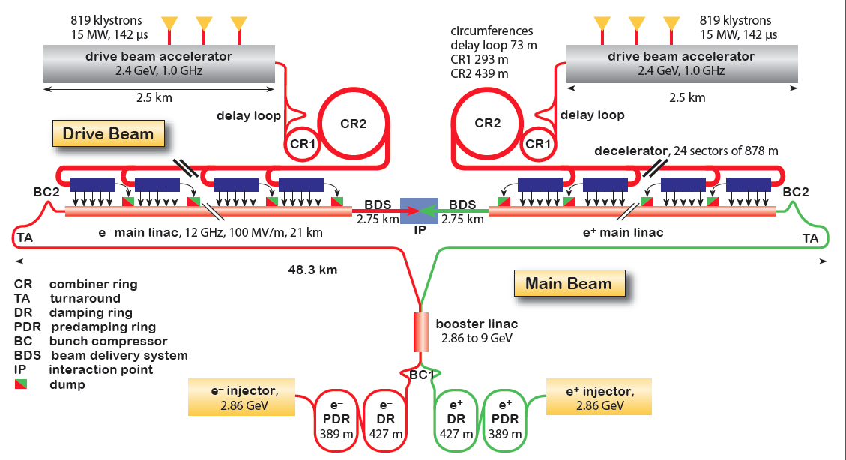
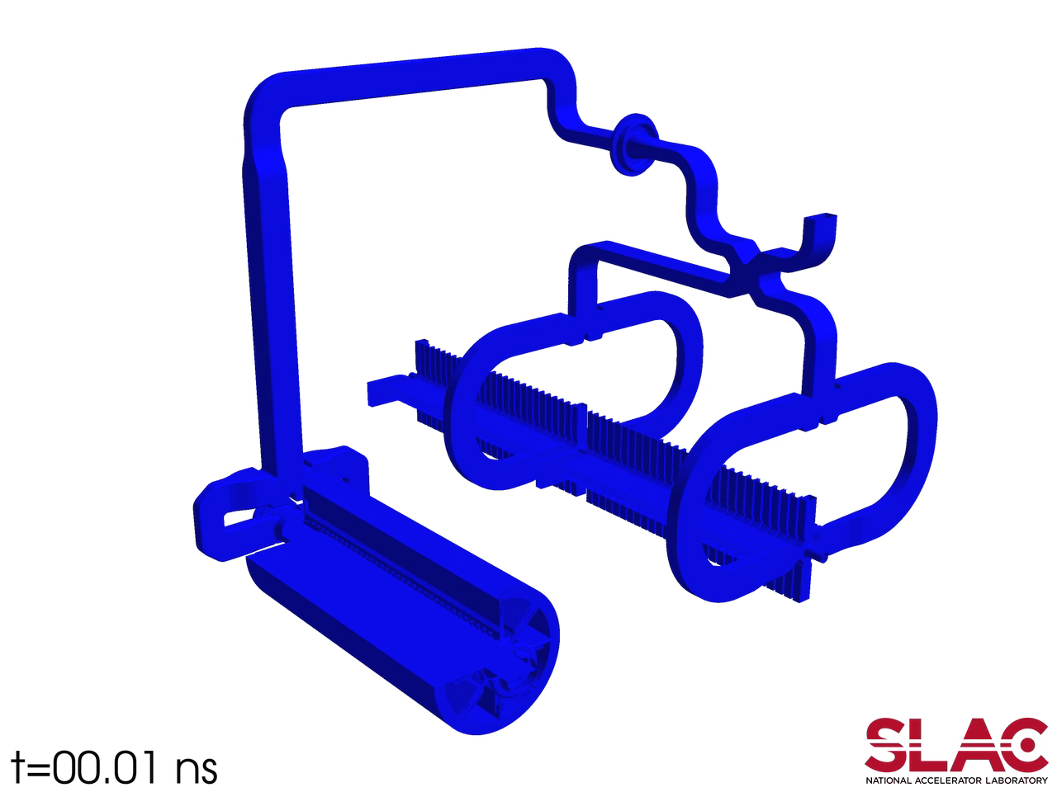
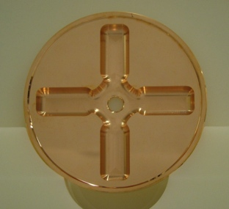
CLIC Layout at 3 TeV
Drive Beam Generation Complex
Drive beam time structure - initial
Drive beam time structure - final
240 ns
240 ns
5.8 μs
140 μs train length - 24 × 24 sub-pulses
4.2 A - 2.4 GeV – 60 cm between bunches
24 pulses – 101 A – 2.5 cm between bunches
Main Beam Generation Complex

Slide 8
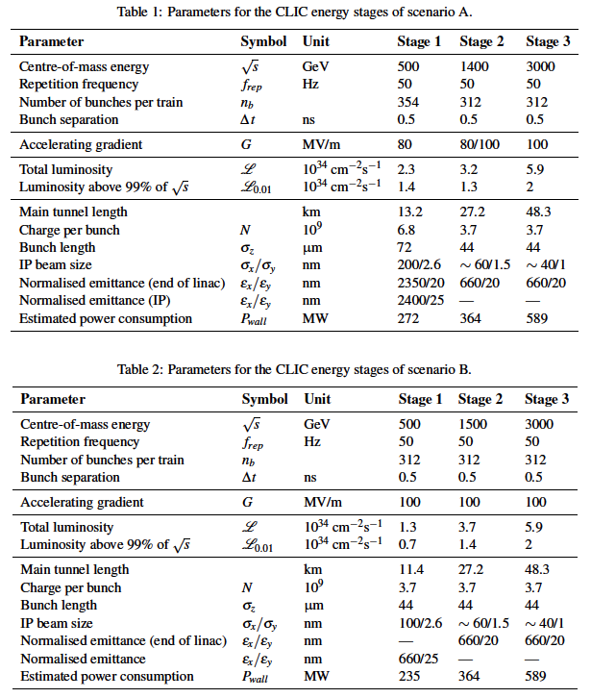
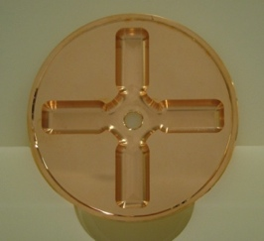
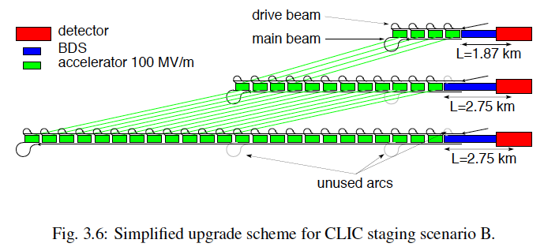
Possible CLIC stages studied in the CDR
Key features:
High gradient (energy/length)
Small beams (luminosity)
Repetition rates and bunch spacing (experimental conditions)
<number>

Slide 9
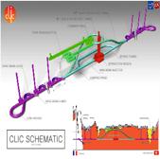
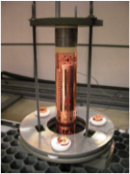
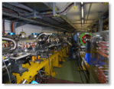

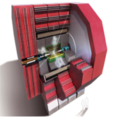
Parameters, Design and Implementation
  Integrated Baseline Design and Parameters
  Integrated Modeling and Performance Studies
  Feedback Design, Background, Polarization
  Machine Protection & Operational Scenarios
  Electron and positron sources
  Damping Rings
  Ring-To-Main-Linac
  Main Linac - Two-Beam Acceleration
  Beam Delivery System
  Machine-Detector Interface (MDI) activities
  Drive Beam Complex
  Cost, power, schedule, stages
Main activities
X-band Technologies
  X-band Rf structure Design
  X-band Rf structure Production
  X-band Rf structure High Power Testing
  Novel RF unit developments (high efficiency)
  Installation and Operation of High power Testing Facilities
  Basic High Gradient R&D
Experimental verification
  CTF3 Consollidation & Upgrades
  Drive Beam phase feed-forward and feedbacks
  Two-Beam module string, test with beam
  Drive-beam front end including modulator development and injector
  Modulator development, magnet converters
  Drive Beam Photo Injector
  Low emittance ring tests
  Accelerator Beam System Tests (ATF and FACET, others)
Technical Developments
  Damping Rings Superconducting Wiggler
  Survey & Alignment
  Quadrupole Stability
  Warm Magnet Prototypes
  Beam Instrumentation and Control
  Two-Beam module development
  Beam Intercepting Devices
  Controls
  Vacuum Systems
  Beam Transport Equipment
Detector and Physics
  Physics studies and benchmarking
  Detector optimisation
  Technical developments
<number>

Slide 10
Parameters, Design and Implementation
  Integrated Baseline Design and Parameters
  Integrated Modeling and Performance Studies
  Feedback Design, Background, Polarization
  Machine Protection & Operational Scenarios
  Electron and positron sources
  Damping Rings
  Ring-To-Main-Linac
  Main Linac - Two-Beam Acceleration
  Beam Delivery System
  Machine-Detector Interface (MDI) activities
  Drive Beam Complex
  Cost, power, schedule, stages
Main activities
X-band Technologies
  X-band Rf structure Design
  X-band Rf structure Production
  X-band Rf structure High Power Testing
  Novel RF unit developments (high efficiency)
  Installation and Operation of High power Testing Facilities
  Basic High Gradient R&D
Experimental verification
  CTF3 Consollidation & Upgrades
  Drive Beam phase feed-forward and feedbacks
  Two-Beam module string, test with beam
  Drive-beam front end including modulator development and injector
  Modulator development, magnet converters
  Drive Beam Photo Injector
  Low emittance ring tests
  Accelerator Beam System Tests (ATF and FACET, others)
Technical Developments
  Damping Rings Superconducting Wiggler
  Survey & Alignment
  Quadrupole Stability
  Warm Magnet Prototypes
  Beam Instrumentation and Control
  Two-Beam module development
  Beam Intercepting Devices
  Controls
  Vacuum Systems
  Beam Transport Equipment
Detector and Physics
  Physics studies and benchmarking
  Detector optimisation
  Technical developments
<number>

Slide 12
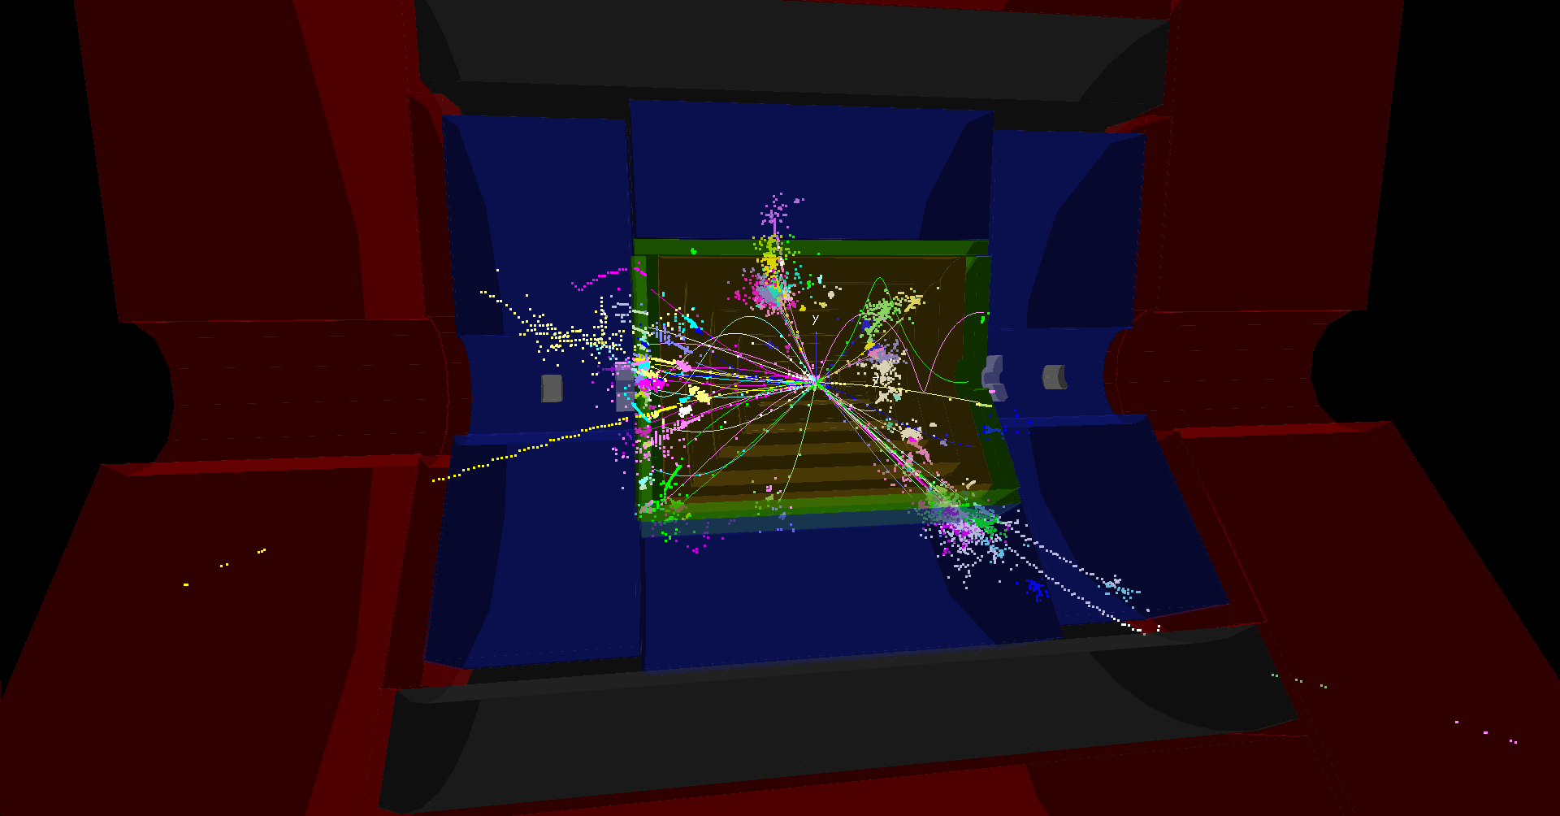
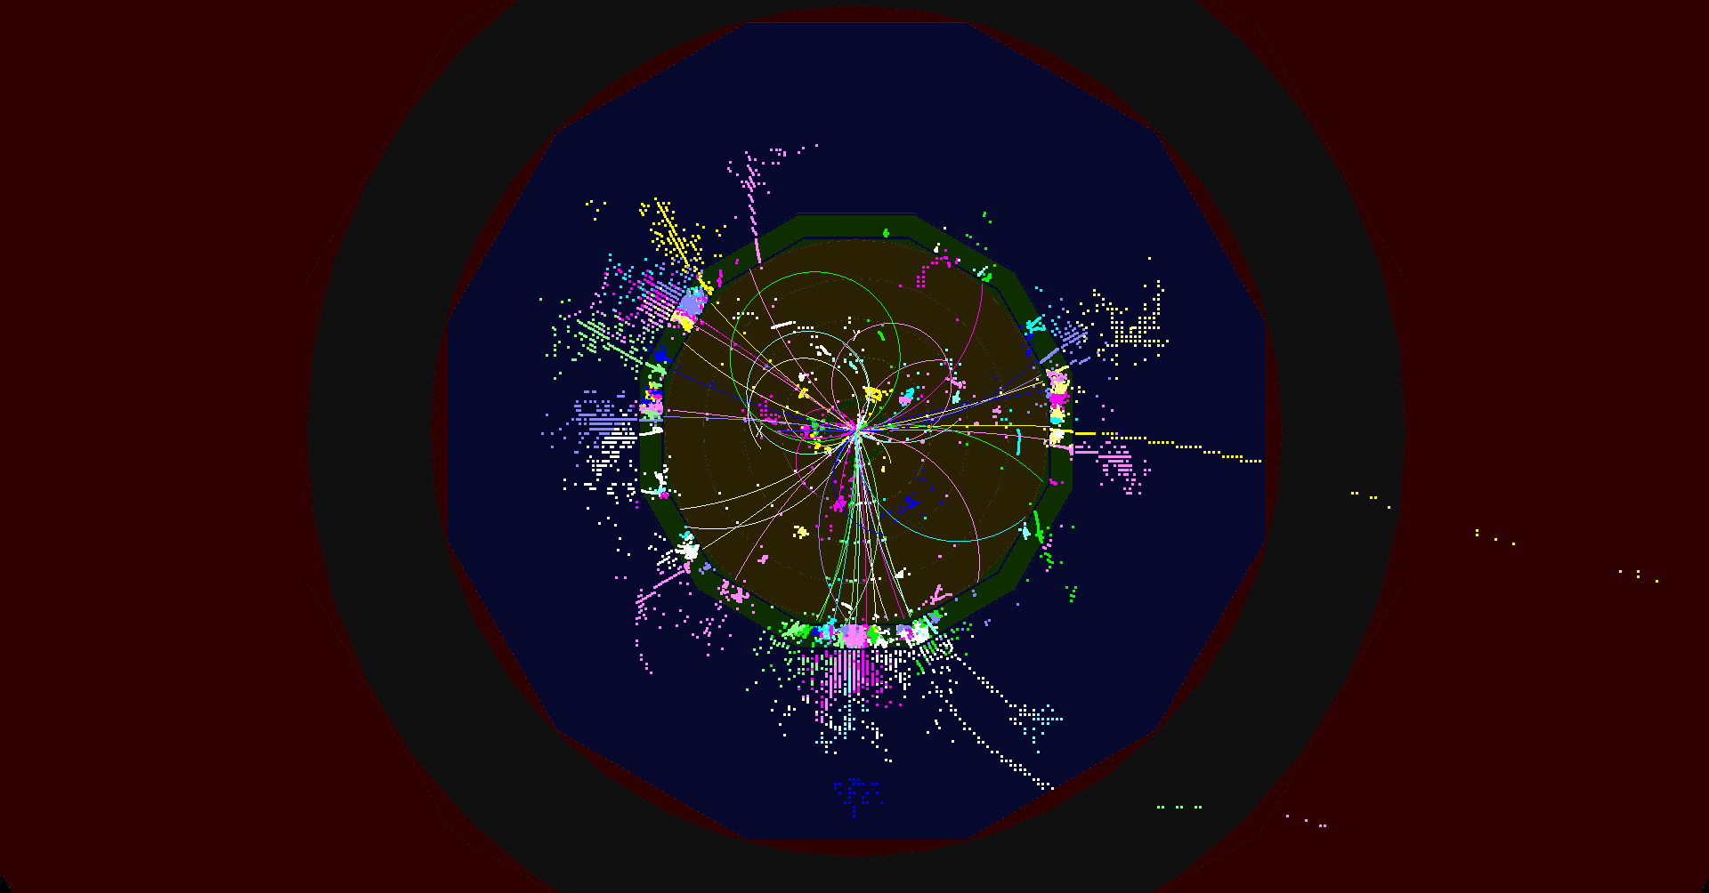
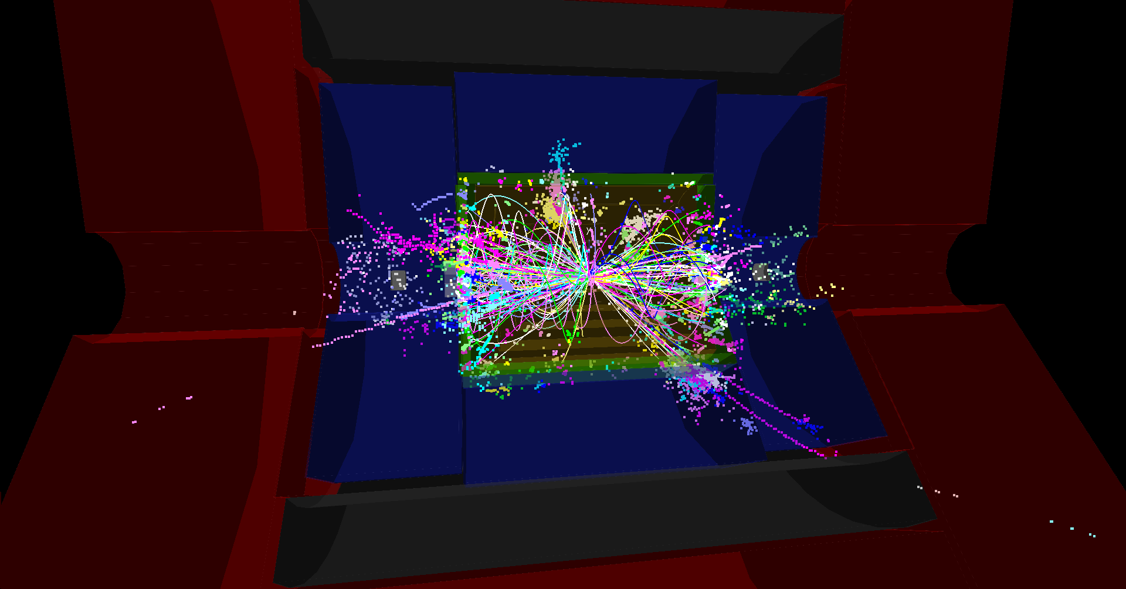
-
-
-
-
-
e+e- ➔ ttH ➔ WbWbH ➔ qqb τνb bb
CLIC 1.4 TeV
same event before cuts on beam-induced background
<number>
Lucie Linssen, March 5th 2015

Slide 16
CLIC det & phys activities 2014-15
Notes:
<number>

Slide 17
Parameters, Design and Implementation
  Integrated Baseline Design and Parameters
  Integrated Modeling and Performance Studies
  Feedback Design, Background, Polarization
  Machine Protection & Operational Scenarios
  Electron and positron sources
  Damping Rings
  Ring-To-Main-Linac
  Main Linac - Two-Beam Acceleration
  Beam Delivery System
  Machine-Detector Interface (MDI) activities
  Drive Beam Complex
  Cost, power, schedule, stages
Main activities
X-band Technologies
  X-band Rf structure Design
  X-band Rf structure Production
  X-band Rf structure High Power Testing
  Novel RF unit developments (high efficiency)
  Installation and Operation of High power Testing Facilities
  Basic High Gradient R&D
Experimental verification
  CTF3 Consollidation & Upgrades
  Drive Beam phase feed-forward and feedbacks
  Two-Beam module string, test with beam
  Drive-beam front end including modulator development and injector
  Modulator development, magnet converters
  Drive Beam Photo Injector
  Low emittance ring tests
  Accelerator Beam System Tests (ATF and FACET, others)
Technical Developments
  Damping Rings Superconducting Wiggler
  Survey & Alignment
  Quadrupole Stability
  Warm Magnet Prototypes
  Beam Instrumentation and Control
  Two-Beam module development
  Beam Intercepting Devices
  Controls
  Vacuum Systems
  Beam Transport Equipment
Detector and Physics
  Physics studies and benchmarking
  Detector optimisation
  Technical developments
<number>

Slide 18
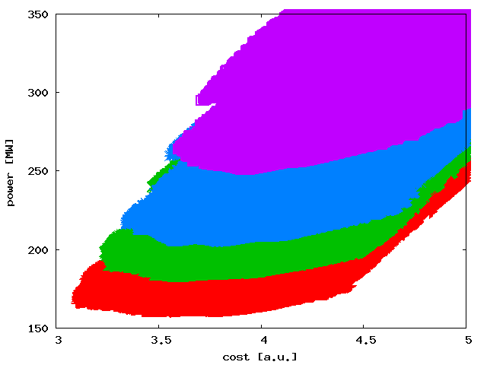
Cost/power: Design/parameters & Technical developments
6.5
L=1.0x1034cm-2s-1
L=1.25x1034cm-2s-1
L=1.5x1034cm-2s-1
L=2.0x1034cm-2s-1
Automatic procedure scanning over many structures (parameter sets)
Structure design fixed by few parameters
a1,a2,d1,d2,Nc,f,G
Beam parameters derived automatically
Cost calculated – and power
L=0.5x1034cm-2s-1
L=1.0x1034cm-2s-1
L=2.0x1034cm-2s-1
S=1.1
Luminosity goal significantly impact minimum cost
For L=1x1034cm-2s-1 to L=2x1034cm-2s-1 :
Costs 0.5 a.u. and O(100MW)
Cheapest machine is close to lowest power consumption
12

Slide 19
Stages to be studied
  First stage: Ecms=380Gev, L=1.5x1034cm-2s-1, L0.01/L>0.6
    Luminosity based on physics and machine studies in 2014
    420 GeV and 360GeV have also been studied
Second stage: Ecms=O(1.5TeV)
Final stage: Ecms=3TeV, L=5.9x1034cm-2s-1, L0.01/L>0.3
Next natural steps: Optimised cost and power for given luminosity
Hopefully needed to redo with new LHC results at some point

Slide 20
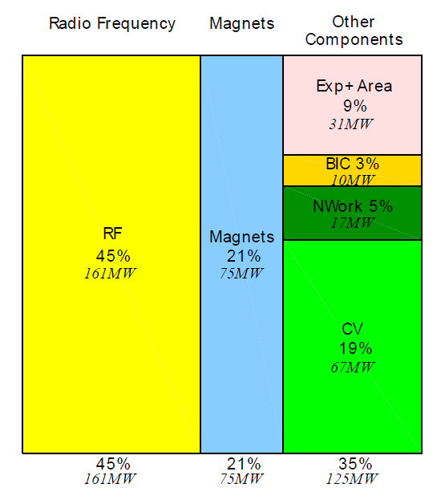
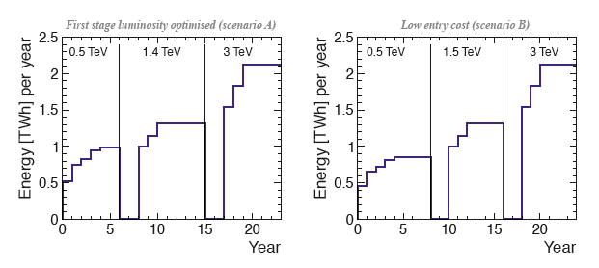
e+/e- Colliders: PAC vs ECM
Power reductions are being looked at:
Machine parameters and technical developments
Consider where the power is dissipated (distributed or central)
Look at daily and yearly fluctuation – can one run in “low general demand” periods
Understand and minimize the energy (consider also standby, MD, down periods, running scenarios
CERN energy consumption 2012: 1.35 TWh
<number>

Slide 21
e+/e- Colliders: PAC vs ECM
Beyond the parameter optimization there are other on-going developments (design/technical developments):
Use of permanent or hybrid magnets for the drive beam (order of 50’000 magnets)
Optimize drive beam accelerator klystron system
Electron pre-damping ring can be removed with good electron injector
Dimension drive beam accelerator building and infrastructure are for 3 TeV, dimension to 1.5 TeV results in large saving
Systematic optimization of injector complex linacs in preparation
Optimize and reduce overhead estimates
CERN energy consumption 2012: 1.35 TWh
<number>

Slide 22
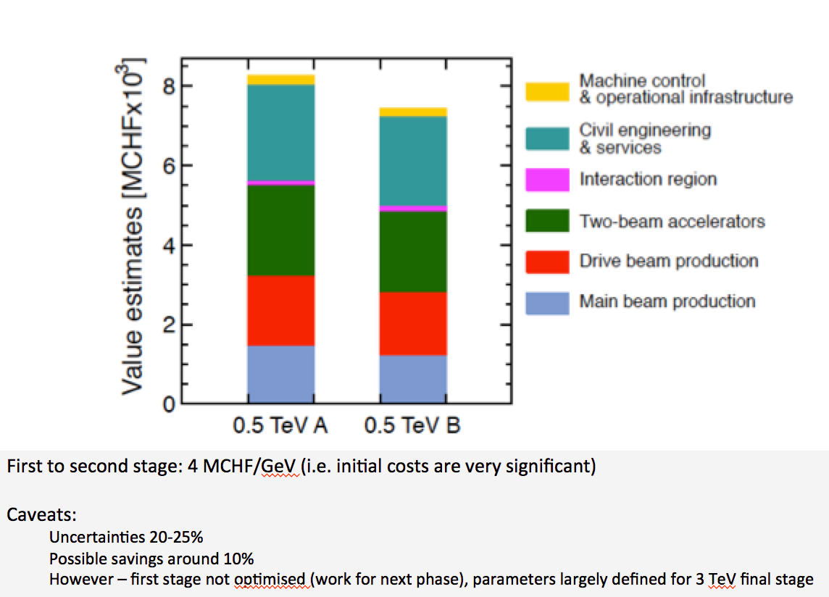
Developments for costs
CDR costs can now be updated
New parameters optimizing costs, affect mostly initial stages
Technical developments, affects all stages
Too early for updated industrial quotes in some areas (other areas can be updated)
2012 CHF versus 2015 CHF ?
<number>

Slide 23
Parameters, Design and Implementation
  Integrated Baseline Design and Parameters
  Integrated Modeling and Performance Studies
  Feedback Design, Background, Polarization
  Machine Protection & Operational Scenarios
  Electron and positron sources
  Damping Rings
  Ring-To-Main-Linac
  Main Linac - Two-Beam Acceleration
  Beam Delivery System
  Machine-Detector Interface (MDI) activities
  Drive Beam Complex
  Cost, power, schedule, stages
Main activities
X-band Technologies
  X-band Rf structure Design
  X-band Rf structure Production
  X-band Rf structure High Power Testing
  Novel RF unit developments (high efficiency)
  Installation and Operation of High power Testing Facilities
  Basic High Gradient R&D
Experimental verification
  CTF3 Consollidation & Upgrades
  Drive Beam phase feed-forward and feedbacks
  Two-Beam module string, test with beam
  Drive-beam front end including modulator development and injector
  Modulator development, magnet converters
  Drive Beam Photo Injector
  Low emittance ring tests
  Accelerator Beam System Tests (ATF and FACET, others)
Technical Developments
  Damping Rings Superconducting Wiggler
  Survey & Alignment
  Quadrupole Stability
  Warm Magnet Prototypes
  Beam Instrumentation and Control
  Two-Beam module development
  Beam Intercepting Devices
  Controls
  Vacuum Systems
  Beam Transport Equipment
Detector and Physics
  Physics studies and benchmarking
  Detector optimisation
  Technical developments
<number>

Slide 24
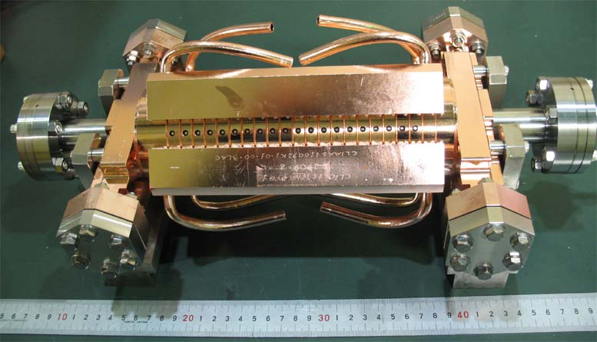
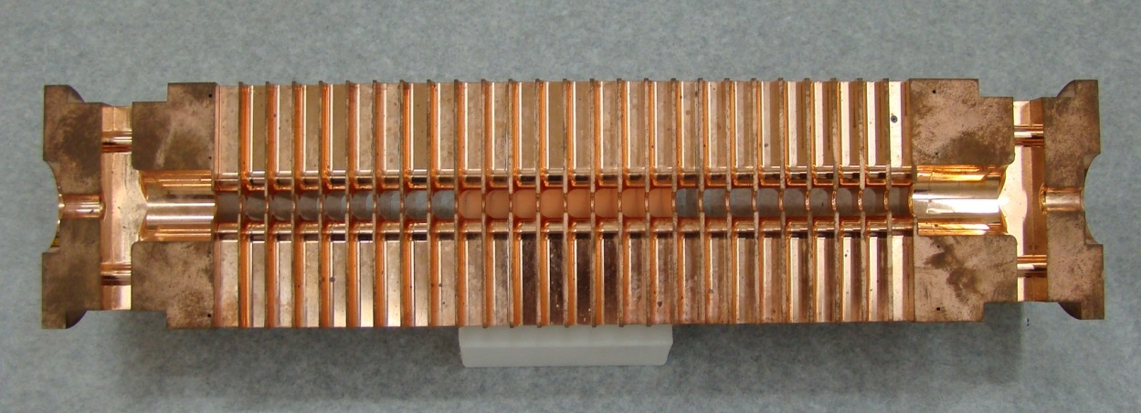
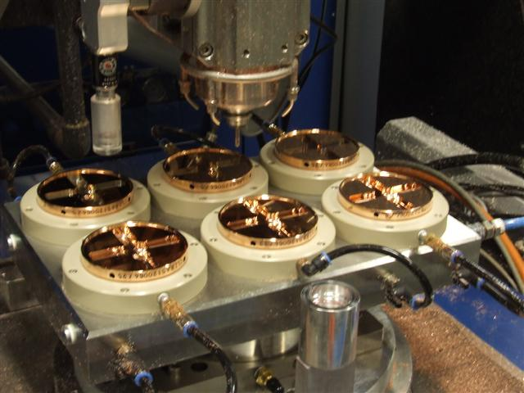
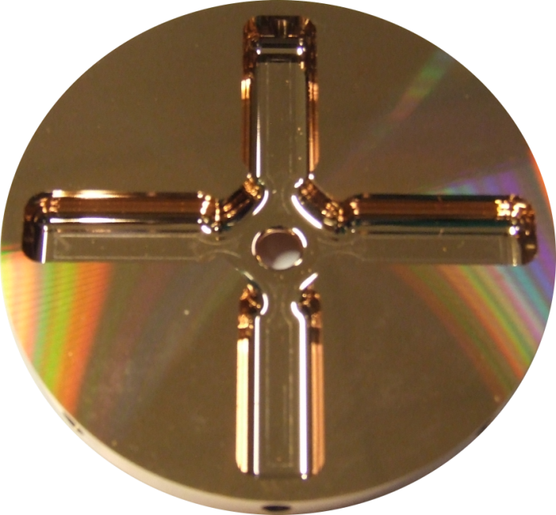
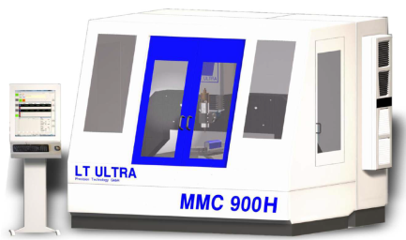
CLIC accelerating structure
Inside (cut)
Outside
6 mm diameter beam aperture, 25 cm long
Micron-precision turning and milling.

Slide 25
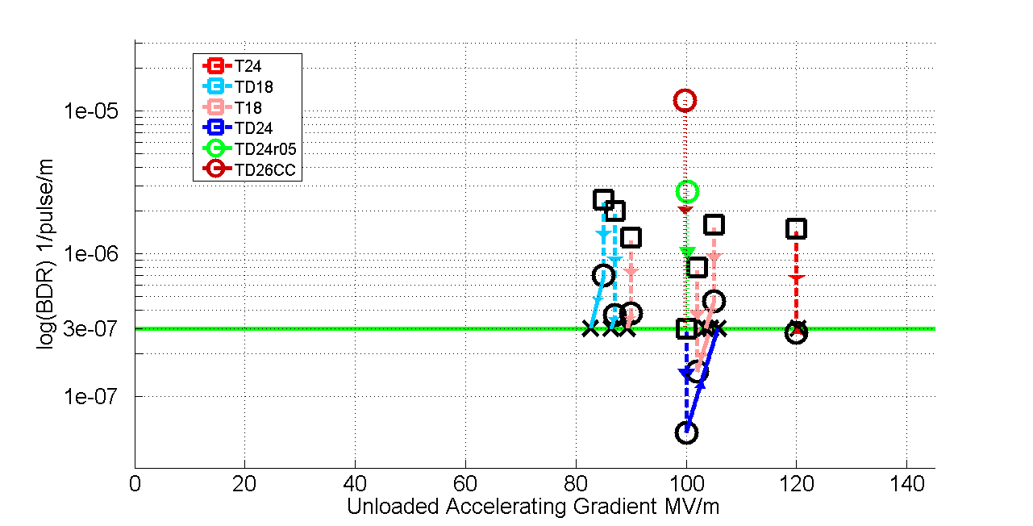
High-gradient accel. structure test status
Results very good, design/performance more and more understood – but:
numbers limited, industrial productions also limited
basic understanding of BD mechanics improving
condition time/acceptance tests need more work
use for other applications (e.g. FELs) needs verification in coming years
In all cases test-capacity is crucial

Slide 26
Limitations of Gradient Eacc
Surface magnetic field
  Pulsed surface heating => material fatigue => cracks
Field emission due to surface electric field
  RF break downs
  Break down rate => Operation efficiency
  Local plasma triggered by field emission => Erosion of surface
  Dark current capture
  => Efficiency reduction, activation, detector backgrounds
RF power flow
  RF power flow and/or iris aperture have a strong impact on achievable Eacc and on surface erosion. Ongoing studies.

Slide 27
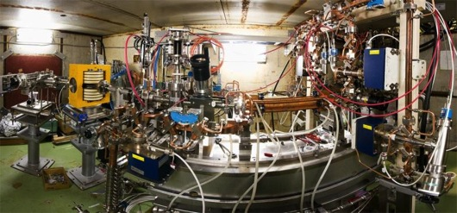
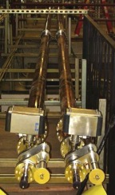
X-band test-stands
Previous:
Scaled 11.4 GHz
tests at SLAC and KEK.
NEXTEF at KEK
ASTA at SLAC
… remain important, also linked to testing of X-band structures from Tsinghua and SINAP
XBox-1 – T24, beam loading experiment ongoing and will continue.
XBox-2 – Finish crab cavity, TD26CC next.
XBox-3 – Under preparation.
NEXTEF – Finish Tsinghua-built T24. KEK-built TD24R05 next.
ASTA – Commissioning clone of our NI-based control system. KEK/SLAC-built TD24R05 installed and ready to go.
Very significant increase of test-capacity:
First commercial 12 GHz klystron systems available
Confidence that one can design for good (and possibly better) gradient performance
As a result: now possible to use Xband technology in accelerator systems – at smaller scale
Notes:
<number>

Slide 28
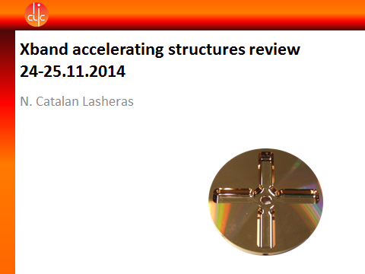
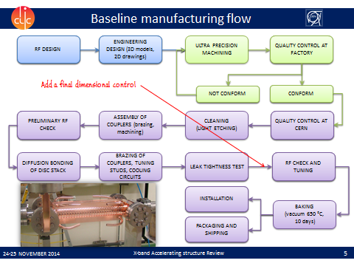
Accelerating structures in the pipeline
CLIC structures:
Two TD26CC built and tested by KEK. Still superb production
One TD26CC built by CIEMAT. Next step after PETS.
Two T24s built by PSI in their production run. Vacuum brazing alternative, benchmark for their production line.
One T24 built by SINAP. Potentially leads to large X-band installation.
Whole structure in industry – Technical specifications are under preparation. Industrialization, cost estimate.
Other related structures:
Structure in halves by SLAC. Potentially cheaper, hard materials, preconditioned surfaces possible.
Choke-mode damping by Tsinghua. Potentially cheaper
Four XFEL structures by SINAP. New application with large potential.
High-gradient proton funded by KT (CERN technology transfer). New application.

Slide 29
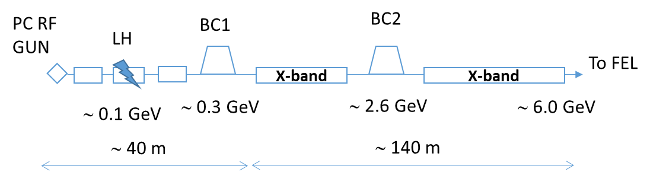
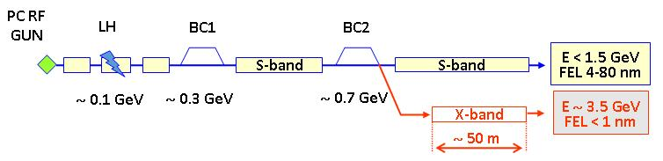
Xband facilities - FELs
X-band technology appears interesting for compact, relatively low cost FELs – new or extensions
  Logical step after S-band and C-band
  Example similar to SwissFEL: E=6 GeV, Ne=0.25 nC, σz=8μm
Use of X-band in other projects will support industrialisation
  They will be klystron-based, additional synergy with klystron-based first energy stage
Started to collaborate on use of X-band in FELs
  Australian Light Source, Turkish Accelerator Centre, Elettra, SINAP, Cockcroft Institute, TU Athens, U. Oslo, Uppsala University, CERN
Share common work between partners
  Cost model and optimisation
  Beam dynamics, e.g. beam-based alignment
  Accelerator systems, e.g. alignment, instrumentation…
Define common standard solutions
  Common RF component design, -> industry standard
  High repetition rate klystrons (200->400 Hz now into test-stands)
Important collaboration for X-band technology

Slide 30
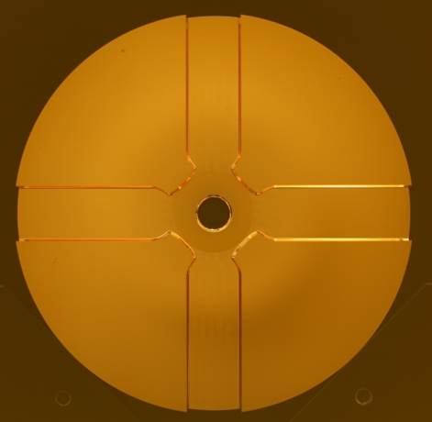
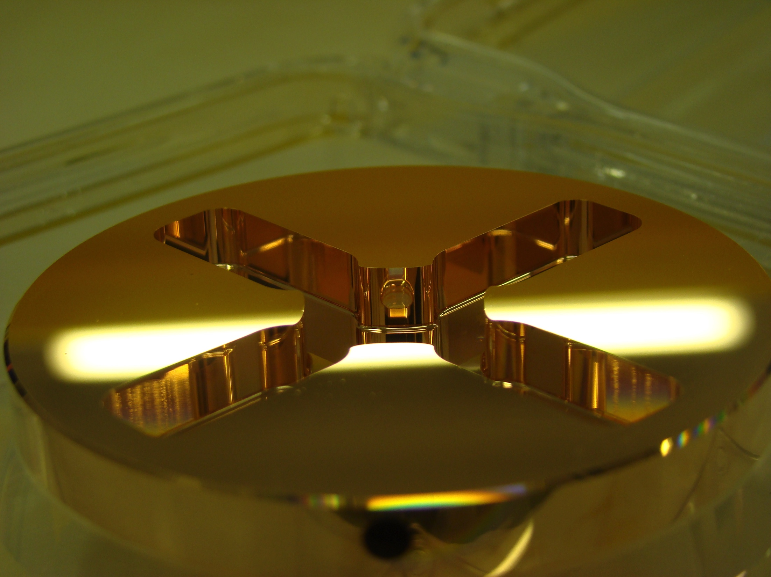

X-band structures and testing
X-band Technologies:
High gradient structures and high efficiency RF (structure prod. in green)
X-band High power Testing Facilities (x3 increase) (in red)
Use of X-band technologies for FELs
VDL
CERN
PSI
CIEMAT
SLAC
◉
◉
◉
KEK
◉
Tsinghua
SINAP
◉
◉
◉
◉
◉
◉
◉
8

Slide 31
Novel RF developments
Work shared between researchers and industry at CERN, in the US, UK, France, Sweden, Russia … covering much wider than CLIC but seed funded from the CERN LC budget:
The increase in efficiency of RF power generation for the future large accelerators such as CLIC, ILC, ESS, FCC and others is considered a high priority issue.
The deeper understanding of the klystron physics, new ideas and massive application of the modern computation resources are the key ingredients to deign the klystron with RF power production efficiency at a level of 90% and above.

Slide 32
Parameters, Design and Implementation
  Integrated Baseline Design and Parameters
  Feedback Design, Background, Polarization
  Machine Protection & Operational Scenarios
  Electron and positron sources
  Damping Rings
  Ring-To-Main-Linac
  Main Linac - Two-Beam Acceleration
  Beam Delivery System
  Machine-Detector Interface (MDI) activities
  Drive Beam Complex
  Cost, power, schedule, stages
Main activities
X-band Technologies
  X-band Rf structure Design
  X-band Rf structure Production
  X-band Rf structure High Power Testing
  Novel RF unit developments (high efficiency)
  Creation and Operation of x-band High power Testing Facilities
  Basic High Gradient R&D
Experimental verification
  Drive Beam phase feed-forward and feedbacks
  Two-Beam module string, test with beam
  Drive-beam front end including modulator development and injector
  Modulator development, magnet converters
  Drive Beam Photo Injector
  Low emittance ring tests
  Accelerator Beam System Tests (ATF and FACET, others)
Technical Developments
  Damping Rings Superconducting Wiggler
  Survey & Alignment
  Quadrupole Stability
  Warm Magnet Prototypes
  Beam Instrumentation and Control
  Two-Beam module development
  Beam Intercepting Devices
  Controls
  Vacuum Systems
  Beam Transport Equipment
Detector and Physics
  Physics studies and benchmarking
  Detector optimisation
  Technical developments
<number>

Slide 33
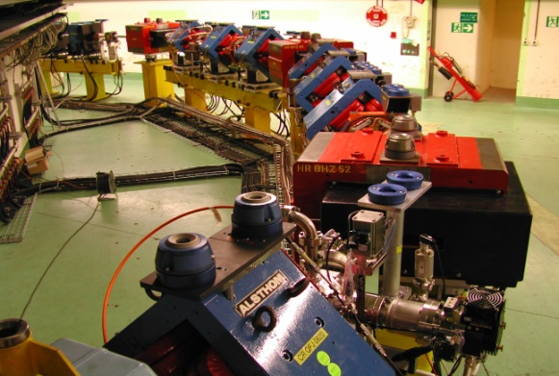
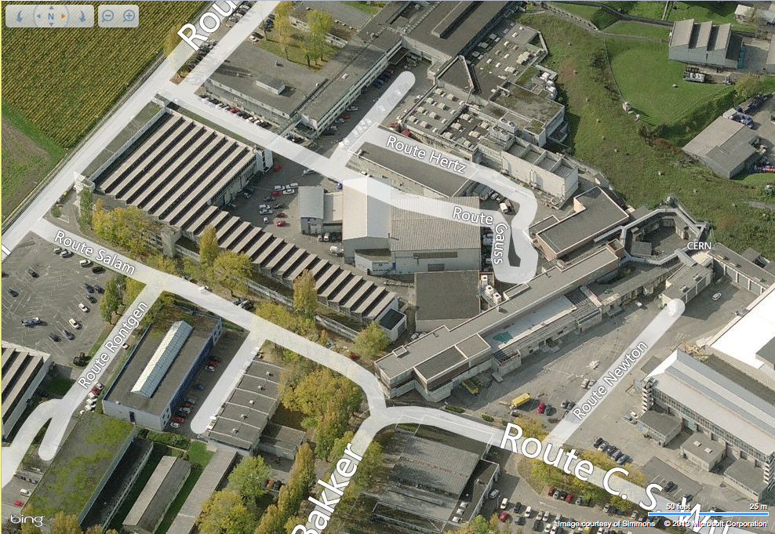
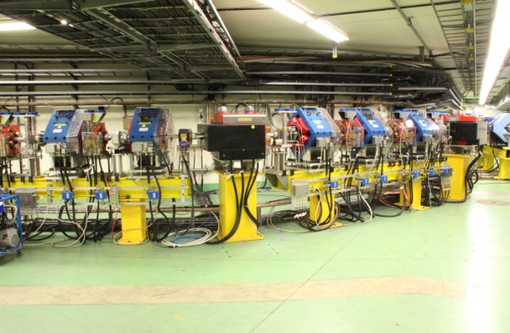
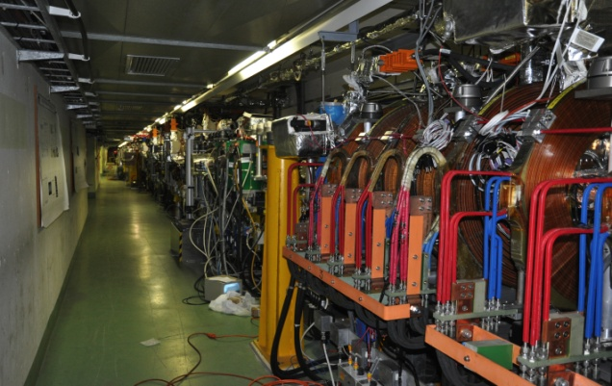


CLIC Test Facility (CTF3)
DELAY LOOP
COMBINER
RING
CLEX
DRIVE BEAM LINAC
TBL
Two Beam Module
6/4/15
Notes:
<number>

Slide 34



CTF3 programme 2013-2016
CLIC test facility - CTF3
Phase feed-forward,
DB stability studies
4 A, 1.4us 120 MeV
1st turn
Combiner Ring
Two-Beam studies, Wake-field monitors, RF pulse shaping
4th turn
30 A, 140 ns 60 MeV
Power production,
RF conditioning/testing with DB & further decelerator tests

Slide 35



The next two years (2015-16)
Phase feed-forward experiment
Diagnostics R&D using CALIFES
Dogleg Beam loading experiment
TBL deceleration
Two Beam Module,
Wake-field monitors…

Slide 36

drive beam
Recently installed 2-beam acceleration module in CTF3
(according to latest CLIC design)
First 2-beam tests stand reached 145 MV/m (2012)
main beam
Lucie Linssen, March 5th 2015
<number>

Slide 37
CLIC system tests beyond CTF3
Drive beam development beyond CTF3
  RF unit prototype with industry using CLIC frequency and parameters
  Drive beam front-end (injector), to allow development into larger drivebeam facility beyond 2018
Damping rings
  Tests at existing damping rings, critical component development (e.g. wigglers) ... large common interests with light source laboratories
Main beam (see slide later)
  Steering tests at FACET, FERMI, …
Beam Delivery System (see slide later)
  ATF/ATF2

Slide 38





Main Linac Tolerances
Performance verifications – CLIC
Stabilise quadrupole
O(1nm) @ 1Hz
1) Pre-align BPMs+quads
accuracy O(10μm) over about 200m
3) Use wake-field monitors accuracy O(3.5μm) – CTF3
2) Beam-based alignment
Test of prototype shows
  vertical RMS error of 11μm
  i.e. accuracy is approx. 13.5μm
<number>
Notes:
<number>

Slide 39

FACET measurements of wakefields
e-, NRTL
e+, Driven bunch
Dump
e-, Witness bunch
Dipole
Dipole
e+
Downstream BPMs
e-
CLIC-G TD26cc
Transverse offset
deflected orbit
e+, SRTL

Slide 40
ATF2: Stabilisation Experiment
The CLIC coll. is very interested in a longer term programme at ATF2 and ideas exist for:
Building 2 octupoles for ATF2 (to study FFS tuning with octupoles)
Test of OTR/ODR system at ATF2
Test and use of accurate kicker/amplifier system is considered
General support for ATF2 operation

Slide 41
Parameters, Design and Implementation
  Integrated Baseline Design and Parameters
  Integrated Modeling and Performance Studies
  Feedback Design, Background, Polarization
  Machine Protection & Operational Scenarios
  Electron and positron sources
  Damping Rings
  Ring-To-Main-Linac
  Main Linac - Two-Beam Acceleration
  Beam Delivery System
  Machine-Detector Interface (MDI) activities
  Drive Beam Complex
  Cost, power, schedule, stages
Main activities
X-band Technologies
  X-band Rf structure Design
  X-band Rf structure Production
  X-band Rf structure High Power Testing
  Novel RF unit developments (high efficiency)
  Installation and Operation of High power Testing Facilities
  Basic High Gradient R&D
Experimental verification
  CTF3 Consollidation & Upgrades
  Drive Beam phase feed-forward and feedbacks
  Two-Beam module string, test with beam
  Drive-beam front end including modulator development and injector
  Modulator development, magnet converters
  Drive Beam Photo Injector
  Low emittance ring tests
  Accelerator Beam System Tests (ATF and FACET, others)
Technical Developments
  Damping Rings Superconducting Wiggler
  Survey & Alignment
  Quadrupole Stability
  Warm Magnet Prototypes
  Beam Instrumentation and Control
  Two-Beam module development
  Beam Intercepting Devices
  Controls
  Vacuum Systems
  Beam Transport Equipment
Detector and Physics
  Physics studies and benchmarking
  Detector optimisation
  Technical developments
<number>

Slide 42









Technical activities – examples
Technical Developments are motivated by several possible reasons:
Key components for systemtests
Critical for machine performance
Aimed at cost or power reduction
Notes:
<number>

Slide 43






Slide 44
Issues for a next CERN machine … timescales
2013-18 Development Phase
Develop a Project Plan for a staged implementation in agreement with LHC findings; further technical developments with industry, performance studies for accelerator parts and systems, as well as for detectors.
4-5 year Preparation Phase
Finalise implementation parameters, Drive Beam Facility and other system verifications, site authorisation and preparation for industrial procurement.
Prepare detailed Technical Proposals for the detector-systems.
Construction Phase
Stage 1 construction of CLIC, in parallel with detector construction.
Preparation for implementation of further stages.
2018-19 Decisions
On the basis of LHC data
and Project Plans (for CLIC and other potential projects as FCC), take decisions about next project(s) at the Energy Frontier.
2024-25 Construction Start
Ready for full construction
and main tunnel excavation.
Commissioning
Becoming ready for data-taking as the LHC programme reaches completion.
Notes:
<number>

Slide 45


LHC at 13 TeV – the key to it all ?

Slide 46
Summary
The goals and plans for 2015-18 are well defined for CLIC, focusing on the high energy frontier capabilities – well aligned with current strategies – also preparing to align with LHC physics as it progresses in the coming years:
Aim provide optimized stages approach up to 3 TeV with costs and power not too excessive compared to LHC
Very positive progress on X-band technology, due to availability of power sources and increased understanding of structure design parameters
  Applications in smaller systems; FEL linacs key example – with considerable interesting in the CLIC collaboration
Also recent good progress on performance verifications, drivebeam, main beam emittance conservation and final focus studies
  BBA discussions, BDS/ATF important
  CTF3 running and plan until end 2016, strategy for systemtests beyond
Technical developments of key parts well underway – with increasing involvement of industry – largely limited by funding
Collaborations for CLIC accelerator and detector&physics studies are growing
<number>

Slide 47
Thanks
Slides/figures/advice from CLIC collaboration members. Knowingly from L. Linssen, M.Thomson, A. Latina, K.Kubo and ATF colleagues, D.Schulte, R.Corsini, W.Fang, W.Wuensch and X-band team, , F.Tecker, T.Lefevre, M.Modena, N.Catalan, C.Garion, I.Syratchev, H.Mainaud Durant and PACMAN team, R.Tomas, Y.Papaphilippou, G.D’Auria, … and several more unknowingly or indirectly
<number>

