Slide 1
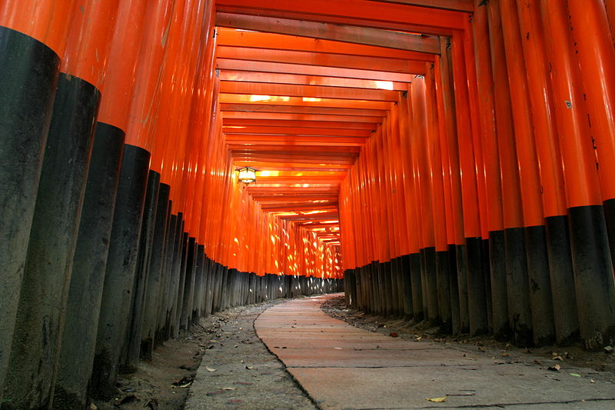
Neutrino (oscilllation) Physics –
Past, Present, and Future
DESY Seminar
Hamburg
February 5th, 2012
Dave Wark
Imperial College London/RAL

Slide 2
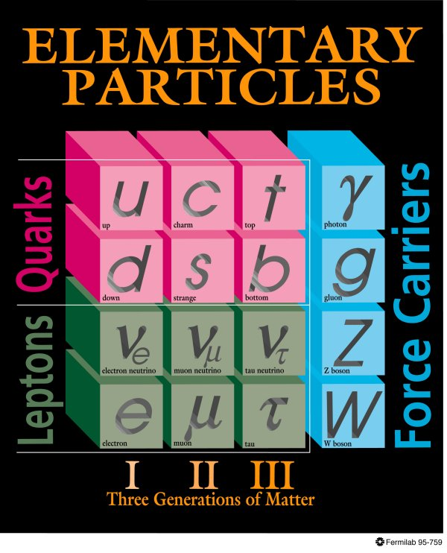
The Standard Model (~1981)
Neutrinos in the 1981 Standard:
  Three neutrinos with a conserved lepton flavour number.
  Massless.
  Strictly Left-handed.
?
??
?
??
???
H
Higgs

Slide 3
The Standard Model (~now)
Neutrinos in the 1981 Standard:
  Three neutrinos with a conserved lepton flavour number.
  Massless.
  Strictly Left-handed.
?
??
?
??
???
H
Higgs

Slide 4
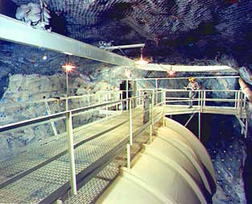
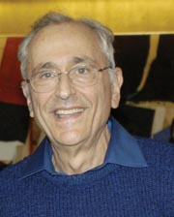
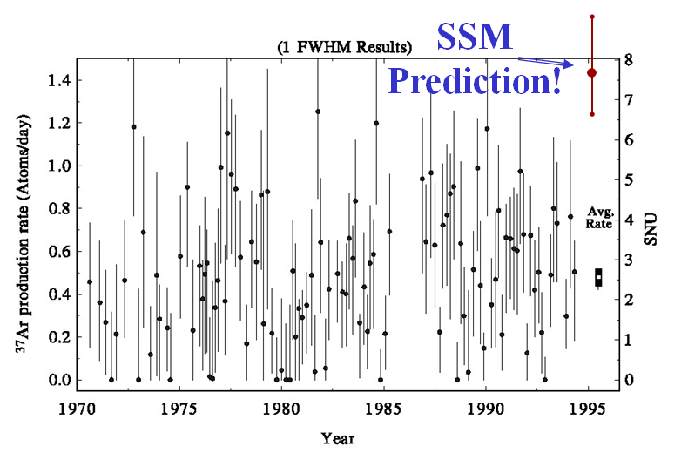
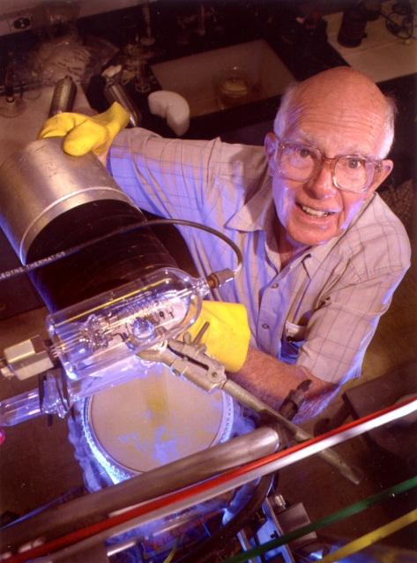
The Davis Experiment
John Bahcall
Ray Davis
Oops!

Slide 5
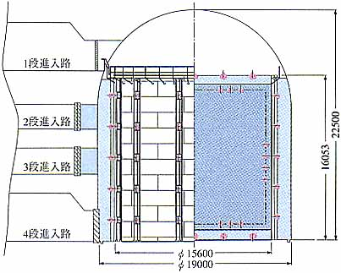
Kamiokande
Translation –
“Do not fill above this line”

Slide 6
ν_{x}+ e⁻→ ν_{x}+ e⁻
Translation –
“Do not fill above this line”

Slide 7
ν_{x}+ e⁻→ ν_{x}+ e⁻
ν_{x}
Translation –
“Do not fill above this line”
ν_{x}
Ĉ
e⁻

Slide 8
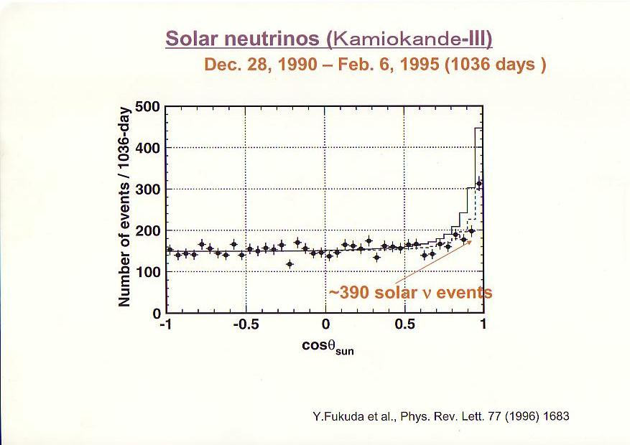
Kamiokande
Translation –
“Do not fill above this line”

Slide 9
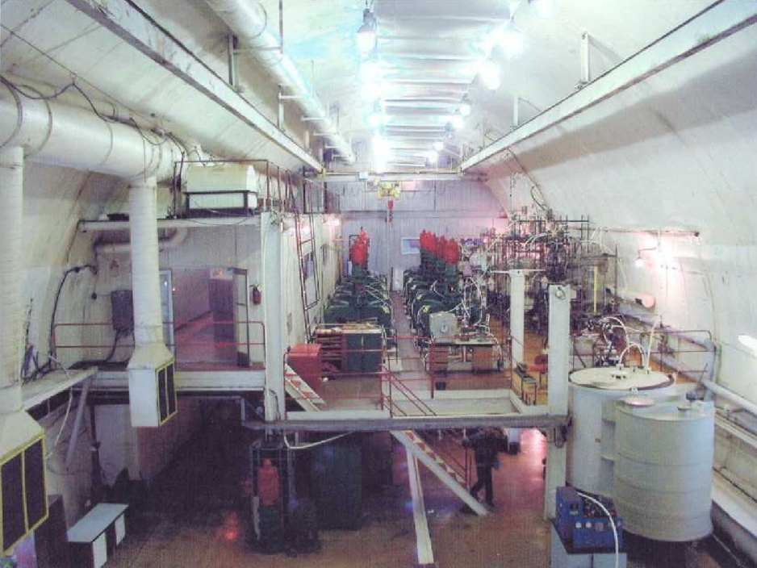
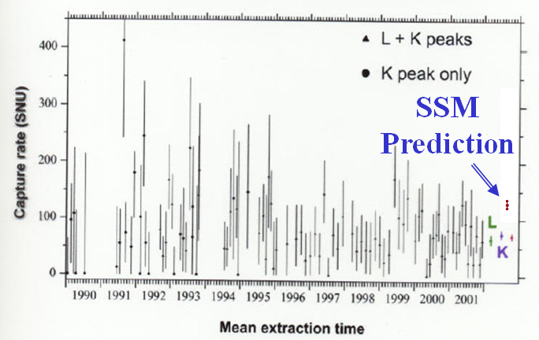
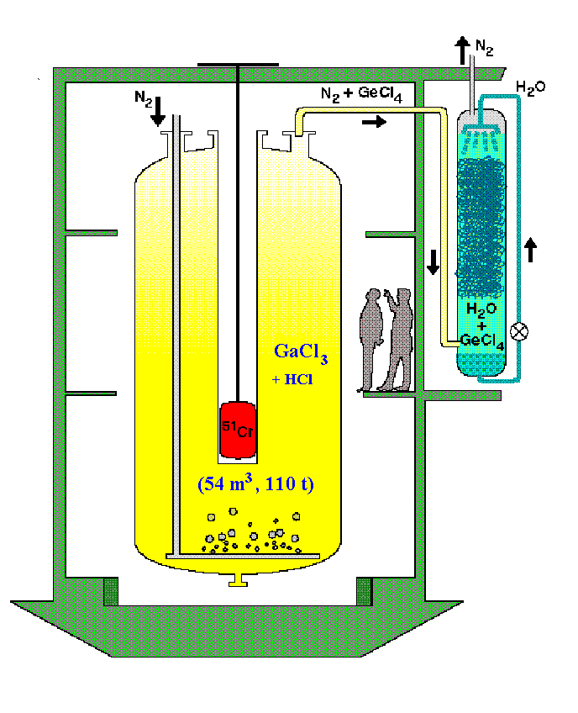
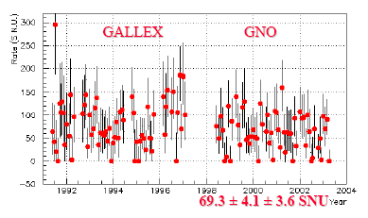


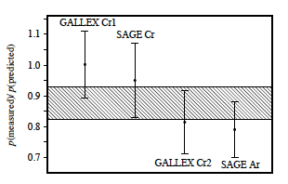
Gallium Solar ν Experiments
SAGE
Rates suppressed too much for astrophysics…

Slide 10
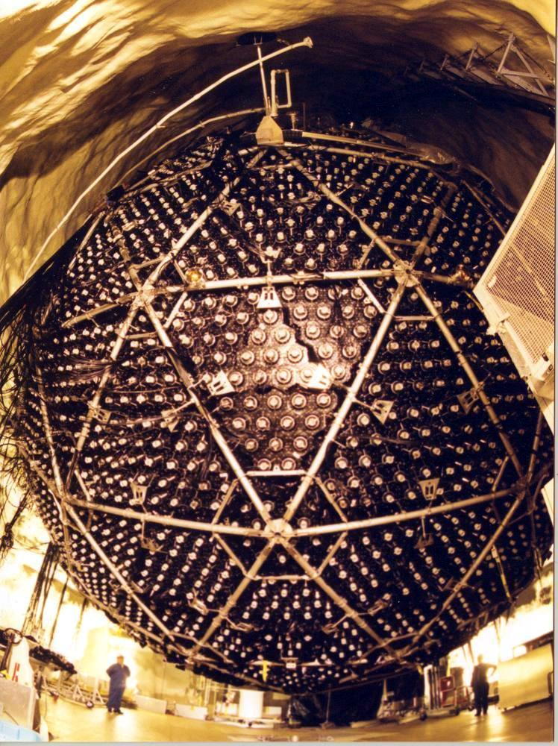
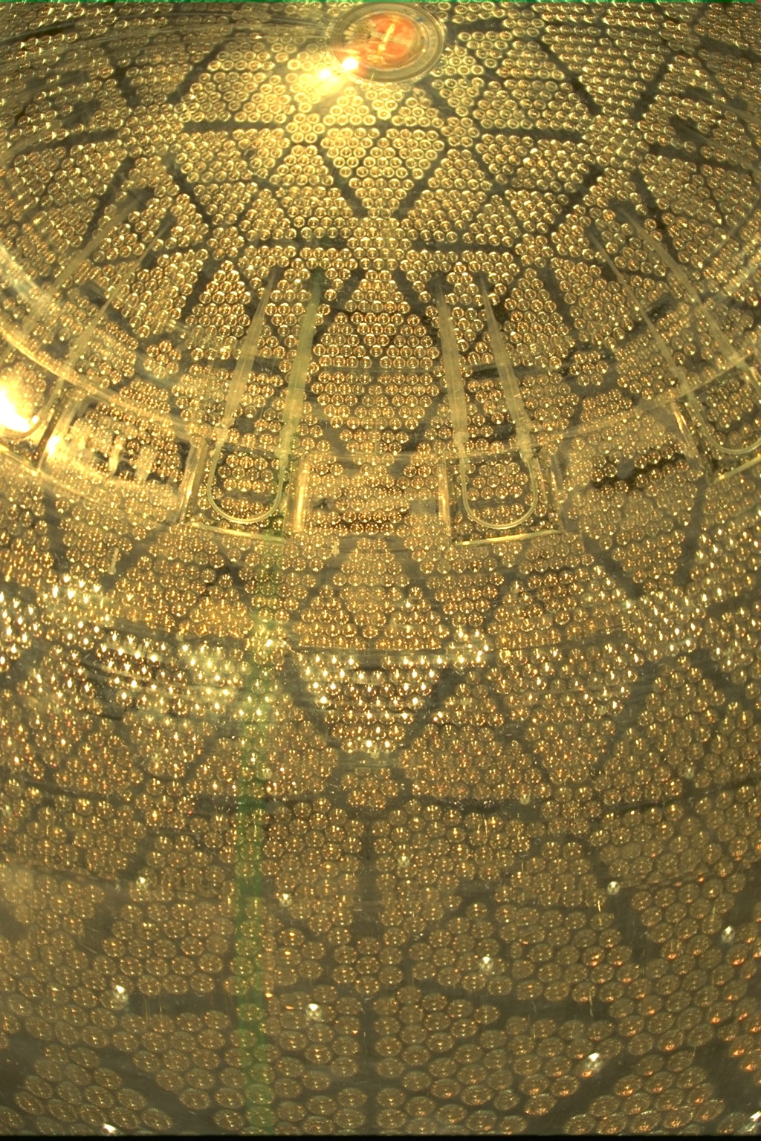
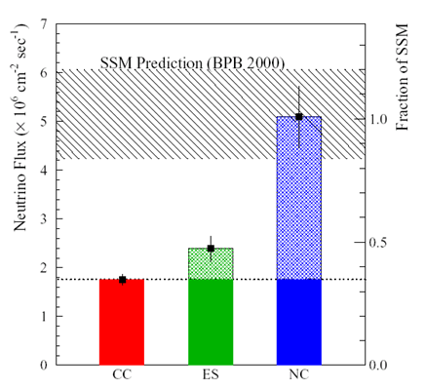
The Sudbury Neutrino Observatory

Slide 11
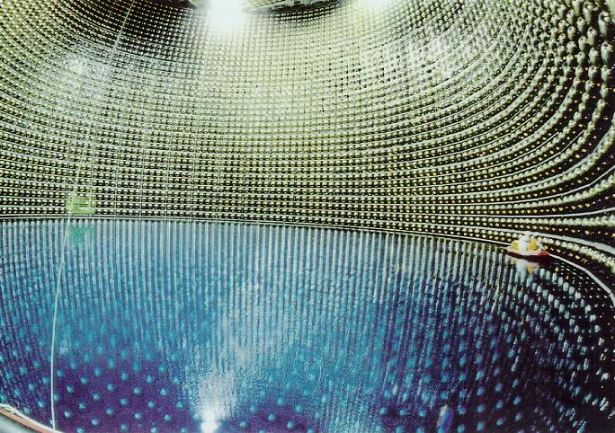
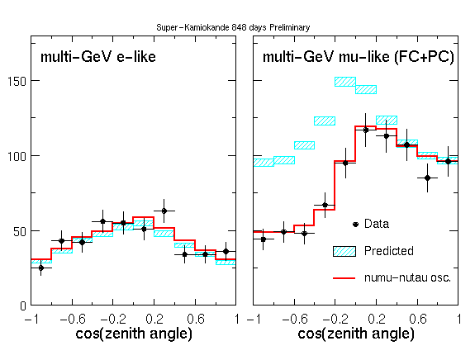
Super Kamiokande

Slide 12
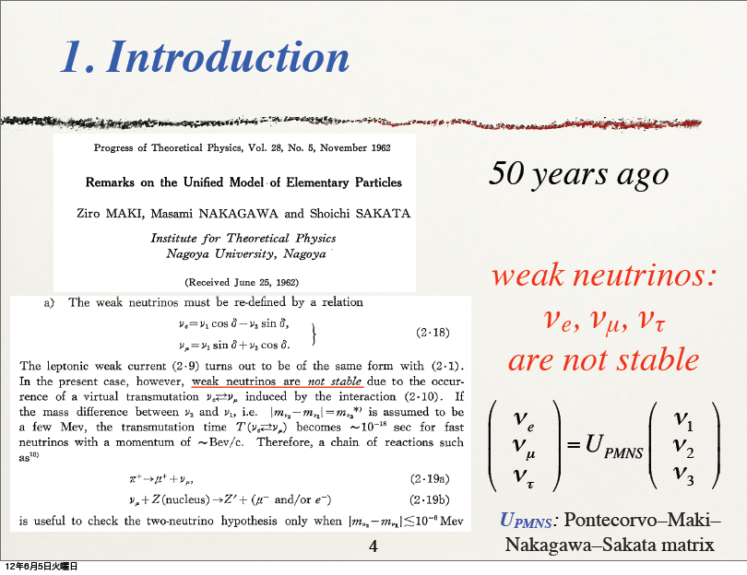
A Historic Anniversary…
From Nakaya-san’s talk at Nu2012

Slide 13
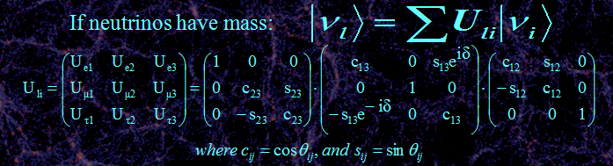
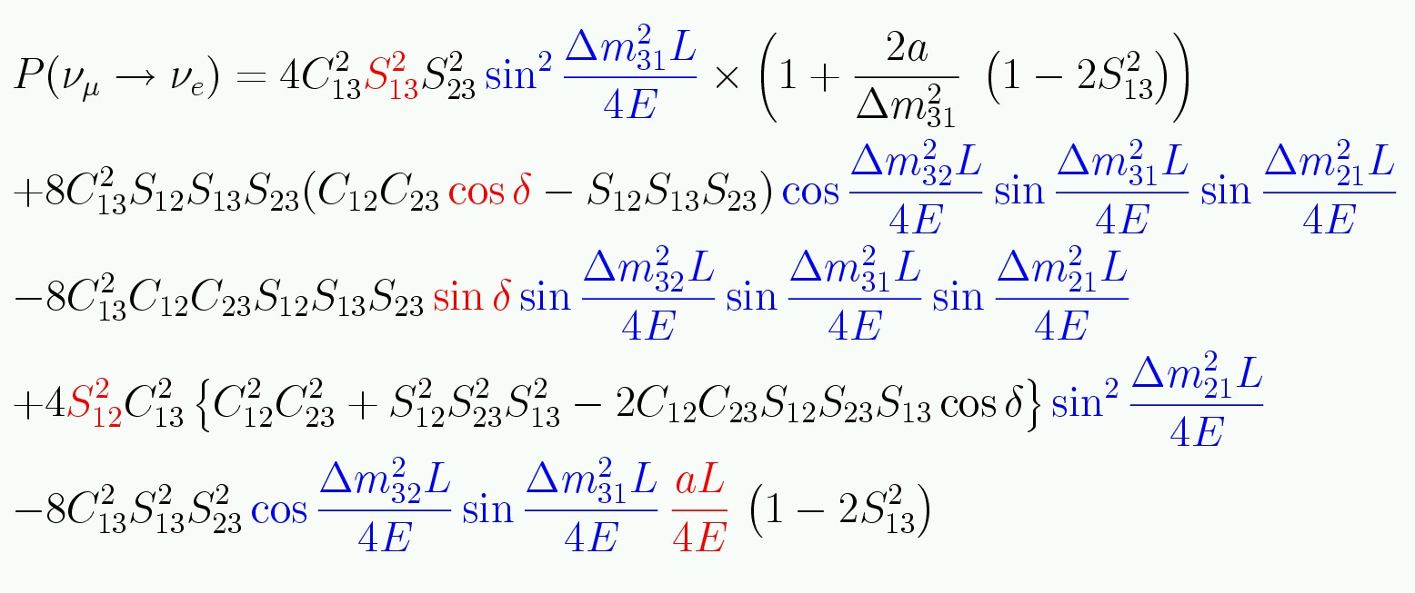
Three neutrino mixing.
Complicated equation means
covariances and degeneracies!
CP sensitivity mainly because this term flips sign for ν and anti-ν
If only two neutrinos contribute:
Need Matter effects to
get the signs of Δm²_{ij}

Slide 14
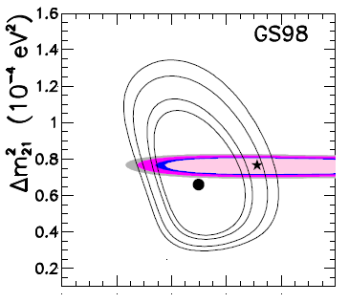
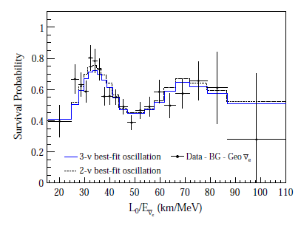

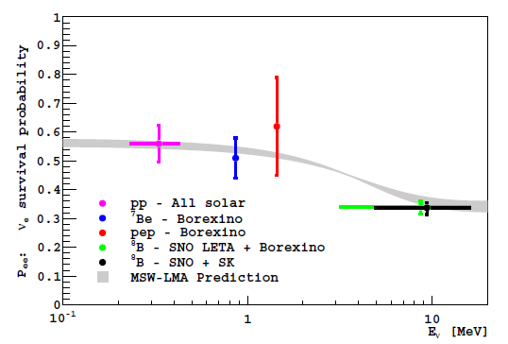
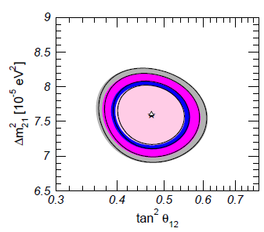

How well do we know θ₁₂?
KamLAND gives the final piece of evidence…
Gonzalez-Garcia, Maltoni, Salvado

Slide 15
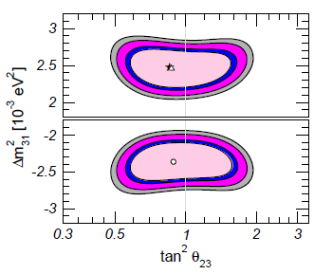
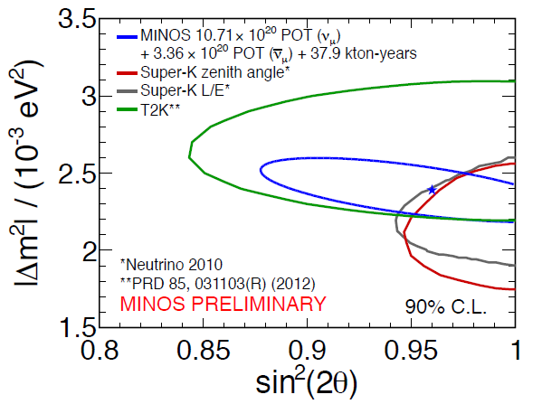
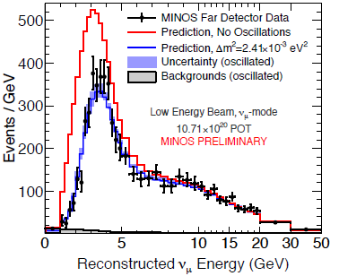
How well do we know θ₂₃?
Gonzalez-Garcia, Maltoni, Salvado

Slide 16

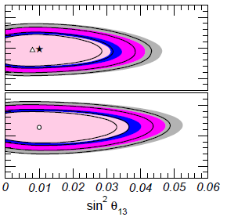
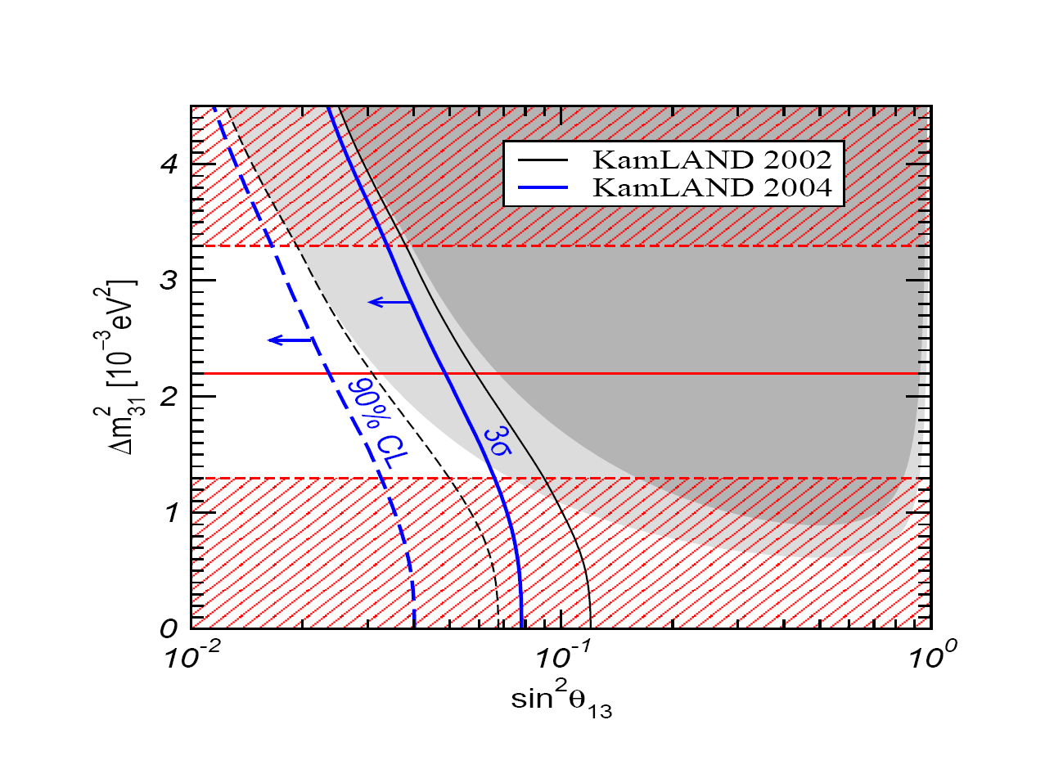
2004 limits on θ₁₃
2011
J.W.F. Valle, hep-ph/0410103
Dave Wark
Imperial College/RAL

Slide 17
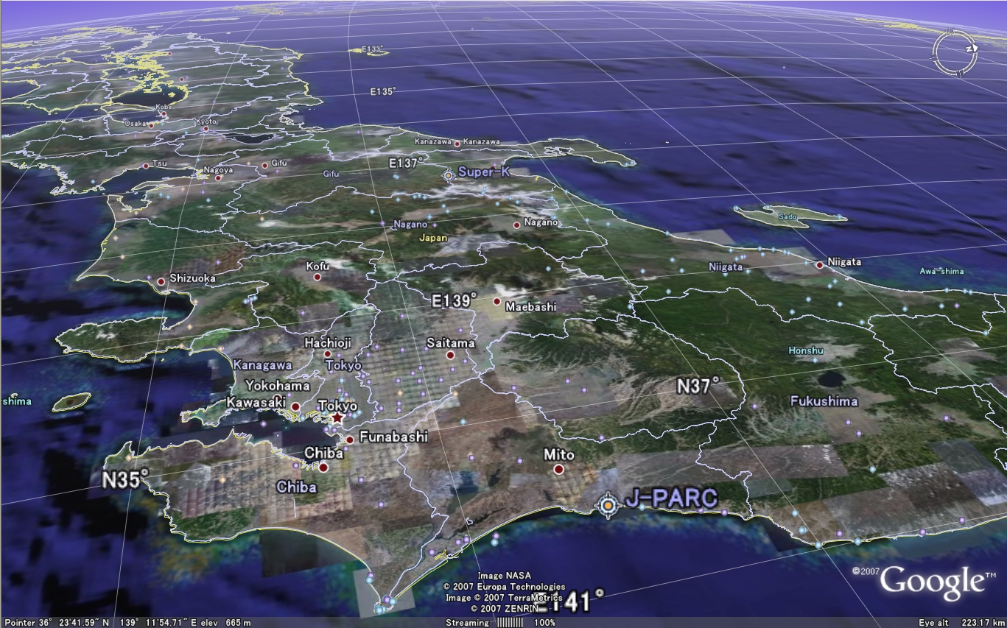

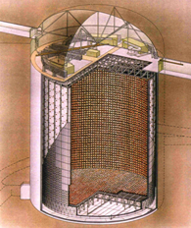
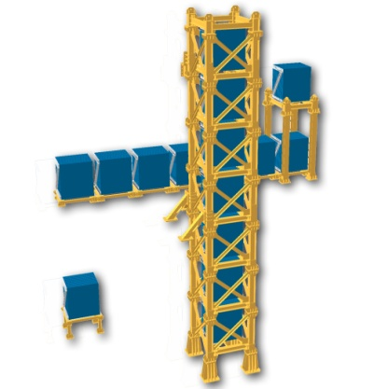
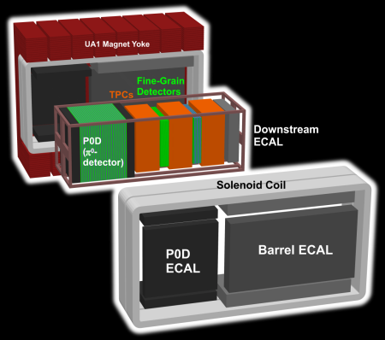
#

Slide 18
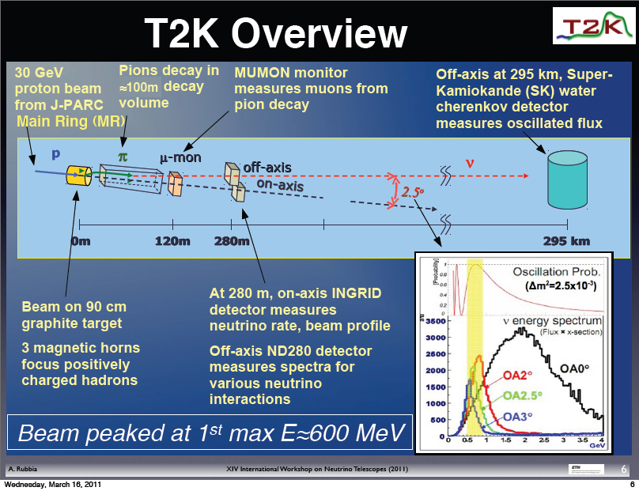

Slide 19
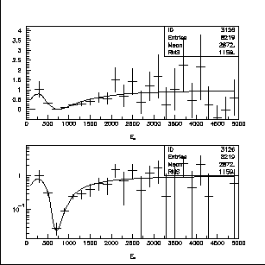
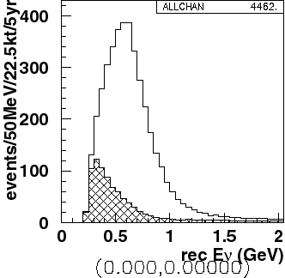
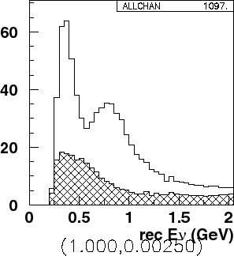
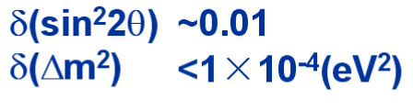
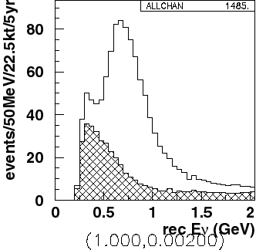
What are we trying to measure?
ν_{μ} disappearance
No oscillation
sin²2θ₂₃
Δm²= 2.5 x10⁻³ eV²
Δm²= 2.0 x10⁻³ eV²
Δm₂₃²
Precision measurements

Slide 20
What are we trying to measure?
ν_{e} appearance
sin²2θ₁₃

Slide 21
Optimal Far Detector – Super Kamiokande

Slide 22
Background
from NC
interactions
e
ν_{μ}
disappearance
signal
π⁰
ν_{e}
appearance
signal
μ
In this energy range, Super Kamiokande well understood,
Excellent for separating
electrons, μ, π⁰

Slide 23
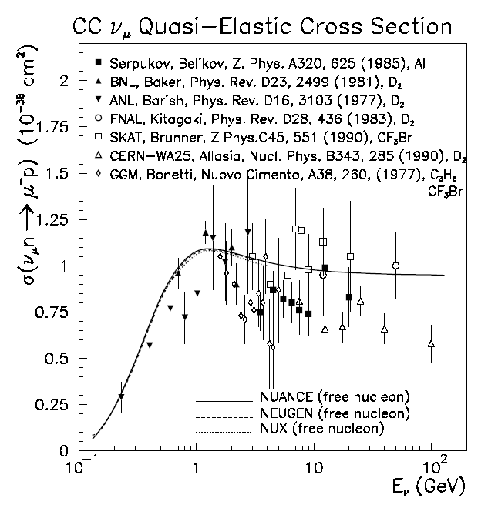
Cross sections are poorly known in range 0.1-10 GeV
Data compiled by G.Zeller, hep-ex/0312061

Slide 24
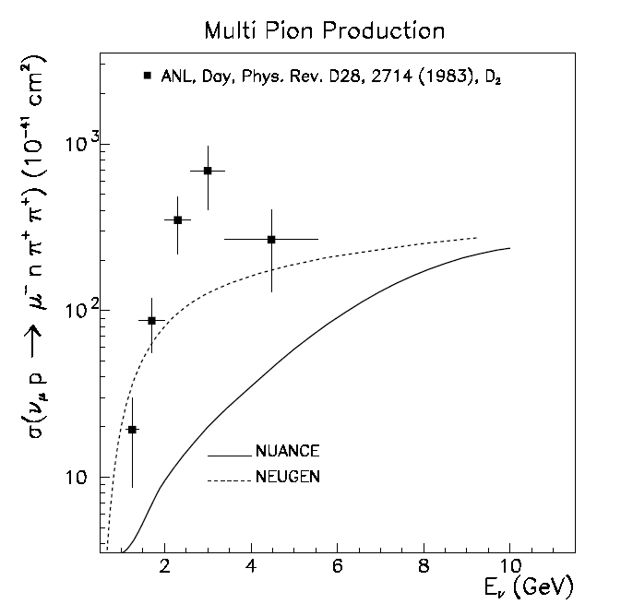
Cross sections are poorly known in range 0.1-10 GeV
Data compiled by G.Zeller, hep-ex/0312061

Slide 25
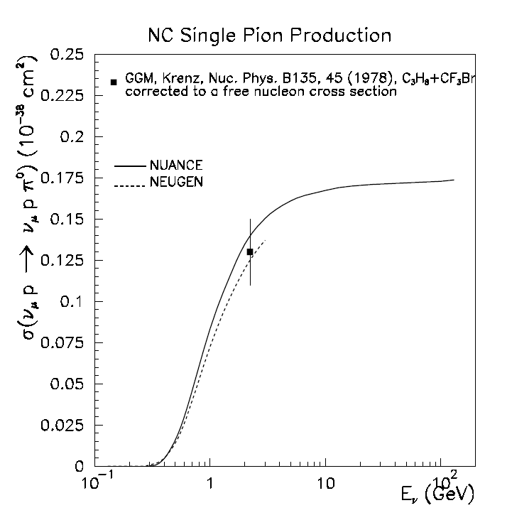
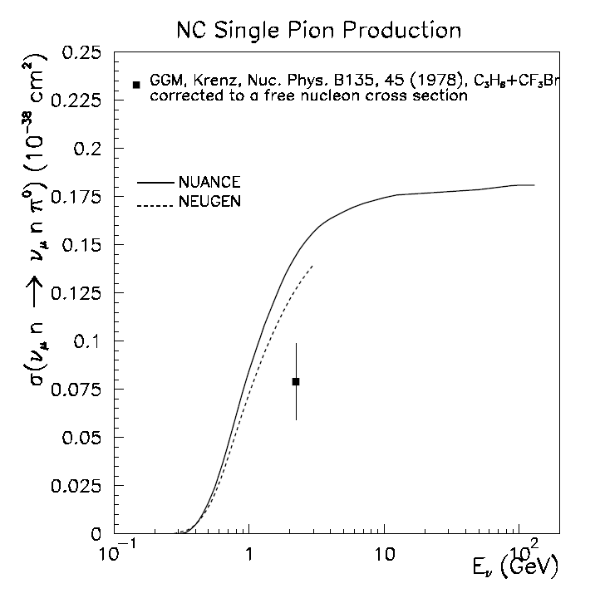
Some are worse than others…
Data compiled by G.Zeller, hep-ex/0312061

Slide 26
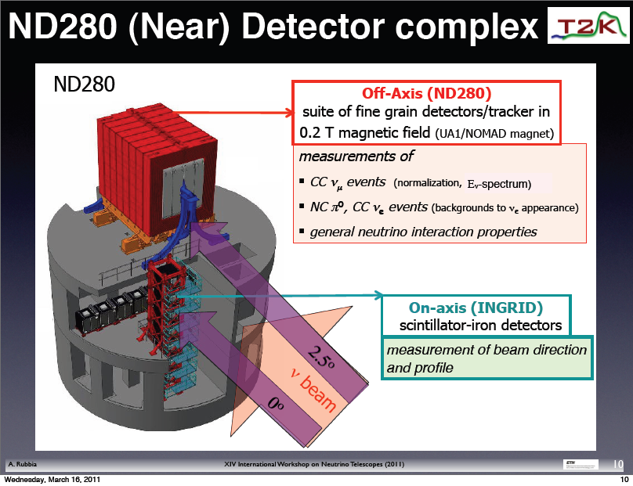
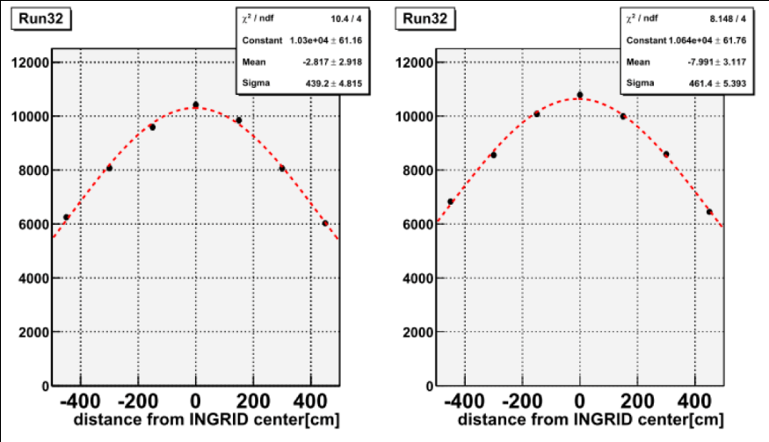
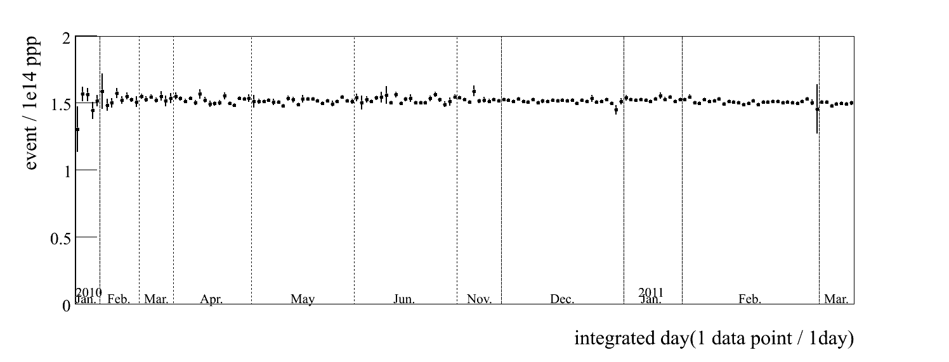

Slide 27
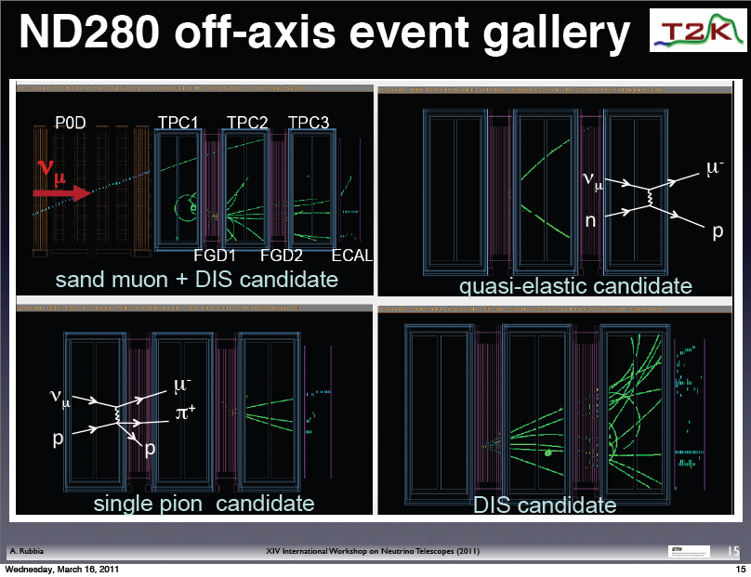

Slide 28
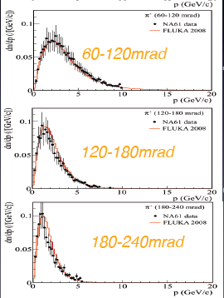
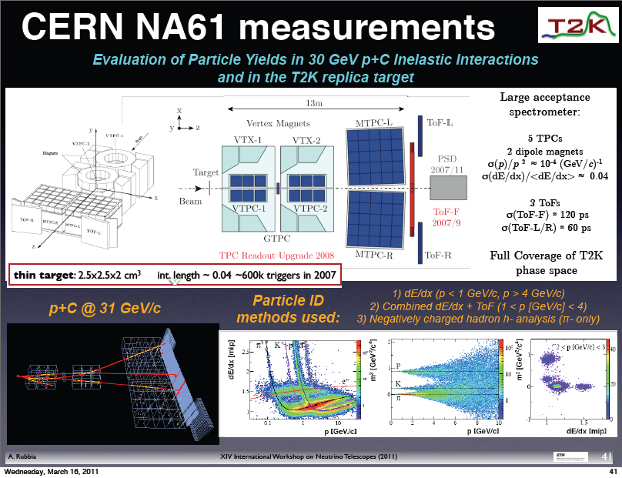
In the systematics dominated era
support measurements are essential!
One slide on hadron production

Slide 29

Slides from Sakashita-san’s presentation at ICHEP12

Slide 30

Analysis uses 3.06 x 10²⁰ POT

Slide 31

Analysis uses 1.43 x 10²⁰ POT

Slide 32


As of this morning, 4.785 x 10²⁰
More results very soon….

Slide 33

Effect of 3ν on reactor disappearance
Disappearance on very
short baselines –
no MSW, no CP viol
sin²2θ₁₃
Measure this small deficit. Due to Δm²₁₂<Δm²₂₃₍₁₃₎, this is almost pure θ₁₃ measurement
Figure from Josh Klein
Dave Wark
Imperial College/RAL

Slide 34




Double Chooz Results
Currently only far detector, so
use Bugey results for norm.

Slide 35




Daya Bay Results!

Slide 36




RENO Results

Slide 37

A word of caution about Global Fits…
Global Solar ν fit
prior
to SNO/KamLAND

Slide 38


These are 99% c.l. contours!
Global Fits do not replace compelling experiments, particularly in ν physics!

Slide 39

What is
the MH?
Is θ₂₃
maximal?
If θ₂₃≠45º
what is
the octant?
What is
δ?
Gonzalez-Garcia,Maltoni,Salvado,Schwetz

Slide 40
What is
the MH?
Is θ₂₃
maximal?
If θ₂₃≠45º
what is
the octant?
What is
δ?
Gonzalez-Garcia,Maltoni,Salvado,Schwetz
The determination of these parameters, including δ, is critical to completing our understanding of the Standard Model.
There is no credible alternative to long-baseline experiments to measure δ.

Slide 41



How will we learn more?
where:

Slide 42

How will we learn more?
where:
NH,

Slide 43


Slide 44


Slide 45


Slide 46


Slide 47

Statistics an issue for all experiments, and systematics
become important once you have enough statistics.

Slide 48

Additional Information from Continuing Long Baseline Experiments - T2K, NOνA (+ reactors)
Indications, hints, guidance – Yes! Discoveries, sadly, no….

Slide 49




The Next Step in Japan
Hyper Kamiokande L=295km OA=2.5deg
J-PARC MR
→~1.0MW
Water Cerenkov selected as the current option.
European involvement almost inevitable
because of the 280m detector, but greater
involvement is being considered..
Interference with ILC in Japan?

Slide 50




US: Long Baseline Neutrino Experiment
CD 0: January 2010
CD 1: December 2012!
1300 km
34 kT of LAr
desired option.
For cost reasons, the project has
been phased to a 10 kT detector
on the surface and no ND.

Slide 51



Possible synergy with a NF beam
Possible synergy with a β beam

Slide 52


LENA ?

Slide 53


Slide 54

From Pilar Hernandez’s talk in Kracow…
>5σ in
2 yrs. vs. 10
Near
Detectors?
Other proposals to measure the MH with atm. or reactor ν, hard
to get convincing evidence at 5σ but more work needed.

Slide 55




νStorm
β Beam
ν_{e} σ!
EURONu has considered options and costs and recommends Neutrino Factory
Costs will be high – R&D needed to reduce.
Neutrino Factory

Slide 56

Neutrinos in the proposed CERN Strategy…

Slide 57
Conclusions
Neutrino oscillations are the first confirmed BSM particle physics.
We still have a lot of work to do to completely characterize the MNSP matrix.
The measurement of “large” θ₁₃ has opened up a whole range of new experiments on a realizable scale.
There is no other way to do this physics than build major projects to measure a few numbers – but we need those numbers!
A strong case exists for at least two long-baseline projects in the near to mid-term.
There is and will (or at least should) be a continuing programme to develop towards a Neutrino Factory.
The sterile neutrino question also needs an answer.
European involvement in T2HK is almost certain if the project proceeds, involvement in LBNE being considered.
The LAr prototype at CERN is a near-term opportunity, and extensive other R&D is needed (like νStorm).
There is much work to be done!
JOIN US!.
Dave Wark
Imperial College/RAL

Slide 58




LSND Starts it all...
Short baselines
(L/E ~ 1)
and Sterile ν.
MiniBooNE says....
No!
Latest…
Yes?
Dozens of proposed experiments to test...

Slide 59



Synergy/Interference with Long-Baseline proposals?

Slide 60


Slide 61


Slide 62

SPSC feedback very positive, recommends we proceed to a TDR…

Slide 63


Slide 64


Slide 65


Slide 66



Slide 67


Slide 68


Slide 69


Slide 71


Slide 72


Slide 74

Scenarios in Japan
Hyper Kamiokande L=295km OA=2.5deg
Okinoshima L=658km OA=0.78deg
Almost On-Axis
J-PARC
→1.7MW

Slide 75

US: Long Baseline Neutrino Experiment
CD 0: January 2010
1300 km
For cost reasons, the project has
been de-scoped to a 10 kT detector
on the surface and no ND.

Slide 76
US: Long Baseline Neutrino Experiment
CD 0: January 2010
1300 km
Could international contributions restore the performance to the
baseline, in particular the ND
and underground site?

Slide 77
From Pilar Hernandez’s talk in Kracow…
2km
detector?

Slide 78


Slide 79

Atmospheric Neutrinos

Slide 80


Slide 81




CERN to Super-K?

Slide 82

Atmospheric Neutrinos

Slide 83

Atmospheric Neutrinos

Slide 84


Slide 85

Comments:
  5% systematics !?! Give me a break.
  What is plotted is E_{ν}, what is measured is the amount of charge in the tubes, true reconstruction needed.
  Sorting of events between classes has energy dependent systematics, needs full reconstruction.
  All based on Monte Carlo, and always will be!

Slide 86

Further future for reactor experiments.
FT of data –
Does not create
information!
Slide from Nishikawa’s summary.
Assumes 3% energy resolution and 0.1%
Energy scale linearity in a 20 kT organic scintillator!

Slide 87
Sterile Neutrinos
LSND Starts it all...

Slide 88

New MiniBooNE Results (from C. Polly’s talk)
LSND Starts it all...

Slide 89


Other Indications of Sterile ν
(or underestimates of systematics)
Gallium Anomaly
Must include all data (CDHS, atmos. ν, MINOS, etc.)

Slide 90

Atmospheric Neutrinos

Slide 91

Atmospheric Neutrinos
Adding more sterile ν’s doesn’t help!

Slide 92

From M. Shaevitz talk
Could measure ν_{e} cross-sections, critical (?) for 5% systematics?

Slide 93



Slide 94

Atmospheric Neutrinos

Slide 95


Slide 96

Atmospheric Neutrinos

Slide 97

We are comparing sensitivities
using a model which is known
to be wrong!

Slide 98


Slide 99


Slide 100


Slide 101


Slide 102


Slide 103


Slide 104


Slide 105


Slide 106


Slide 107


Slide 108


Slide 109


Slide 110


Slide 111


Slide 112


Slide 113

Atmospheric Neutrinos (plots from Itow-san’s talk)

Slide 114

Atmospheric Neutrinos

Slide 115

Atmospheric Neutrinos

Slide 116

Atmospheric Neutrinos

