Slide 1
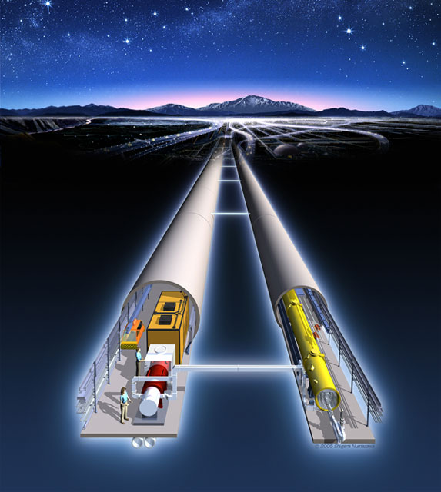
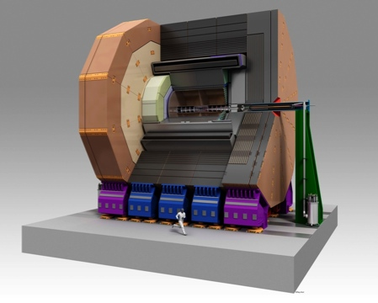
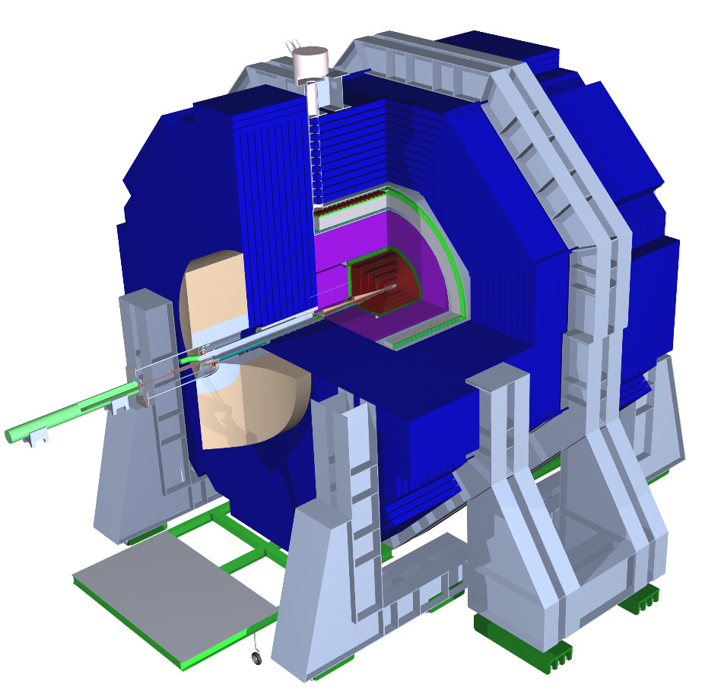
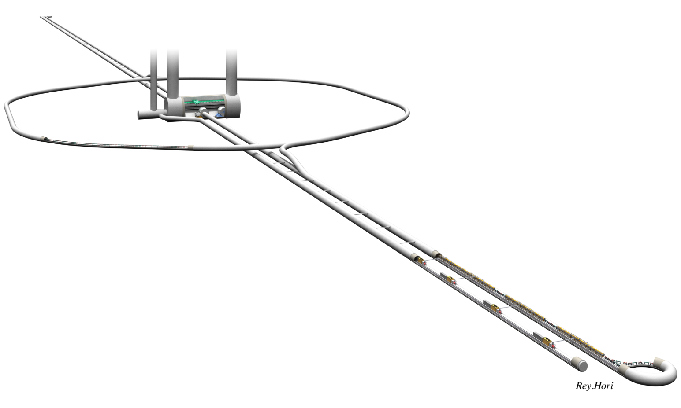
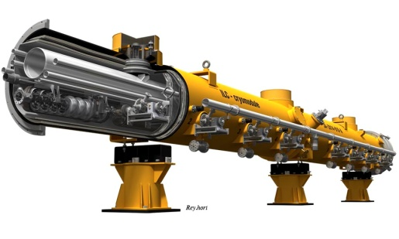
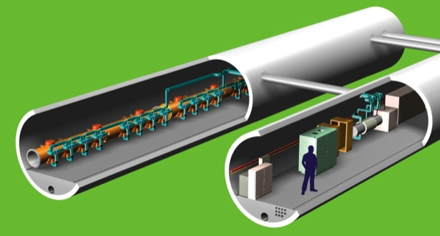
Physics at the ILC
Kiyotomo Kawagoe / Kyushu University
The 3rd LCFORUM meeting & DESY Colloquium
February 07, 2012
International Linear
Collider
Notes:
Let me start. I am Kiyotomo Kawagoe, from Kyushu University in Japan. I talk about Physics at the ILC, the international linear collider.

Slide 2
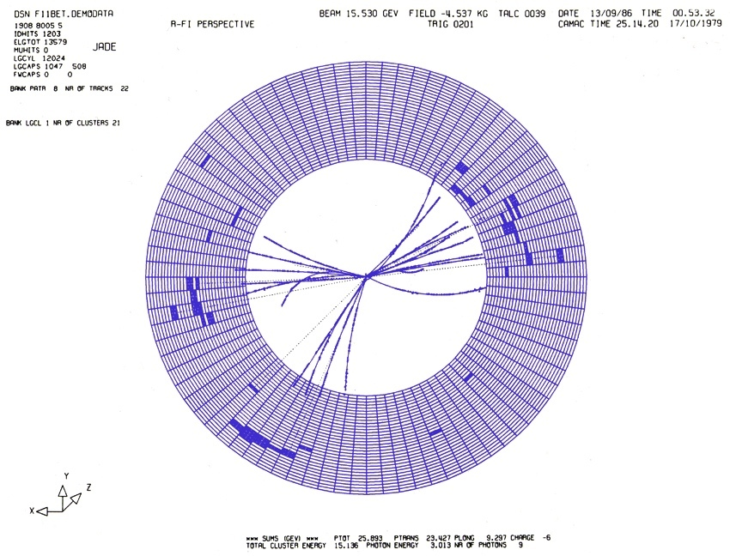
Thank you very much for the invitation
My career of collider physics started in the JADE experiment at PETRA, DESY.
I was a Ph. D student sent from Tokyo to Hamburg by DAAD scholarship.
Notes:
Before starting this talk, I would like to thank you for inviting me to the linear collider forum that started today and this colloquium at DESY. This picture shows a famous three-jet event of the JADE experiment at the PETRA e+ e- collider, that led to the discovery of the gluon, the intermediate gauge boson of the strong force. I show this picture because my career of collider physics started in the JADE experiment here at DESY. I was the last Ph. D student sent from Tokyo university to Hamburg University for JADE by DAAD scholarship.

Slide 3
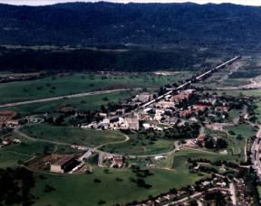
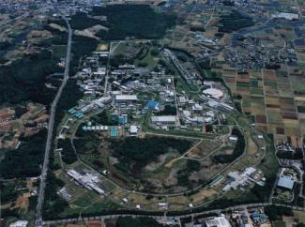
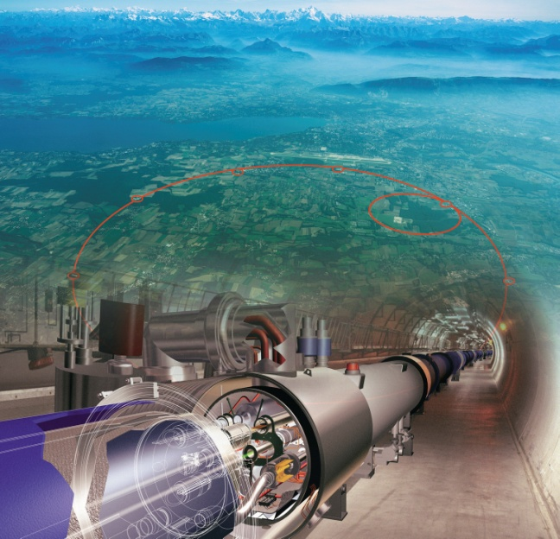
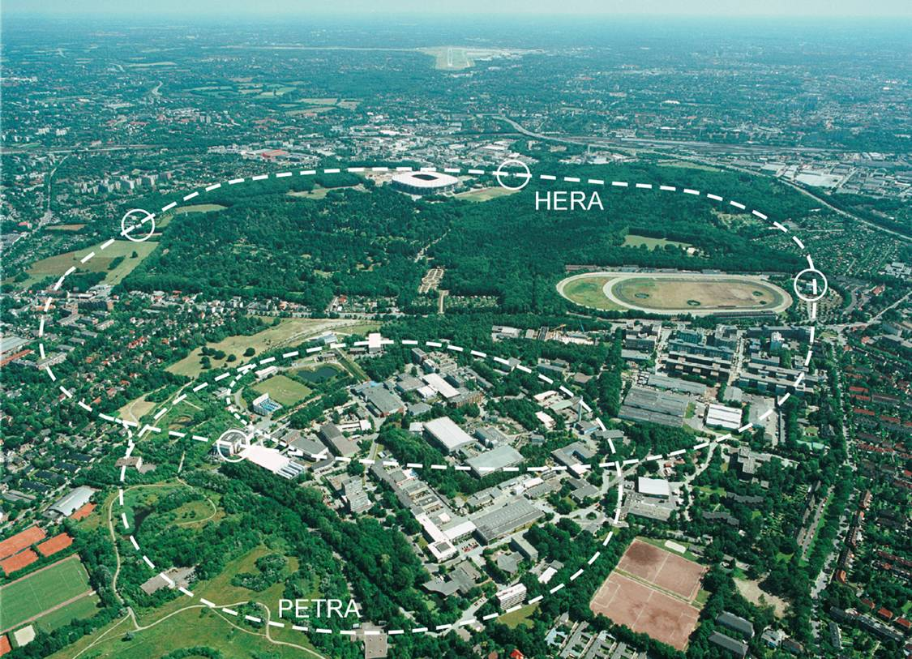
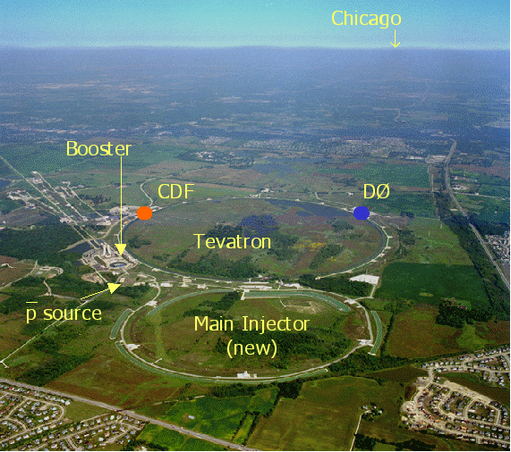
Energy-frontier colliders in 5 major HEP laboratories (since 1980’s)
KEK＠Tsukuba, Tokai
SLAC＠Stanford
TRISTAN 1987-1995
➔ Intensity frontier
KEKB 1999-2009
J-PARC 2007-
Super-KEKB 2014?
LHC
PEP 1980-1990
SLC 1988-1998
Intensity frontier
PEP-II 1998-2008
X-ray source
LCLS
CERN＠Geneva
HERA
SppS 1981-1984
LEP 1989-2000
ＬＨＣ 2009-
LEP
SLC
For energy-frontier particle physics,
We have currently one powerful hadron collider (LHC).
But, we have had no lepton colliders since 2000.
TRISTAN
Tevatron
SppS
DESY＠Hambug
FNAL＠Chicago
PEP
PETRA
PETRA 1979-1986
HERA 1992-2007
X-ray source
European XFEL
TEVATRON 1987-2011
Intensity frontier
Project X
Notes:
This page shows the hostory of energy-frontier particle colliders in the world, since 1980’s. PETRA, PEP, TRISTAN, SLC, and LEP were e+e- colliders. The LEP collider had the highest center-of-mass energy, 209 GeV. HERA was a unique electron-proton collider. SppbarS and Tevatron were the proton-anti-proton colliders, where W and Z gauge bosons, and the top quark were discovered. Among the five five laboratories, DESY and SLAC have currently no colliders for particle physics, and photon-factories will be the core of the laboratories. KEK has accelerators for particles physics, but the J-PARC and KEK-B are for the intensity frontier. Fermilab has a plan for the project X, that is also for the physics of intensity-frontier. At CERN, the Large Hadron Collider started its operation since 2009. The current situation is the following:
For energy-frontier particle physics, we have only one very powerful hadron collider, but have had no lepton colliders since 2000, when tle LEP collider finished its operation.

Slide 4
Energy-frontier colliders in 5 major HEP laboratories (since 1980’s)
ILC
KEK＠Tsukuba, Tokai
SLAC＠Stanford
TRISTAN 1987-1995
➔ Intensity frontier
KEKB 1999-2009
J-PARC 2007-
Super-KEKB 2014?
LHC
PEP 1980-1990
SLC 1988-1998
Intensity frontier
PEP-II 1998-2008
X-ray source
LCLS
CERN＠Geneva
HERA
SppS 1981-1984
LEP 1989-2000
ＬＨＣ 2009-
The International Linear Collider (ILC) is the next-generation lepton (electron-positron) collider, being developed and designed by GDE
1st stage at 500 GeV (length ~31 km)
extendable to 1 TeV (length ~50 km)
LEP
SLC
TRISTAN
Tevatron
SppS
DESY＠Hambug
FNAL＠Chicago
PEP
PETRA
PETRA 1979-1986
HERA 1992-2007
X-ray source
European XFEL
TEVATRON 1987-2011
Intensity frontier
Project X
Notes:
Our realistic hope is to build the international linear collider, ILC. The ILC is the next generation e+e- collider, being developed by the global design effort, GDE. The ILC is to be started at a center-of mass energy of 500 GeV with a length of about 31 kilometer, and should have extendability to 1 TeV center-of-mass energy with a length of 50 kilometer.

Slide 5
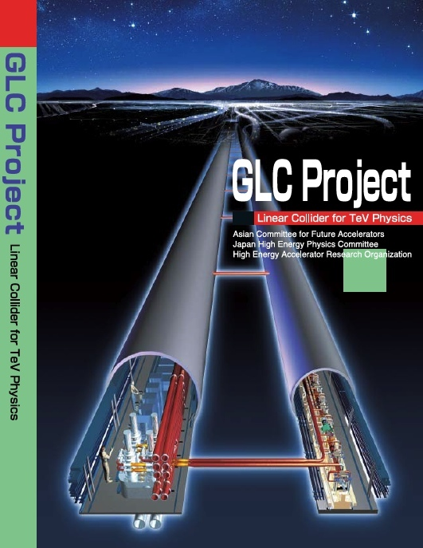
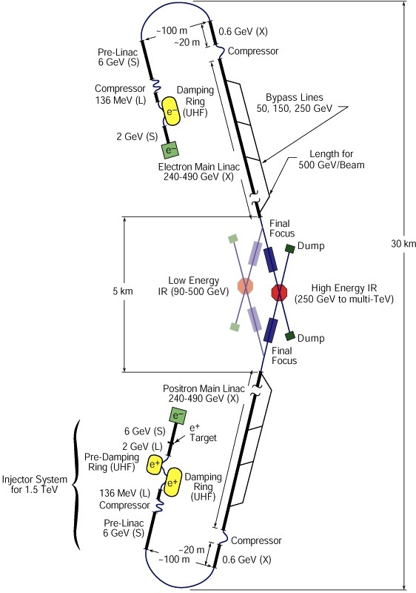
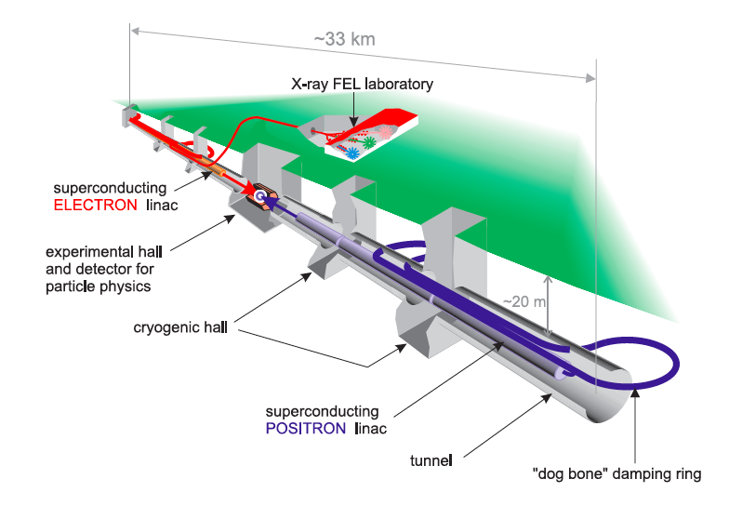
History toward the ILC
R&D studies of linear colliders started in 1980’s in three regions:
Asia, Europe, and North America
The future linear collider was
too big as a regional project.
TESLA in Europe
GLC in Asia
NLC in North America
Notes:
Linear colliders were proposed in 1980’s and R&D studies started in the three regions. They are TESLA project in Europe, here at DESY, Next Linear Collider in the US, and JLC and then GLC in Asia. However, none of them could become a real approved project. Probably the future linear collider is too big as a regional project.

Slide 6
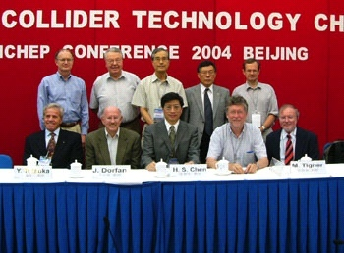
The International Linear Collider
-- a truly international project --
2004: The cold technology was chosen for the ILC by ITRP (International technology Recommendation Panel).
2005: GDE (Global Design Effort) organized for the accelerator design.
2007: RDR (Reference Design Report) published.
2012: TDR (Technical Design Report) to be completed.
2013: A new organization after GDE, site-selection, …
Notes:
Therefore the efforts in the three regions were unified into a truly international project. This is the international linear collider. In 2004, the cold technology developed for TESTLA was chosen by ITRP. In 2005, Global Design effort was organized for the accelerator design. In 2007 RDR, reference design report of the ILC was published. Technical Design Report will be completed and published by the end of this year. At the same time the role of GDE will be completedh, and a new organization after GDE is being planed, which will start next year. The site-selection procedure may also start.

Slide 7
Operation of the ILC accelerator
Damping Ring
electrons
positrons
Electron source
Main linac
Main linac
Animation by T. Takahashi (Hiroshima)
Notes:
I try to show you how the ILC works using an animation.. This animation was made by Takahashi-san of Hiroshima University. An electron beam with very low emittance is made in the damping ring, and transferred to the main linac. This electrons are accelerated and is used to produce positrons. The positron beam with low emittance is then produced in the damping ring. The electrons and positrons are accelerated by the main linac, and are collided at the interaction point.

Slide 8
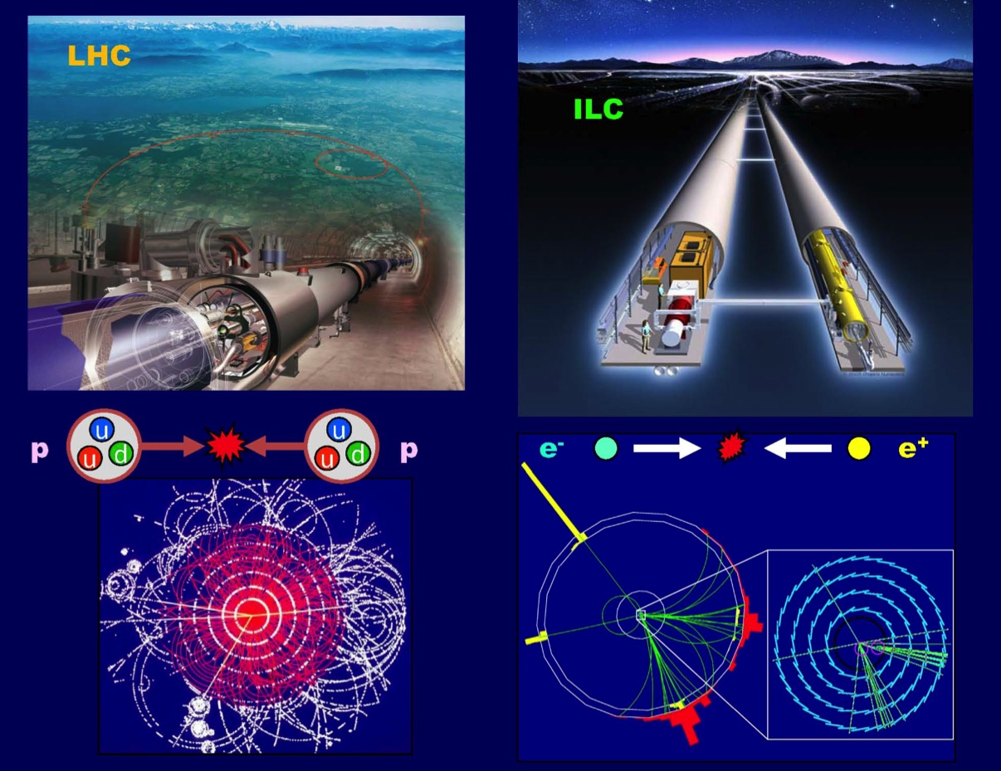

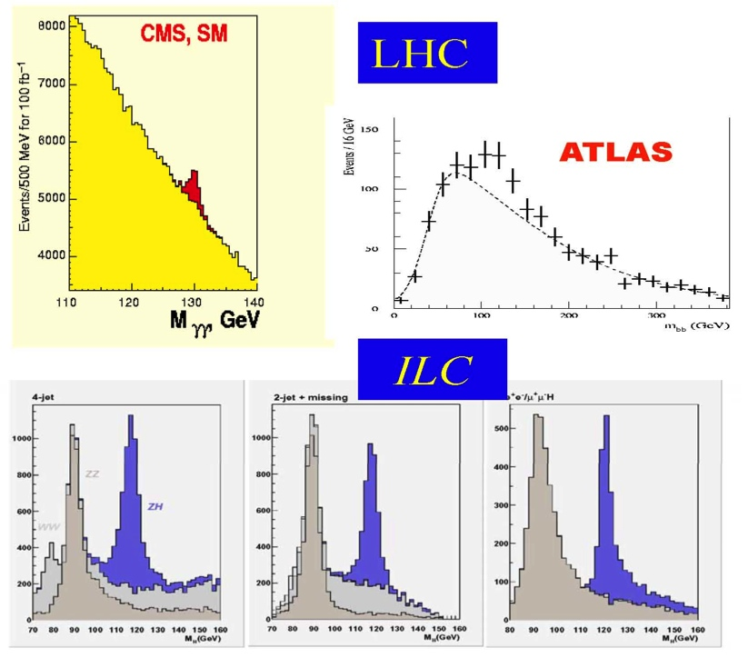

Why ILC ?
At first hadron collisions,
then e⁺e⁻ collisions:
they are complementary.
At the ILC, we will perform much more precise measurements of new particles, discovered at the LHC, in a much cleaner environment.
  Mass, Spin, and Couplings
  Symmetries and basic principles behind them
  Information for yet-undiscovered particles
  Determination of the next step to fully understand TeV-scale physics toward the much higher energy
Open new road
Higgs Particle Study
A. Suzuki
Make up the road
Notes:
This is a slide that Suzuiki-san, the director general of KEK, often shows. Why do we need the linear collider ? For me the answer is very simple. The LHC has enormous discovery potential of new particles. But, we need lepton colliders to fully understand the physics behind the new particles, by the precision measurements. The lepton cilliders and hadron colliders are complementary and we need both. These are the Higgs events expected at the LHC and the ILC. The event at the ILC is much simpler than that at the LHC. The Higgs signal can be observed at many independent channels with very low background. The Higgs signal would be confirmed in one day at the ILC.
The LHC is a machine to make a first road in a bush. The ILC is a machine to make a highway.
At the ILC, we will perform much more precise measurements of new particles, discovered at the LHC, in a much cleaner environment.
Mass, Spin, and Couplings
Symmetries and basic principles behind them
Information for yet-undiscovered particles
Determination of the next step to fully understand TeV-scale physics toward the much higher energy

Slide 9
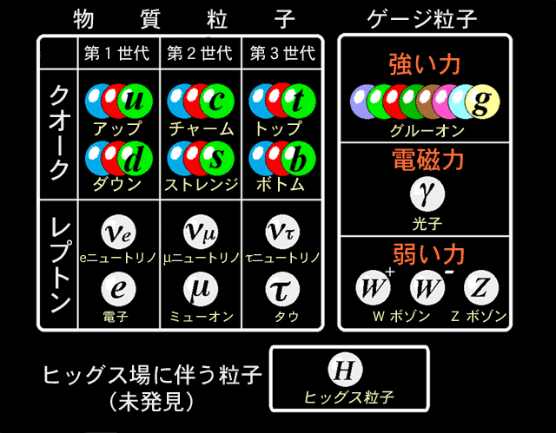
Composition of the Standard Model
Gauge interactions
Matter
Yukawa
Higgs
Notes:
Now I move on to the physics at the ILC. This slide shows the composition of the standard model. In the standard model we have matter fermions, the gauge bosons to mediate fundamental forces, and the Higgs boson, the origin of the electroweak symmetry breaking, and giving the mass to the particles

Slide 10
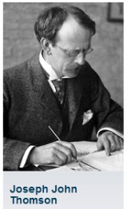
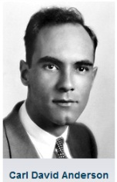
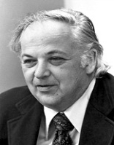
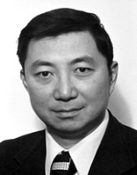
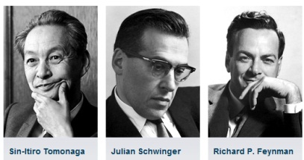
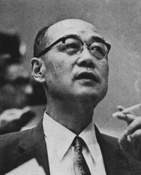
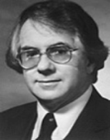
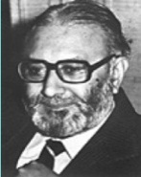

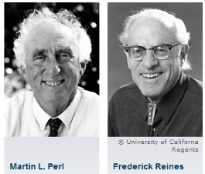


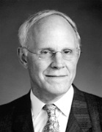
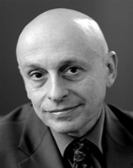
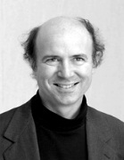
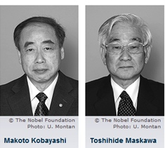
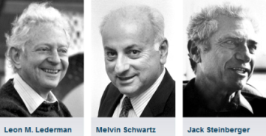
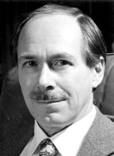
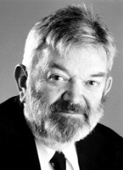
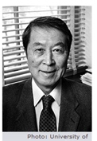
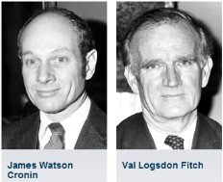
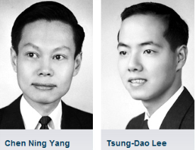
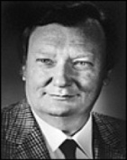
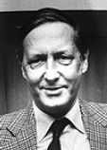
Dark side of the Standard Model
Gauge interactions
Matter
Yukawa
This part is completely unknown.
Higgs
Notes:
What is known about the standard model ? The matter and gauge boson sectors have been investigated theoretically and experimentally for the last 100 years by many physicists. However, this part, the Higgs sector is, at least experimentally, totally unknown.

Slide 11

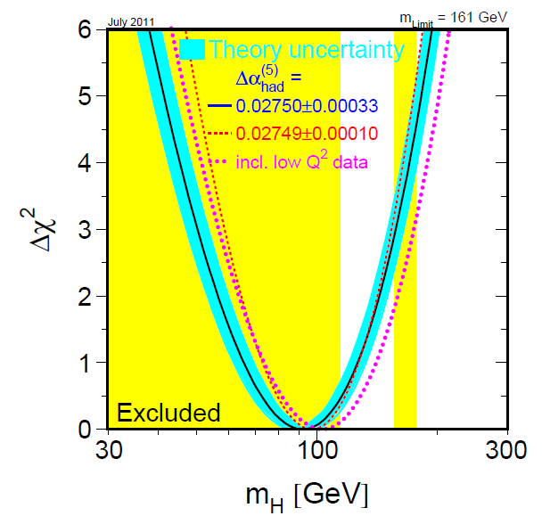
Higgs Searches before the LHC
The precise electroweak measurements at LEP/SLC and Tevatron indirectly constrain the SM Higgs boson mass to be
M_{H} < 161 GeV
Gauge bosons
Matter
Yukawa
Higgs
For the SM Higgs boson:
Direct searches at LEP
  M_{H} > 114 GeV
Direct searches at Tevatron rejected a mass region around 160 GeV
Notes:
This slide shows the status of the standard model Higgs searches before the LHC. The precise electroweak measurements at LEP/SLC and Tevatron prefer light Higgs, and an indirect mass upper limit of 161 was obtained for the standard model Higgs. On the other hand, direct search at LEP told us that the standard model Higgs boson mass is larger than 114 GeV. At 95 % confidence level. The Tevatron searches rejected a narrow mass region around 160 GeV.

Slide 12
What will be discovered at the LHC ?
(Table at the end of 2010)
Case | Light Higgs | Heavy Higgs | No Higgs | Other New Particles
1 | Y |  |  | Y
2 |  | Y |  | N
3 |  |  | Y | Y
4 | Y |  |  | N
5 |  | Y |  | Y
6 |  |  | Y | N
Light Higgs (M_{H} < 161 GeV) is consistent with the electroweak measurements at LEP.
Heavy Higgs (M_{H} > 161 GeV) is inconsistent with the electroweak measurements at LEP.
Physics cases at the LHC have enormous impacts
on the possible physics scenario at the ILC.
Notes:
This table shows six possible cases on what will be discovered at the LHC. Namely, three cases for the Higgs boson, light, heavy, or no Higgs boson. And we have two cases for other new particles to be found or not.. The results should have enormous impact on the physics scenario at the ILC.

Slide 13
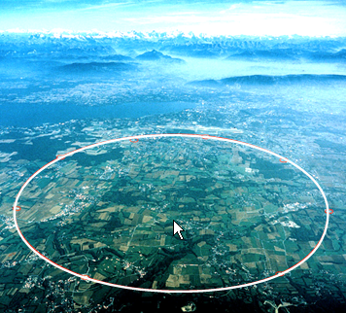
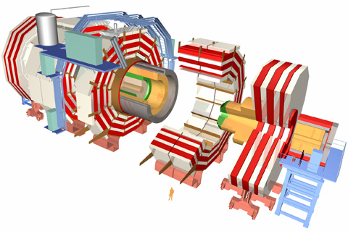
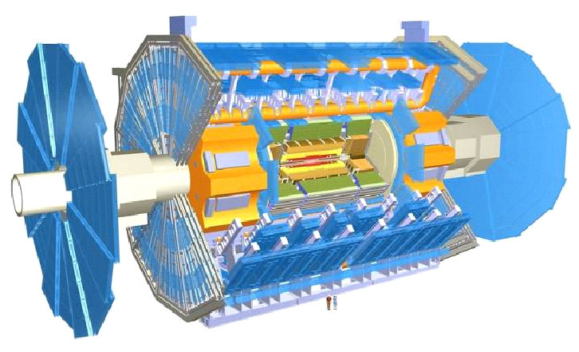
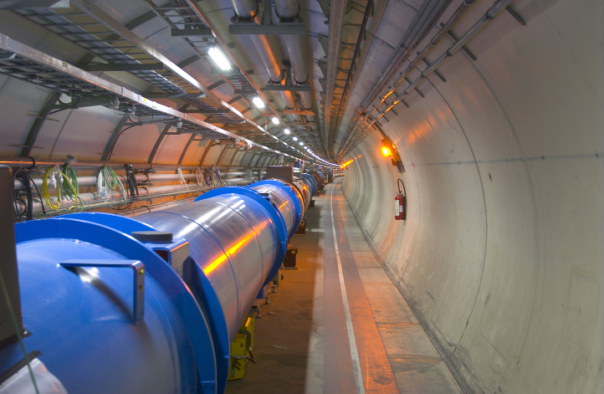
Higgs Searches at the LHC
CMS
ATLAS
LHC
CERN@Geneva
Notes:
Let me show you some slides on the Higgs searches at the LHC.

Slide 14
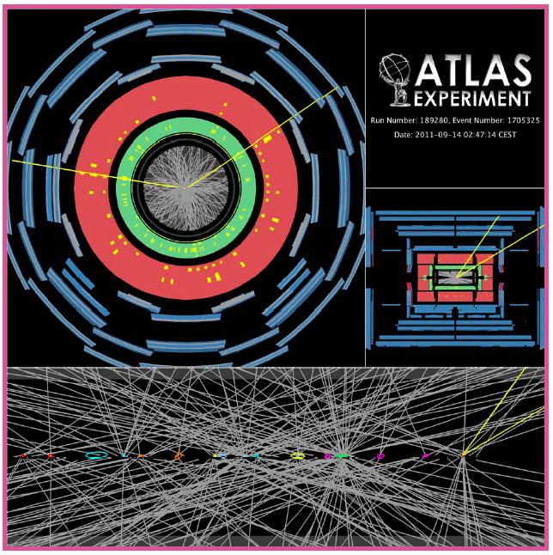
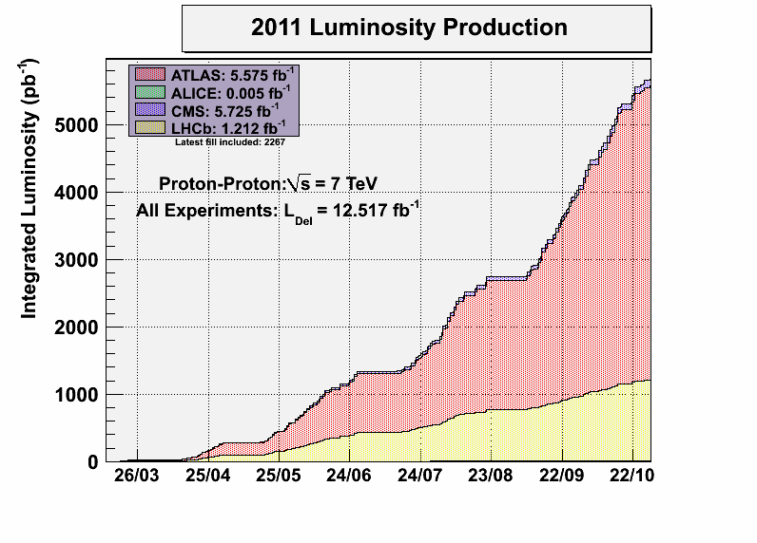
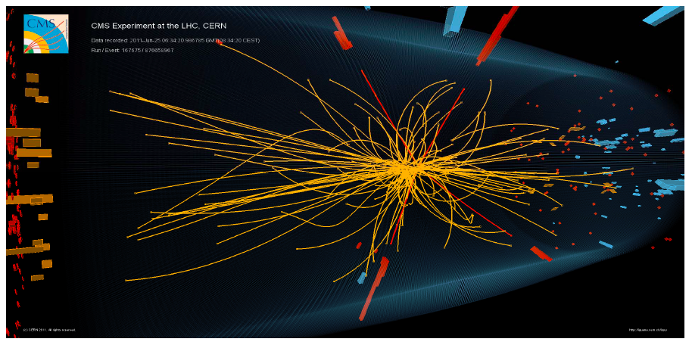
Great success of the LHC accelerator and experiments in 2011
Notes:
As you know, the last year was a great success for the LHC. The LHC provided more than 5 inverse femt barn to each experiment. Because of the high luminosity, the number of proton-proton collisions per bunch crossing was typically more than 10, which increased the difficulty of the physics analysis. Nevertheless, both of the ATLAS and CMS experiments succeeded in getting the Higgs results very quickly.

Slide 15
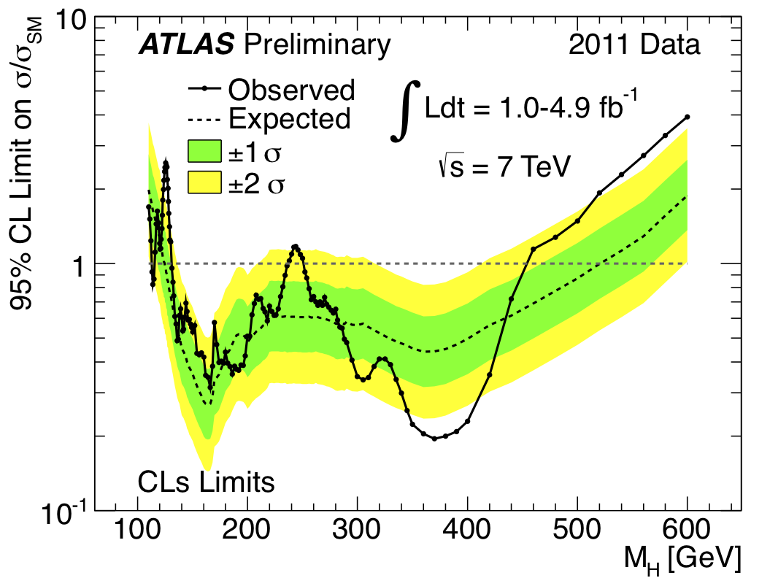
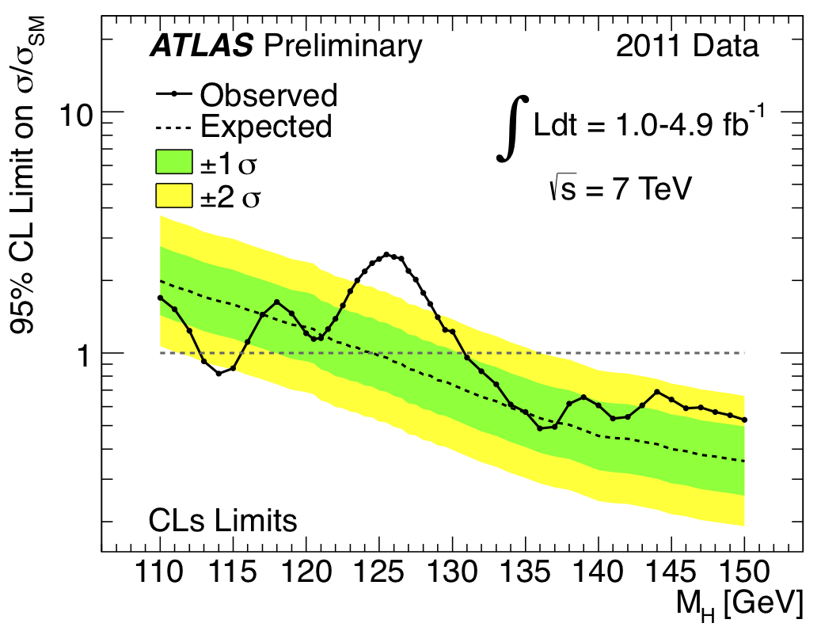
H→γγ, H→ ττ
H→ WW^{(*)}→ lνlν
H→ ZZ^{(*)} → 4l, H→ ZZ → llνν
H→ ZZ → llqq, H→ WW→lνqq
W/ZH→ lbb+X not included
Putting all channels together → combined constraints
LEP
ATLAS+CMS
Combination
ATLAS
today
Excluded at 95% CL
112.7 < m_{H} < 115.5 GeV
131 <m_{H} < 453 GeV, except 237-251 GeV
Expected if no signal
124.6-520 GeV
F. Gianotti
2011/12/13
Excluded at 99% CL
133 <m_{H} < 230 GeV, 260 < m_{H} < 437 GeV
Notes:
This is a slide that was shown by Fabiola at the CERN seminar last December. The left plot shows the 95 % confidence limit of the standard model Higgs cross section normalized by the expectation. If the ratio is less than 1, the mass region is rejected. The right figure is a close-up view of the light Higgs region. There is a bump around 125 GeV, and only the mass region between 115.5 and 131 GeV is allowed in this plot.

Slide 16

Notes:
The plots were shown at the same CERN seminar by the CMS spokesperson. In the left plot you see that the mass region where the standard model Higgs boson can survive is very narrow now. The right figure shows the top mass and W mass correlation plot and the yellow region is excluded. The heavy Higgs region is still left, but the light Higgs is clearly favored by the top mass and W mass measurements.

Slide 17
What will be discovered at the LHC ?
(My personal view as of February 2012)
Case | Light Higgs | Heavy Higgs | No Higgs | Other New Particles
1 | Y |  |  | Y
2 |  | Y |  | N
3 |  |  | Y | Y
4 | Y |  |  | N
5 |  | Y |  | Y
6 |  |  | Y | N
In 2012, a center-of-mass energy of 8 TeV, and 15 fb⁻¹/experiment are expected at the LHC.
A light “Higgs” may be discovered at the LHC (cases 1 and 4).
We still have a significant chance for the scenario 1 (the best case for the ILC),
In either case, the ILC should be naturally started as “The Higgs Factory”.
Notes:
This table again shows the possible cases of the discovery at the LHC, this time with my personal view as of today. I think a light Higgs will be discovered at the LHC, namely the scenario 1 or 4. Although no new particles have been discovered at the LHC, we still have a significant chance to find new particles. This is scenario 1, the best scenario for the ILC. In either case of 1 or 4, the ILC should be naturally started as the Higgs factory.

Slide 18
Why “the Higgs Factory” ?
The Higgs boson is a completely new type of particles that we have never encountered. The properties are experimentally totally unknown.
  SM Higgs or not ?
  Spin, CP, Couplings to fermions, gauge bosons, and Higgs itself ?
  Number of Higgs bosons ?
The properties of the Higgs boson, to be discovered at the LHC, must be thoroughly investigated in a good condition at the ILC.
  Interactions of elementary particles, with the initial state well known
  Relatively simple final states with low background
  Polarization of electrons (and positrons) as a powerful tool
Notes:
Why do we need the Higgs factory ? My answer is the following:
The Higgs boson is a completely new type of particles that we have never encountered. The properties are experimentally totally unknown.
SM Higgs or not ?
Spin, CP, Couplings to fermions, gauge bosons, and Higgs itself ?
Number of Higgs bosons ?
The properties of the Higgs boson, to be discovered at the LHC, will be thoroughly investigated at the ILC.
Interactions of elementary particles, with the initial state well known
Relatively simple final states with low background
Polarization of electrons (and positrons) as a powerful tool

Slide 19

Strategy of the center-of-mass energies
E_{CM}〜M_{H}+120 GeV(〜250 GeV)
  Precise measurement of the mass and production cross section
  Determination of the spin
  Precise measurement of the decay branching fractions
E_{CM}〜500 GeV or higher
  Measurement of the Higgs self-coupling
    Essential for the Higgs potential and EWSB mechanism
  Measurement of Top Yukawa coupling
Top quark study at the ttbar threshold
  Precise measurements of the mass, α_{s}(m_{Z}), and Γ_{top}
  Measurement of the top-quark momentum
  Measurement of the forward-backward asymmetry
Notes:
This page shows the strategy of ILC with the light Higgs. We will start the ILC at center-of-mass energy of Higgs mass + about 120 GeV, where the cross section is at maximum. Here we can measure the Higgs properties very precisely.
Precise measurement of the mass and production cross section
Determination of the spin
Precise measurement of the decay branching fractions
At the center-of-mass energy of 500 GeV or higher we can achieve two more essential measurements: the Higgs self-coupling and top-yukawa coupling.
Between the two stages, we can study the top quark at the ttbar threshold, at around 350 GeV. Here we can precisely measure a variety of top-quark properties.

Slide 20



The Higgs Boson: Mass, Spin, and Production Cross section
The Higgs properties can be precisely measured using the e⁺e⁻ → HZ process.
The production cross section is largest at E_{CM}~M_{H}+120 GeV.
Spin determination using
the threshold scan
Higgs cross section measurement independent of its branching fractions
TESLA TDR 2001
GLC project 2003
Notes:
The mass, spin, and the production cross section can be measured using the Higgs strahlung process at the ILC. Please note that the cross section measurement can be done independent of the Higgs branching ratios, because we only have to see Z decays into lepton pairs. This measurement will even include the invisible decay of the Higgs boson.

Slide 21

BR accuracy with different M_{H}
Ecm=250 GeV, L=250 fb⁻¹, Beam pol(e⁺,e⁻)=(+30%, -80%)
preliminarily
H. Ono
Measurement accuracies are extrapolated from M_{H}=120 GeV
Notes:
This is expected resolution of the Higgs branching ratios to be obtained at the ILC as a function of the Higgs mass. Here we assume a center of mass energy of 250 GeV, an integrated luminosity of 250 fb inverse, and the beam polarization of 80% for electrons and 30 percent for positrons. If the light Higgs exists, we will have many decay channels to be measured with good precision. The resolution is typically a few percent.

Slide 22
Prospects of Higgs measurements at the LHC
M. Dührssen (2003)
Error of (cross section x BR) > 20%
Error of coupling constants > 30%
(for m_{H}=120 GeV, 14 TeV, 300 fb⁻¹)
Notes:
The resolutions of the branching ratio measurements may be compared with those to be obtained at the LHC. At the LHC, some of the branching ratios care expected to be measured, however, the resolutions are much worse, typically more than 30%. I don’t think the resolution is good enough to distinguish the models behind the Higgs boson.

Slide 23




Top Yukawa coupling and Higgs self-coupling
Physics at higher energies (> 500 GeV) and high integrated luminosity ( > 1 ab⁻¹)
D.Harada
Theoretical estimation
Notes:
To study the Higgs self-coupling and Top Yukawa coupling, higher center-of-mass energy greater than 500 GeV, and high integrated luminosity will be required. The left plot show the Higgs ttbar cross section as a function of center-of-mass energy, while the right plot show the estimated error of the Higgs self-coupling as a function of the center-of-mass energy. The analysis of these channels are not easy even at the ILC, I think that further studies are necessary to determine the center-of-mass energy suitable for these processes.

Slide 24



The Higgs Branching fractions and BSM
Higgs couplings to leptons and quarks as well as gauge bosons can be measured precisely with precisions at O(1)% level.
Test “Coupling strength ∝mass”
Deviation from the SM expectations may determine the model and parameters of BSM.
SUSY
(2 Higgs Doublet Model)
Extra dimension
(Higgs-radion mixing)
Notes:
Higgs couplings to leptons and quarks as well as gauge bosons can be measured precisely with precisions at O(1)% level.
We can test if the coupling is really proportional to the mass or not.
Deviation from the SM expectations may determine the model and parameters of BSM.

Slide 25






Precise measurements of the Higgs Boson for Terascale Physics
Extra-dim
SUSY
SUSY
The Higgs Boson is our Powerful Tool to explore New Physics at Terascale
ACFA report
J.Guasch, et al
HEPAP report
Little Higgs with T-parity
Stongly-int light Higgs
Electroweak baryogensis
R.C. Chen et al
R.Contino et al
S.Kanemura et al
Notes:
Here are some more plots to show that the branching ratios of the Higgs boson are sensitive to new physics at the Terascale: Supersymmetry, Extra-dimensions, Little Higgs, Strongly interacting Higgs, and electroweak baryogenesis. I would like to stress here that The Higgs Boson is our Powerful Tool to explore New Physics at Terascale.

Slide 26
Studies of the Higgs Boson and the Top quark at the ILC
Integrated
luminosity (ab⁻¹)
2
HHZ
1.5
Rich physics programme are guaranteed at the ILC,
once a light Higgs be discovered at the LHC
1
0.5
HZ
ννH
ttH
tt
200
300
400
500
600
Center-of-mass energy (GeV)
Notes:
The strategy of the ILC is summarized in this slide.
We start the ILC at about 250 GeV to study Higgs properties in detail.
At 350 GeV, we can study the top-pair production in detail.
And at center of mass energy of 500 GeV or higher, we can measure the Higgs self coupling and Top-yukawa coupling.
My conclusion here is that rich physics programme are guaranteed at the ILC, once a light Higgs is discovered at the LHC.

Slide 27
Other New Particles ?
The LHC has so far discovered no indication of other new particles.
  It is still possible that heavy colored particles can be discovered at higher energies and with more integrated luminosity at the LHC
  Once heavy particles are discovered, the masses of lighter new particles may be estimated through their decay chains.
It is possible that lighter new colorless particles are discovered at the ILC, even if the LHC finds no new particles.
  The LHC is very powerful to produce colored particles, but not for colorless particles. Light colorless particles may easily escape detection at the LHC.
Notes:
So much for the light Higgs boson. How about other new particles ?
The LHC has so far discovered no indication of other new particles.
It is still possible that heavy colored particles can be discovered at higher energies and with more integrated luminosity at the LHC
Once heavy particles are discovered, the masses of lighter new particles may be estimated through their decay chains.
It is possible that lighter new colorless particles are discovered at the ILC, even if the LHC finds no new particles.
The LHC is very powerful to produce colored particles, but not for colorless particles. Light colorless particles may easily escape detection at the LHC.

Slide 28
Once a new particle is discovered …
If a new particle is discovered at the LHC or at the ILC, it may not be alone. A series of new particles must exist, and we will enter an era of “New Particle Discoveries”.
  Supersymmetry ? Extra dimensions ? Whatever else ?
  The lightest one may be the dark matter.
Precise measurements of the new particles will determine the energy required for the next collider
  If it is less than 1 TeV, the ILC should be upgraded to the second phase.
  If it is more than 1 TeV, we need CLIC or Muon Collider.
Notes:
If a new particle is discovered at the LHC or at the ILC, it may not be alone. A series of new particles must exist, and we will enter an era of “New Particle Discoveries”.
Supersymmetry ? Extra dimensions ? Whatever else ?
The lightest one may be the dark matter.
Precise measurements of the new particles will determine the energy required for the next collider
If it is less than 1 TeV, the ILC should be upgraded to the second phase.
If it is more than 1 TeV, we need CLIC or Muon Collider.

Slide 29




Various basic measurements of the SUSY model
SUSY relation
GUT relation
GLC Project
Seesaw neutrino mass
ILC RDR
Notes:
In the case of supersymmetry, the masses and couplings of superpartners can be precisely measured, if they are within the reach of the ILC. Then we can test directly the SUSY relations and GUT relations. It is possible to get some information of the neutrino seesaw mechanism.

Slide 30



Dark matter density in the SUSY model
Measurements of SUSY particles at the LHC and the ILC would enable us to precisely calculate the dark matte density in the universe, which will be compared with the future precise measurement by the Planck satellite.
E.A.Baltz,M.Battaglia,M.E.Peskin,and T.Wizansky
Notes:
We may be able to get information of the dark matter.
Measurements of SUSY particles at the LHC and the ILC would enable us to precisely calculate the dark matte density in the universe, which will be compared with the future precise measurement by the Planck satellite.

Slide 31


Even if no new particles were found at the ILC, precise measurements at the ILC can explore the physics at much higher energies
Ex) Discrimination of various Z’ models
Even if the energy of the ILC is not sufficient for production of new particles, precise measurements are powerful to explore physics at much higher energies.
This is achieved by the e⁺e⁻ colliders, with low-background, well known initial kinematics, and polarized beams.
e
f
Z’
m z’ =1, 2, 3 TeV,Ecm=500 GeV, L=1ab⁻¹
e
f
S.Godfrey, P.Kalyniak, A.Tomkins
Notes:
Even if no new particles were found at the ILC, precise measurements at the ILC can explore the physics at much higher energies. A god example is the Z-prime boson, From the precise measurements of fermion pair production at the ILC, the model of the new particle may be determined.

Slide 32
Physics programme at the ILC
Integrated
luminosity (ab⁻¹)
2
HHZ
1.5
In addition to the guaranteed physics,
the ILC has many possibilities to explore the physics beyond the Standard Model.
1
0.5
HZ
ννH
ttH
tt
200
300
400
500
600
Center-of-mass energy (GeV)
Notes:
This is the physics scenario I can imagine now. If the light Higgs is there, we will have guaranteed physics of the Higgs boson and the top quark.
In addition, the ILC has many possibilities to explore the physics beyond the Standard Model.

Slide 33


Summary
A New Revolution in Particle Physics is approaching at the LHC
  The Higgs Boson: the origin of particle masses
  BSM: SUSY, Extra-dimensions, or what ??
  Any “SURPRISE” may still happen…
LHC
Next Step
Precise measurements
The LHC results will determine the direction of the ILC.
We prepare for the ILC to be able to respond to any possible result at the LHC.
ILC
The ILC will reveal the principle of New Physics with much better sensitivity.
Notes:
Let me summarize the physics part.
A New revolution in Particle Physics is approaching at the LHC
The Higgs Boson: the origin of particle masses
BSM: SUSY, Extra-dimensions, or what ??
Any “SURPRISE” may still happen…
As the next step we need the linear collider for precise measurements of the new particles. The ILC will reveal the principle of New Physics with much better sensitivity.
The LHC results will determine the direction of ILC. We have to prepare for ILC to be able to respond any possible result at LHC.

Slide 34
Status in Japan
Please have a look at the ILC NEWSLINE SPECIAL ISSUE (19 December 2011) :http://newsline.linearcollider.org/2011/12/19/
  Japanese interest in hosting the ILC.
  Prime Minister gives address at the ILC symposium in Japan.
  ILC goes one step further.
Notes:
Let me move on to the Status in Japan, you may be curious about it.
I recommend you to read the ILC NEWSLINE SPECIAL ISSUE (19 December 2012). This issue had three articles:
Japanese interest in hosting the ILC
Prime Minister gives address at the ILC symposium in Japan.
ILC goes one step further.

Slide 35

先端加速器科学技術推進協議会
http://www.aaa-sentan.org
AAA (Advanced Accelerator Association Promoting Science and Technology) consisting of 83 corporate organizations and ~30 institutional organizations in Japan (since 2008)
会員数 一般会員 84社（三菱重工業、東芝、日立製作所、三菱電機 他）
特別会員 38機関（ＫＥＫ、東北大学、東京大学、、神戸大学、広島大学、九州大学他) 平成23年12月時点
We also have the Federation of Diet Members to promote the International Linear Collider project (since 2008).
第１回先端加速器シンポジウム
第10回技術部会
（〜３週間に１回の頻度で開催）
Notes:
In Japan we have several groups to promote the ILC. One is AAA, consisting of 83 companies and about 30 institutes. AAA was organized in 2008. We also have the Federation of Diet Members to promote the International Linear Collider project, which was organized also in 2008.

Slide 36


Annual Symposium hosted by AAA jointly with the Federation of Diet Members (December 15, 2011)
Prime minister Noda talked about the Higgs search at the LHC, importance of the accelerator science and its application, and concerns on the ILC:
International framework to realize the ILC
Issues to be solved one by one, with discussion between the world scientists
Understanding and support from the public
In last December, the government approved a few hundred million JPY budget for the geological survey of the two candidate sites.
The ILC has reached the point where the Japanese government is starting to consider it as a possible future project in the context of Japan's national policy.
Notes:
In last December, we had a joint symposium held by AAA and the Federation of Diet members. At the beginning of the symposium, the prime minister Noda, gave a speech.
Prime minister Noda talked about the Higgs search at the LHC, importance of the accelerator science and its application, and concerns on the ILC:
International framework to realize the ILC
Issues to be solved one by one, with discussion between the world scientists
Understanding and support from the public
In last December, the government approved a few hundred million JPY budget for the geological survey of the two candidate sites.
The ILC has reached the point where the Japanese government is starting to consider it as a possible future project in the context of Japan's national policy.

Slide 37



Candidate sites in Japan
Sefuri-mountain site in Kyushu island (southern-western Japan) promoted by
  Fukuoka and Saga prefectures
  Kyushu and Saga universities
  Kyushu Economic Federation
Kitakami-mountain site in Tohoku area (northern Japan) promoted by
  Iwate and Miyagi prefectures
    Iwate prefecture proposed the ILC as a core of the earthquake disaster recovery project.
  Tohoku university
  Tohoku Economic Federation
Each mountain site consists of stable hard granite rocks, suitable for the ILC construction. Each local team has been working on
  Geological surveys including boring investigation
  City-planning with the ILC as the core.
Kitakami
Sefuri
Notes:
As you may heard, there are two candidate sites in Japan. One is Sefuri-mountain site, which is located in the Kyushu island, the third largest island in Japan. This site is promoted by the two prefectures, Fukuoka and Saga, two national universities in this area, as well as the Kyushu economic federation, The other candidate is Kitakami mountain, located in the north part of the main island. The site was also promoted by the prefectures, universities, and an economic federation. It should be noted that the Iwate prefecture officially proposed the ILC as the earthquake disaster recovery project.
Each mountain site consists of stable hard granite rocks, suitable for the ILC construction. Each local team has been working on
Geological surveys including boring investigation
City-planning with the ILC as the core.

Slide 38



Tunneling Study for Mountain Regions in Japan
Courtesy: Enomoto/Miyahara
Study supported by KEK-DG
DRFS RF unit:
2 cavities operated by 800 kW Klystron
RDR RF unit :
3 Cryomodule (9+8+9 = 26 cavity),
operated by using 10 MW Klystron
Notes:
Within the framework of GDE, KEK conventional facility study group is working on the accelerator design, including the tunneling study, for mountain regions in Japan. This work will be of course included in the ILC TDR.

Slide 39


GDE executives visited Japanese mountain candidate sites on January 17-18, 2012. Their visit was nationally broadcasted as a five-minutes segment on the NHK TV morning news, reaching an estimated 30 million homes.
@Sefuri
@Kitakami
Notes:
These pictures were taken when GDE executives visited Japanese mountain candidate sites on January 17-18, 2012. Their visit was nationally broadcasted as a five-minutes segment on the NHK TV morning news, reaching an estimated 30 million homes.

Slide 40


Welcome to Fukuoka, Japan
ILD workshop will be held in Kyushu University, Fukuoka, Japan, May 23-25, 2012.
http://epp.phys.kyushu-u.ac.jp/ildws2012/
The First Asia-Europe-Pacific School of High-Energy Physics (AEPSHEP 2012) will be held in Fukuoka, Japan, October 14-27 2012.
http://2012.aepshep.org/
ILD workshop
@Kyushu-U
Notes:
Let me use one minute for advertisement.
Next ILD workshop will be held in Kyushu University, May 23-25, 2012. After the workshop, a Sefuri-mountain tour is planned.
The First Asia-Europe-Pacific School of High-Energy Physics (AEPSHEP 2012) will be held in a resort hotel in Fukuoka, Japan, October 14-27 2012. Young researchers and Ph D students are encouraged to join.

Slide 41
Acknowledgements
Special thanks to
  K. Fujii, A. Miyamoto, Y. Okada, H. Ono, T. Suehara, H. Sugimoto, T. Takahashi, T. Takeshita, T. Tanabe, S. Yamashita, H. Yamamoto

Slide 42
Backup slides

Slide 43





Organization for the ILC R&D
IUPAP
Governments
ICFA
FALC
ILCSC
Accelerator (GDE)
Detector （RD)
Main laboratories: DESY, KEK, and FNAL
and many other institutes in Asia, Europe, and North America
Two validated detector concepts:
ILD and SiD
Detector R&D collaborations:
CALICE, LC-TPC, SILC, FCAL, …

Slide 44

Illustrations of the ILC
International Linear
Collider
～５０ｋｍ
Notes:
This slide shows some illustrations of the ILC: damping ring, main linac, detector hall, the the detectors.

Slide 45
Prospect of the Higgs discovery in 2012
By the end of 2012
  If the Higgs boson is Standard-Model-like, the LHC experiments will discover it for sure. This is a great discovery.
  If the LHC experiments will not discover any Higgs-like particle, it is also a great discovery. This is the evidence of new physics beyond the Standard Model.
Notes:
This plot shows the prospect of the Higgs discovery this year. By the end of 2012, We expect that the LHC will be operated at a center-of-mass energy of 8 TeV, and the integrated luminosity will be three times more than the last year.
If the Higgs boson is Standard-Model-like, the LHC experiments will discover it for sure. This is a great discovery.
If the LHC experiments will not discover any Higgs-like particle, it is also a great discovery. This is the evidence of new physics beyond the Standard Model

Slide 46


Proposed ILC sites in the world
Site example studies
Conditions to be considered
Electric power
Geological conditions
Access, transportation
Social and cultural environments
and many others

Slide 47

Tunneling Study for Mountain Regions in Japan
Courtesy: Enomoto/Miyahara
Study supported by KEK-DG

